Slide 1
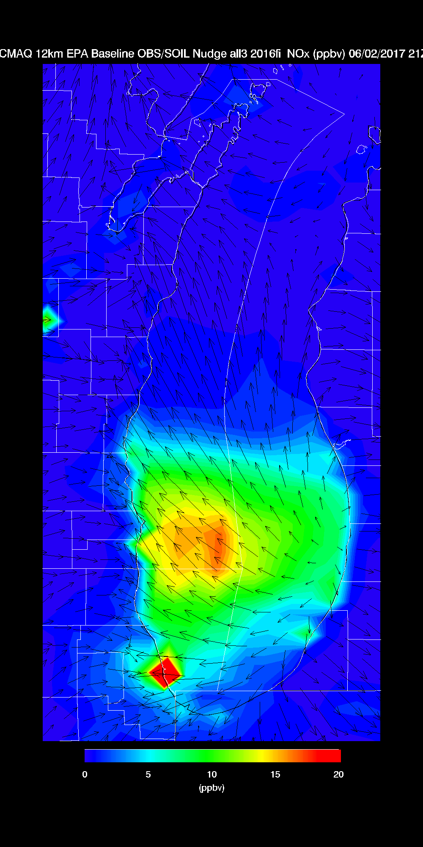
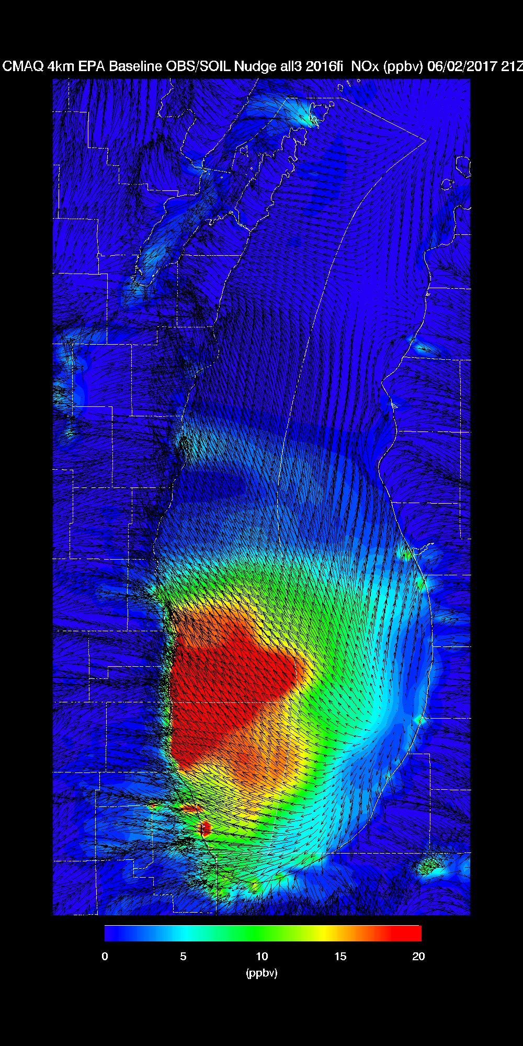
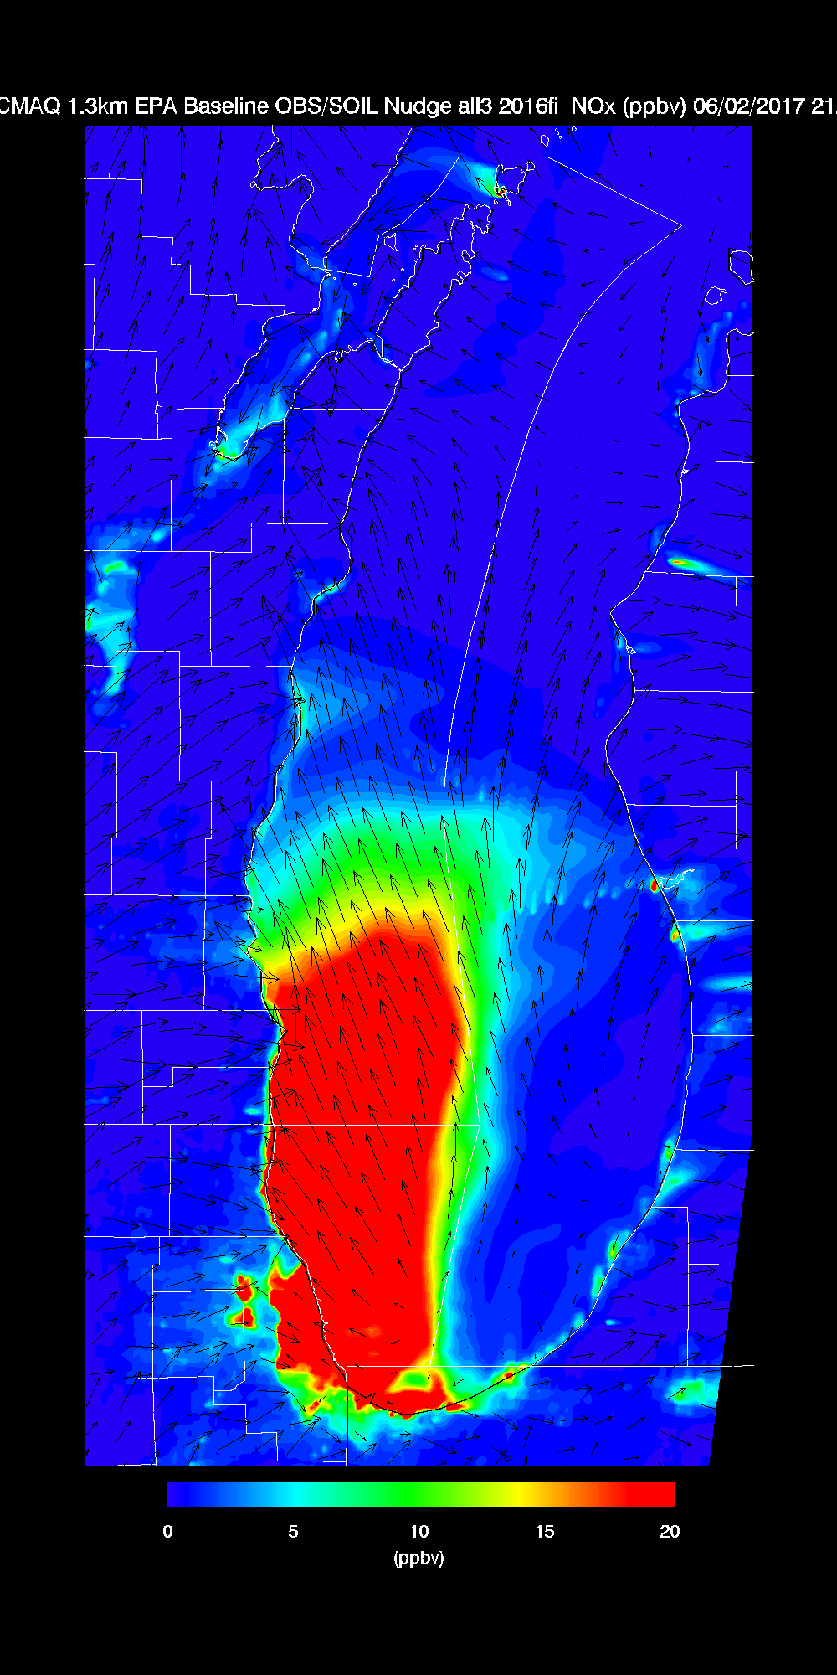
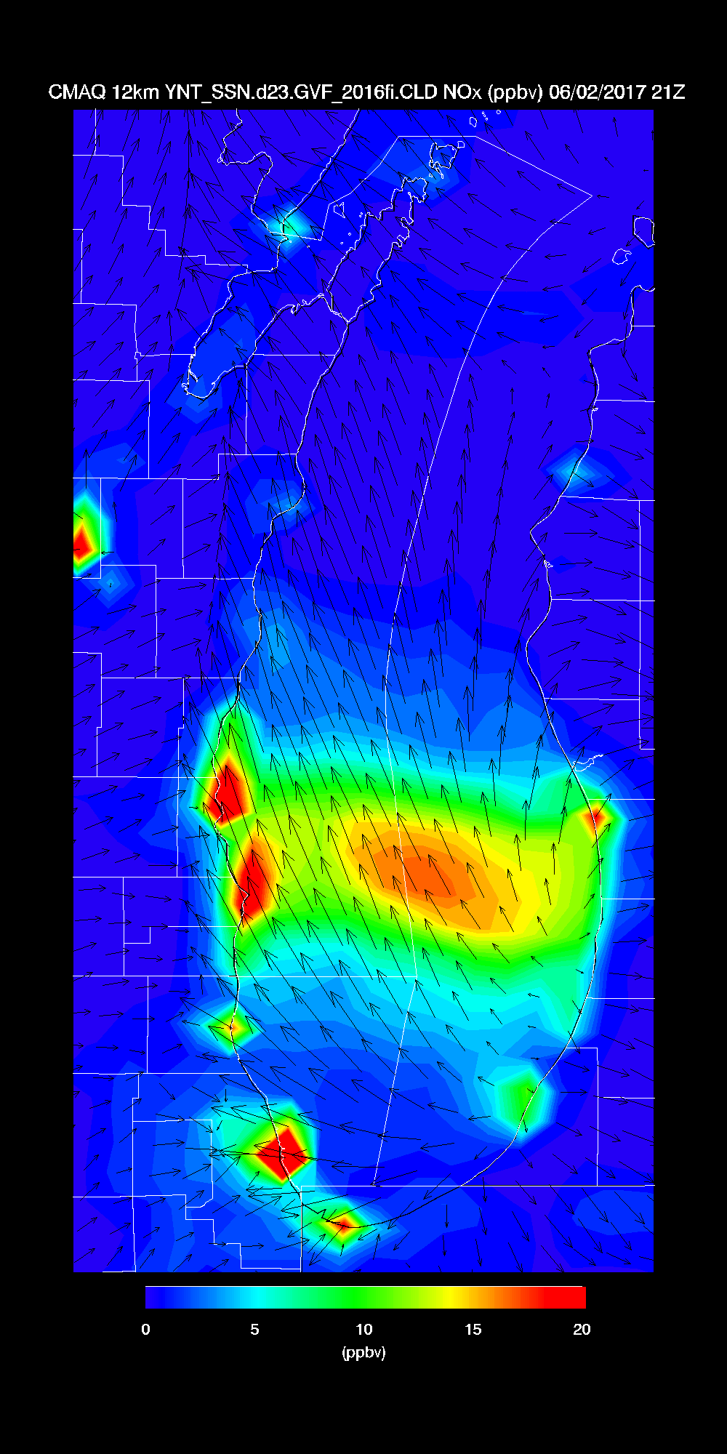
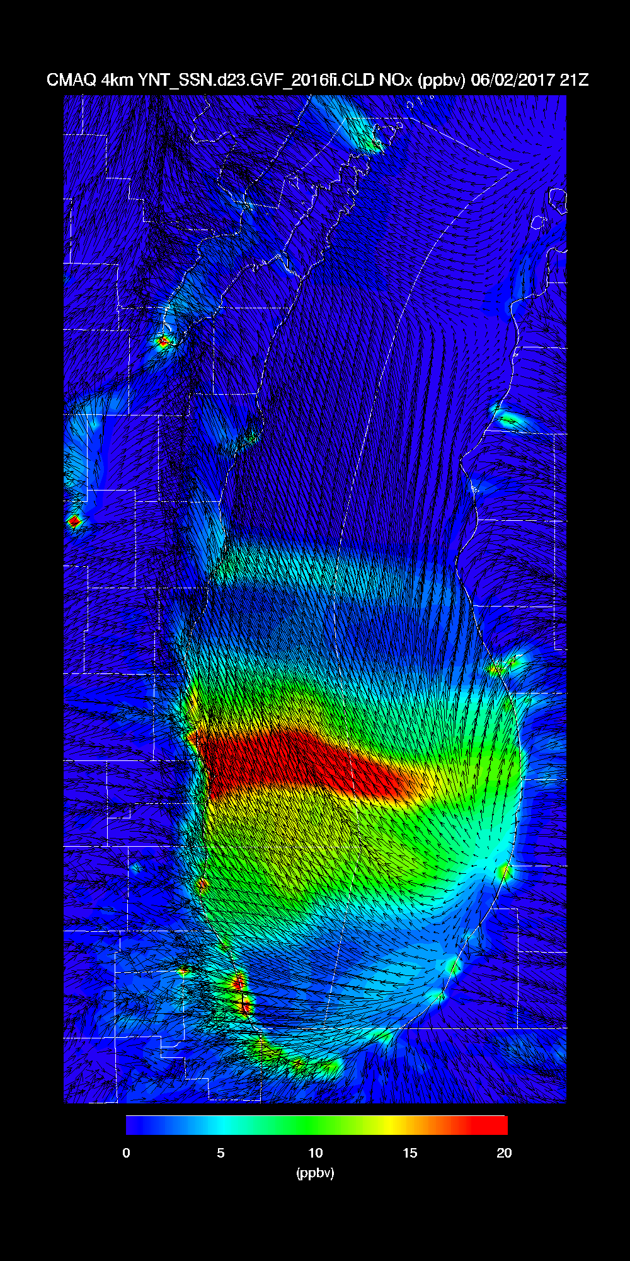
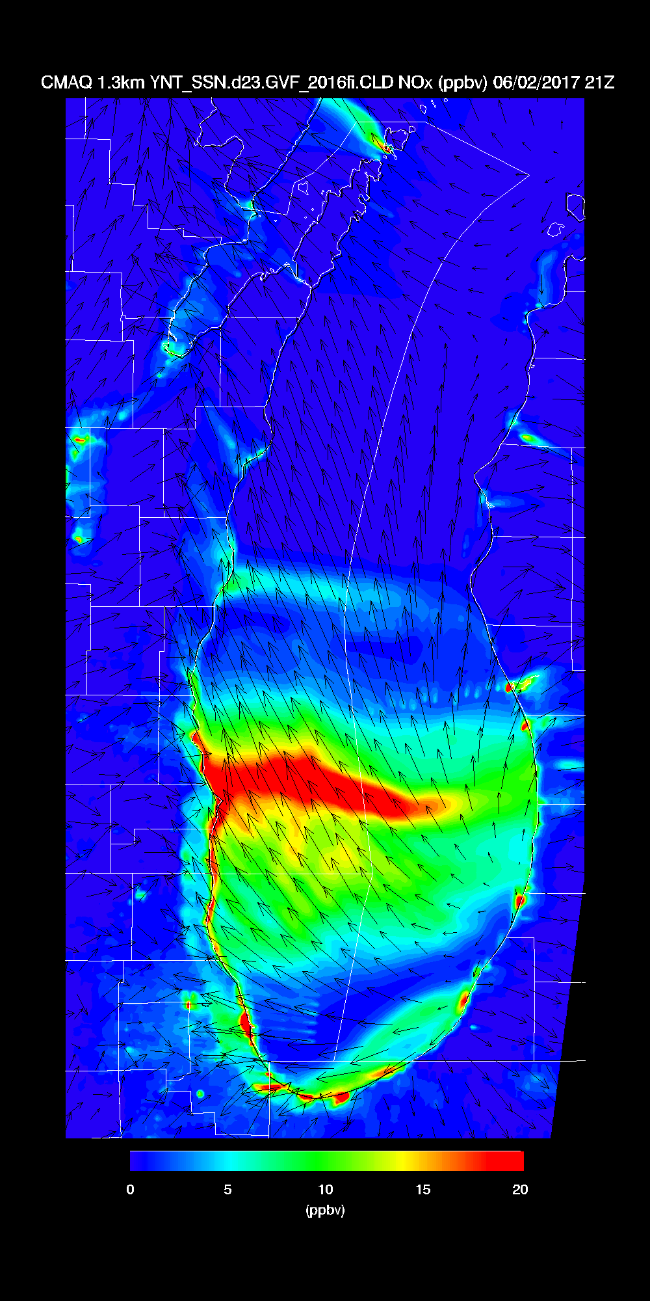
Surface NOx June 02, 2017 21Z (O3 Exceedance Day on Western Shore of Lake Michigan)
EPA
Baseline
EPA
Baseline
EPA
Baseline
LADCO
Optimized
LADCO
Optimized
LADCO
Optimized
12km
4km
1.3km
Significant differences in CMAQ surface NOx as model resolution increases
What model resolution is needed for coastal ozone assessment/forecast modeling?

Slide 2
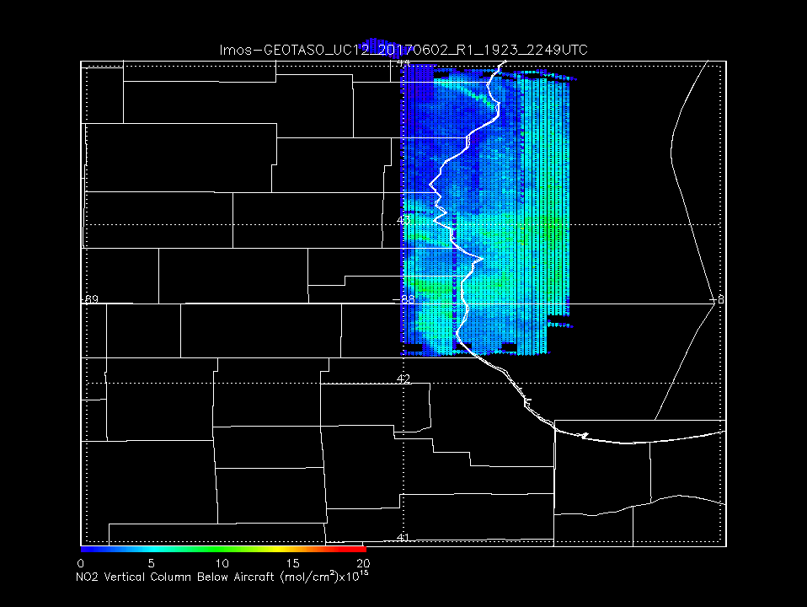
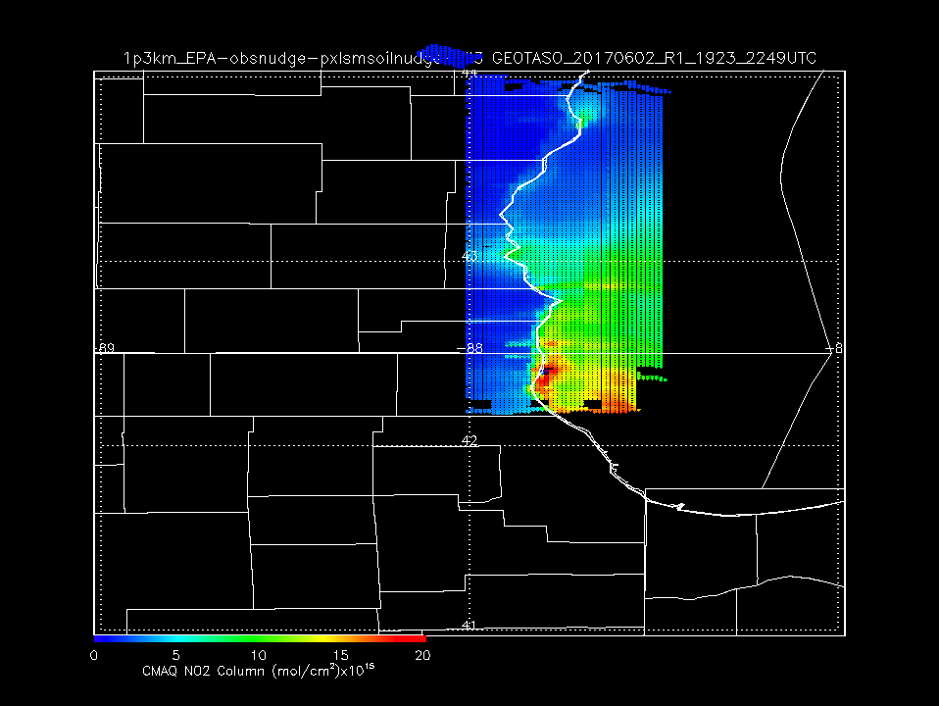
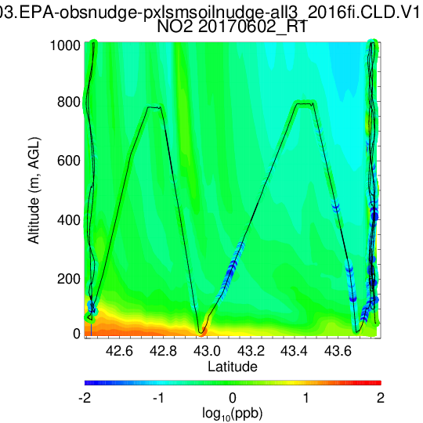
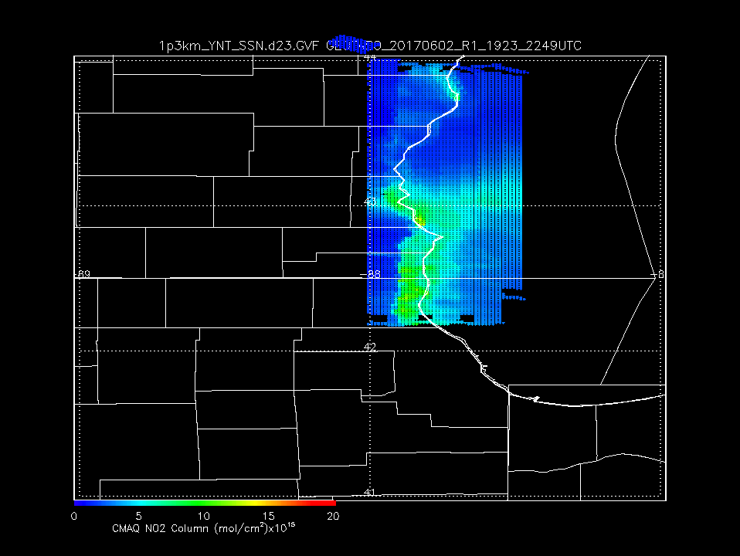
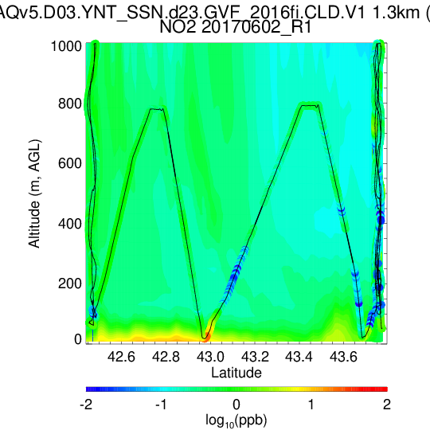
June 02, 2017 GEOTASO NO2 VCD
EPA Baseline NO2 VCD
EPA Baseline NO2
Scientific Aviation
Flight June 02, 2017
GEOTASO NO2 VCD shows significant Lake breeze penetration
Insitu airborne measurements suggest very shallow (60m) NO2 enhancements within marine boundary layer
How will the resolution of GEOS-CF influence TEMPO AMF in coastal regions?
LADCO Optimized NO2 VCD
LADCO Optimized NO2

