Slide 1




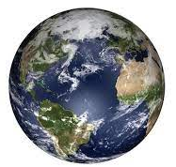
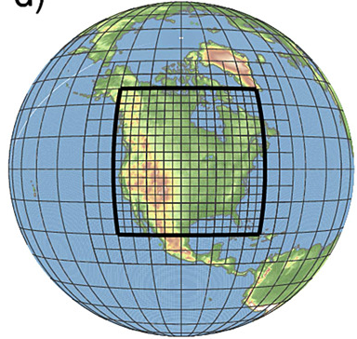

Regional Chemical Data Assimilation Modeling
Matthew Johnson, Arthur Mizzi, Brian McDonald, Kevin Bowman, Kazuyuki Miyazaki, Emma Knowland, Christoph Keller
Satellite-data-constrained:
IC/BC chemical and meteorology conditions
Prior emission estimates
Global Models (TCR-2; GEOS-CF)
Regional Model (WRF-Chem/DART)
Design, test, and implement a regional chemical data assimilation modeling system for high spatiotemporal resolution air quality modeling and forecasting.
Global and regional models assimilate numerous satellite retrievals of chemical constituents.
WRF-Chem/DART assimilates TEMPO retrievals for air quality simulations/forecasting and emissions adjustments.

Slide 2
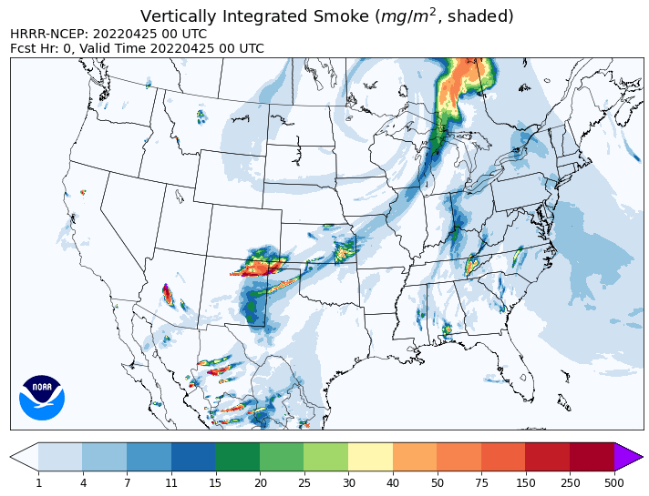
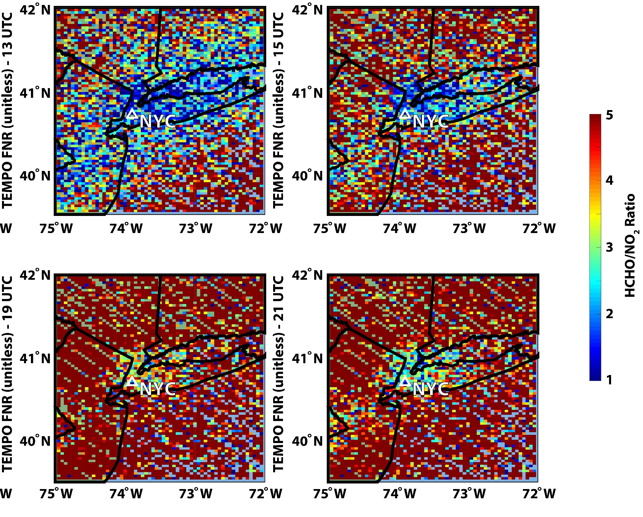

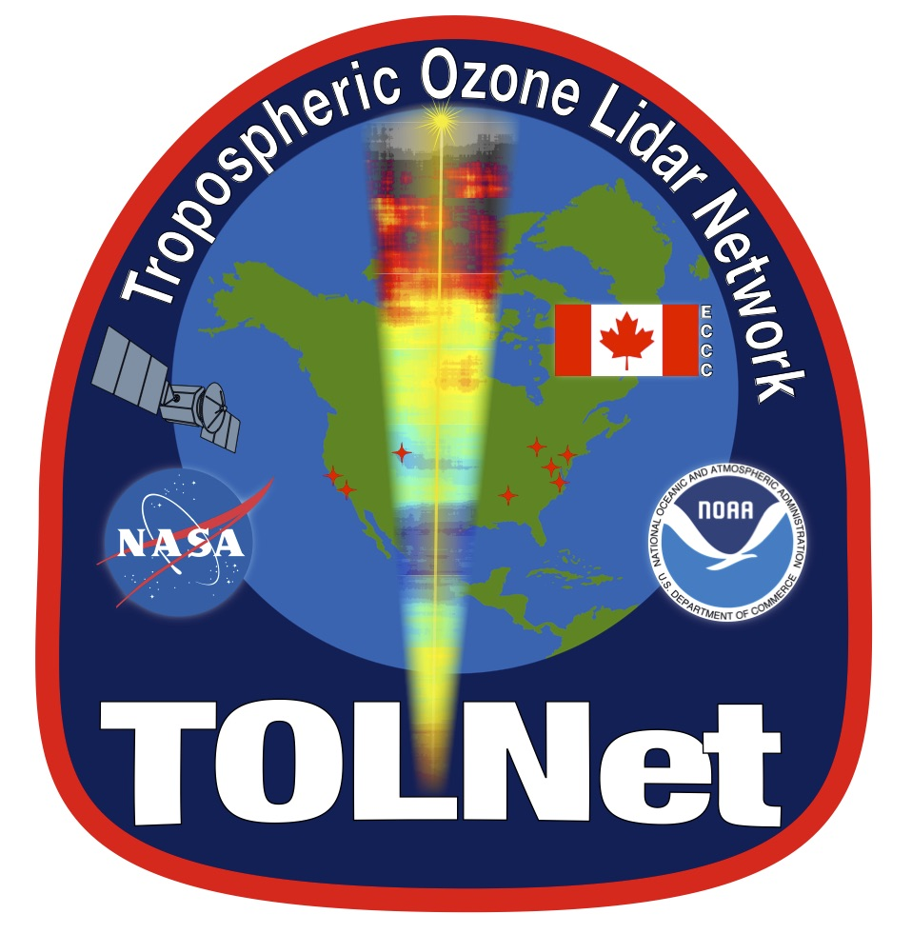

Scientific Studies Applying TEMPO and CTMs
Matthew Johnson, Arthur Mizzi, Brian McDonald, Amir Souri, Rajesh Kumar, Aaron Naeger, Weile Wang, GeoNEX and TOLNet Science Team
2022 AZ/NM wildfires
courtesy: Chris Senff
Combine CTM/AQ model simulations with TEMPO to investigate:
Constraining wildfire emissions and transport ↔ air quality
Diurnally-varying HCHO/NO₂ ratios ↔ ozone production sensitivity
PBL (0-2 km) ozone partial column ↔ air quality
surface vs. LMT column O₃

