Slide 1
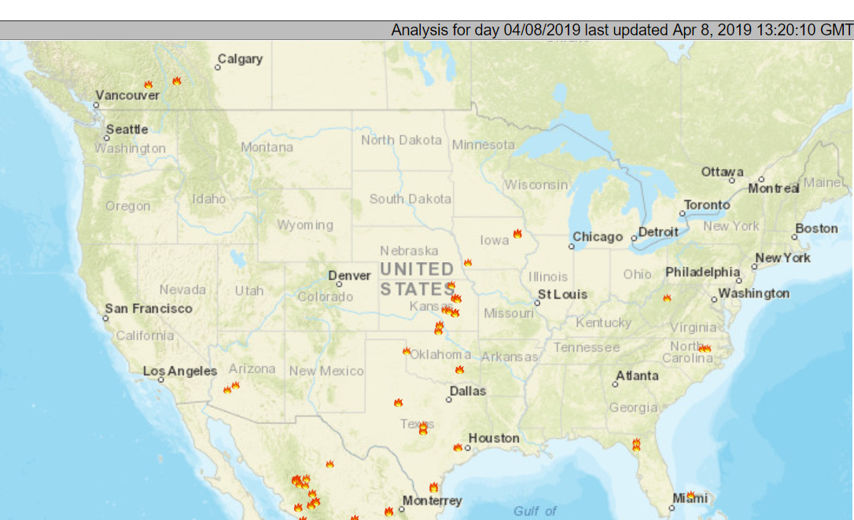
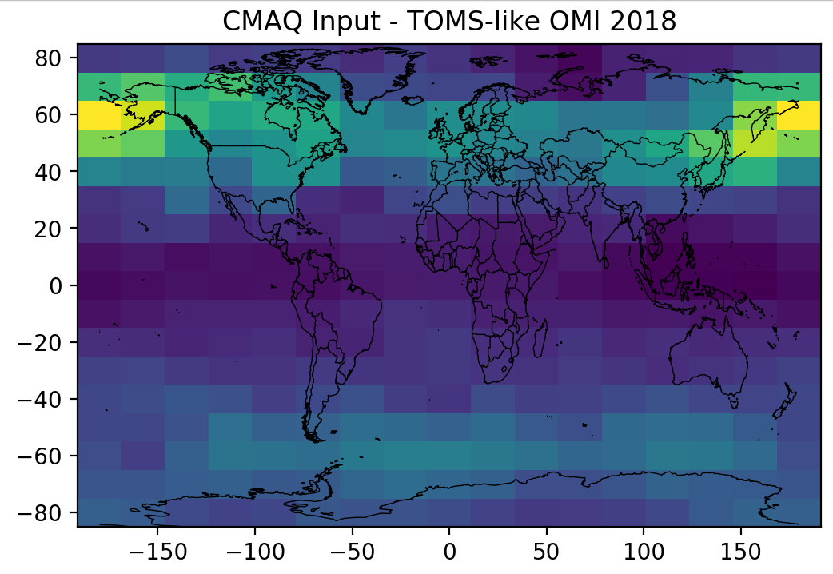
EPA uses satellite data regularly: Where can TEMPO help?
Barron Henderson
OMI O3 Averaging Kernel
100
Not a substitute for monitoring data
Most often total column measurement with low sensitivity to the surface for some species.
Requires model “priors” and “kernels” or “assimilation” for interpretation to ground level.
Pressure (hPa)
Meteorological Model Inputs
Land use/Land Cover, Digital Elevation Maps
GHR Sea Surface Temperatures
Data assimilation (e.g, GEOS, CAMS, GDAS, WRF)
1000
Emissions Inputs
e.g., MEGAN, FINN, GFED, BlueSky
Fire detection, land area burned
Fu et al. 10.5194/acp-13-3445-2013
Fires from NOAA’s Hazard Mapping System
Air Quality Model Inputs
Land use/Land Cover, Digital Elevation Maps
TOMS/OMI Ozone columns to adjust photolysis
OMI NO2
CMAQ Bias
Air Quality Model or Emissions Evaluation
OMI Nitrogen Dioxide Tropospheric Columns
OMI Ozone Tropospheric Columns
OMI Formaldehyde Columns
MODIS Aerosol Optical Depth
CRIS Ammonia
OMI Nitrogen Dioxide
CMAQ Model Input
Satellites inform our emissions and models, which inform our programs!
2020 Ozone Policy Assessment
Notes:
Contributors
https://docserver.gesdisc.eosdis.nasa.gov/repository/Mission/OMI/3.3_ScienceDataProductDocumentation/3.3.2_ProductRequirements_Designs/README.OMI_DUG.pdf

Slide 2
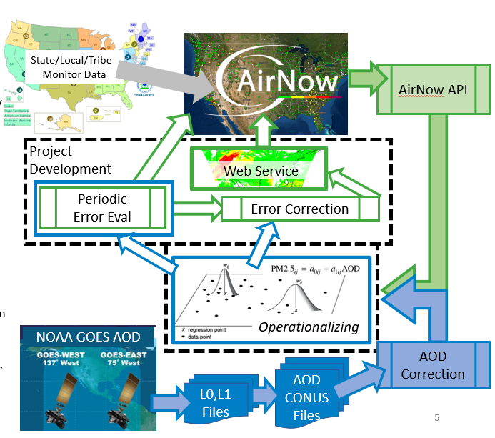
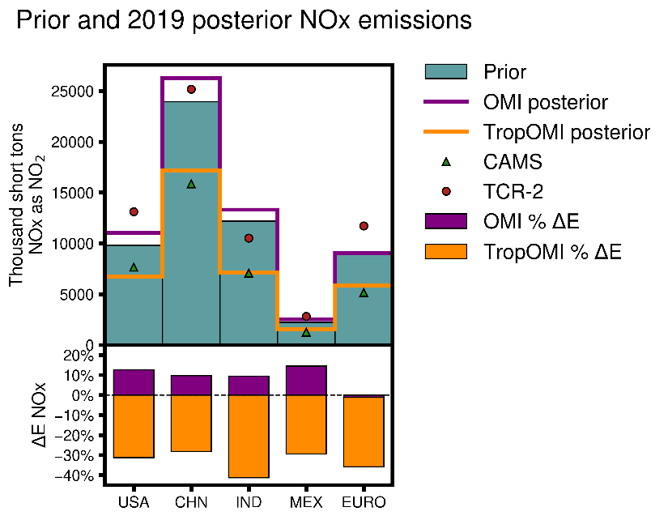
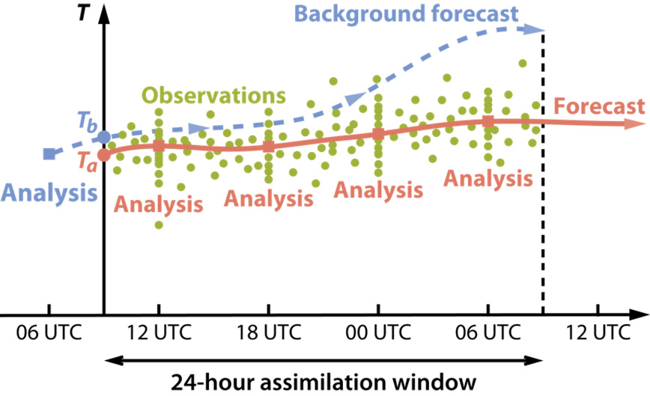
Barron Henderson
Working Toward Application of Geostationary Satellite Products
Finer Scale Assimilation with Fine Temporal Resolution
HAQAST Assimilation (RB Pierce)
HAQAST AirNow Tiger Team (P Gupta)
Will finer resolution undermine 3DVAR assumptions or will statistical power overwhelm?
Which products can be integrated into communication platforms?
$$δC$$
James East’s TEMPO Poster
My talk later at HAQAST
Alqamah Sayeed HAQAST Poster.

