Slide 1

Day 1 TEMPO Lightning Talks Agenda also on website: https://meeting-info.org/tempo-stm2022/
Room # | Presenter | Title
1 | Ahn | TEMPO aerosol algorithm from TROPOMI
2 | Chen | TROPOMI AOCH retrieval over bright surface using O₂ B band
3 | Cho | Retrievals of AOD, SSA, and ALH over Asia from GEMS data
4 | Demetillo | Constraints on diesel share in urban NO₂ inequality
5 | Pusede for Dressel | Daily satellite observations of NO₂ inequality in NYC
6 | East | Assimilation of NO₂ – comparing products and models
7 | Fehr | 2D sensitivity analysis of TEMPO NO₂ at Canadian latitudes
8 | Hsu | TEMPO NO₂ DA NO_{x} emissions constraining
9 | Joiner | Potential rapid land products from TEMPO
10 | Lamsal | Sensitivity of tropospheric NO₂ retrievals to diurnal…
11 | Li | Hyperspectral aerosol and surface optical properties retrieval algorithm
12 | Ortega | Combining FTIR & PANDORA to fully capture NO2 variability
13 | Pickering | Lightning NO_{x} from TEMPO: Plans for a green paper experiment
14 | Wang, Bo | High resolution modeling of NO₂ and O₃ in Greater Boston
15 | Wang, Qiyu | Understanding soil NO_{x} emissions in the Midwest
16 |  | Networking / hangout room for casual discussion after poster visits

Slide 2

AHN–TEMPO Aerosol Algorithm from TROPOMI
Changwoo Ahn, SSAI, and Omar Torres, NASA GSFC
Background
We have processed a multi-decadal data record of global aerosol properties derived from satellite near-UV observations by five sensors (TOMS series (i.e., Nimbus 7 and Earth Probe), OMI, OMPS NM, EPIC, and TROPOMI).
Instrument | Operation Period | Product Name | DOI
N7/TOMS | Oct. 1978 - May 1993 | TOMSN7AER | 10.5067/MEASURES/AER/DATA201
EP/TOMS | Jun. 1996 - Dec. 2005 | TOMSEPAER | 10.5067/MEASURES/AER/DATA202
Aura/OMI | Aug. 2004 - Present | OMIAuraAER | 10.5067/MEASURES/AER/DATA203
Suomi NPP/OMPS NM | Nov. 2011 - Present | NMMIEAI-L2 | 10.5067/40L92G8144IV
DSCOVR/EPIC | Jun. 2015 - Present | EPIC_L2_AER_03 | 10.5067/EPIC/DSCOVR/L2_AER_03
S5P/TROPOMI | Apr. 2018 - Present | TROPOMAER | 10.5067/MEASURES/AER/DATA204
  Data sets listed above are available from Earthdata Search (nasa.gov)
Motivation
We plan to continue to produce aerosol record from TEMPO hourly measurements with a consistent operational aerosol algorithm.
Aerosol information (e.g., AOD, AAOD, and AH) is needed for accurate trace gas retrievals and air quality applications.
Progress
We have developed an initial version of TEMPO aerosol algorithm (TEMPOAER) ported from TROPOMI aerosol algorithm.
The performance of it has been tested with a realistic aerosol information from TROPOMI L2 data (TROPOMAER).

Slide 3


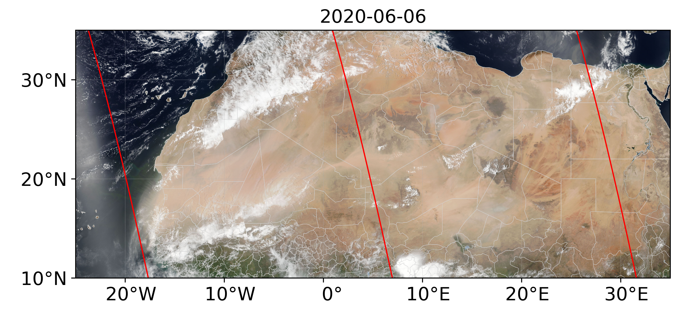
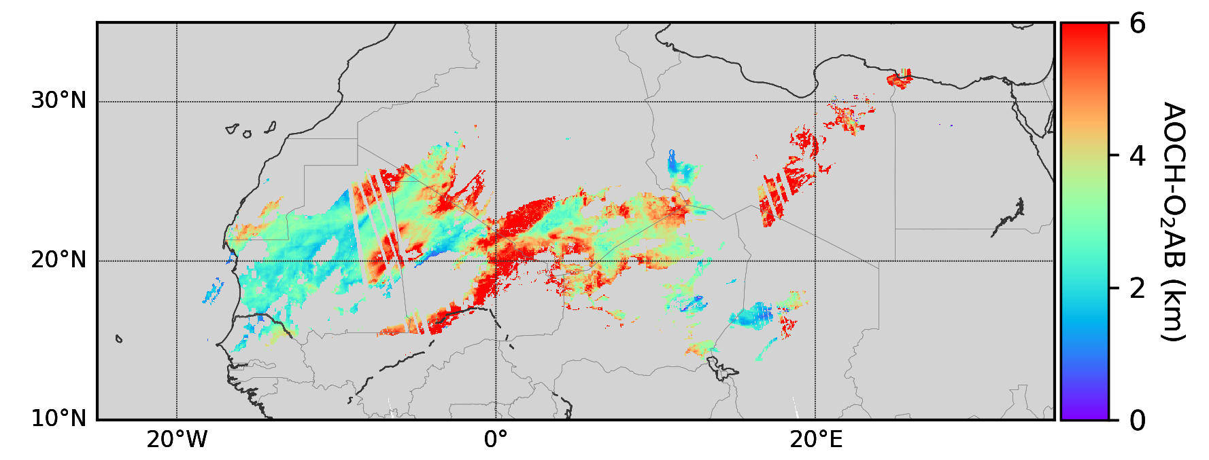
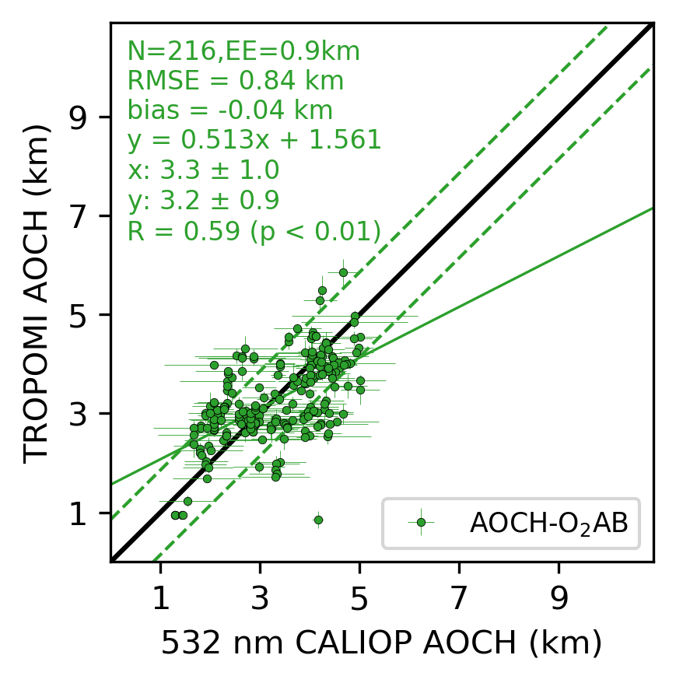
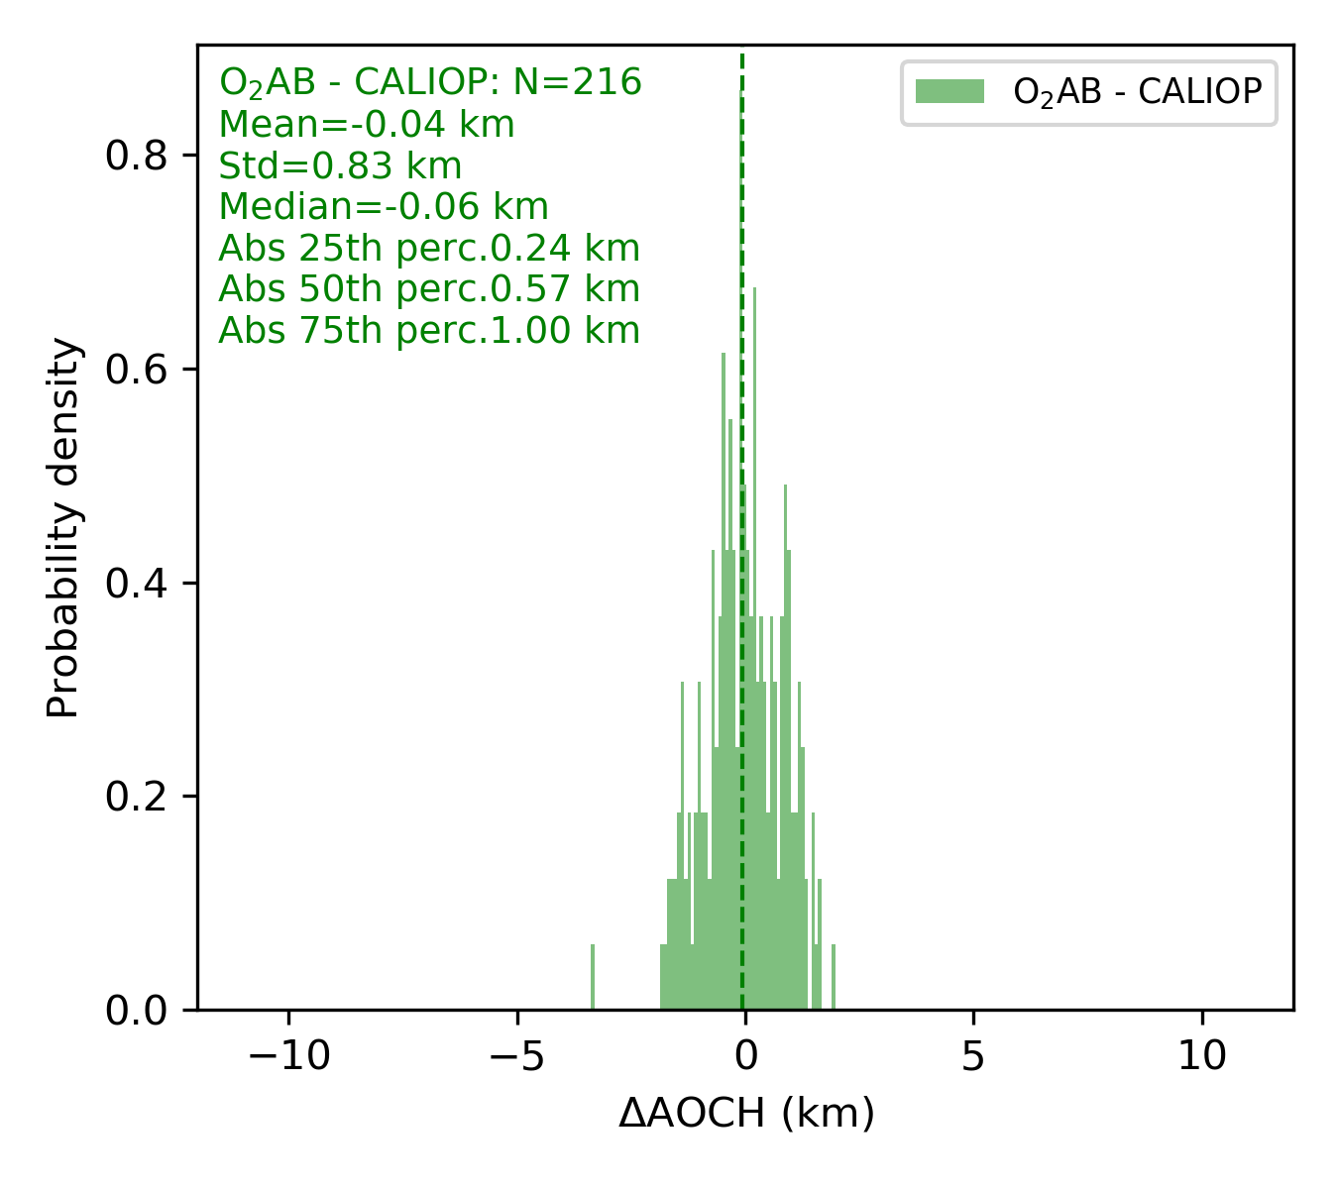
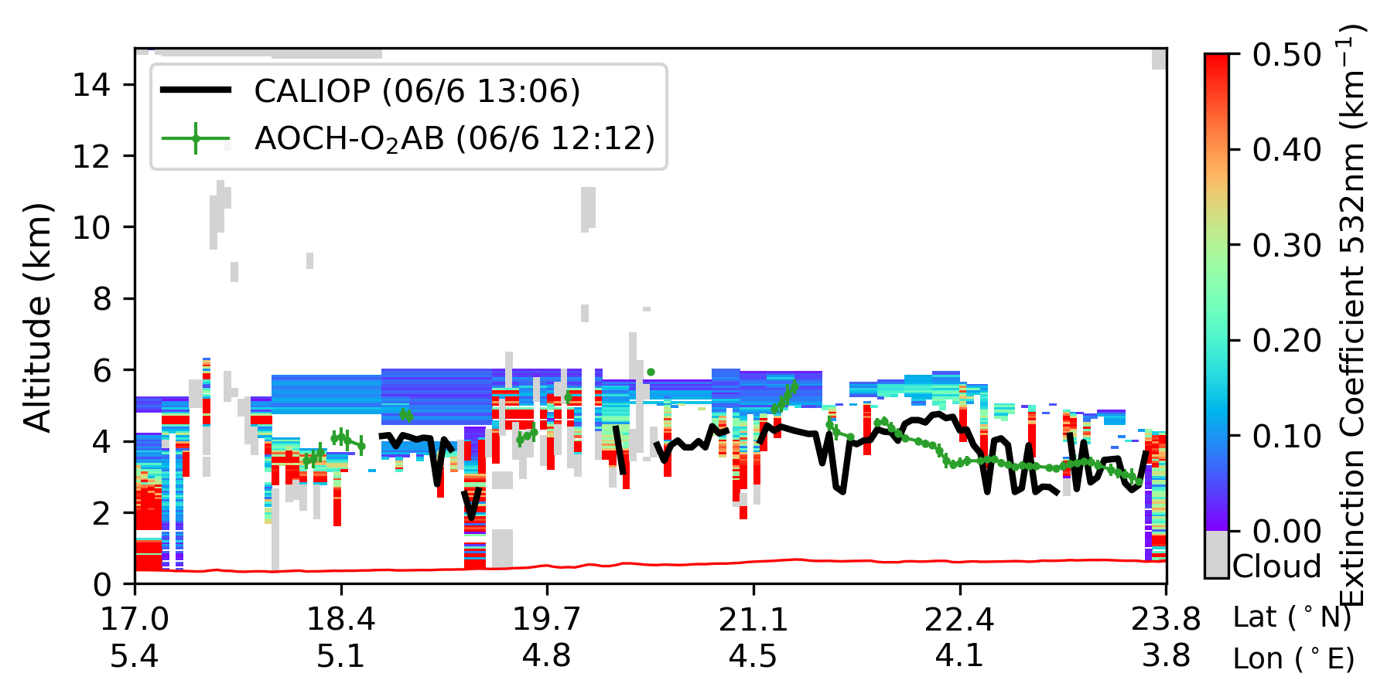
Place a headshot of yourself here
Chen–TROPOMI AOCH retrieval over bright surface using O₂ B band
Xi Chen*, Jun Wang, Mengzhou
University of Iowa
In our O₂AB AOCH retrieval algorithm, the use of blue band and O₂ B band makes it possible to retrieve AOCH over bright surface, compensating the lack of retrieval from TROPOMI operational O₂ A only algorithm.
Although the information of AOCH over bright surfaces observed from space is limited due to the interference from higher surface reflectance, our O₂AB algorithm could provide AOCH retrieval with ~ 1 km uncertainty comparing with CALIOP extinction weighted ALH.
Our O₂AB algorithm is ready to run operationally, and we are trying to apply it globally.

Slide 4

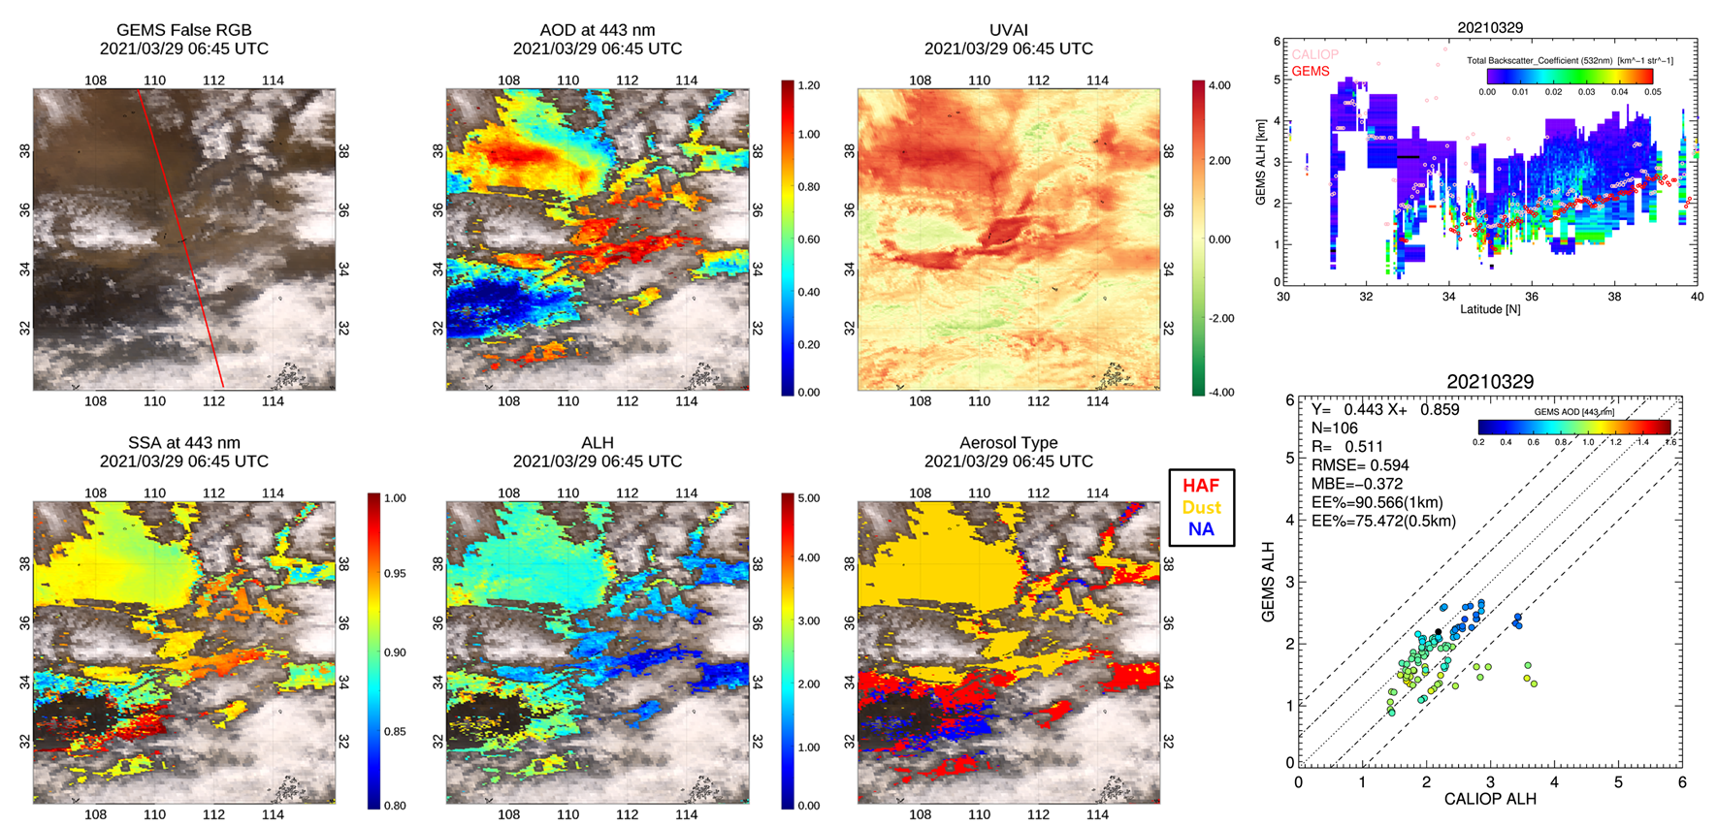
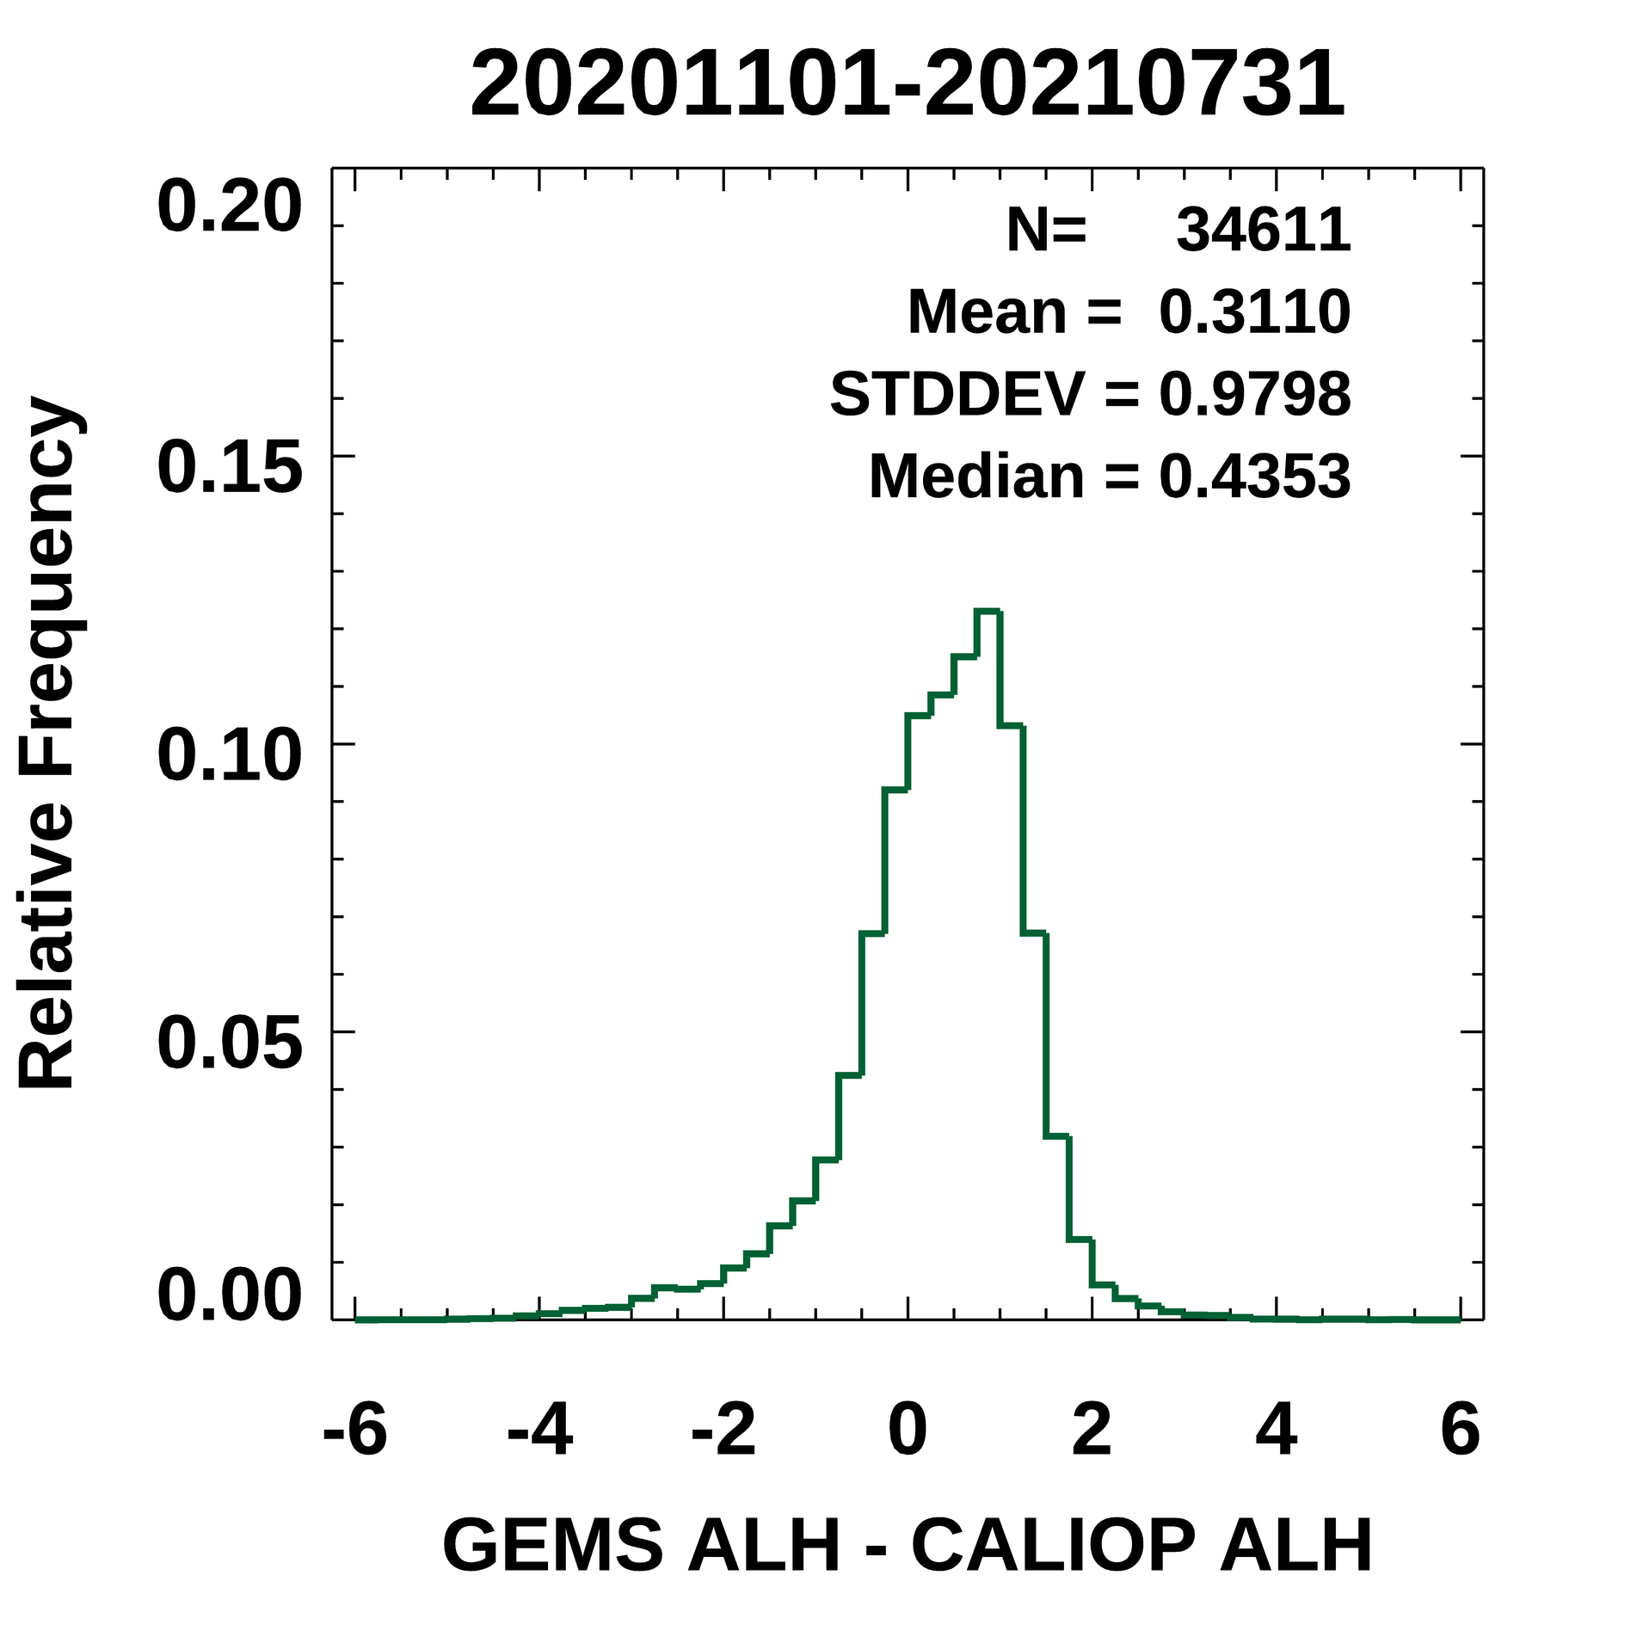
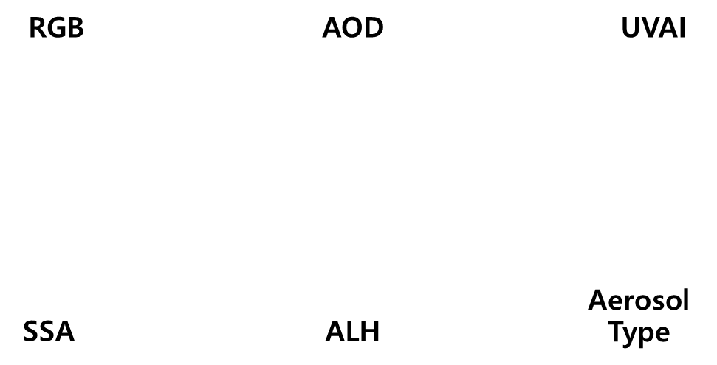
3-Cho–Retrievals of AOD, SSA, and ALH over Asia from GEMS data
Yeseul Cho, Yonsei University,
Jhoon Kim*, Sujung Go, Mijin Kim, Seoyoung Lee, Deok-Rae Kim, Dong-Won Lee, Omar Torres
Example of GEMS aerosol retrieval (2021.03.29)
Comparison results for GEMS ALH with CALIOP data
05:45, 06:45 UTC
GEMS AOD > 0.2
(AOD > 0.2)
GEMS ALH tracks CALOP ALH well from 34°N to 39 °N.
Histogram of differences between GEMS ALH and CALIOP backscatter weighted aerosol height (CALIOP ALH).
Taking advantage of the sensitivity to aerosol absorption and aerosol height information in UV-Vis wavelengths, GEMS aerosol algorithm retrieves AOD, SSA, and ALH by optimal estimation.
We present GEMS aerosol retrieval results for high aerosol loading cases of dust over East Asia and The GEMS ALH is compared to the total backscatter coefficients measured from the CALIOP.

Slide 5

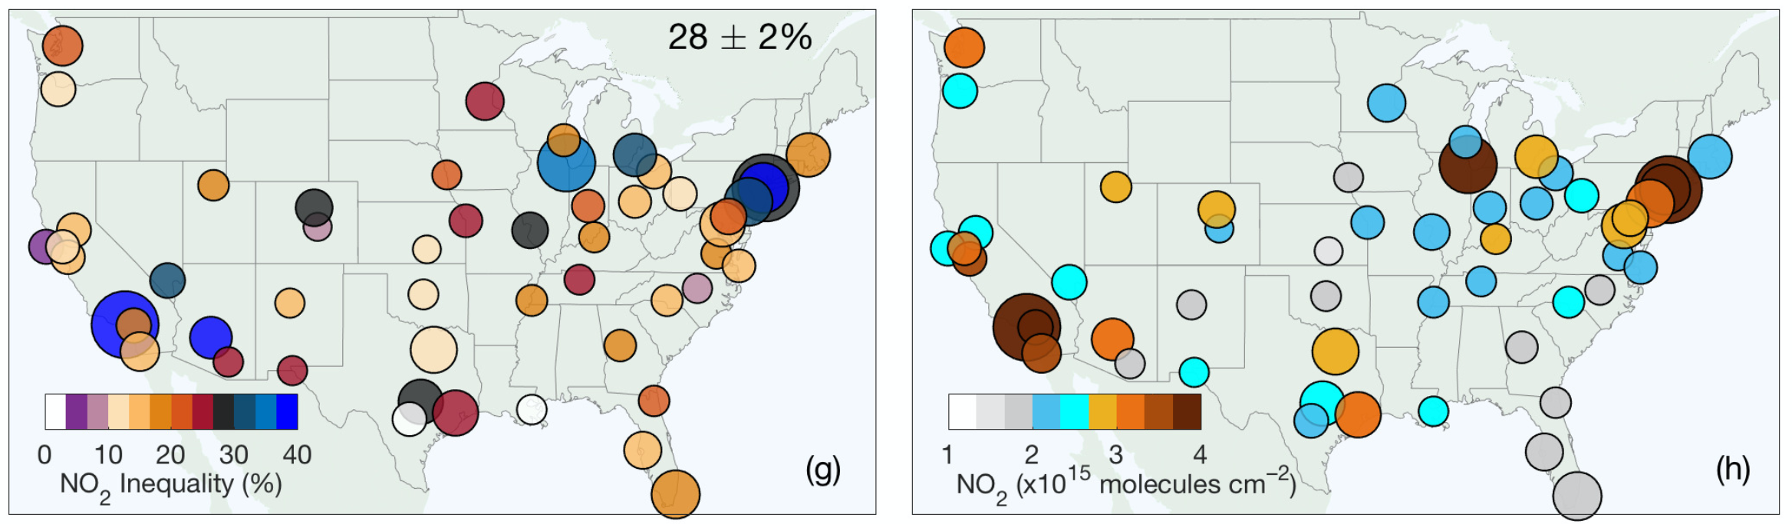
4-Demetillo–Constraints on Diesel Share in Urban NO2 Inequality
Mary Angelique G. Demetillo(1), Colin Harkins(2,3), Brian C. McDonald(3),
Philip S. Chodrow(4), Kang Sun(5,6), and Sally E. Pusede(1)
(1) University of Virginia, (2)Cooperative Institute for Research in Environmental Sciences, (3)NOAA Chemical Sciences Laboratory, (4)Department Mathematics, (5)Department of Civil, Structural and Environmental Engineering (6)Research and Education in eNergy, Environment and Water (RENEW) Institute
Summary: We quantify the portion of NO₂ inequalities with race, ethnicity, and income in 52 major U.S. cities caused by diesel traffic. To do this, we combine two years of TROPOMI observations oversampled to 0.01º x 0.01º and NO_{x} emissions inventories averaged to census tracts. We use differences in inequalities on weekdays and weekends as observational constraints.
We show a 60% reduction in diesel NO_{x} emissions causes a 40% reduction in NO₂ inequalities, providing a test of the impact of the Biden Administration’s new diesel emissions rule to reduce diesel NO_{x} emissions by 60% by 2045.
We add evidence that oversampled TROPOMI observations resolve census tract-level differences, exploring relationships between inequalities and urban segregation structure.
NO₂ disparities with
race-ethnicity and income
Research Questions:
1) How does NO₂ inequality vary in major U.S. cities?
2) What portion of NO₂ inequality is caused by diesel traffic?
3) How does inequality vary with segregation structure?
Mean city-level NO₂ columns
On-road diesel emissions
0 2 4 6 8
NO_{x} (x10⁻³ metric ton h^{–1})
Demetillo et al., Geophys. Res. Lett., 2021
Notes:
In this presentation, I describe work using TROPOMI observations and emissions inventories to observationally constrain the role of diesel traffic emissions to NO2 inequality within 52 major US cities. I will first describe inequality across various sociodemographic groups. Then, I will explain how we evaluate TROPOMI’s ability to resolve census-tract level NO2 through distance-dependent correlations with surface monitor NO2 and through urban segregation patterns. I will also describe how we combined emission inventories with TROPOMI data and found changes weekday-to-weekend inequalities are visible at coarse resolution and then finally quantify the contribution of diesel traffic emissions to intraurban NO2 inequality.

Slide 6

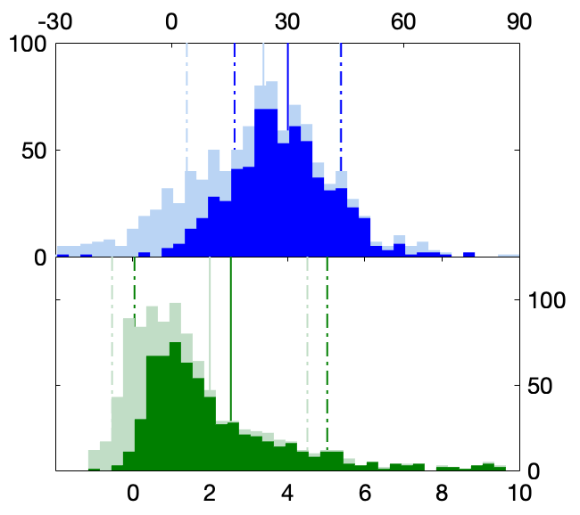
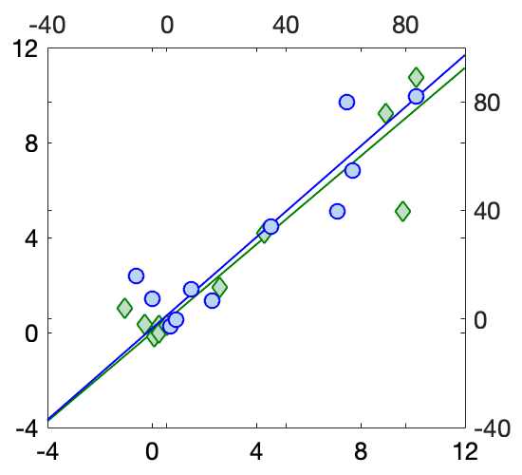
5-Dressel–Daily Satellite Observations of NO₂ Inequality in NYC
Isabella M. Dressel¹, Mary Angelique G. Demetillo¹, Laura M. Judd², Scott J. Janz³, Kimberly P. Fields¹, Kang Sun⁴, Arlene M. Fiore⁵, and Sally E. Pusede¹
University of Virginia¹, NASA Langley Research Center², NASA Goddard Space Flight Center³, University at Buffalo⁴, Massachusetts Institute of Technology⁵
Can daily TROPOMI observations resolve census tract-scale NO₂ inequalities?
NO₂ Inequality (%)
All days
Days with
>30% coverage
NO₂ inequalities are largely insensitive to TROPOMI pixel areas
Inequalities are biased low on days with low coverage
Mean daily inequalities are consistent with results from oversampled data
Daily TROPOMI observations are highly correlated with and resolve most inequalities from aircraft
Number of Days
Airborne NO₂ Inequality (%)
All days
Days with
>30%
coverage
m = 0.96 ± 0.06
Number of Days
r = 0.92
TROPOMI NO₂ Inequality
(x10¹⁵ molecules cm^{–2})
TROPOMI NO₂ Inequality (%)
NO₂ Inequality
(x10¹⁵ molecules cm^{–2})
What do we learn from the daily inequalities?
Communities of color are overburdened by NO₂ sources
Climate change will likely worsen neighborhood-level NO₂ inequalities
Reducing NO₂ inequalities will have city-wide ozone co-benefits
m = 0.93 ± 0.05
r = 0.93
Airborne NO₂ Inequality
(x10¹⁵ molecules cm^{–2})

Slide 7

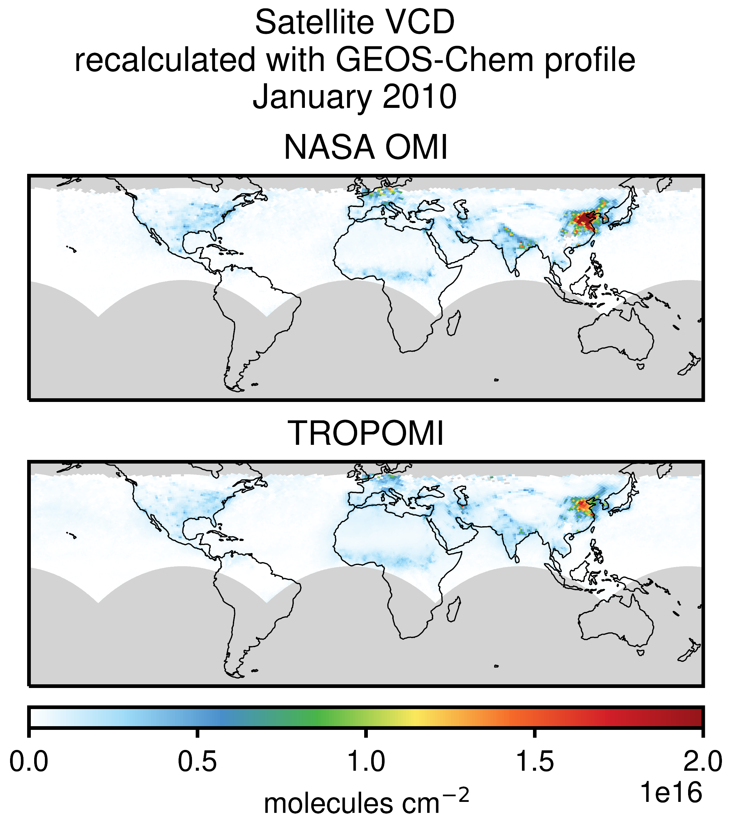
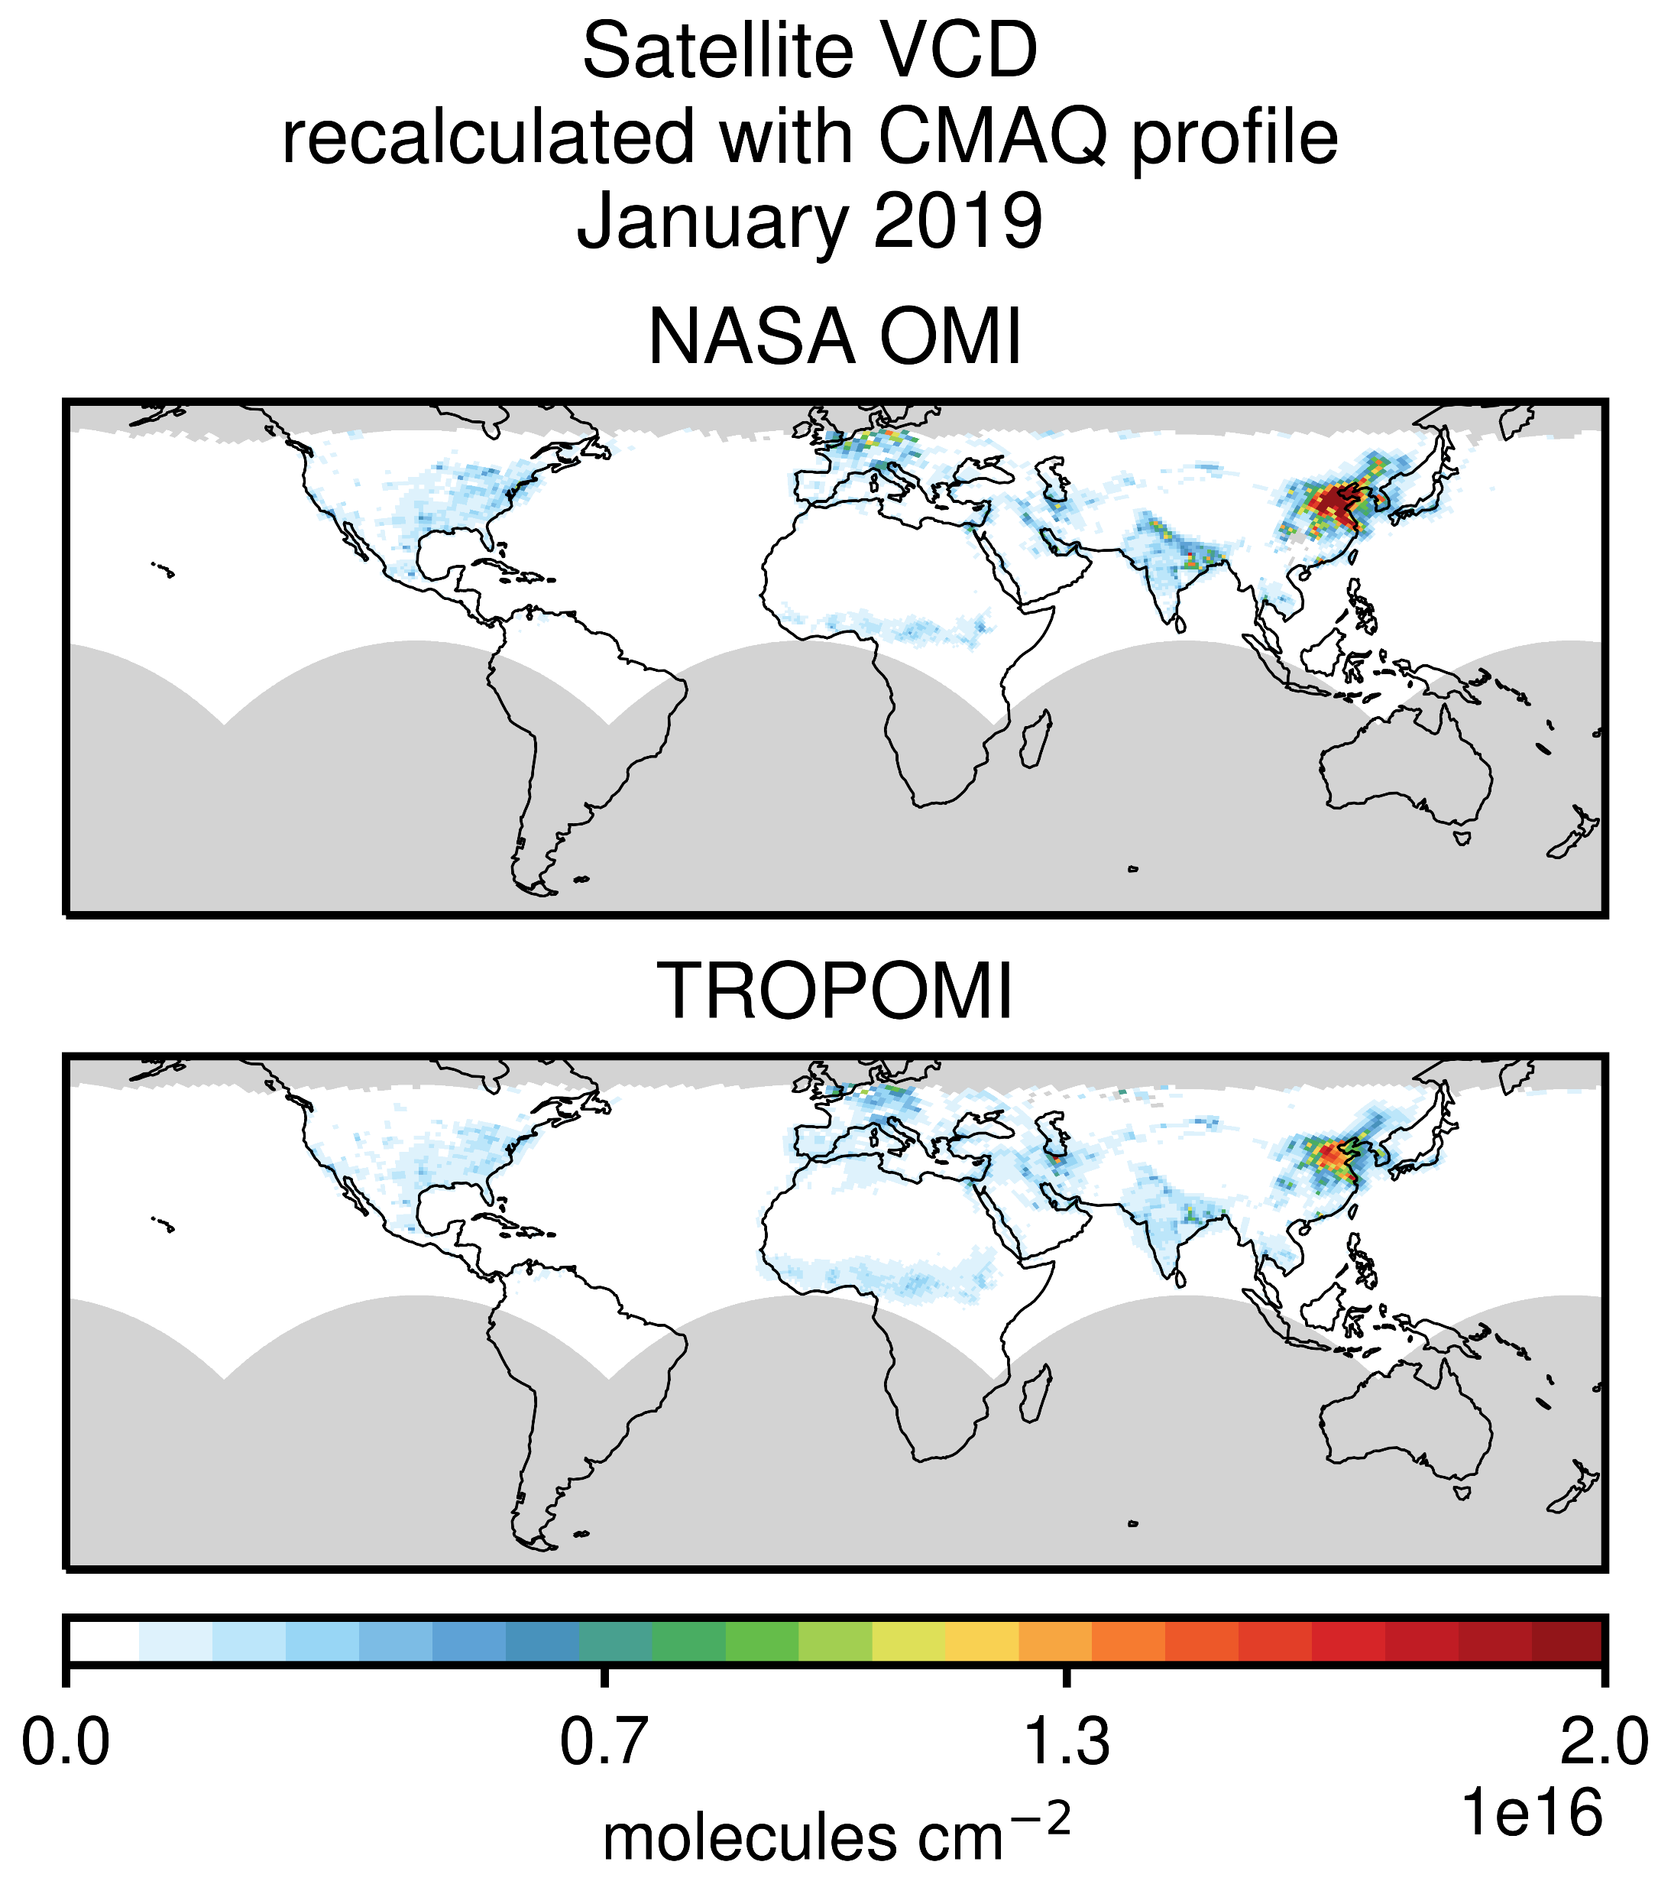
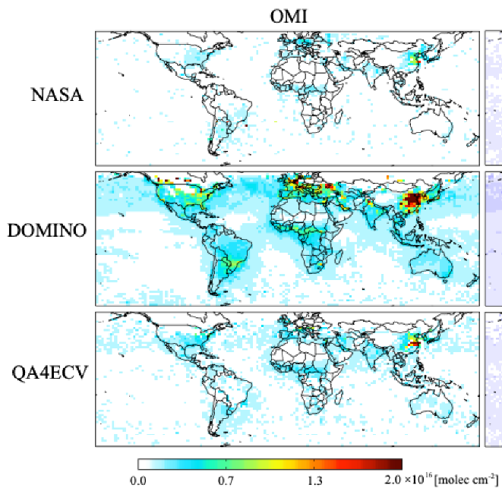
6-East–Assimilation of NO₂ – comparing products and models
James D. East^{1,2}, Barron H. Henderson³, Zhen Qu⁴, Sergey L. Napelenok⁵, Shannon N. Koplitz³,
R. Bradley Pierce⁶, Allen Lenzen⁶, Daniel Tong⁷, Rob Gilliam⁵, Golam Sarwar⁵, Fernando Garcia Menendez²
1. ORISE Research Fellow at US EPA, 2. NC State University, 3. Office of Air Quality Planning and Standards, US EPA, 4. School of Engineering and Applied Sciences, Harvard University,
5. Office of Research and Development, US EPA, 6. Space Science and Engineering Center, University of Wisconsin—Madison, 7. George Mason University
Used in GEOS-Chem inversion in this poster
Used in CMAQ inversion in this poster
In this poster, we compare NOx emissions inversions using different satellite NO₂ retrievals, and different atmospheric chemistry models.
Satellite NO₂ retrievals
OMI (NASA)
OMI (DOMINO)
TROPOMI
Models & NOx inversions
GEOS-Chem Adjoint + 4DVAR
CMAQ + 3DVAR + Finite difference mass balance
molecules cm⁻²
Figure S1 from Qu et al., 2020³

Slide 8

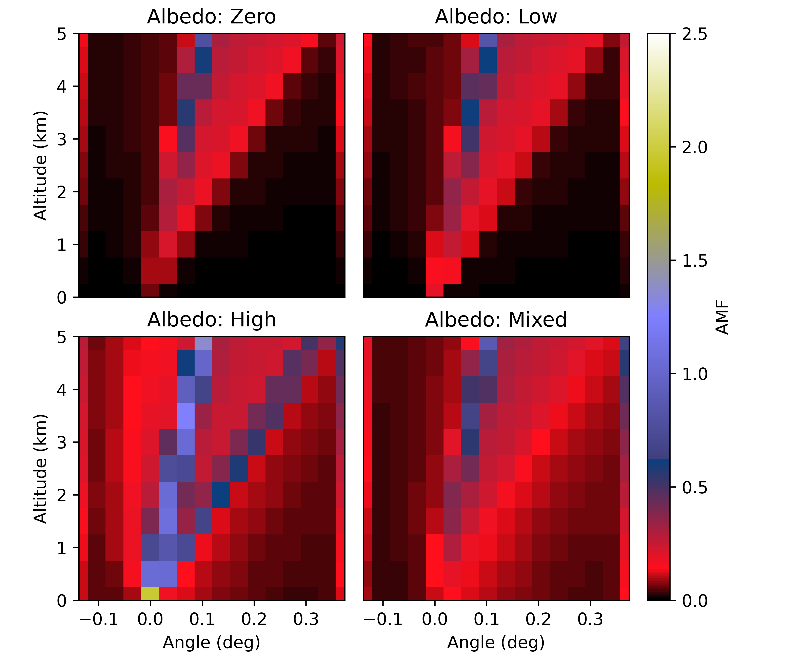
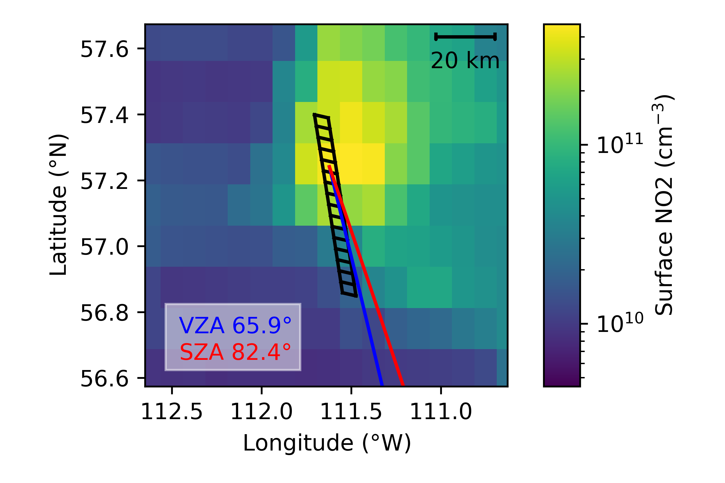
7-Fehr–2D Sensitivity Analysis of TEMPO NO2 at Canadian Latitudes
Lukas Fehr, University of Saskatchewan
Adam Bourassa, Doug Degenstein
Where exactly does a measured trace gas signal come from?
How is it distributed horizontally?
Under what conditions could this be significant for retrievals?
Method:
column of TEMPO pixels around the oil sands
high surface NO₂ with horizontal gradient
compare 1D and 2D retrieval approach
2D Air Mass Factors

Slide 9

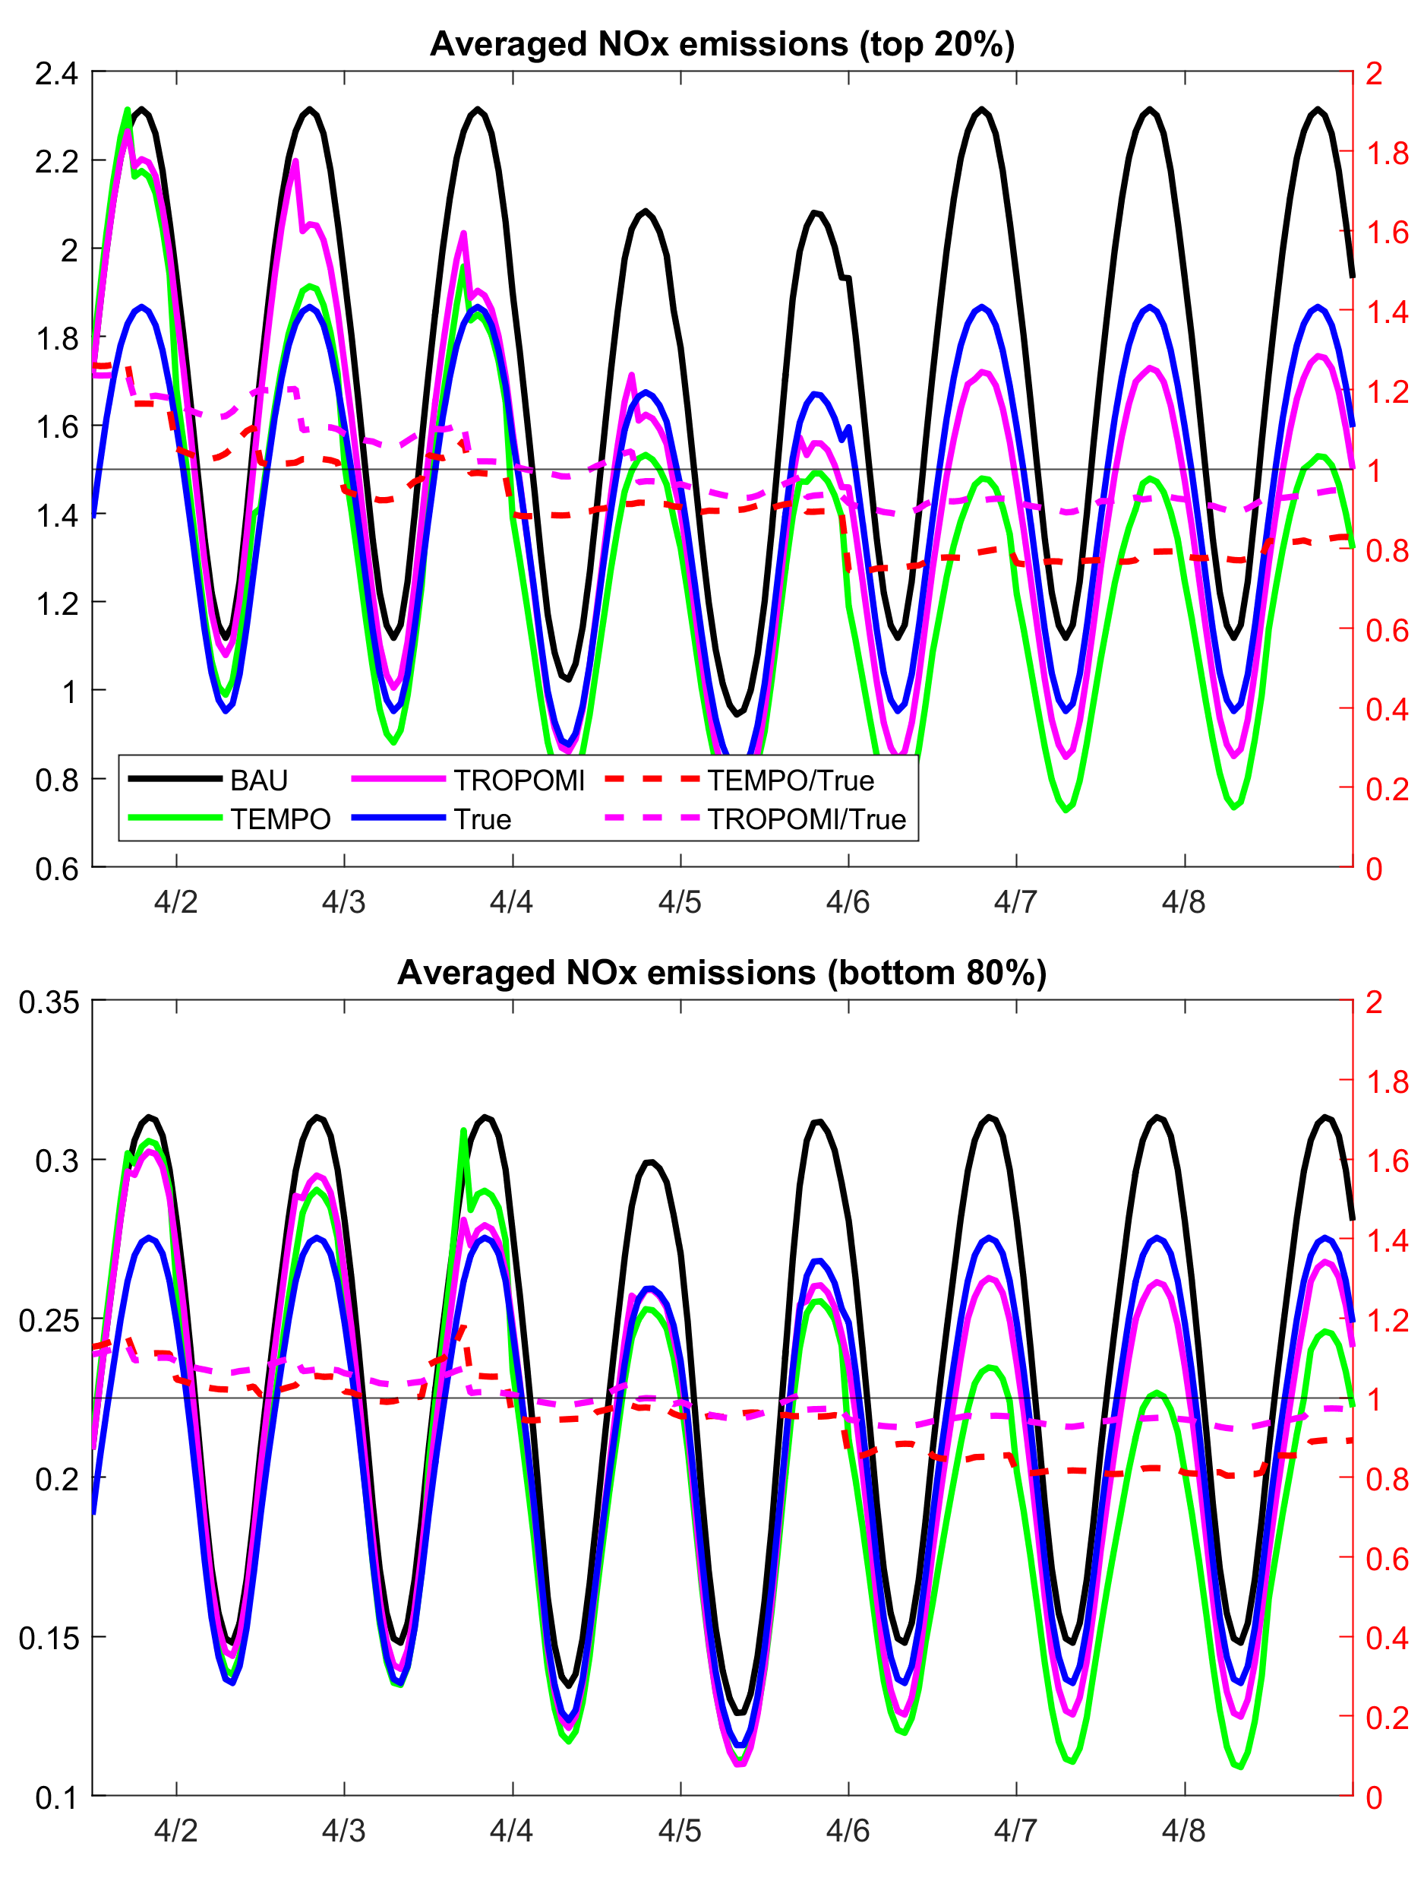
8-Hsu–TEMPO NO2 DA Nox emissions constraining
How well can assimilation of geostationary trace‐gas observations constrain NOx emissions in the US?
Chia-Hua Hsu^{1,3}, Arthur P. Mizzi^{1,2}, Daven K. Henze¹ and Brian C. McDonald³
¹Department of Mechanical Engineering, University of Colorado, Boulder, CO, USA, ²NASA Ames Research Center/BAERI, Moffett Field, CA, USA,
³NOAA Chemical Sciences Laboratory, Boulder, CO
We explored the potential benefit of assimilating high spatial-temporal resolution NO₂ measurement from a geostationary instrument such as TEMPO, or NOAA’s potential GEO-XO mission.
Synthetic TEMPO and TROPOMI NO₂ measurements based on emissions consistent with the COVID-19 lockdown period were created and assimilated in an Observing System Simulation Experiments (OSSEs) framework to demonstrate how well the TEMPO vs TROPOMI measurements would help to recover actual emissions.
The true NOx emissions can be retrieved within one day of simulation in TEMPO NO₂ experiment while TROPOMI NO₂ experiment takes about three days to achieve comparable results.
The longer-term stability and convergence of emissions adjustment is still being investigated.
We expect that future geostationary satellite observations could improve the skills of emissions top-down constraining.

Slide 10

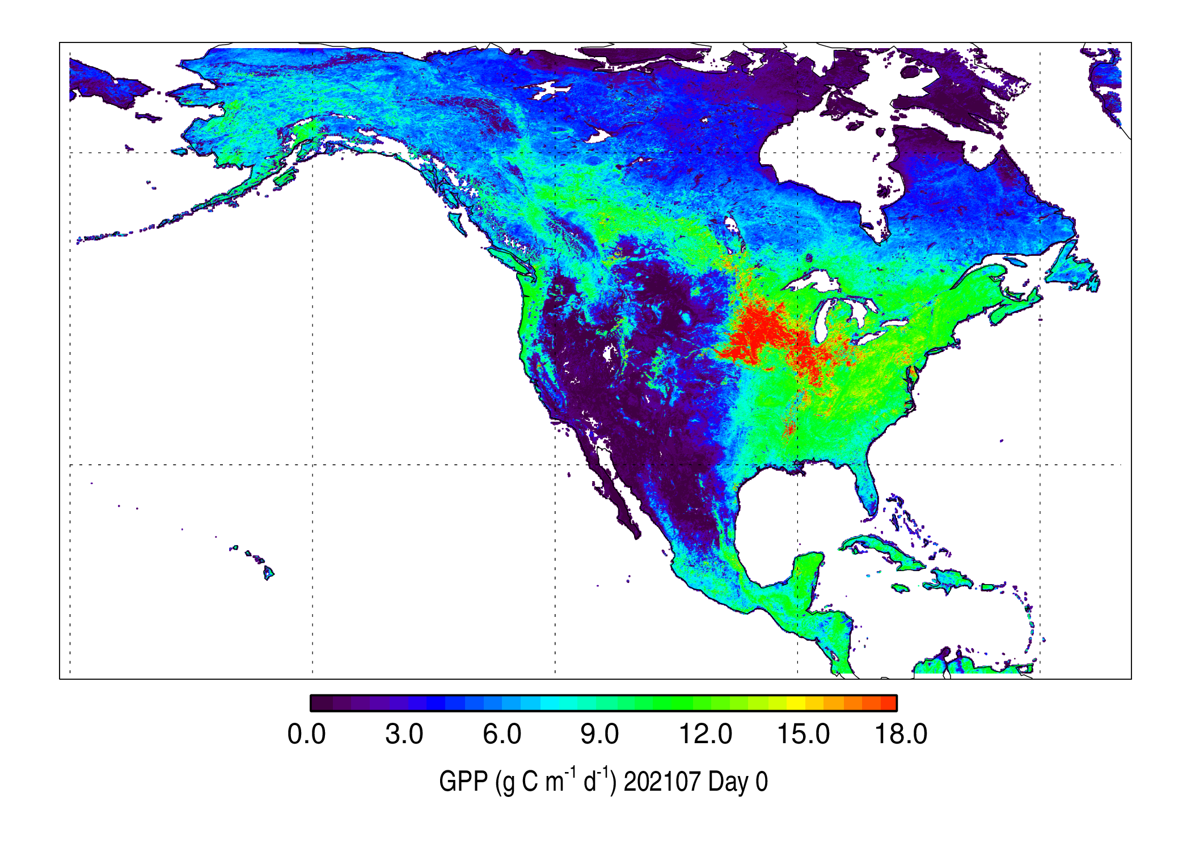
Place a headshot of yourself here
9-Joiner - Potential Rapid Land Products from TEMPO
Joanna Joiner (NASA GSFC), Yasuko Yoshida (Science Systems and Applications, Inc., SSAI),
Fred Huemmrich (Univ. Maryland, Baltimore County), John Gamon (Univ. Nebraska)
The unique ability of TEMPO to make unique hourly “ultra-spectral” measurements from the UV through NIR will enable rapid atmospheric and BRDF correction to provide accurate land surface reflectance even in the presence of light clouds and aerosol.
TEMPO will be able to deliver products such as gross primary production and vegetation indices that show rapid stress response (to dry conditions) shortly after overpass.
These products can be cross-calibrated using data from MODIS or VIIRS in low Earth orbit.
FluxSat-MODIS GPP (gC m⁻² d⁻¹) on 1 July 2021

Slide 11

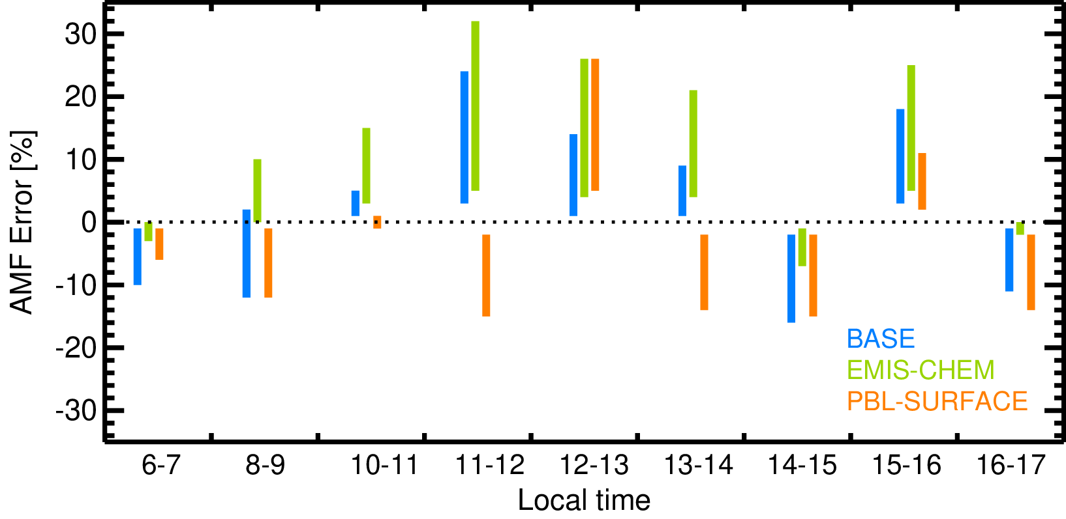
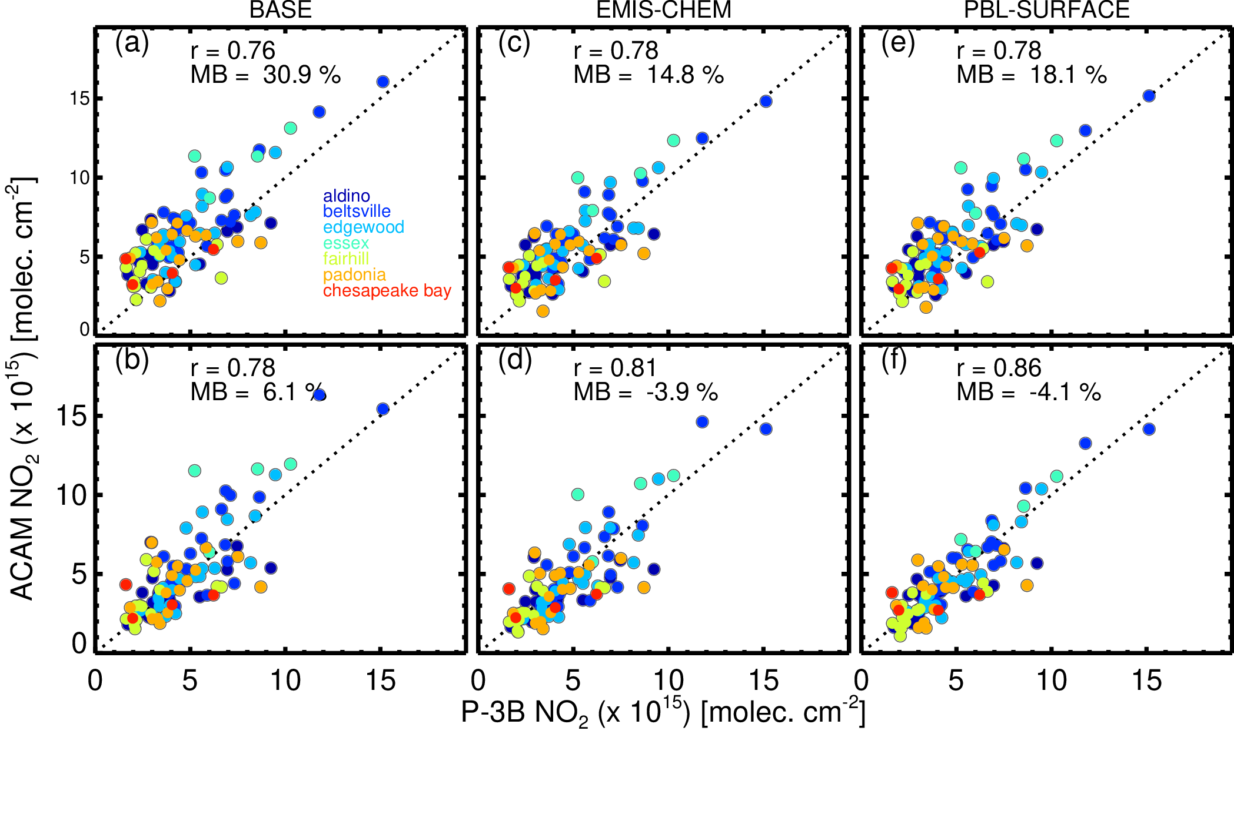
10-Lamsal–Sensitivity of tropospheric NO₂ retrievals to diurnal…..
Lok Lamsal (UMBC/NASA GSFC), Melanie Follett-Cook, Kenneth Pickering, Christopher Loughner, William Swartz, Sungyeon Choi, Scott Janz, Dale Allen, Nickolay Krotkov
How much error one can possibly introduce in NO₂ retrievals through model-derived a-priori NO₂ profiles?; applicable for other species as well
Conducted simulation and retrieval studies using observations and model during NASA DISCOVER-AQ campaign
Three CMAQ simulations: BASE, EMIS-CHEM (perturbing mobile NO_{x} emissions & chemistry), and PBL-SURFACE (changing PBL scheme)
Up to $±$20% model-dependent diurnal NO₂ retrieval errors
AMF (or retrieval) errors from model profiles relative to observations

Slide 12

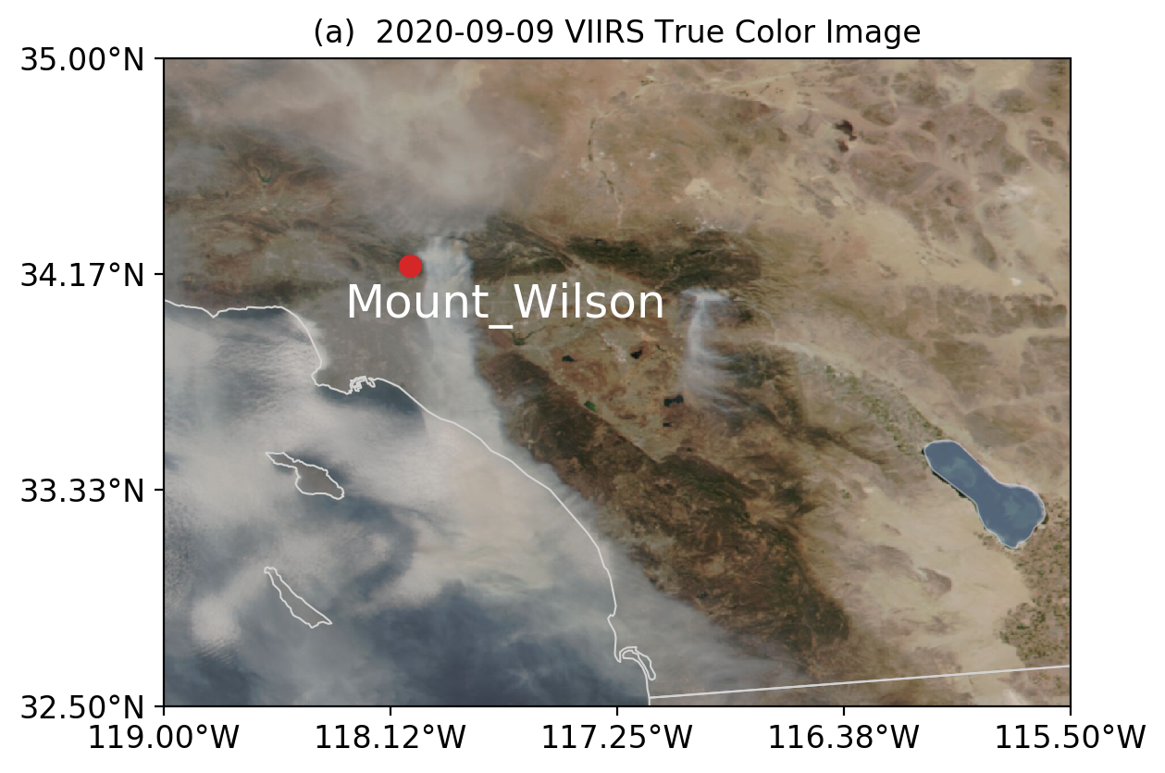
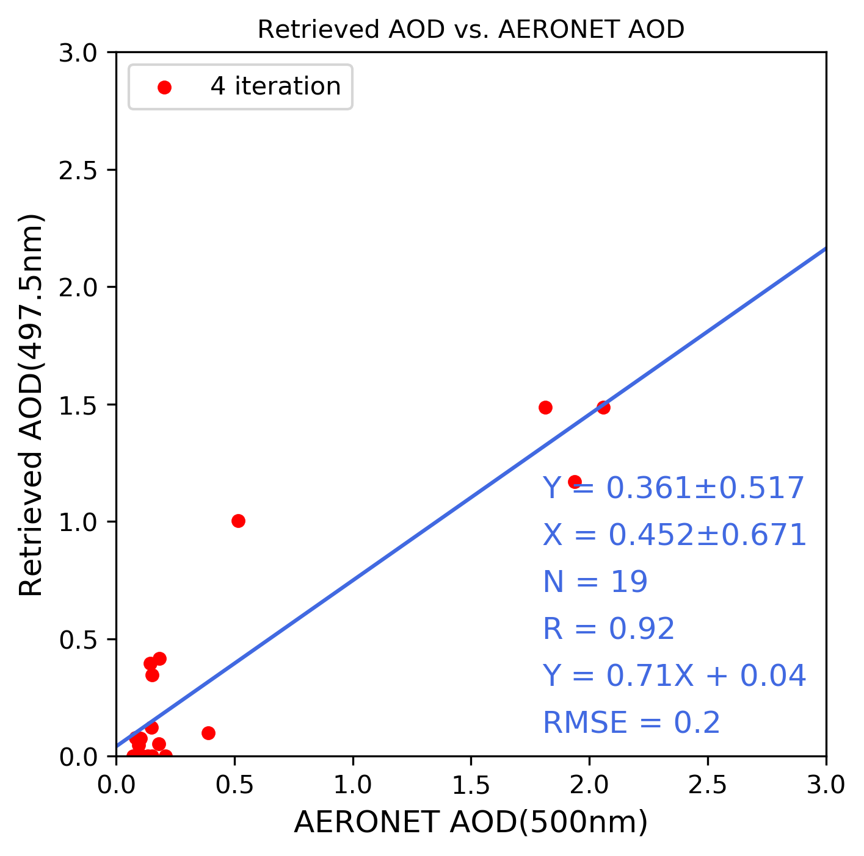
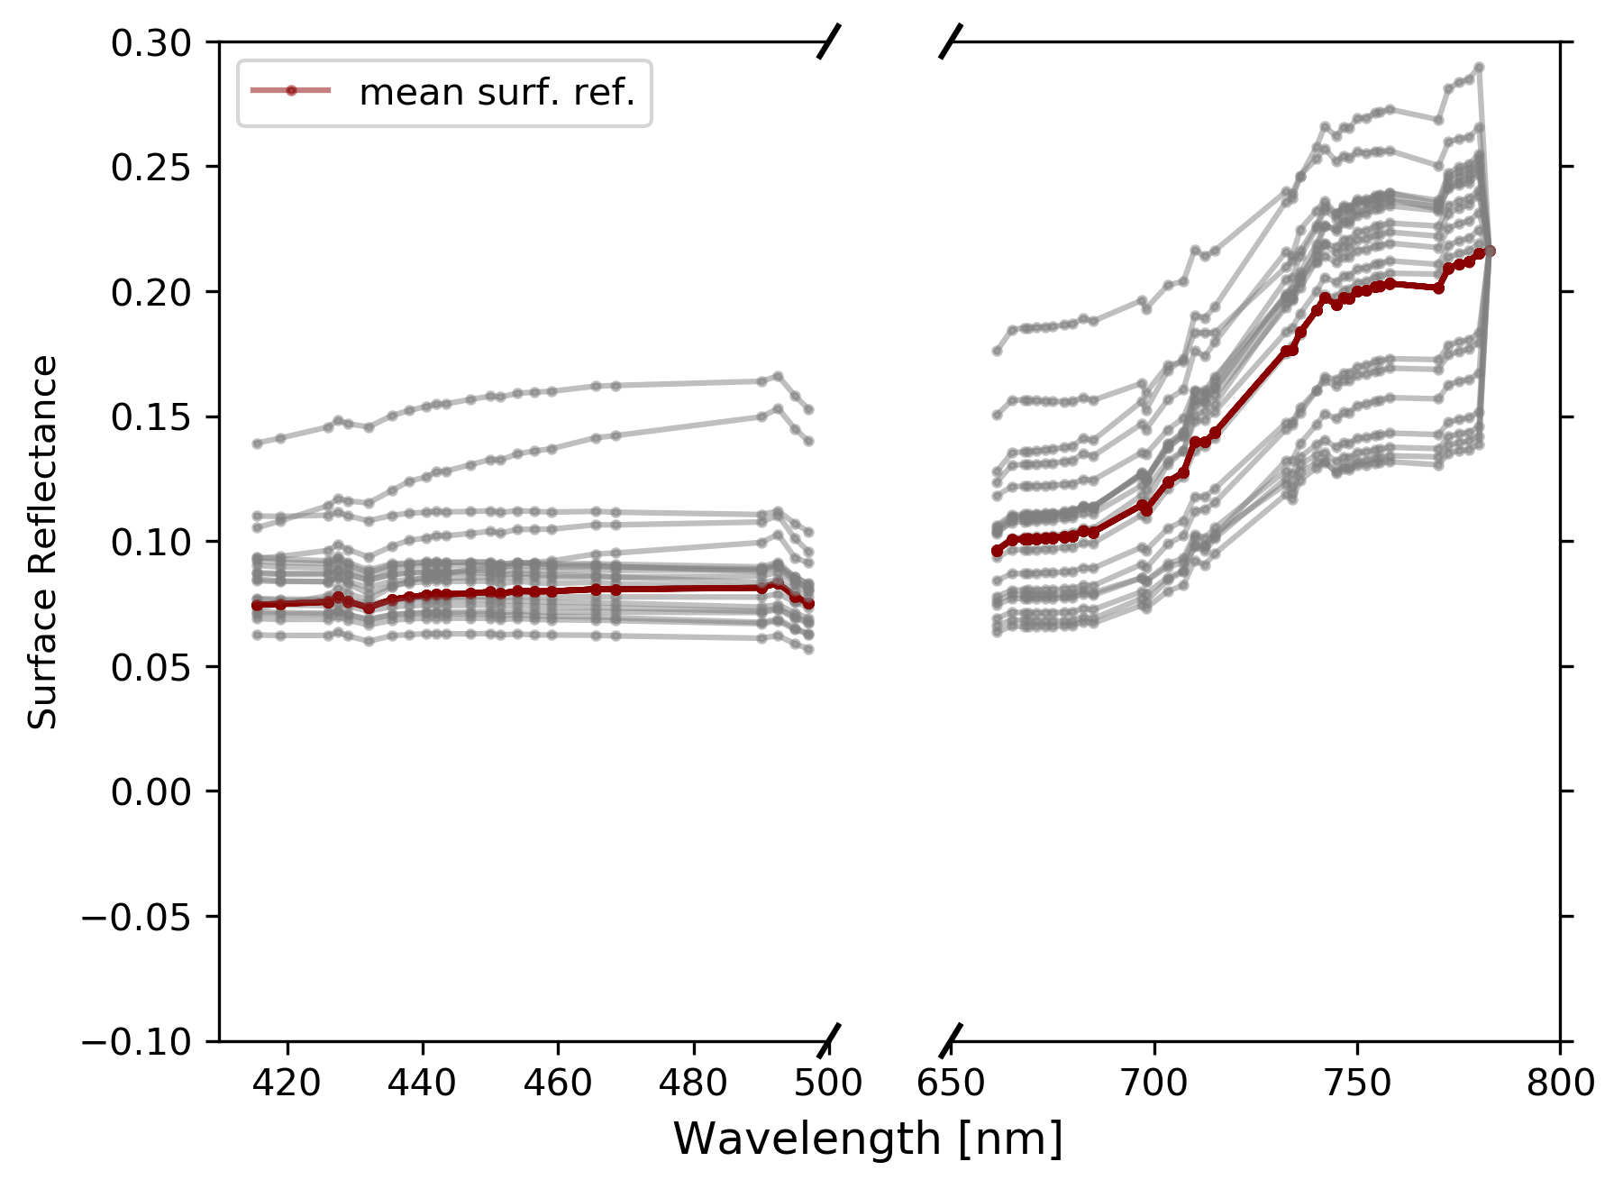
Headshot of yourself
11-Li – Hyperspectral Aerosol and Surface Optical Properties Retrieval Algorithm
Chengzhe Li, The University of Iowa
Jun Wang, Weizhen Hou, Xiaoguang Xu, Meng Zhou, Xi Chen, Jeffrey S. Reid, Scott J. Janz, James W. Leitch
Goal:
  Develop algorithms for simultaneous retrieval of aerosol parameters and surface spectral reflectance from hyperspectral satellite observation.
Approach:
  Derive land surface PCs through Principal Component Analysis (PCA).
  Develop OE-based AOD retrieval algorithm. (Utilize hyperspectral observation measured by TROPOMI)
Results
  TOA reflectance simulation agree well with the TRPOPMI observations.
  (R = 0.92, RMSE = 0.2)
  High spectral resolution surface reflectance can be predicted.
  Preliminary retrieved 500nm AOD results partially agree with MODIS MAIAC AOD.
Retrieved Surface Reflectance
Contact: Chengzhe Li chengzli@uiowa.edu, Jun Wang jun-wang-1@uiowa.edu

Slide 13

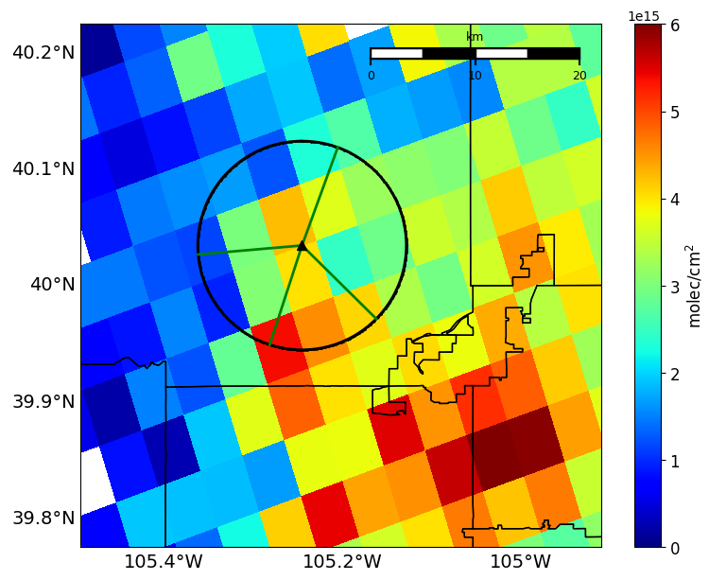
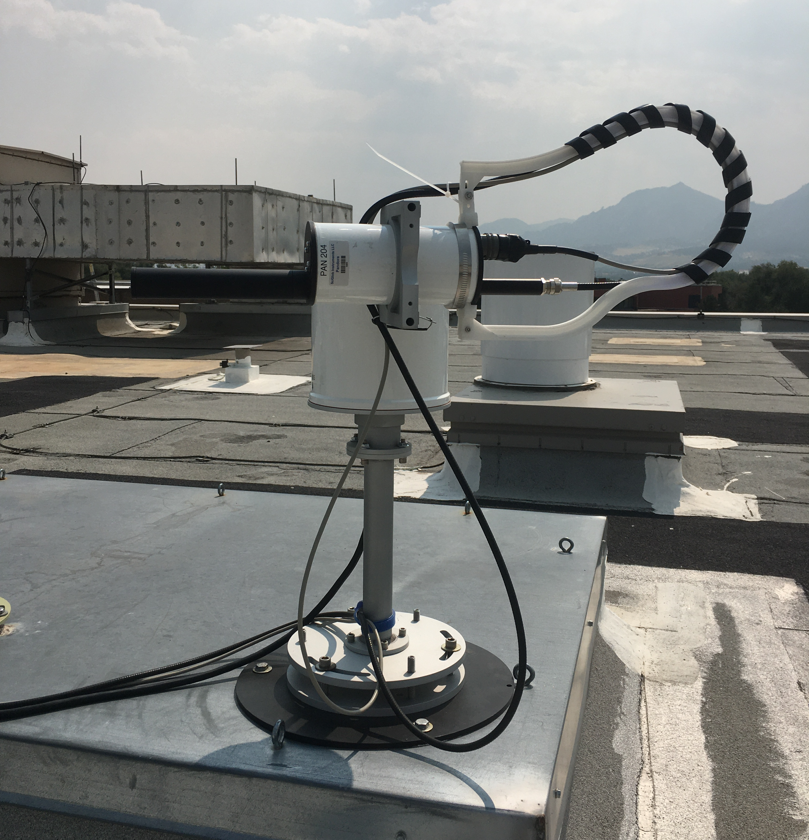
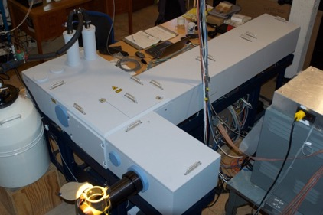
Place a headshot of yourself here
12-Ortega–Combining ground-based FTIR & PANDORA to fully capture NO₂ variability
Ivan Ortega, James Hannigan, David Edwards, National Center for Atmospheric Research (NCAR)
The day to day NO₂ sub-grid variability can be high, especially under complicated local sources and transport
How to assess sub-grid variability within satellite pixels using ground-bases observations?
TROPOMI overpass - Colorado
PANDORA
125HR-FTS (NDACC)
20$∘$
NCAR
265 $∘$
134 $∘$
198 $∘$
Strat & trop NO₂ + greenhouse, ozone chemistry, and antro/bio-genic gases
Boundary layer NO₂, HCHO
Apr 20 2022
NO₂ horizontal/vertical inhomogeneities better captured by using multiple azimuth views from Pandora & direct sun FTIR observations → TEMPO validation
Notes:
- For every pointing azimuth angles we obtain NO2 tropospheric column sensitive to the line of sight (boundary layer).
The area probed using multiple pointing azimuth angles (PAA) may represents better the foot print from satellites/models (better for validation)
The diurnal inhomogeneities already captured should taken into account for the upcoming TEMPO validation and minimize errors due to spatial/temporal variability
The diurnal inhomogeneities already captured should taken into account for the upcoming TEMPO validation and minimize errors due to spatial/temporal variability

Slide 14

Place a headshot of yourself here
13-Pickering–TEMPO Lightning NO_{x}: Green Paper Experiment
Kenneth Pickering and Dale Allen
Dept. of Atmospheric and Oceanic Science, University of Maryland
TEMPO in conjunction with lightning data from Geostationary Lightning Mappers (GLM) on GOES-16 and GOES-18, will provide a unique opportunity to quantify NO_{x} production by lightning (LNO_{x}).
Thus, a LNO_{x} experiment that utilizes GLM data and special observations from TEMPO is planned for Summer 2023.
High time resolution scans (every 10 minutes) will be conducted over a ~800 km wide swath, where convective activity is forecast, allowing for a Lagrangian view of the evolution of NO₂ columns associated with LNO_{x} plumes from a variety of thunderstorm types with a wide range of flash rates.
Initially, tropospheric NO₂ columns will be obtained from the standard TEMPO NO₂ algorithm. Post-experiment, refined NO₂ columns will be obtained using an algorithm appropriate for deep convection (Bucsela et al., 2019; Allen et al., 2019; 2021).
The resulting NO₂ columns will be converted to NO_{x} columns using NO_{x}/NO₂ ratios from the GEOS-CF model and profile shapes appropriate for electrified storms, and will be used to estimate mean LNO_{x} production per flash.

Slide 15

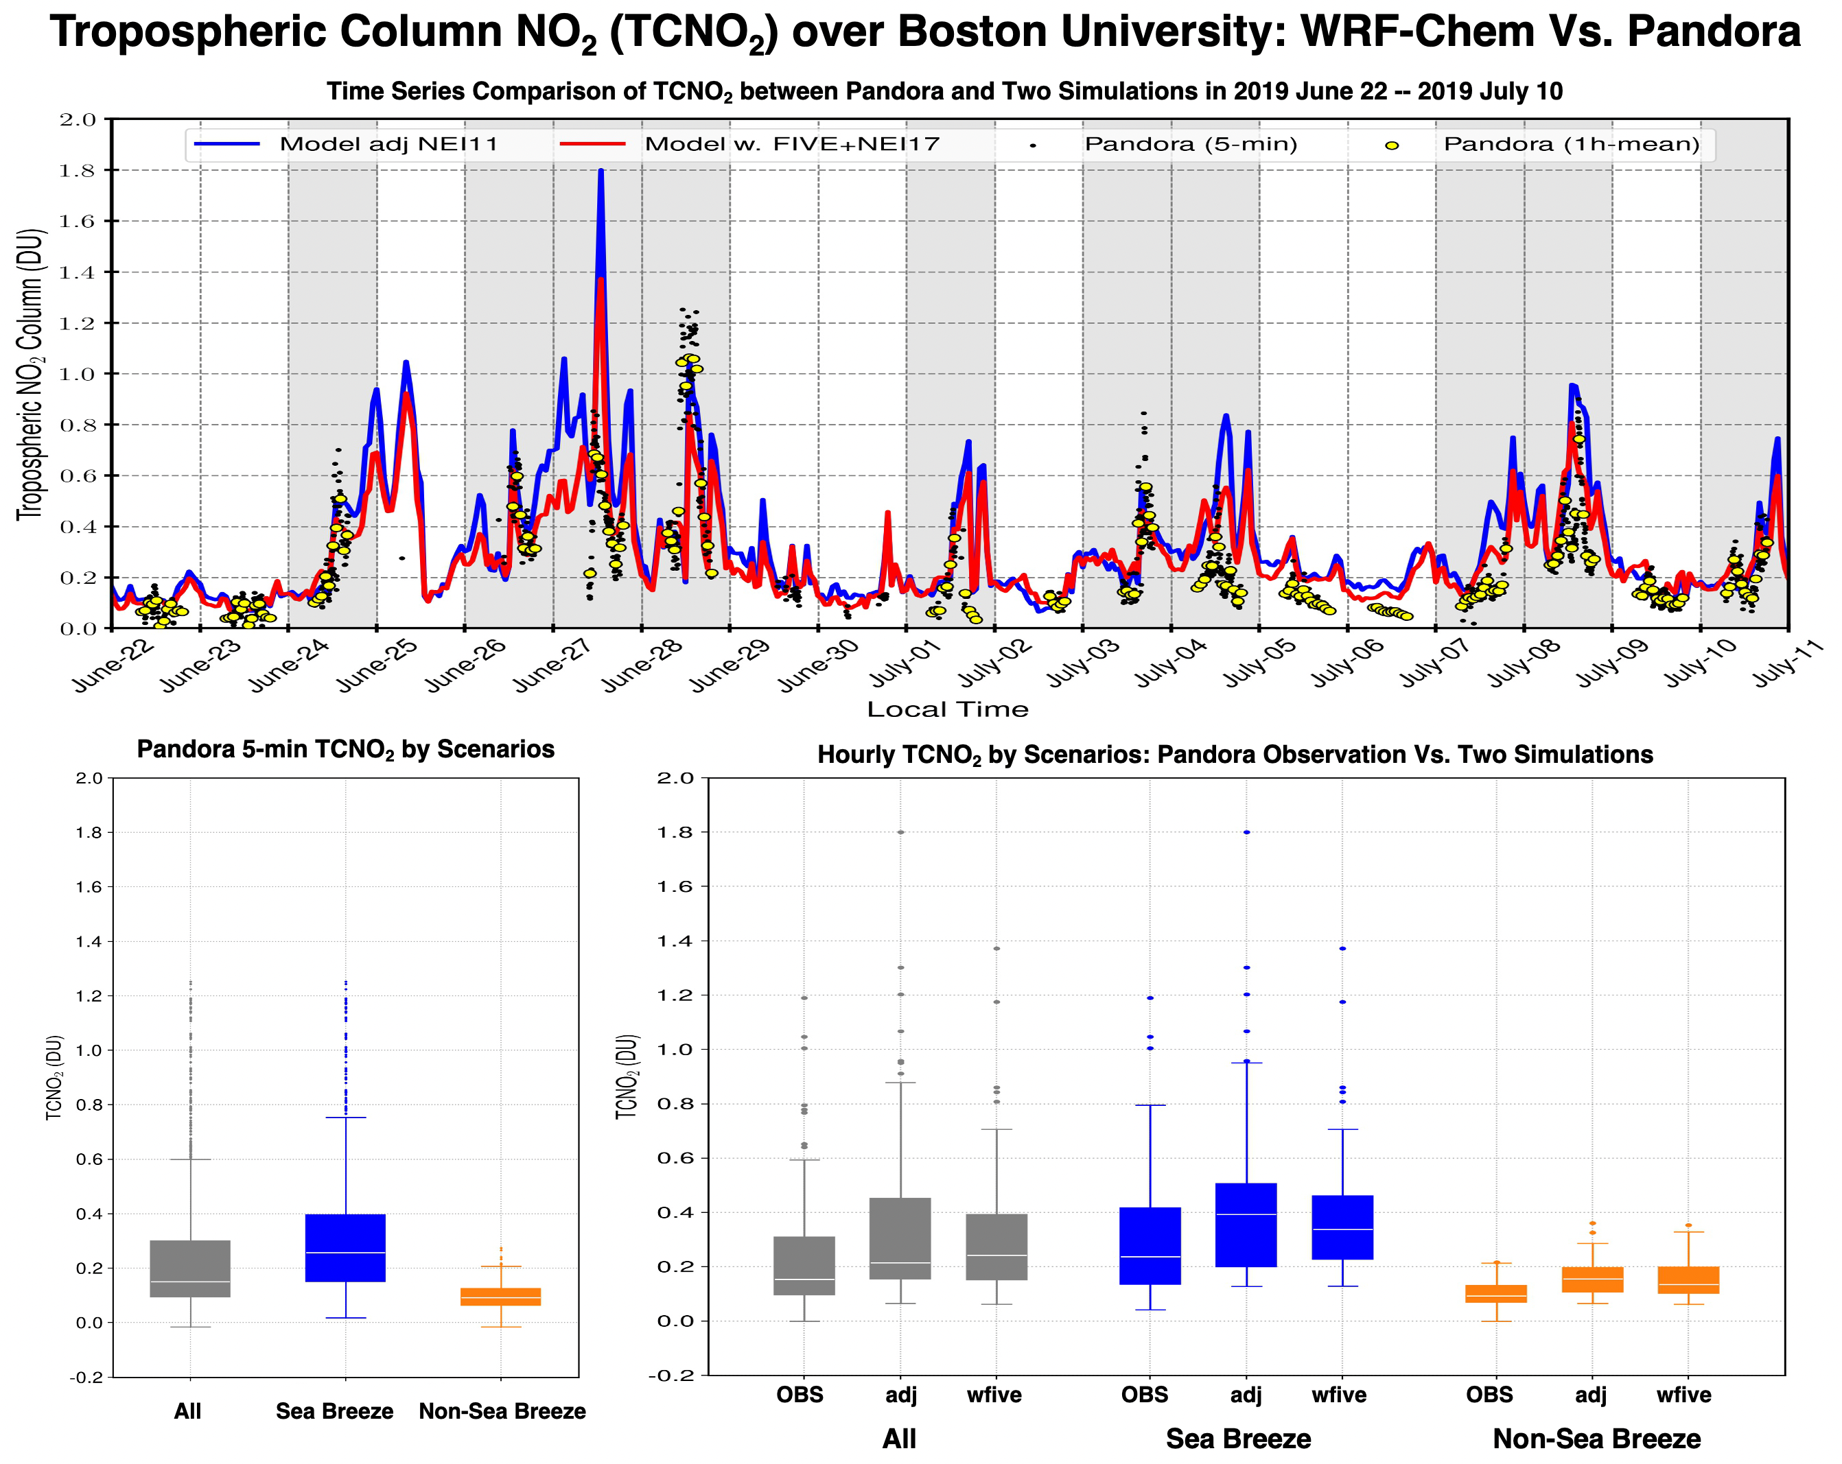
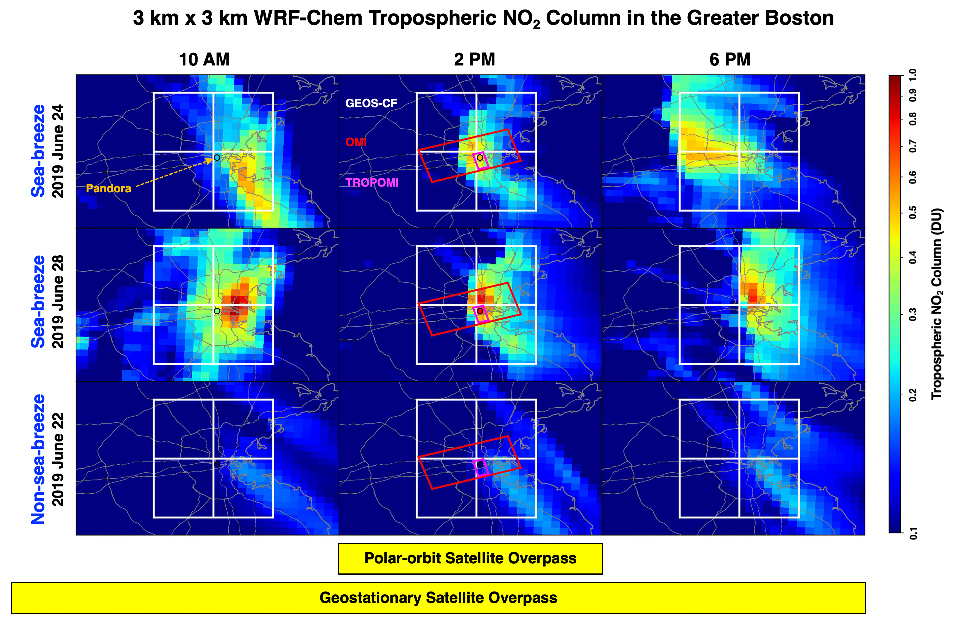
Place a headshot of yourself here
14-Wang–High Resolution Modeling of NO₂ and O₃ in Greater Boston
(on Sea Breeze and Non-Sea Breeze Days)
Bo Wang¹, Jeffrey A. Geddes¹, Taylor Adams¹, Dan Li¹, Gabriele G. Pfister², Elena S. Lind³
1. Boston University, 2. NCAR, 3.Virginia Tech University Acknowledgement: Brian C. McDonald, Jian He, NOAA ESRL
Can high-resolution modeling reproduce the observed temporal variability in pollution associated with the sea breeze in the Greater Boston Area?
How does the modeling inform aspects of local air quality not captured by routine monitoring, and what are the implications for geostationary observations?

Slide 16

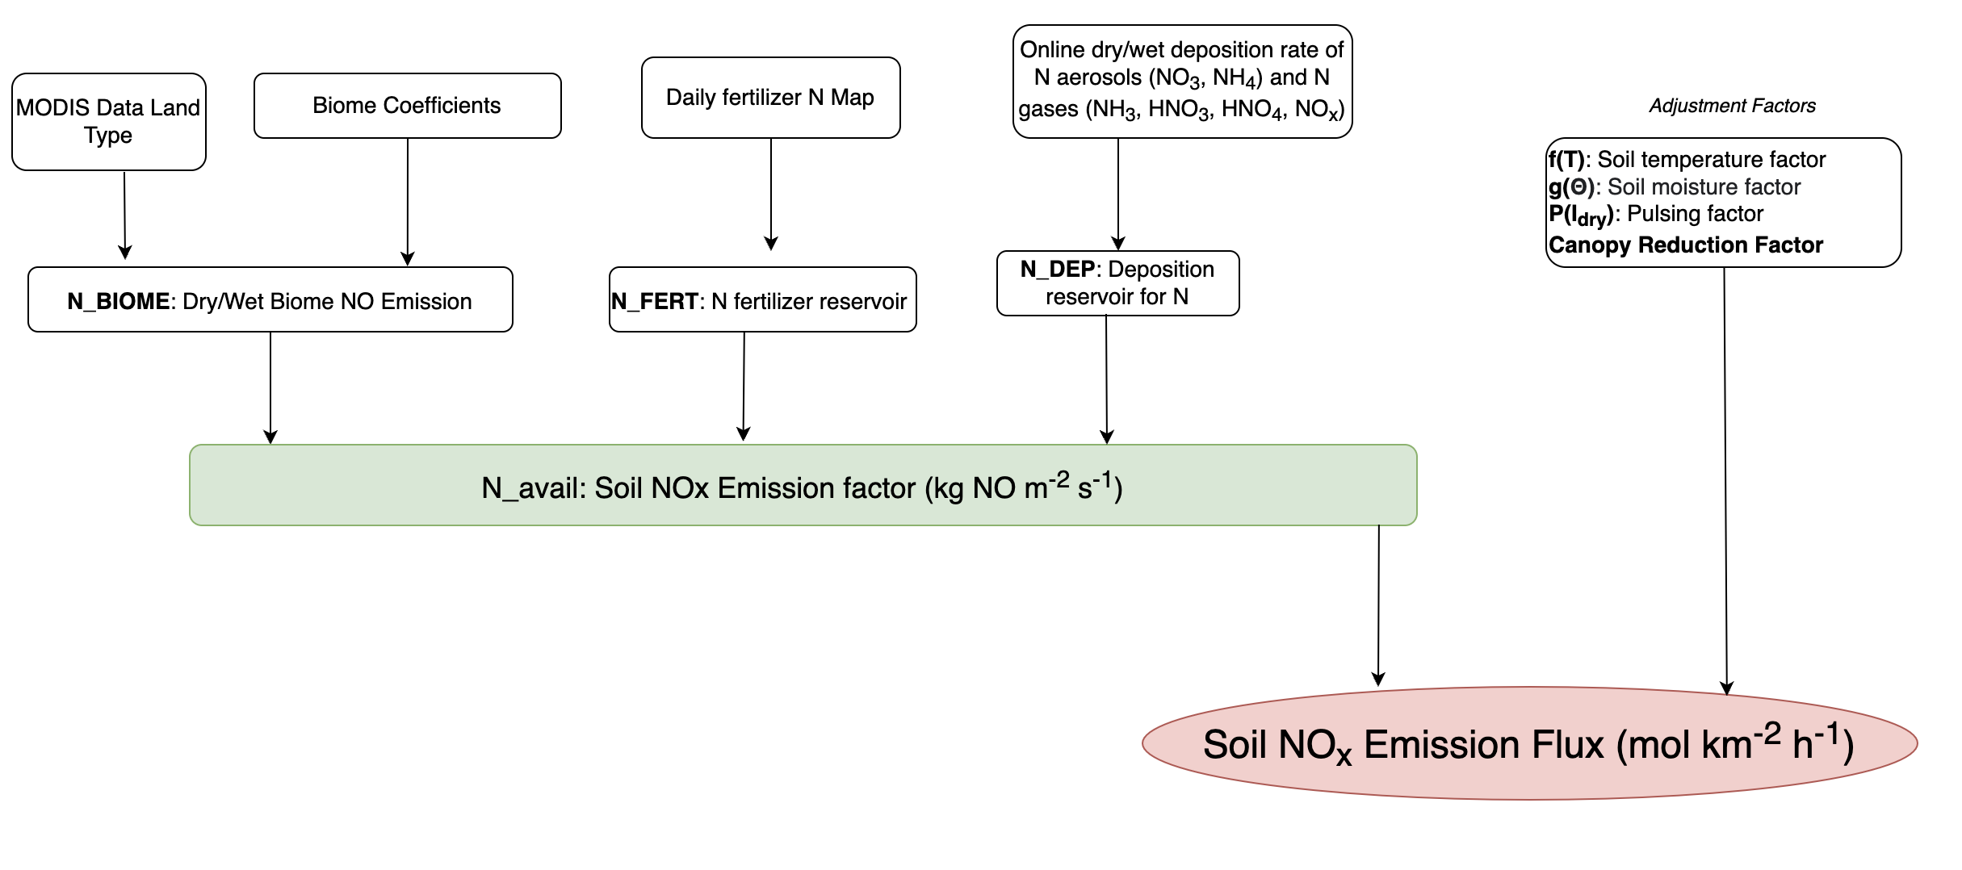
15-Wang–Understanding Soil NO_{x} Emissions in the Midwest
Qiyu Wang, Jessie Zhang, Jun Wang
University of Iowa
Using the UI-WRF-Chem with the BDISNP scheme to simulate the proportion of agriculture originated soil NO_{x} emissions over the Midwest.
Providing a way to understand potential impacts form the soil NO_{x} emissions to the regional air quality.
Case Study in the Midwest

Slide 17

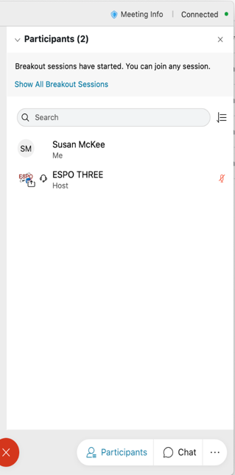
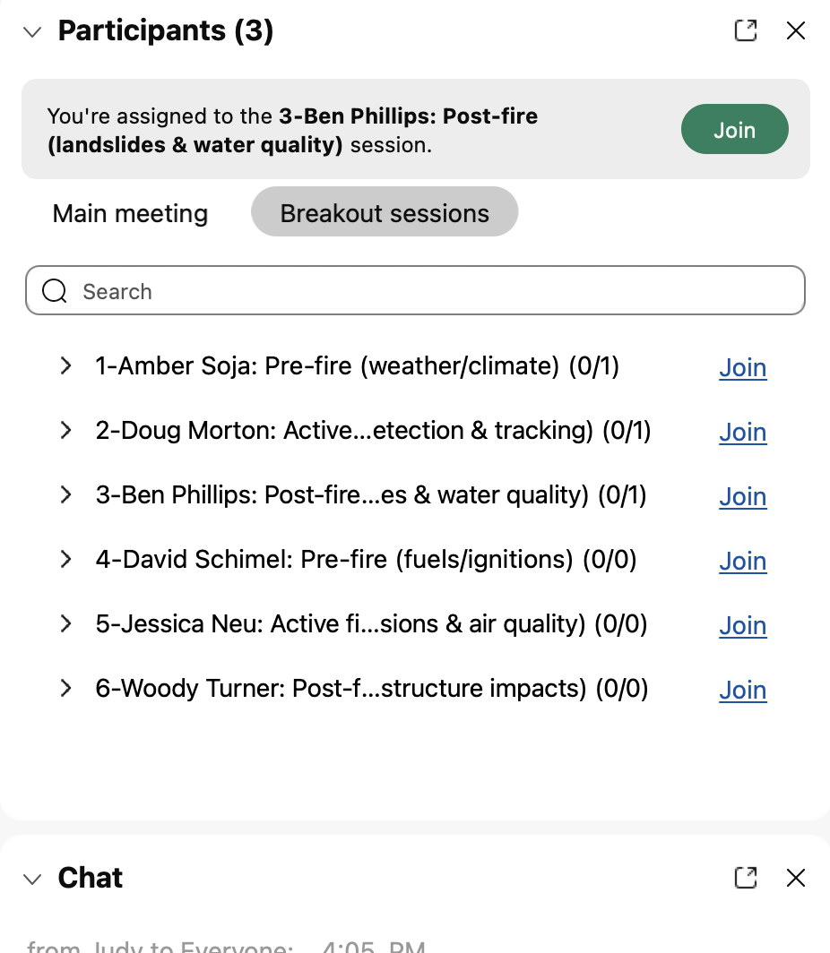
WebEx Breakout Instructions
Breakout Instructions:
Once the host starts the breakout groups:
Go to the “Participants” panel
Click “Show all breakout sessions”
Click “Join” next to the group you would like to participate in
Note: Breakout hosts are preassigned to their rooms – click the green Join button to accept
Breakout Audio Instructions:
Dial-in phone connections cannot move to breakout rooms; connect via Webex audio
2
3
1

Slide 18
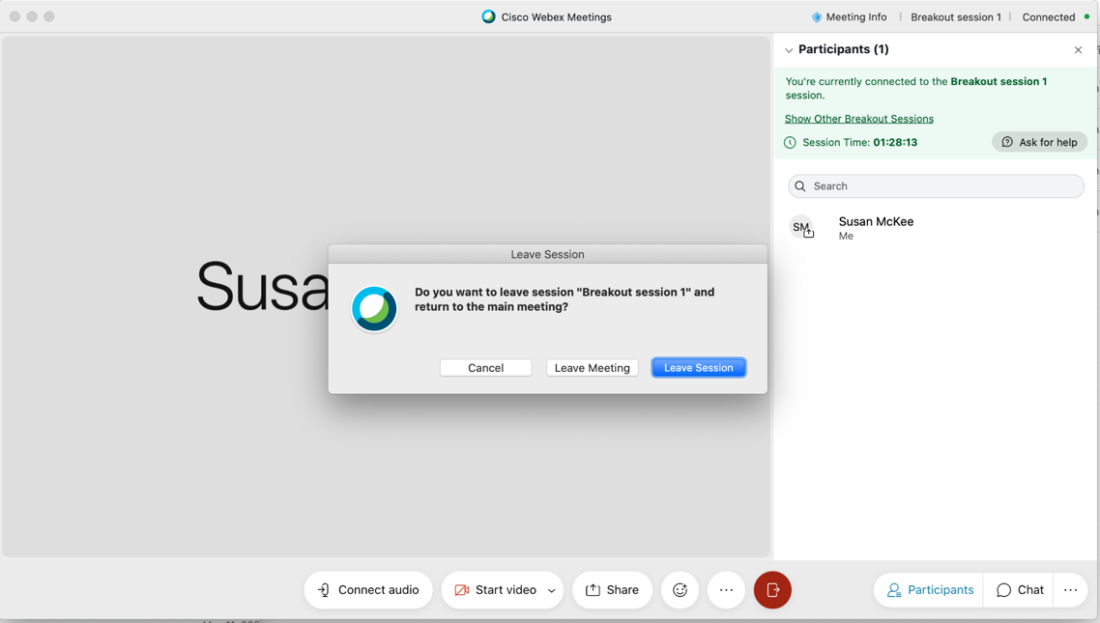
WebEx Breakout Instructions
Breakout Instructions, continued:
You can move between breakout rooms or return to the main room. Click “leave session.” Don’t click “leave meeting.”
Breakout Audio Instructions:
Dial-in phone connections cannot move to breakout rooms; connect via Webex audio.
Join another room
Leave Breakout Room
for Main Room
Leave Webex

Slide 19
Joining WebEx Breakout Rooms
Open “Participants” panel
Click “Show All Breakout Sessions”
Click “Join” next to the poster session you want to attend first
Note: Poster presenters are preassigned to their rooms – click the green “Join” button to accept
2
3
Join another room
1
You can move between breakout rooms or return to the main room
  Click “Show Other Breakout Session” and “Join” one.
  Click “leave session.” Don’t click “leave meeting.”
Note: Dial-in phone connections cannot move to breakout rooms; connect via Webex audio (you can have Webex call you)
Leave Breakout Room for Main Room
Leave Webex

Slide 20

Joining WebEx breakout rooms
Switching to another room
Open “Participants” panel
Click “Show All Breakout Sessions”
Click “Join” next to the poster session you want to attend
Note: Poster presenters are preassigned to their rooms – click the green “Join” button to accept
Join another room
Leave Breakout Room for Main Room
Leave Webex
3
You can move between breakout rooms or return to the main room
  Click “Show Other Breakout Session” and “Join” one.
  Click “leave session.” Don’t click “leave meeting.”
Note: Dial-in phone connections cannot move to breakout rooms; connect via Webex audio (you can have Webex call you)

