Slide 1
TEMPO as a tool for monitoring crop damage and productivity
Jack Fishman¹, Wasit Wulamu^{2,1}, Bethany Marshall², Matt Maimaitiyimg²
¹Department of Earth and Atmospheric Sciences
²Center for Sustainability
Saint Louis University
St. Louis, MO 63108
Presented at 5th TEMPO Science Team Meeting
Cambridge, MA
June 1, 2017

Slide 2
Origin of Agricultural Work Can Be Traced to Using Satellite Measurements to Observe Tropospheric Ozone

Slide 3
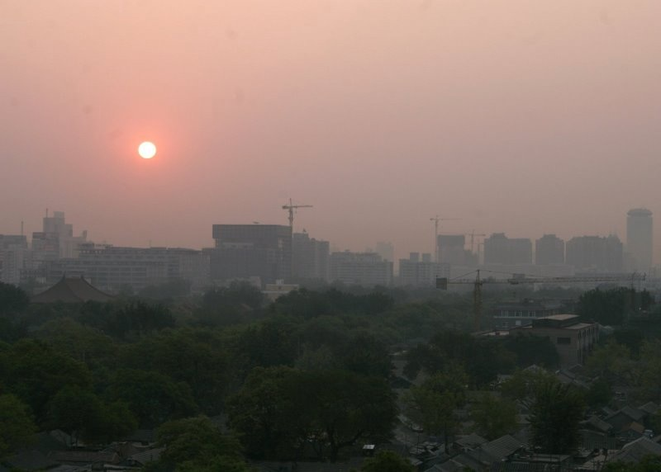
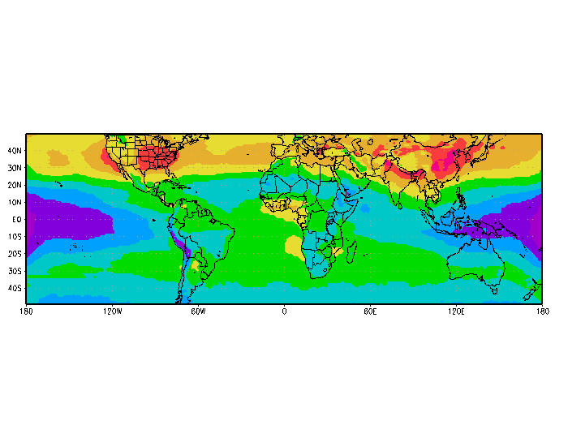
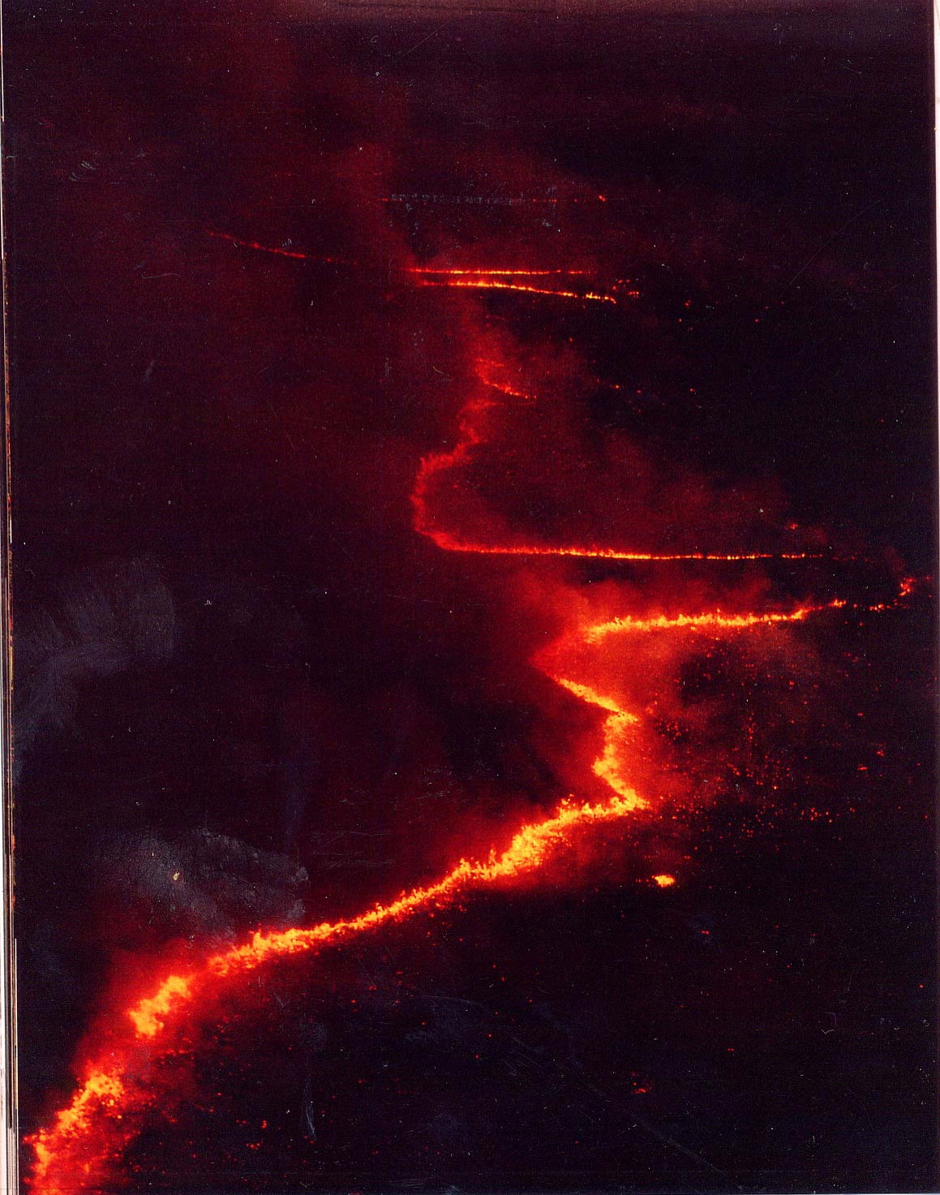
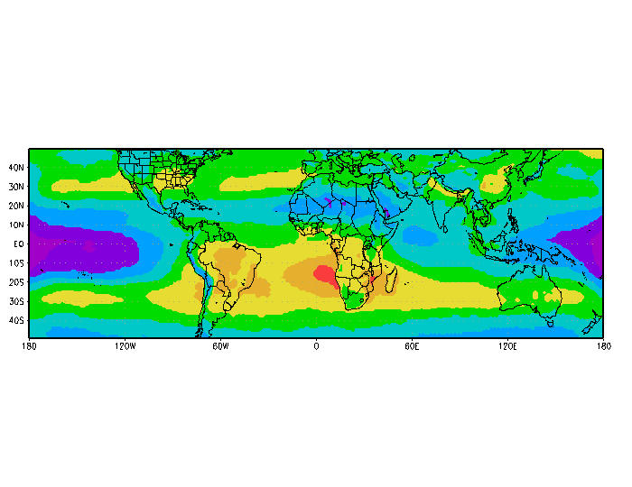
Satellites Provide Tools to See the Extent of Global Pollution:
Largest Sources: in NH from Fossil Fuel Combustion during NH Summer; in Tropics from Biomass Burning during SH Spring
Jun-Aug
Pollution over Beijing
Sep-Nov
Burning in Botswana

Slide 4
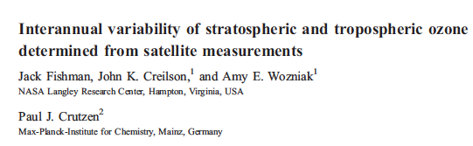
Use of Satellite Measurements for Scientific Studies
Interannual Variability Linked to El Niño – Southern Oscillation
Dobson
Units
(DU)
June 1982 - Strong El Niño Year
June 1999 - Strong La Niña Year
Periods of strong El Niño
R=+0.63

Slide 5
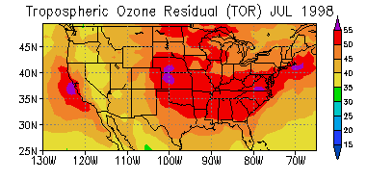
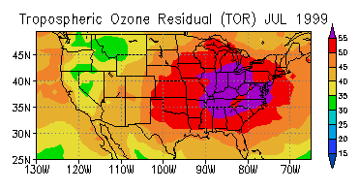
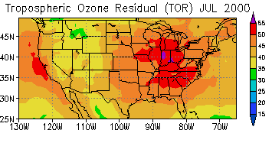
Stretching the Utility of the Use of TOR:
Can interannual variability in TOR O₃ be linked to crop productivity?
Key Finding from University of Illinois SoyFACE study: Soybean yield decreased 17% when ambient O₃ is increased 20%
Hypothesis: Establish relationship between TOR, surface O₃, soybean crop yield, and other variables to see if satellite information can be used to forecast and improve crop yield
2-Step Methodology:
• Obtain O₃, meteorological, and crop data
• Use state-of-the-art statistical tools to perform analysis

Slide 6
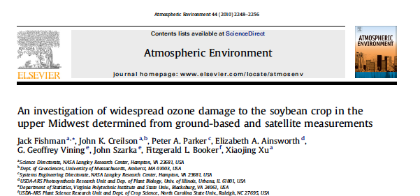
Findings of Relationship Between O₃ (both in situ and TOR)
and Crop Yield Published in 2010

Slide 7
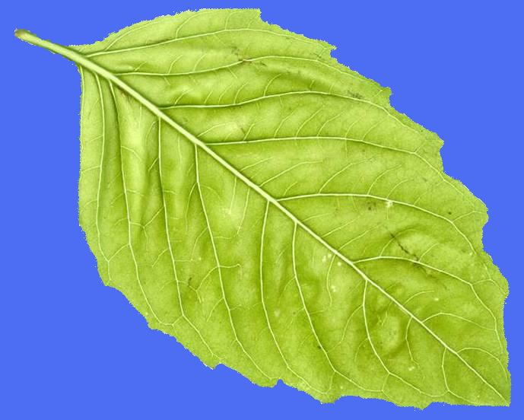
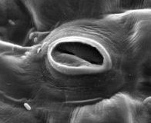
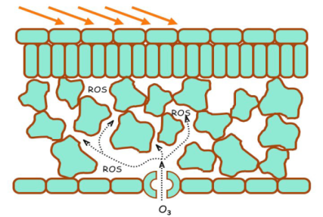
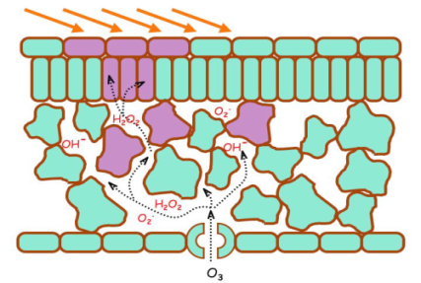
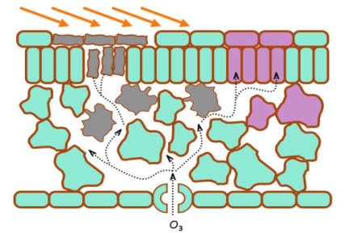
An Integral Part of Tropospheric Ozone Story:
Its Impact on Vegetation
• Ozone enters plants through pores on leaves called stomata
In the leaf O₃ reacts with other chemicals
The resulting reactive molecules cause a variety of problems within a leaf, including stippling and cell death
Leads to inhibited growth → decreased crop yield
Stoma
Provided by H. Neufeld; from NASA’s Ozone-Induced Foliar Injury Field Guide
Stomata open and close in response to environmental conditions such as daylight, temperature, humidity, and CO₂ concentrations; many plants close their stomata to prevent high water loss during periods of hot temperatures (above 95°F), low humidity, and drought

Slide 8
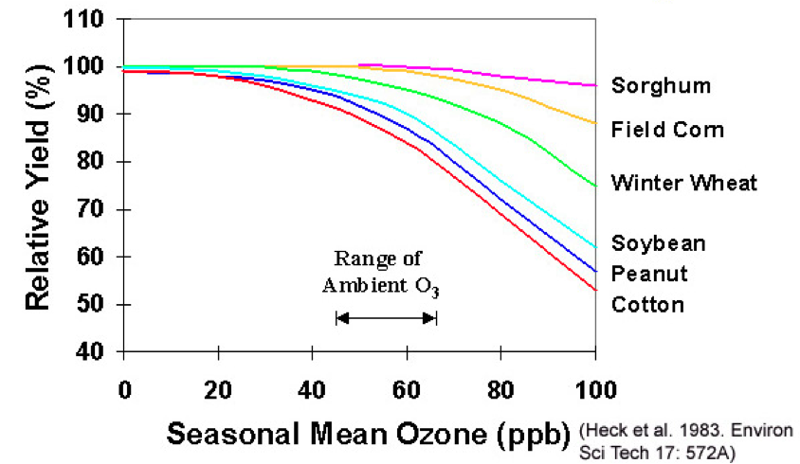
National Crop Loss Assessment Network (NCLAN) Conducted Studies in the 1980s to Assess Impact of Ozone on Crops
Many crops show decreased yield ~40 ppb

Slide 9
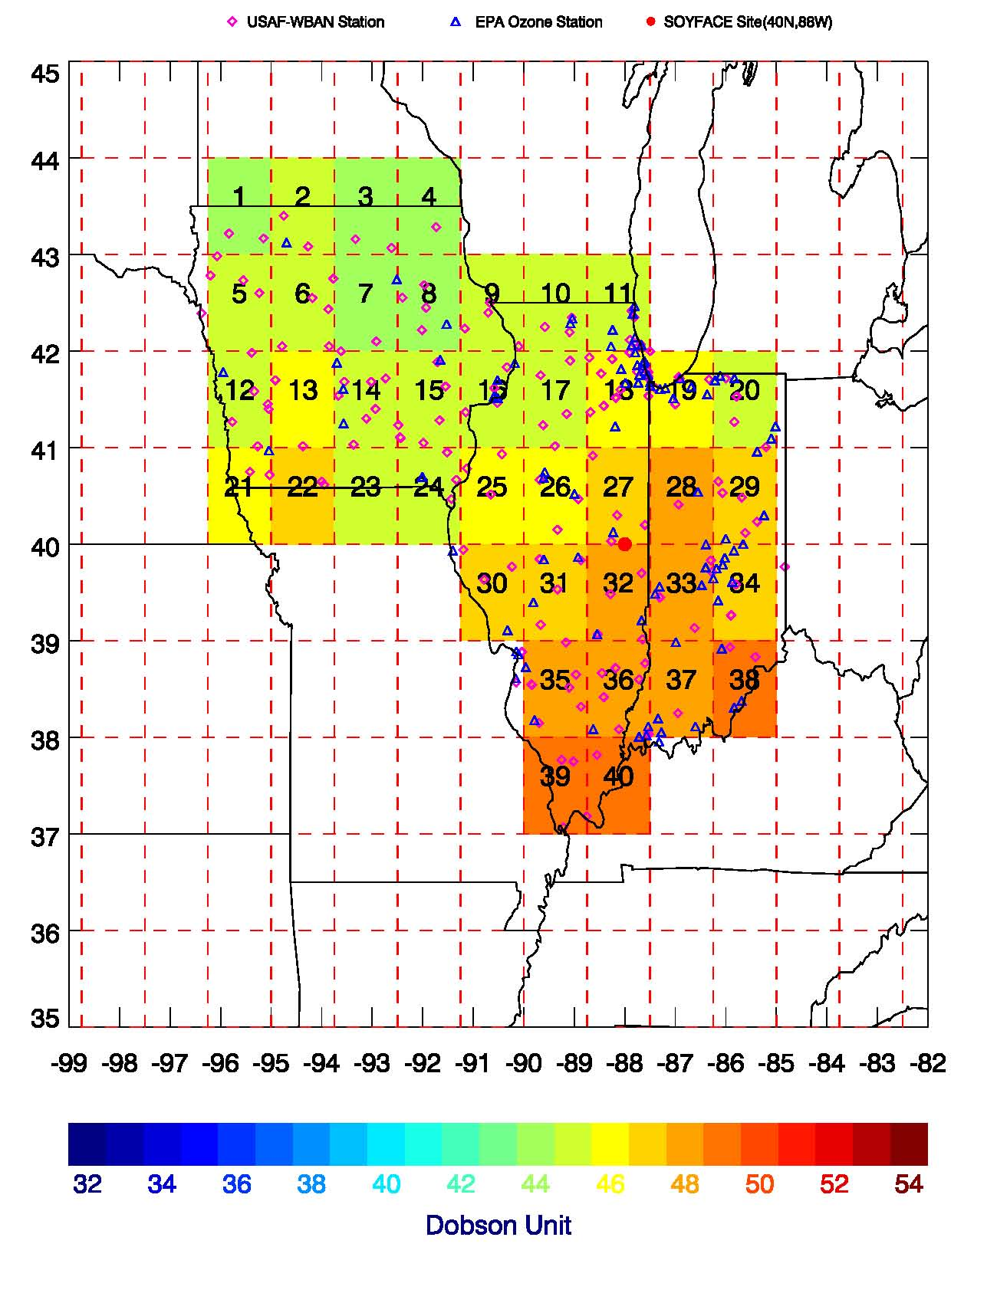
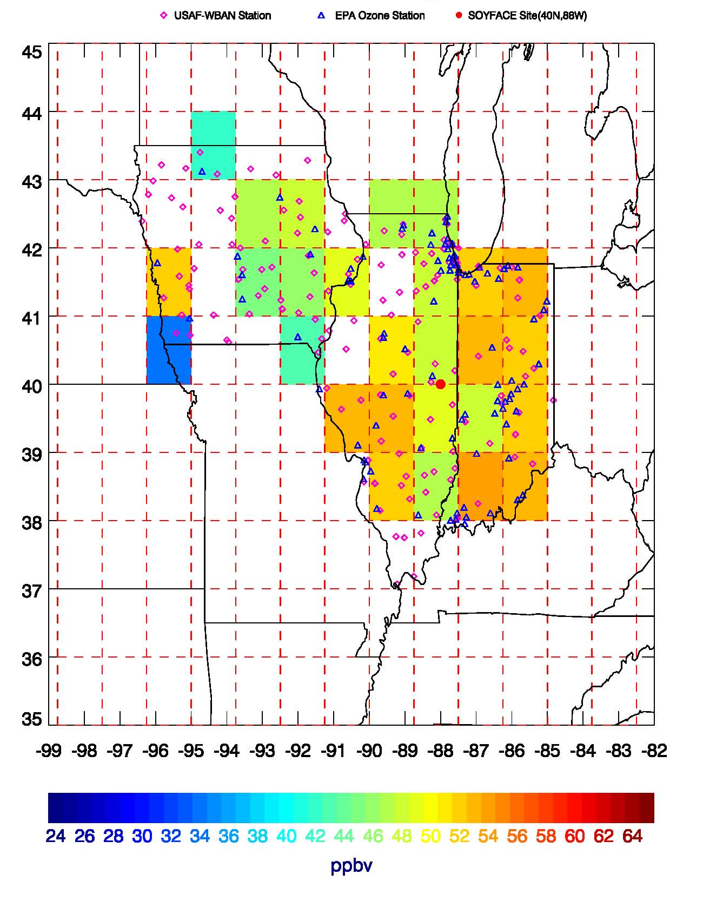
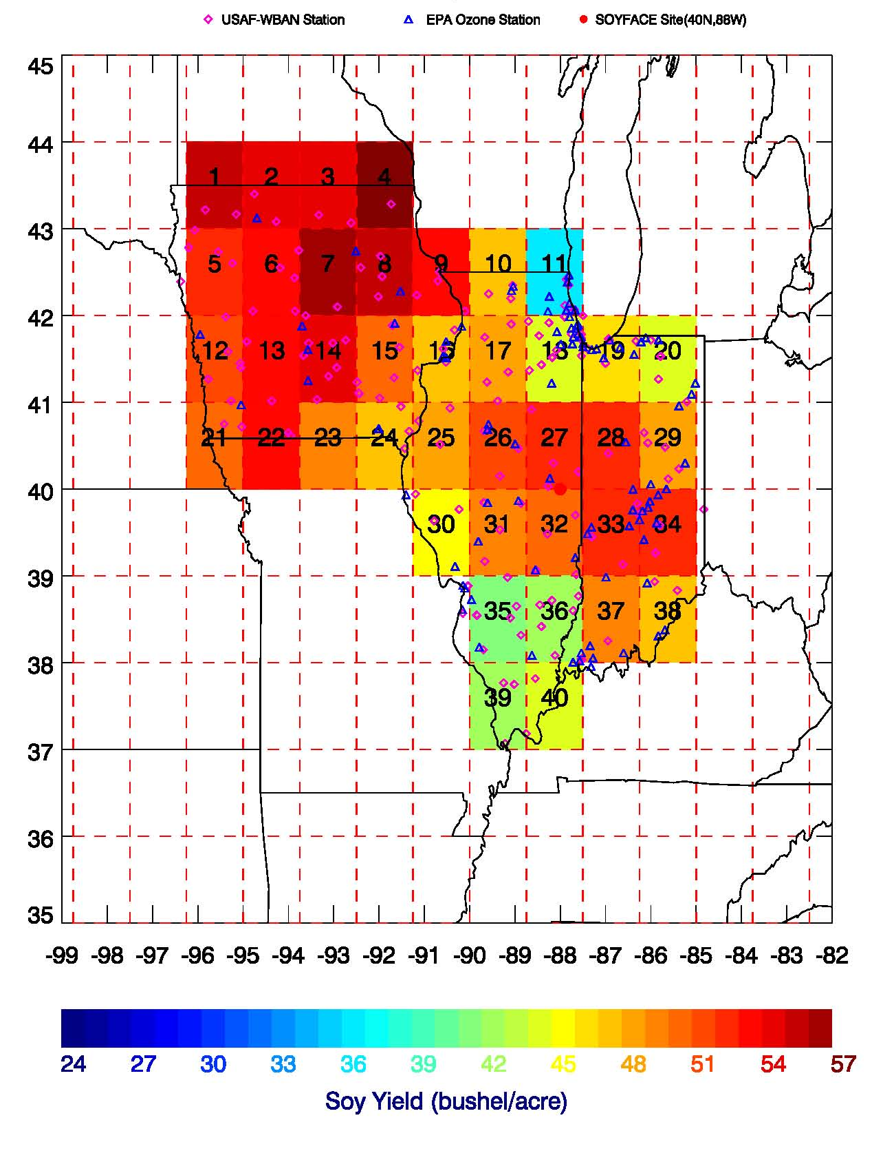
Significant Regional Variability within 3-State Study Area for Any Specific Year
Jun-Aug 2005 Satellite O₃
Jun-Aug 2005 Surface O₃
2005 Soybean Crop Yield
• Initial analysis finds correlation between soybean crop yield, and O₃, using both surface O₃ and TOR satellite measurements
• Multiple linear regression developed to determine interdependence between O₃, temperature and soil moisture

Slide 10
Strong Correlation between TOR and Surface O₃
R=0.74
• Monthly averages over 5 years (20 points) June-September
• Prescreening for both TOMS and surface O₃:
- Used only values where reflectivity < 0.2 for both TOR and sfc O₃
- Sfc O₃ is average afternoon value: 1300-1700 LT
• Sfc O₃ value was average of 7 sites within box
• Only time this strong correlation between TOR and sfc O₃ has ever Been published!

Slide 11
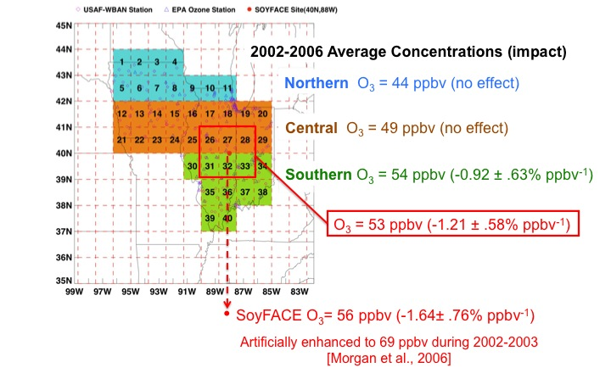
Summary of Findings from Multiple Linear Regression Statistical Model
• Applied over entire region: statistically insignificant correlation found between O₃ and soybean crop yield
• Statistically significant correlation found in southern region

Slide 12
Laboratory Studies in 1980s Are Now Supported by Larger Scale Field Studies

Slide 13

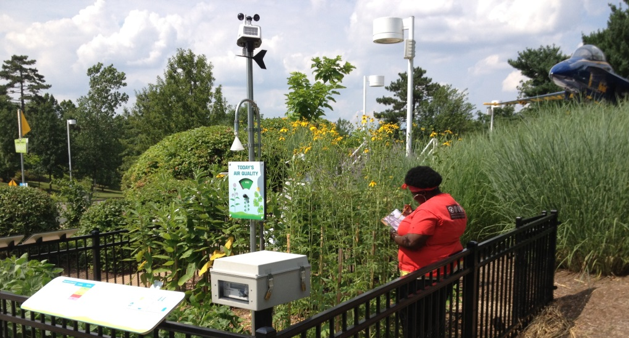
The St. Louis Ozone Garden Project:
Providing a National Model for Creating an Awareness of the Detrimental Effects of Air Pollution on Vegetation
Public Outreach Project Provides First Platform for Measuring Spectral Properties of Ozone Damage to Soybeans (part of AQAST & TEMPO Education/Public Outreach:

Slide 14
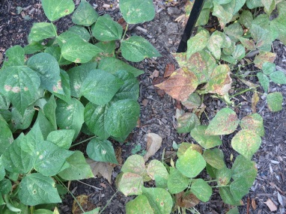
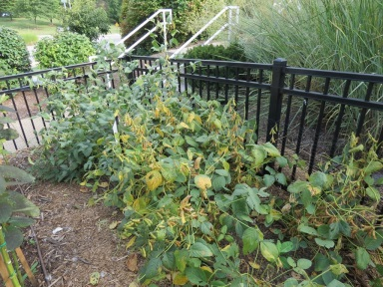
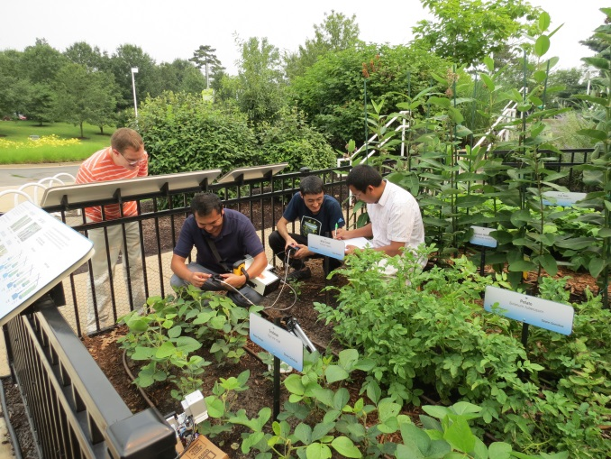
Observable Differences Between Ozone-Sensitive and
Ozone-Tolerant Cultivars at Ozone Garden
Sensitive
Tolerant
Snap Beans
Soybean Cultivars Late in the Season
(9 Sept. 2014)
Spectral measurements characterized O₃ damage to vegetation

Slide 15
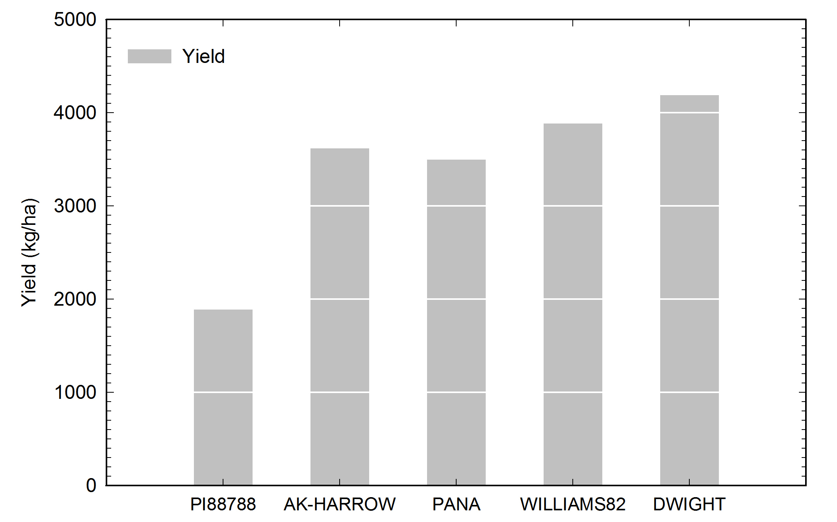
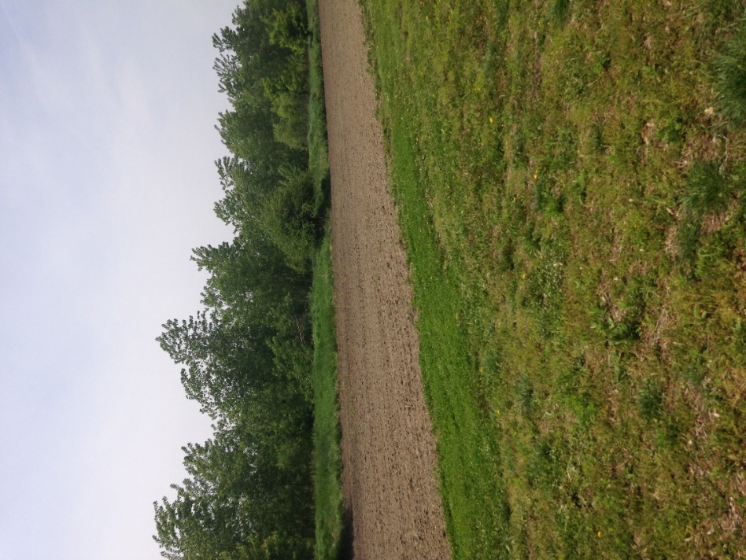
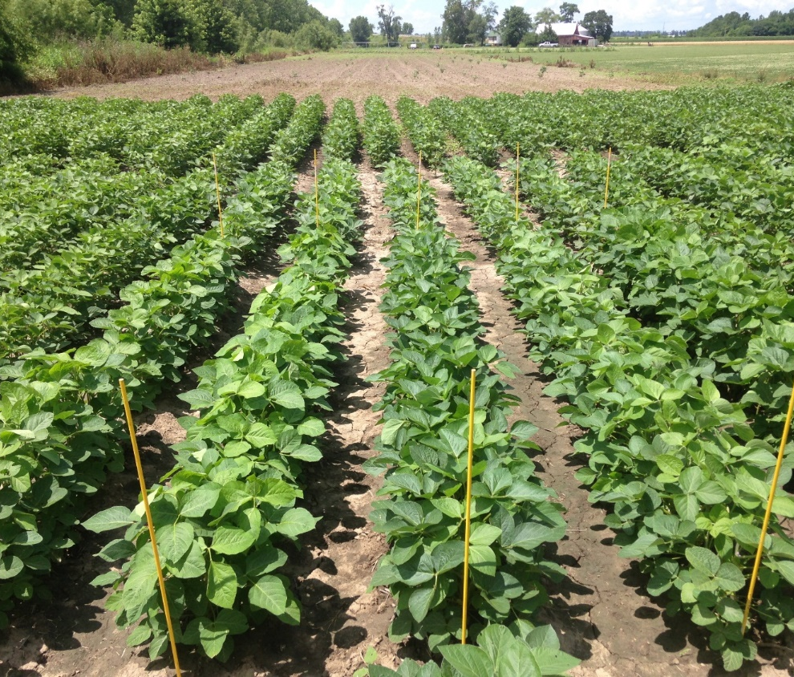
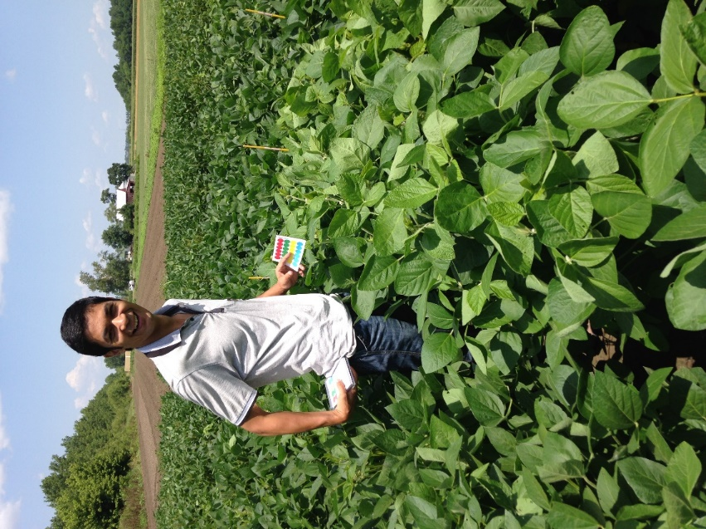
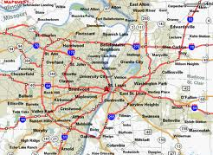

Yield of Soybean Cultivars from Maryland Heights Field Study
Study Led by Wasit Wulamu at SLU
May
Ozone Sensitive Cultivar
June
Maryland Heights
Measurements from Experimental Plot used by Monsanto
Maryland Heights Experimental Plot:
~30 km NW of city
July
Notes:
ΔF/Fm’: quantum yield of photosystem II or fluorescence yield, which is measured as Fm’-Fs/Fm’.
Where, Fm’ is the maximum fluorescence in field conditions, and Fs is the steady state fluorescence. These were measured in the field on August 13, 2014
Highest and lowest fluorescence yield was recorded with AK-HARROW and PI88788, respectively, and the same trend is true for photochemical quenching values of the genotypes. Second highest values of ΔF/Fm’ were found with WILLIAMS82, which was followed by PANA and DWIGHT. Highest yield was obtained from DWIGHT, and second-highest yield from WILLIAMS82 was closely followed by AK-HARROW and PANA. Harvested yield was the lowest from PI88788.

Slide 16
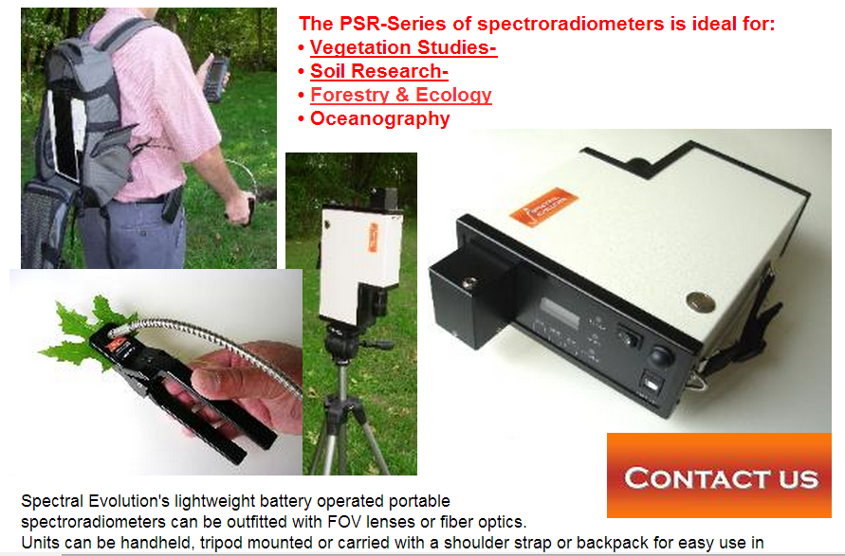
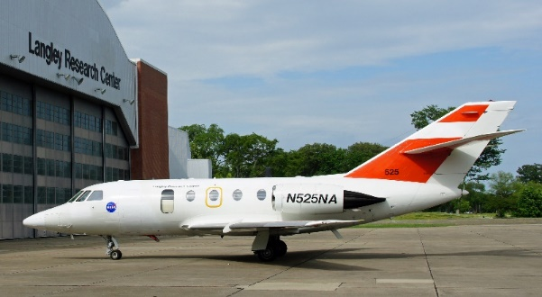
Field Study Conducted at Monsanto Test Site in Maryland Heights MO
Can spectral differences due to ozone-induced foliar damage be measured?
Spectroscopic Leaf and Canopy
Measurements in Vis/IR
Coordinated with GEO-TASO Overpass on NASA Falcon Aircraft (12 August 2014)

Slide 17
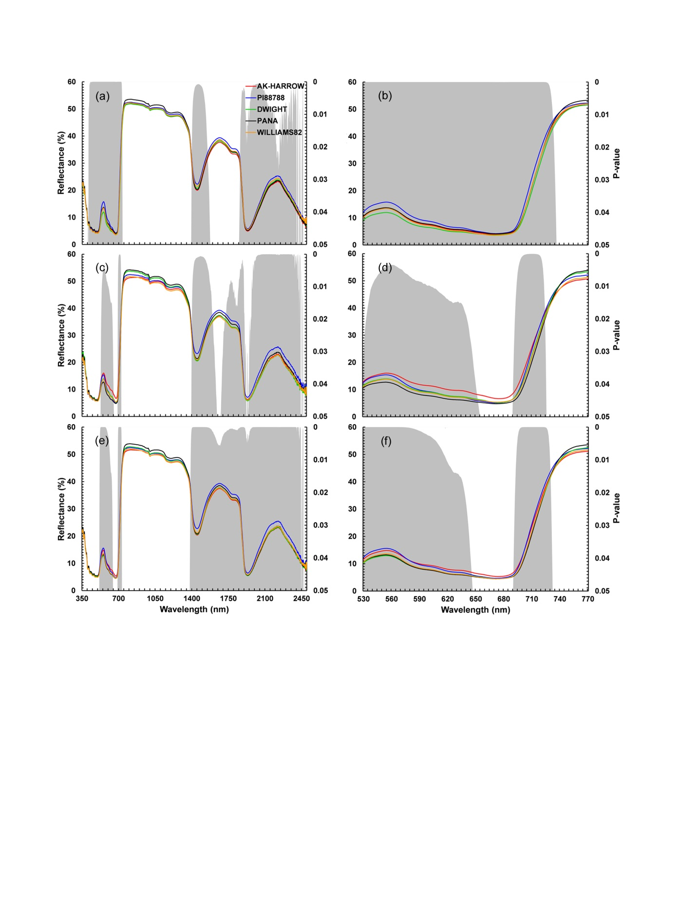
Statistical Analysis of Soybean Spectra
Gray Regions Indicate Statistically Significant Differences of Cultivars
Complete Vis/IR Spectrum
Vis/Near Red Spectrum
Early Growing Season
530 - 730 nm
Late Growing Season
Entire Growing Season
Notes:
Mean leaf spectra of five soybean genotypes in 1st-half growth period (a), 2nd-half growth period (c), all growth period (e) and corresponding close-up of 530-770 nm region for each growth period (b), (d) and (f), with ANOVA tests showing significant differences in gray shading (p-value ≤ 0.05). The experimented genotypes can be spectrally separated in green, red and shortwave infrared (SWIR) portions of the spectrum. SWIR region is mostly related to leaf water content, but the Visible wavelengths from 530 – 650 m and red edge centered at 700 nm and shortwave region demonstrate strong significance in tracking plant physiological status. These regions are related to photosystem II and fluorescence emission

Slide 18
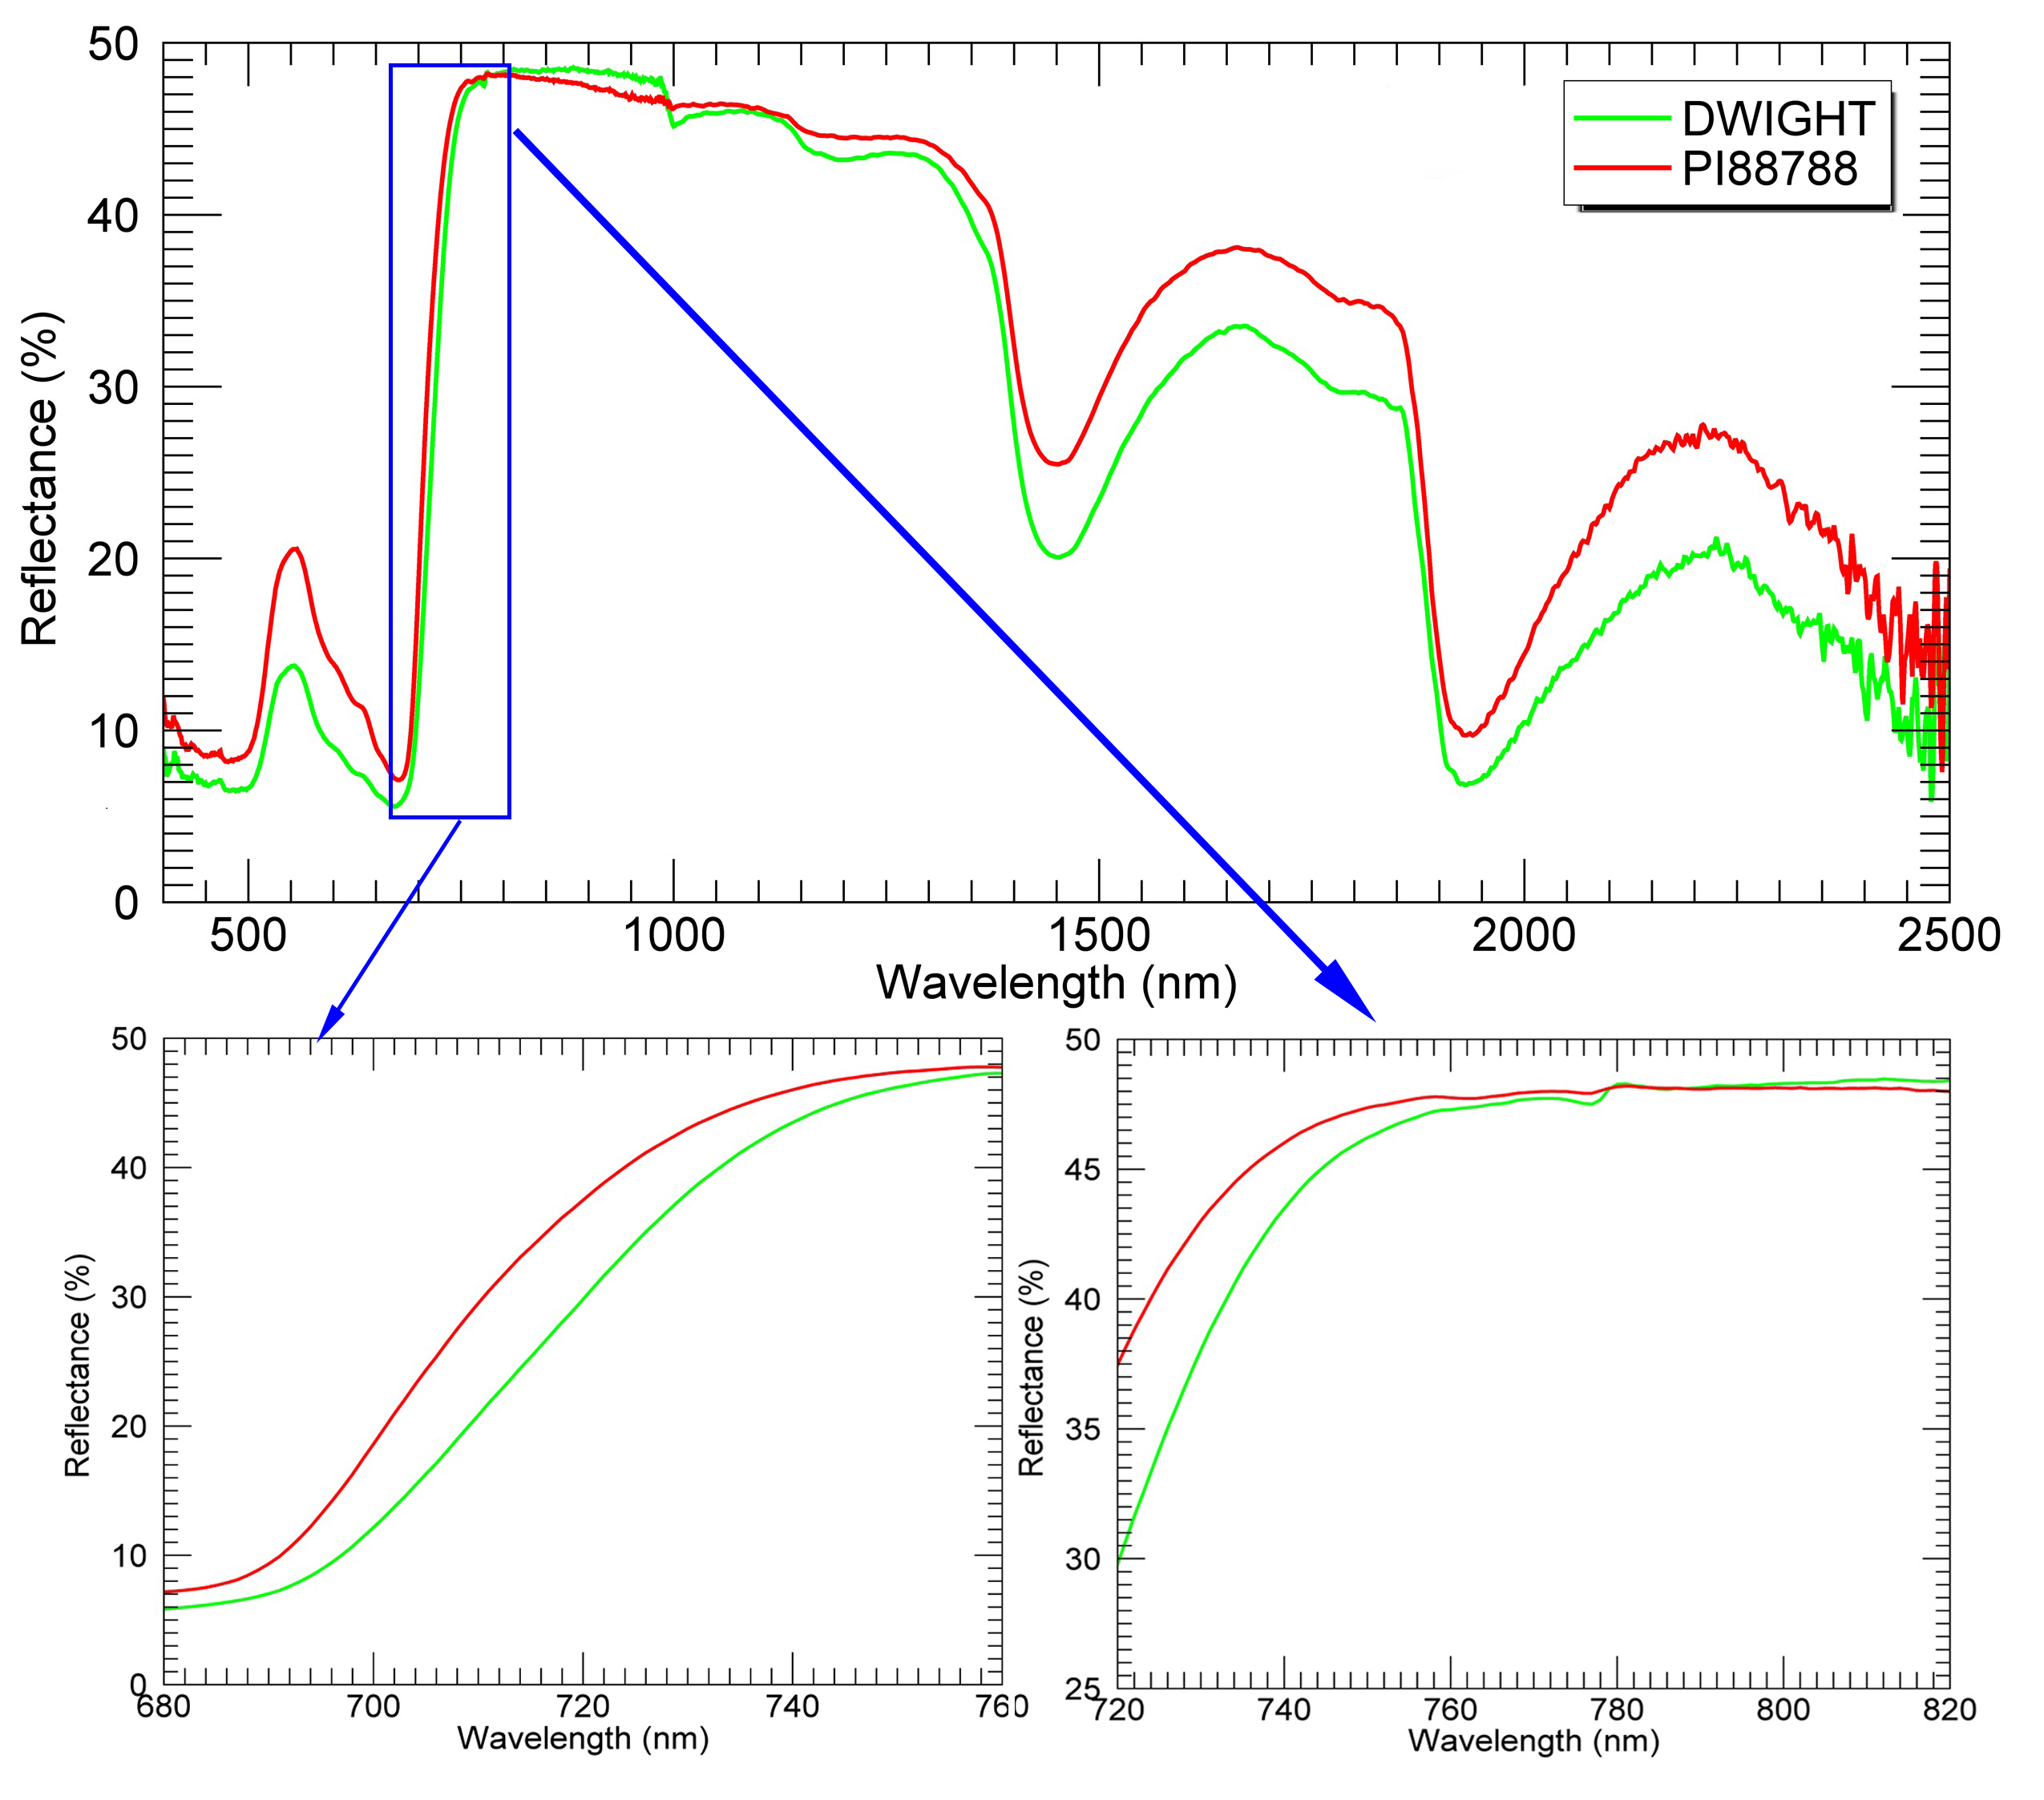
Average spectra of tolerant and less tolerant genotypes
Notes:
Red edge: difference in slope is shifted to left (right panel) indicates that plant is stressed and exposed to damage (IEEE, geosci and rem sens lttrs). Red edge for ozone damage shifts to the left.

Slide 19
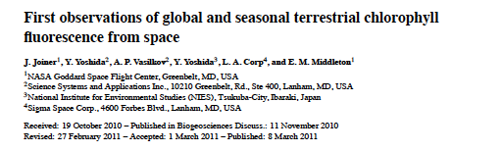
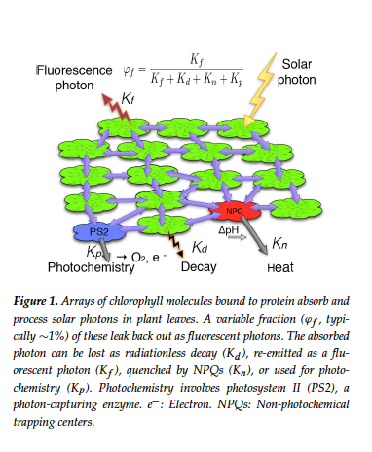
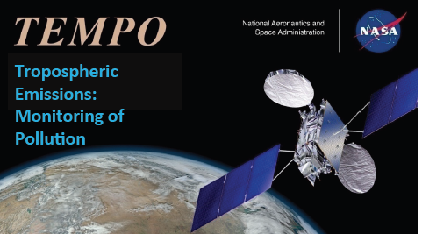
Application of TEMPO Air Quality Satellite Measurements to Improve USDA Commodity Forecast Models
TEMPO will provide measurements in the near-red (red edge) portion of the spectrum that can be used to measure chlorophyll fluorescence

Slide 20
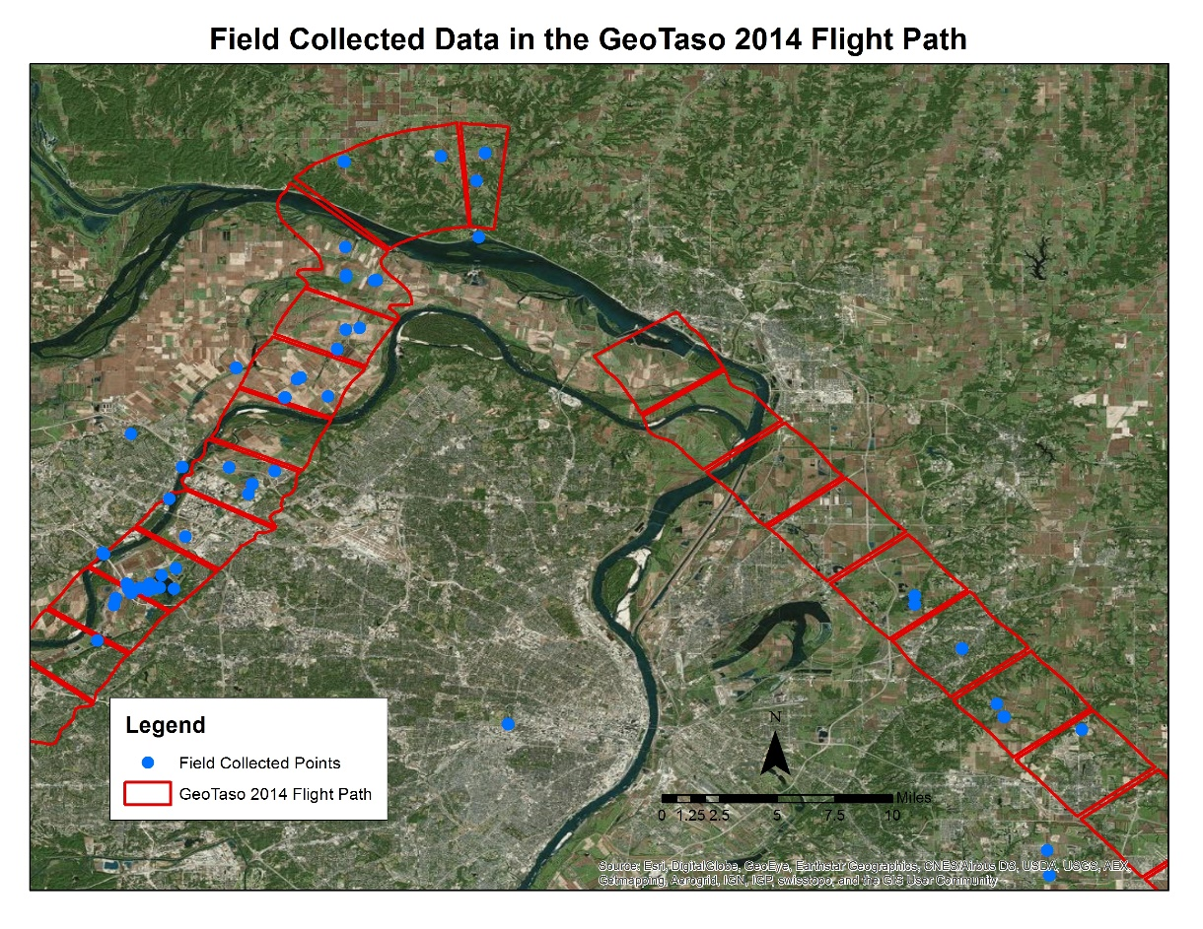
Geo-TASO flight instrument
Geostationary Trace gas and Aerosol Sensor Optimization (Geo-TASO)
“Precursor test-bed” for the TEMPO satellite
Flown over the St. Louis Metropolitan Area on August 13, 2014
Notes:
flight instrument was originally created to demonstrate the air quality measurements for the Geostationary Coastal and Air Pollution events (Geo-CAPE)
Geo-TASO flight instrument was flown onboard the NASA HU-25C Falcon aircraft in order to collect data over the St. Louis Metropolitan area on August 13, 2014

Slide 21
Study Area and data
Data were collected in both 2014 and 2015
461 upwelling and downwelling radiances at over 110 sites
Spectral reflectance was collected at over 299 locations in Missouri, Illinois, Indiana, and Colorado
110 lab spectral measurements of rock samples
Notes:
The Midwestern United States is a centralized location where many different targets can be collected, such as snow, ice, water, and agricultural products

Slide 22
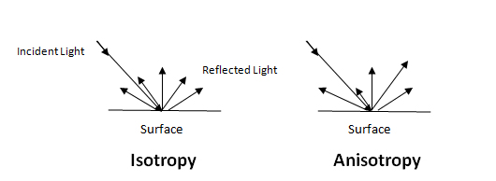
Lambertian and Anisotropic Reflectance
Lambertian
Anisotropic
The reflectance is the same regardless of viewing angle
Isotropic
Reflectance is dependent on viewing angle
http://www.gisresources.com/wp-content/uploads/2013/08/isotropy.jpg

Slide 23
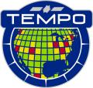
BRDF with a fixed viewing zenith angle
TEMPO observes the earth from a fixed view angle as a geostationary satellite
Effect of sun zenith angle (time of the day) is important
BRDF with fixed view angle as a function of sun zenith angle characterize what time of the day provides most useful measurements
0º
30º
60º
100%
87%
50%
80º
17%
Notes:
Since the TEMPO satellite is a geostationary satellite with a fixed viewing zenith angle over North America, BRDF polar plots were also created using a fixed viewing zenith angle and a changing solar zenith angle.
The changing solar zenith angle reflects diurnal changes of solar irradiances incident upon land surfaces during a day. The viewing angle was set to 23 degrees for the following plots.
This was determined based on the viewing zenith angle of airborne Geo-TASO instrument used to collect data in Saint Louis metro area on August 13, 2014

Slide 24
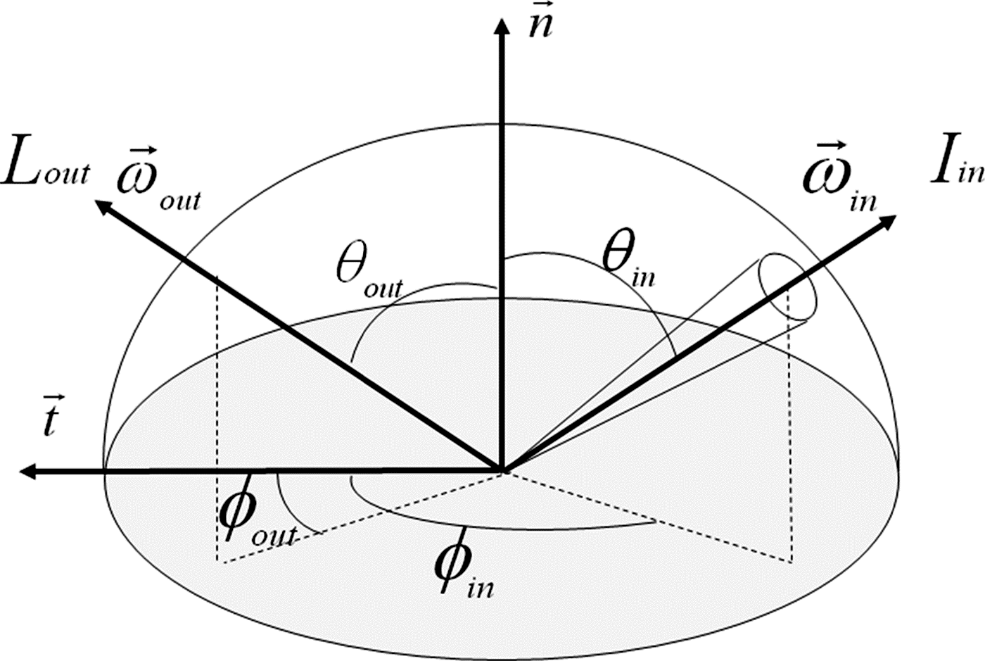
During Daylight Hours:
TEMPO Provides Measurements from Different Incoming Sun Angles
Bidirectional reflectance distribution function (BRDF)
• The BRDF is the single parameter used for describing the reflectance properties of an object
• It is measured radiance from one particular direction to another particular direction
• Cannot be directly measured
• When the parameters of an object change, the BRDF will also change
Notes:
Solar azimuth is arrow on left side of sphere;
View angle is angle from which satellite sees the radiant energy
(Nicodemus, et al. 1977) (Gatebe and King 2016) (Schaepman-Strub et al. 2006)
http://opticalengineering.spiedigitallibrary.org/data/Journals/OPTICE/22126/093601_1_1.png

Slide 25
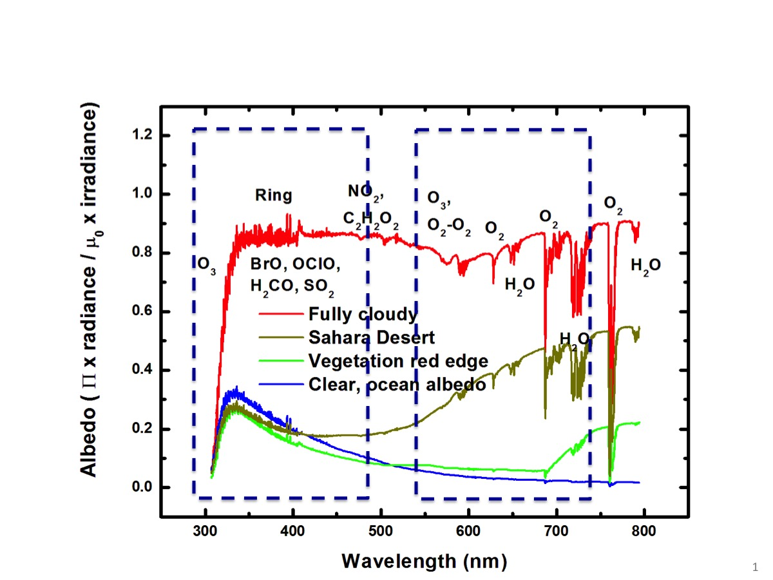
Bidirectional reflectance distribution function (BRDF) is calculated for three specific wavelengths with TEMPO spectral range
Perform BRDF Calculations at 550, 675 & 740 nm

Slide 26
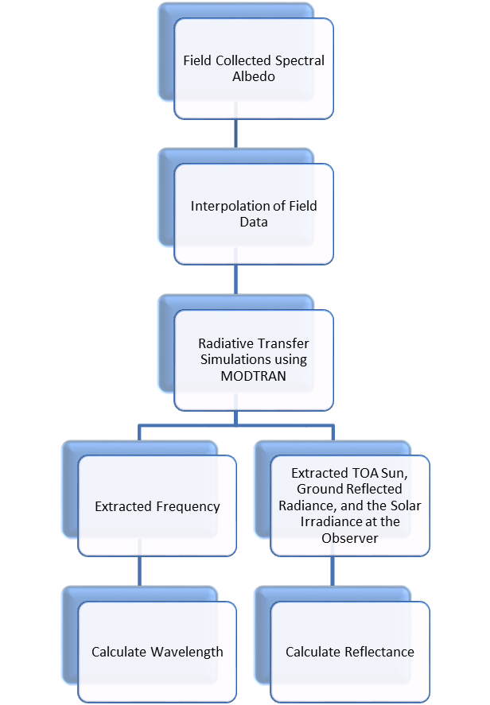
BRDF simulations
Raw field measured data was interpolated to 0.2nm
Interpolated data were simulated to Geo-TASO height parameters and target’s solar angle parameters
Polar Plots were created to show the BRDF of each target

Slide 27
Calculating the Bidirectional Reflectance Distribution Function (BRDF)
BRDF(θi,θv,ϕ, λ) = F_{iso} (λ) +f_{geo}(λ) +k_{geo}(θi,θv,ϕ+f_{vol}(λ) + k_{vol}(θi,θv,ϕ) (3)
where BRDF(θi,θv,ϕ, λ) is the BRDF
K_{geo}(θi,θv,ϕ) is the geo-optical scattering kernel
k_{vol}(θi,θv,ϕ) is the volumetric scattering kernel
ϕ is the solar relative azimuth angle
θ_{i} is the incident solar zenith angle
θ_{v} is the reflected solar zenith angle
F_{iso} (λ), f_{geo}(λ), f_{vol}(λ) are the kernel coefficients
for the isotropic, geometric, and volumetric scattering (Liu et al. 2010).

Slide 28
Soybean BRDF
Half circle is relative azimuth angle.
Healthy Soybean
Sun zenith angle
Sun zenith angle
Sun zenith angle
550 nm
675 nm
740 nm
Ozone damaged
Sun zenith angle
Sun zenith angle
Sun zenith angle
550 nm
675 nm
740 nm
Notes:
The Figure shows the comparison between healthy and ozone damaged soybeans with a fixed viewing zenith angle. Figure 30a shows the healthy soybeans and Figure 30b shows the ozone damaged soybeans. Just as with the fixed solar angle plots for healthy and ozone damaged soybeans, there is a significant difference in the green, 550 nm, region plot. The hotspot is very apparent in the ozone damaged soybean and it almost non-existent in the healthy soybeans. The same can be seen in a smaller capacity in the red region, 675 nm. The near-infrared region plots are very similar. This implies the significance of green wavelength regions from 531 to 570 nm, that are sensitive to xanthophyll cycle activity, on detection of ozone damage (Gamon et al. 1997).

Slide 29
Soybean BRDF
Healthy Soybean
550 nm
675 nm
740 nm
Ozone damaged
550 nm
675 nm
740 nm
“The Figure shows the comparison between healthy and ozone damaged soybeans with a fixed viewing zenith angle. Just as with the fixed solar angle plots for healthy and ozone damaged soybeans, there is a significant difference in the green, 550 nm, region plot. The hotspot is very apparent in the ozone damaged soybean and it almost non-existent in the healthy soybeans. The same can be seen in a smaller capacity in the red region, 675 nm. The near-infrared region plots are very similar. This implies the significance of green wavelength regions from 531 to 570 nm, that are sensitive to xanthophyll cycle activity, on detection of ozone damage (Gamon et al. 1997)” -- Wasit Wulamu
Notes:
The Figure shows the comparison between healthy and ozone damaged soybeans with a fixed viewing zenith angle. Figure 30a shows the healthy soybeans and Figure 30b shows the ozone damaged soybeans. Just as with the fixed solar angle plots for healthy and ozone damaged soybeans, there is a significant difference in the green, 550 nm, region plot. The hotspot is very apparent in the ozone damaged soybean and it almost non-existent in the healthy soybeans. The same can be seen in a smaller capacity in the red region, 675 nm. The near-infrared region plots are very similar. This implies the significance of green wavelength regions from 531 to 570 nm, that are sensitive to xanthophyll cycle activity, on detection of ozone damage (Gamon et al. 1997).

Slide 30
Grapevine BRDF
Half circle is relative azimuth angle.
Irrigated grapevine
Sun zenith angle
Sun zenith angle
Sun zenith angle
550 nm
675 nm
740 nm
Stressed grapevine
Sun zenith angle
Sun zenith angle
Sun zenith angle
550 nm
675 nm
740 nm
Notes:
Figure 28 compares the BRDF of healthy and water stressed grapevines with a fixed viewing zenith angle at 550 nm, 675 nm, and 740 nm. Once again, the blue region, at 550 nm, shows the most differentiating results. The hotspot in the healthy grapevine is more circular and centered around 30 degrees at the view zenith angle than the high BRDF portion of the water stressed grapevine plot. The water stressed grapevine plot does not have a circular high BRDF area, but most of the plot is a higher BRDF. When looking at the healthy grapevine, it is apparent that the best relative azimuth angle is around 150-180 degrees. For the water stressed grapevine, the best relative azimuth angle ranges from about 110-180 degrees. These findings provide important implications for detecting and differentiating water and ozone stress.

Slide 31
Tropospheric Ozone’s Impact on Vegetation
• Ozone enters plants through pores on leaves called stomata
In the leaf O₃ reacts with other chemicals
The resulting reactive molecules cause a variety of problems within a leaf, including stippling and cell death
Stoma
Provided by H. Neufeld; from NASA’s Ozone-Induced Foliar Injury Field Guide
Stomata open and close in response to environmental conditions such as daylight, temperature, humidity, and CO₂ concentrations; many plants close their stomata to prevent high water loss during periods of hot temperatures (above 95°F), low humidity, and drought

Slide 32
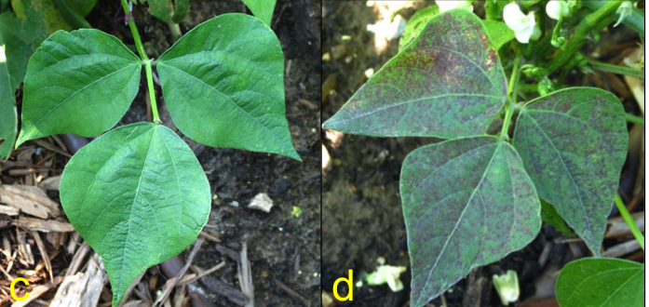
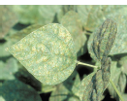
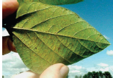
Ozone Damage has a Unique Appearance and therefore a Specific Spectral Signature
Damaged Plant from Ozone is unique compared to injury from
disease, pests or fungus
Healthy Plant
O₃-damaged Plant

Slide 33
Summary
• Successfully demonstrated use of satellite-derived TOR to identify decreased crop yield
• Demonstrated that ozone-damaged soybean plants have a characteristic difference in the “red-edge” portion of the spectrum – should be identifiable from TEMPO measurements
• Visible light scatters differently at specific wavelengths measurable by TEMPO
• Calculation of Bi-directional Reflectivity Distributions Functions (BDRF) distinguishing ozone-damaged plants from healthy plants could lead to identifying such regions – useful application for agricultural community
• Continuous monitoring of tropospheric ozone during growing season allows for calculation of ozone exposure indices – another useful agricultural application

Slide 34
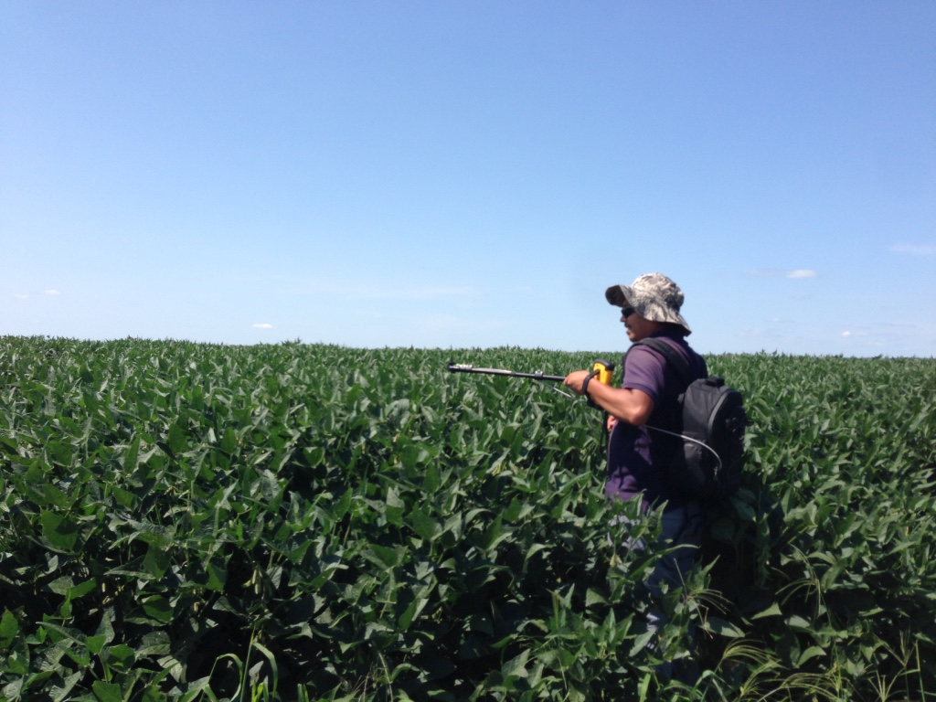
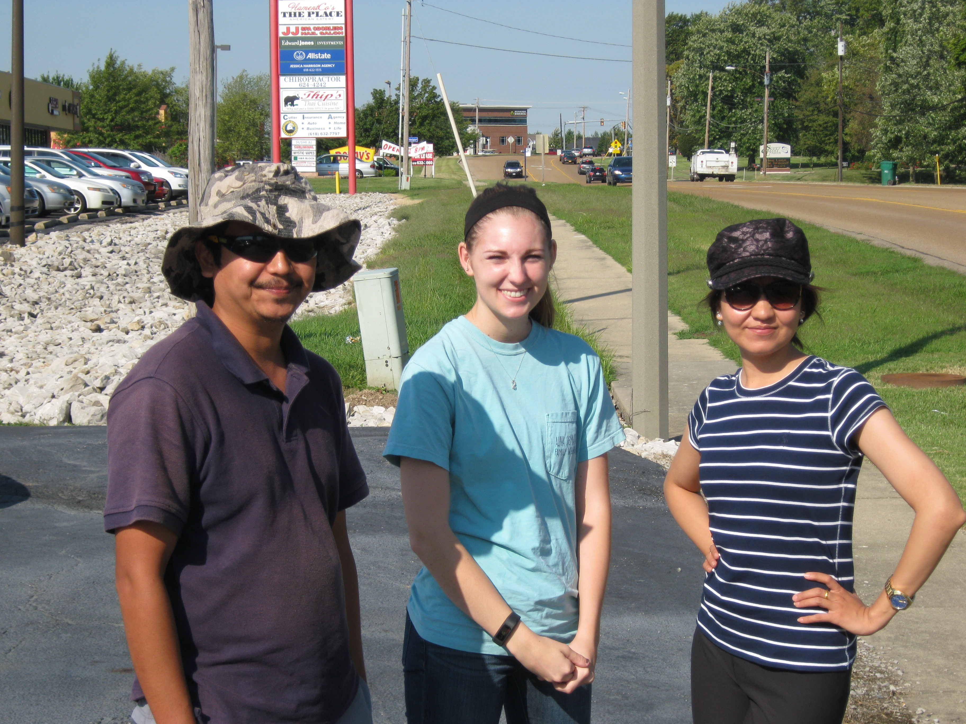
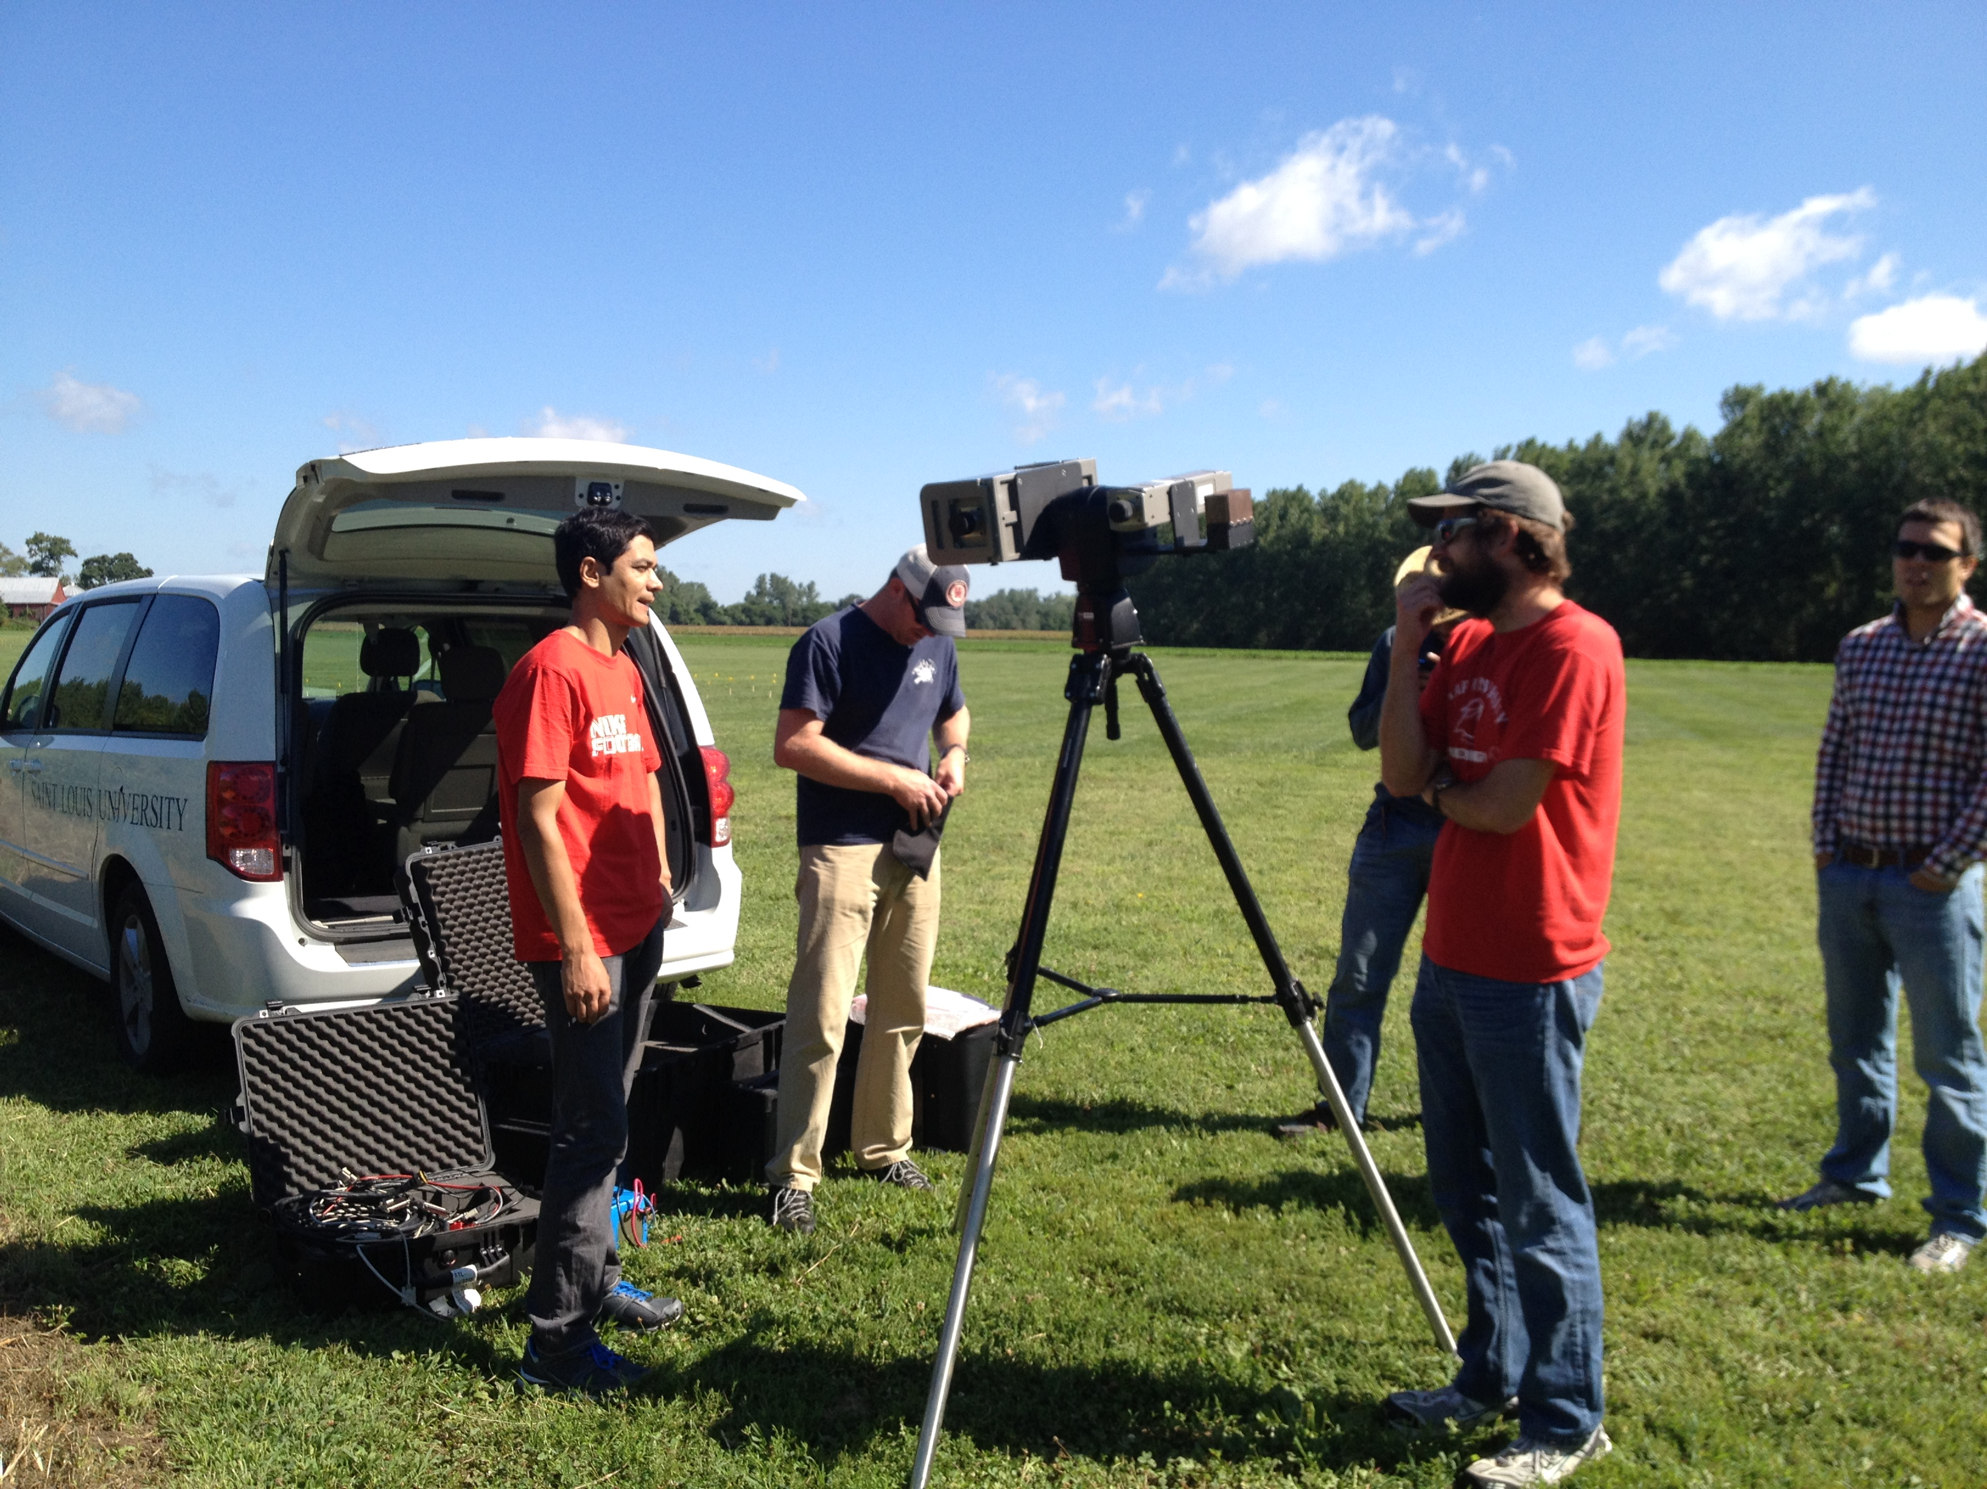
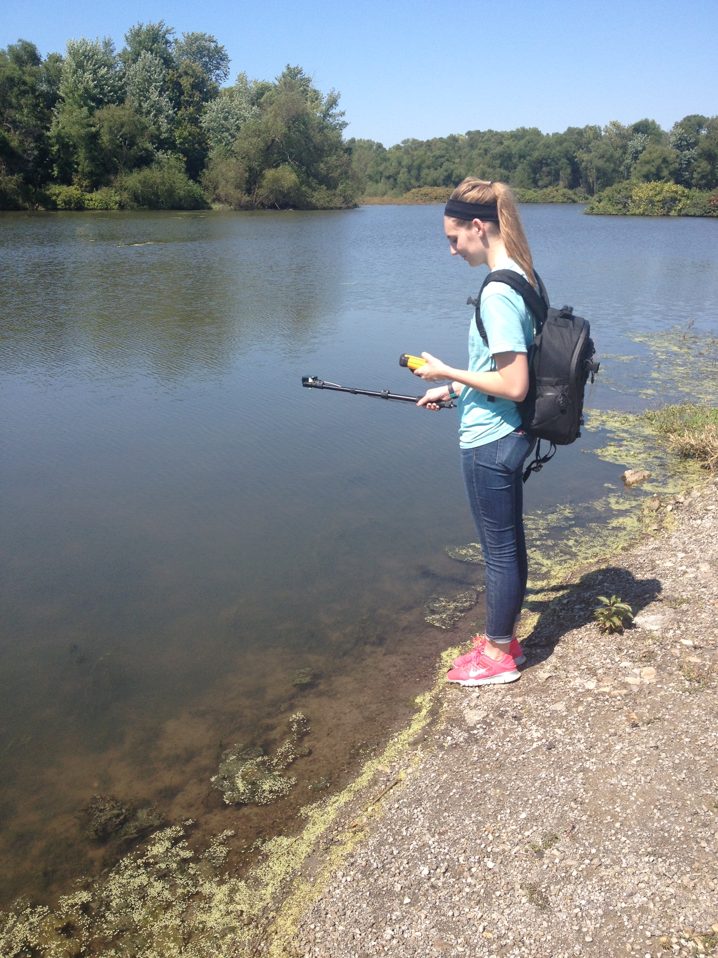
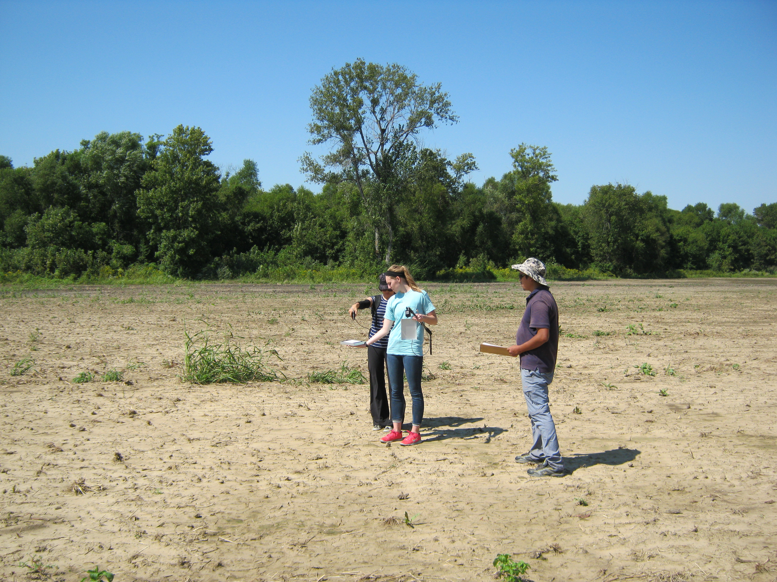
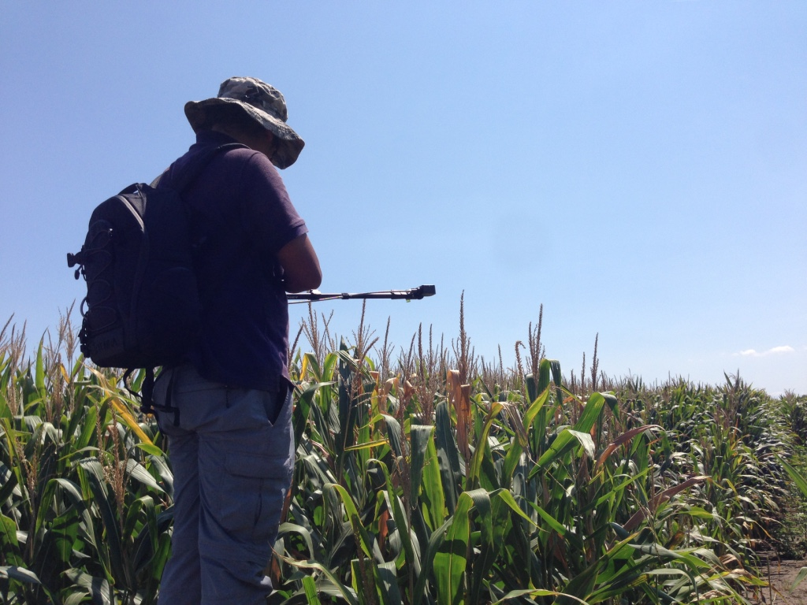





Notes:
Field collected data photos

Slide 35

USGS ASTER Spectral Library
USGS ASTER are only spectral data today
  Mostly measured in the lab
  Used thousands of times worldwide
  Spectral resolution does not match to TEMPO
Only spectral database used widely but does not reflect sun and view angle geometries.
Baldridge, A. M., S.J. Hook, C.I. Grove and G. Rivera, 2009.. The ASTER Spectral Library Version 2.0. Remote Sensing of Environment, vol 113, pp. 711-715.
Notes:
Comprised of USGS, JPL, and John Hopkins’s spectral database
Used millions of times world wide
Our work is very similar, but actually suited for TEMPO (higher spectral resolution) and accounts for sun and view angles in an open field environment while the ASTER library was created in a lab

Slide 36
Bidirectional reflectance distribution function (BRDF)
The BRDF is the single parameter used for describing the reflectance properties of an object
It is measured radiance from one particular direction to another particular direction
Cannot be directly measured
When the parameters of an object change, the BRDF will also change
(Nicodemus, et al. 1977) (Gatebe and King 2016) (Schaepman-Strub et al. 2006)
http://opticalengineering.spiedigitallibrary.org/data/Journals/OPTICE/22126/093601_1_1.png

Slide 37

Observed Increase in Tropospheric Ozone during the Anthropocene:
Similar to Increases of Greenhouse Gases
1870
2000
1870
2000
1870
2000
1870
2000
(from Marenco et al., 1994; JGR, doi: 10.1029/94JD00021)
Ground-level background ozone concentrations have increased significantly since the industrial revolution.
Notes:
Carbon dioxide, nitrous oxide, methane. 50% “significantly”-Vingarzan,2004

Slide 38






Five St. Louis Ozone Garden Locations

