Slide 1
Air Quality, Public Health, and Potential TEMPO Applications
Tracey Holloway
Lead, NASA Health and Air Quality Applied Sciences Team
Professor, Nelson Institute for Environmental Studies
& Atmospheric and Oceanic Sciences
University of Wisconsin—Madison

Slide 2
USFS
USFS
USFS
EPA
Health orgs
USFS
Cities
States
Industry
USFS
USFS
USFS

Slide 3
USFS
USFS
USFS
EPA
Health orgs
USFS
Cities
States
Industry
USFS
USFS
USFS

Slide 4
NASA Health and Air Quality Applied Sciences Team (HAQAST)
Tracey Holloway (Team Lead, UW-Madison)
Bryan Duncan (NASA GSFC)
Arlene Fiore (Columbia University)
Frank Freedman (San Jose State University)
Daven Henze (University of Colorado, Boulder)
Jeremy Hess (University of Washington, Seattle)
Yang Liu (Emory University)
Jessica Neu (NASA Jet Propulsion Laboratory)
Susan O’Neill (USDA Forest Service)
Ted Russell (Georgia Tech)
Daniel Tong (George Mason University)
Jason West (UNC-Chapel Hill)
Mark Zondlo (Princeton University)
haqast.org

Slide 5
HAQAST Scope of Work
Connect with Education & Training
Active
“friendly reviews”
What do you need?
Dialogue
Research collaborations
Advice
Meetings
Basic
Advanced
Videos
Case studies
Tools and “How to”
Research to address
knowledge gaps
Twitter
Popular Science
Diffuse
Data for download
Success stories
Publications

Slide 6
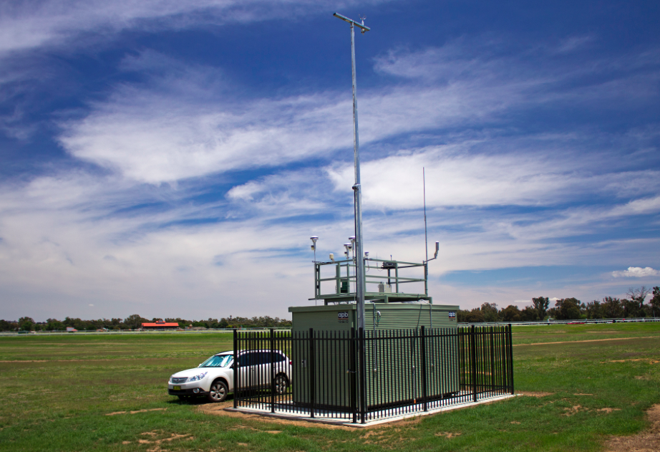
Potential Monitoring Site Purposes
To Determine Compliance with National Ambient Air Quality Standards (NAAQS)
To Develop Regional Pollution Trends in Urban and Rural Areas
To Evaluate the Effects of Population, Land Use and Transportation on Air Quality
To Evaluate Air Dispersion Models
To Provide Air Quality Information to the Public
Text from a slide of Bart Sponseller, WI DNR

Slide 7
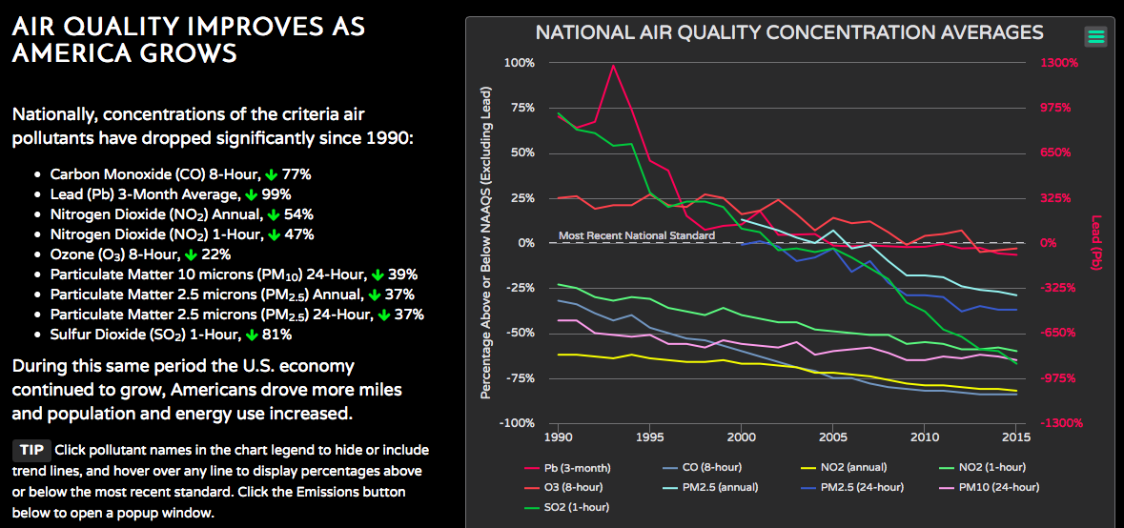
EPA Trends Report

Slide 8
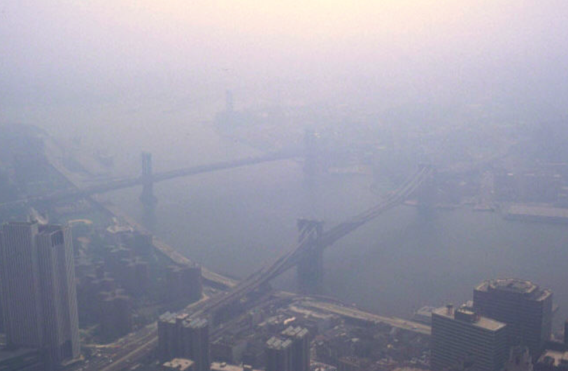
wikimedia

Slide 9
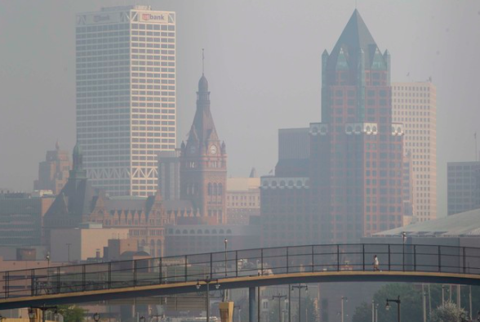
Mike De Sisti / Journal Sentinel

Slide 10
Bob Donaldson / Post-Gazette

Slide 11
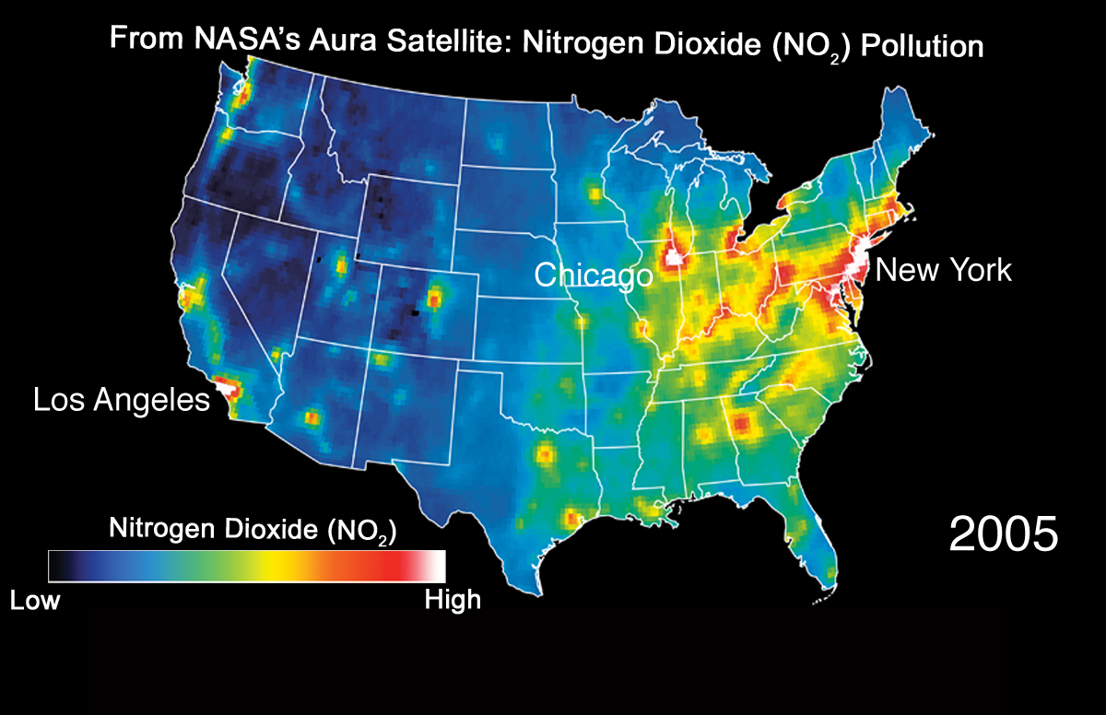
Bryan Duncan, NASA GSFC

Slide 12
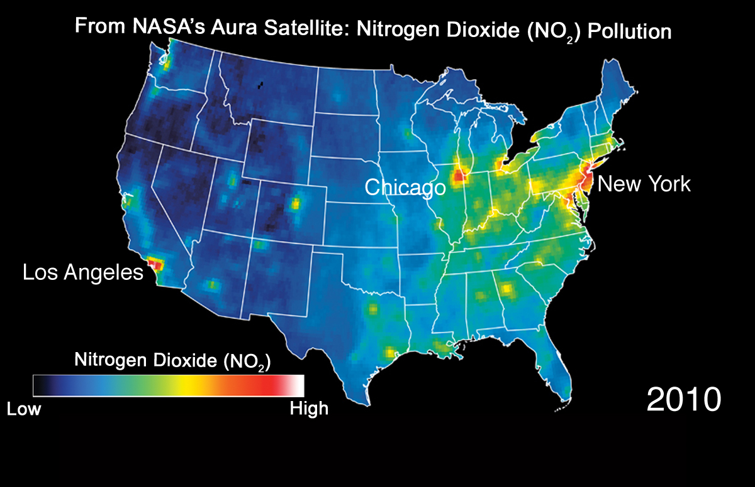
Bryan Duncan, NASA GSFC

Slide 13
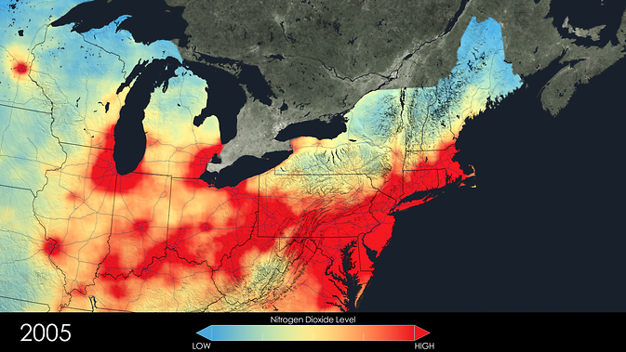
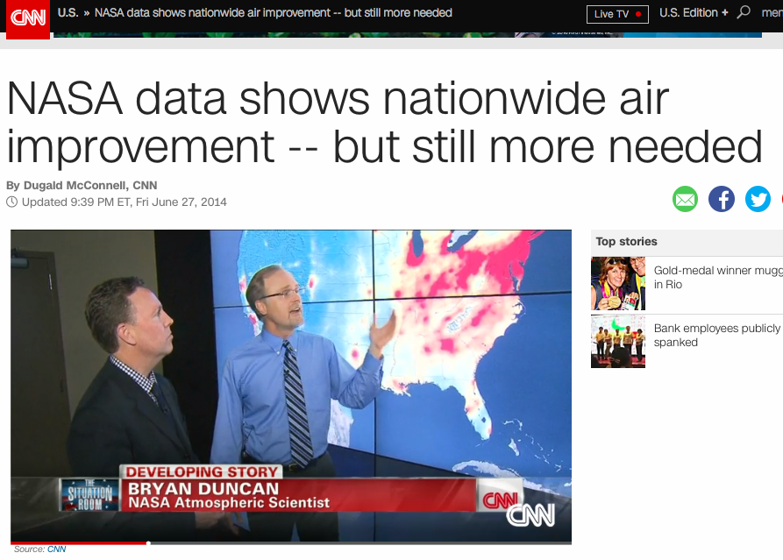
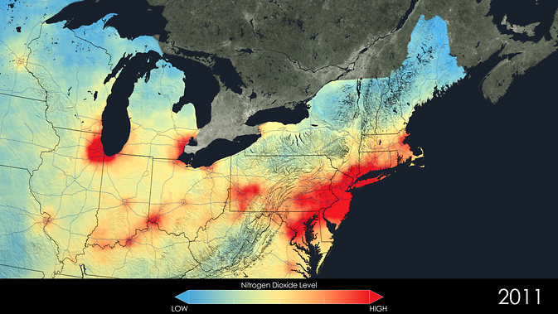

Slide 14
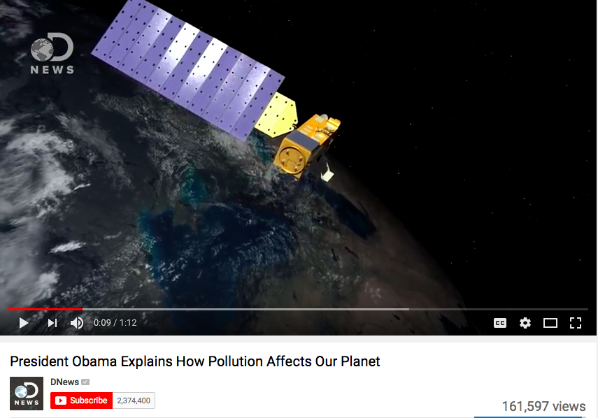
http://tinyurl.com/obamaNO2

Slide 15
Potential Monitoring Site Purposes
A Role for Remote Sensing?
To Determine Compliance with National Ambient Air Quality Standards (NAAQS)
To Develop Regional Pollution Trends in Urban and Rural Areas
To Evaluate the Effects of Population, Land Use and Transportation on Air Quality
To Evaluate Air Dispersion Models
To Provide Air Quality Information to the Public
No
Yes
Yes
Yes
Yes
Adapted from a slide of Bart Sponseller, WI DNR (remote sensing added)

Slide 16
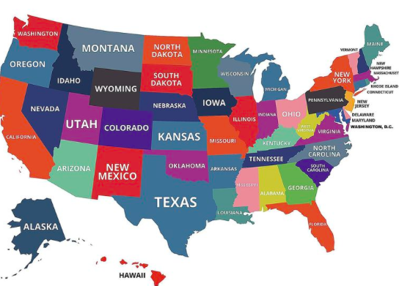
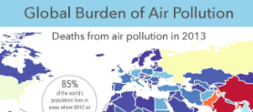
(U.S.) Air Quality Management
Public Health
Clean Air Act
Compare w/ Monitoring
Litigious
Federal (especially EPA)
States, sometimes counties
Regulated pollutants
Exceptional Events
Key opportunities:
Model validation
emissions inventories
Trends
No legal framework
Open to new data
Research-oriented
Global (WHO, other countries)
Federal (CDC, NIH, EPA)
Cities & Communities
All pollutants of interest
Key opportunities:
Population health risk
Connect with low cost sensors
Public outreach

Slide 17
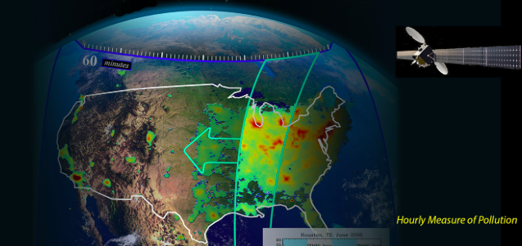
TEMPO Opportunities
Tutorials, ARSET workshops & help line for “dumb” questions
Active
Active sales pitch to existing or “almost” users
Basic
Advanced
Consider data downloads in Excel and GIS formats
Worldview-like interface
Diffuse

Slide 18
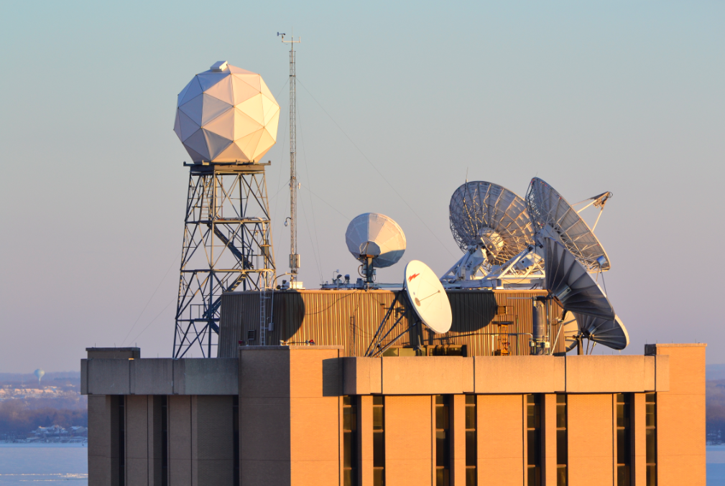
For more information
www.aqast.org www.haqast.org
@tracey_holloway
@NASA_HAQAST
taholloway@wisc.edu

