Slide 1
SPoRT Overview and Potential TEMPO Roles
Bradley Zavodsky and Emily Berndt
Presentation to TEMPO Science Team Meeting
May 31, 2017

Slide 2
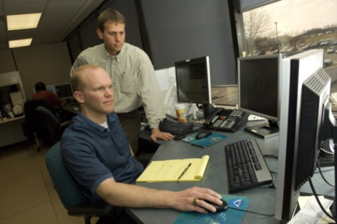
Short-term Prediction
Research and Transition (SPoRT) Center
Mission: Transition unique satellite observations and research capabilities to the operational weather community to improve short-term weather forecasts on a regional and local scale.
Demonstrate capability of NASA and NOAA experimental products to weather applications and societal benefit
Proven paradigm for transition of research and experimental data to operations
Strategy to engage with new NASA missions with current users and expand to collaborate with users from other government agencies and private sector

Slide 3
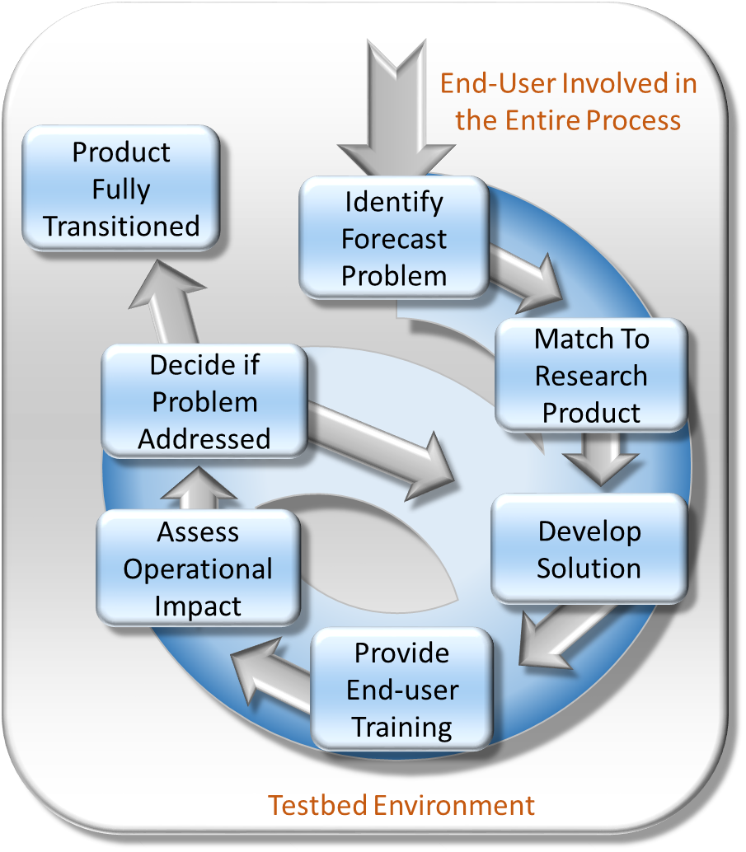
SPoRT R2O/O2R Paradigm
Concept has been used to successfully transition a variety of satellite datasets to operational users for 15 years
Bridge the “Valley of Death”
Can’t “throw data over the fence”
maintain interactive partnerships with help of specific advocates
integrate into user decision support tools
create product training
perform targeted product assessments
Use experimental datasets and proxies in advance of operational use to demonstrate utility and impact
Other groups in the community have adopted this paradigm
Notes:
Note that our experience in this area—15 years—allows us to more efficiently perform R2O/O2R activities

Slide 4
SPoRT Areas of Expertise
Modeling and Data Assimilation
Perform targeted research activities to exploit unique capabilities of NASA satellites and technologies to solve specific weather forecasting challenges
Lightning
Remote Sensing
Disasters
Decision Support Systems
Support for product dissemination to end-user decision support tools (e.g., WMS/GIS, NAWIPS, etc.)
Transitions, Training, and Assessment
Apply unique R2O/O2R paradigm for transitioning data and obtaining valuable feedback from end users/forecasters

Slide 5
Desired SPoRT Roles
Combine SPoRT paradigm with NASA’s Early Adopter concept in defined role to lead coordination of mission applications
Coordinate/facilitate feedback between product developers, science team, and end-users to ensure value-added product
Concept has been implemented for applications for TROPICS EVM (Zavodsky DPA Lead) and S-NPP (Jedlovec DPA Co-Lead)
Collaborated with Mike Newchurch and UAH to host highly-attended and very successful 1st TEMPO Applications Workshop last summer in Huntsville as demonstration of opening dialogue
Participate in application process
Transition experimental, community-developed products to end-users
Develop targeted, end-user focused training and assist with assessment of data impacts by operational decision makers
Early Adopter project
SPoRT has had successful projects for SMAP and ICESat-2 EA programs
SPoRT receives directed funding from NASA’s R&A Program to support R2O for select products for select users
Notes:
Suggest Emily as DPA for TEMPO in second subbullet of first bullet.

Slide 6
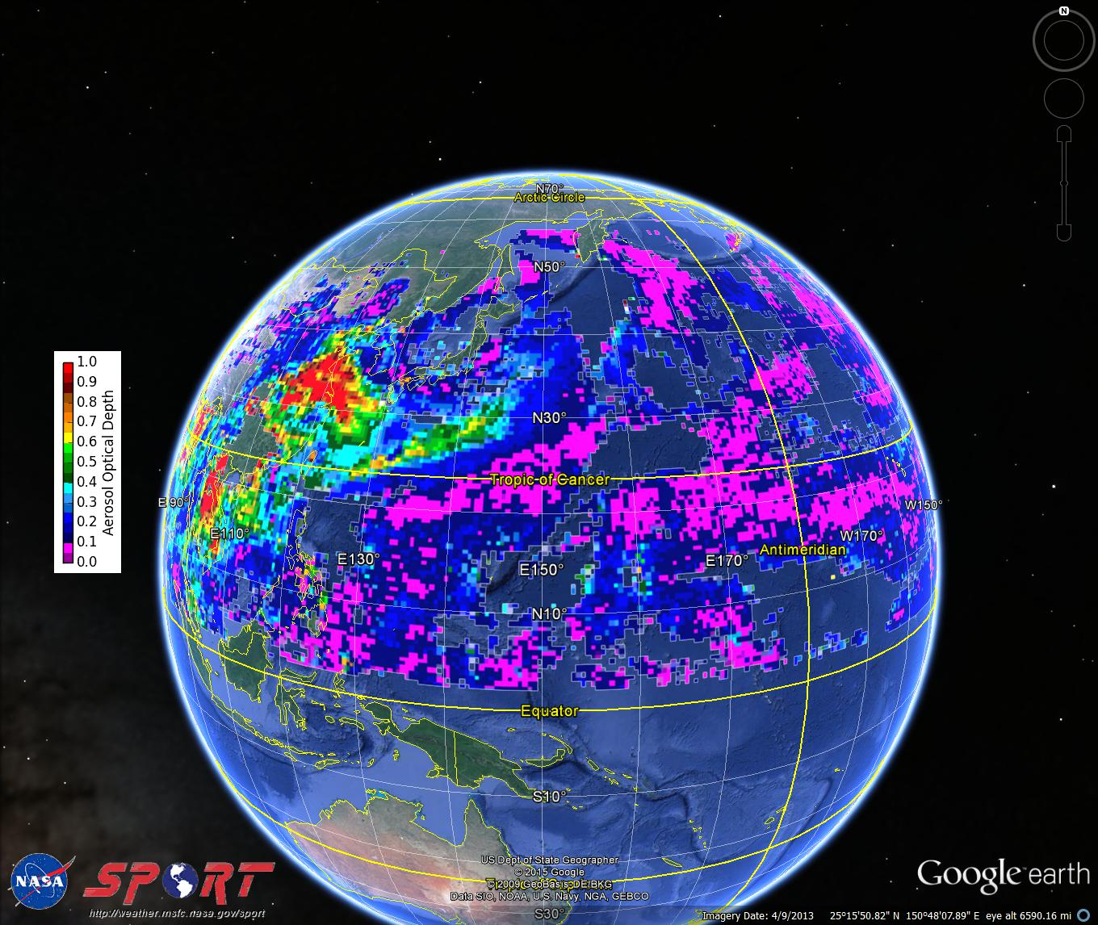
Aiding Dissemination and Visualization
SPoRT maintains a robust real-time data dissemination process to easily transfer products to customers
SPoRT near-global Aerosol Optical Depth (AOD) product displayed in KML format for use with Google Earth (easily converted to other formats)
Experimental TEMPO data products could be developed in collaboration with SPoRT and served to users
Notes:
Make sure to note that we are not suggesting being the mission operations center or DAAC for the mission but rather can work with the EAs and others in the community to transfer and demonstrate experimental products that are outside of the baseline requirements.
Make sure to note that you understand that aerosols are no longer a core product from the mission.

Slide 7
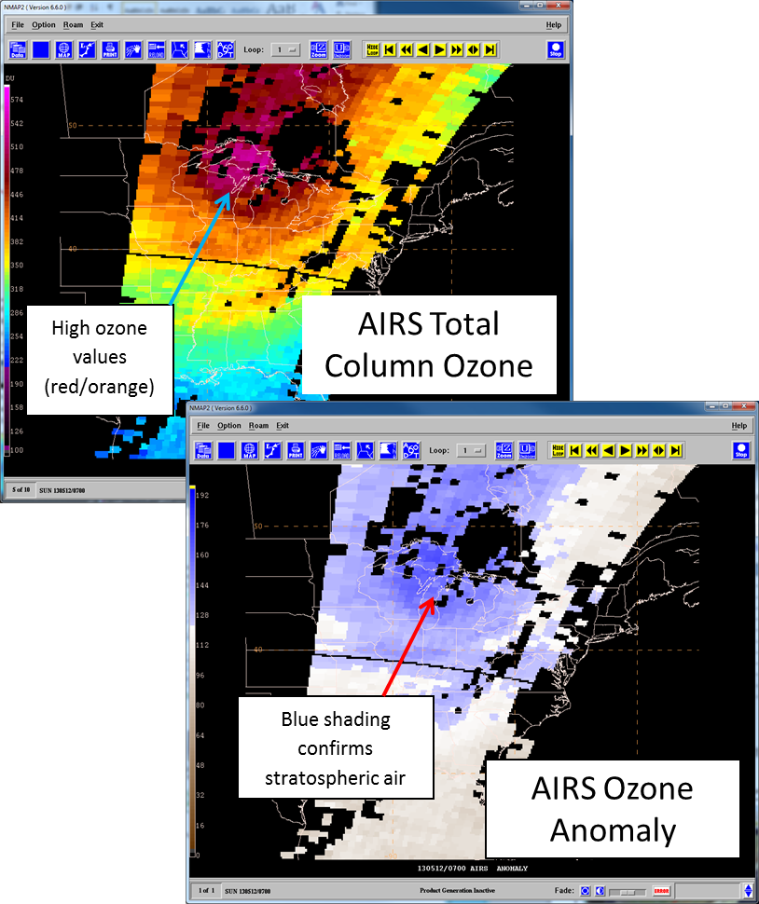
Collaborations with NOAA National Centers
SPoRT has long-standing partnerships with many of the NOAA National Centers and has transitioned a number of products
Total column ozone products derived from Hyperspectral IR Sounder retrievals provided to operational forecasters in N-AWIPS/AWIPS format
Identify stratospheric intrusions that can lead to rapid cyclogenesis and stratospheric driven high wind events (WPC, OPC)
Aviation forecasting challenges of identifying turbulence near the jet stream and health/safety issues associated with elevated ozone near flight level (AWC)

Slide 8
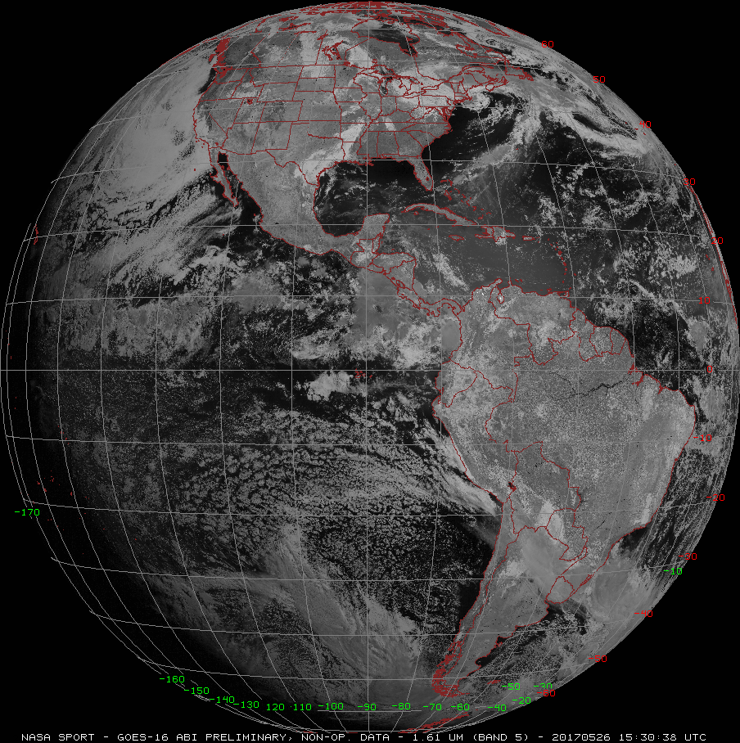
Community Proxy Products
There is an opportunity to use real-time GOES-16 data combined with OMPS/OMI radiances as a proxy for TEMPO for demonstration of O₃ & NO₂ baseline products and development of prototype products (AOD, SO₂, etc.) important for air quality monitoring and forecasting.
Create partnerships (Jun Wang, U. Iowa; GOES-R AQ Proving Ground) to develop/ disseminate proxy products and training
Wang, J. and co-authors, A numerical testbed for remote sensing of aerosols, and its demonstration for evaluating retrieval synergy from a geostationary satellite constellation of GEO-CAPE and GOES-R, J. Quant. Spectrosc. Radiat. Transfer., 146, 510-528, 2014. http://arroma.unl.edu/docs/publication/paper_pdf/2014/Wang_JQSRT_2014.pdf
GOES-R/TEMPO Synergy and Air Quality Proving Ground Activities, Shobha Kondragunta, NOAA/NESDIS ftp://geo.nsstc.nasa.gov/SPoRT/people/zavodsky/TEMPO_Workshop/Session6.2_Kondragunta_GOESRTEMPO.pptx
Notes:
Last TEMPO Applications meeting Shobha presented information about combining OMI or OMPS with GOES-16 data. She used simulated data at that point. She demonstrated that when you combine GOES-16 and TEMPO you can retrieve AOD. TEMPO is missing a shortwave IR channel near 2.1 but GOES-16 has a 2.3 channel so combining GOES-16 2.3 with TEMPO visible can yield AOD. At that time since GOES wasn’t up…I was thinking you could use AHI and OMPS since OMPS is similar to TEMPO in some regards. Both Wang and Shobha’s groups are already doing work in this area but Wang a UAH alumni has had trouble getting plugged into the Air Quality Proving Ground…but he has a paper with Kelley. So we don’t necessarily want to do the work but facilitate the distribution of proxy products…if there is a place for our role there given the AQ proving ground is pretty established with end users and creation of training.

Slide 9
Summary
SPoRT is a highly-successful, long-standing R2O/O2R center that specializes in transition of satellite datasets to the operational decision-making community
SPoRT maintains a proven paradigm for transition of research and experimental data to operations to demonstrate capabilities of satellite datasets on end-user decisions
SPoRT has expertise in the areas of remote sensing and modeling that would be relevant Early Adopter capabilities for specific projects with specific end users
SPoRT wants to work with the mission team and NASA HQ to carve out a specific role that our project personnel could play to lead an applications team to accelerate the operational use of TEMPO data to the growing user community

Slide 10
Questions/Comments/Discussion
For More Information or Examples of Our Interaction with End-Users:
Website: http://weather.msfc.nasa.gov/sport/
Blog: https://nasasport.wordpress.com/
Twitter: @NASA_SPoRT
Facebook: NASA SPoRT Center

