Slide 1
LISTOS GCAS/GeoTASO CH₂O Product Status and example
VCDs have been generated for all GCAS sorties on a 1.5 km grid over the LISTOS domain
GeoTASO in-progress and nearly finished
VLIDORT inputs
TM5 1 degree chemical profile information
Both OMI LER based surface albedo and MODIS 500 m BRDF parameterization (shifted to 340 nm via OMI 0.5 degree LER) are available
Comparisons with TROPOMI are encouraging
Some systematic offsets are seen
Working with TROPOMI retrieval team to identify sources
Current data set will be available on the archive by end of June.
Plan will be to update revision once finer grid chemical profiles are available
Notes:
Current status of retrievals, ready for archive in a couple of weeks.

Slide 2
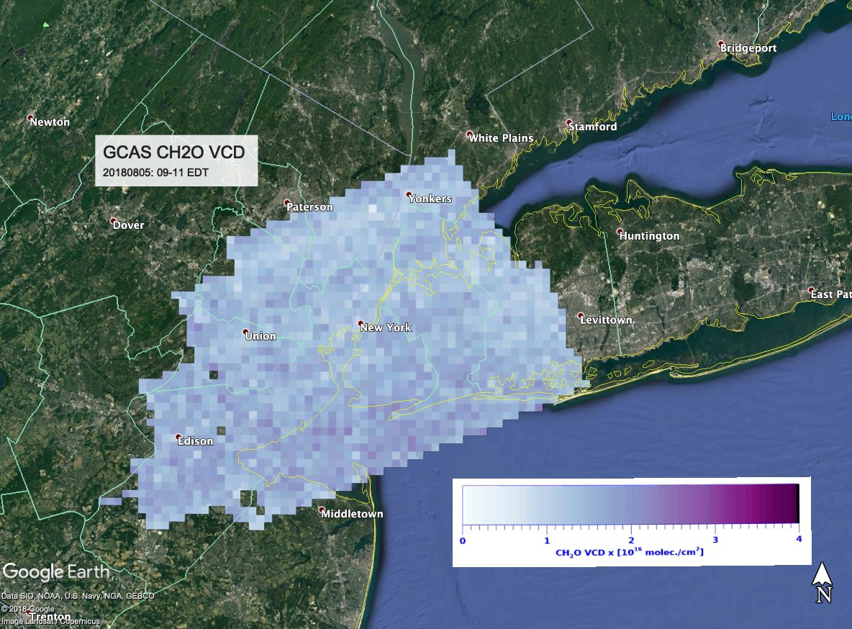
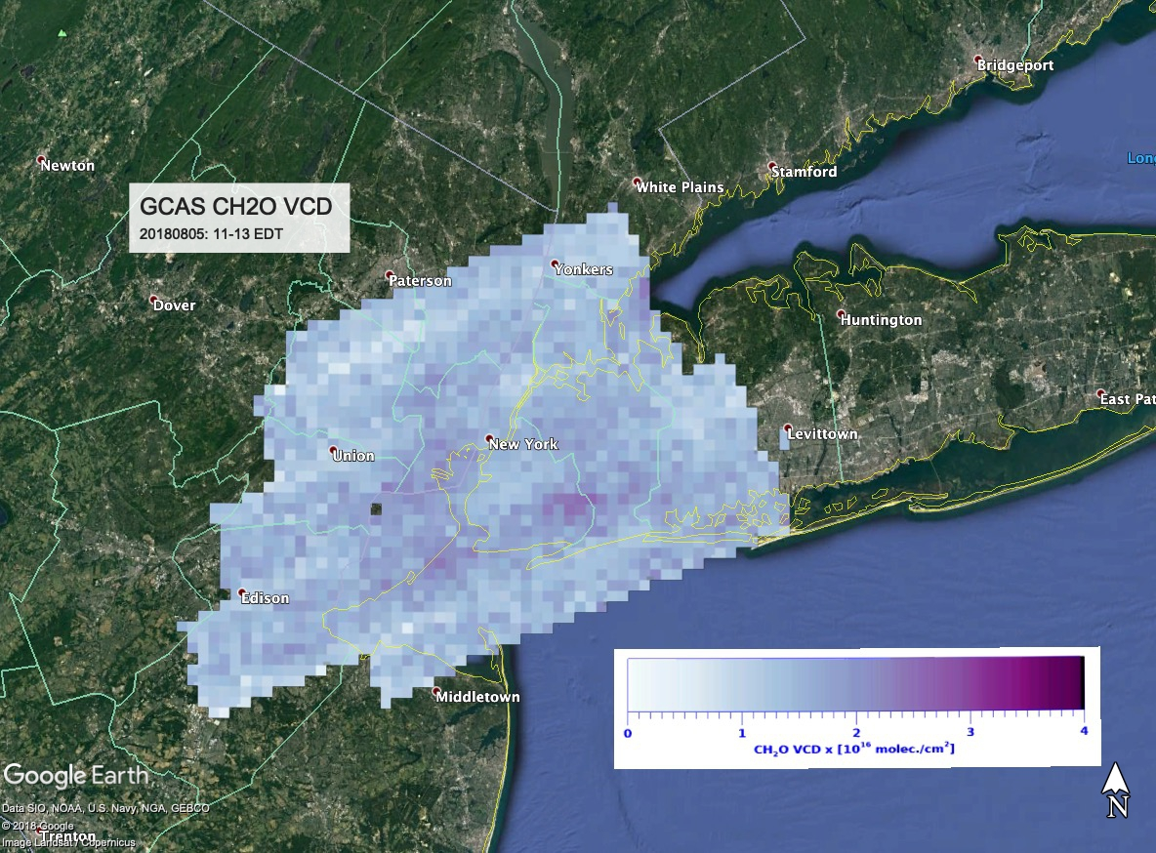
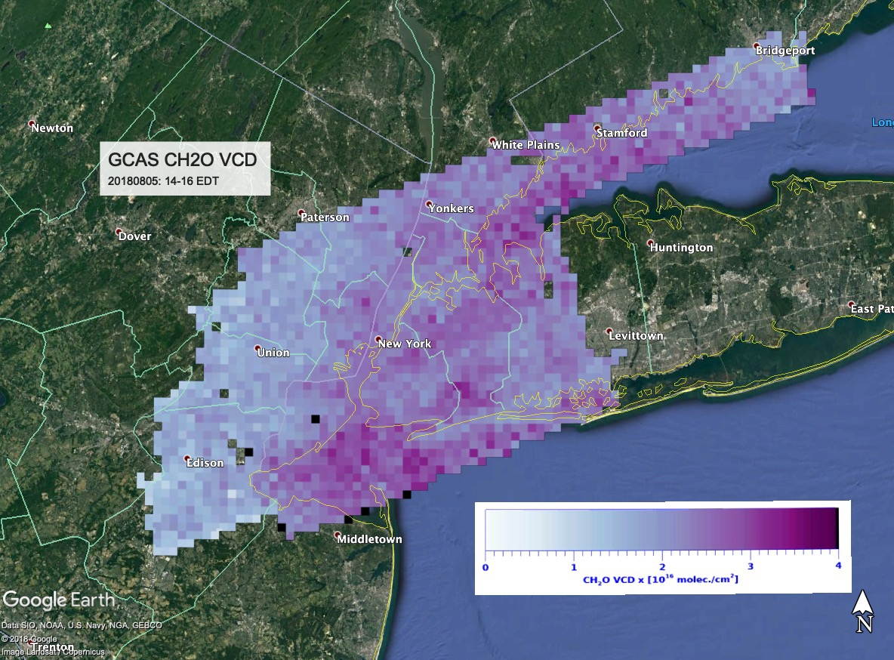
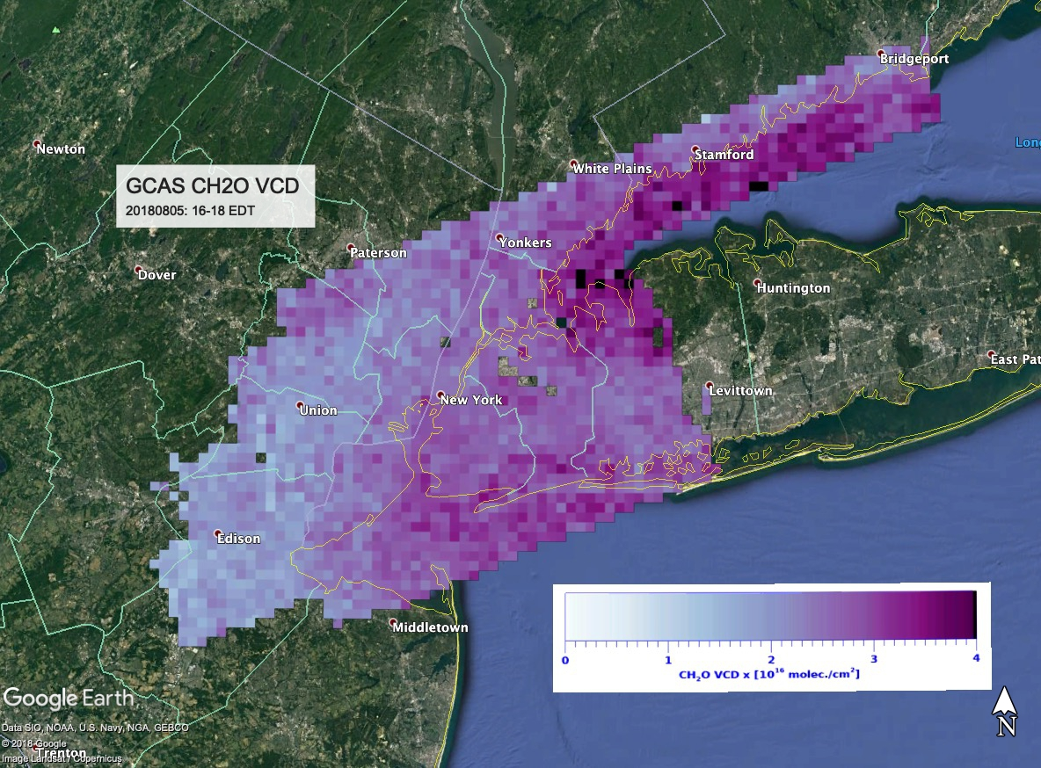
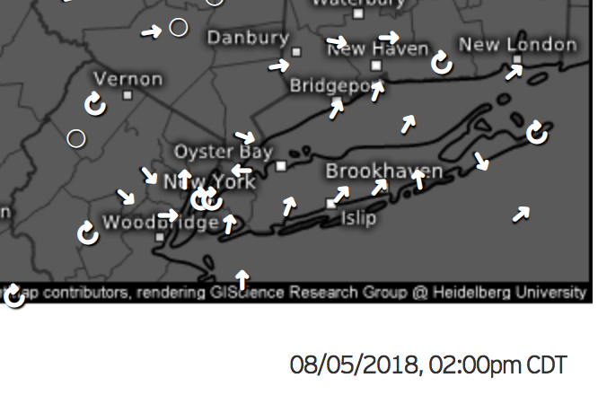
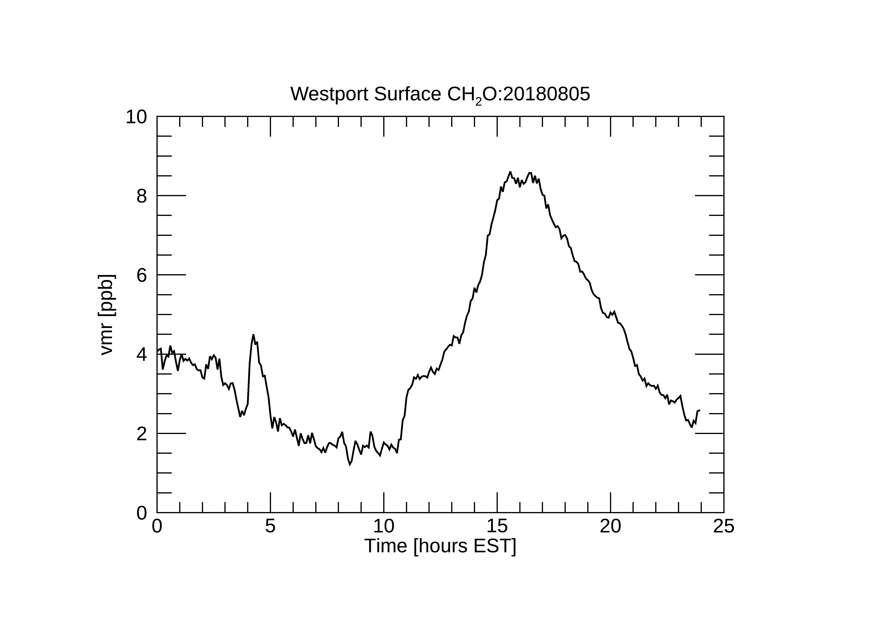
LIS Moderate Ozone Event CH₂O Time Evolution
August 5th moderate ozone event
Winds onshore from southwest
Buildup morning->afternoon over LI sound evident
1-2E16 molec./cm² morning
3-4E16 molec./cm² afternoon
Westport monitor measured a peak vmr of 8 ppb at surface 16-18 EDT
Notes:
4 sortie day shows temporal evolution. CH2O builds up over eastern LI and the sound following onshore breeze. Agrees well with surface monitoring at Westport. VCDs shown here use OMI minimum monthly LER based surface albedos (TROPOMI input)

