Slide 1
Long Island Sound Tropospheric Ozone Study (LISTOS)
Paul J. Miller
Northeast States for Coordinated Air Use Management (NESCAUM)
June 4, 2019

Slide 2
LISTOS
General overview and objectives
Measurements
Highlights
Analysis status & next steps

Slide 3
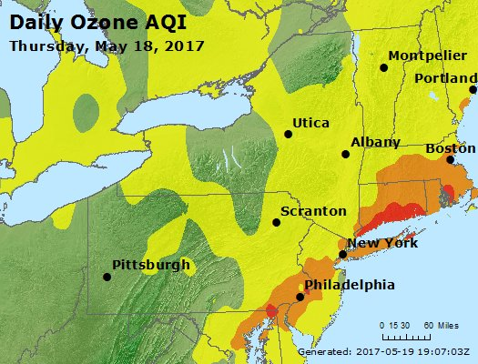
NYC metro area/Long Island Sound region is complicated
Chronic regional ground-level ozone (smog) problem
Multiple pollution transport pathways affecting area
Complicated, varied, and dense pollution source region
Land-water interactions downwind of NYC
AIRNow
Source: AirNOW

Slide 4
LISTOS Objectives
  Investigate impact of air quality programs and shifting electricity generation patterns on NYC air quality
  Improve understanding of urban pollution plume upwind and downwind of NYC metro area
    Key VOC sources and species (e.g., consumer products, transportation, industrial)
    Temporal and spatial resolution of NOx emissions
    Met measurements of Long Island Sound pollutant flows/marine mixing layer
  Develop new case study of air pollution in NYC region to complement studies elsewhere (e.g., OWLETS, LMOS, DISCOVER-AQ, etc.)
  Probe future implications of distant wildfire plumes on NYC air quality
  LISTOS draft White Paper: Retrospective and Future Analysis of Air Quality In and Downwind of New York City (2017), http://www.nescaum.org/documents/nyc-metro-lis-ozone-whitepaper-draft-v5.pdf

Slide 5
LISTOS Participants & Activities
  State AQI forecasters predicting ozone episodes to launch activities
  NOAA-ESRL oxygenated/consumer product VOC mobile van measurements in NYC during March and July
  Univ. Maryland 8-12 flights (depends on episodes, flight durations)
  Maine DEP and NYS DEC labs VOC canister analysis
  NASA GeoTASO/GCAS 20-30 high altitude flights; ozonesondes at Rutgers, NJ
  EPA Pandoras Long Island Sound (LIS) coastline, Rutgers PAMS, NYC; ozonesondes & continuous HCHO at Westport, CT
  CCNY boat-based air pollution measurements in LIS
  CCNY aerosol LIDAR in northern Manhattan
  Stony Brook Univ. oxygenated VOC measurements at Flax Pond PAMS site (Long Island north shore) during summer
  Stony Brook Univ. aircraft fine resolution wind field measurements over LIS
  Univ. at Albany O₃, NOx, VOC mobile measurements across Long Island south to north shore transects
  Univ. at Albany ozonesondes at Flax Pond, Long Island, NY
  NASA ozone LIDARs upwind at Rutgers Univ., NJ, and downwind on CT’s LIS shoreline
  CT DEEP ozone monitor on LIS ferry between Bridgeport, CT and Port Jefferson, NY
  PAMS VOC measurements at Rutgers, NJ & the Bronx, with new NYS DEC PAMS site at Flax Pond, Long Island
  Yale Univ. Coastal Field Station – VOCs on CT coast

Slide 6
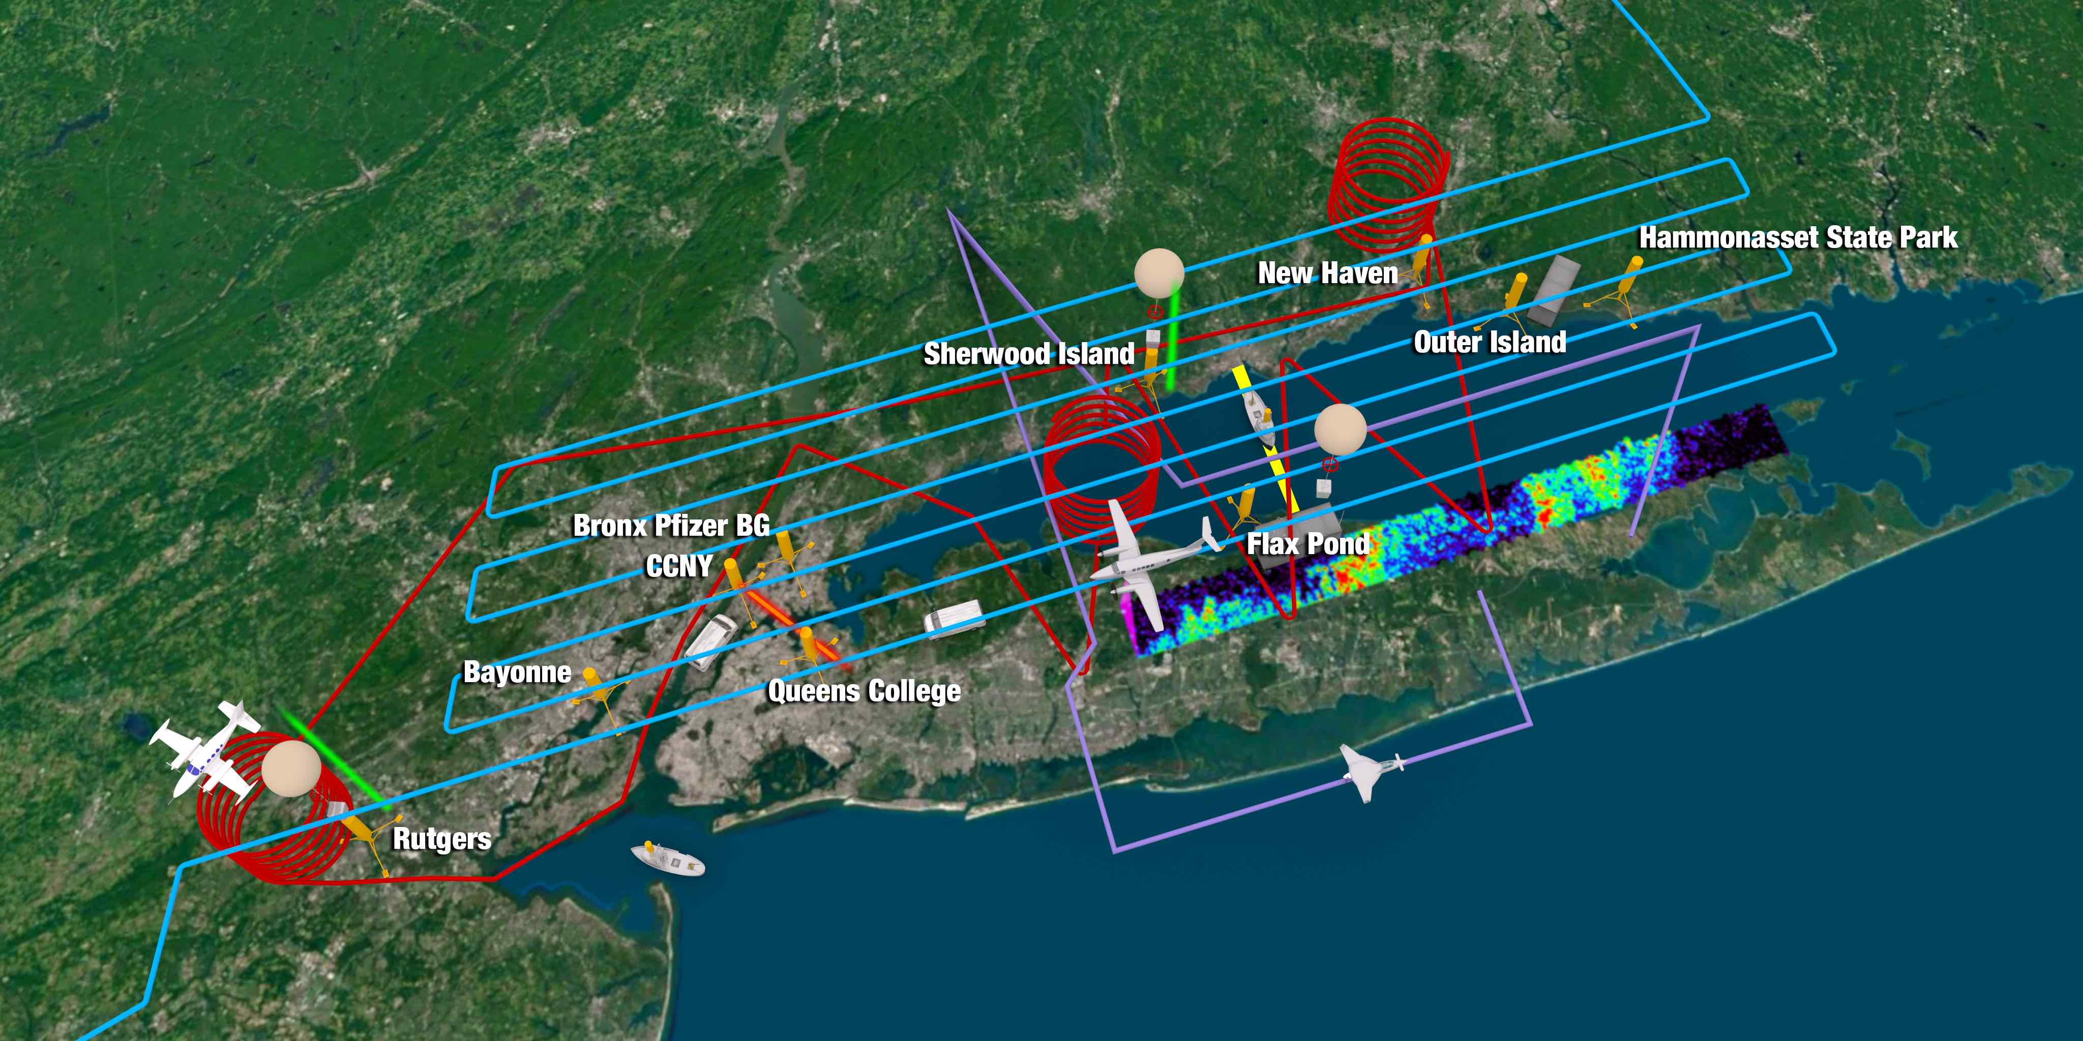
LISTOS in One Picture
NASA Langley Research Center

Slide 7
Highlights - VOCs

Slide 8
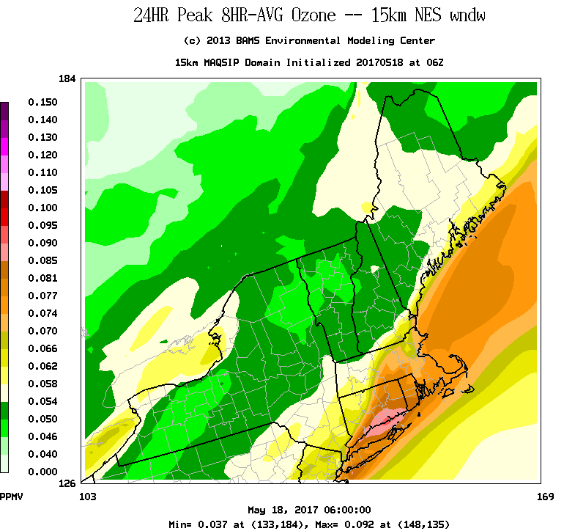
UMD May 18, 2017 Afternoon Flight
Ozone forecast
Observed O₃ on flight track
The ozone episode was well forecast by the model!
Credit: Xinrong Ren, NOAA; Russ Dickerson, UMD
8

Slide 9
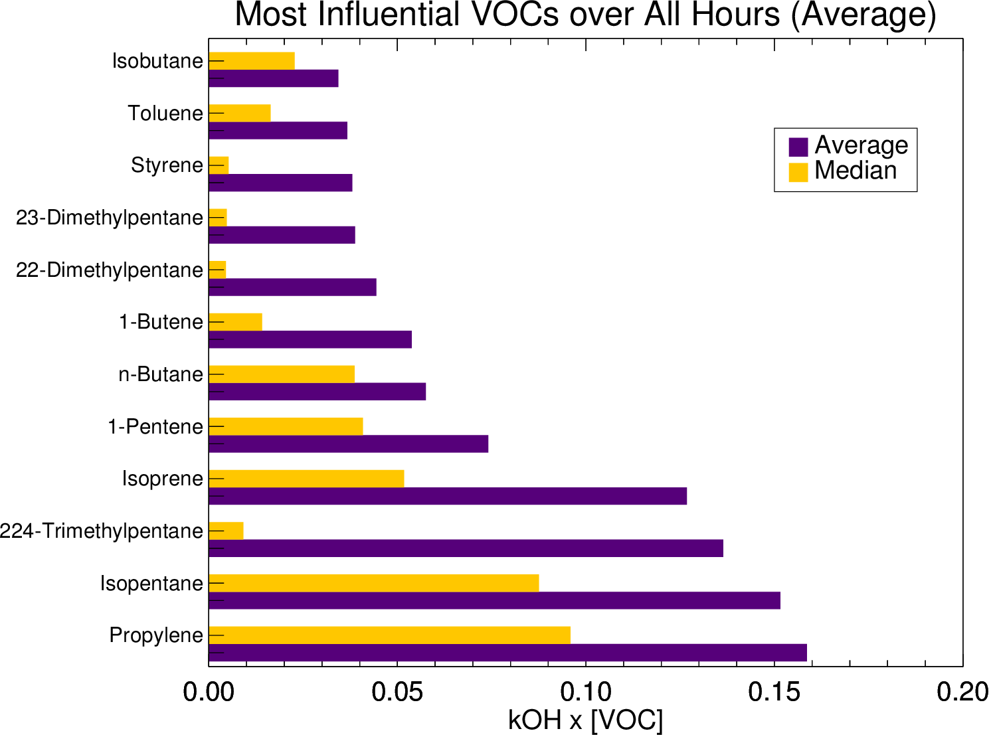
VOCs Measured May 17 and 18, 2017
Ranked by Reactivity with OH
Least Influential
Ranked by Average of All VOC Cans (Purple)
Preliminary
Most Influential
(s⁻¹)
Isoprene is not dominant
Based on the 50 VOCs measured – does not include oxygenates, consumer products
From A. Ring, UMD, et al., in prep.; VOC can analysis by ME DEP
9

Slide 10
Highlights - NOx

Slide 11
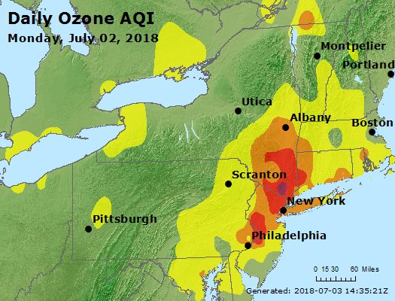
NYC Bad Air Day: July 2, 2018
Highest ozone
since 2006:
8 hr: 115 ppb
1 hr: 143 ppb

Slide 12
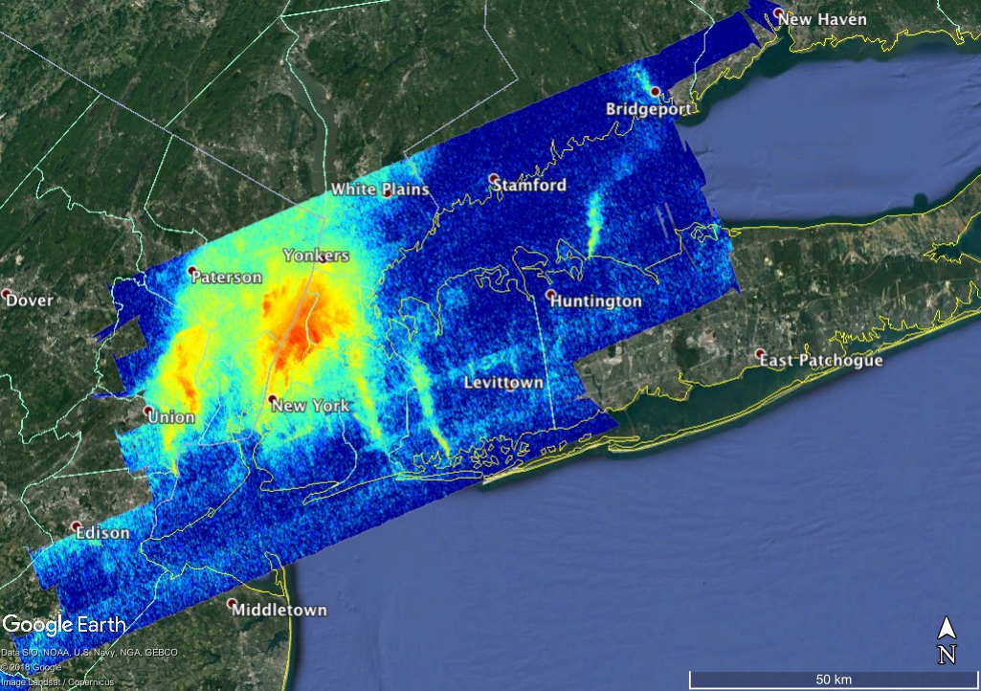
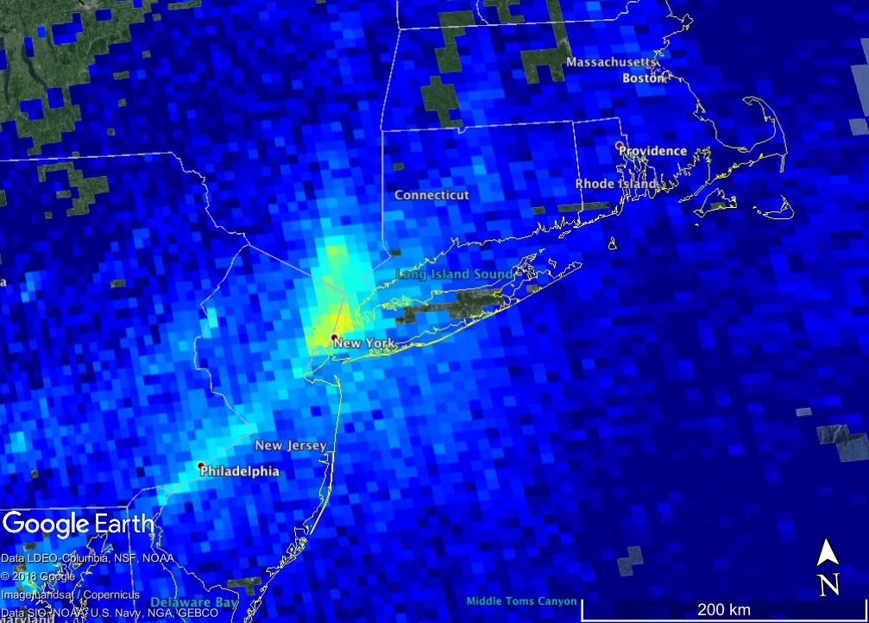
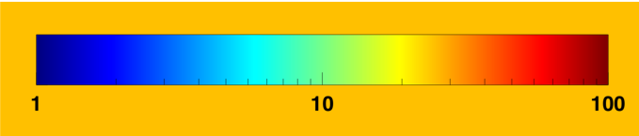
3. NASA GeoTASO/GCAS
NYC July Heat Wave Day 3: July 2, 2018
Credit: NASA Langley, NOT FOR DISTRIBUTION
GCAS NO₂ Differential Slant Columns
~18:00-21:00 UTC
Preliminary
TROPOMI Tropospheric Vertical Column
~18:30 UTC
NO₂ DSC X10¹⁵ molecules cm⁻²
Source: https://s5phub.copernicus.eu/dhus/#/home
12

Slide 13
NOx Weekend / Weekday + Power Plant(s)?
Ports,
railyards,
highways
Newark
Airport
Preliminary
Data courtesy of Laura Judd, Jay Al‐Saadi (NASA LaRC) and Scott Janz (NASA GSFC)

Slide 14
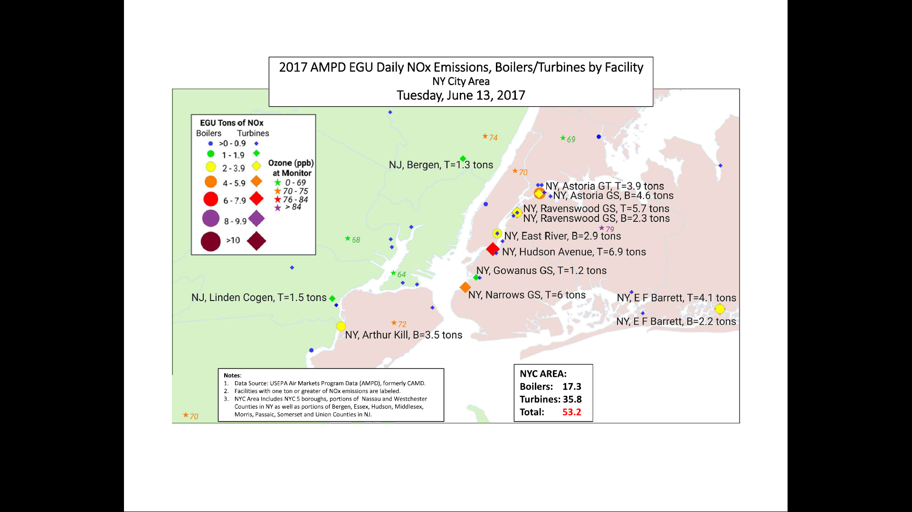
14

Slide 15
Highlights – Wildfire Plume & Ozone
O3 LIDAR + HALO
Westport, CT
Aug. 24-25, 2018
Preliminary
Credit: Tim Berkoff, NASA Langley
15

Slide 16
Analysis Plans
NASA LISTOS archive site to make all data sets easily accessible
Modeling analysis of 2018 results (UMD, EPA-RTP, NOAA-Boulder)
Policy-relevant synthesis paper

Slide 17
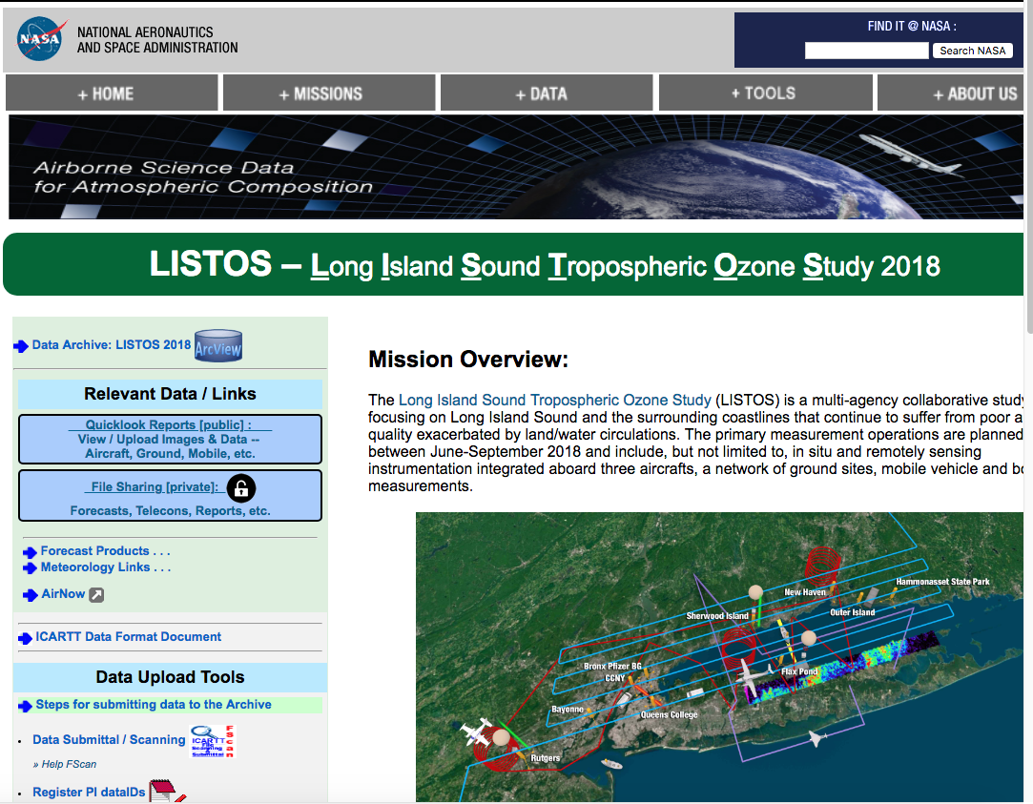
LISTOS Data Archive
The website is located at:
https://www-air.larc.nasa.gov/missions/listos/index.html

Slide 18
2019 Field Campaign Plans
2 formaldehyde analyzers at PAMS in the Bronx and Flax Pond (NYS DEC)
Mobile ozone LIDAR based in NYC (CCNY)
Longer-term speciated VOC measurements in NYC (Yale & Stony Brook)
Additional ozonesonde launches on Long Island (UAlbany)
Mobile lab on Long Island (UAlbany)
Additional in situ aircraft sampling in NYC-LIS region with 2 planes (UMD & Stony Brook)

Slide 19
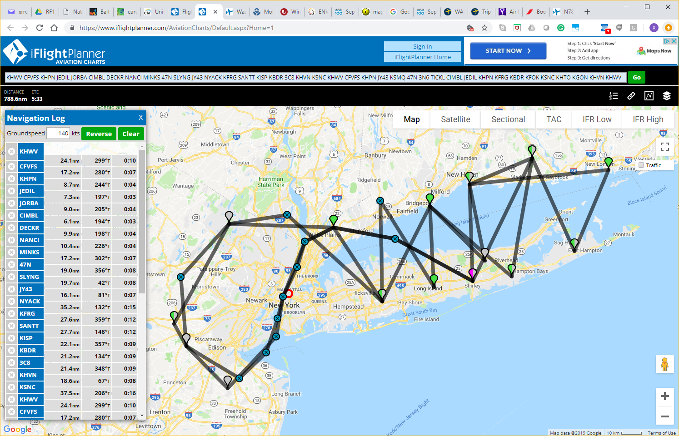
A Tentative Flight Plan for LISTOS 2019: Aircraft #1 & #2
Brookhaven Airport
19

Slide 20
Supporters
    Funders
      NY State Energy Research & Development Authority (NYSERDA)
      CT DEEP
      NJ DEP
      NYS DEC
      National Fish & Wildlife Foundation
    Federal collaborators with own funding
      NOAA
      NASA
      EPA

Slide 21
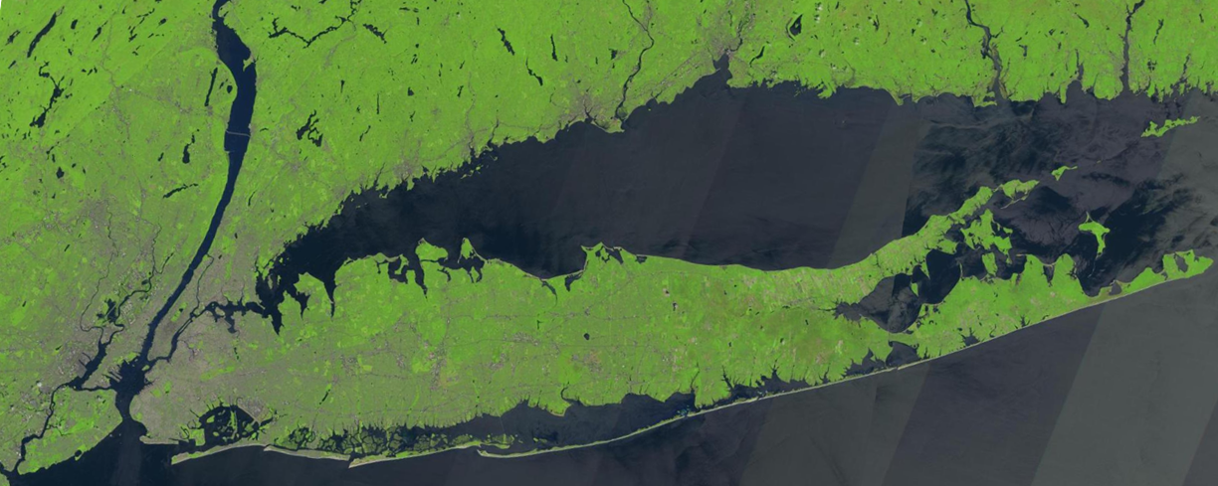
    Questions?
    http://www.nescaum.org/documents/listos

