Slide 1

Multi-sensor (OMPS, OMI, VIIRS, TROPOMI) inversion of aerosol emissions: Implication for TEMPO and GEMS
Yi Wang, Jun Wang
Daven Henze
Zhen Qu
Yi Wang in 2014
Yi Wang defended his Ph.D. on 5 June 2019

Slide 2
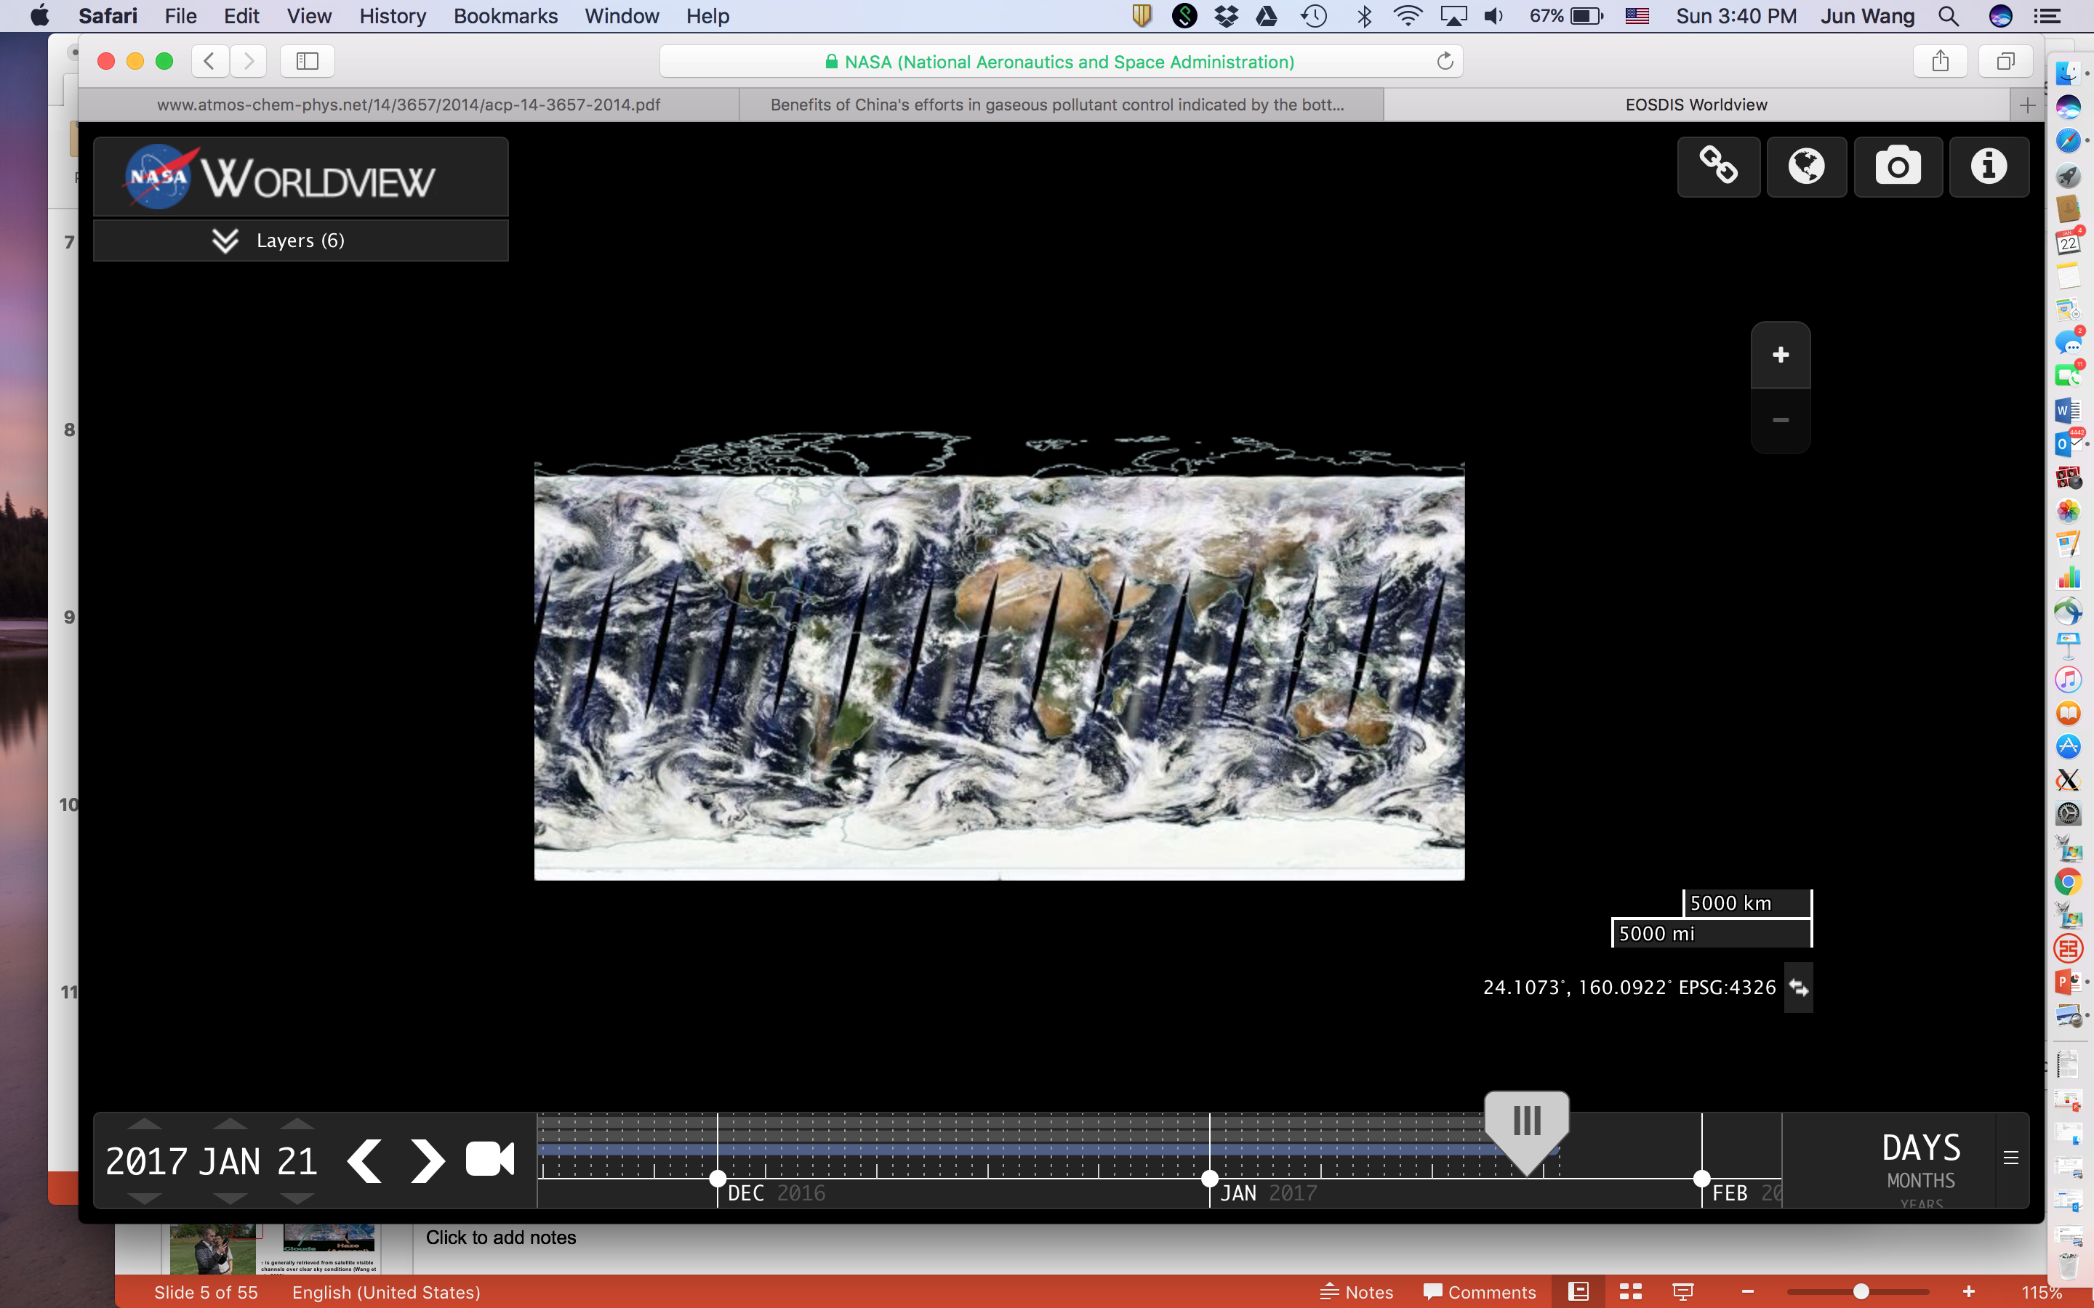
Importance of aerosol emissions
CTM model simulations can only be as good as the emissions.
Data assimilation for forward modeling only:
  suffers from emission errors that are persistent.
  may improve forecast when observation is available, but such improvement decay quickly with time once obs. are not available.
For both climate studies and air quality forecast, there is a need to have a holistic interpretation from emissions to observations, and vice versa.
emissions
CTM
1/22/2017
forecast&
Validation

Slide 3
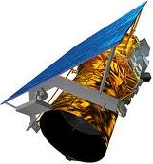

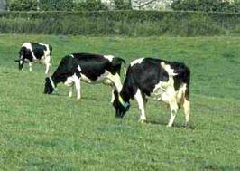
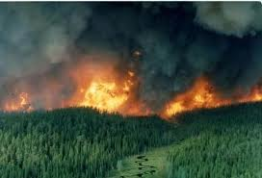
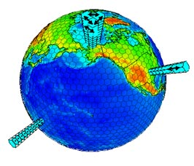
Top-Down vs. Bottom-Up estimate of aerosol emission
Bottom-up emission estimate
Top-down emission estimate
Ground-based network/data
Usually has a 2~3 yr lag
Seasonal/ monthly
Point or area average
Chemically speciated
Lack of constraint on emission above the surface
Has the potential for near real time
Daily (polar-orbiting) or higher (geo..)
Globally with high spatial resolution
Trace gases & optical thickness
Reflecting the columnar mass, and thus 1st order of emission

Slide 4
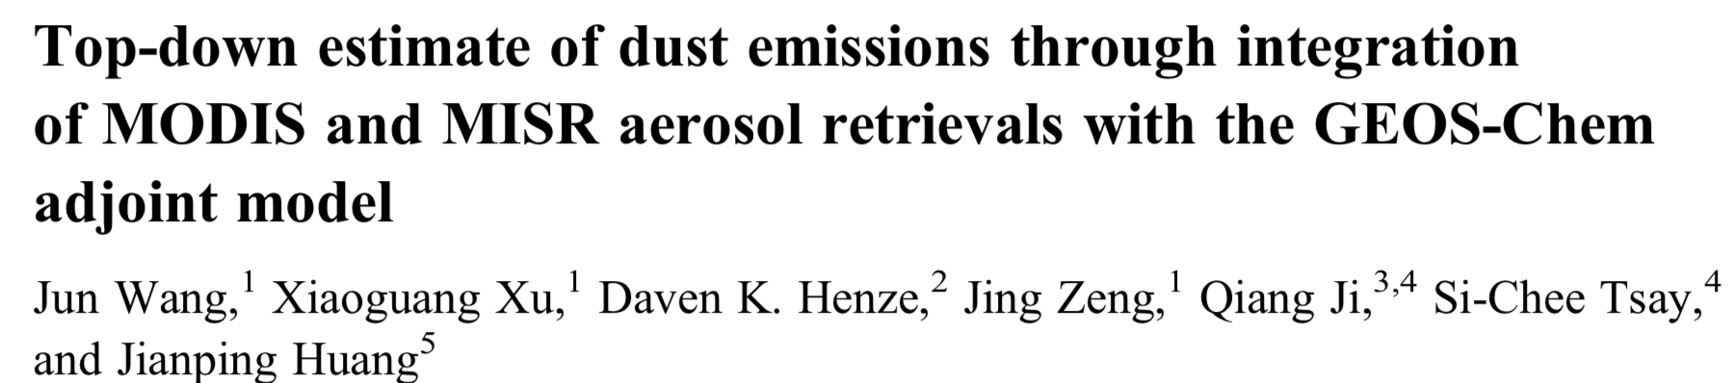
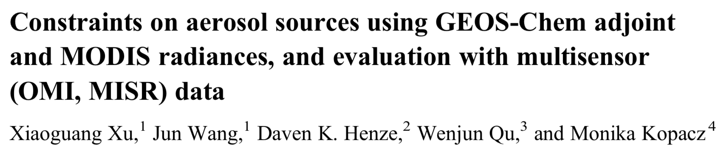
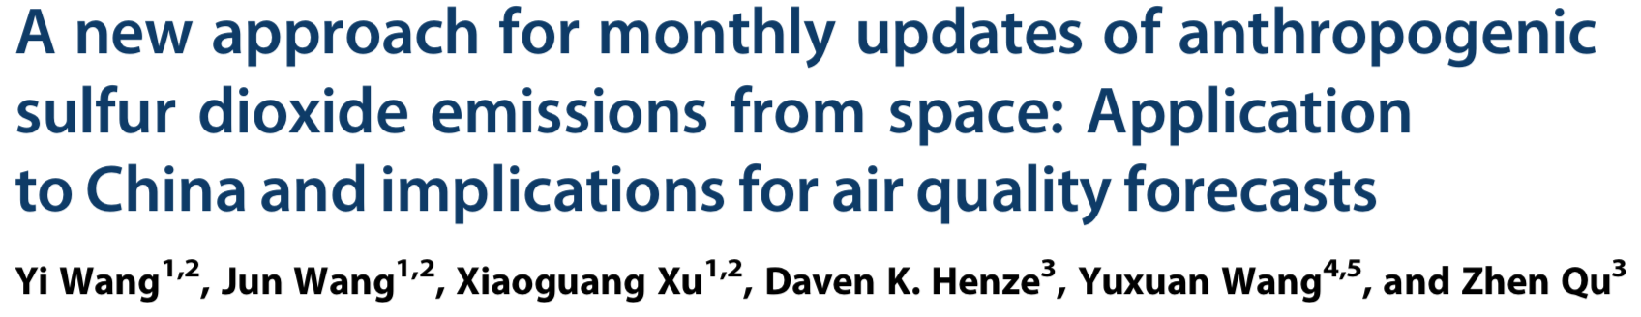
Our past studies
GRL, 39, L08802, doi:10.1029/2012GL051136, 2012
JGR, 118, 6396–6413, doi:10.1002/jgrd.50515, 2013
GRL, 43, 9931–9938 doi:10.1002/2016GL070204, 2016

Slide 5
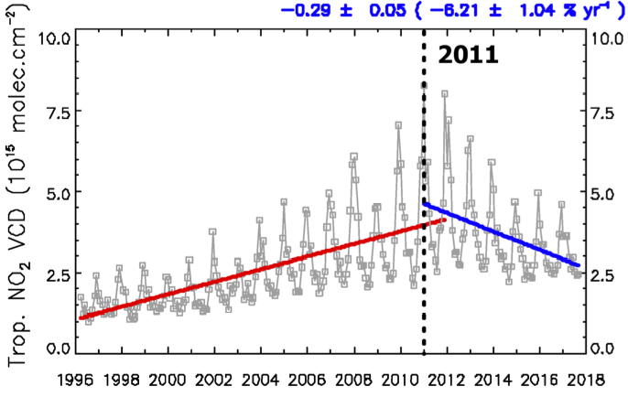
Questions to be addressed:
Separate vs. joint inversion of SO₂ and NO₂ from OMPS
Implication for AQ forecast – needs of downscaling …
Implication for TEMPO and beyond
10.0
10.0
2011
7.5
7.5
5.0
5.0
2.5
2.5
(Georgoulias et al., 2019)
0.0
0.0
1996
1998
2000
2002
2004
2006
2008
2010
2012
2014
2016
2018
GOME
SCIAMACHY
OMI
GOME-2
OMPS
TEMPO
GEMS…
GOME-2
OMPS
TROPOMI
1996
1998
2000
2002
2004
2006
2008
2010
2012
2014
2016
2018

Slide 6
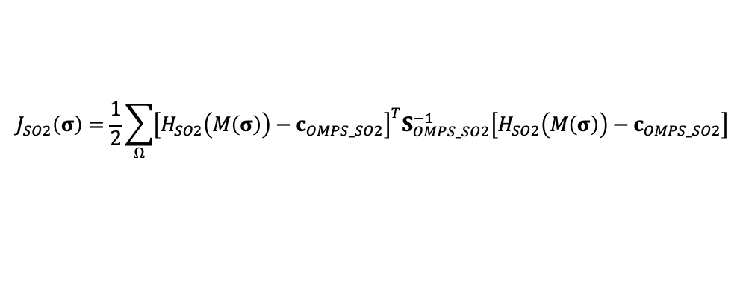
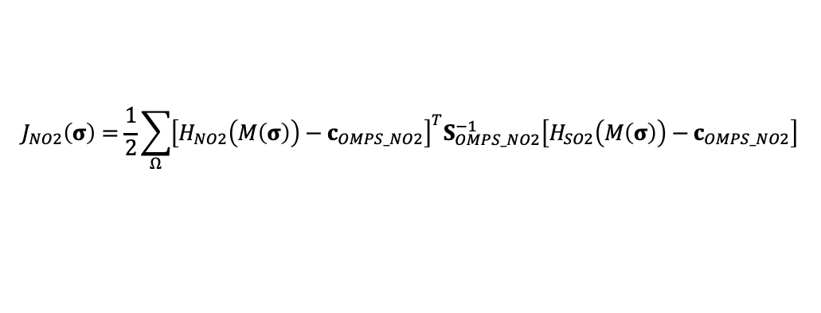


Cost function for joint assimilation of OMPS SO₂ and NO₂
Cost function:
$$J\left(σ\right)=s∙J_{SO2}\left(σ\right)+J_{NO2}\left(σ\right)+J_{p}\left(σ\right)$$
The inconsistency between simulation and observation
OMPS SO₂:
$$J_{SO2}\left(σ\right)=\frac{1}{2}\sum_{Ω}{{\left[H_{SO2}\left(M\left(σ\right)\right)−c_{OMPS_SO2}\right]}^{T}S_{OMPS_SO2}^{−1}\left[H_{SO2}\left(M\left(σ\right)\right)−c_{OMPS_SO2}\right]}$$
OMPS NO₂:
$$J_{NO2}\left(σ\right)=\frac{1}{2}\sum_{Ω}{{\left[H_{NO2}\left(M\left(σ\right)\right)−c_{OMPS_NO2}\right]}^{T}S_{OMPS_NO2}^{−1}\left[H_{SO2}\left(M\left(σ\right)\right)−c_{OMPS_NO2}\right]}$$
s is significant to balance the above two terms
The inconsistency between prior and posterior emissions
$$J_{p}\left(σ\right)=\frac{1}{2}{\left[σ−σ_{a}\right]}^{T}S_{a}^{−1}\left[σ−σ_{a}\right]$$
Notes:
Here shows the cost function to be used. There are two observational terms. The first term measures the inconsistency between simulation and observations for SO2, and the second term is for NO2.
To jointly assimilate OMPS SO2 and NO2, it is significant to balance the observational SO2 term and observational NO2 term. In the prior simulation, the value of NO2 observational term is a factor of 200 larger than the value of SO2 observational term. If the two terms are not well balanced, SO2 observations will have negligible impacts on the joint emission estimate. Here I use parameter s to balance them.

Slide 7
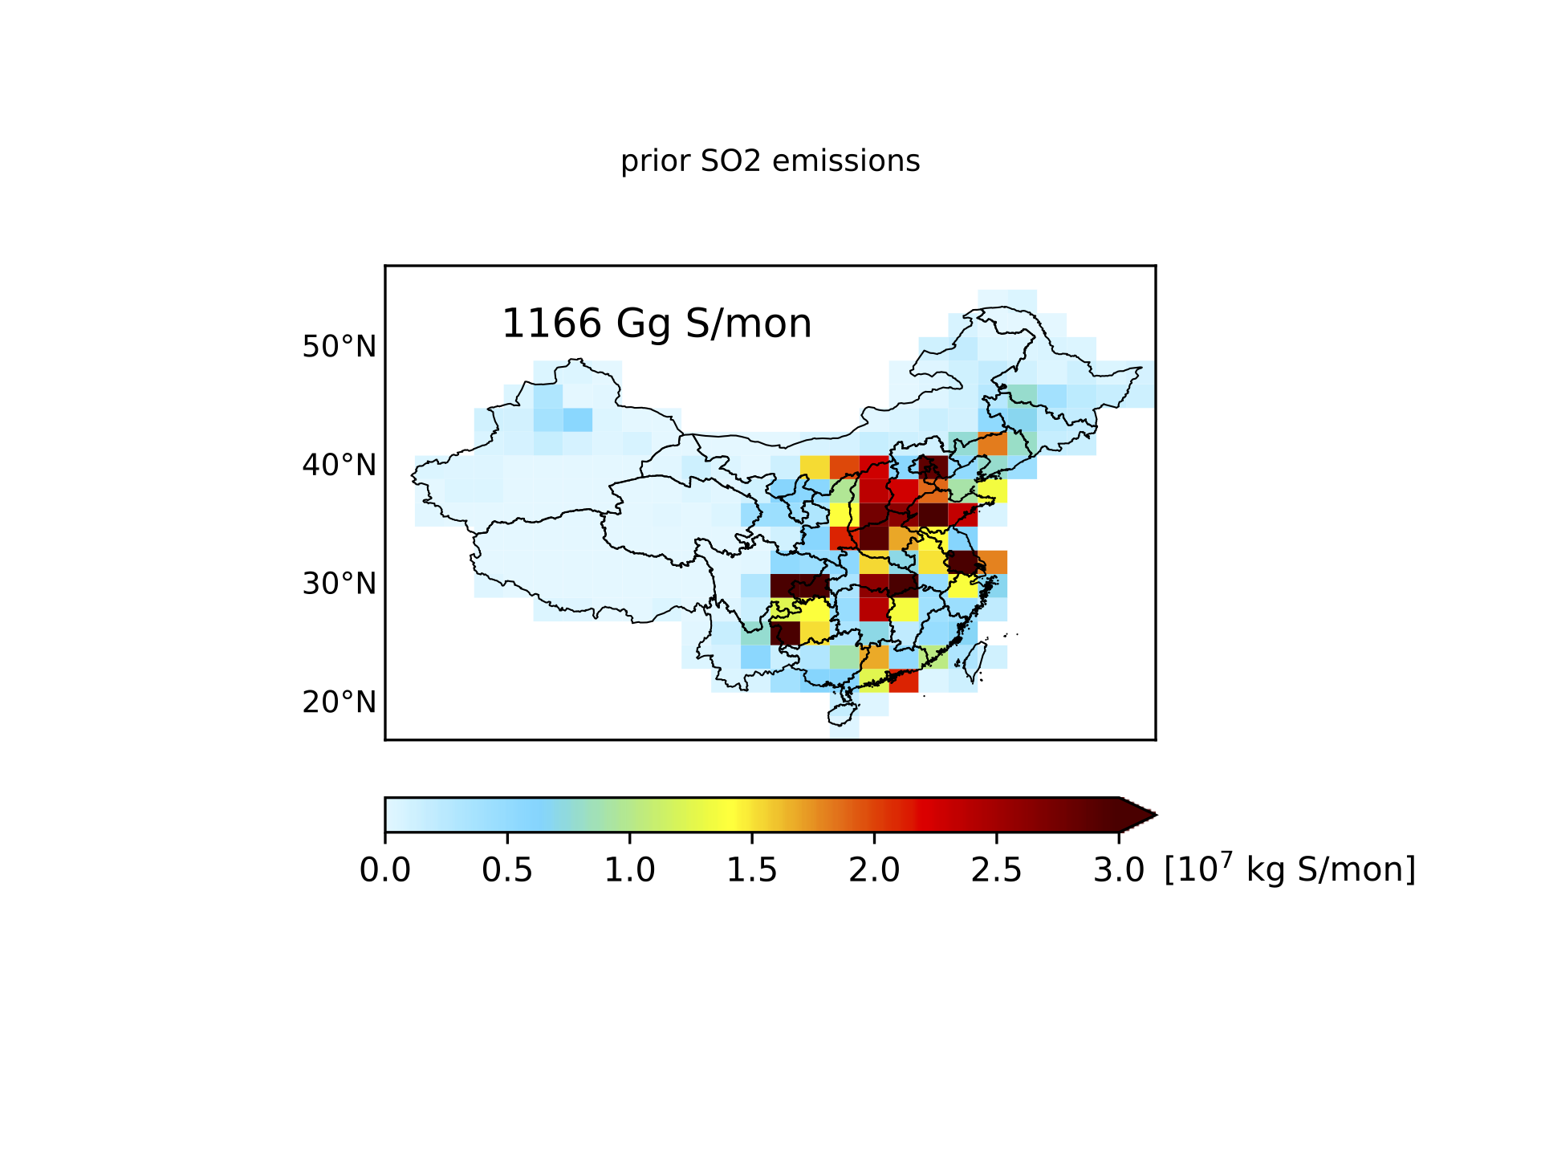
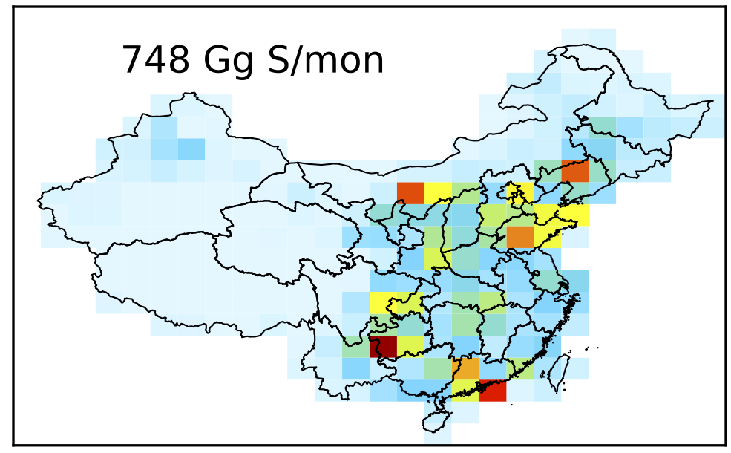
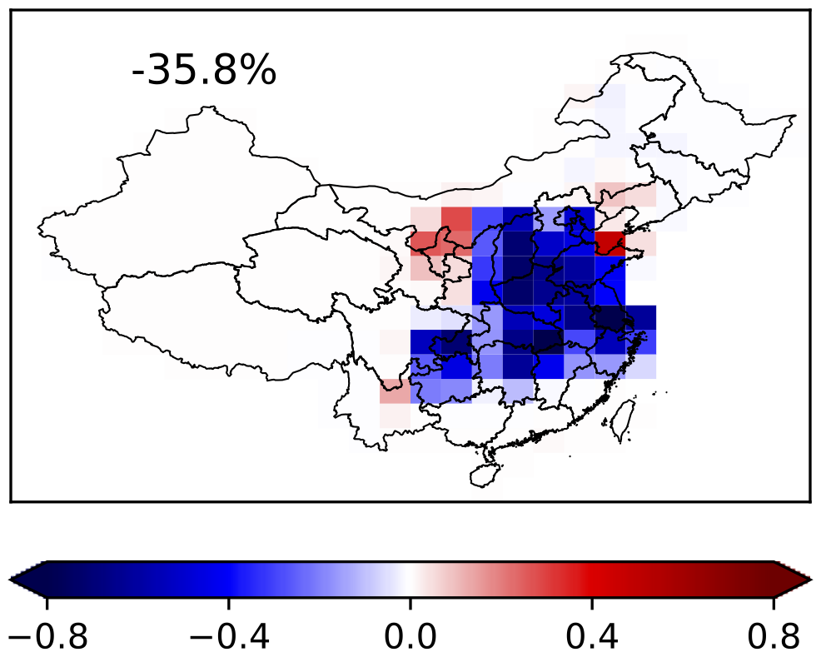
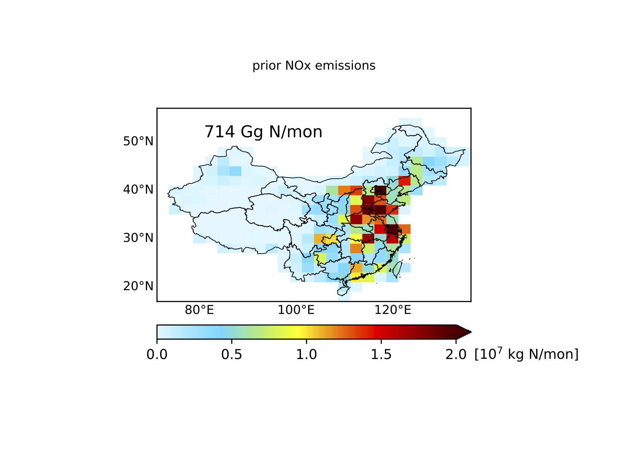
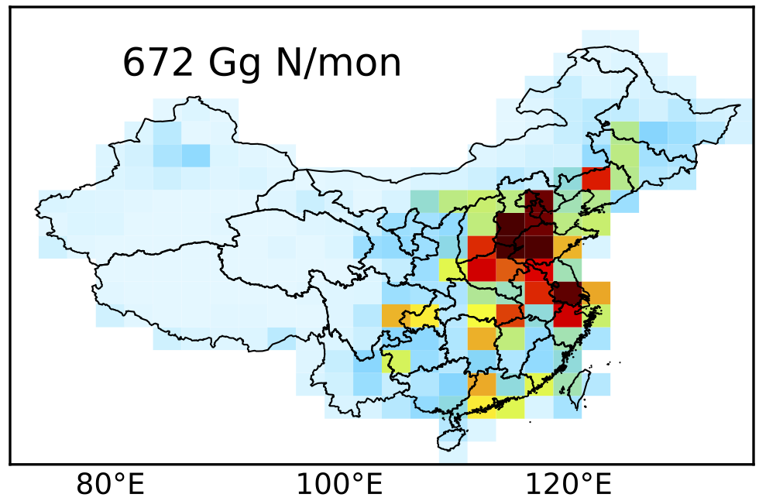
Anthropogenic SO₂ and NO_{x} emissions (October 2013)
OMPS-constrained
(Posterior – Prior) / Prior
Prior (MIX, 2010)
Posterior
SO₂
NO_{x}
Results using GEOS-chem adjoint (V.8) at 2º x 2.5º resolution
Notes:
A case study is conducted for October 2013. The prior emission inventory used is MIX. The latest MIX emission inventory available is for year 2010, as it takes much time to collect data needed for constructing MIX emission inventory.
SO2 emission is mainly over North China Plain and Southwest China. Emission reduction exist over both north China and south China, although increase exist over some regions. In sum, posterior SO2 emission is ~36% smaller than prior emission
NOx emission is mainly over North China Plain and east China. Both increase and decrease exist over North China Plain. Totally, posterior NOx emission is ~6% smaller than prior emission.
50’’ ?

Slide 8
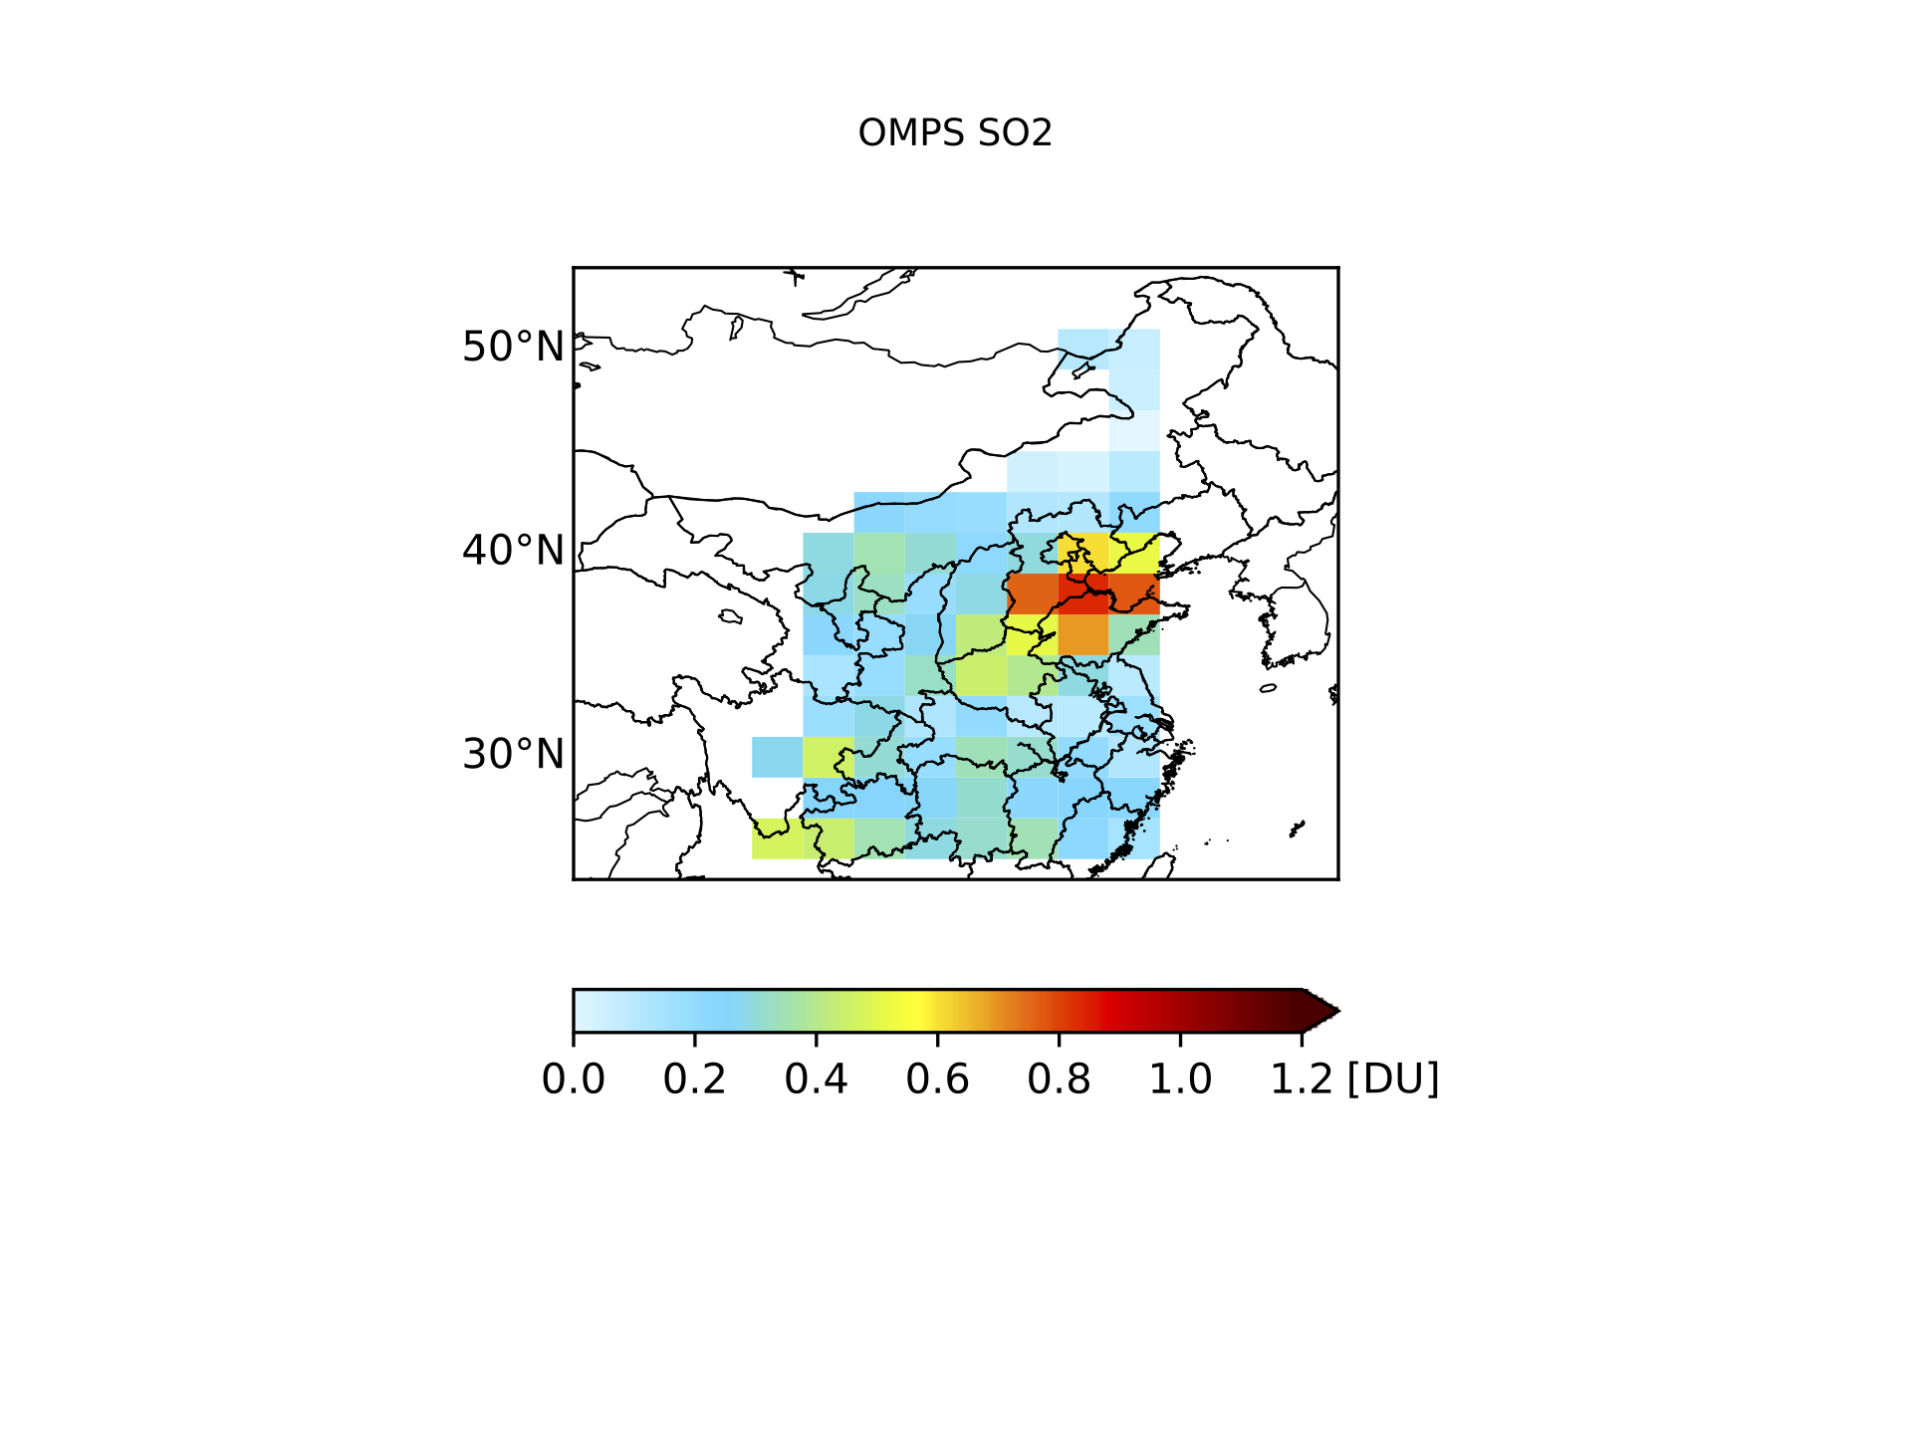
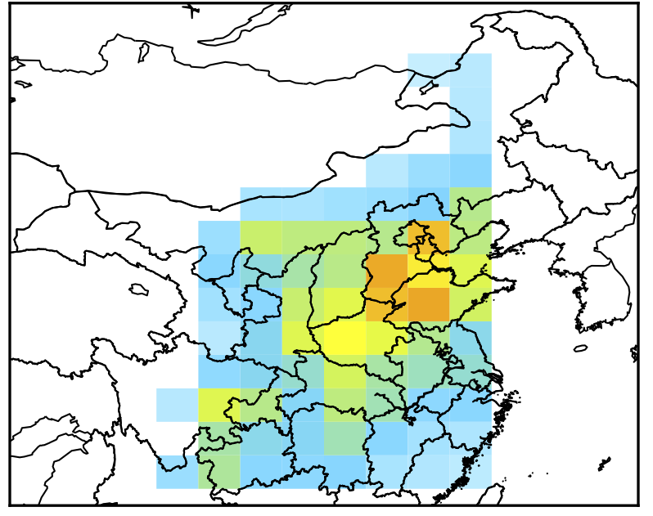
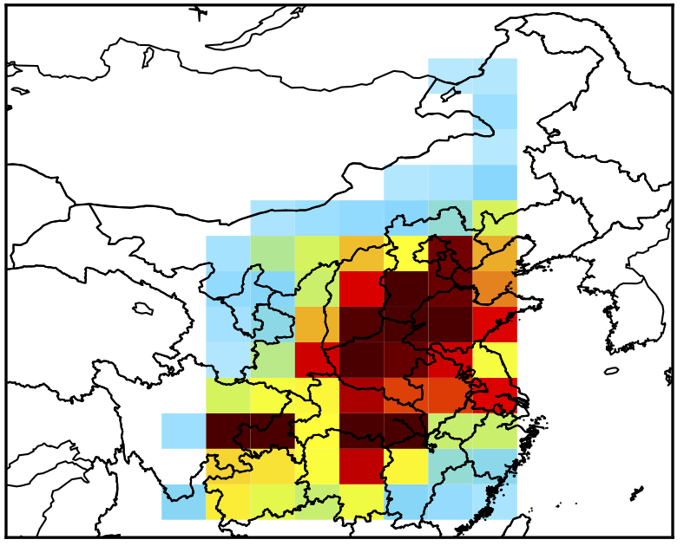
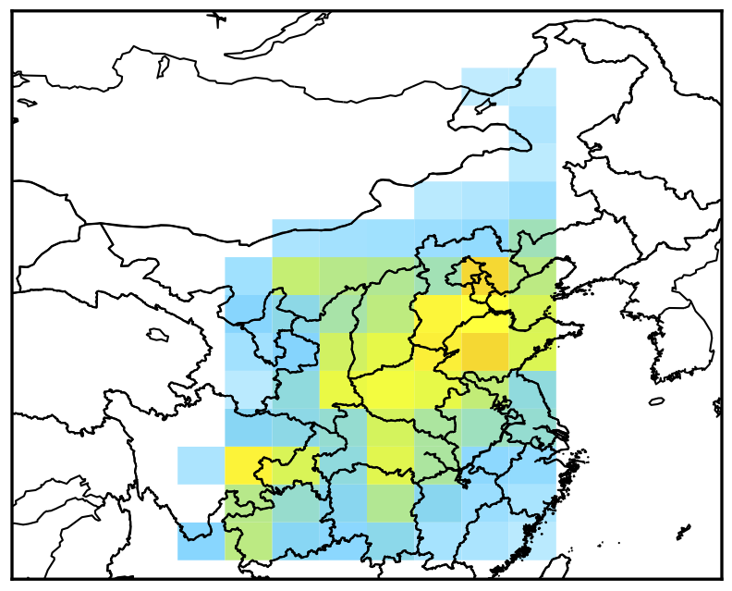
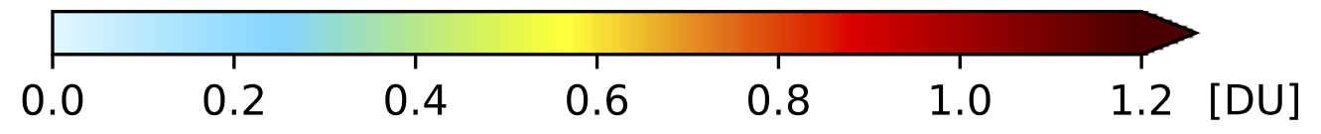
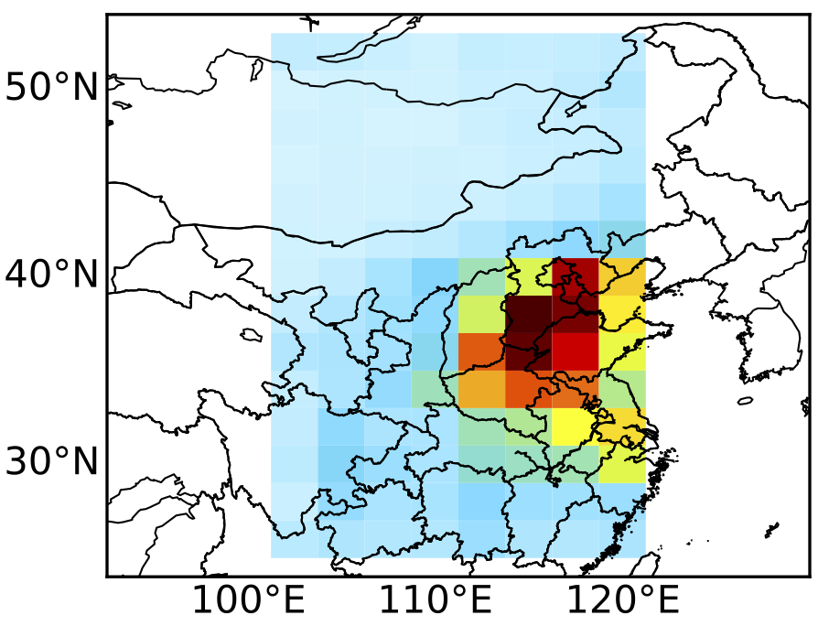
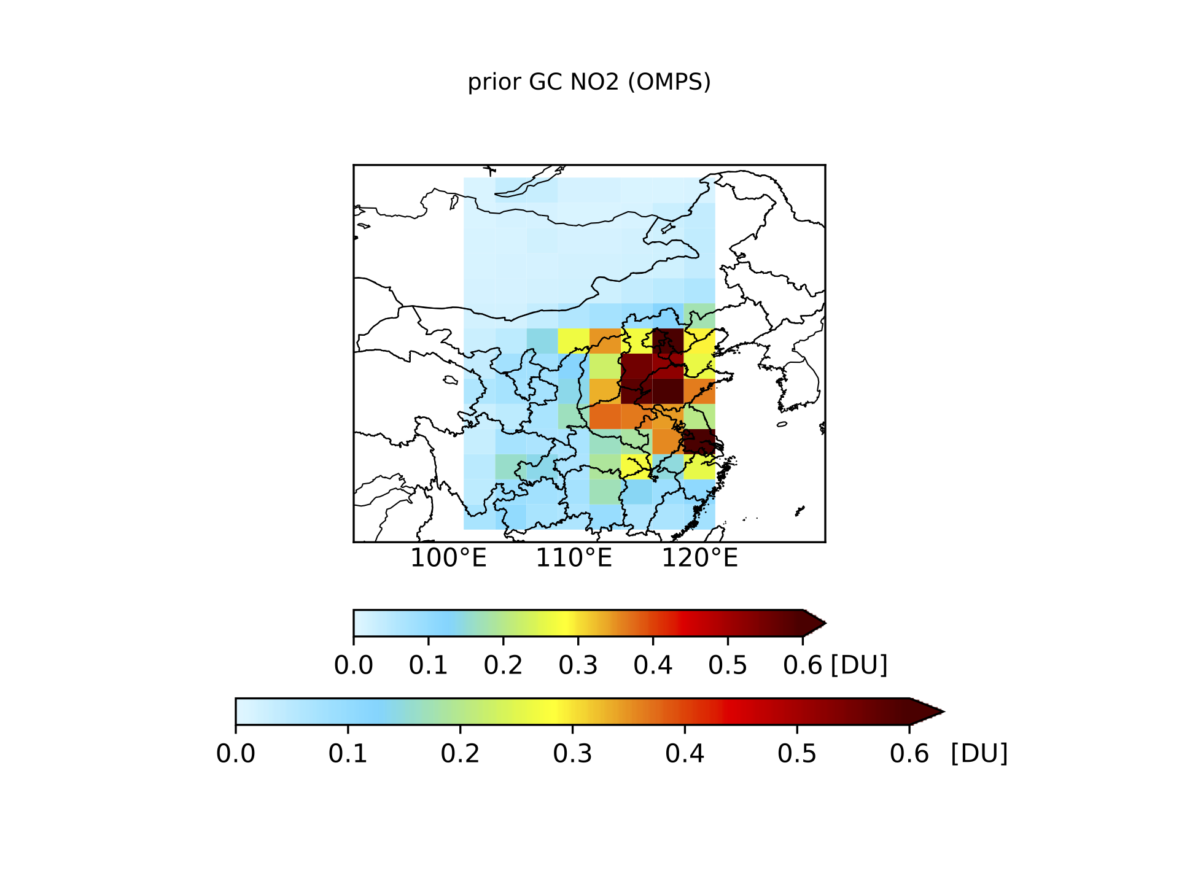
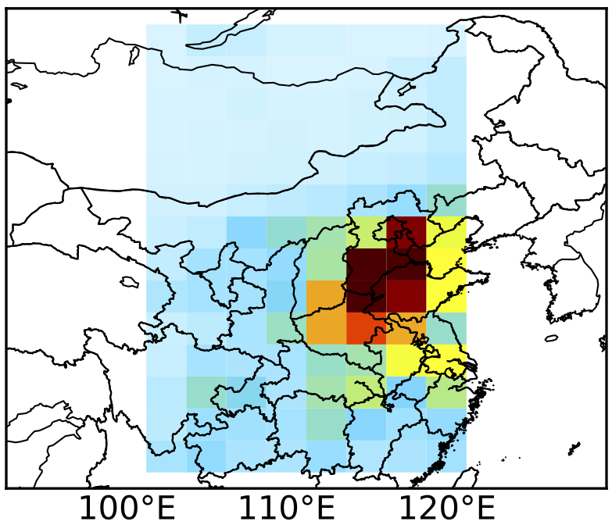
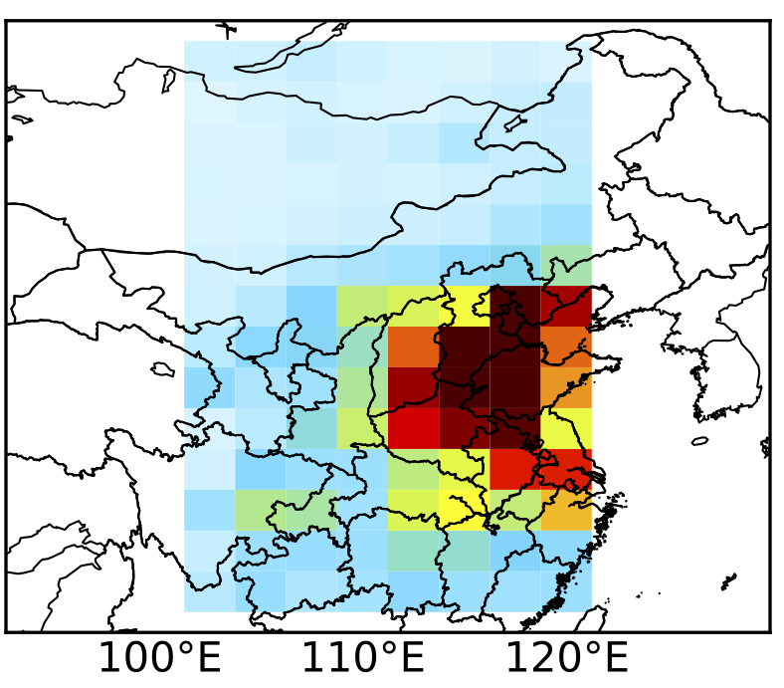
Comparisons of OMPS based SO₂ and NO₂ with OMI (NASA L3)
GC-adjoint
OMPS
+
Prior GC
Posterior GC
V.S.
OMI
SO₂
NO₂
Notes:
Prior and posterior emission inventories are used to simulate SO2 and NO2 in the atmosphere through GEOS-Chem model and results are validated with OMI NASA L3 observations
Prior SO2 simulation is much larger than OMI observation, and posterior simulation is in more agreement with OMI.
For NO2, Posterior simulation show improvements in terms of spatial distribution.

Slide 9
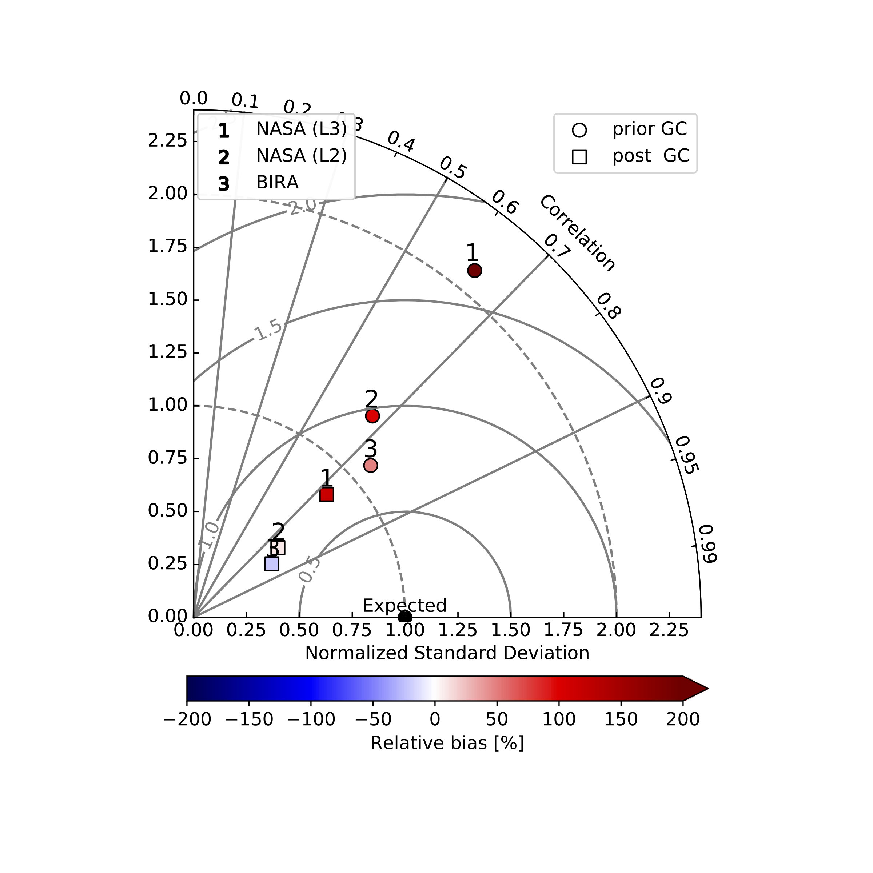
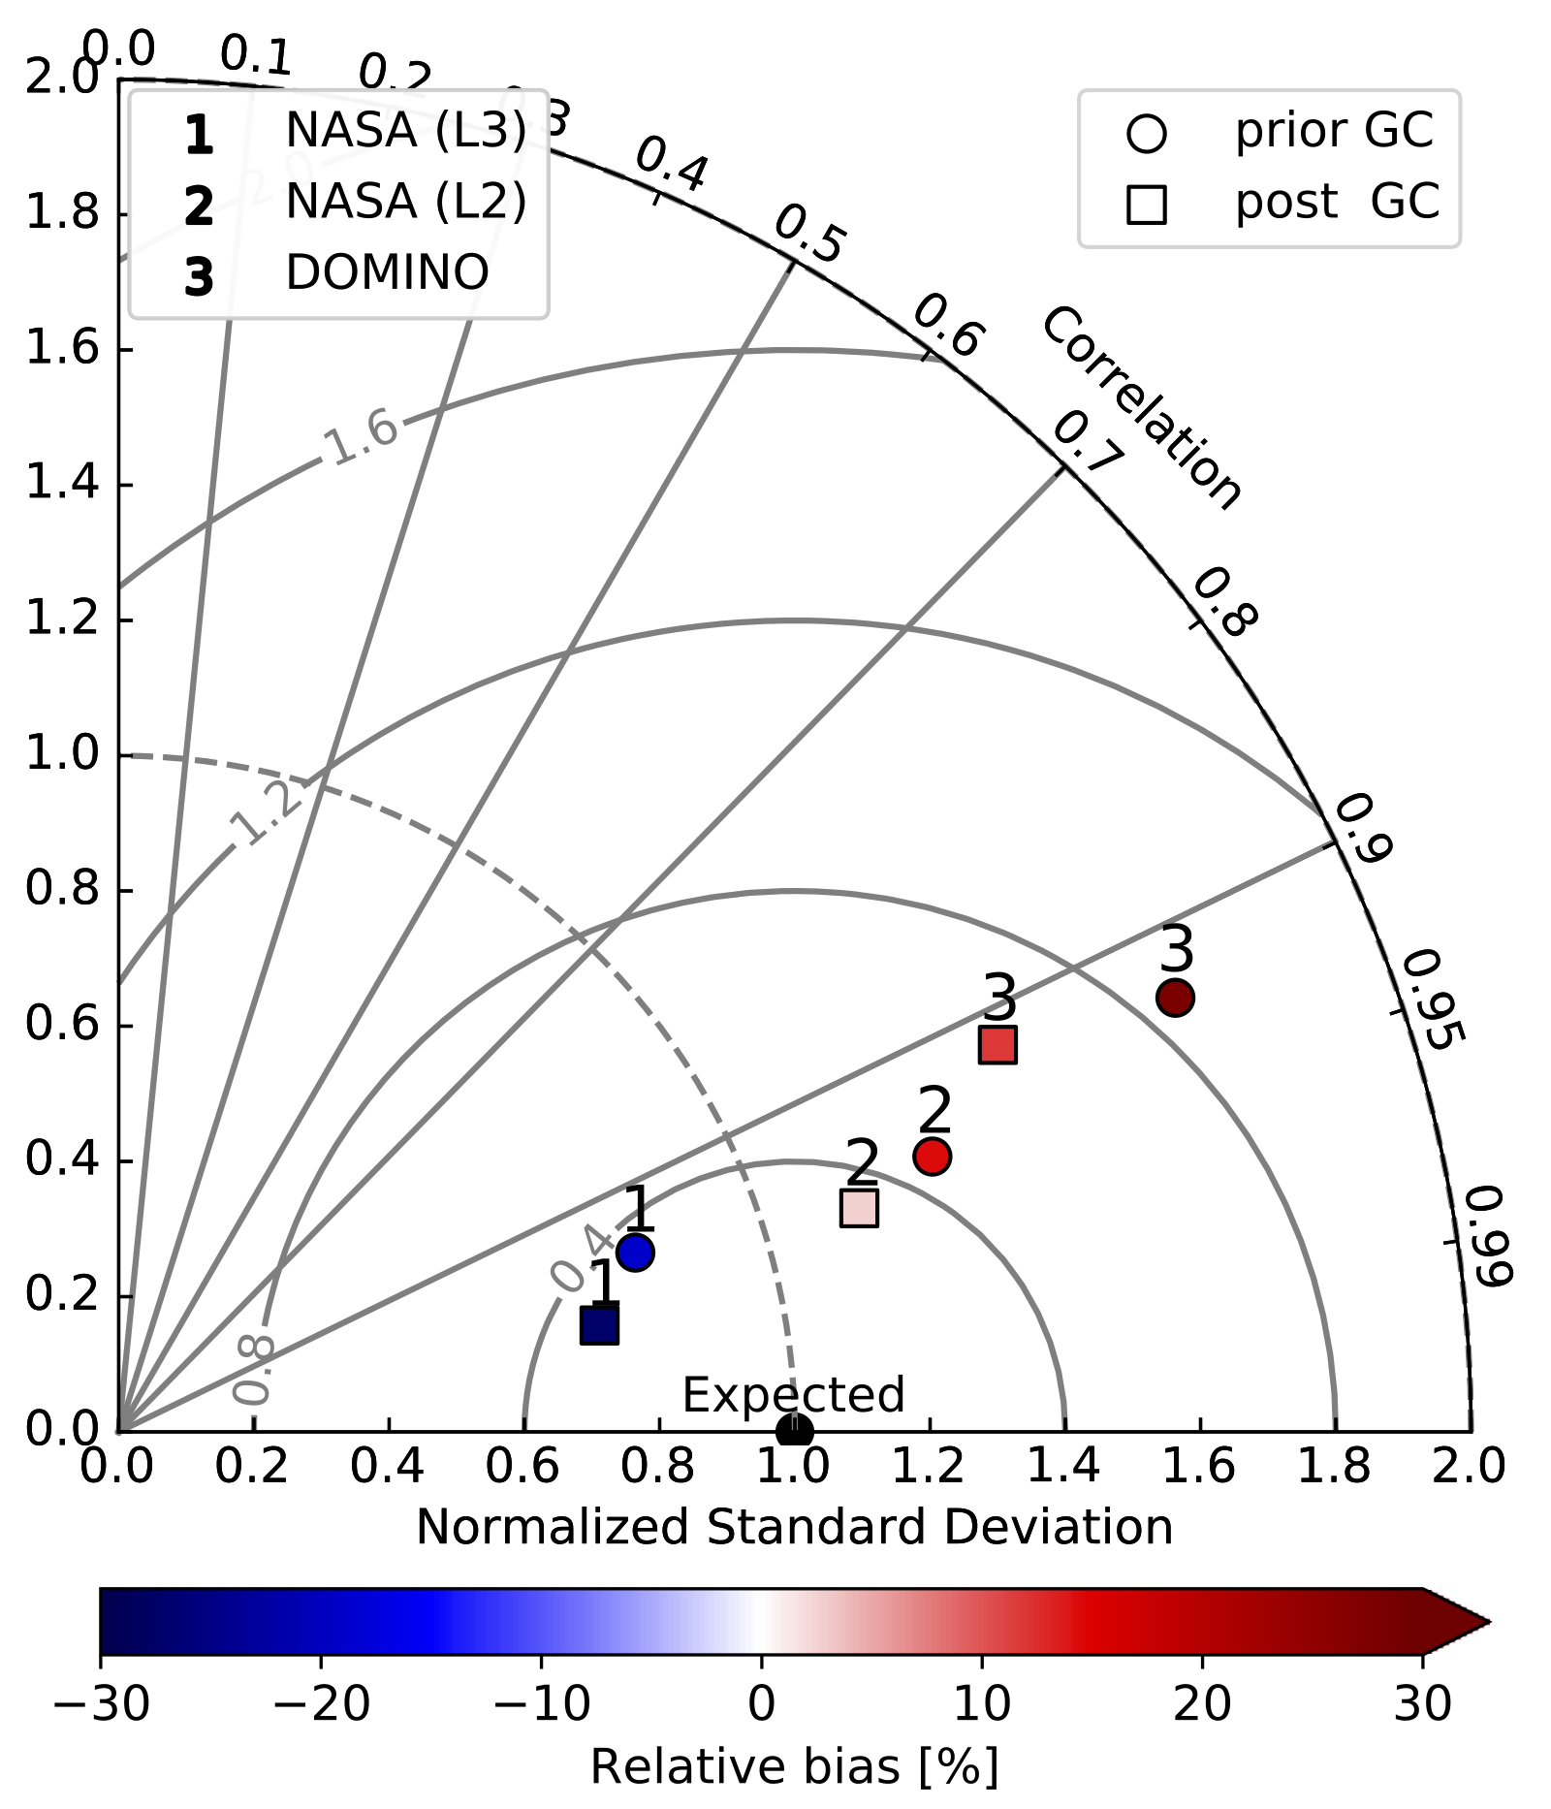
Evaluation of GC results with different OMI products
SO₂
NO₂
piror
posterior
Regardless of SO₂ or NO₂, posterior simulations always improve spatial distributions (in many cases bias) than prior simulations when evaluated with OMI products from different algorithms.
Notes:
NASA L3 SO2 and NO2 are not the only OMI product. There are other OMI SO2 and NO2 products, which are also used for validation here.
Posterior SO₂ and NO₂ simulations always show better spatial distributions than prior simulations when validating with corresponding OMI products retrieved through various algorithms.

Slide 10
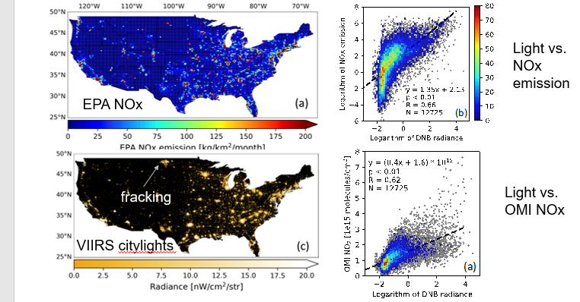
Artificial lights vs. NOx emissions

Slide 11
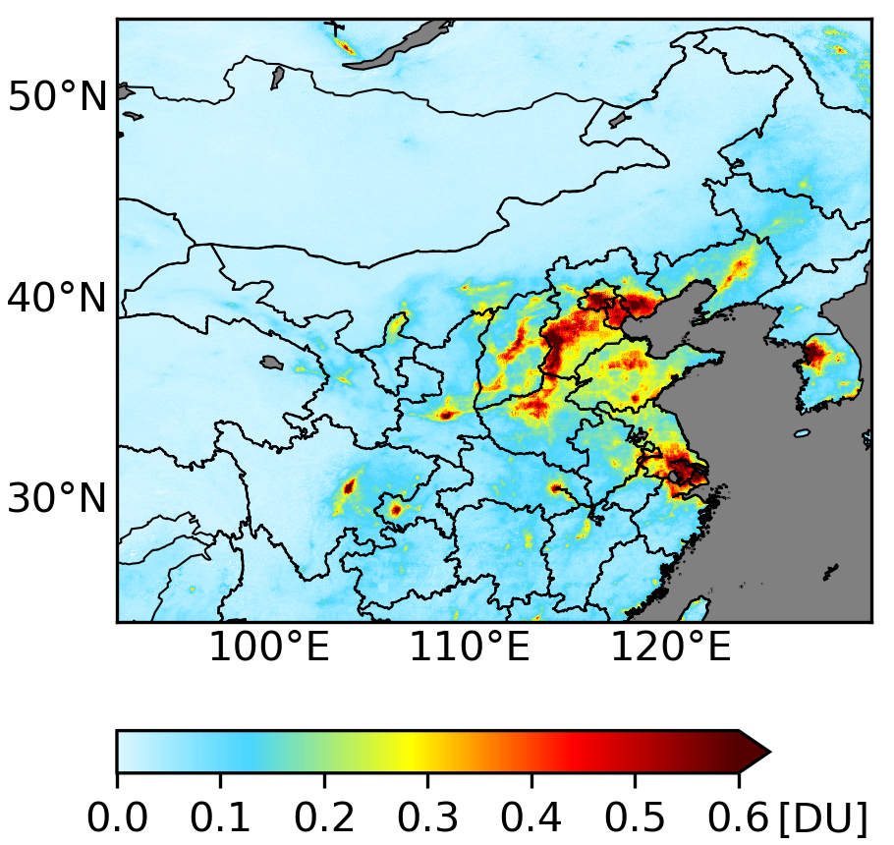
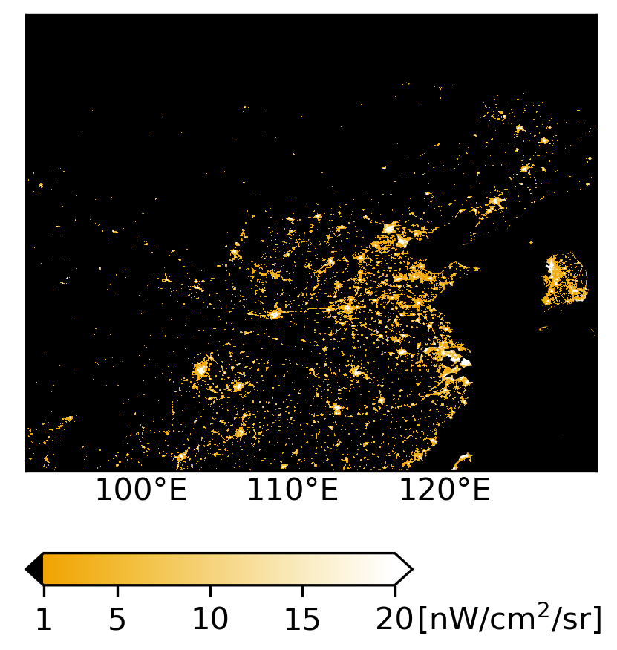
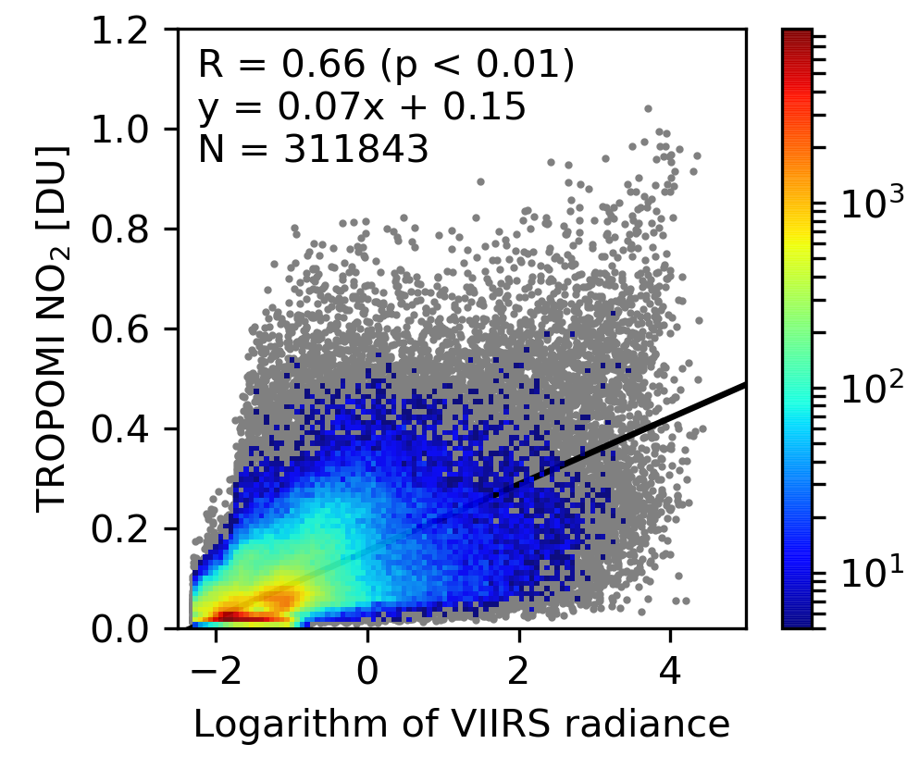
The relationship between TROPOMI NO₂ and VIIRS nighttime light
TROPOMI NO₂
VIIRS nighttime light
NO₂ VS nighttime light
#
There is good correlation between TROPOMI NO₂ vertical column density and VIIRS nighttime light, thus VIIRS nighttime light should be good proxy for downscaling NO_{x} emissions.
Notes:
I have already shown downscale posterior SO2 emission inventory and apply it to improve surface SO2 simulation. The emission downscale approach can also be applied for posterior NOx emissions inventory.
But here I will introduce another approach for downscaling NOx emission inventory.
Here shows NO2 columns observed by TROPOMI and nighttime light observed by VIIRS.
Due to good correlation between VIIRS nighttime light and TROPOMI NO2 vertical column density. Another approach is using VIIRS nighttime light to downscale NOx emissions,

Slide 12
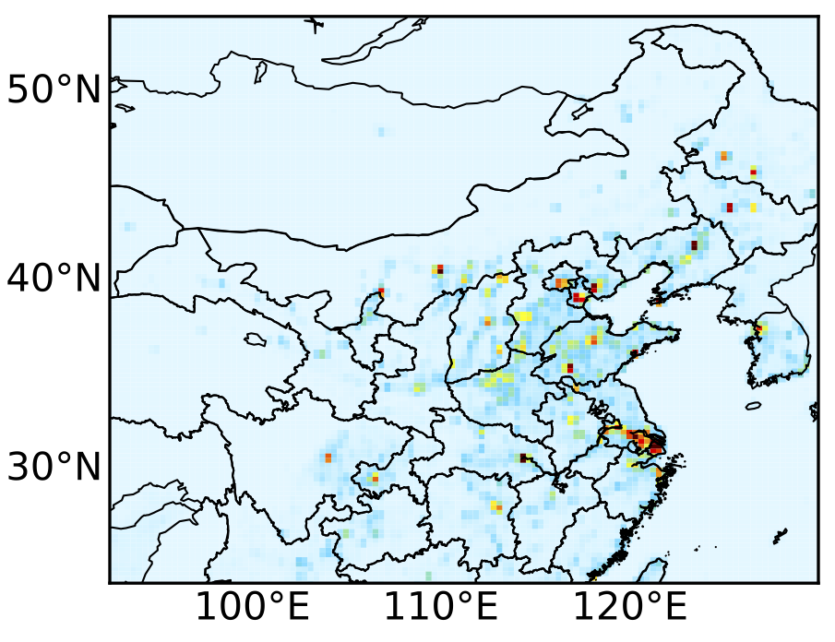

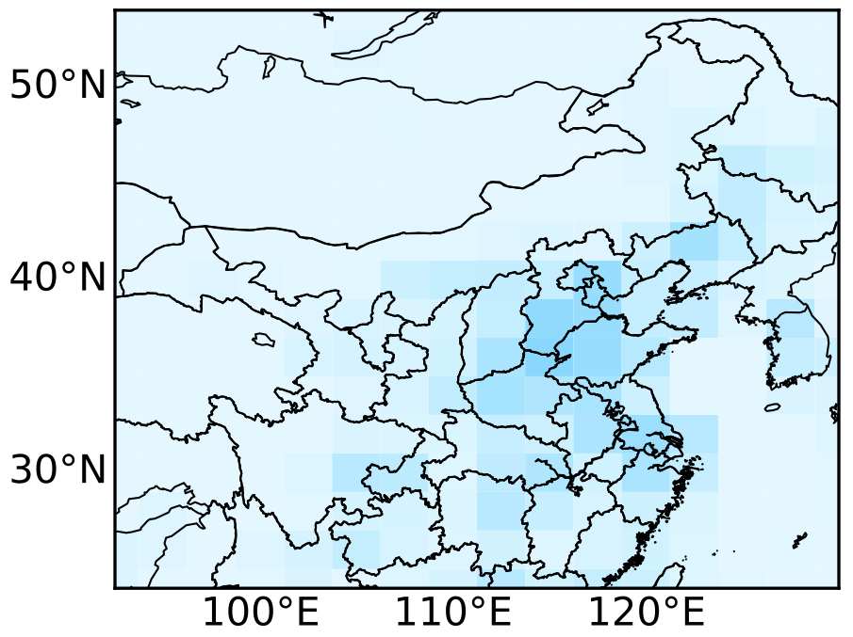
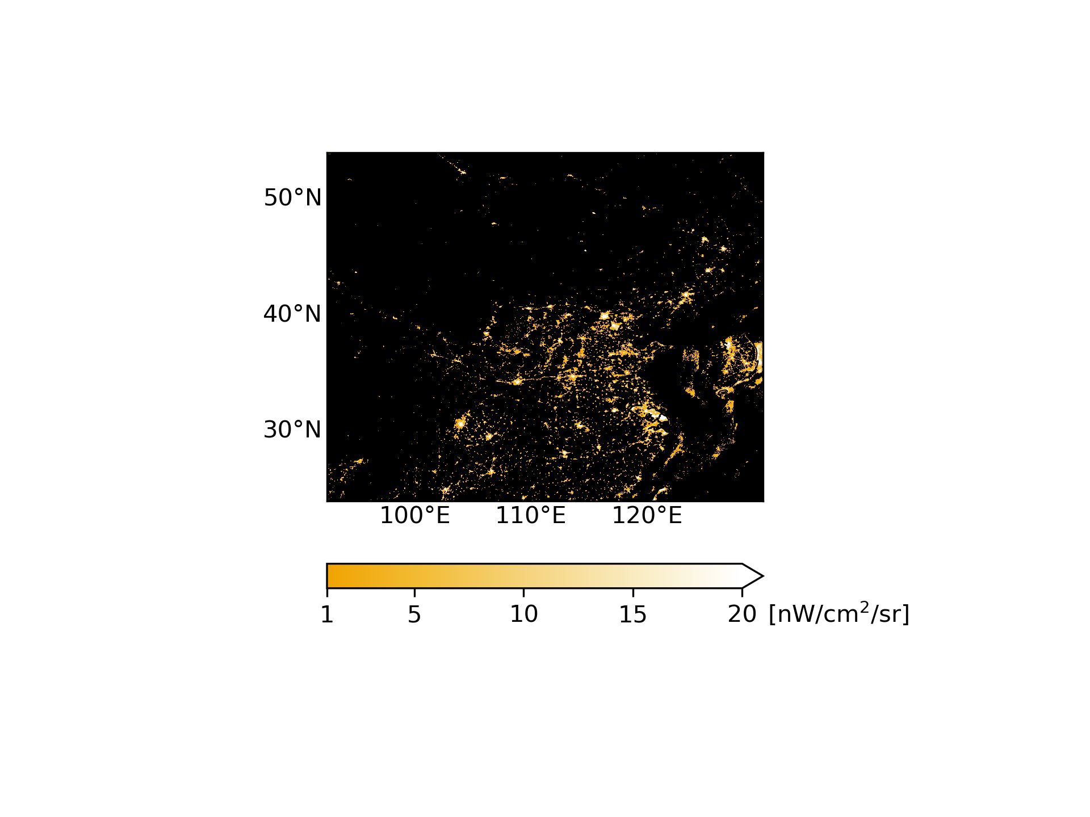

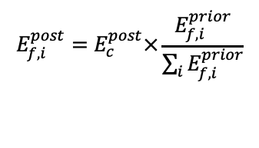
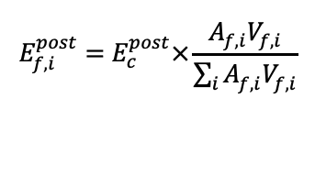
Two methods to downscale posterior NO_{x} emissions
Amount
Spatial Distribution
Posterior fine
Prior fine
MIX emission downscaled
$$E_{f,i}^{post}=E_{c}^{post}×\frac{E_{f,i}^{prior}}{\sum_{i}{E_{f,i}^{prior}}}$$
Posterior coarse
+
VIIRS nighttime light
Nighttime light downscale
$$E_{f,i}^{post}=E_{c}^{post}×\frac{A_{f,i}^{}V_{f,i}^{}}{\sum_{i}{A_{f,i}^{}V_{f,i}^{}}}$$
+
Notes:
Thus, for NOx emissions, we designs two approaches to downscale posterior NOx emission inventory.
The first one is similar to SO2 emission downscale appraoch, posterior coarse resolution NOx emission is also downscaled according to prior emission.
The second is use VIIRS nighttime light to downscale NOx emissions

Slide 13
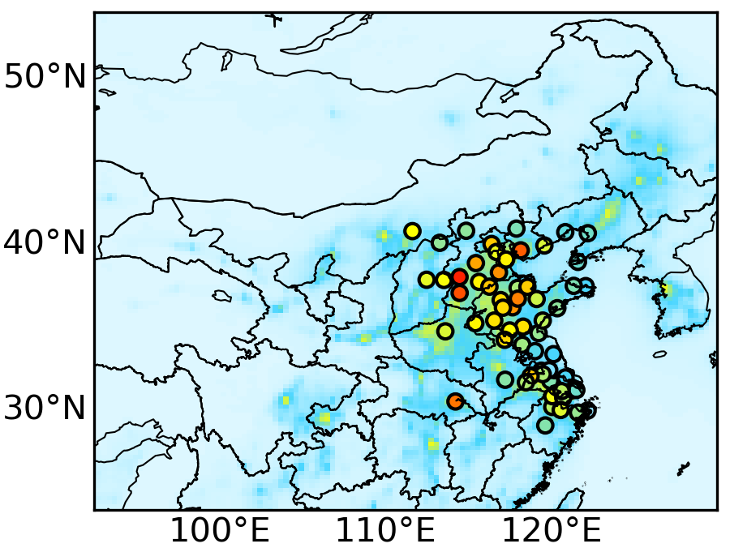
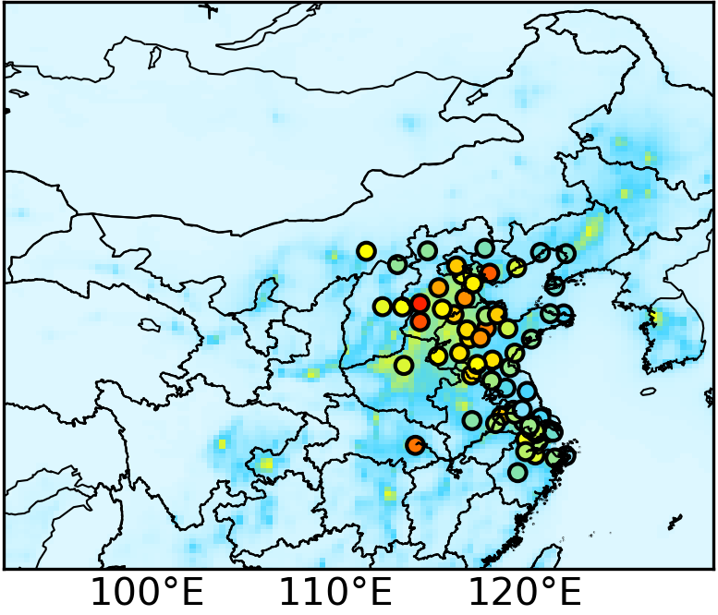

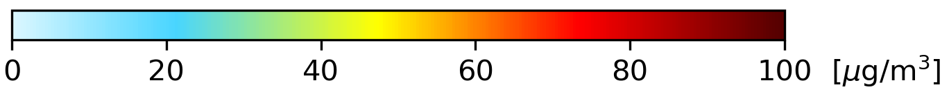
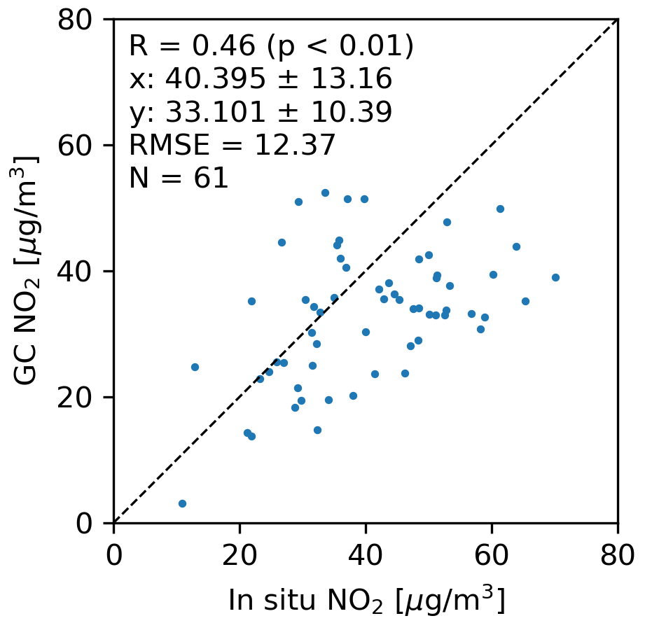
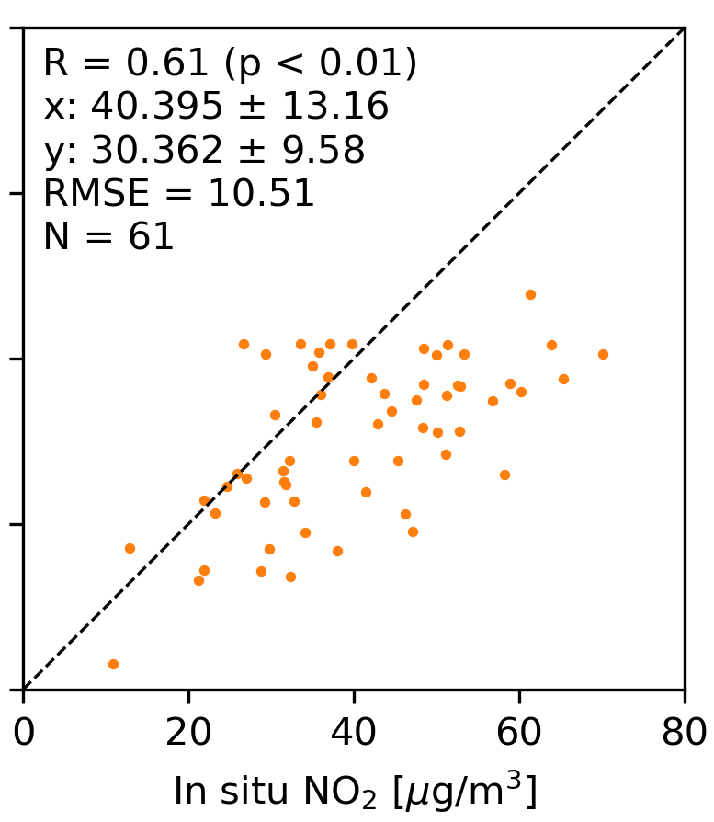

GC (v12) evaluation with in situ surface NO₂ observations
Posterior fine
Artificial light
downscale
Prior
MIX downscale
Linear correlation coefficient increases from 0.46 (prior) to 0.61 (MIX emission downscale) and 0.58 (nightlight emission downscale)
Root mean square error decreases from 12 μg/m³ (prior) to 10 μg/m³ (MIX emission downscale) and 11 μg/m³ (nightlight emission downscale)
(b)
(c)
R: 0.46
R: 0.61
R: 0.58
RMSE: 12.37 μg/m³
RMSE: 10.51 μg/m³
RMSE: 11.06 μg/m³
Notes:
All the fine resolution NOx emission inventories are used to simulate surface NO2. When validating with in situ observations, the two posterior simulations show larger linear correlation and smaller root mean square error than prior simulation.
Here, using prior MIX emission inventory to downscale show better result than using VIIRS nighttime light. Exact location information of point source is used to construct MIX emission inventory, while we treat all sources as area sources when using VIIRS nighttime light to downscale emission inventory.
15’’

Slide 14
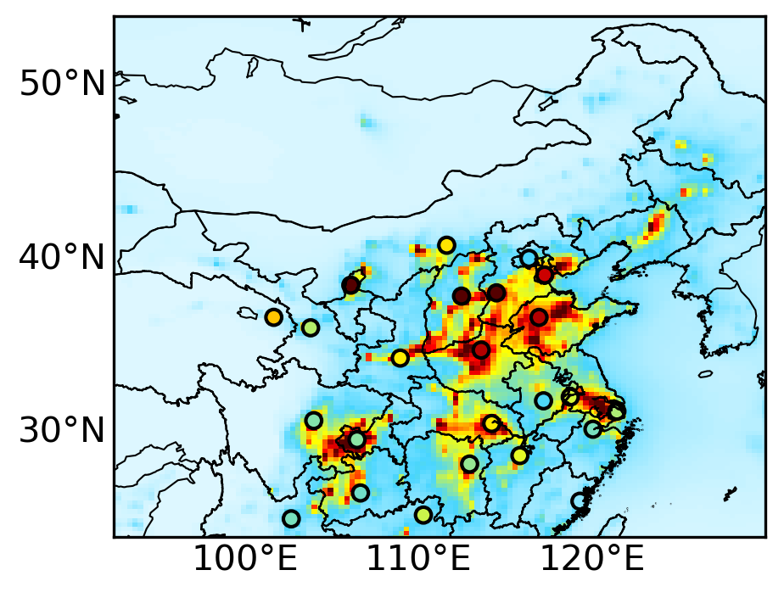
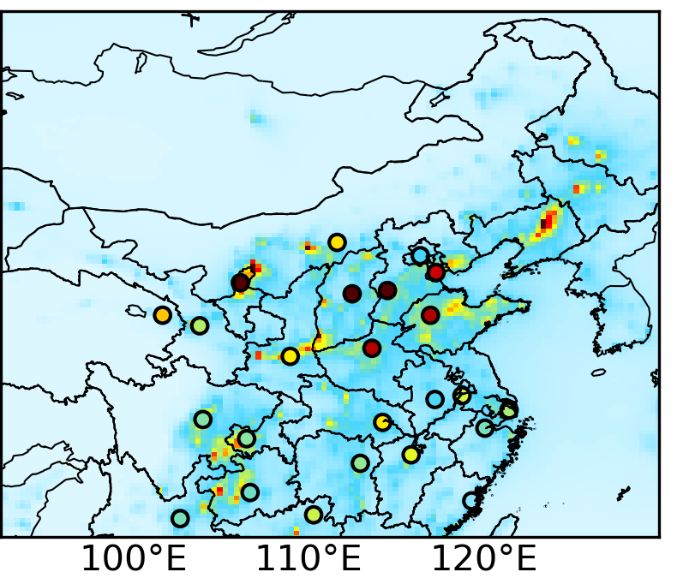

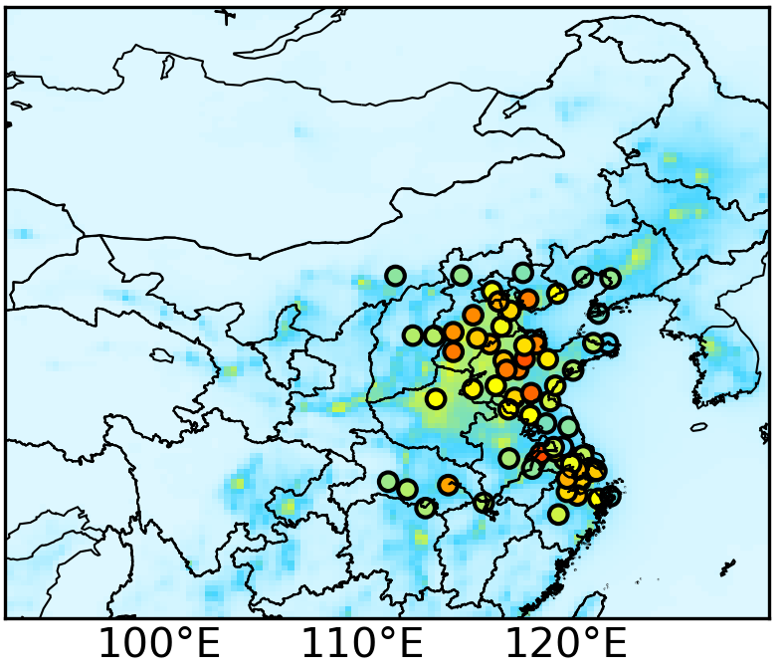

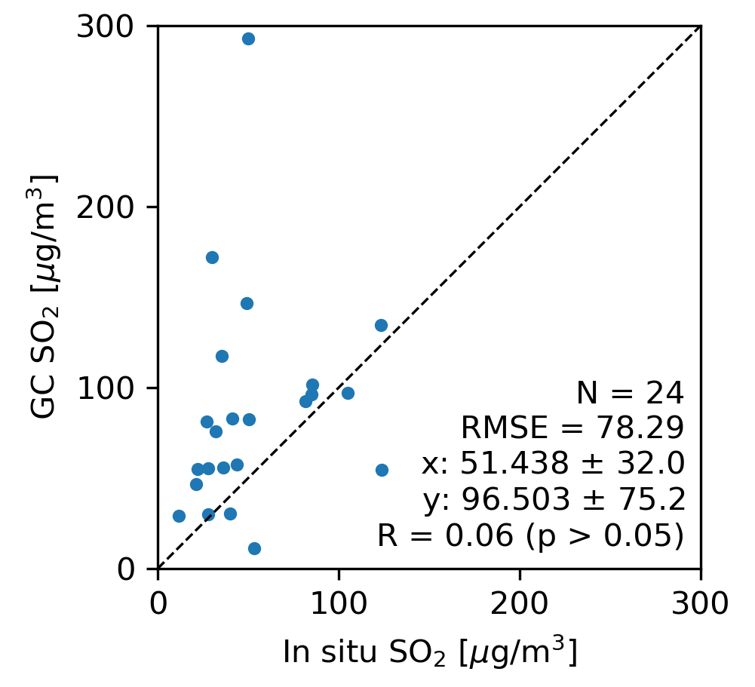
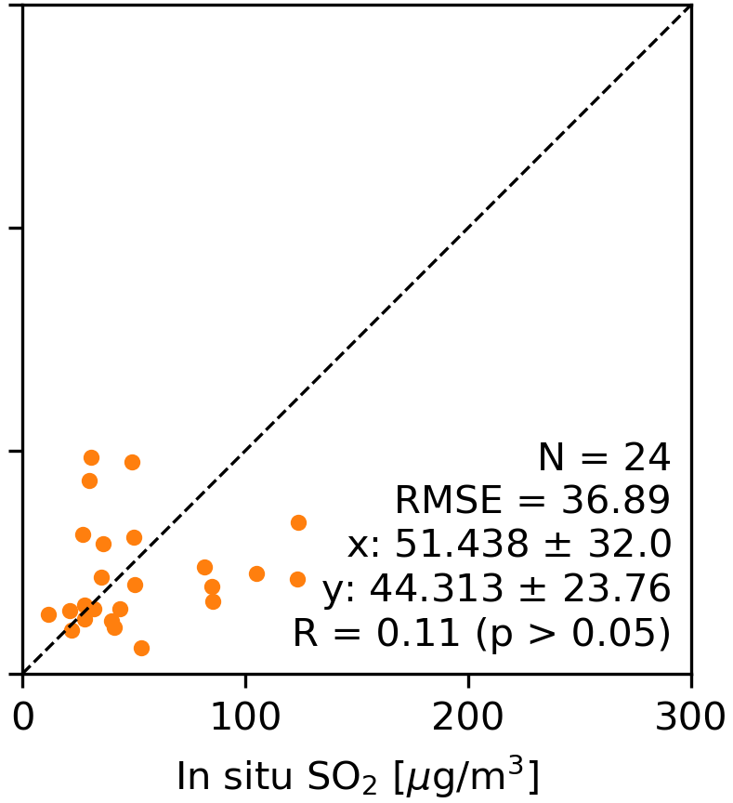
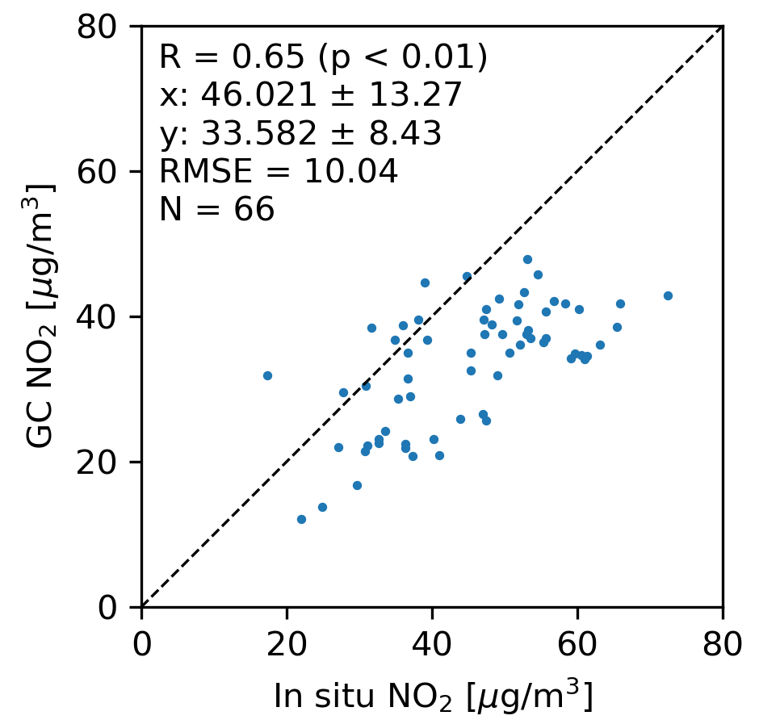
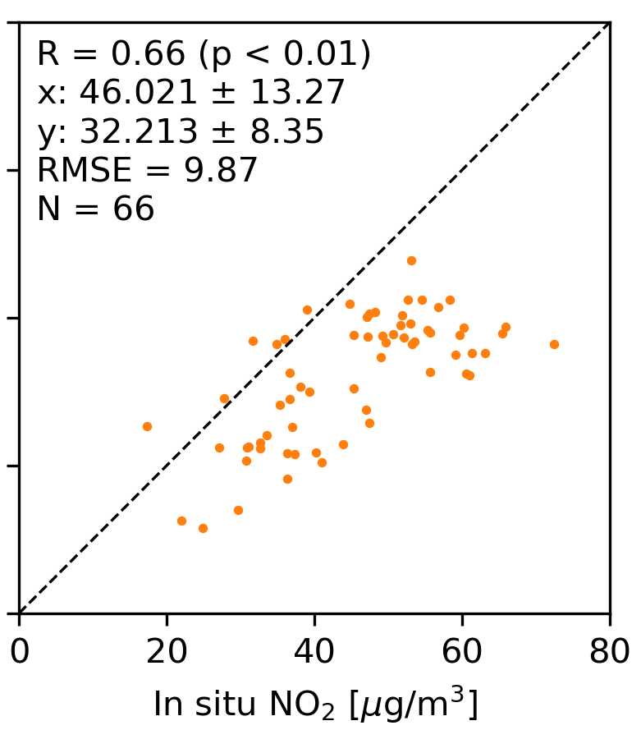
Apply top-down emissions to next month for improving forecasts
Prior
SO₂
Posterior
Prior
NO₂
Posterior
Bias: 44 μg/m³
RMSE: 78 μg/m³
Bias: -7 μg/m³
RMSE: 37 μg/m³
Bias: 13
RMSE: 10
Bias: 14
RMSE: 10
Results for Nov. 2013 at fine resolution.
Notes:
The posterior fine-resolution emissions inventories are applied for air quality forecast. And we assume prior emission inventory has correct temporal profile.
Here the emission estimate is conduct for October 2013, and we scale the posterior emission inventory for October 2013 to November 2013 according to the temporal variation information from prior emission inventory. Due to the time lag of bottom-up emission inventory, prior MIX emission for November 2010 is used as prior forecast.
For SO2, posterior forecast has much smaller bias and root mean square error than prior forecast.
For NO2, posterior forecast also show improvement in terms of linear correlation.

Slide 15
Joint inversion assessment for SO2
more for
NO2
label | s
1 | 20
2 | 50
3 | 100
4 | 200
5 | 300
6 | 500
7 | 1000
8 | 1500
9 | 2000
prior
prior
SO₂ only
SO₂ only
OMPS
OMI
more for
SO2
OMPS & NASA L3 of OMI is used.
Results are for Oct. 2013.
Notes:
All the emissions are used to simulate SO2, which is validated with OMPS and OMI observations.
The left Taylor diagram shows validation with OMPS observations, and the right Taylor diagram shows validation with OMI observations.
All posterior simulations show better result than prior simulation. When s is in range of 200-2000, simulations from using joint posterior emissions are close to that from using separate posterior emissions.

Slide 16
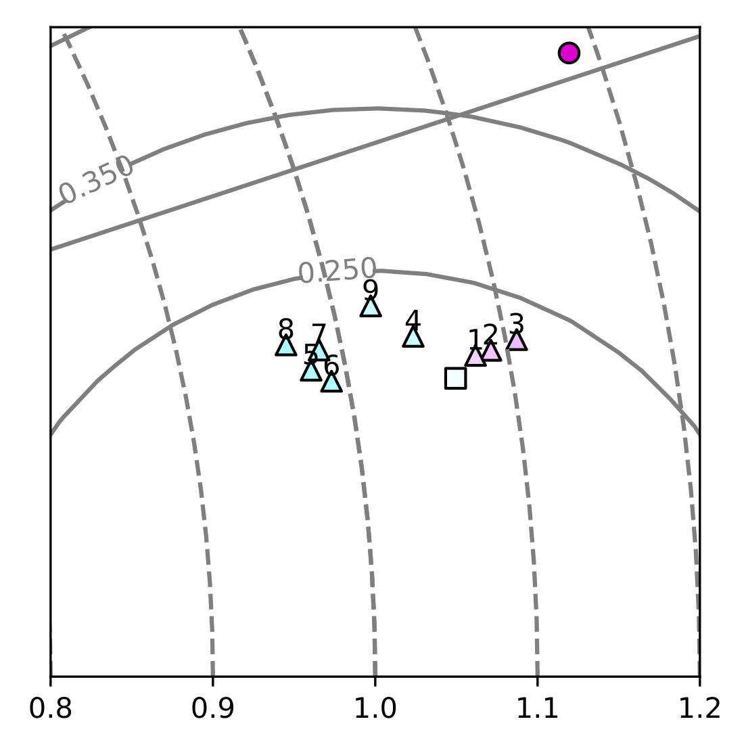
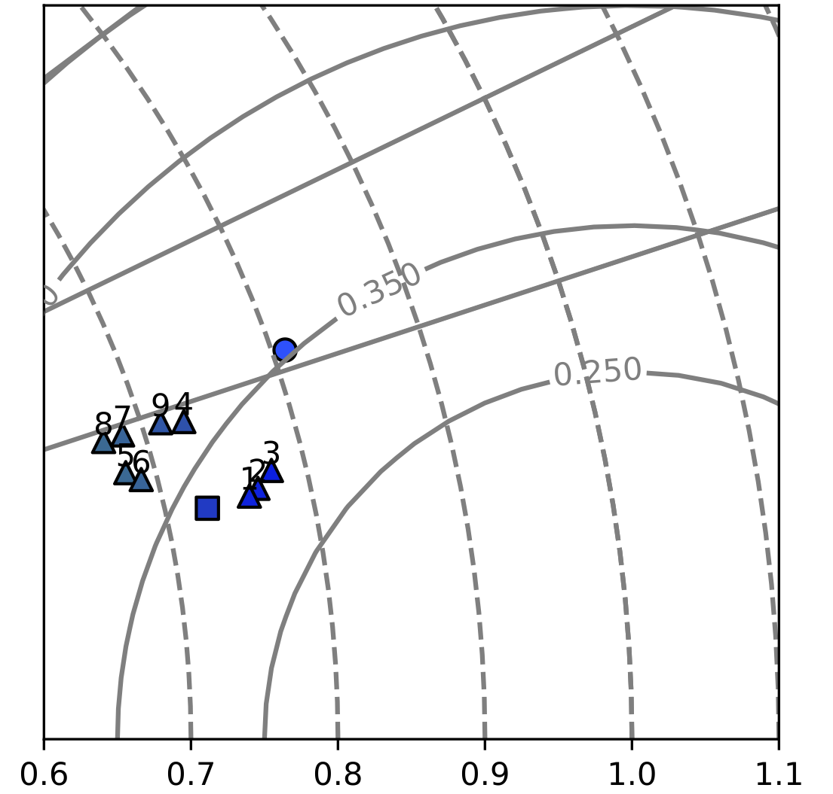

Joint inversion assessment for NO2
:prior
: NO₂ only
: joint (SO₂ + NO₂)
label | $$s$$
1 | 20
2 | 50
3 | 100
4 | 200
5 | 300
6 | 500
7 | 1000
8 | 1500
9 | 2000
prior
prior
NO₂ only
NO₂ only
OMPS
OMI
Notes:
Similarly, here shows the validation for NO2. Let zoom in on the red boxes.
When comparing with OMPS observations, no matter what s value is used, posterior simulations have much smaller de-biased root mean squared error than prior simulation, and the results are close to that using NO2 only.
When comparing with OMI observations, all posterior simulations have larger linear correlation coefficient than prior simulation. When s is in the range of 200 to 2000, de-biased root mean squared error of posterior simulations is larger than prior simulation, which could partly ascribe to the fact the standard deviation of OMPS observations is smaller than that of OMI.
To sum up, separate emission estimate shows better result than joint emission estimate when SO2 and NO2 simulations are validated with satellite observations. When s is in the range of 200 to 2000, joint emission estimate results are close to separate emissions estimate result, but save about ~50% computational time. For separate emission estimate, we need to run model twice, while for joint emission estimate, we only need to run model once.

Slide 17
RMSE for posterior SO₂ and NO₂ simulation with respect to surface data
S
S
When cost function is well balanced for SO2 and NO2, joint assimilation gives over best performance and also minimal computation cost for assimilation of SO₂ and NO₂
Results for Oct. 2013 at fine resolution

Slide 18

Outlook
(http://tempo.si.edu/overview.html)
All the three future GEO satellite will provide hourly retrievals of SO₂ and NO₂, which will facilitate optimization of SO₂ and NO_{x} emissions at high temporal resolution (and possibly spatial resolution as computational resource permits and with downscaling method applied).

Slide 19
Summary & Recommendations
Developed OMPS (polar-orbiting sensor for next 2-3 decades) SO₂ and NO₂ observation operators to separately constrain corresponding emissions at coarse resolution to save computational time, and posterior simulation is in better agreement with OMI observations than prior simulation.
Developed two downscaling (one with VIIRS) approaches for coarse-resolution posterior emission inventories to improve simulation and forecasts of surface SO₂ and NO₂ in urban areas.
Balancing SO₂ and NO₂ observational terms in cost function is significant for joint inversion. When the two terms are well balanced, posterior total emissions from joint inversion are similar to that from separately inversions, but joint assimilation gives overall better performance and lower (by ~50%) computational time.
Future use of TEMPO, GEMS, and others multi-sensor data toward rapid update of emissions for improving urban scale air quality forecast looks promising!
Case studies are great; system thinking (such as RSIG/EPA-NSAA and IDEA/NOAA-NASA) is needed and can be greater regarding the application of satellite data for air quality monitoring and forecast.

Slide 20
Acknowledgement
ACMAP
DAAC
SNPP-Terra-Aqua
Top—down emission data for China is available at
https://arroma.uiowa.edu/all_datasets.php

Slide 22


GEOS-Chem model and its adjoint
Species concentration
GEOS meteorological fields
Transport
Chemistry
Deposition
GEOS-Chem
Emissions inventory
Satellite observations
Adjoint of transport
Adjoint of chemistry
Adjoint of deposition
GEOS-Chem adjoint
The sensitivity of cost function w.r.t. emission
$$\frac{∂J}{∂σ}$$
Adjoint forcing
Notes:
The models I shall use are GEOS-Chem and its adjoint
GEOS-Chem is a three dimensional chemistry transport model driven by Meteorological field and emission inventory. The model consists of transport, chemistry, and deposition process and output species concentration in the atmosphere.
GEOS-Chem adjont is a useful tool to calculate the sensitivity of scalar valued cost function with respect to massive model parameters efficiently. With GEOS-Chem simulations and satellite observations, we calculate a term called adjoint forcing, which further is inputted into GEOS-Chem adjoint model. The GEOS-Chem adjoint model consists of adjoint of transport, adjoint of chemistry, and adjoint of depostion, and output the sensitivity of of cost function w.r.t. emissions

Slide 23


Four-dimension variational (4D-Var) data assimilation approach
Flow chart
Cost function:
$$J\left(σ\right)=J_{obs}\left(σ\right)+γJ_{p}\left(σ\right)$$
The inconsistency between simulation and observation
The inverse of observational error covariance
$$J_{obs}\left(σ\right)=\frac{1}{2}\sum_{Ω}{{\left[H\left(M\left(σ\right)\right)−c_{obs}\right]}^{T}S_{obs}^{−1}\left[H\left(M\left(σ\right)\right)−c_{obs}\right]}$$
The difference between simulation and observation
OMI SO₂
Model SO₂
𝛔: emission inventory to be adjusted
M: GEOS-Chem model
H:OMI SO₂ observation operator
C_{obs}: OMI SO₂ observations
S_{obs}: SO₂ observational error covariance
Inconsistencies (cost function)
GEOS-Chem
Simulation
Satellite vs. model
GEOS-Chem adjoint
Inverse theory
Adjust
emission
The inconsistency between prior and posterior emissions
$$J_{p}\left(σ\right)=\frac{1}{2}{\left[σ−σ_{a}\right]}^{T}S_{a}^{−1}\left[σ−σ_{a}\right]$$
Emission sources
Notes:
Here shows the flowchart of 4D-Var approach.
Prior bottom-up emission inventory is used to simulate SO2 loadings in the atmosphere through GEOS-Chem model. Due the uncertainty of bottom-up emission inventory, there are inconsistencies between OMI observations and GEOS-Chem simulations. The inconsistencies are measured through cost function, which will be briefly introduced later. We use GEOS-Chem adjoint model to calculate the sensitivity of cost function with respect to emissions. The sensitivity is used adjust emission inventory according to inverse theory. This is an iterative process, and we obtain the optimized posterior emission inventory when the cost function value is small enough.
The cost function consists of two parts.
The first part is related to OMI SO2 observations. Sigma is emission inventory to be adjusted, M is GEOS-Chem chemistry transport model. It simulate SO2 concentration in the atmosphere. H is observation operator, which maps SO2 concentration from model space to observational space. C_obs is OMI SO2 observation, S_obs is OMI SO2 observational error covariance matrix. Thus, the terms underscored by purple lines are the differences between simulations and observations. The term underscored by green line is the inverse of OMI SO2 observational error covariance matrix. Therefore, the first part of cost function is the weighted sum of squared differences between simulations and observations.
Similarly, the second part measures the inconsistency between prior and posterior simulations.

Slide 24


Comparison of SO₂ from GC and OMPS with OMI (NASA L3)
Comparison with OMI
OMPS minus OMI
Prior GC
Posterior GC
OMPS
OMPS versus OMI
OMI
Notes:
The SO2 validation is summarized in the Taylor diagram.
When comparing with OMI NASA L3 SO2 product, bias reduces from 300% in prior simulation to 100% in posterior simulation. Considering that OMPS observation is ~100% larger than OMI observations, the validation result is reasoanable.

Slide 25









Dynamic Downscaling (DD) of posterior simulation for AQ applications
Use spatial distribution from fine-resolution prior simulation to downscale coarse-resolution posterior simulation
$$C_{f,i}^{dd}=C_{c}×\frac{C_{f,i}^{prior}}{1/{64}×\sum_{i=1}^{64}{C_{f,i}^{prior}}}$$
Prior
Posterior
Prior
Posterior
A
B
Coarse
(2°x2.5°)
Fine
(0.25°x
0.3125°)
C
DD = B & C
Notes:
The top-down emission estimates are conducted at coarse resolution to save computational time.
The top row shows simulations of surface SO2 concentrations using prior and posterior emission inventories, respectively, and they are validated with in situ observations.
Both prior and posterior simulations smear at coarse resolution, and they cannot capture observational hot spots. Thus, when comparing with in situ observations, coarse resolution simulations should be downscaled to fine resolution.
Here I introduce dynamic downscale approach. We have fine resolution prior bottom-up emission inventory, which can be used to simulate surface SO2 concentrations at fine-resolution. Large bias exists in the prior fine resolution simulation due to the uncertainty of prior emission inventory
However, we assume the prior fine resolution simulation has correct spatial distribution, we downscale coarse resolution simuations to fine resolution, as shown at bottom row.
Apparently, the downscaled prior simulation show overestimation, and the downscaled posterior simulation can better capture SO2 hot spot.

Slide 26











Introduction OMI inverse modeling OMPS inverse modeling and downscale Joint inverse modeling Summary
Posterior anthropogenic NO_{x} emissions in different NH₃ emission scenarios
NO₂ only
Joint(S=200)
Joint(S=500)
100% NH₃ scenario
Relative change at
50% NH₃ scenario
Relative change at
20% NH₃ scenario
Notes:
No matter it is separate emission estimate or joint emission estimate, Posterior NOx emissions decrease as NH3 emissions decrease. And the reduction is more significant in joint emission estimate than in separate emission estimate.

Slide 27










Introduction OMI inverse modeling OMPS inverse modeling and downscale Joint inverse modeling Summary
Posterior anthropogenic SO₂ emissions in different NH₃ emission scenarios
SO₂ only
Joint(S=200)
Joint(S=500)
100% NH₃ scenario
Relative change at
50% NH₃ scenario
Relative change at
20% NH₃ scenario
Notes:
For separate emission estimate, reduction of NH3 has negligible impact on posterior SO2 emissions. For joint emissions estimate, when s is 500, as NH3 emission reduce, posterior SO2 emissions reduce

