Slide 1





Connecting TEMPO with Air Quality, Health, and Energy Needs: Lessons from NASA HAQAST
Dr. Tracey Holloway, NASA HAQAST Team Lead
Dr. Daegan Miller, NASA HAQAST Communications

Slide 2

What is “hay-kast”?
Health and Air Quality Applied Sciences Team
NASA-funded Applied Sciences Team
3 4-year funded project (thru summer ’19 ‘20)
13 Members and 70+ co-investigators
Mission: Connect NASA science with air quality and health applications
~ $15 Million Total Cost
Three types of work:
  Member projects
  Tiger team projects (collaborative)
  Outreach, engagement, rapid response

Slide 3
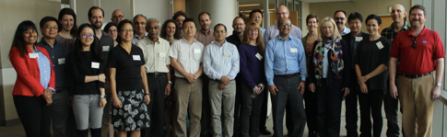


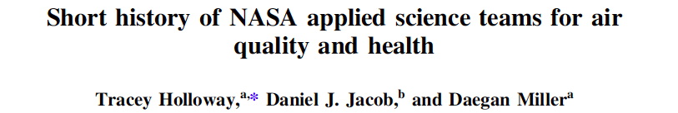

The team structure fundamentally changes outcomes.
Increased visibility of work and resources to end-users
Culture to support and promote collaborations and synergies
Growth of two-way dialogue
Increased collaborations to meet stakeholder needs
Rapid spin-up of high-value activities

Slide 4

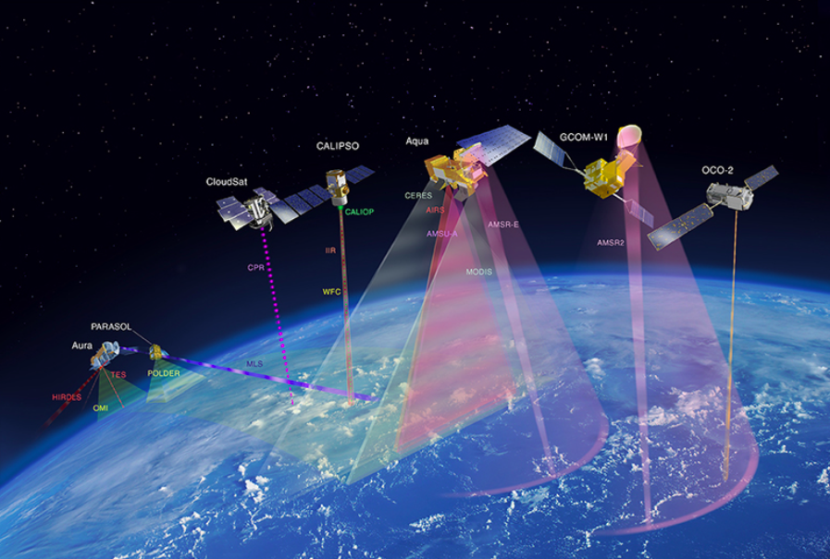
https://aura.gsfc.nasa.gov/outreach/images/A-Train_Web.jpg

Slide 5













13 NASA Health and Air Quality
Applied Sciences Team Members (HAQAST)
Tracey Holloway (Team Lead, UW-Madison)
Bryan Duncan (NASA GSFC)
Arlene Fiore (Columbia University)
Minghui Diao (San Jose State University)
Daven Henze (University of Colorado, Boulder)
Jeremy Hess (University of Washington, Seattle)
Yang Liu (Emory University)
Jessica Neu (NASA Jet Propulsion Laboratory)
Susan O’Neill (USDA Forest Service)
Ted Russell (Georgia Tech)
Daniel Tong (George Mason University)
Jason West (UNC-Chapel Hill)
Mark Zondlo (Princeton University)
haqast.org

Slide 6

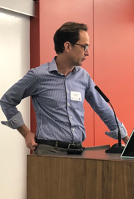
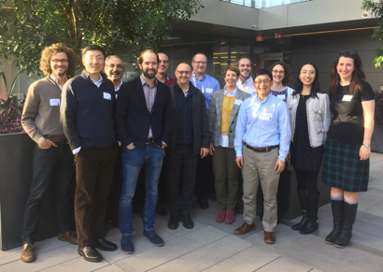
Major Accomplishments
Steady increase in output metrics: Publications, stakeholders engaged, meeting attendees, meeting satisfaction, social media followers, etc.
Team Meetings in Madison (7/18); Phoenix (1/19); Pasadena (7/19)
Sessions at AGU/DC (12/18); AMS/Phoenix (1/19)
High-profile research successes
High-Impact Tiger Teams
Engagement with related NASA initiatives
HAQAST publications by calendar year
Multiple PIs involved; single PI involved
2016 2017 2018

Slide 7
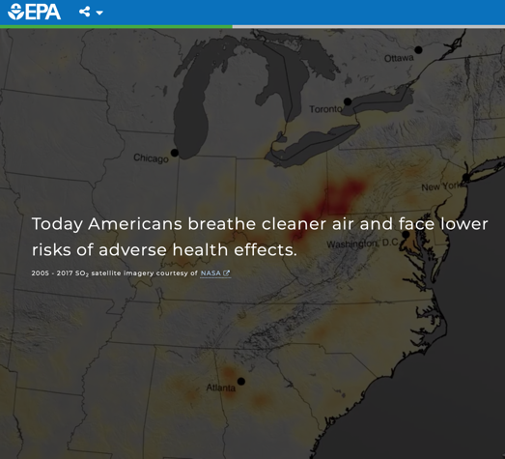
Promoting TEMPO for Health & AQ
“Pretty” plots as an early (& double) win for TEMPO
An hourly ”Worldview” for TEMPO + GOES
Encourage OMI and TROPOMI use
Grow relationships with different types of orgs

Slide 8
Awareness
Skepticism
Curiosity
Interest
Utilization

Slide 9
Awareness
Skepticism
Curiosity
Interest
Utilization
Identify clear audiences; (net)work to get a meeting
Learn about user needs
“Salesperson”
NASA Image of Day

Slide 10
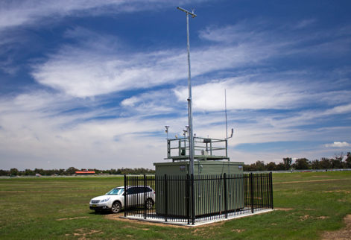
Potential Monitoring Site Purposes
To Determine Compliance with National Ambient Air Quality Standards (NAAQS)
To Develop Regional Pollution Trends in Urban and Rural Areas
To Evaluate the Effects of Population, Land Use and Transportation on Air Quality
To Evaluate Air Dispersion Models
To Provide Air Quality Information to the Public
Text from a slide of Bart Sponseller, WI DNR

Slide 11
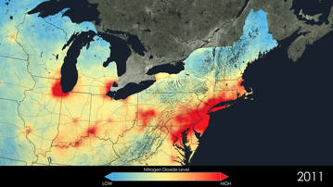
Potential Monitoring Site Purposes
A Role for Remote Sensing?
To Determine Compliance with National Ambient Air Quality Standards (NAAQS)
To Develop Regional Pollution Trends in Urban and Rural Areas
To Evaluate the Effects of Population, Land Use and Transportation on Air Quality
To Evaluate Air Dispersion Models
To Provide Air Quality Information to the Public
Not Now
Yes
Yes
Yes
Yes
Adapted from a slide of Bart Sponseller, WI DNR (remote sensing added)

Slide 12

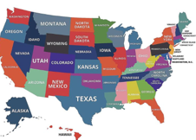
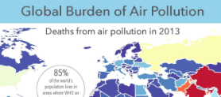
(U.S.) Air Quality Management
Public Health
Clean Air Act
Compare w/ Monitoring
Litigious
Federal (especially EPA)
States, sometimes counties
Regulated pollutants
Exceptional Events
Key opportunities:
  Model validation
  emissions inventories
  Trends
No legal framework
Open to new data
Research-oriented
Global (WHO, other countries)
Federal (CDC, NIH, EPA)
Cities & Communities
All pollutants of interest
Key opportunities:
  Population health risk
  Connect with low cost sensors
  Public outreach

Slide 13
Awareness
Skepticism
Curiosity
Interest
Utilization
Appreciate data limitations
Listen to concerns
Be flexible, find common ground
Stakeholder success stories

Slide 14
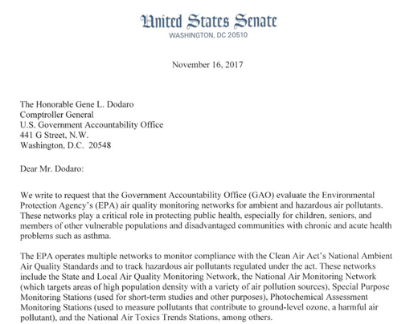
Example Engagement
June, 2019: Speaking at AWMA in Quebec City
May, 2019: Rocky Mountain Institute & WattTime/Satellite Data
May, 2019: LA County Public Works, California/Satellite Data
April, 2019: NRDC Chicago/Community Health
March, 2019: Clean Air Institute/Earth Observations for Latin America
March, 2019: GAO Review of EPA's Oversight of Air Quality Monitoring Networks
February, 2019: County Health Rankings & Roadmaps / PM data coverage
February, 2019 : Lancet Countdown / vehicle NOx
January, 2019 : Health Effects Institute
January, 2019 – Engagement with MAIA Leadership at Town Hall and follow-up

Slide 15
Awareness
Skepticism
Curiosity
Interest
Utilization
Find diverse ways to engage – online & in person, big & small
Recognize different roles, cultures, etc.
Welcoming culture
NASA Worldview

Slide 16


Designing Meetings to Engage Stakeholders
Novel format of topical panels, with 75% of all talks limited to 5-minutes, 1/3 time for Q&A
Based on past survey results, we have:
  Increased the proportion of stakeholder/scientist talks.
  Funded stakeholders to attend the meeting.
  Prioritized talks by stakeholders (every stakeholder who requests a talk is given a talk; we also solicit stakeholder talks).

Slide 18
Awareness
Skepticism
Curiosity
Interest
Utilization
Double-down on new interests - e.g. offer to visit, offer to help
Relationships matter
Manage expectations
NASA Giovanni

Slide 19
“Do satellites provide ground-level PM for health exposure?”
- common question from health organizations

Slide 20
Actions:
Discussions with stakeholders, at meetings and one-on-one
Provide an overview spatially continuous ground-level PM_{2.5}

Slide 21
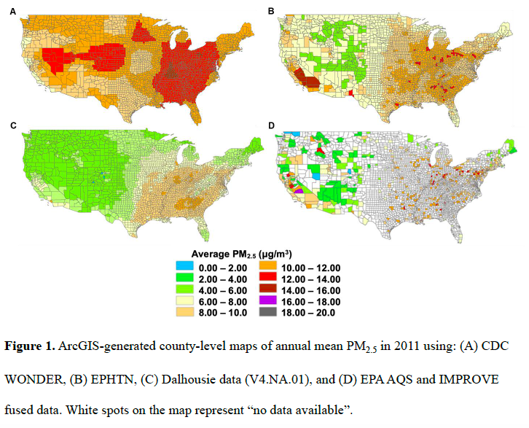
Obs + Satellite
Obs + Model
Obs +
Model+ Satellite
Obs
From Grad Student Seohyun (“Grace”) Choi in Diao, Holloway, et al., in review, JAWMA

Slide 22
Awareness
Skepticism
Curiosity
Interest
Utilization
Using satellite data in any form, any way
Engage users as experts & advocates
NASA ARSET
TEMPO early adopters

Slide 23

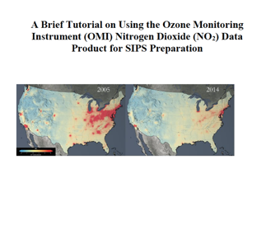
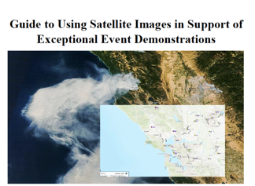
Tiger Team 1 Deliverables
Arlene Fiore: Supporting the use of satellite data in State Implementation Plans (SIPs)
Stakeholders: SCAQMD, MARAMA, NESCAUM, GA Environmental Protection Divisions, TCEQ, BAAQMD, EPA, CTDEEP
Created a series of 3 technical guidance documents to help state air quality managers use NASA data and products for meeting their SIPs, all avialable at https://airquality.gsfc.nasa.gov/state-implementation-plans

Slide 24
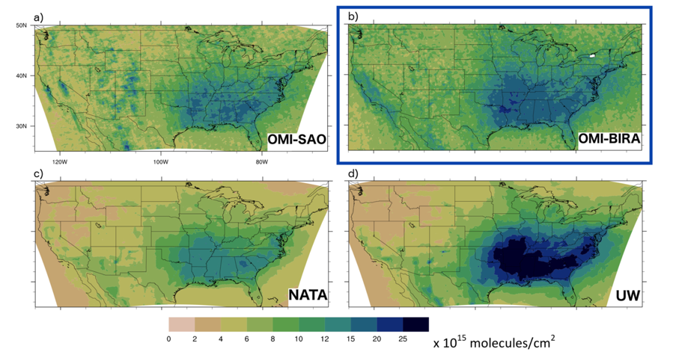
Satellite HCHO
Model HCHO
Harkey, Holloway, Baker, Henderson, in prep

Slide 25
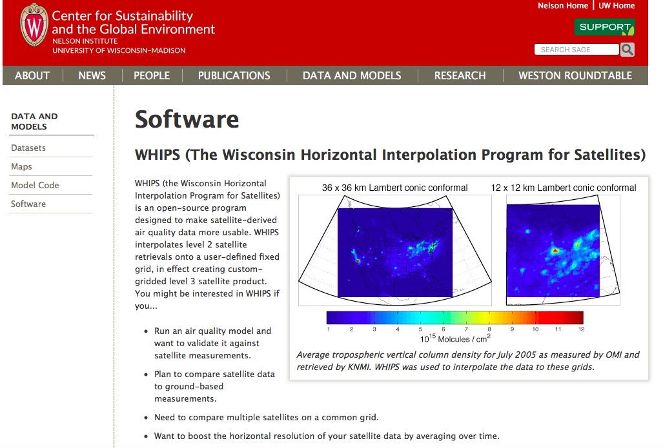
Google: “SAGE WHIPS”

Slide 26
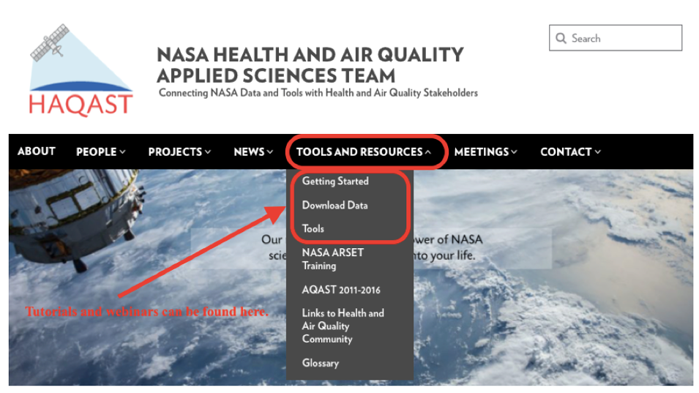
haqast.org

