Slide 1
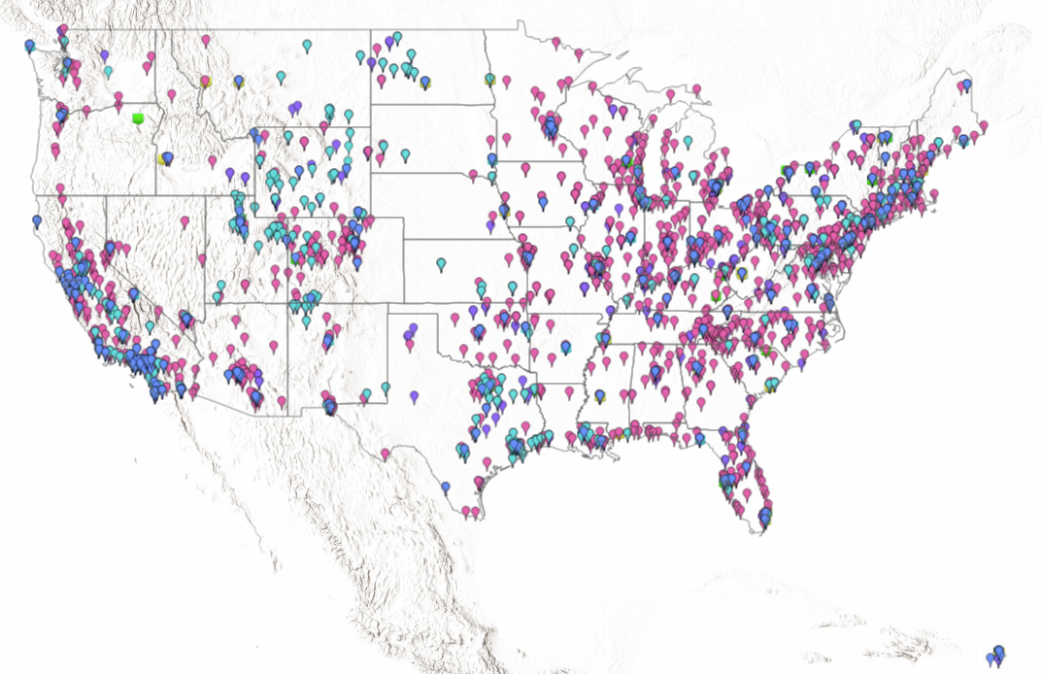
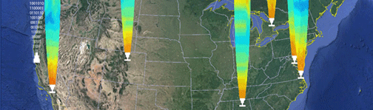

Coordination of ground-based networks and data collection
What are the science questions we hope to address?
What validation opportunities are unmet?
What state or region has an interesting AQ problem, would be a willing collaborator and meet the validation and science needs of TEMPO STM?
US EPA and state air quality monitoring networks
High-density networks
Ceilometer and profilers
Pandoras in US/Canada

Slide 2
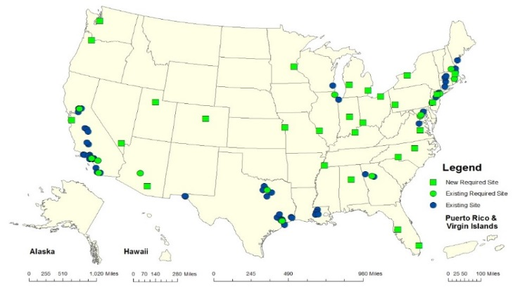
Core effort of EPA ORD is to align Pandonia Global Network with EPA PAMS network
EPA ORD, and NASA GSFC, CCNY, BU (Geddes) and SAO are coordinating with a subset of states in Ozone Transport Region (OTR) to place ~15 units at AQ sites in the region by end of FY2019. Further expansion will depend on operations outlook and funding.
Not all Pandora deployments to AQ sites are officially PAMS sites (e.g., three sites in Connecticut), but Pandora deployment does fall under the PAMS Enhanced Monitoring requirement, which applies to all states in the OTR
L. Valin, Alex Kotsakis, Fernando Santos and Lena Shalaby traveled to LuftBlick in Austria in May 2019. EPA is interested in adapting current documentation of hardware, lab calibration and data processing protocols in to the format of a formal EPA method
EPA Region 1, OAQPS monitoring group, NESCAUM, MARAMA, LADCO and states have been very helpful!
**
**Specific site locations subject to change with state and regional input

Slide 3
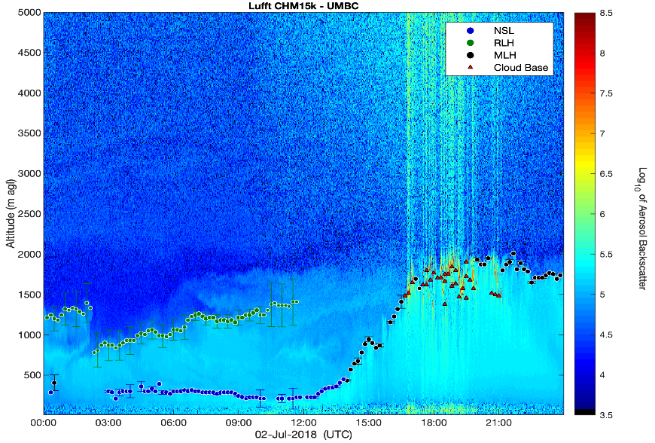
Development of PAMS profiling network
EPA is working with UMBC Atmospheric Lidar Group to establish a prototype Aerosol Profiling Network in support of PAMS mixing height requirements:
Maryland is the initial focus area via MDE:
Data transfer of raw data from ceilometers (new) and existing wind profilers into data archive.
Development and implementation of a common algorithm (Haar wavelet) with site specific settings.
  Signal corrections (noise, artifacts, overlap, etc.)
  Continuity of diurnal evolution of boundary layer (transtions)
  Calculation of MLH uncertainties in retrievals
  Cloud identification and classification in order to include convective cloud-topped boundary layers and cloud cover information
Near real-time (1 hr.) web-based display.
Data retrieval of archive.

Slide 4
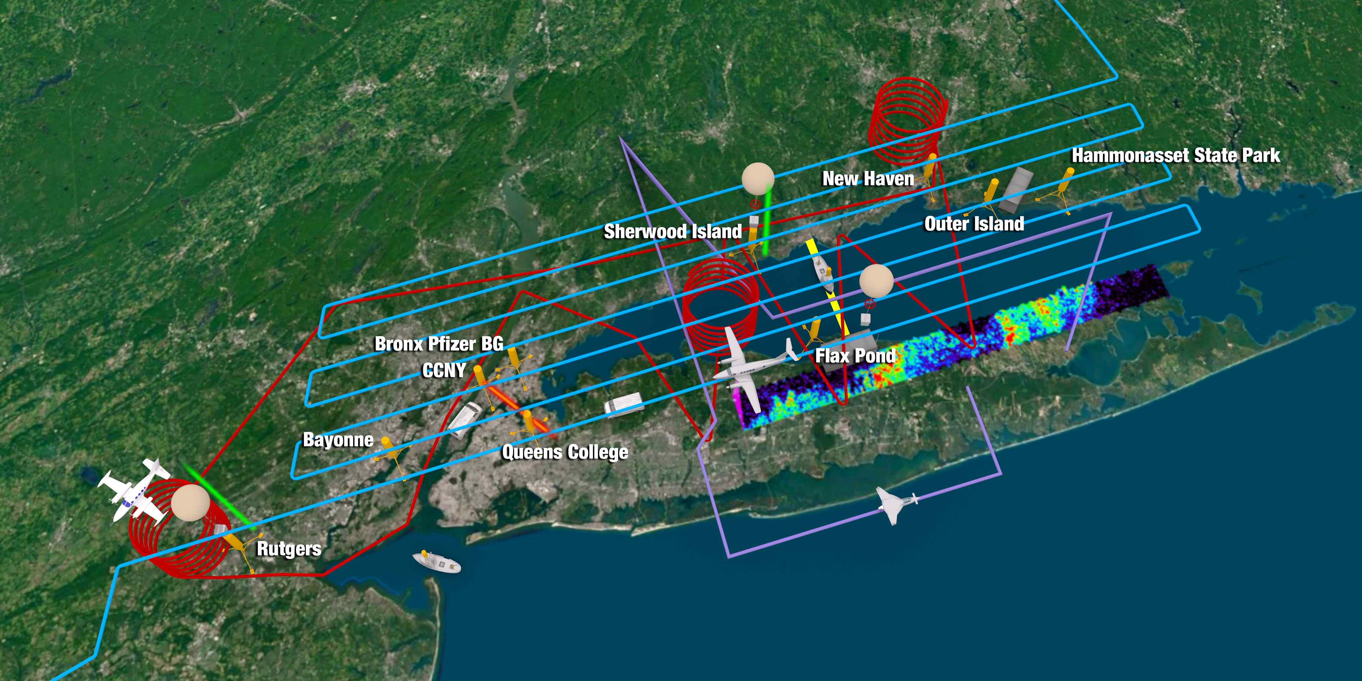
LISTOS ongoing monitoring as coordinating activity
PAMS Enhanced Monitoring provision is key to success. NASA archival also key.
Long-term Pandora added to 8 sites
Integrated BEACO2N nodes at 7 AQ sites in NYC; hope to expand to ~25 NYC sites with calibration support from Roisin Commane
NJ and CT DEEP will push full backscatter profile data to UMBC/EPA archive
NJ, and hopefully others, routinely pushing 1-minute NOx, CO and O3 data
Flax Pond HCHO instrument comparison helped result in NESCAUM purchase of two continuous monitors for NYS PAMS sites
TROPOMI data integration in to RSIG and very valuable AQ staff feedback
Graphic courtesy of NASA LaRC
CT DEEP and Yale AQ group (Gentner) interaction helped develop a new Yale coastal site
Summer 2018 TOLNET deployment + support to develop TOLNET instrument at CCNY

Slide 5
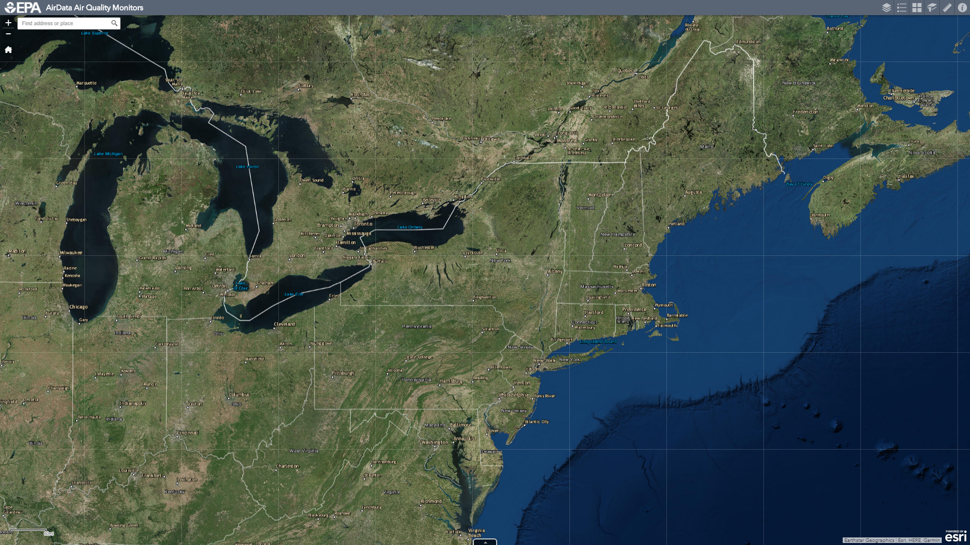
Phase II / III PAMS-EMP Pandora Long-Term Deployment Sites
EPA Priority:
RI
NH
Maine
Alleghany
New trackers at all existing sites
15 m cables at Queens and Flax Pond
NASA GSFC:
PADEP
McMillan (DC)
Jeff Geddes (Boston University)
Willing to collaborate. Will operate instruments in accordance with forthcoming EPA QAPPs
Maine
New Hampshire
Westport
New Haven
Hammonasset
Flax Pond
Rhode Island
*
*
Bronx BG
QCNY
Rutgers
CCNY
Phase 1 EPA-coordinated. Spring 2018
Phase 2 EPA-coordinated.
No later than summer 2019
Ongoing Operations
Seeking intramural opportunities for CASTNET (AMPD formerly CAMD)
ACHD
*
PADEP
UMBC
NASA GSFC
NASA HQ
McMillan
VCU – Rice Center
NASA LaRC

Slide 6
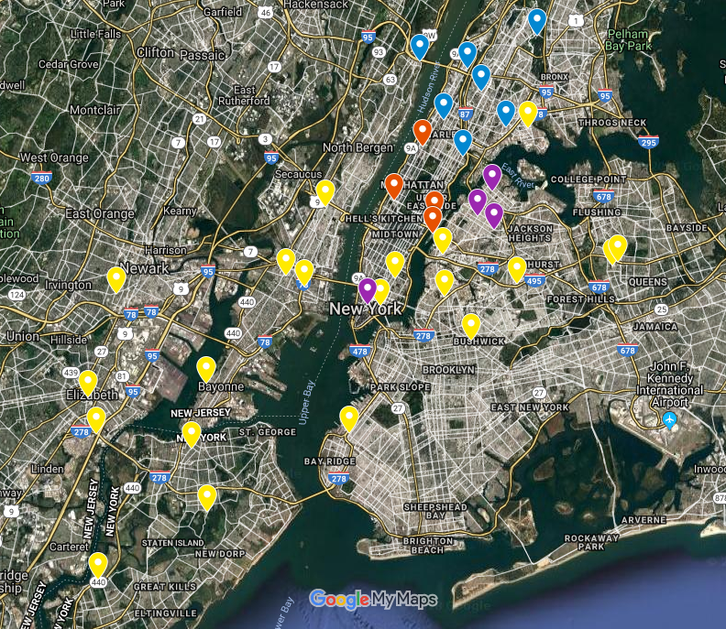
Potential to expand BEACON

Slide 7
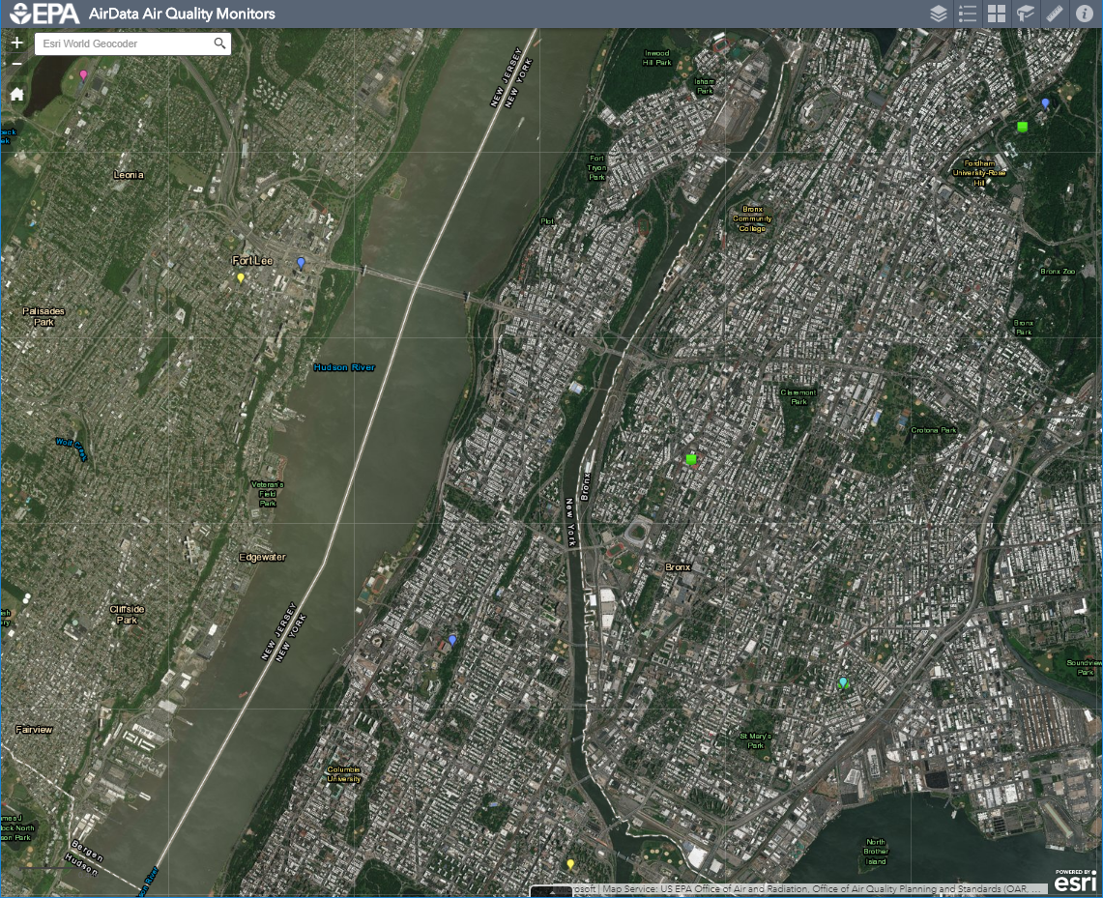




High density urban networks for understanding
Moderate precision NDIR on/off-band CO2 (±0.5 ppm) Alphasense AQ sensor package (four gases), optical PM sensor
In NYC units are deployed side-by-side with FRM/FEM instrumentation
Applications of these units are multiplying: ~60 units in Bay Area, a network of ~20 in Houston with collaborator health, hyper-local emissions studies ongoing or published
In NY, exploring expanding CO2 monitoring and BEACO2N to ~20 sites
Bronx Botanical Garden PAMS supersite
I95 GW Bridge Near road
High Precision CO, PM2.5, NO2
IS143
PM2.5 mass only
GW Bridge
New Jersey
Morrisania II
PM2.5 mass only
Bronx
CCNY
O3, CO
IS52
O3, NOx, toxics, PM speciation, low-level SO2
8 km × 10 km
Manhattan
IS45
PM2.5 mass only

Slide 8
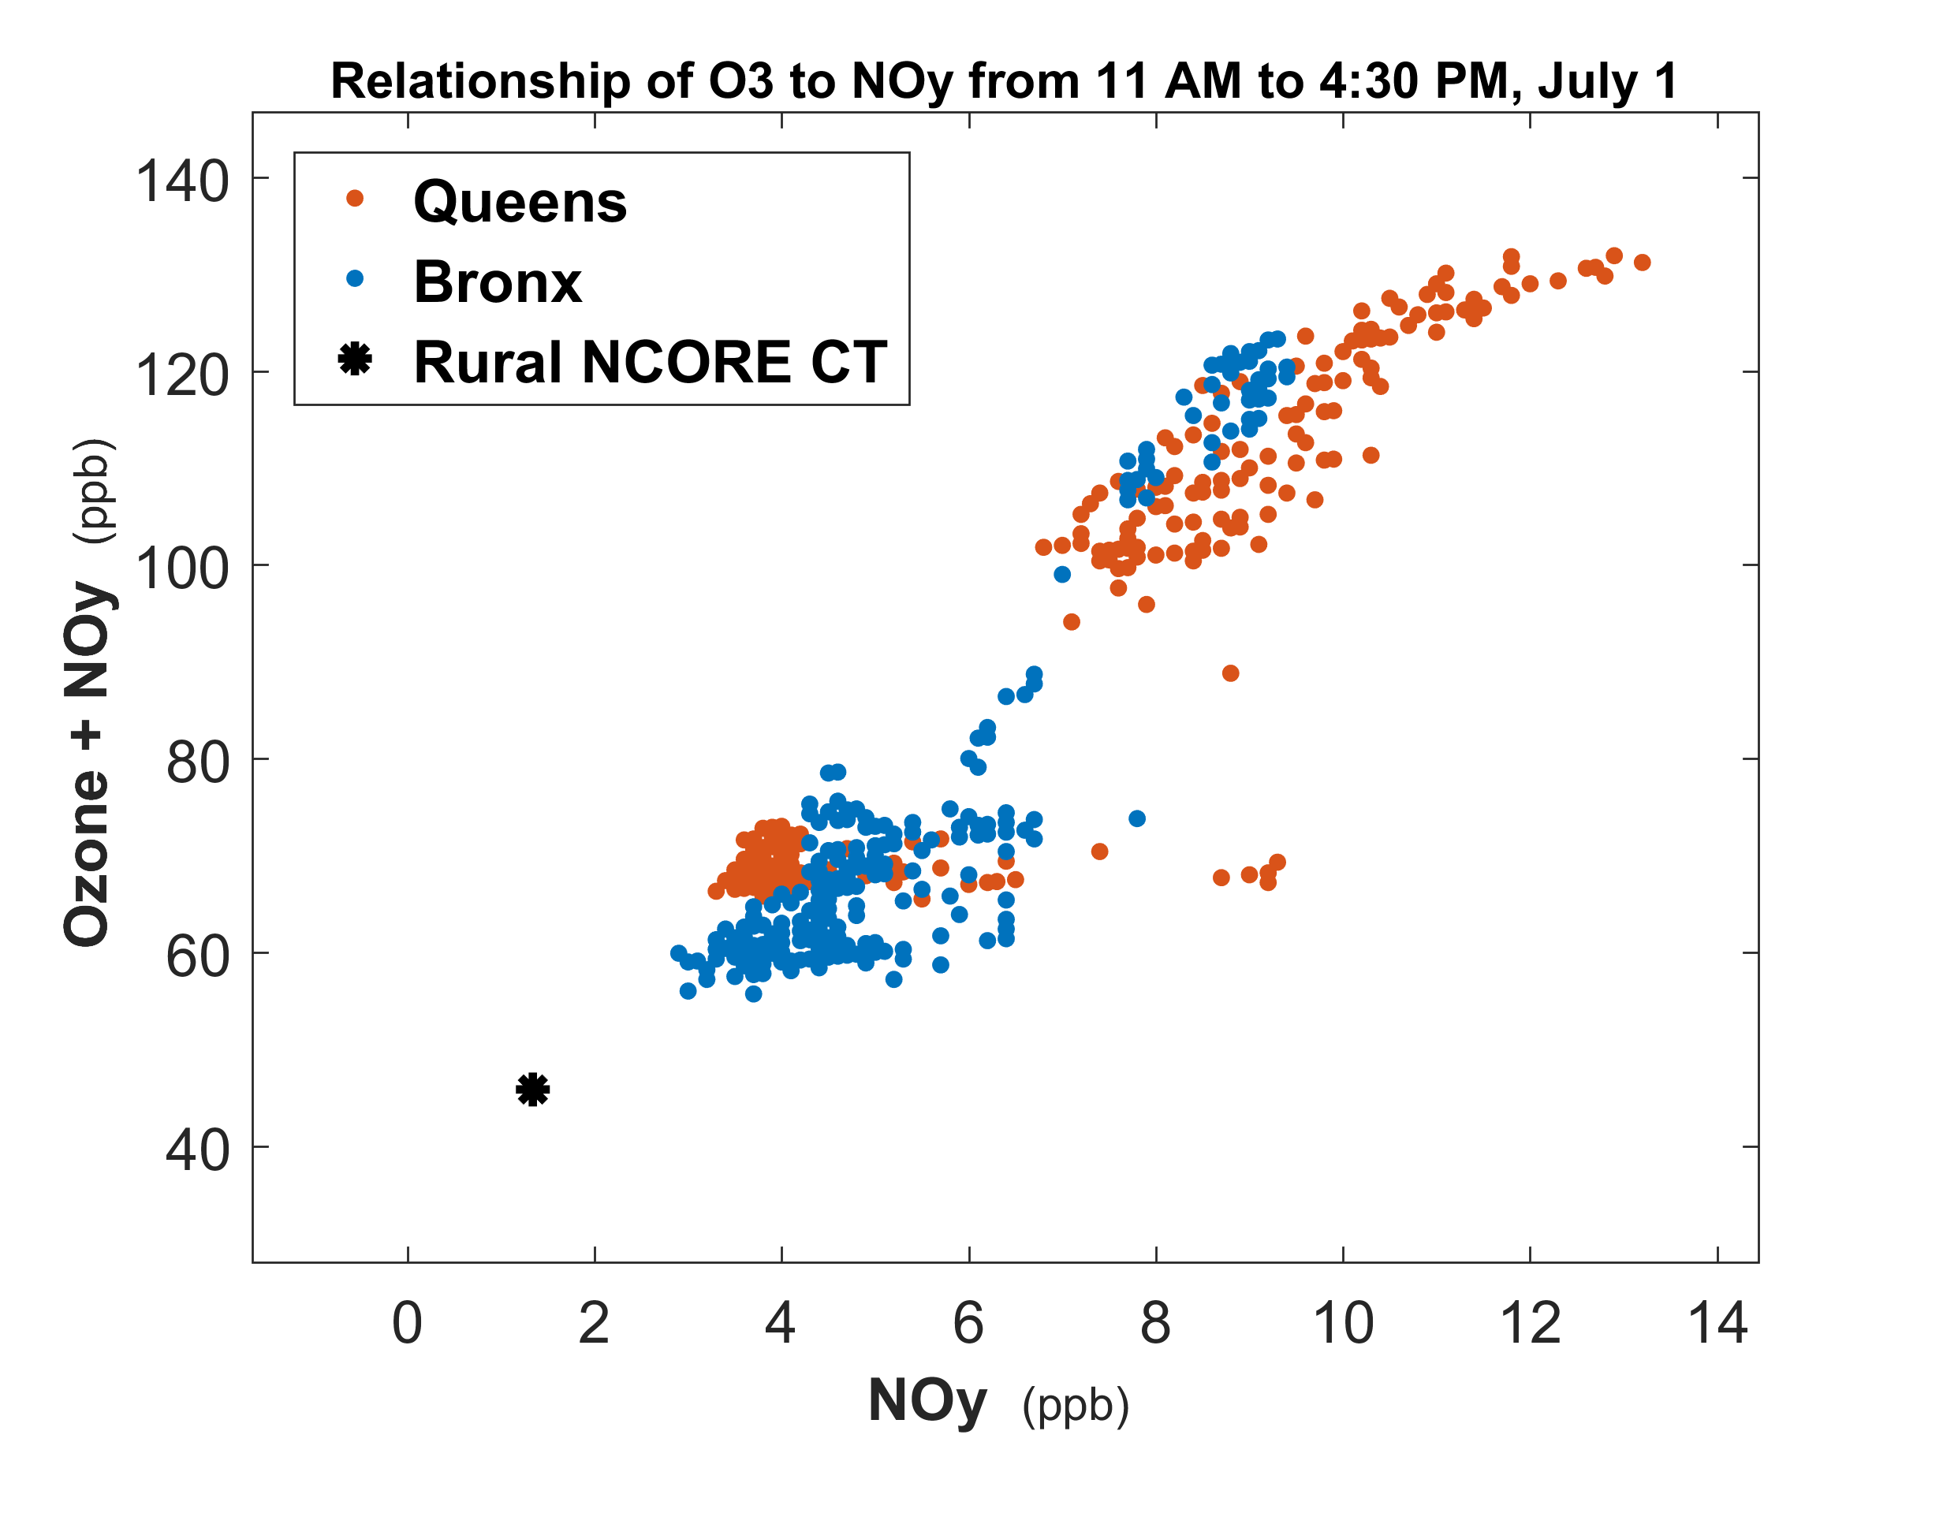
Routinely capturing1-minute surface NO2 data
In this example, 1-minute data from the Queens, NY NCore site were useful for distinguishing freshly-emitted NO_{y} from aged NO_{y}, and for quantifying ozone production.
Archival and participation of states are open questions
Aged emissions
Fresh emissions
Data courtesy of NYS DEC and CT DEEP

Slide 9
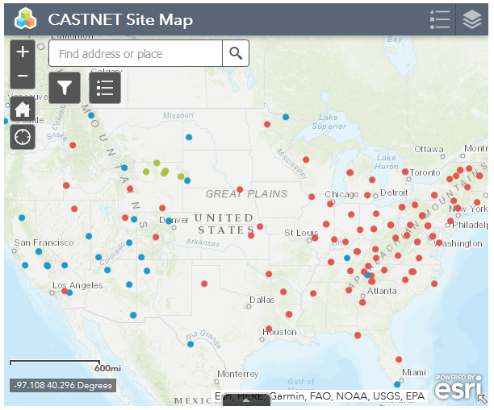
CASTNET – an opportunity for rural sites

Slide 10
Coordination of ground-based networks and data collection
What are the science questions we hope to address?
What validation opportunities are unmet?
What state or region has an interesting AQ problem, would be a willing collaborator and meet the validation and science needs of TEMPO STM?
US EPA and state air quality monitoring networks
High-density networks
Ceilometer and profilers
Pandoras in US/Canada

Slide 11
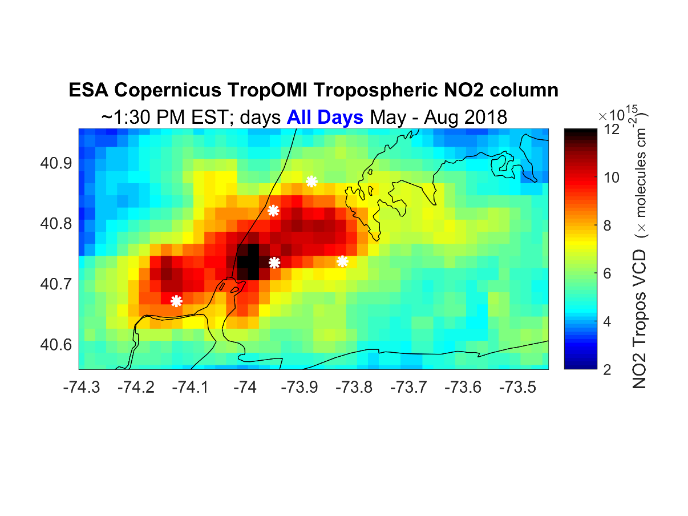
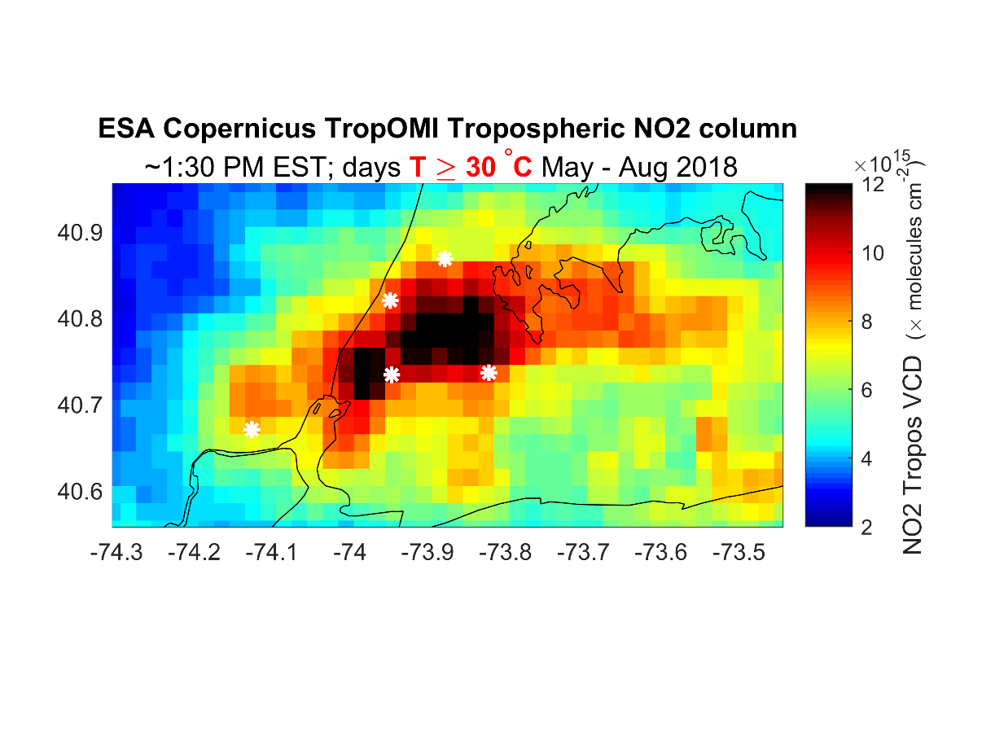
TROPOMI provides a Meso-Sacle View of NO2
Pollution Important to understanding the Ozone Problem
Satellite NO₂ measurements indicate a large NO₂ enhancement over Queens and the East River on hot days (T > 30 C). There is no conventional trace gas monitoring network near these sites.
Pandora network at air quality sites around Long Island Sound will help assess uncertainty in satellite based NO₂ columns. Goal is to improved understanding of emission sources through a more integrated spatial and temporal analysis of NO₂.
Source: L. Valin EPA/ORD

Slide 12
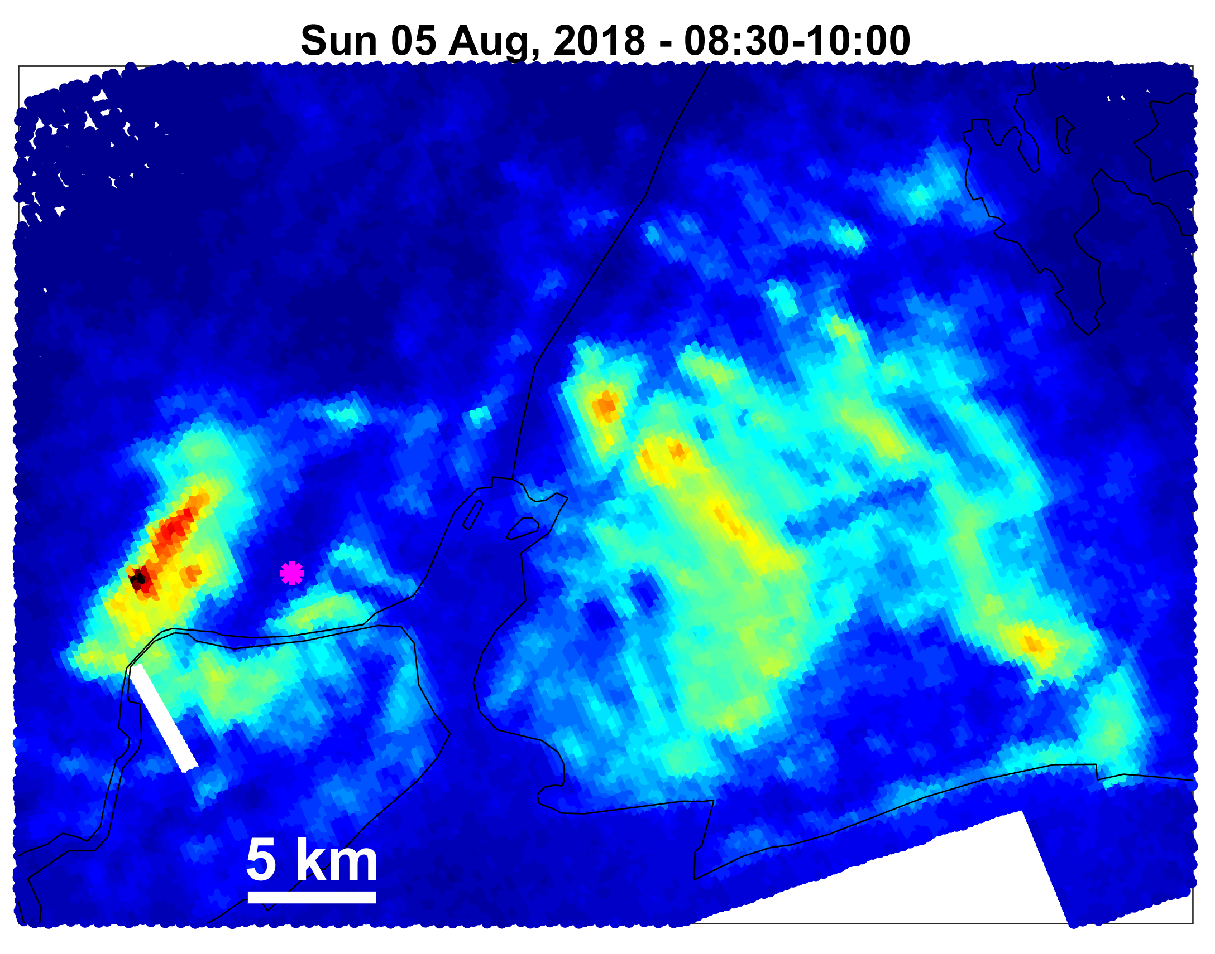
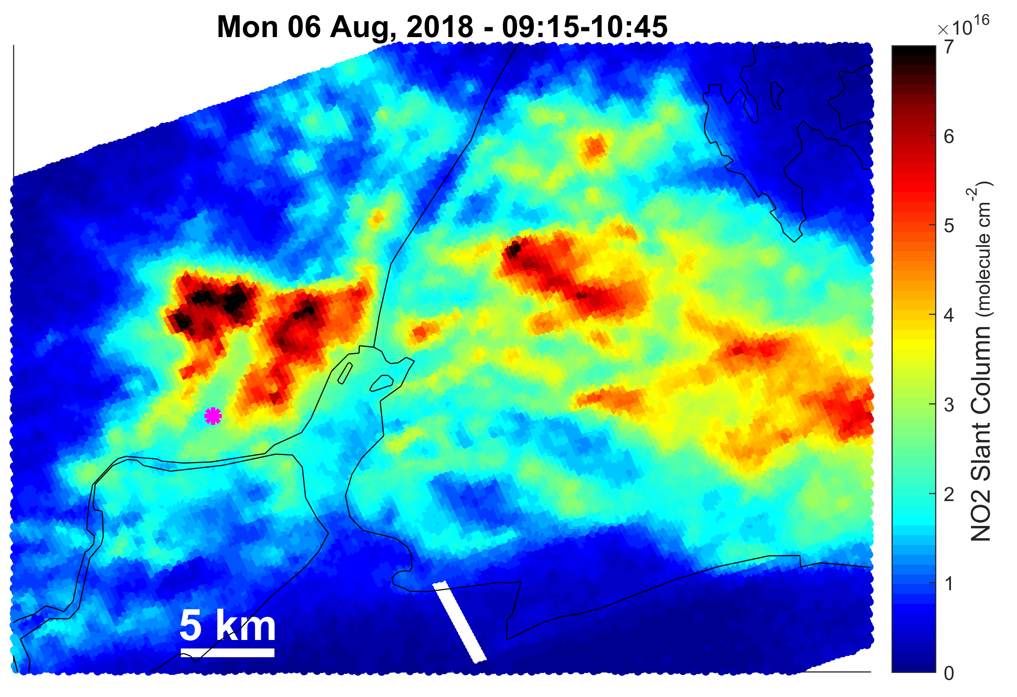
UV/Vis mappers provided valuable information on NOx sources and lessons for interpreting TEMPO/TROPOMI data
Ports, railyards, highways
Newark Airport
Data courtesy of Laura Judd, Jay Al-Saadi (NASA LaRC) and Scott Janz (NASA GSFC)

Slide 13
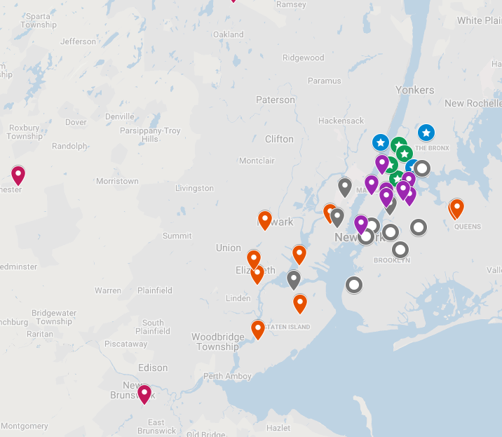
7 BEACON nodes in Bronx, Harlem and Fort Lee
Deployed side-by-side with FRM/FEM instrumentation
Vaisala GMP343 CO2 (±0.5 ppm) Alphasense AQ sensor package (four gases), optical PM sensor
CO2 is the key measurement because it is a relatively high quality measurement of an emitted species aiding interpretation of AQ sensor data.
Applications of these units are multiplying: ~60 units in Bay Area, with collaborator health, hyper-local emissions studies ongoing or published
Bronx Botanical Garden PAMS supersite
I95 GW Bridge Near road
High Precision CO, PM2.5, NO2
IS143
PM2.5 mass only
GW Bridge
New Jersey
Morrisania II
PM2.5 mass only
Bronx
CCNY
O3, CO
IS52
O3, NOx, toxics, PM speciation, low-level SO2
8 km × 10 km
Manhattan
IS45
PM2.5 mass only

Slide 14
Flax Pond Continuous HCHO comparison
NY DEC and SUNY-Stony Brook hosted
EPA/NERL, Harvard University (NASA $) and vendors Aeris, Gasera, Picarro, Vaporsens participated
Dry zero, humid zero, stepped calibration on reference cylinder, ambient comparison
Analysis of data is underway. Dirk and Pete are actively involved in analysis. Pete was present during operations and has hands-on experience with some of the instruments

Slide 15
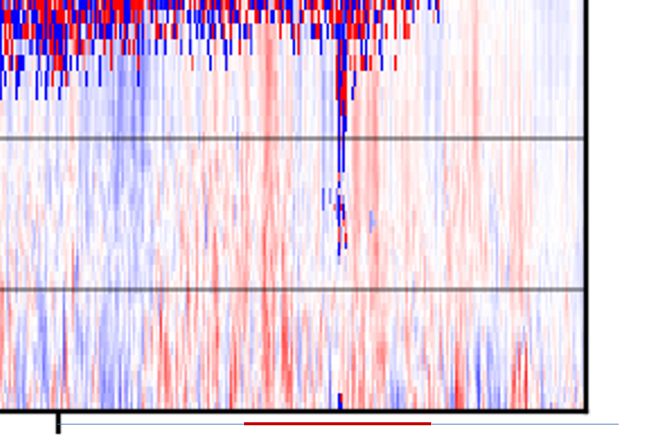
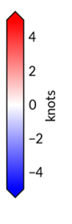
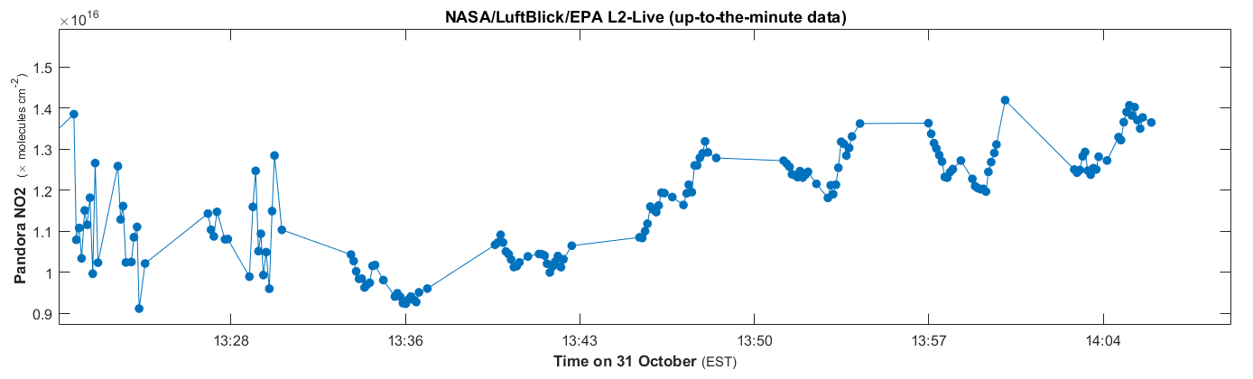
Exploring the use of High Time Resolution (5 sec)
Pandora NO2 Measurements to assess Pollution Dynamics
Mesonet-NYS, Bronx NY, Windcube 100s
In addition to measuring NO₂ advection, Pandora is sensitive enough (1σ = 5×10¹³ in 10 s) to capture variations driven by large PBL eddies (up to ±1×10¹⁵ molecule cm⁻² over 1-minute, or ~10%-20% of tropospheric column). Column water vapor should be a straightforward, not yet available product as well
Clouds
Clear-sky Eddies
Bronx NY Pandora
Clouds - noisy
Clear-sky NO2 Advection + Large Eddies
Very precise

Slide 16
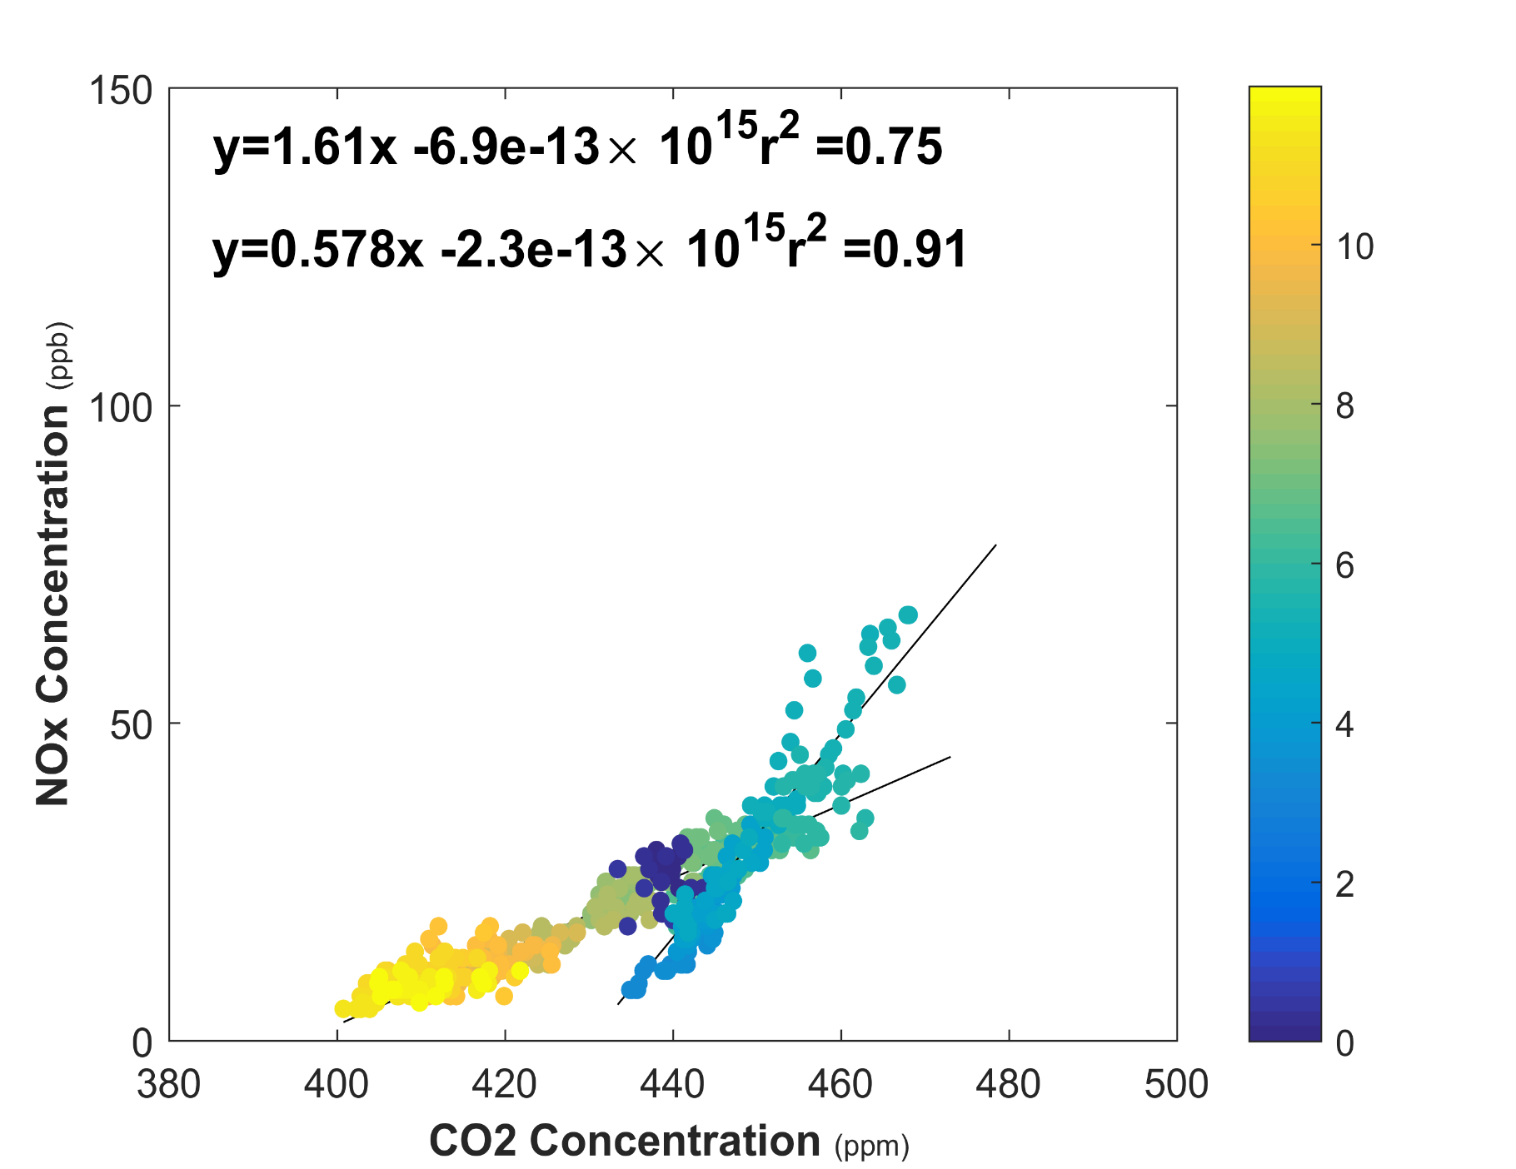


1 BEACON node and FRM NOx at GW Bridge near-road monitoring site
Application to address a pressing AQ management need: What is the rate of NOx emission per unit of fuel burned in real world conditions?
Low-cost, value-added measurement for near-road networks
Near-road site GW Bridge, Fort Lee, NJ
Sunday Morning April 22, 2018
Hour of Day

Slide 17
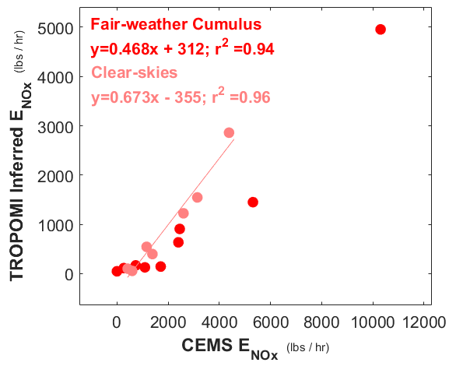
Sub-grid clouds hiding NO2?
When skies are fully clear, the slope of inferred emissions to CEMS emissions increases.
  It’s possible that sub-grid clouds on 5 July act to block sampling of boundary layer NO2, diminishing the signal
These kinds of questions can be answered using Pandora system that was operationally deployed at NJDEP, NYDEC and CTDEEP AQ monitoring sites in May 2018.

Slide 18
What time scale measurement is necessary to disentangle local from regional influences?
NO measurements: the value of 1-minute measurements and sub-100 ppt precision
Luke Valin EPA, Luis Lim NJ DEP
*Data are Preliminary*

Slide 19
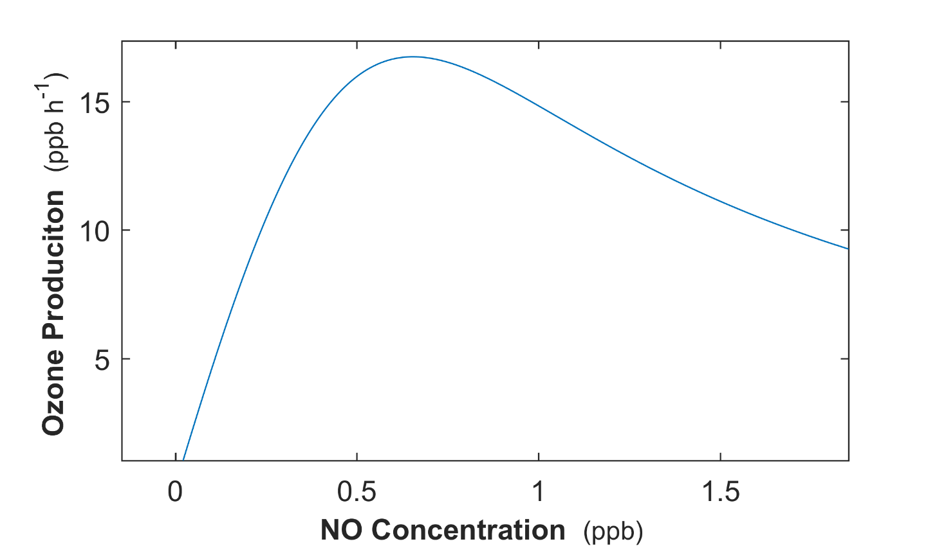
Ozone production varies widely at concentrations of NO below 1 ppb
NO measurements at monitoring stations are often reported in hourly-averages, rounded to nearest 1 ppb.

Slide 20
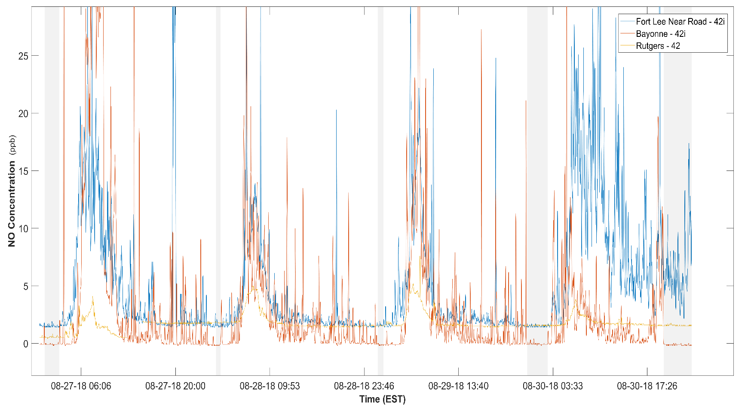
Without the temporal detail of NO measurements, it is impossible to characterize the rate of ozone production
Baseline Correction required

Slide 21
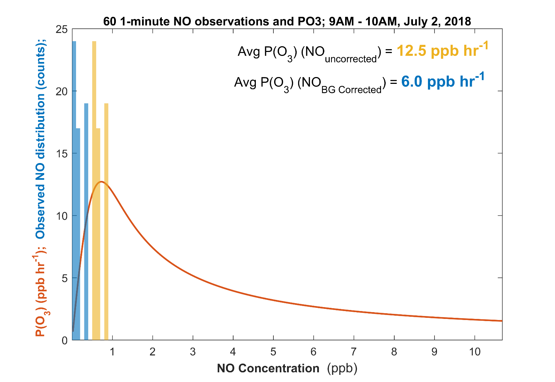
NO baseline correction at Rutgers would result in 50% slower rate of inferred PO3

Slide 22
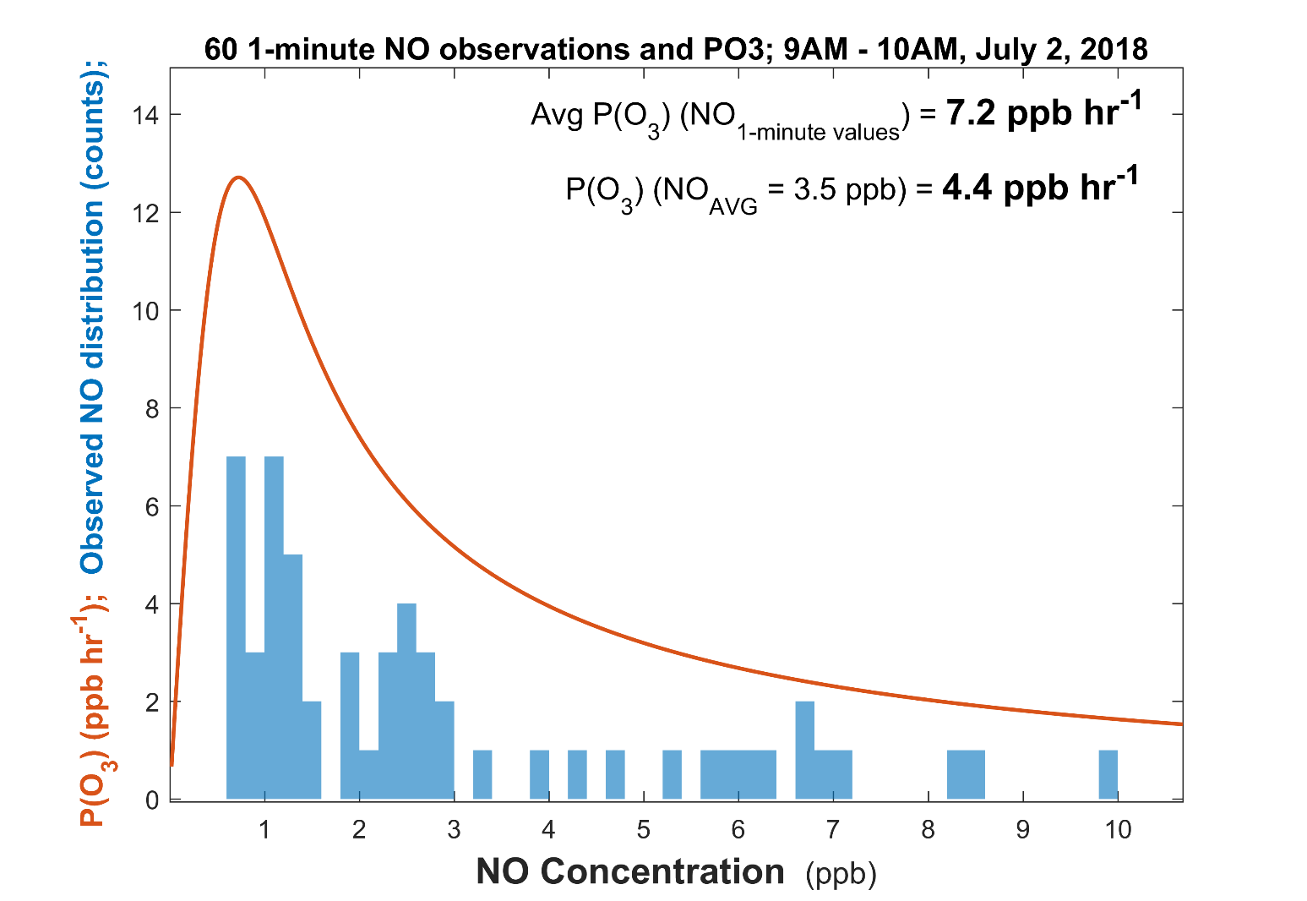
Inferred O3 production rate from 1 hour average [NO ] vs 60 1-minute [NO] measurements: ~75% faster

Slide 23
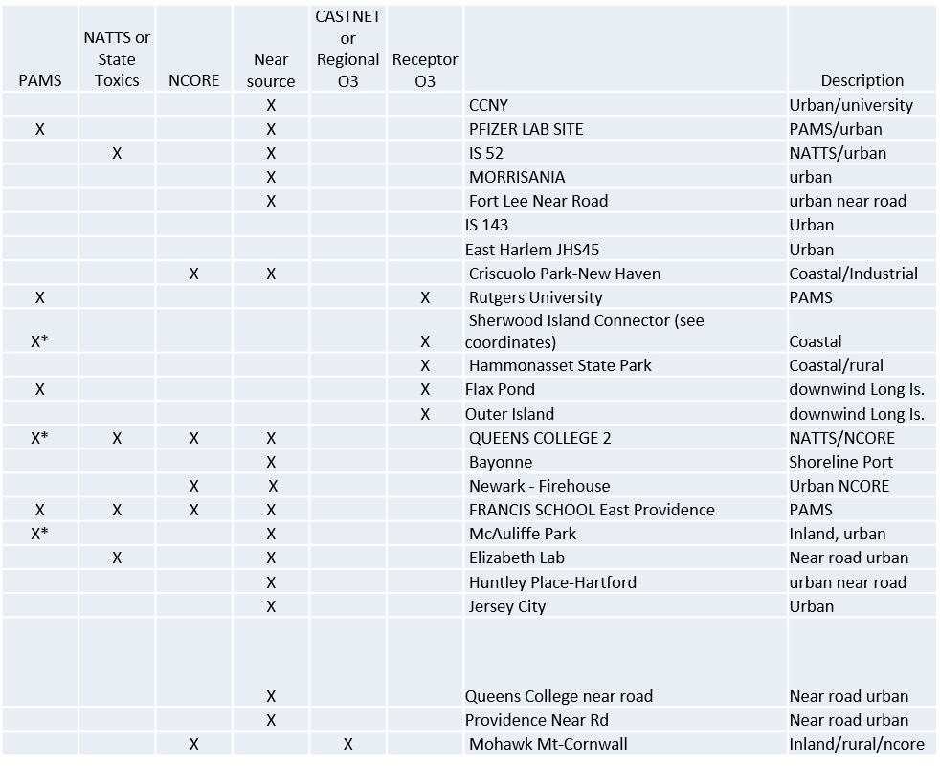
Continue sharing 1-minute data?
Parameters of interest:
O3 and high precision CO, SO2, NO/NO2/NOy, black carbon:
Should such and effort be considered “Enhanced Monitoring”?
Is there interest amongst states?
What is easiest path forward on data delivery, QA/QC?
    Use AIRNOW system?
    Include calibration data, flagged?

Slide 24
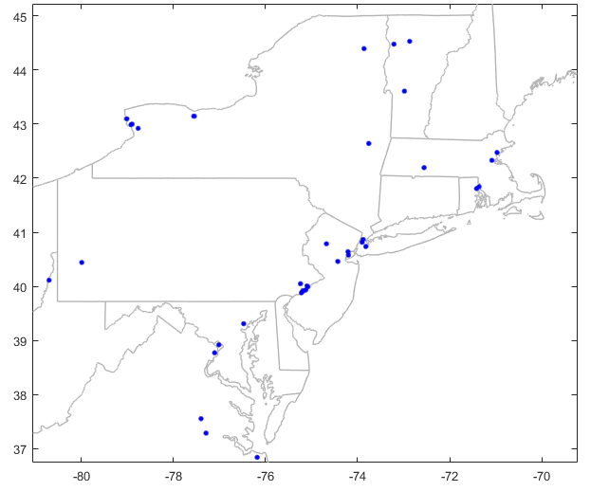
HCHO cartridge measurement sites and early adopters of continuous measurement.
The map to right shows sites at which at least one DNPH TO11-A measurement was taken in 2016 or 2017
NESCAUM and NYS are in process of procuring two units for NYBG (Bronx) and Flax Pond (Long Island N. Shore)
CT DEEP is exploring potential procurement at Sherwood Island, Westport site
Houston has contacted us and is interested in light of an air toxics research grant.
State of Utah may be interested due to importance of HCHO in wintertime inversion O3 and PM episodes.

Slide 25
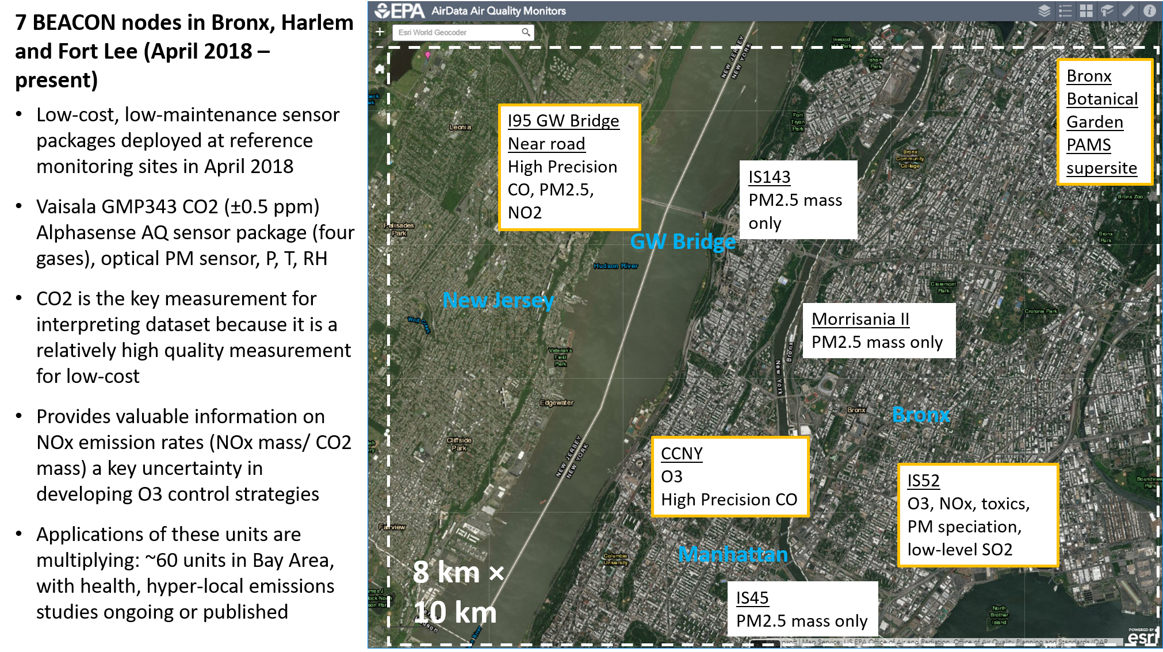
BEACON in NY and NJ

Slide 26
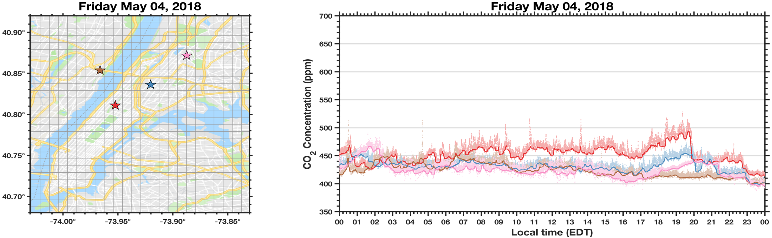
What’s very-local, what’s neighborhood and what’s urban?
Higher frequency measurements enable removal of influences of very local sources. (low-pass filter)
Preliminary data from BEACON network (NY DEC, UC Berkeley) Image courtesy of Alex Turner.

Slide 27
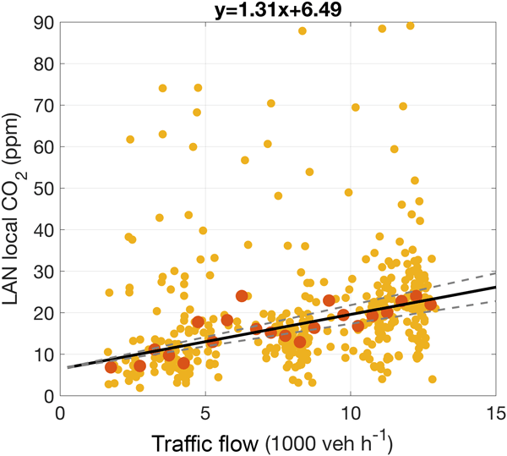
What’s very-local, what’s neighborhood and what’s urban?
Higher frequency measurements enable quantification of influences of very local sources, such as traffic (high-pass filter)
Analyzed BEACON data from SF Bay Area with regional background subtracted: Emissions per local traffic
Shusterman et al., 2018; 10.5194/acp-18-13773-2018

