Slide 1
Planning for TEMPO data access via
U.S. EPA Remote Sensing Gateway
RSIG Development Team
Jim Szykman, EPA-ORD, Project Lead
Todd Plessel, CSRA, Architect and Data Processing
Matt Freeman, ARA, GUI and Visualization
Heidi Paulsen, EPA-OEI, Project Manager
TEMPO Science Team
June 5-6, 2019
Madison, WI

Slide 2
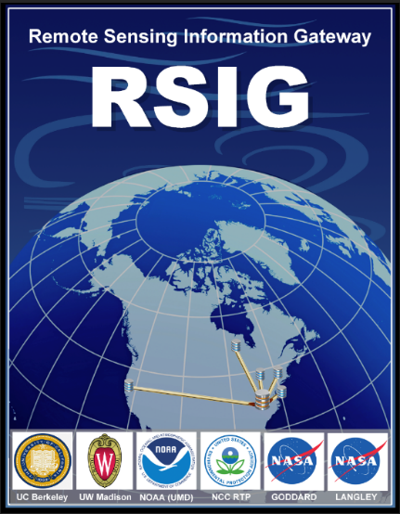
Remote Sensing Information Gateway
Interoperable web-based infrastructure application for 2D and 3D visualization and data retrieval of air quality and atmospheric data.
Allows users to quickly visualize and save subsets of multi-terabyte data from original data archives holdings of satellite, model and air quality network data.
Develop and implement a TEMPO specific web-coverage service from SAO or ADSC.
Notes:
R

Slide 3
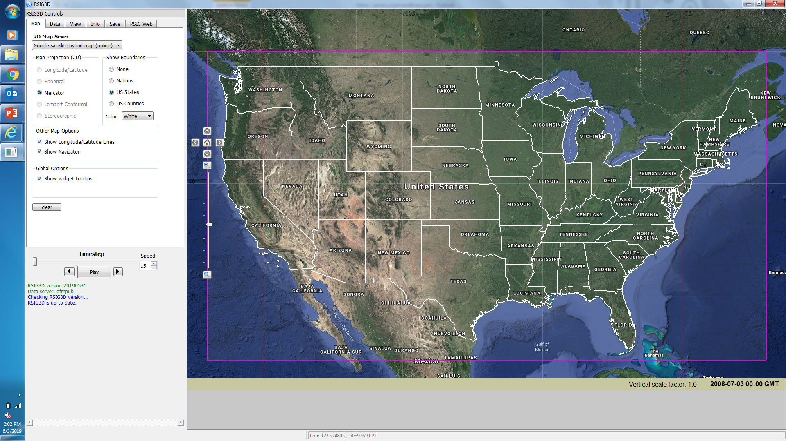
Remote Sensing Information Gateway Data Access
1.) RSIG application via a Graphical User Interface, which allows for quick data visualization. Data requests limited to 7 consecutive days.
2.) Use of http scripts to request larger amounts of data.
WCS: http://ofmpub.epa.gov/rsig/rsigserver?SERVICE=wcs&VERSION=1.0.0&REQUEST=GetCoverage&FORMAT=xdr&TIME=2018-07-14T00:00:00Z/2018-07-14T23:59:59Z&BBOX=-93.020000,24.630000,-66.320000,49.840000&COVERAGE=tropomi.offl.no2.nitrogendioxide_tropospheric_column&CORNERS=1&minimum_quality=75
Notes:
R

Slide 5
Current thoughts on TEMPO-RSIG data delivery
Develop research-quality, applications-ready, TEMPO Level-3 and Level-4 Products available via RSIG. These products will reduce the amount of time users spend on data processing.
NASA EOS Data Processing Levels :
Level 2 Derived geophysical variables at the same resolution and location as Level 1 source data.
Level 3 Variables mapped on uniform space-time grid scales, usually with some completeness and consistency.
Level 4 Model output or results from analyses of lower-level data (e.g., variables derived from multiple measurements).

Slide 6
TEMPO Level 2 and 3 Data Products
Level 2 – WCS will provide access to level 2 data products with recommended QA flags implemented. Large request for L2 data should be done directly from SAO ftp or ASDC.
Level 3 – Derived from the L2 data, the WCS will provide for composites over time (daily, monthly, seasonal) and re-gridding onto common modeling grids and domains for CMAQ. Other potential considerations:
weekday-weekend composites
time of day composites
others?

Slide 7
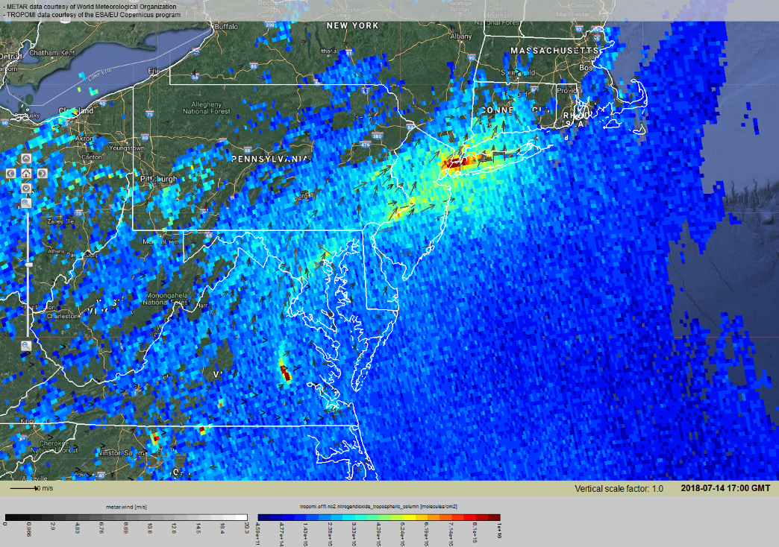
TEMPO Level 4 Data Products
Level 4 WCS will provide the ability to over-plot and visualize TEMPO data products (hourly time-step) with other data sets available via RSIG, such:
AIRNow/AQS ambient concentrations
NWS surface weather observations
NOAA-HMS thermal anomalies (fires) and Fire radiative Power (FRP)
Other data sets under consideration:
EPA Air Markets Program Data on hourly EGU emissions.
Pandora
High resolution model winds fields
Other data to consider?
Data included in image:
TROPOMI NO2
NWS surface winds

Slide 8
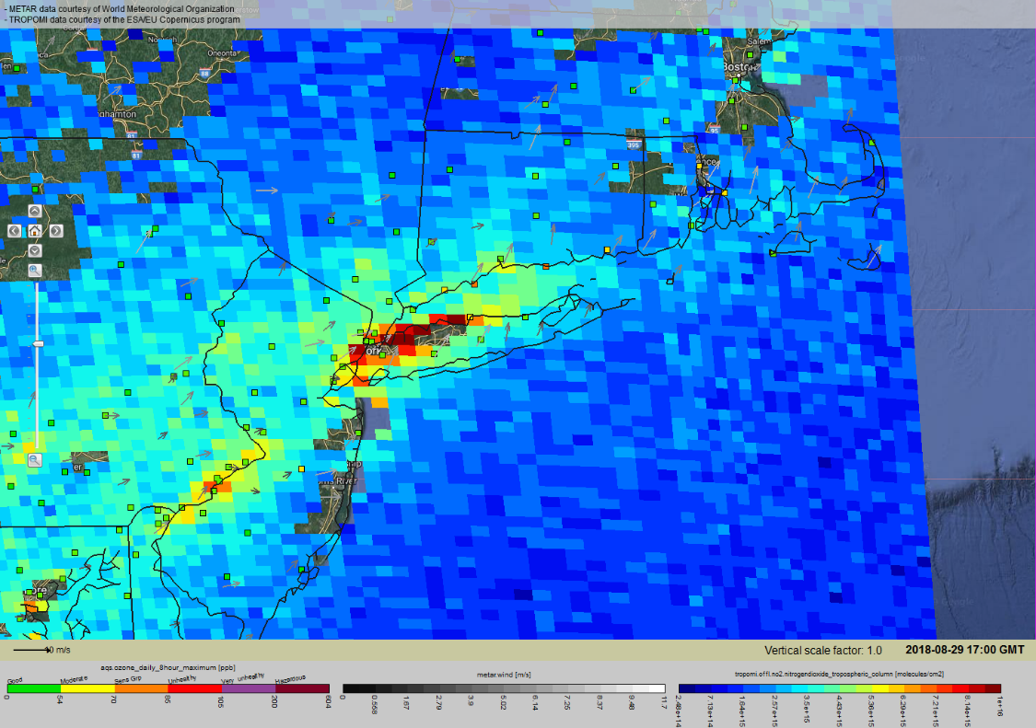
User Services provides via RSIG
Use as a data screening tool via GUI
Access for sub-setted TEMPO data over domain of interest
General Application Areas:
Pollution Episodes Analyses, including Exception Events
Model Comparison
AQI forecast support
Trends
Data included in image:
TROPOMI NO2
AQS O3 MD8
NWS surface winds

Slide 9
http://www.epa.gov/rsig

