Slide 1
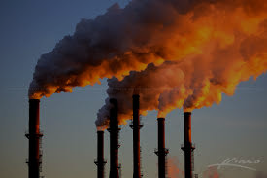
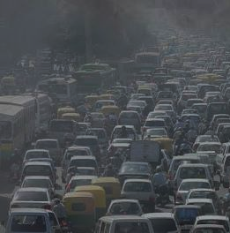
MDE Perspective on the
Usefulness of
TEMPO
Joel Dreessen
June 5, 2019

Slide 2
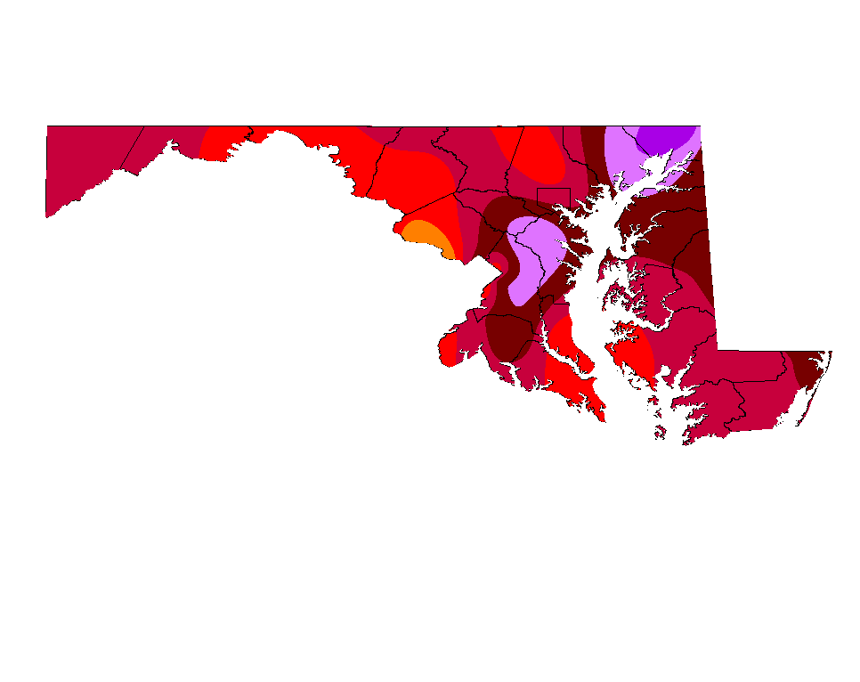
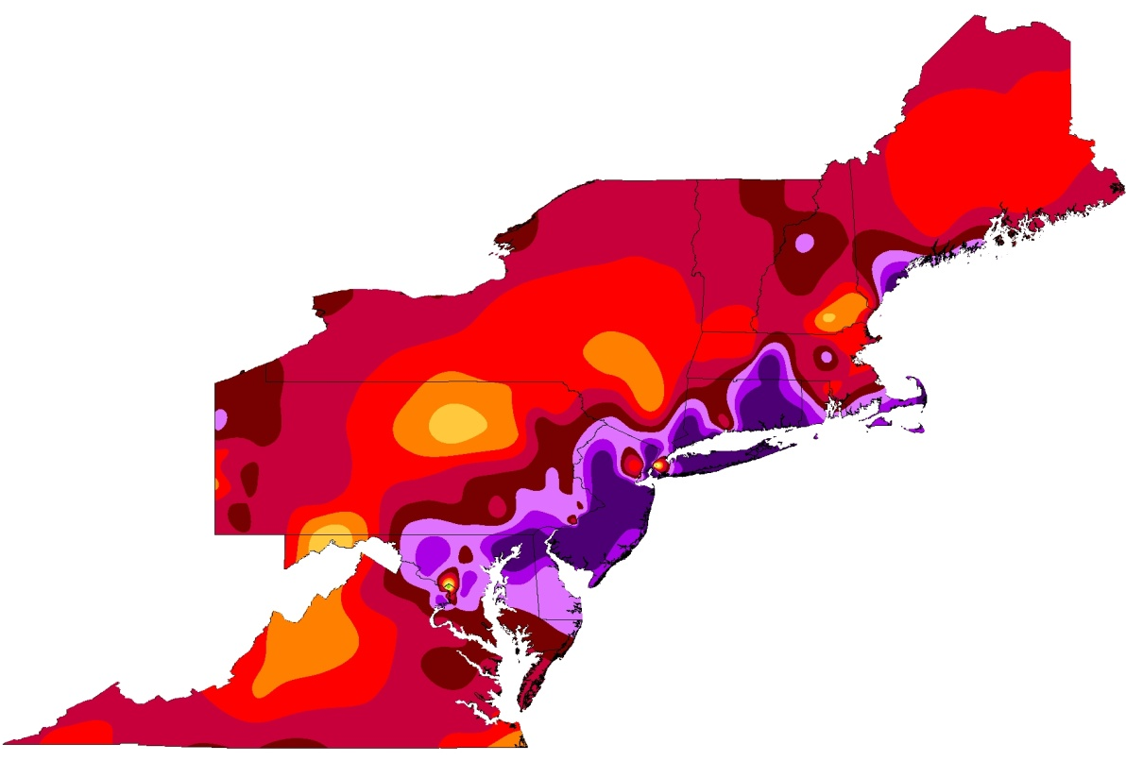
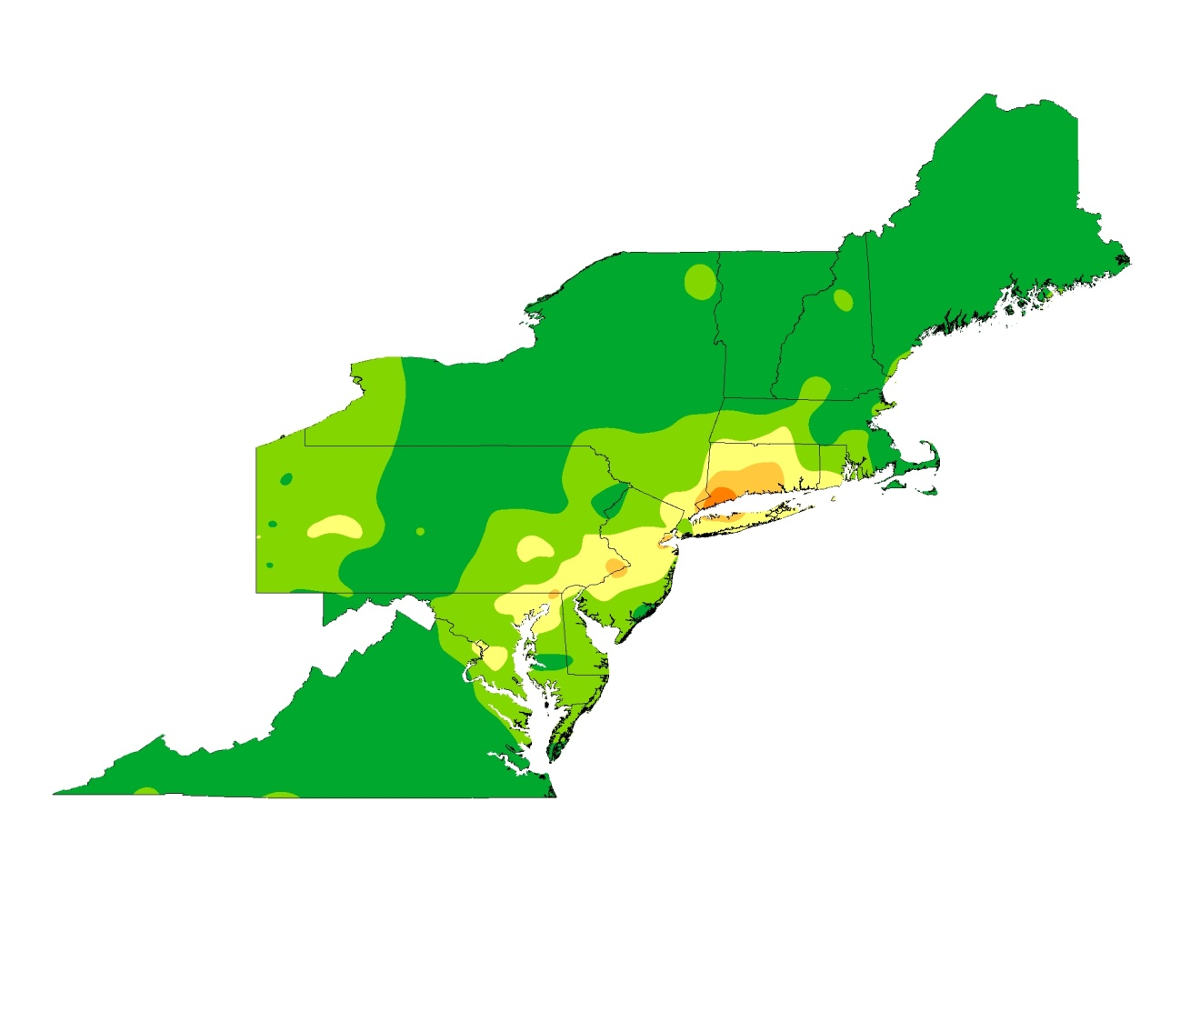
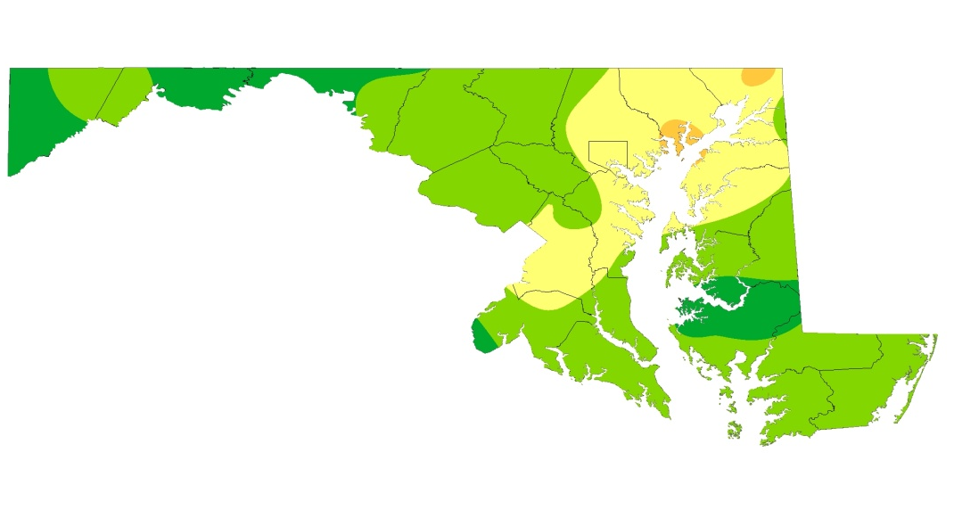
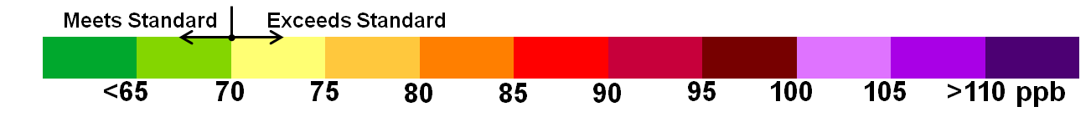
The Shrinking Ozone Problem
1998
2017*
1990
2016
Hot spots
The Shrinking Ozone Problem: Not just the magnitude, but its nature: “We’re going local”
Victims of the state’s own success
8-Hour Ozone
*Preliminary – Does not reflect EPA 2016 Exceptional Event Concurrence
Notes:
We’ve gone from a super-regional issue to a local problem. This is not to say that regional contributions never matter now…no, they still do, but its starting to look like the local contribution is starting to dominate the large scale.

Slide 3
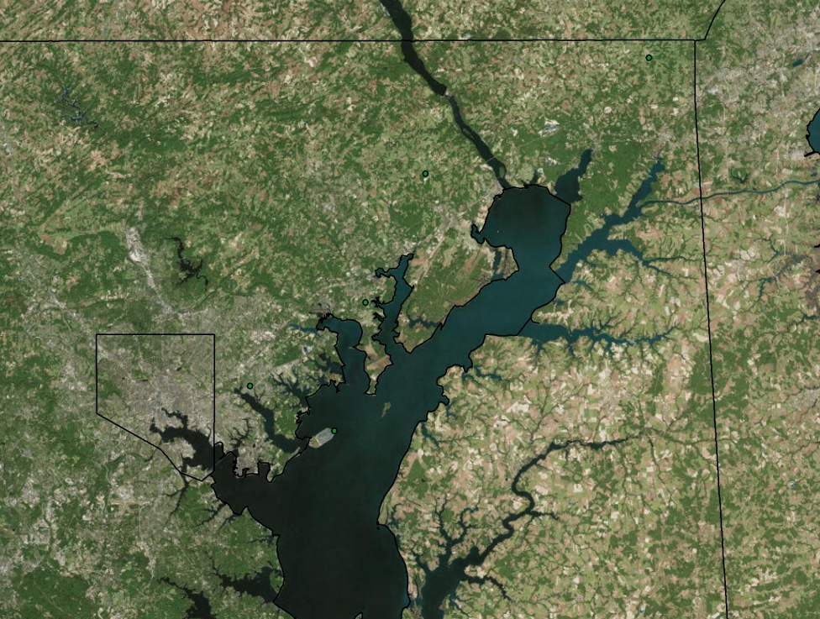
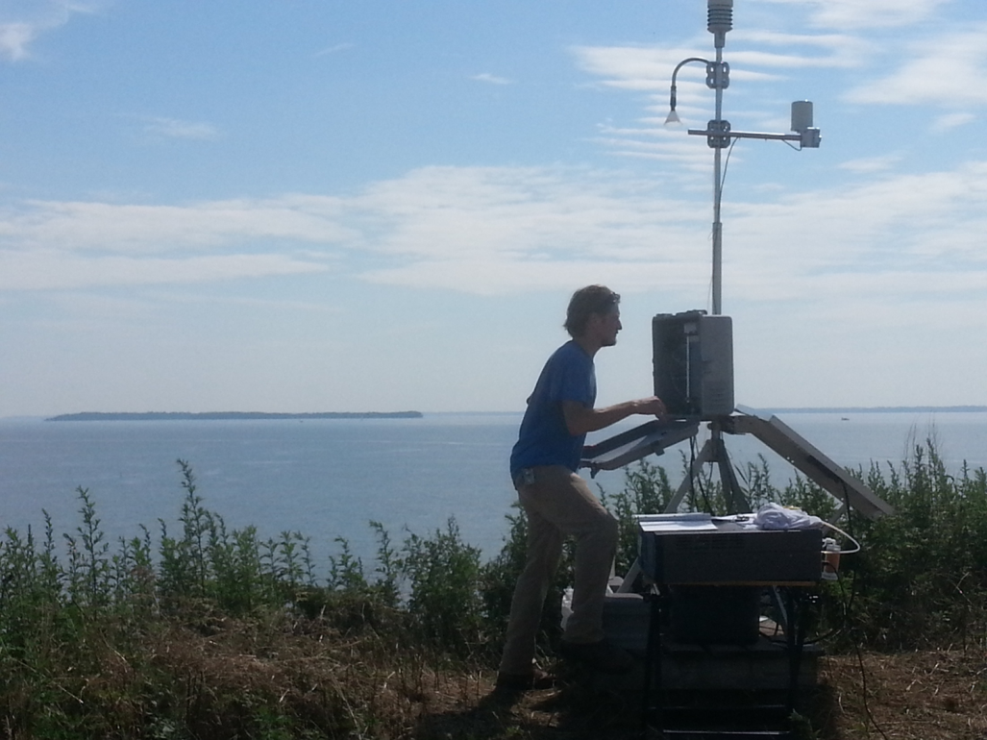
Maryland Issues:
MESO-SCALE MATTERS
Regional NOx diminishing, local dominating
Long range vs local
Mobile vs point vs non-traditional
NOx emissions variability
NOx transport (Bay, intracity)
Smoke
Magnitude
1-50 miles in size; < 1 day in time
Spatial Scale
“We need to know what was running and where on any particular day in the context of the meteorological set-up to explain our exceedance patterns.”

Slide 4
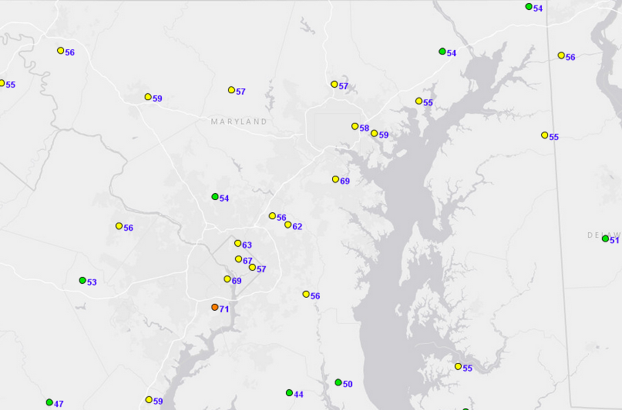
Saturday June 1, 2019
Need for source attribution
Displayed: Maximum 8-hour average Ozone

Slide 5
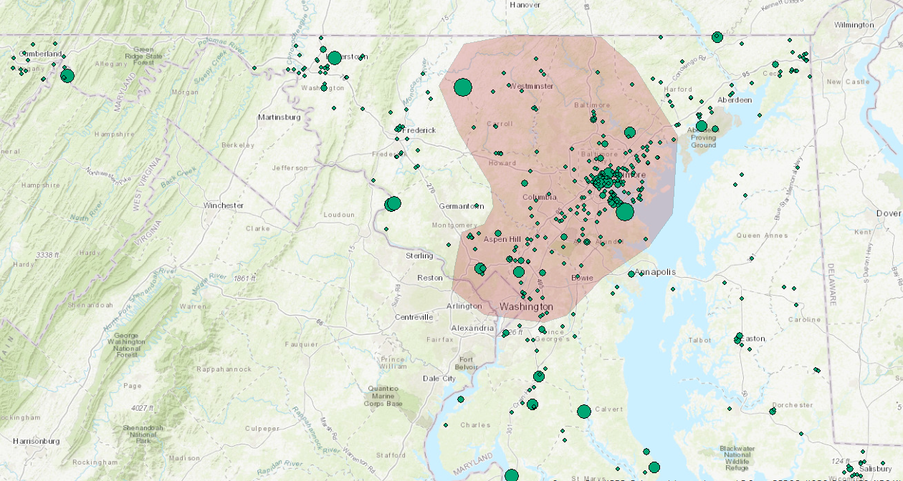
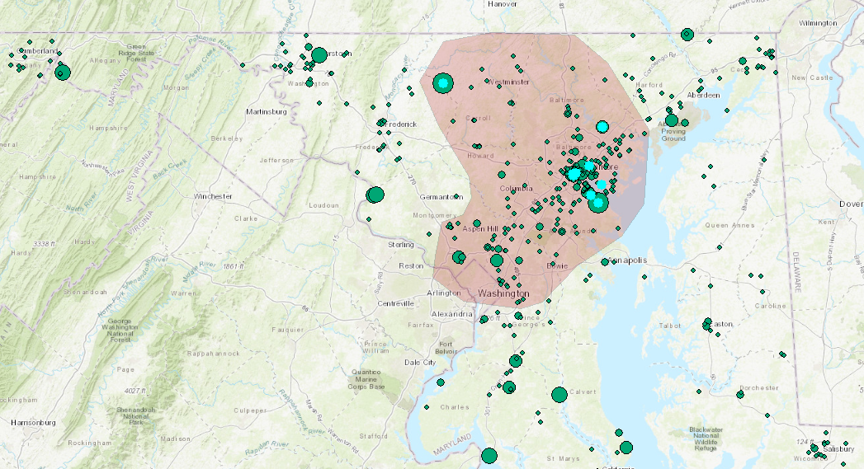
Wider Search for NOx
2016 model framework
10 facilities contribute ~86% of NOx in red area on an annual basis (2016 platform)
Nothing is known about the TEMPOralization of the remaining sources in red area
Credit: Emily Bull

Slide 6
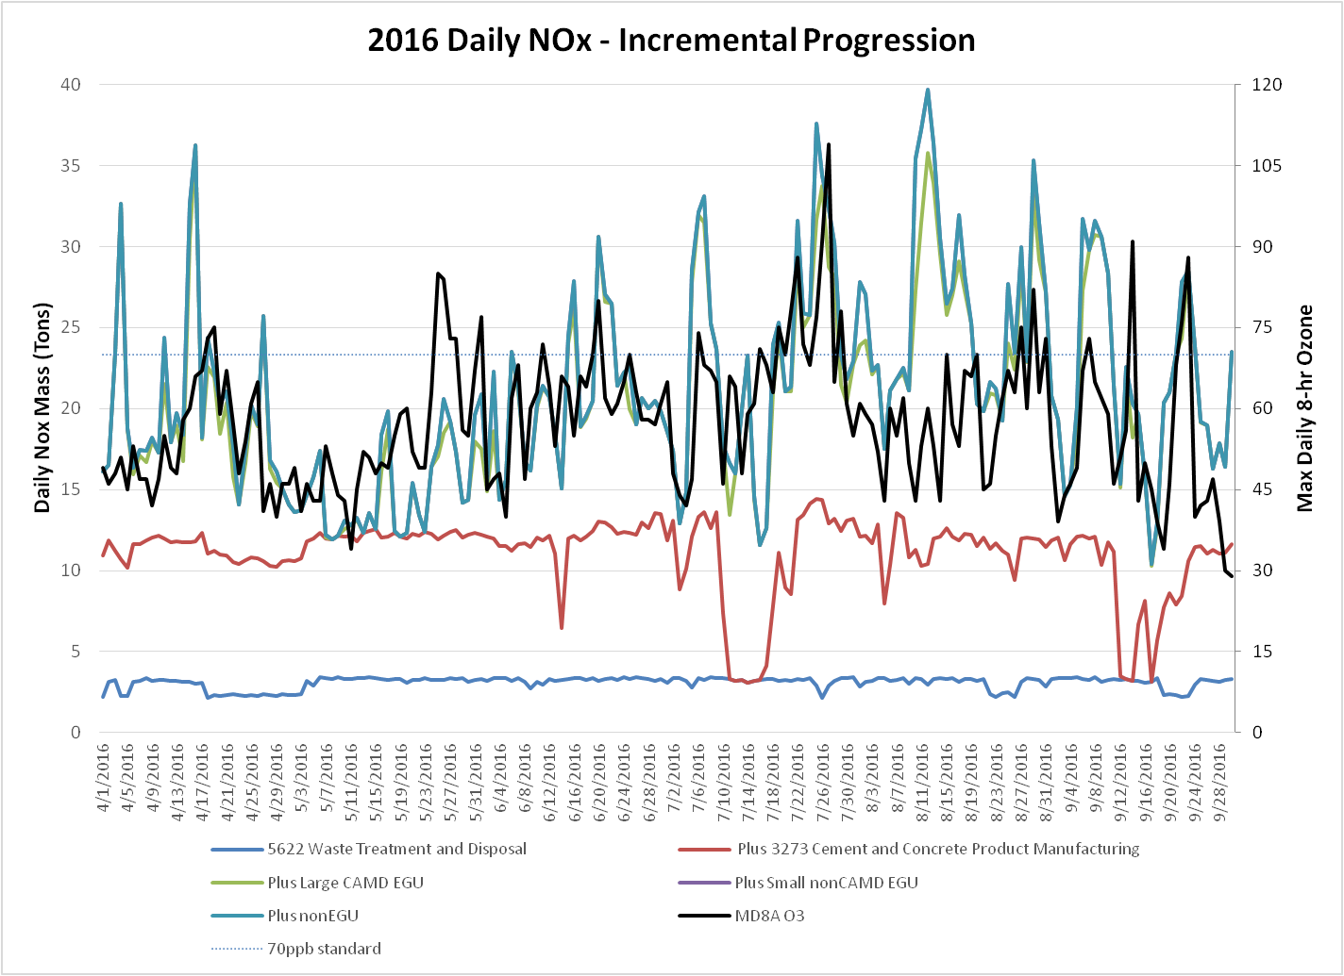
4/4 – Rain clouds, cold
4/15-4/16 - Cold
Aug 10 - 19; Tropical atmosphere, very moist (high Td), daily overturning
May 25-26; long range smoke transport
Credit: Emily Bull
Excluding 15 days, the correlation of ozone to NOx is 0.57 in 2016. Working to develop 2017 and 2018

Slide 7
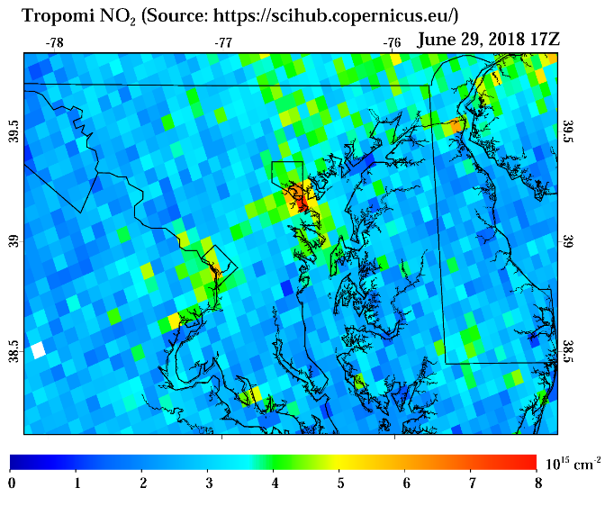
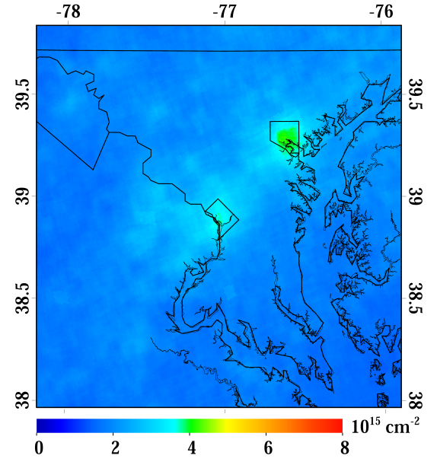
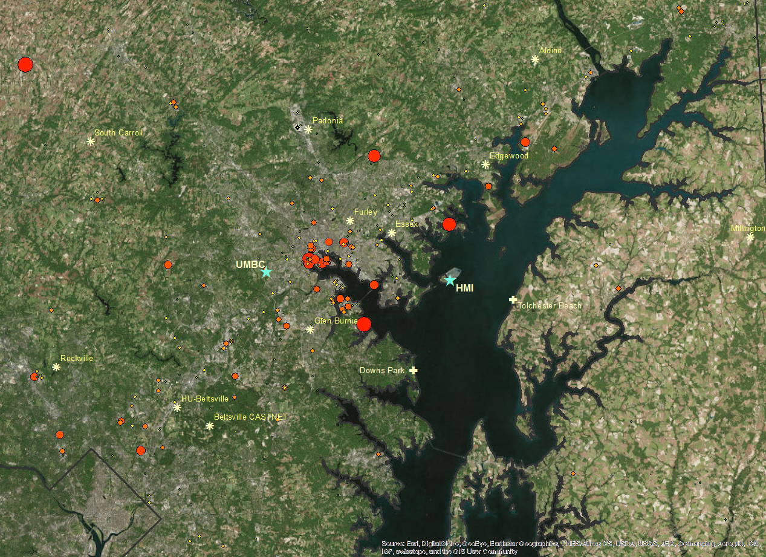
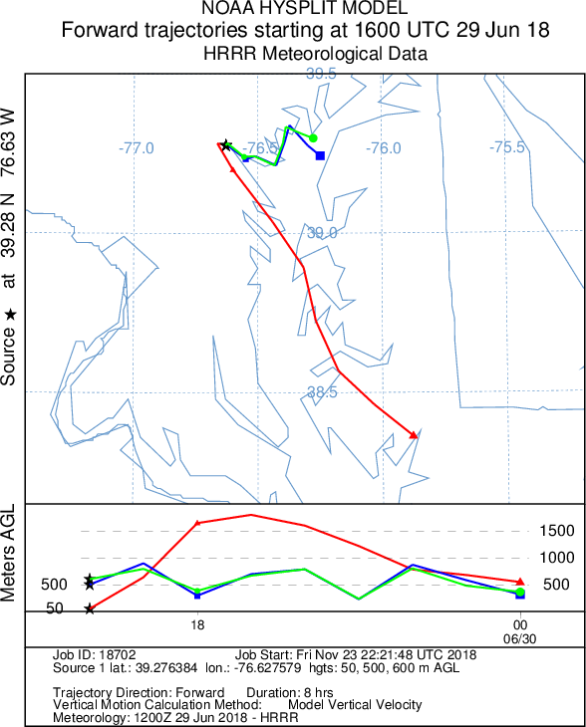
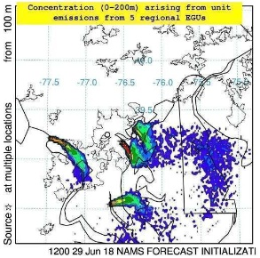
Satellite Captured “City” Plume
50-600m transport in cone area
TropOMI: Dan Goldberg; Argonne National Laboratory
Hysplit Dispersion: Mark Cohen; Air Resources Lab; NOAA
All data is considered preliminary and subject to change

Slide 8
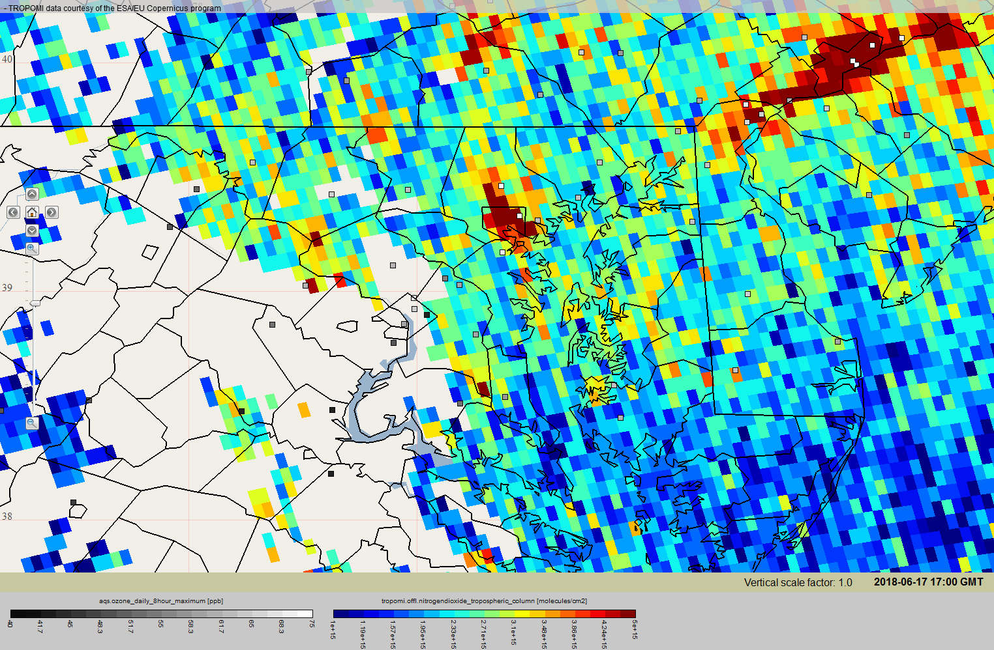
NO2 from TropOmi Sunday, June 17, 2018.
Ozone exceedance at Padonia monitor and HMI. Near exceedance at UMBC, Furley.
More emissions?
Geometrical/Additive issue?
*
NO2 plume (ozone precursor) moving northward towards exceeding monitor
-Squares are monitor locations; white squares are ~70ppb of max 8-hr average ozone
-Rainbow colors are NO2. Dark red shows greatest concentrations of NO2
Wind Direction

Slide 9
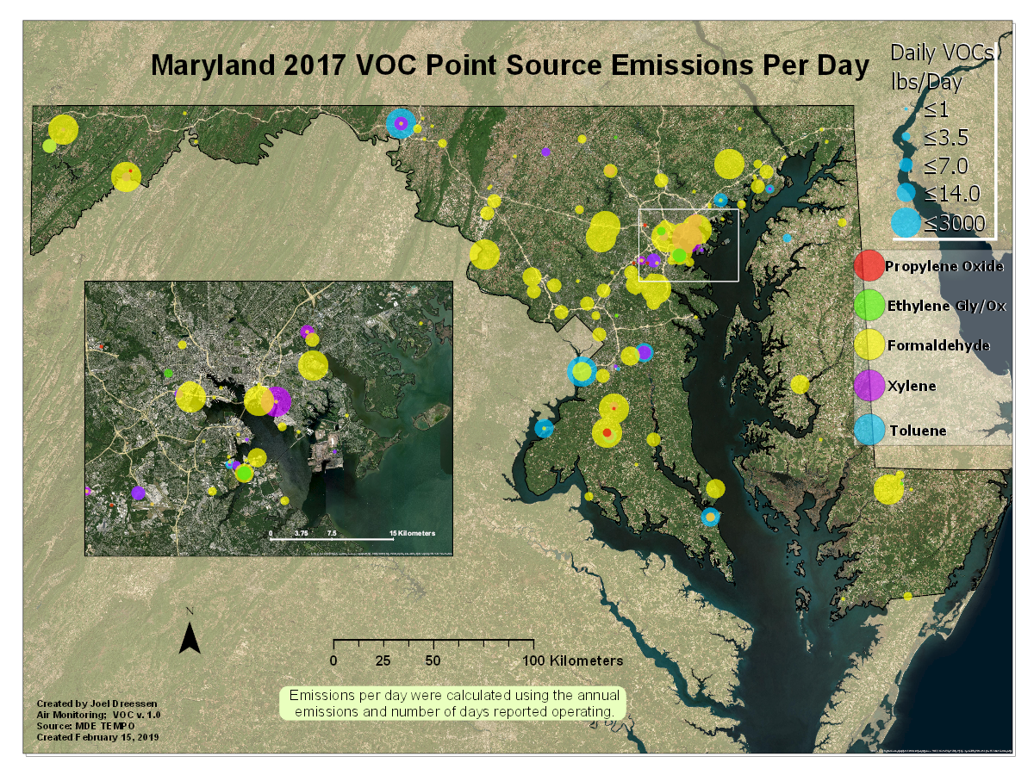
Impact of Natural Gas?
Formaldehyde falls under HAPS except when a by-product of energy generation. Thus, an inefficient gas turbine could be generating substantial formaldehyde as well as NOx (essentially an ozone plume).
Where are these facilities?
Emissions per day does not reflect the frequency of when facilities run

Slide 10
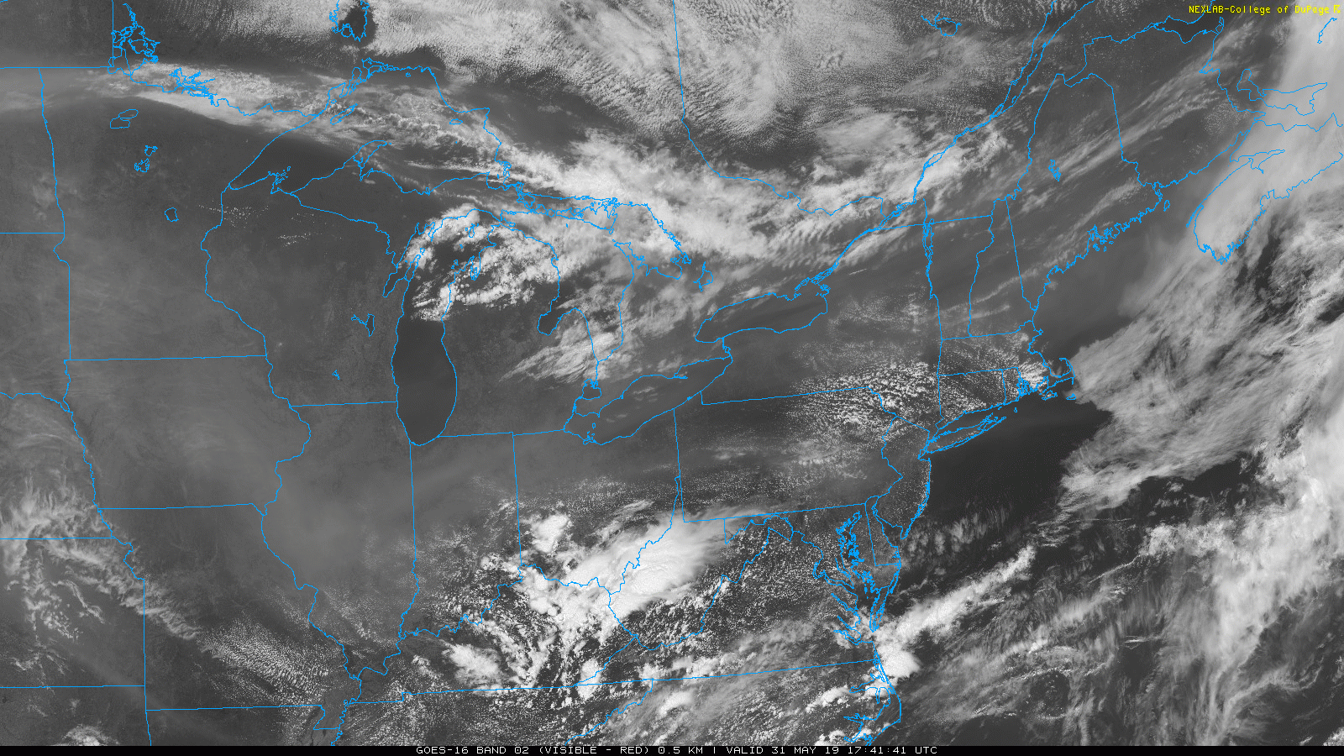
Friday May 31, 2019
GOES-16 Band 2

Slide 11
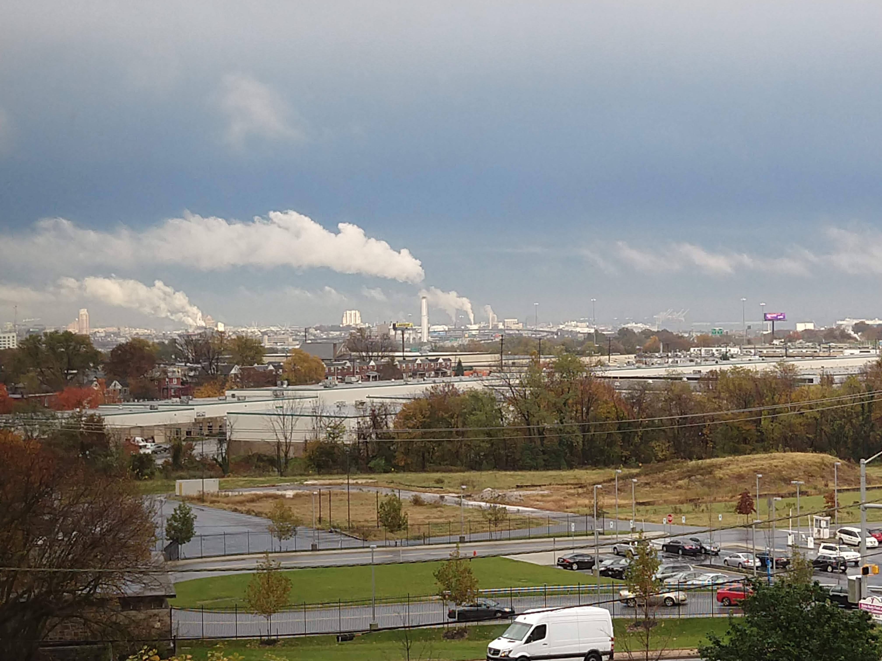
Questions

Slide 12
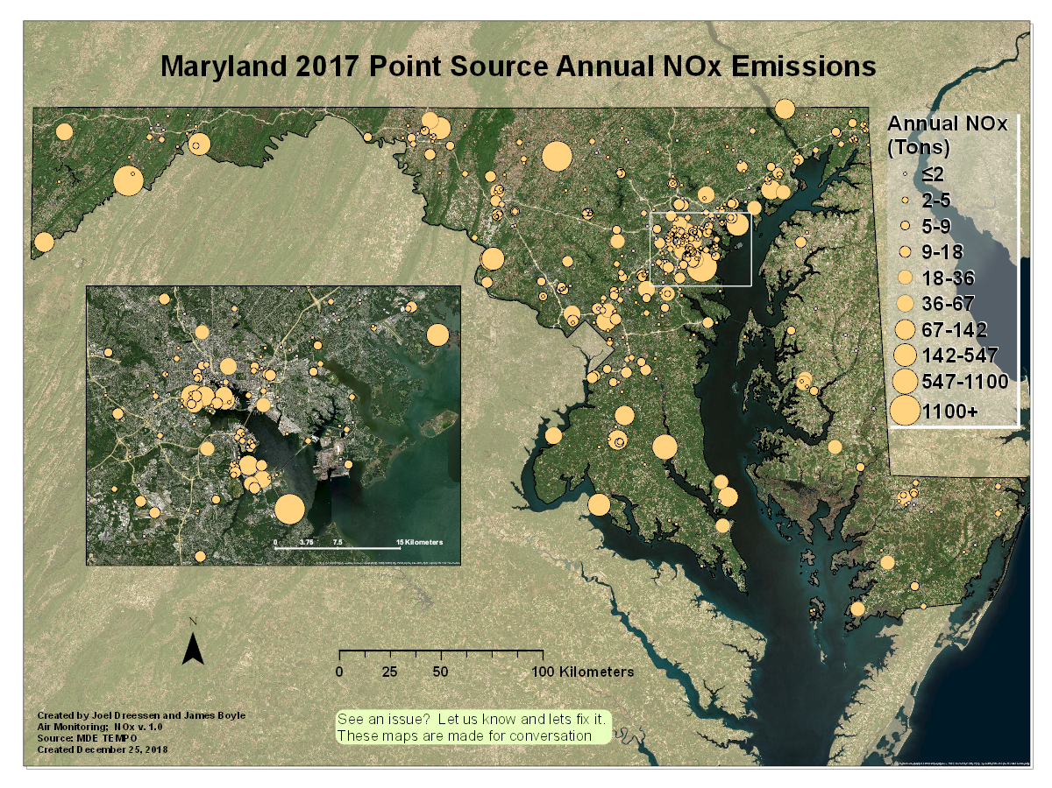

Slide 13
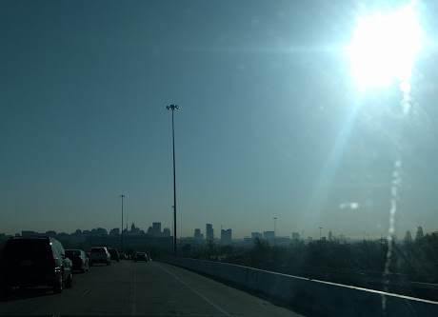
Exceedances at HMI: Baltimore Point Sources
1.5 tons
Mobile/ Marine / Local Industry?
July 3 and July 4

Slide 14
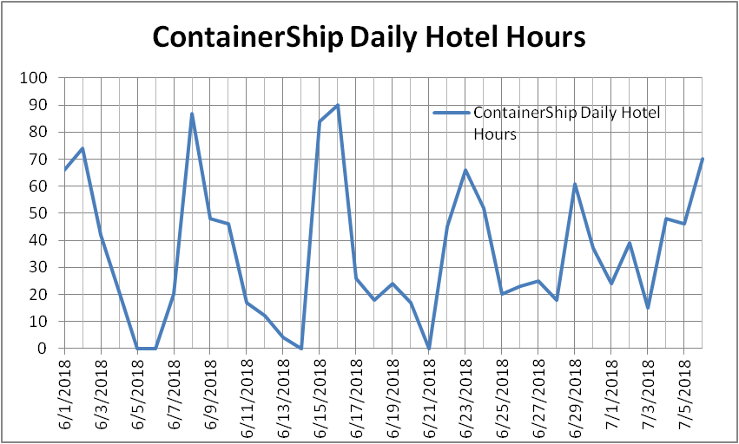
Other/Boats/Port/Industry
Port Activity – HMI observed high CO and SO2 simultaneously, transitioning to high NOx and CO

Slide 15
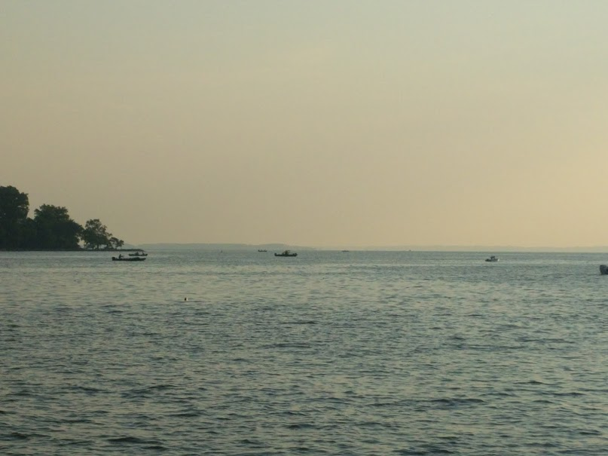
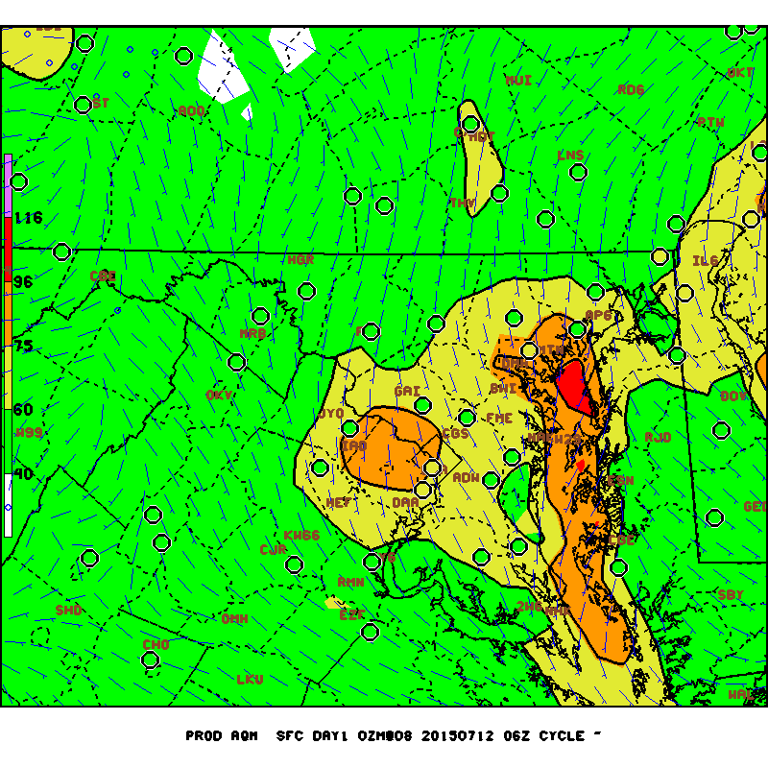
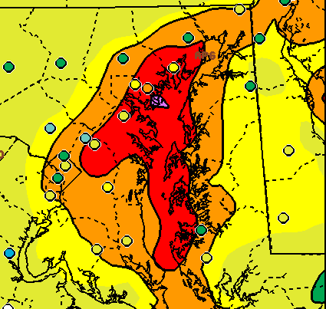
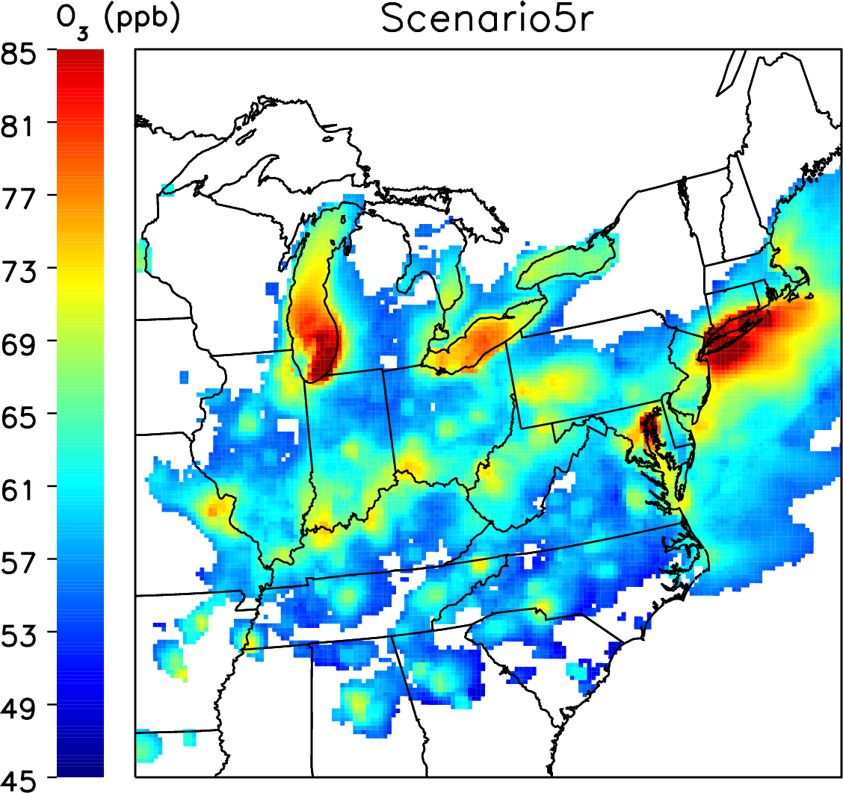
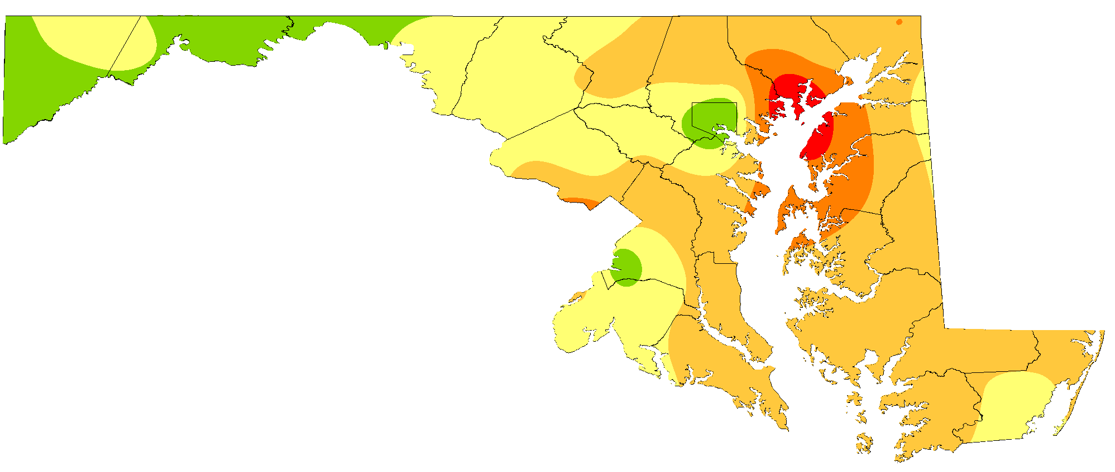
Chesapeake Bay Ozone Background
Maryland “Water Issues”
Edgewood’s “Bay Breeze”
Ozone Forecasts
Compliance
modeling
106ppb at HMI
Forecast 8-hour average ozone (background fill by Air Quality Index (AQI) colors) for Maryland on July 11, 2015 overlaid with verified ozone AQI at ozone monitoring stations across the region (circles).
NOAA Forecast 8-hour maximum ozone averages July 6, 2016 [06z run]
How do we verify any of this?
Tim Canty, PhD, UMD
Picture: Chesapeake Bay, July 20, 2017
Notes:
From the state of Maryland’s perspective, our ozone air quality problems are becoming related to understanding fundamentals around the Chesapeake and what is causing ozone to develop there…

Slide 16
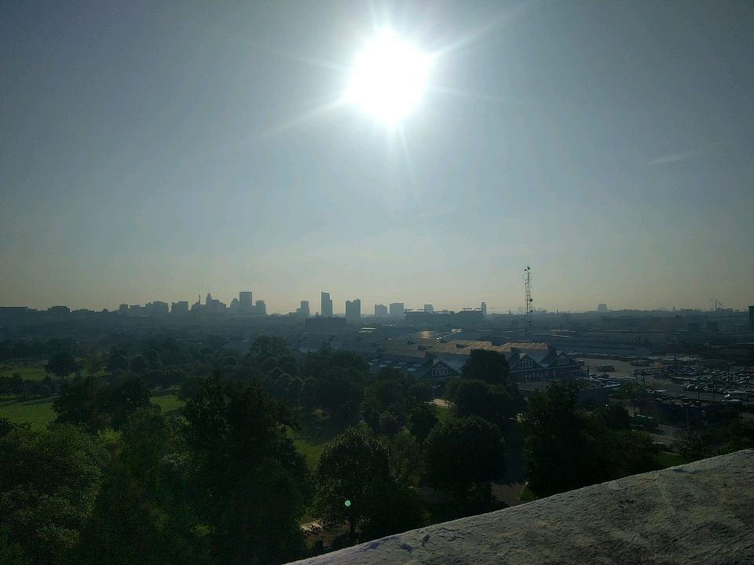
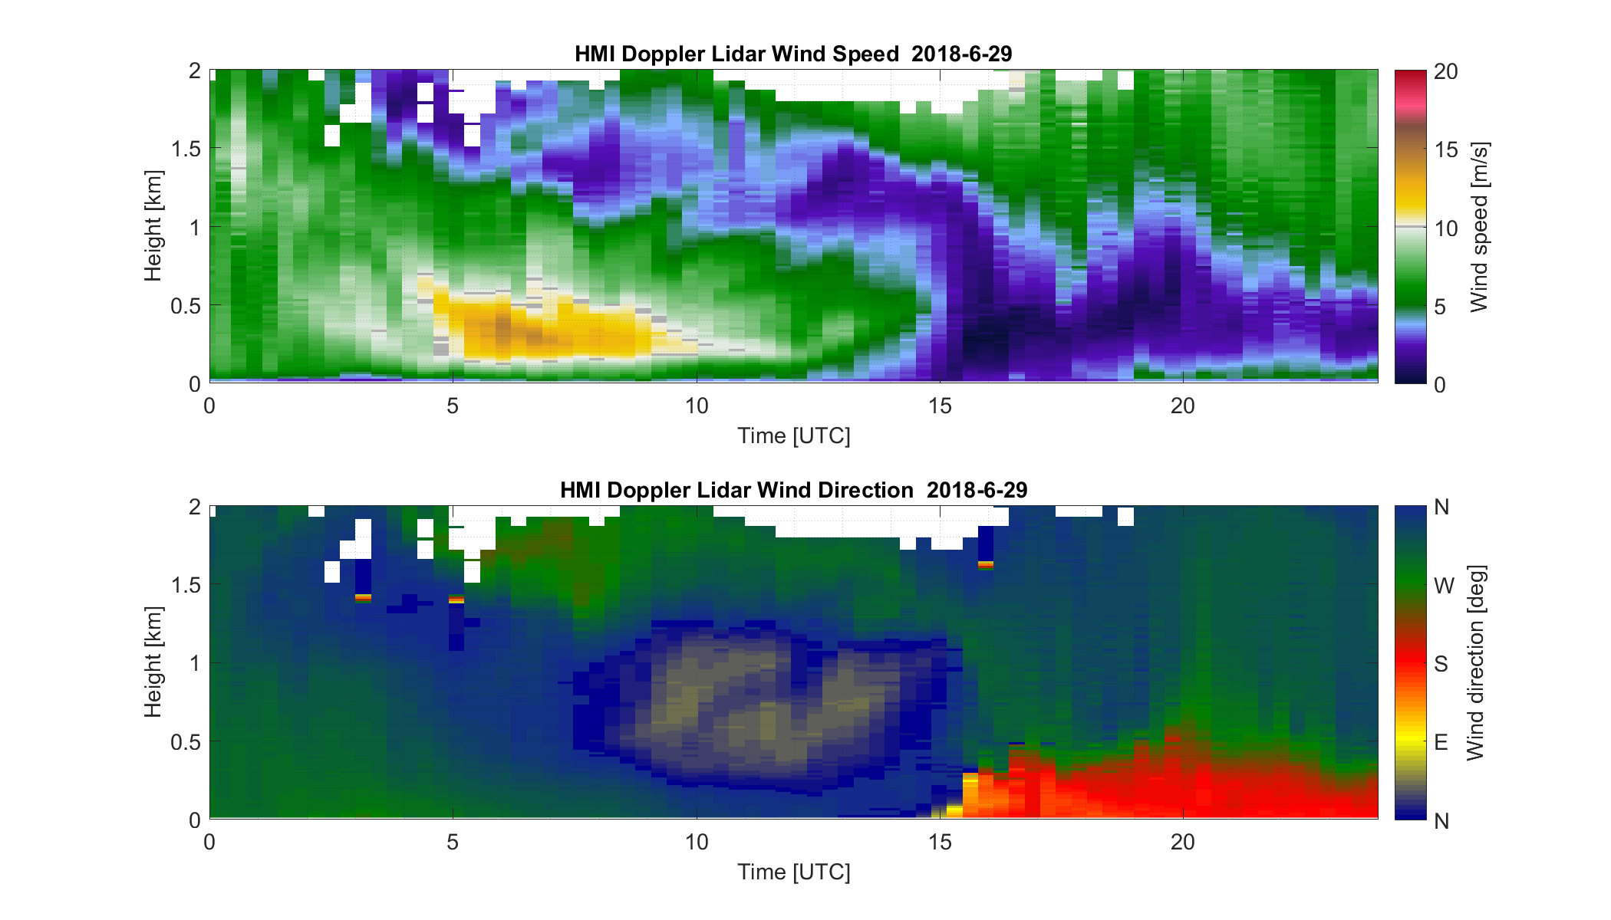
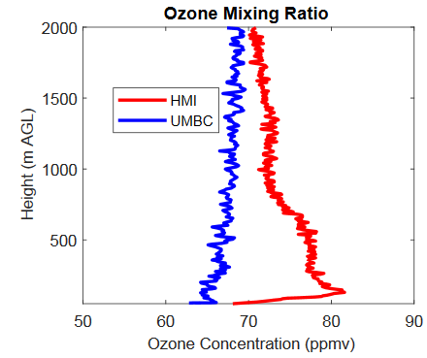
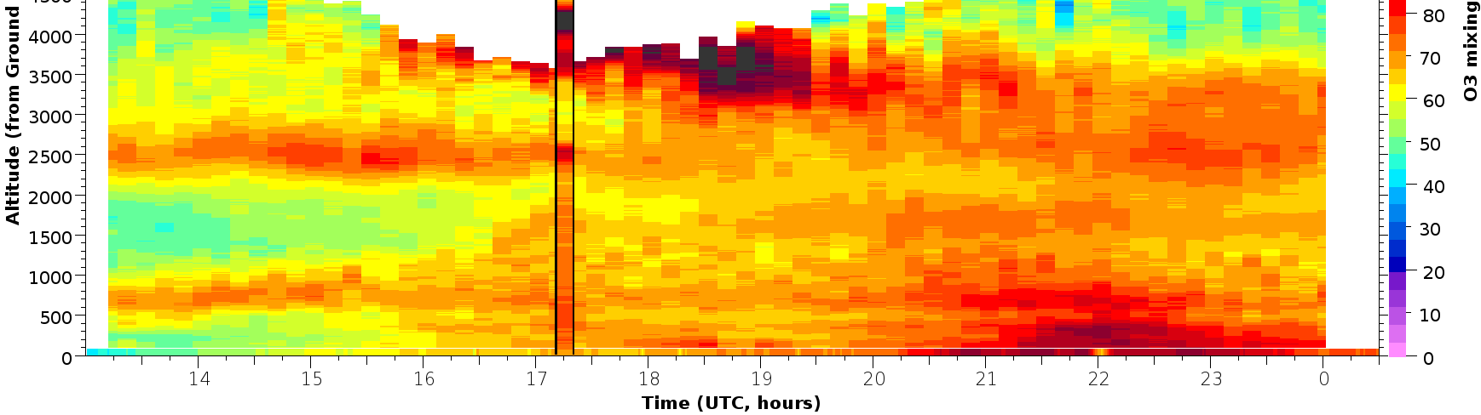
June 29, 2018; Type-α
3)Near surface wind speed from south matches depth on the ozonesonde
2000 UTC
4 pm EDT
Wind Lidar provided by UMBC: Delgado
All data is considered preliminary and subject to change
1) Initiation of Bay Circulation at HMI
4)Northwest flow atop Bay
northeast
northwest
west
southerly
All data is considered preliminary and subject to change
Ozone Lidar provided by NASA LARC
5) Near surface faster transport accounts for higher surface concentration before Lidar
2) Sub 500m ozone increases with subsidence from aloft

Slide 17

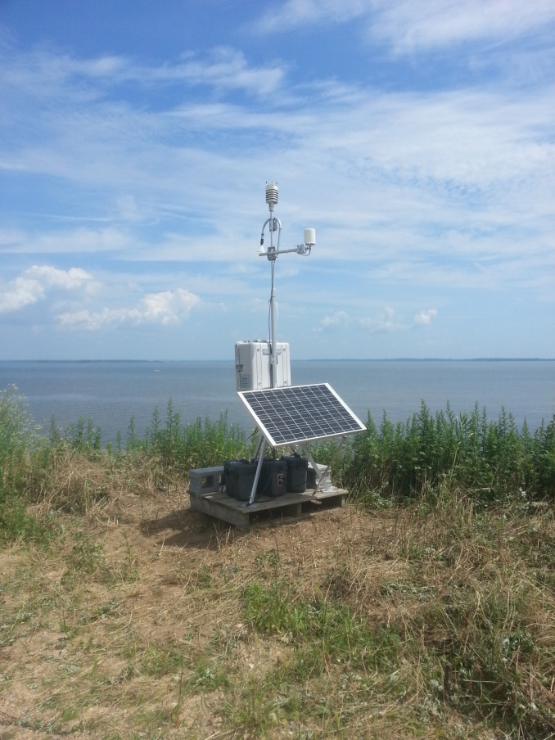
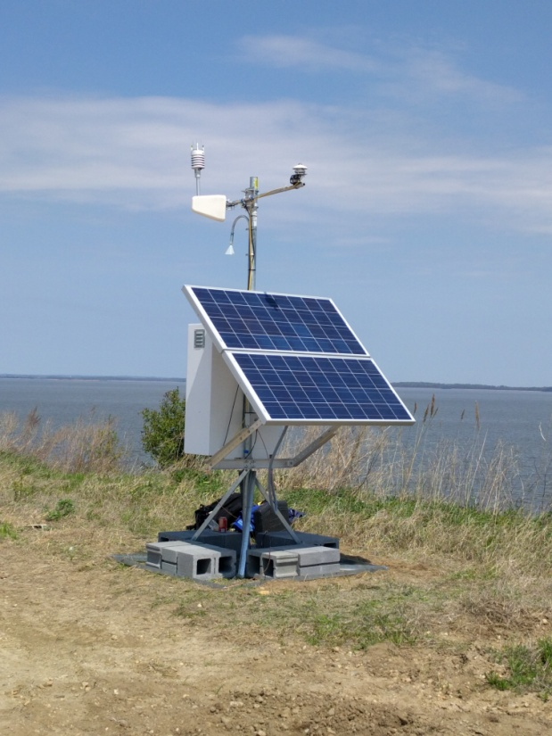
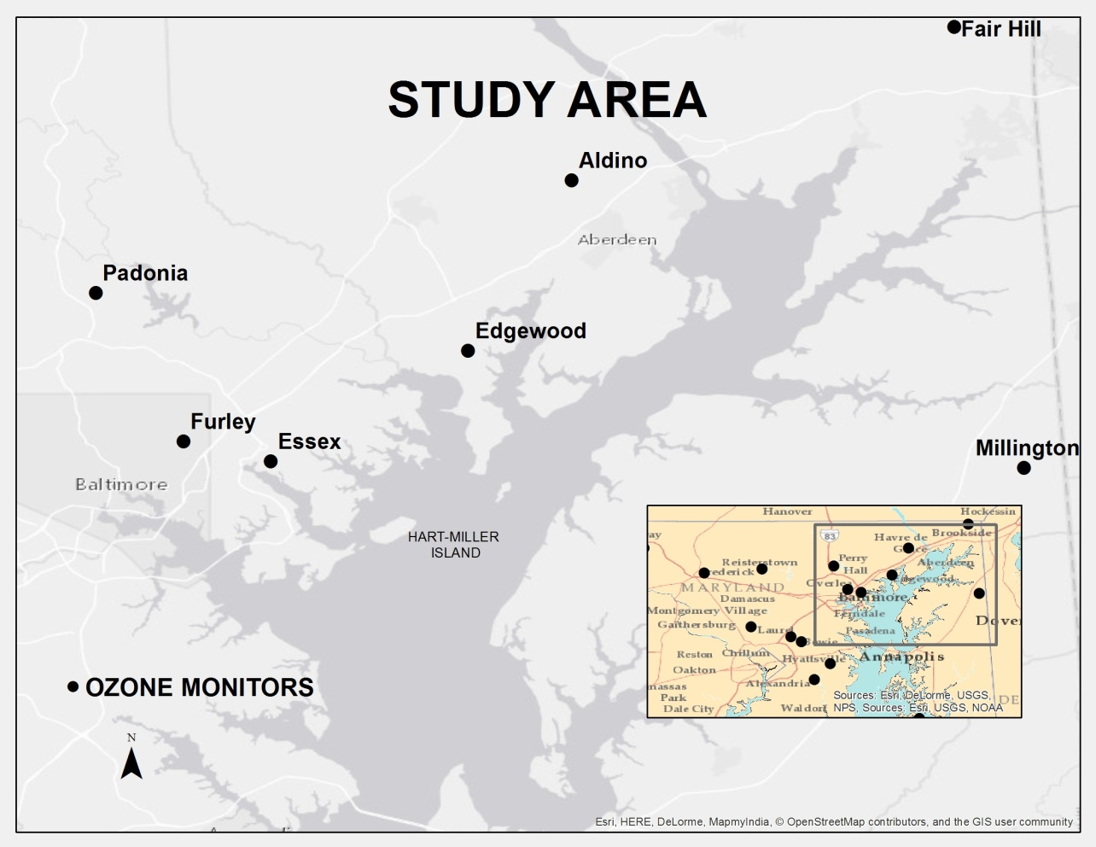
OWLETS-2 Background & Purpose
Portable Ozone Monitor [“POM”] - mobile autonomous ozone observing platform
Solar panel charges 2 deep cell batteries
Communication via cell signal
Includes weather data
POM
East of the Baltimore Inner Harbor by 15 miles
Northeastern most point on the Island putting it as close to the middle of the Bay as possible
Access via boat only
Notes:
Over 3 years and a lot of networking, I connected with the right people and we found an island within the Chesapeake Bay….

Slide 18
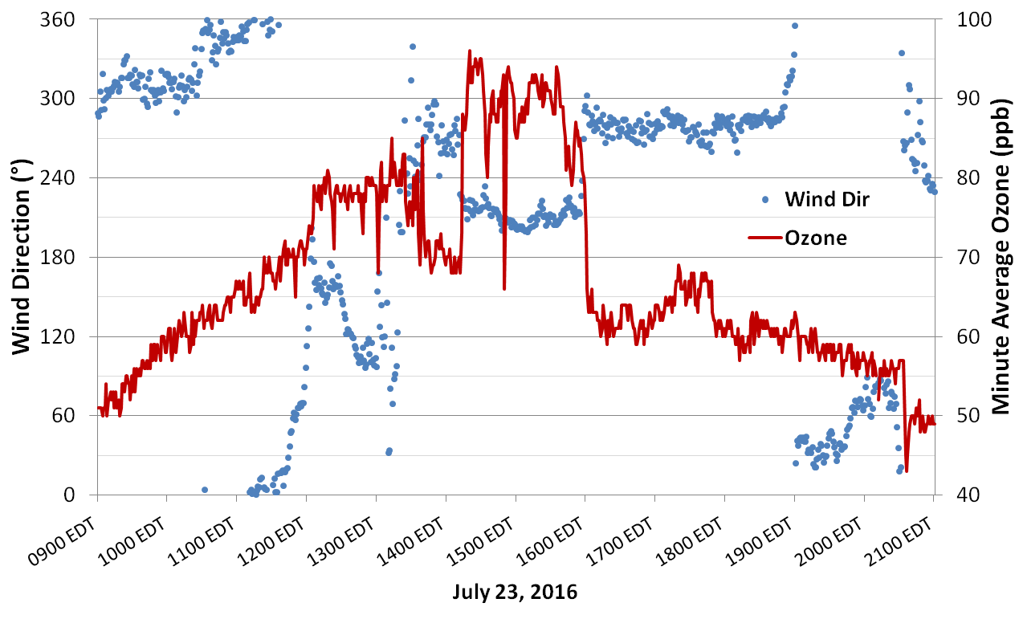
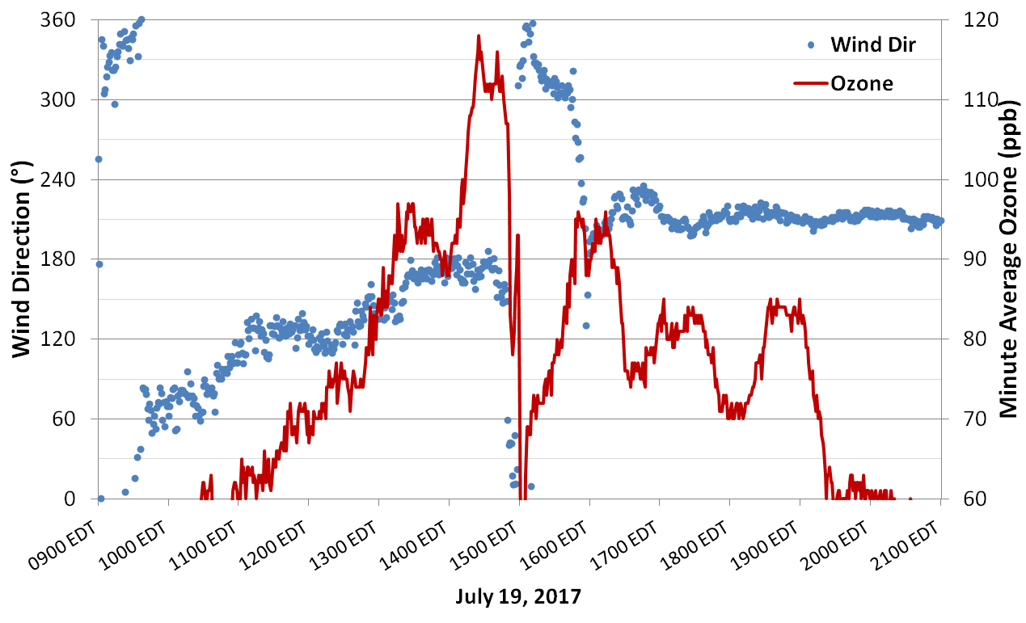
Changes in wind direction led to BIG ozone changes at HMI
Hart-Miller Island Pilot Project Results
240 observation days; 2016 and 2017; Exceedances of 70ppb: 24; 75ppb: 12; 84ppb: 7; Small number of days that ultimately exceed the standard; When ozone IS present, higher than land
Exceedance Days Highest Ozone Hour:
Hourly HMI | Ozone (ppb) | Wind Direction (°) | Land-Water Temperature Afternoon Difference (°) | 850mb 12Z Wind Direction (°)
Mean(Med) | 92 (89.5) | 192 (191) | 11.1 (9.9) | 300 (300)
11ppb in 17 minutes
25ppb in ~10 minutes
>60ppb in ~20 minutes
10ppb in ~10 minutes

Slide 19
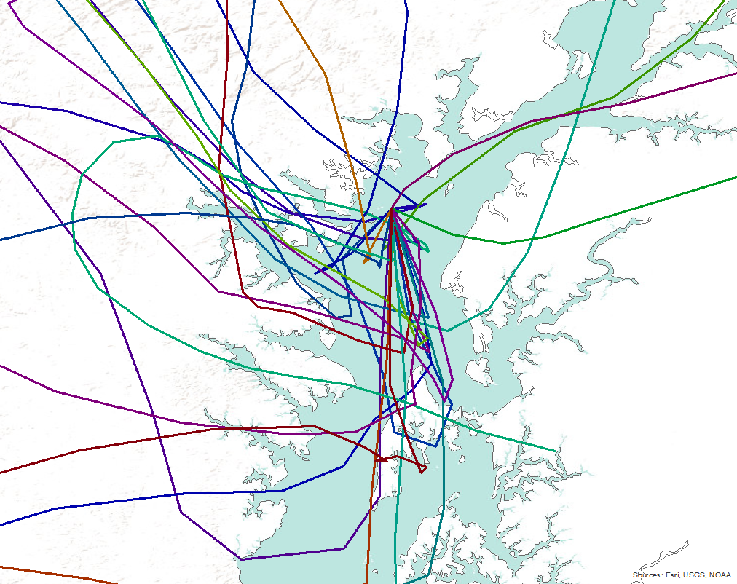
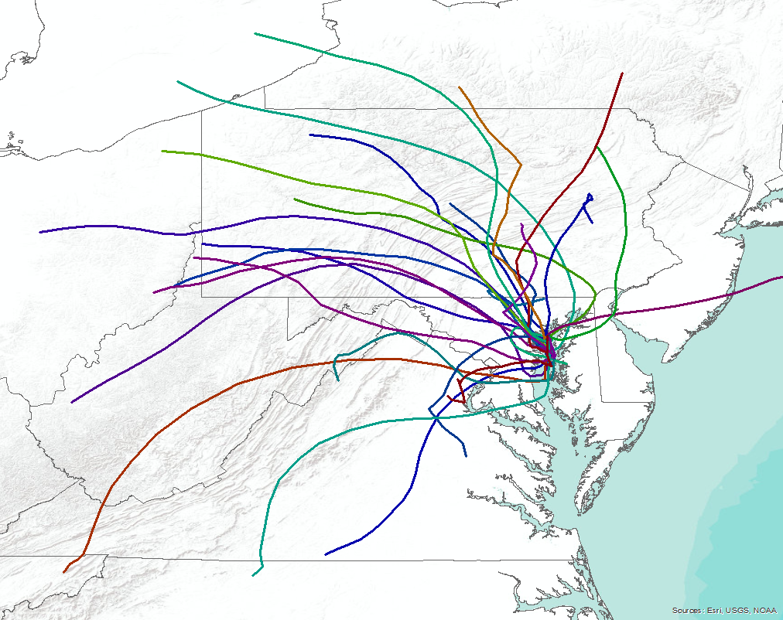
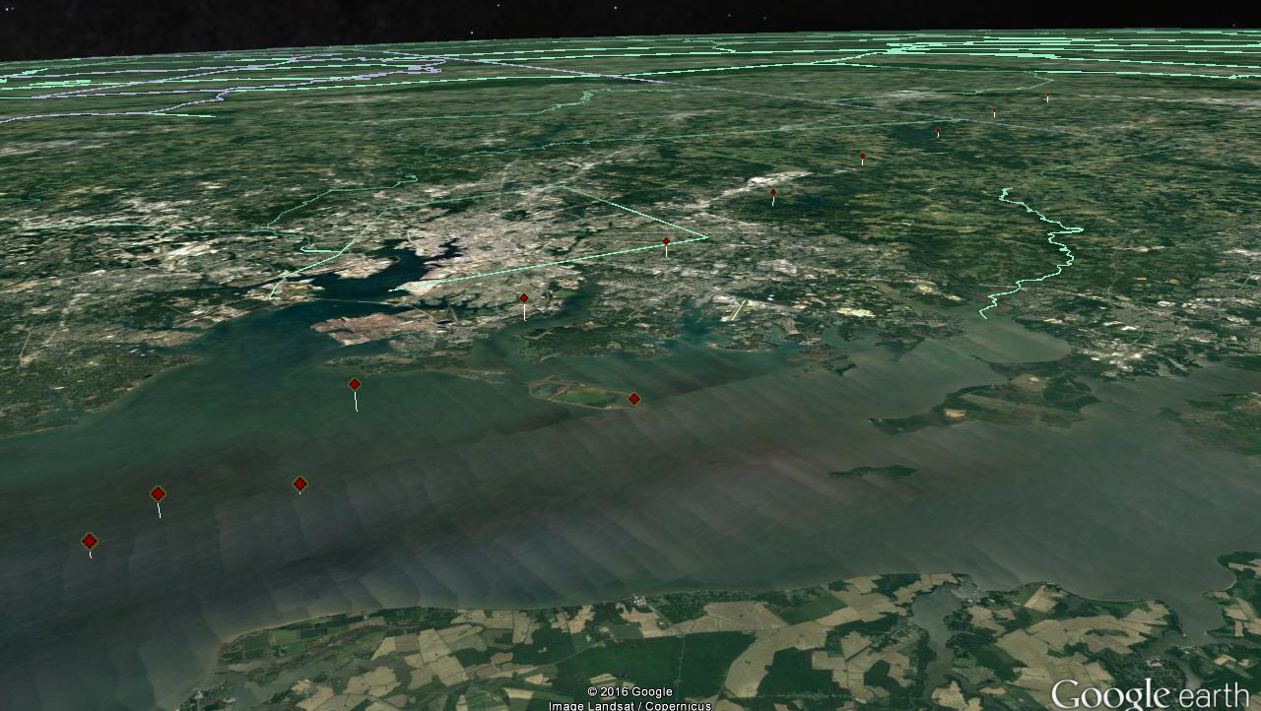
10m HRRR Trajectories on Days with Bay ozone >70ppb
The HRRR is a 3km resolution dataset
500m drop in altitude in 2-3 hours; ~4.6cm/s
600m +
Baltimore
1pm 634m
N
5pm 10m: HMI
3pm 170m
Data Source: Air Resources Laboratory: HYSPLIT
Rolph, G., Stein, A., and Stunder, B., (2017). Real-time Environmental Applications and Display sYstem: READY. Environmental Modelling & Software, 95, 210-228, https://doi.org/10.1016/j.envsoft.2017.06.025

Slide 20
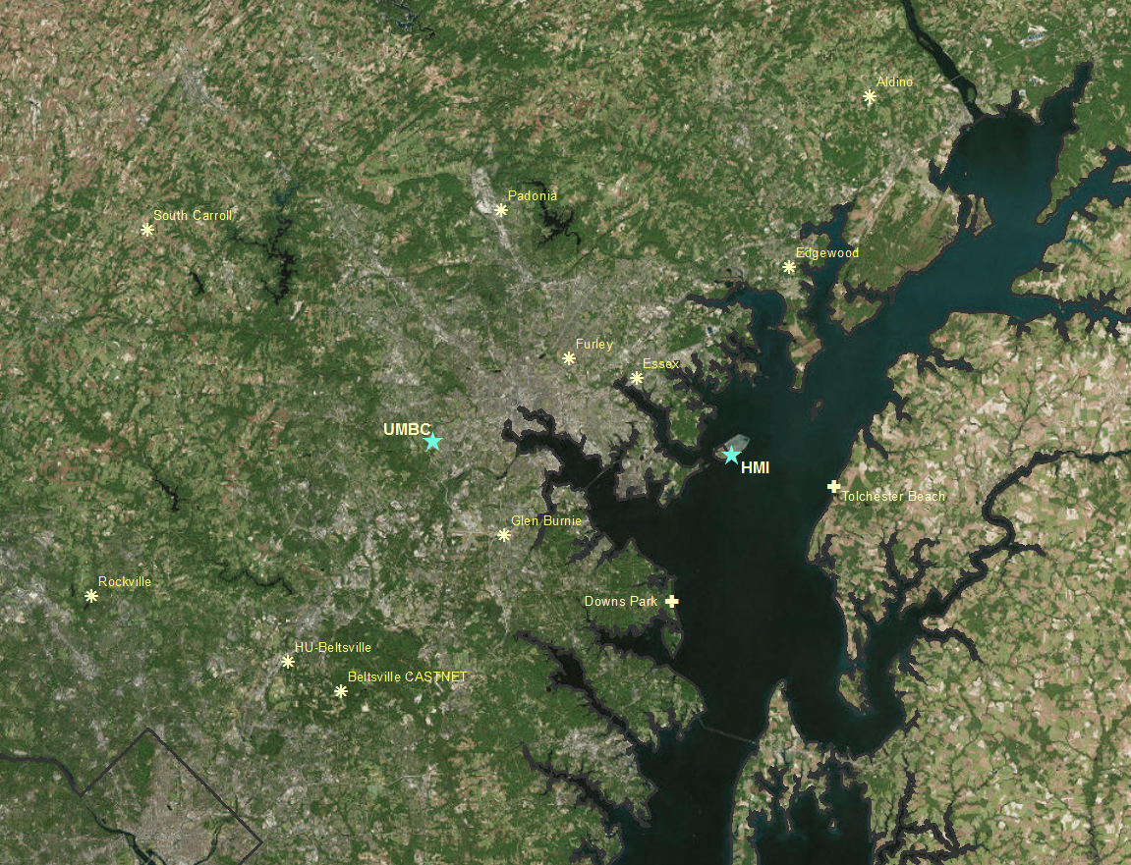
What do we know from 2016 and 2017?
What is happening??
0.5-1.5km layer
average wind:
12z Radiosondes: 311°
HUB RWPs: 286°
15 tons Nox /day on average!
(When operating)
Surface winds during high ozone:
191.1° [189.5°] @ 4.3kts [3.6kts])
Land-Water Transition:
Median Afternoon Temperature Difference: 9.9°F
Median Morning Temperature Difference: 10.7°F
Bay Temperature in Summer: 70-85°F
10 miles

Slide 21
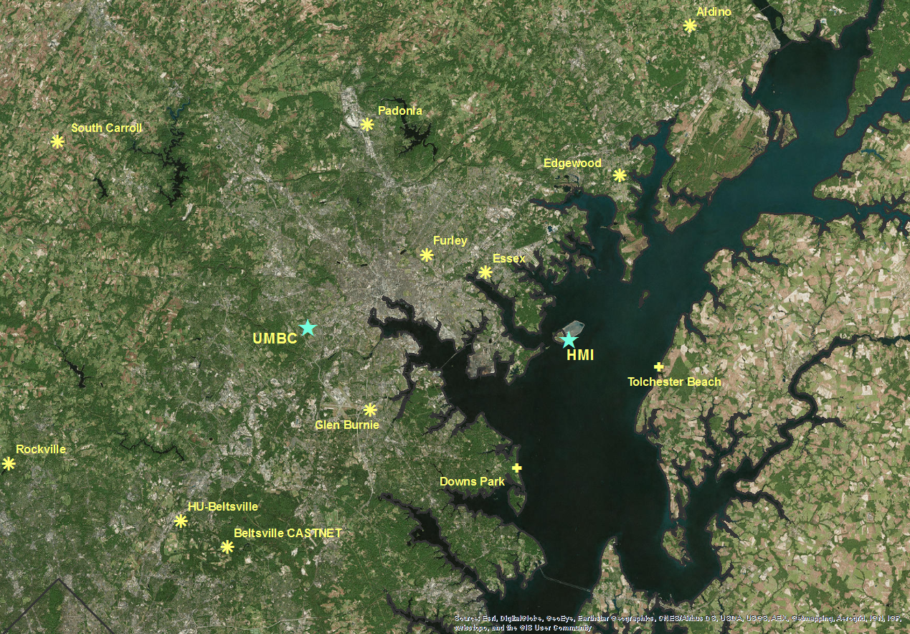


OWLETS-2
Date | HMI Max 8-hr Avg (ppb)
June 1 | 73
June 17 | 74
June 18 | 63
June 29 | 79
June 30 | 84
July 1 | 80
July 2 | 64
July 3 | 79
July 9 | 71
July 10 | 99
Not Intensive Campaign
Bay Only Exceedance
Saturday
Intensive Campaign
Bay Only Exceedance/Sunday
Not Intensive Campaign
Not Intensive Campaign
HMI's fourth high for 2018 was 79 ppb (with a pretty short record compared to other years). If the island had a design value, it would be 82ppb (fourth highs: 2017 - 81ppb 2016 - 88ppb); Highest DV in Maryland at the moment is Edgewood at 75ppb
All data is considered preliminary and subject to change

Slide 22
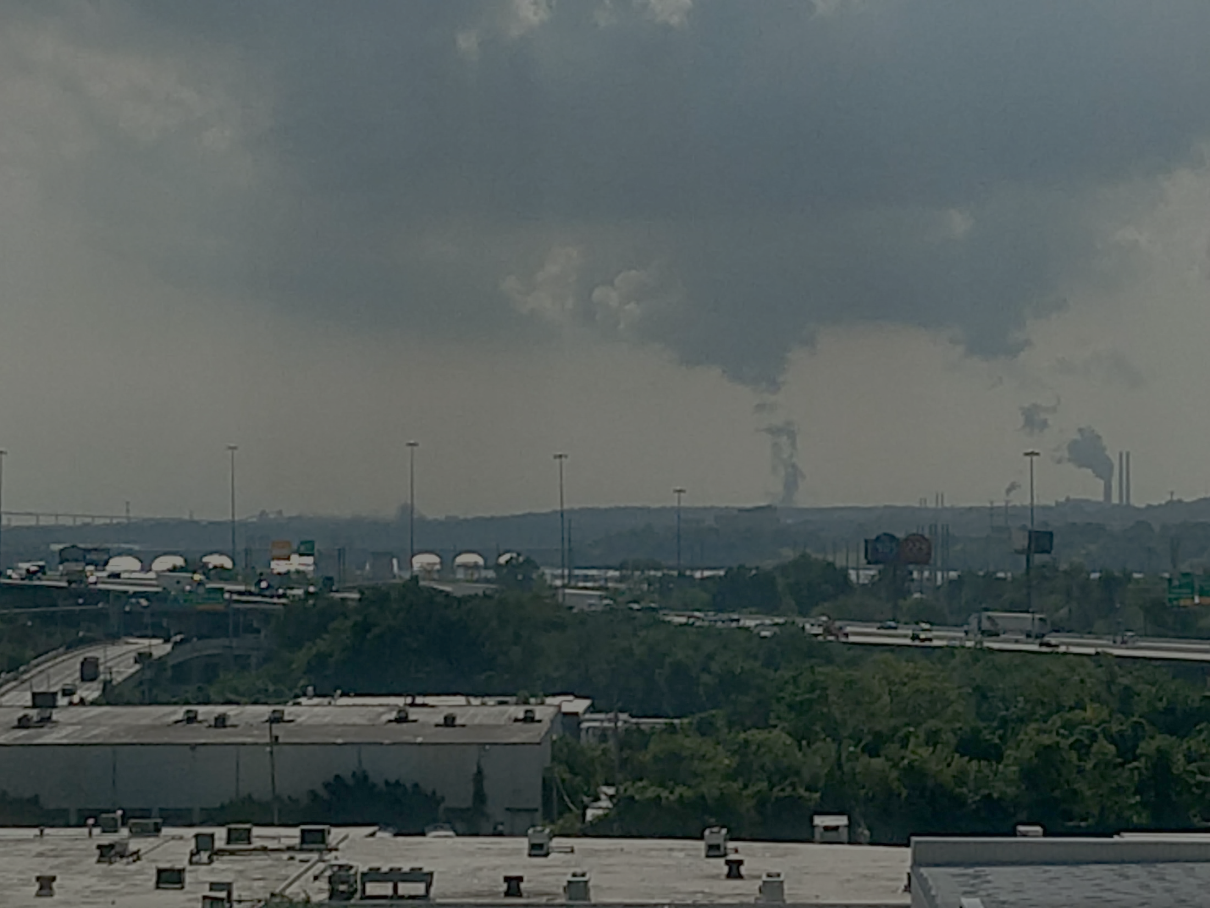
OWLETS-2 Objectives
What is the spatial and vertical extent of the ozone (and ozone precursors) in and around the Chesapeake Bay?
What are the mechanisms (low boundary layer, chemistry, weather) that produce high ozone over the Chesapeake Bay and lead to high ozone at locations on land near the Chesapeake Bay?
How much of the ozone (ozone precursors) is a result of local sources (EGUs, mobile, ship, boat, etc) and/or pollutant transport (westerly, nocturnal low level jet) into Maryland?
Why do the photochemical models appear to over-predict ozone concentrations in and around the Chesapeake Bay?
What source groups and in what locations do policy makers need to focus on to reduce ozone over the Chesapeake Bay?

Slide 23
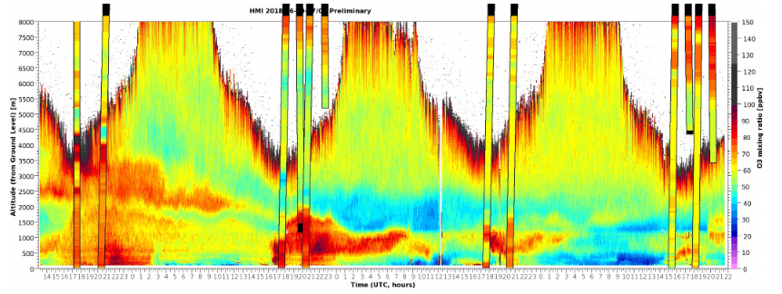
Types of Exceedances at Hart-Miller Island
Type-α: ‘α’ or “air above”
  Air is transported downward from above the Bay’s Surface
Type-β: ‘β’ or “bottom-boats-below”
  Pollution confined to air directly over the water’s surface or the “bottom” of the atmosphere. Primary source appears to be boats
Type-c : ‘c’ or “carry-over”
  Carry-over from a previous day’s pollution helps to further exacerbate either Type-α or β
All data is considered preliminary and subject to change
Data Sources: Berkoff/Gronoff, NASA; MDE

Slide 24
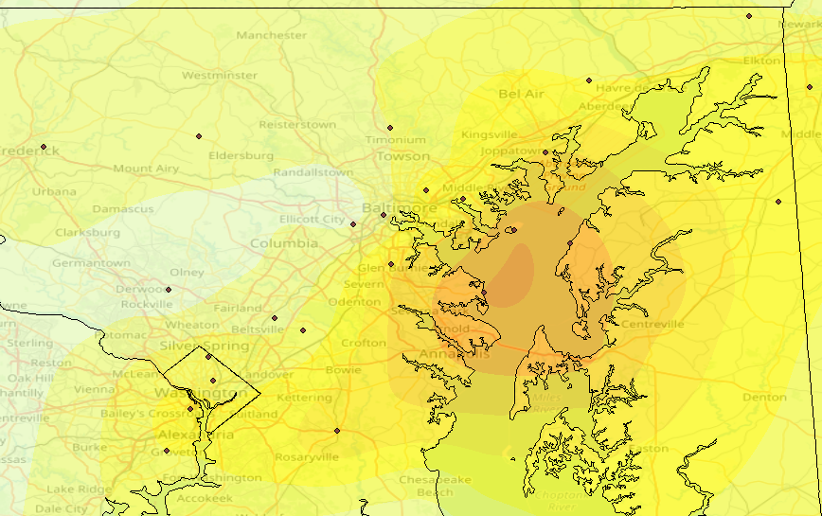
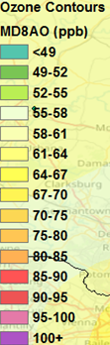
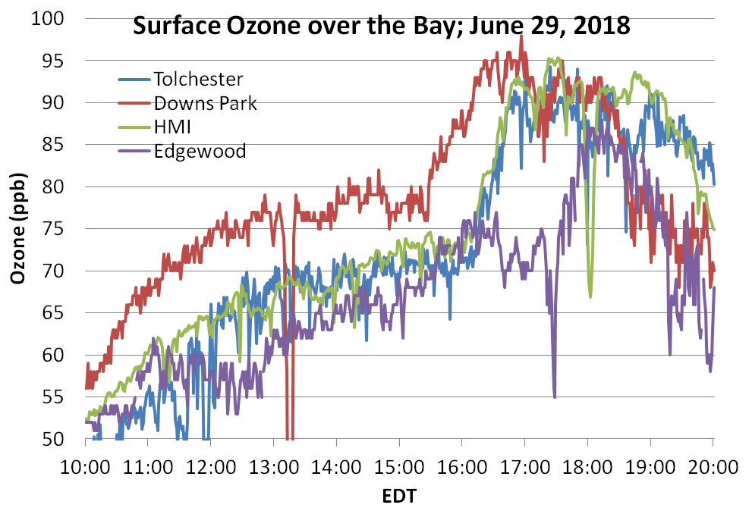
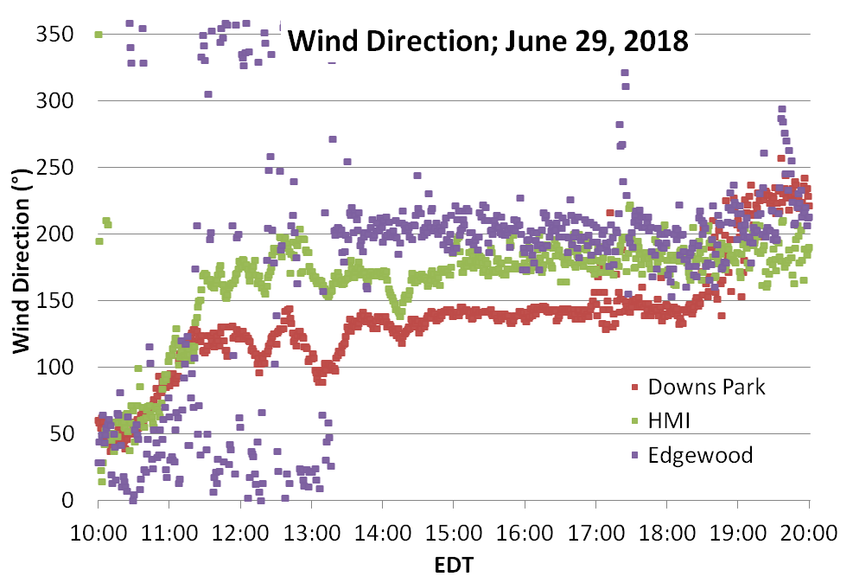
June 29, 2018; Type-α
Exceedance at HMI, Downs Park
and Tolchester Beach
93°F @ BWI; North winds
20ppb increases in 1 hour
“Classic” Edgewood late-day BB
Edgewood [70ppb Max 8-hr Avg]
Edgewood
HMI
Downs Park
Tolchester Beach
BB
Divergence
Ozone moving south to north
No change in WD with ozone
All data is considered preliminary and subject to change

Slide 25



HMI Surface Observations: June 29, 2018
Mercury and SO2 increase with Ozone
NOY increase with Ozone
HMI surface observations provided by Xinrong Ren, UMD/NOAA
Increase in SO2 and Mercury (Hg) at the same time ozone increased around 4:30pm (EDT) on June 29, 2018
Increase in NOy for the duration of the heightened ozone period
This ozone led to the
dirty Edgewood BB!
VOCs during high ozone (3-6pm) are
consistent with coal, but also with gasoline….
…But all found in Curtis Bay area (white circle)
VOC Canisters at HMI showed greatest increases (%) from 12-3pm to 3-6pm (EDT) in: o-, m&p -XYLENE
TOLUENE
ETHYLBENZENE
HEPTANE
2-METHYLHEXANE
Trichloroethene
All data is considered preliminary and subject to change

Slide 26


June 29, 2018 Observations; Type-α
1700 UTC
1 pm EDT
2000 UTC
4 pm EDT
Within 20 minutes, surface ozone at HMI rose 10+ppb
Extreme vertical ozone gradient at HMI ~20 ppb in 120 m
Greater ozone downwind of Baltimore than upstream, but not at surface of water initially (~10 m)
Still ~70ppb of ozone at Bay surface corresponding to southerly winds seen in earlier years
Ozonesondes provided by OWLETS-2 Science team
All data is considered preliminary and subject to change

