Slide 1
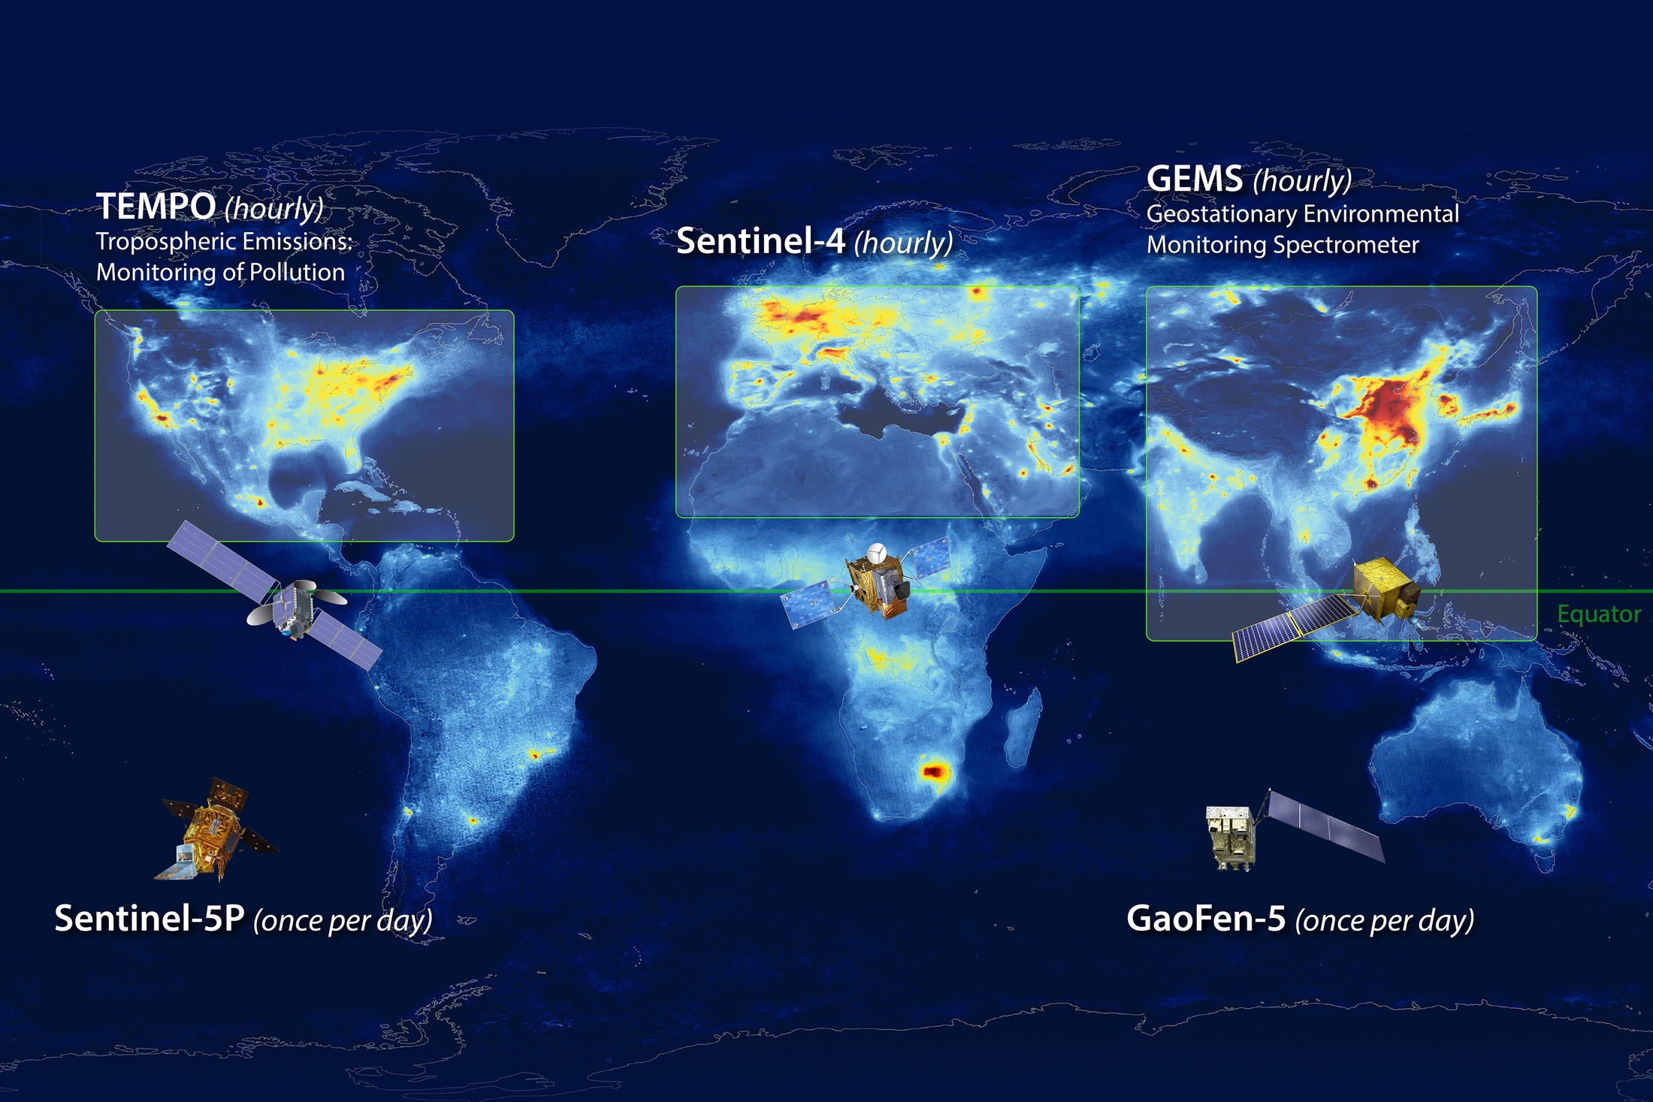
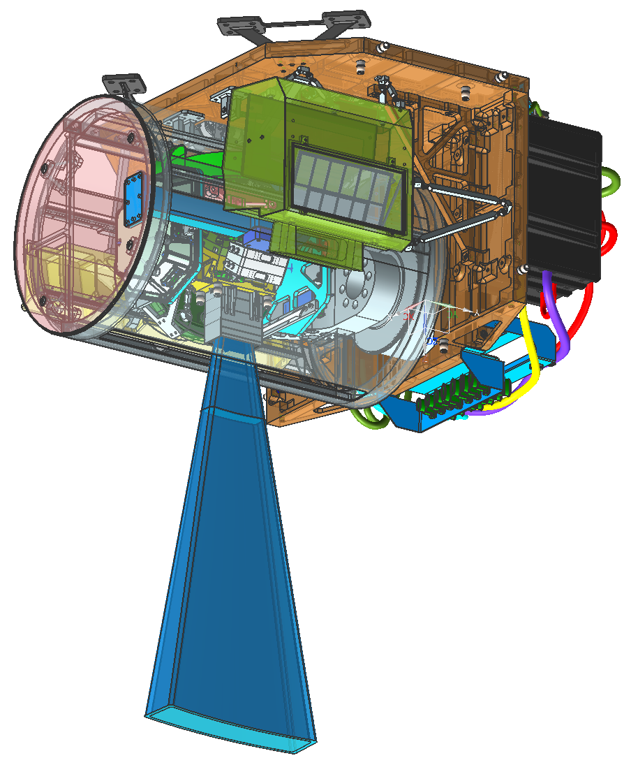
Status Updates of GEMS
tempo.si.edu
gems1.yonsei.ac.kr
MAIA (once per day)
Image Credit: NASA LaRC
Jhoon Kim*, GEMS Science Team, & NIER
* Department of Atmospheric Sciences, Yonsei University, Seoul, Korea

Slide 2
Development of Satellite RS for AC
week
VIIRS
TROPOMI
SEAWIFS
GOSAT₍₃₎
MOPITT(5)
SCIAMACHY(3)
MODIS
OMI
MAIA
IASI(0.5)
GOME(3)
LEO
day
OCO-2, TANSAT
GOME-2(1.5)
MISR(9)
TES(16)
GF-5
GeoCarb
GCOM
TOMS
TEMPO
OMPS
Temporal Resolution
GOCI-2
GEMS
Sentinel-4
hr
GOCI
INSAT 3D
GEO
MI
FY-4A
Aerosol
AHI
ABI
AMI
MTSAT
GOES-8
Trace Gases
min
Purple : UV-Vis
Red : IR
White : UV - IR
Italic & dashed line : to be launched
GHG(CH₄,CO₂)
0.1
1
10
100
1000
Spatial Resolution (km)

Slide 3
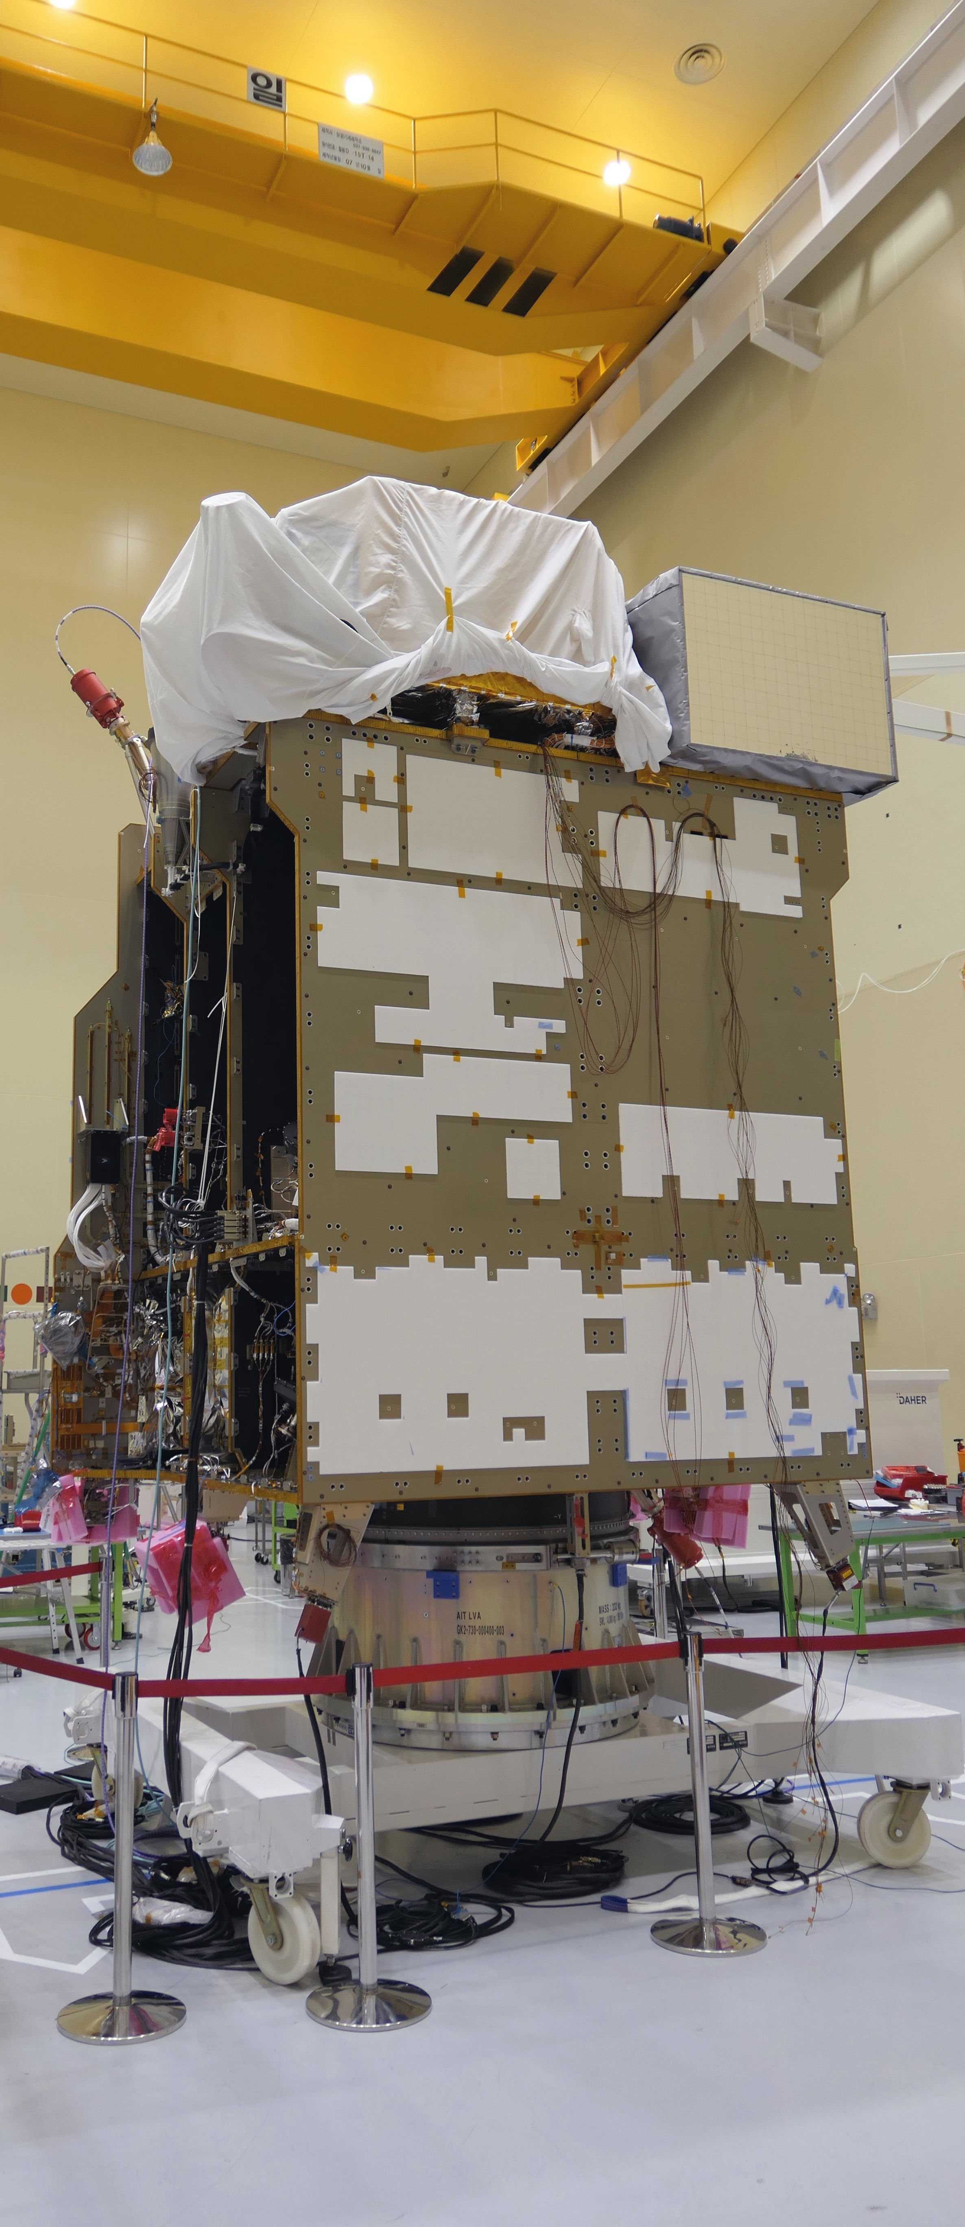
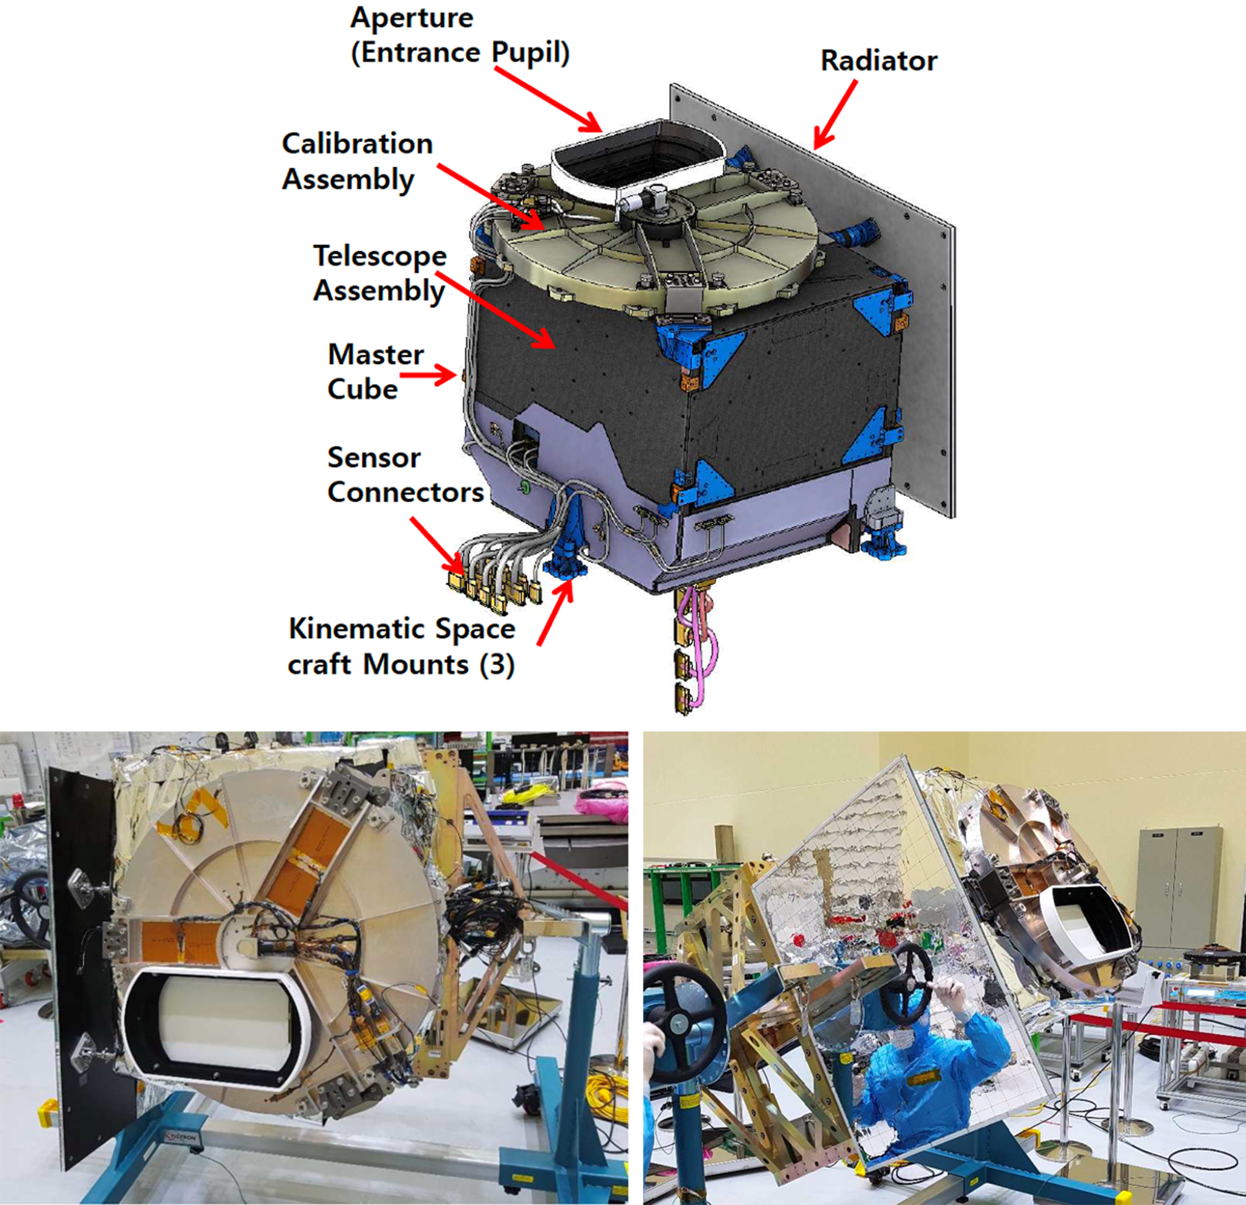
GEMS FLIGHT MODEL
Scanning UV-visible Spectrometer
Onboard GK-2B
Under AIT to GK-2B S/C
Vibration Test finished
Acoustic Test : this week
Separation Shock Test : next week
Thermal-Vac : Jul-Aug 2019
PSR : Nov., 2019
GK-2A launched in Dec., 2018
Launch : mostly likely in Feb., 2020 (Guiana Kourou)

Slide 4
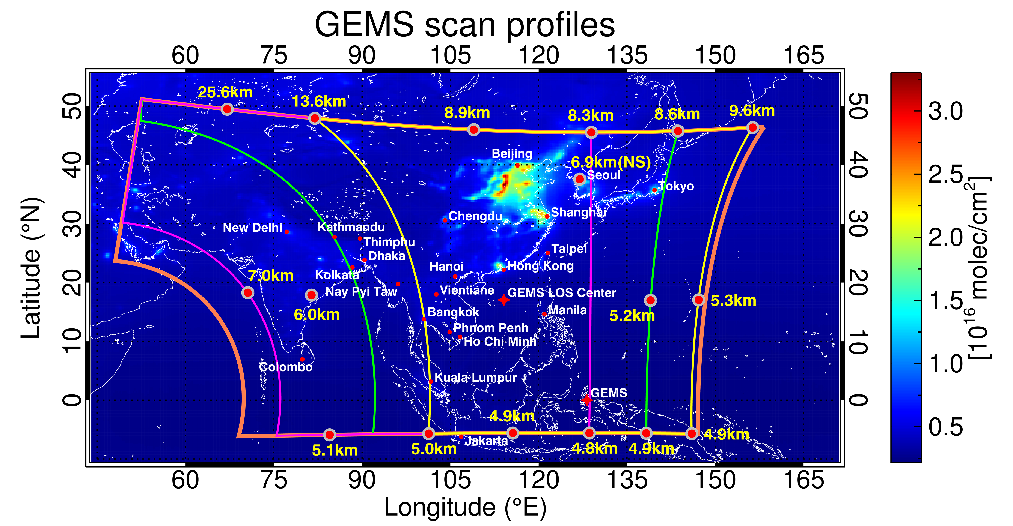
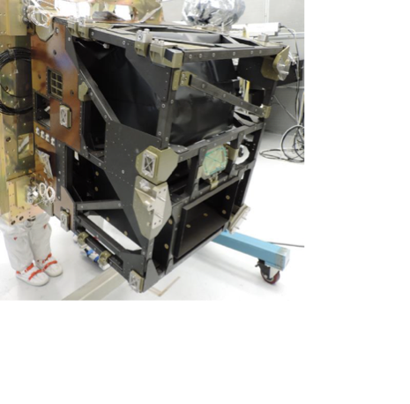
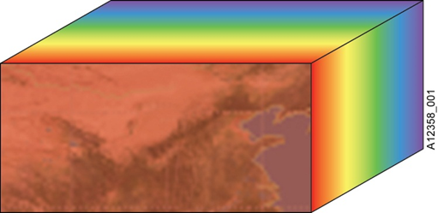
GEMS E-W SCAN SCENARIO
Morning
Noon
Afternoon
2000 N-S x 697 E-W
x 8 times/day
= 11,152,000 spectrum/day
N
S
λ
y(t)
W
E

Slide 5
GEMS Baseline products (21)
Num | Product | Importance | Min (cm⁻²) | Max (cm⁻²) | Nominal (cm⁻²) | Accuracy | Window (nm) | Spat Resol (km²)@Seoul | SZA (deg) | method
3 | TropO₃ StratO₃ TotalO₃ | Oxidant Pollutant O₃ layer | 4x10¹⁷ | 2x10¹⁸ | 1x10¹⁸ | 3%(TOz) 5%(Stra) 20(Trop) | 300-340 | 7 x 8 | < 70 | OE TOMS
4 | AOD AI SSA AEH | Air quality Climate Public Health | 0 (AOD) | 5 (AOD) | 0.2 (AOD) | 20% or 0.1@ 400nm | 300-500 | 3.5 x 8 | < 70 | Multi-λ O₂O₂ OE
1 | HCHO | VOC proxy | 1x10¹⁵ | 3x10¹⁶ | 3x10¹⁵ | 1x10¹⁶ cm⁻² | 328.5-356.5 | 7 x 8 x 4 pixels | < 50 | DF
1 | CHOCHO |  | 1x10¹⁴ | 1x10¹⁵ | 5x10¹⁴ | 1x10¹⁵ cm⁻² | 435-461 | 7 x 8 x 4 pixels | < 50 | DF
2 | TropNO₂ StratNO₂ | O₃ precursor | 3x10¹³ | 1x10¹⁷ | 1x10¹⁴ | 1x10¹⁵ cm⁻² | 425-450 | 7 x 8 x 2 pixels | < 70 | DOAS
1 | SO₂ | Aerosol precursor Volcano | 6x10⁸ | 1x10¹⁷ | 6x10¹⁴ | 1x10¹⁶ cm⁻² | 310-330 | 7 x 8 x 4 pixels x 3 hours | < 50 | DOAS PCA
4 | UVI VitD UVI DNA UVI Plant UVI | Public health | 0 | 12 62 25 48 | 6.8 33 mWm⁻² 12 mWm⁻² 25 mWm⁻² | 20% | 300-360 | 7 x 8 | < 70 | Multi-λ RTM
2 | Surface Prop. (LER, BRDF) | Environment | 0 | 1 | - | 20% | 300-500 | 3.5 x 8 | < 70 | Multi-λ
3 | ECF CCP CRF | Retrieval Climate | 0 (COD) | 50 (COD) | 17 (COD) | 20% | 300-500 | 7 x 8 | < 70 | O₂O₂ RRS
5

Slide 6
GEMS PROCESSORS
L2 Processor
L1 Processor
Newly Added Codes which reflect latest test data since CDR
Codes which need modifications/refinements to achieve optimal performance
Code which should be implemented to achieve an optimal performance

Slide 7
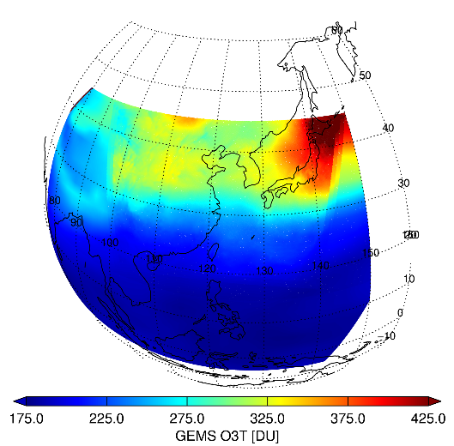
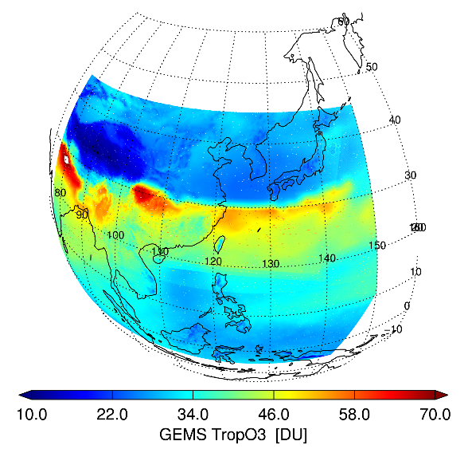
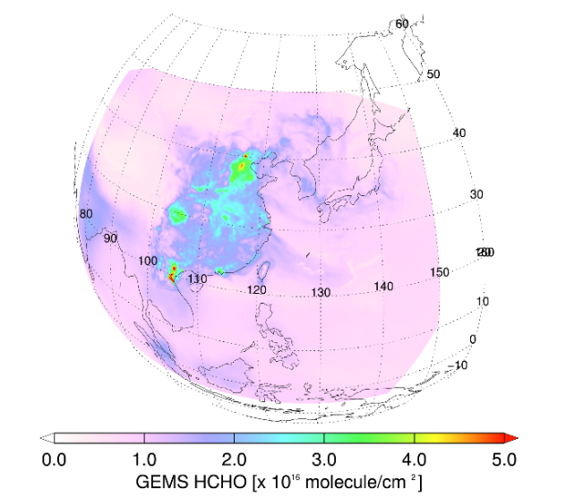
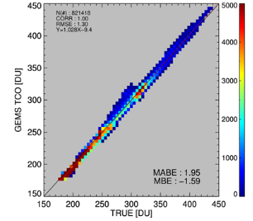
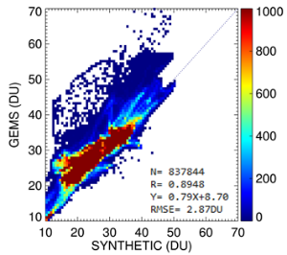
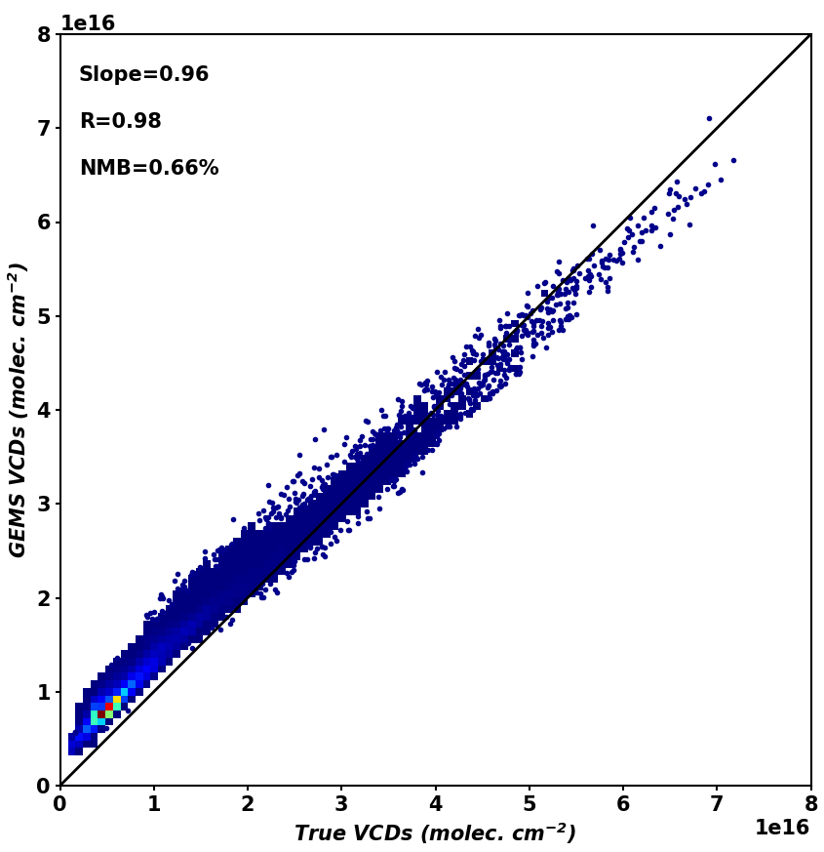
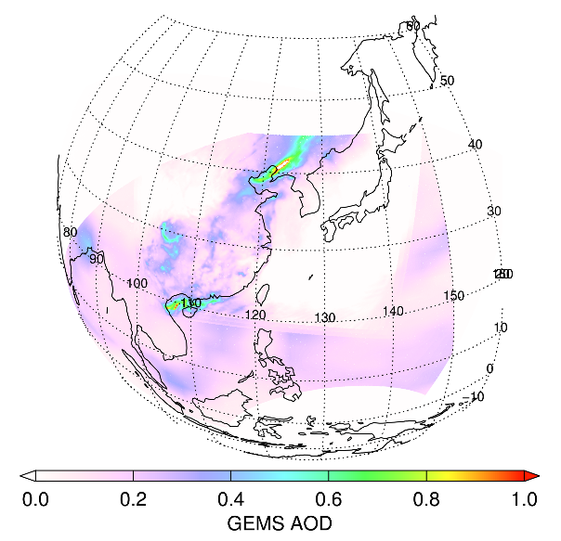
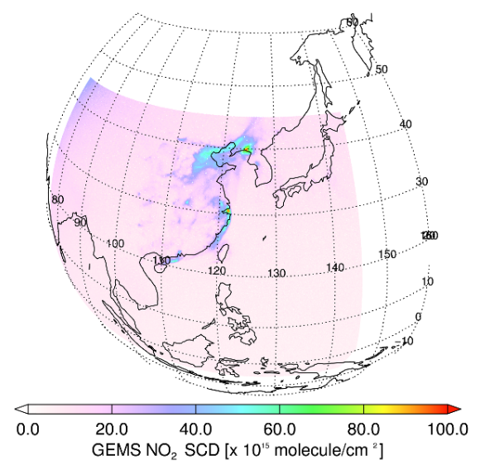
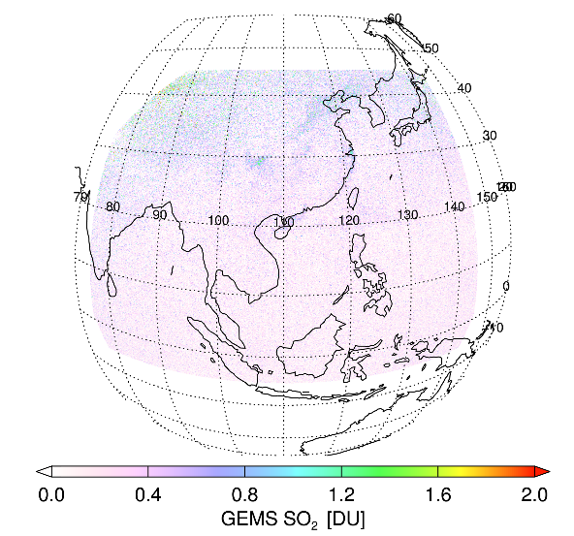
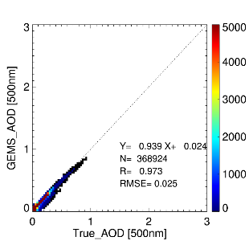
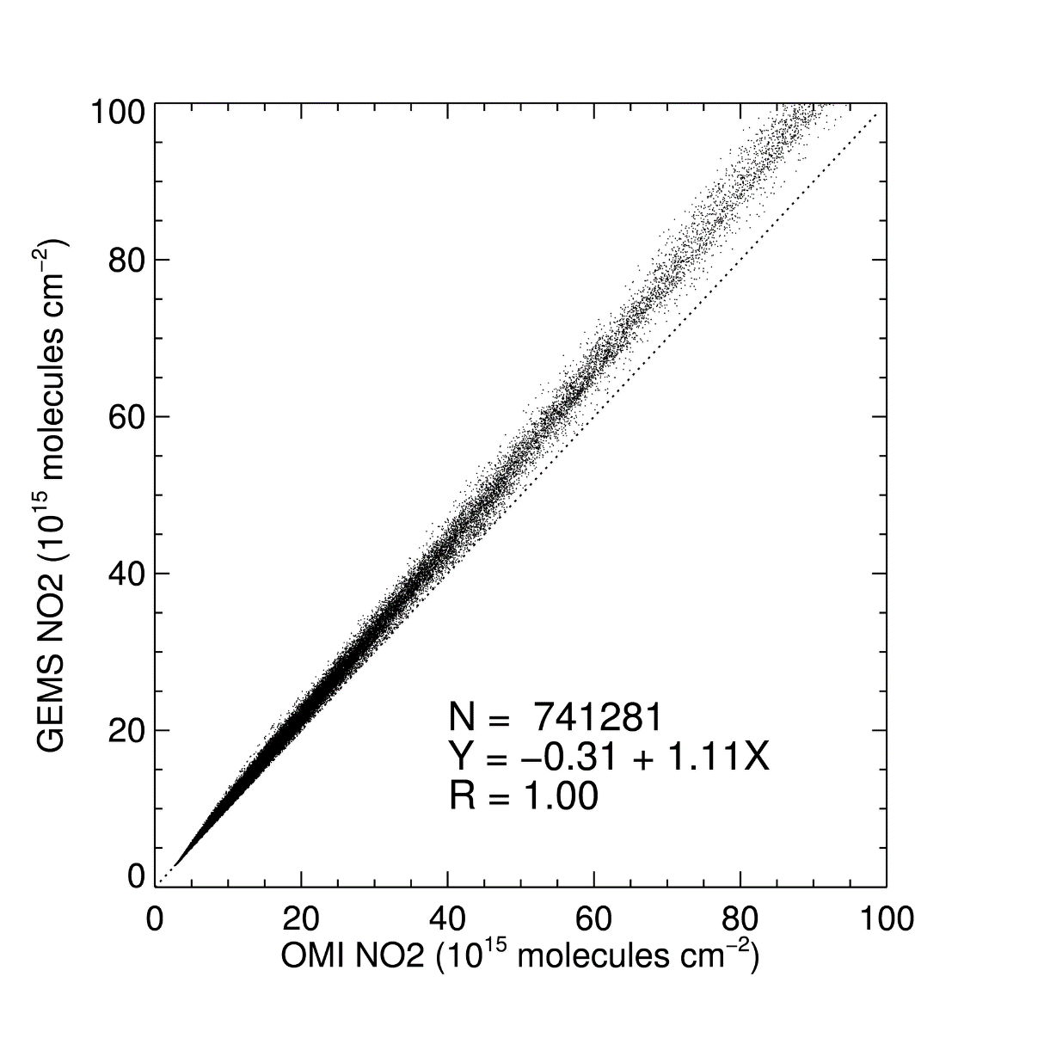
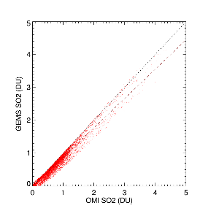
GEMS L2 Algorithm Test with Simulated Radiance
2016. 01. 15. 03 UTC
R > 0.9, and R=0.89 for TropO3
O3T (Total O₃)
O3P (Trop O₃)
HCHO
R=1.00
R=0.89
R=0.98
AOD
NO₂
SO₂
R=0.97
R=1.00
R=0.98
7

Slide 8
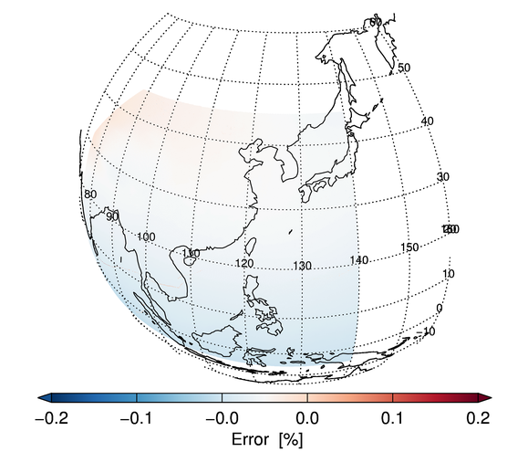
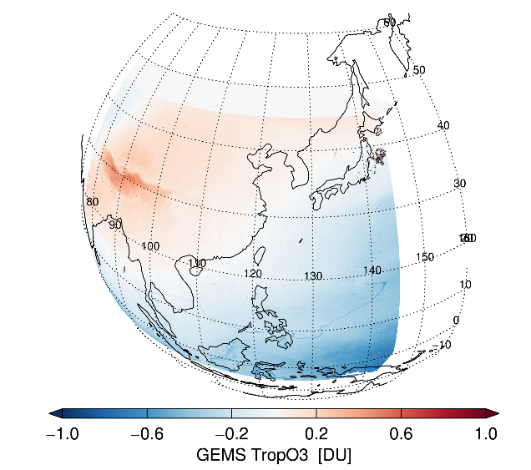
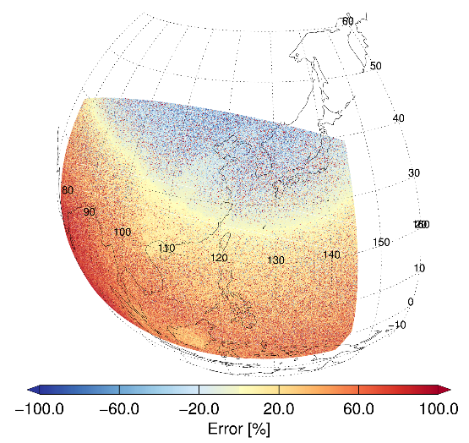
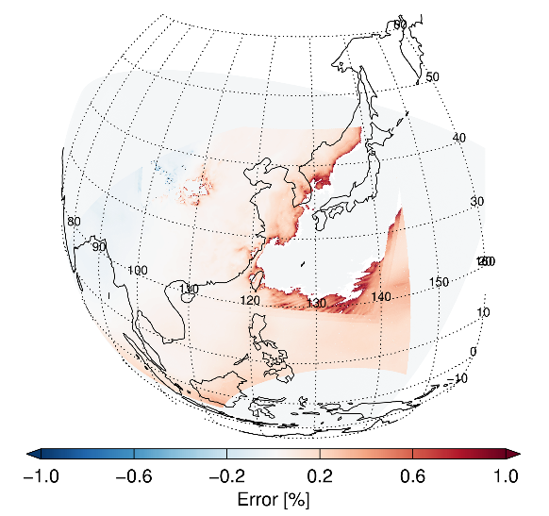
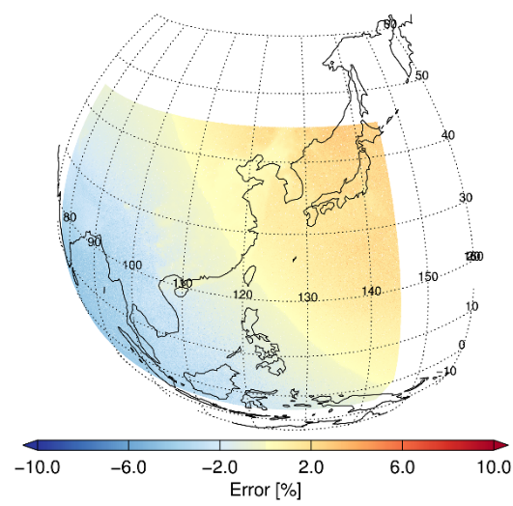
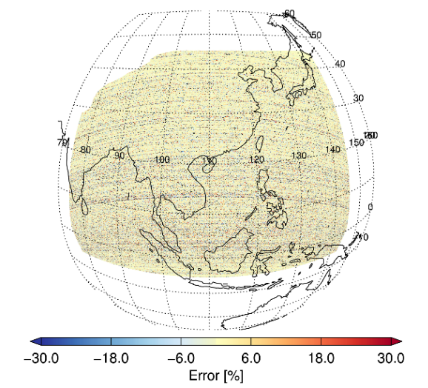
Error due to noises added to the Simulated Radiance
Noise based on SNR, and polarization added
Trop O3 and HCHO are sensitive to noises
Less geometry dependent noise effect for SO₂ due to PCA
O3T (Total O₃)
-0.2~0.2%
O3P (Trop O₃)
-1~1%
HCHO
-20%~
AOD
-1~1%
NO₂
-6~6%
SO₂
~6%
8

Slide 9
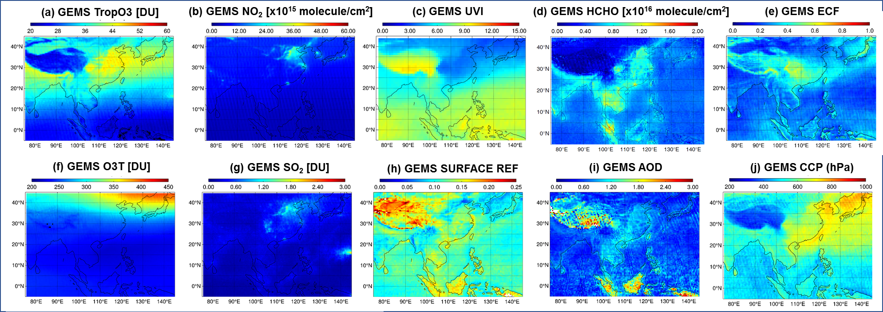
GEMS L2 Algorithm Test with OMI L1B data
[Mean value of GEMS L2 simulated with OMI L1B (0.5° x 0.5°)]
Periods : 2005.01.01 – 2005.12.31
Retrieved products were validated with ground-based measurement data or OMI Level 2 operational products.
[Intercomparison results of GEMS algorithm using OMI L1b data V003]
 | Corr.(R) | Slope | Intercept | RMSE | References | Credits
O₃ (Total) | 0.97 | 1.00 | 2 DU | 2.53 DU | Brewer Spectro-photometer | Jae H. Kim
O₃ (Trop) | 0.93 | 1.07 | -3.14 DU | 5.14 DU | Ozonesonde
HCHO | 0.92 | 1.01 | 3.3 x 10¹⁴ molec/cm² | 3.14 x 10¹⁵ molec/cm² | OMI Products | Rokjin J. Park
NO₂ | 0.87 | 1.34 | -2.29 x 10¹⁵ molec/cm² | 2.66 x 10¹⁵ molec/cm² | OMI Products | Hanlim Lee
SO₂ | 0.75 | 0.72 | 0.15 DU | 0.43 DU | OMI Products
ECF | 0.96 | 0.96 | 0.007 | 0.026 | OMI Products | Yong-Sang Choi
CCP (ECF>0.2) | 0.94 | 0.99 | -28.45 hPa | 68.11 hPa | OMI Products
Surface Ref. | 0.76 | - | - | 0.033 | MODIS BRDF | Kwon-Ho Lee
AOD | 0.85 | 0.83 | 0.16 | 0.27 | AERONET | Jhoon Kim
UV Index | 0.99 | 1.02 | -0.07 | 0.54 | OMI Products
Notes:
Previously, developed GEMS L2 algorithm are tested with OMI L1B data.
Top Figure shows the Mean value of GEMS L2 simulated with OMI L1B data.
Retrieved products were validated with ground-based measurement data or OMI Level 2 operational products.
The Table shows Intercomparison results of GEMS algorithm using OMI L1B data.
Compared with OMI or ground-based measurement data, it showed a high correlation coefficient over 0.8

Slide 10
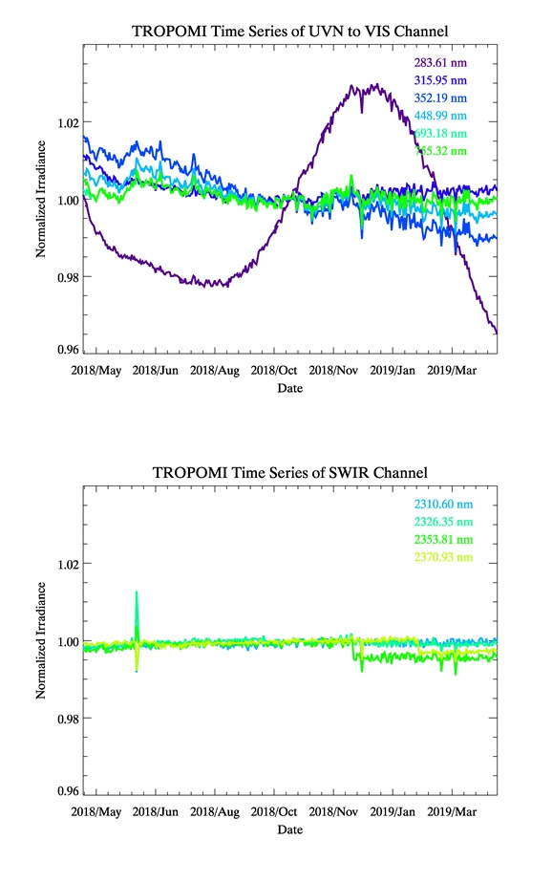
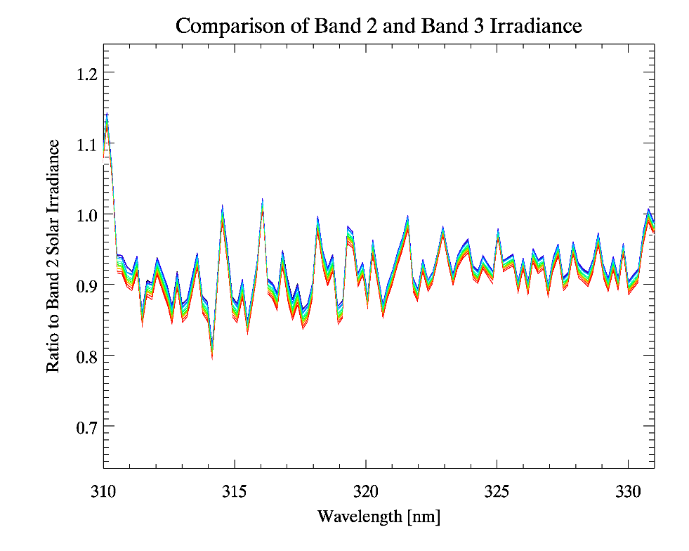
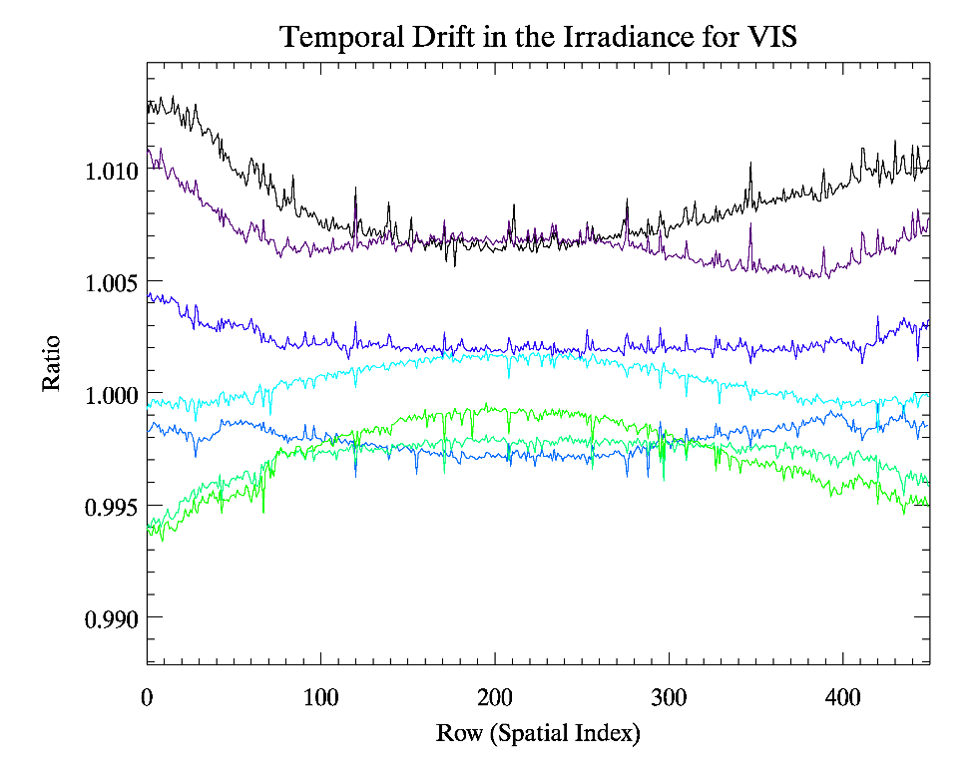
TROPOMI Irradiance Data
20180430
20180625
20181130
20190123
20190317
Irradiance Time Series of UV to VIS
Ratio of Band 3 to Band 2 Irradiance
Temporal Drift in the Irradiance for VIS
20180430
20180625
20181130
20190123
20190317
20180430
20180625
20181130
20190123
20190317
20180601
20180917
20181212
20190102
20190306
20180430
20180625
20181130
20190123
20190317
20180430
20180625
20181130
20190123
20190317
20180430
20180625
20181130
20190123
20190317
BD1
Irradiance Time Series of SWIR
Periods : 2018.04.30 – 2019.04.30
Consistency in time series of irradiance (< 2%) except BD1
Radiometric discrepancy between band 2 and band 3 (band 2 > band 3, Tends to increase with time)
Vis channel : Temporal drift (0.5-1%) due to diffuser degradation
Myoung-Hwan Ahn (terryahn65@ewha.ac.kr)
Notes:
Based on the algorithm presented above, TROPOMI data were analyzed.
For the Irradiance measurement data, it showed consistency in time series except for BD1.
Also, Radiometric discrepancy between band 2 and band 3 are found.
These discrepancy tends to increase with time.
Not only in UV channel, Vis channel also showed temporal drift about 0.5-1% due to diffuser degradation.
TROPOMI measured irradiance (30.04 2018 – 30.04.2019)
- 1년치 모든 채널에서 관측된 값을 이용함 2018.10.31 자 자료를 이용해 정규화하여 비교한 1년치 자료 간 변동성은 밴드 1번을 제외하고 2%미만으로 안정적으로 나타나나, SWIR 채널에서 특정 기간에 나타나는 비 이상적인 감소 및 증가는 확인이 필요 함.
밴드 2와 밴드3간 겹치는 영역에 대한 비교 시 차이가 존재하며, 이 차이는 일년 치 자료 비교 시 시간이 갈 수록 증가하는 경향이 나타남. (밴드3가 상대적으로 값이 작음)UV 채널 뿐 아니라 vis 채널에서도 diffuser degration 에 따른 관측 복사 값의 저하 현상이 확인됨 (0.5-1% 정도)

Slide 11
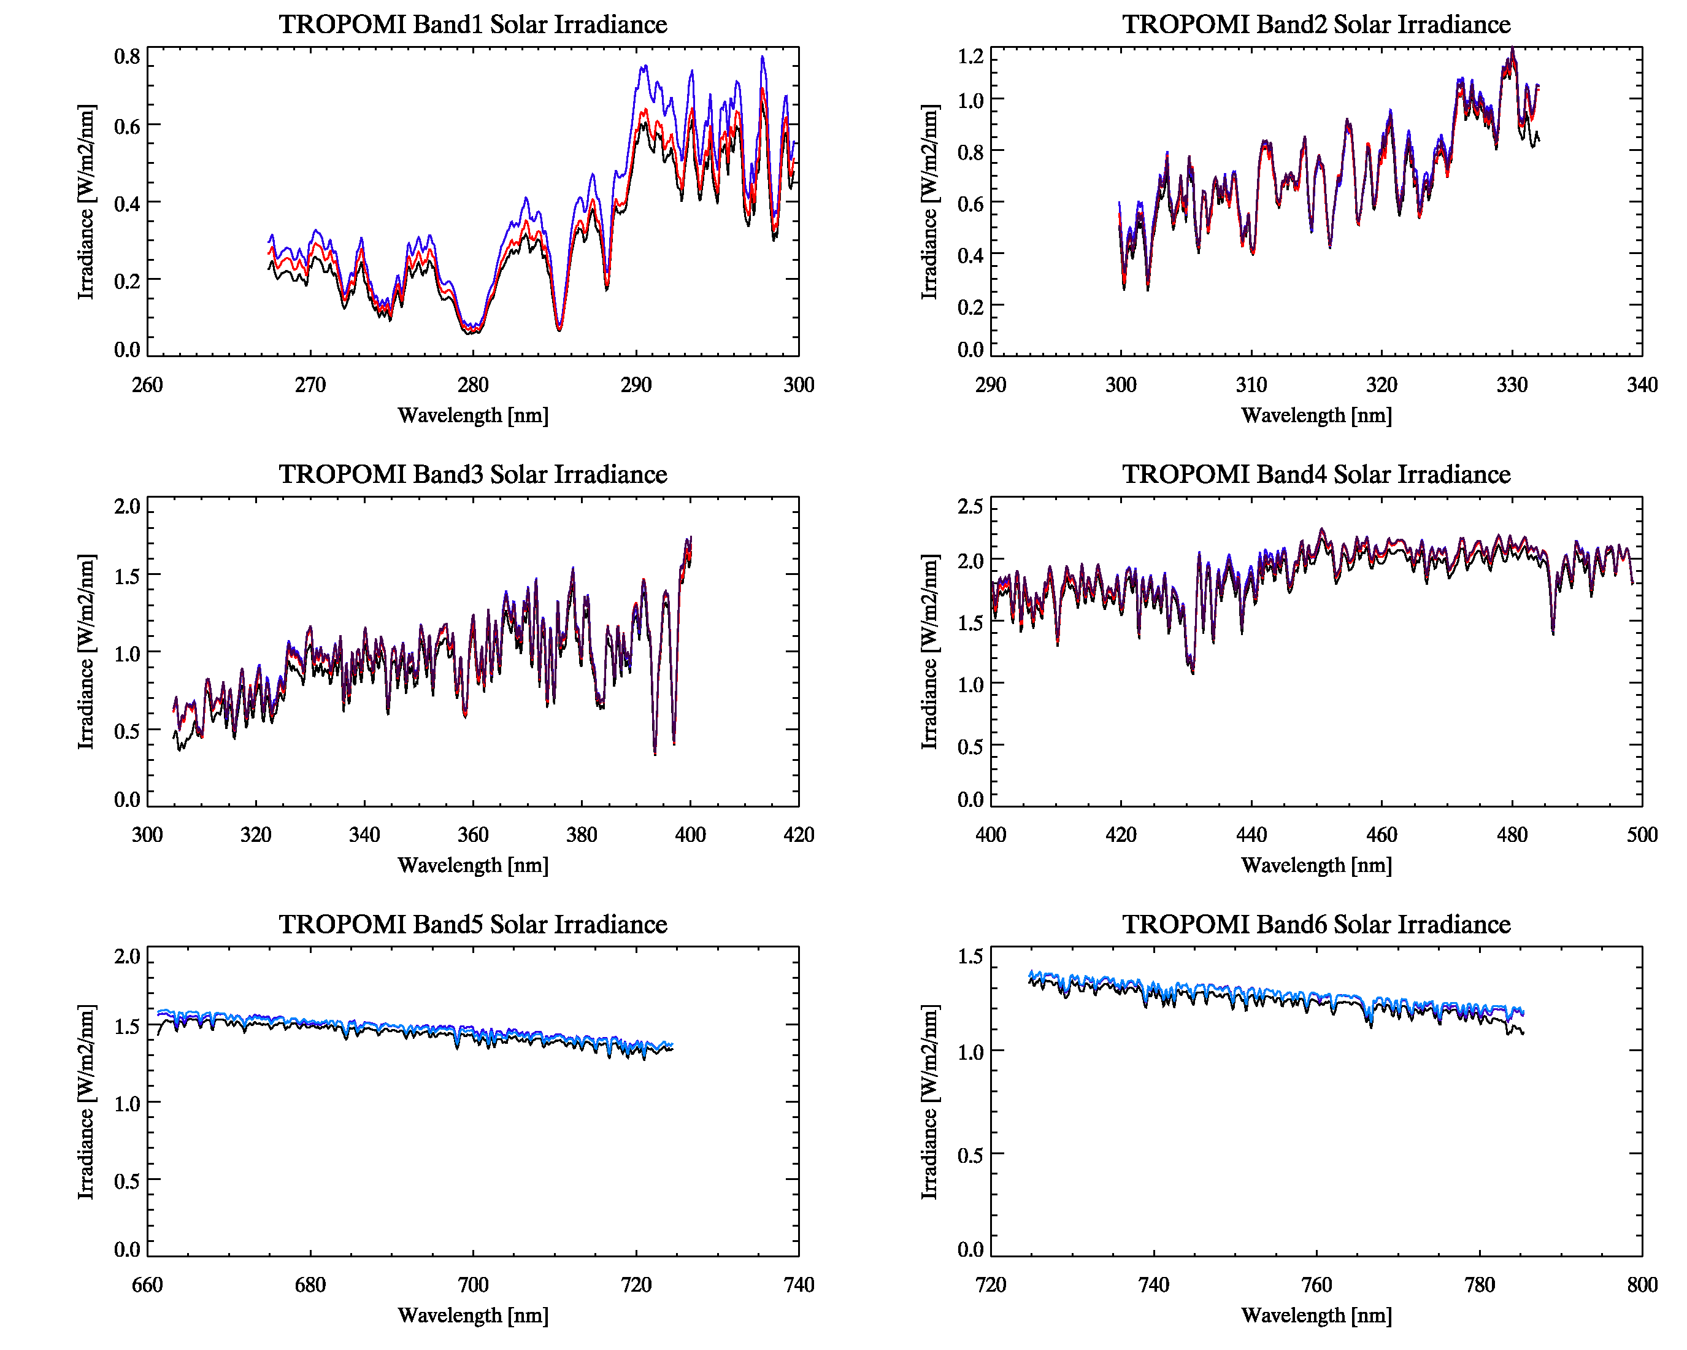
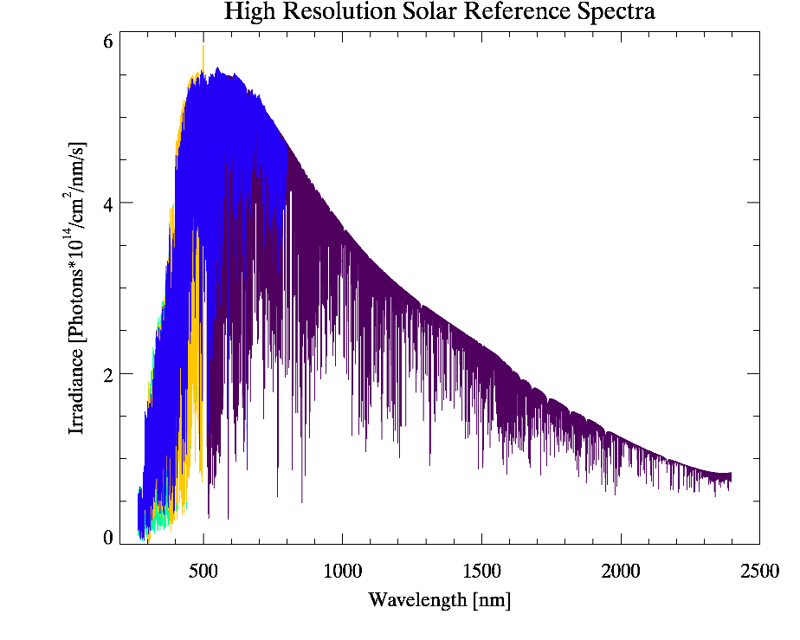
TROPOMI Irradiance Data
Validation using high resolution solar reference spectra (convoluted using TROPOMI ISRF)
Regardless of the reference solar spectrum, 3-10% differences
[Solar Irradiance at each Band]
[High Resolution Reference Spectra]
TROPOMI
SAO
KNMI
TROPOMI
SAO
KNMI
KNMI (Dobber et al 2008)
QAS (Julian et al 2017)
SAO (Chance and Kurucz 2010)
JPL (Toon et al 2014)
Band1
Band2
Band3
TROPOMI
SAO
KNMI
QAS
TROPOMI
SAO
KNMI
QAS
Band4
TROPOMI
SAO
JPL
TROPOMI
SAO
JPL
Band5
Band6
Myoung-Hwan Ahn (terryahn65@ewha.ac.kr)
Notes:
TROPOMI Irradiance data are validated using high-resolution solar references spectra.
The figure on the left shows the high resolution standard solar spectrum // used in the study with the wavelength.
For all bands, regardless of the reference solar spectrum, TROPOMI solar irradiance values ​​show discrepancies within 3-10% of the reference data
TROPOMI measured irradiance (30.04 2018 – 30.04.2019) - 1년치 모든 채널에서 관측된 값을 이용함 2018.10.31 자 자료를 이용해 정규화하여 비교한 1년치 자료 간 변동성은 밴드 1번을 제외하고 2%미만으로 안정적으로 나타나나, SWIR 채널에서 특정 기간에 나타나는 비 이상적인 감소 및 증가는 확인이 필요 함 밴드 2와 밴드3간 겹치는 영역에 대한 비교 시 차이가 존재하며, 이 차이는 일년 치 자료 비교 시 시간이 갈 수록 증가하는 경향이 나타남. (밴드3가 상대적으로 값이 작음) UV 채널 뿐 아니라 vis 채널에서도 diffuser degration 에 따른 관측 복사 값의 저하 현상이 확인됨 (0.5-1% 정도)

Slide 12
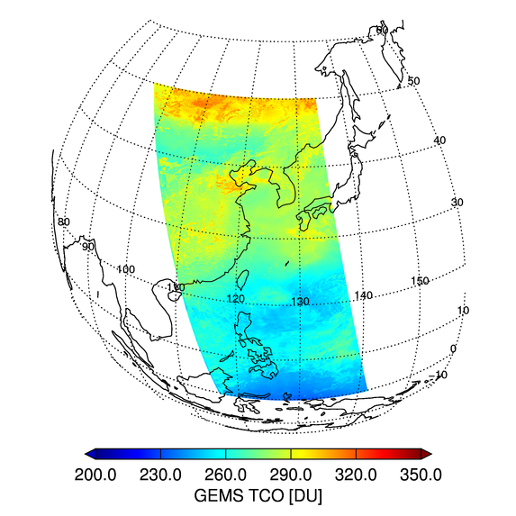
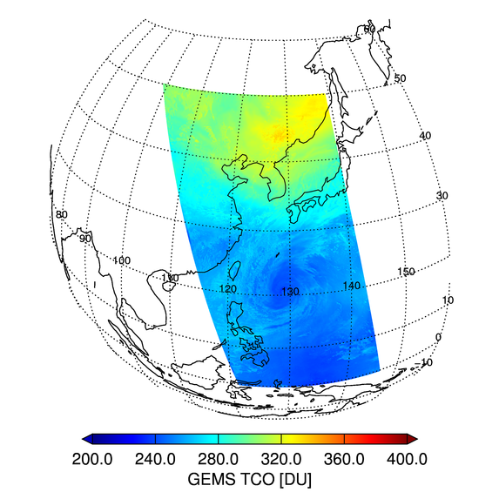
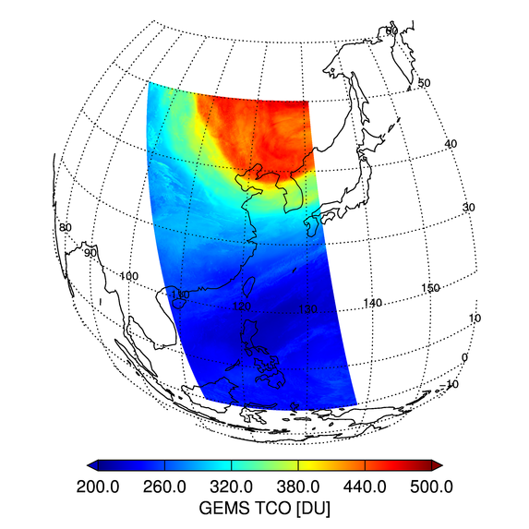
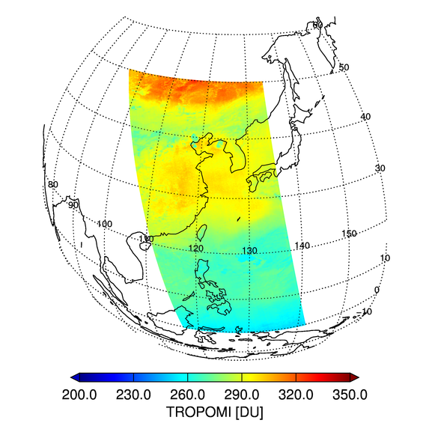
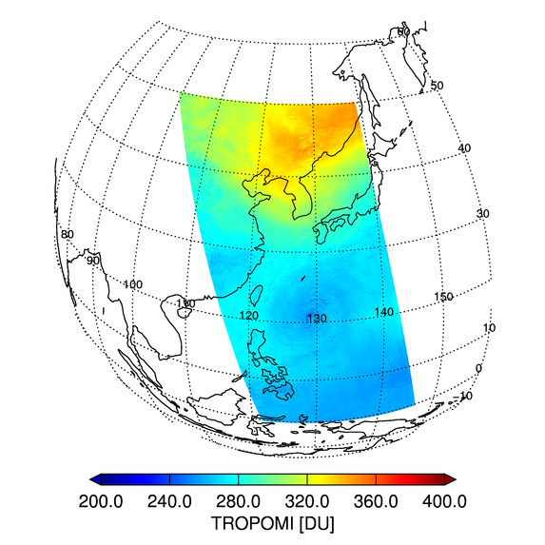
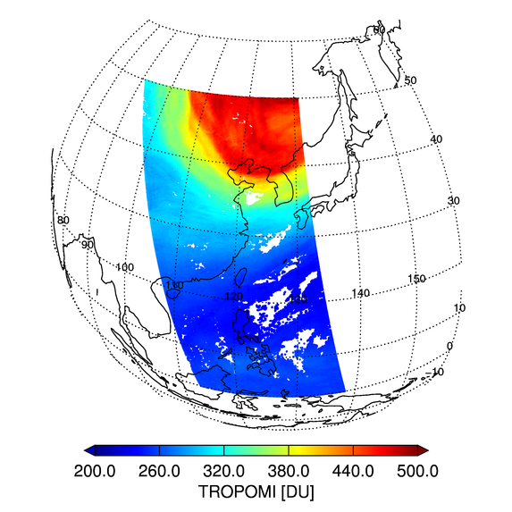
Total Ozone
2018.08.08
2018.09.26
2019.03.30
GEMS L2
Algorithm
High Value
in Spring
TROPOMI L2
(Operational)
GEMS : TOMS method, TROPOMI : DOAS method
GEMS L2 algorithm products slightly underestimate TROPOMI operational products.
Jae H. Kim (jaekim@pusan.ac.kr)
Notes:
For the L2 product, we tried to analyze the TROPOMI // by comparing the patterns of the products // with GEMS algorithm products.
GEMS Total Ozone algorithms are based on TOMS method, and TROPOMI algorithm are based on DOAS method.
For Total Ozone, the GEMS L2 algorithm and Operational results showed similar pattern.
High Ozone concentration was observed in April (500 DU ) and the Low Ozone Concentration at 280 DU was shown in autumn.
However, GEMS algorithm products slightly underestimated TROPOMI products.

Slide 13
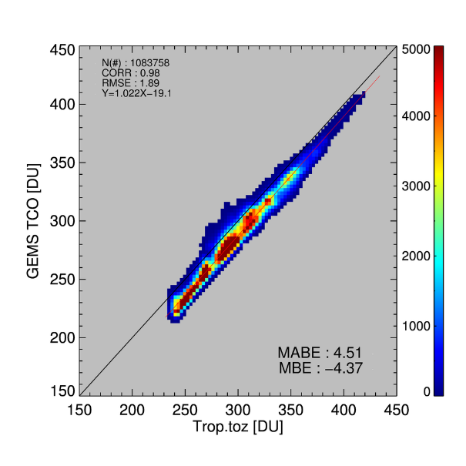
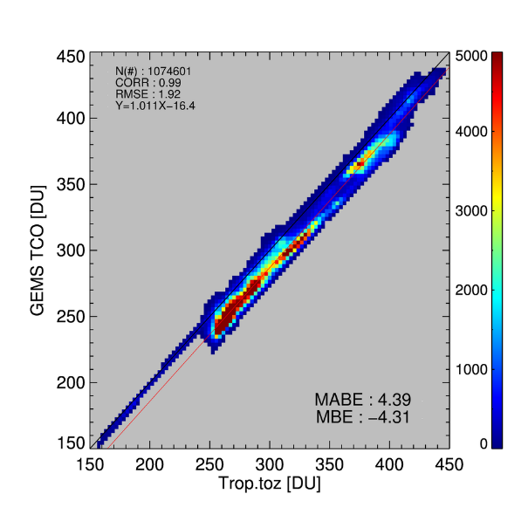
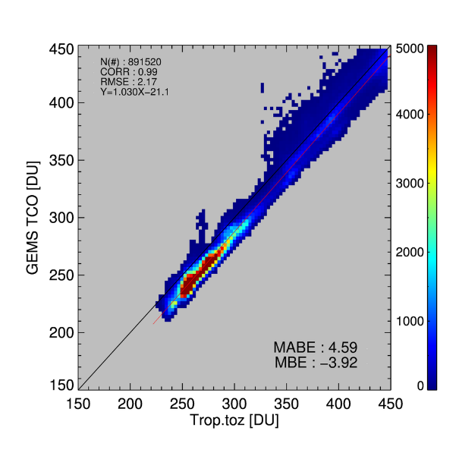
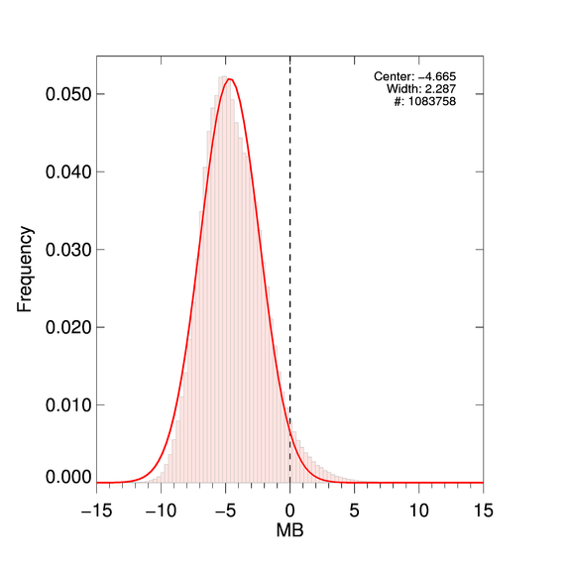
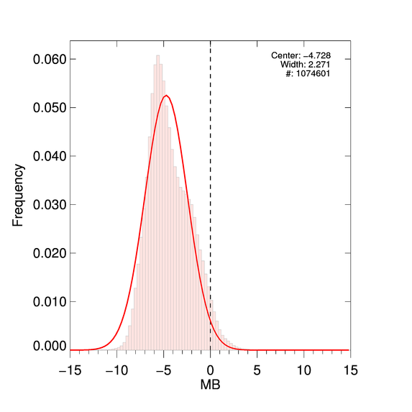
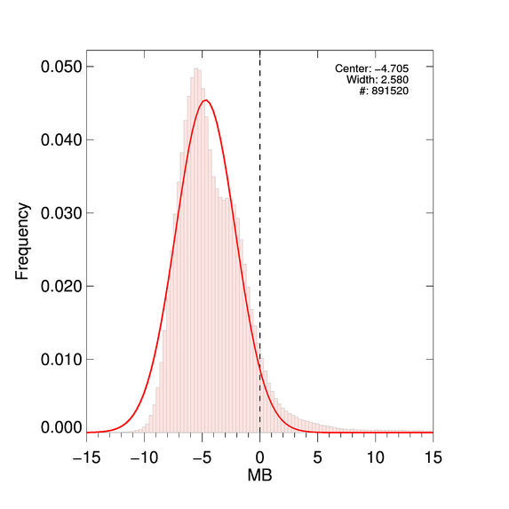
Total Ozone
2018.08.08
2018.09.26
2019.03.30
Scatter Plots
(X: TROPOMI L2,
Y : GEMS L2 Algorithm)
Histogram of
Mean Bias
The mean differences in the ozone column derived from the two algorithms was about 0-4%, No Seasonal Dependence
Differences are possibly due to algorithmic rather than instrumental errors.
For OMI, differences of ozone column between OMI-TOMS and OMI-DOAS vary from 0 to 9 DU (0-3%) [Kroon, M., et al., 2008]
Jae H. Kim (jaekim@pusan.ac.kr)
Notes:
We analyzed the discrepancy with scatter plot and histogram,
GEMS Total Ozone Algorithm Products Underestimates the Operational Products about 4%, and there were no seasonal dependence for the Biases.
Some of the differences are possibly due to algorithmic rather than instrumental errors.
For OMI, differences of ozone column between OMI-TOMS and OMI-DOAS vary from 0 to 9 DU (0-3%)

Slide 14
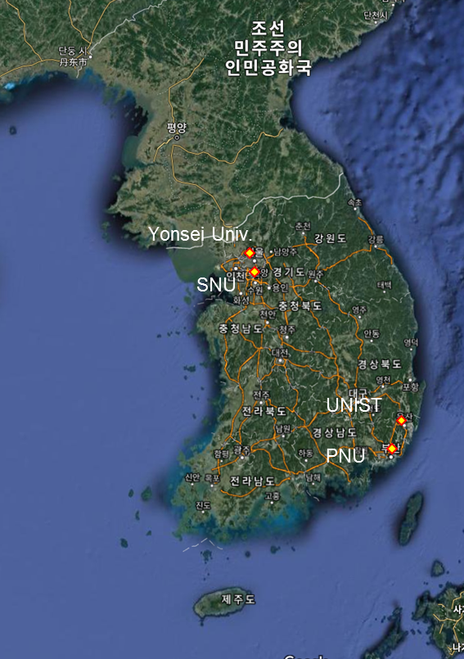
Validation of Operational Total Ozone with Pandora data in Korea
Seoul
Busan
Seoul
Busan
X: Pandora, Y : TROPOMI L2 Total Ozone (Operational)
Period : 2018.04.30 – 2019.03.05
High Correlation, overestimate about 18 DU (~6%)
Pandora : SZA < 75°, errorfit < 0.05, VCD Error < 2.0 DU
Spatial Collocation – 0.5°, Temporal Collocation – 30 min
Pandora Network in Korea
Sang-Woo Kim (sangwookim@snu.ac.kr), Chang-Keun Song (cksong@unist.ac.kr)
Notes:
The Operational Total Ozone products are validated using Pandora measurement data in Korea.
At both sites, TROPOMI Total Ozone showed good correlation coefficient, and overestimated the Pandora measurement about 6%
;-----------------------------------------------
오차 추정 요소 : effective temperature for ozone cross section in DOAS, AMF error, calibration problem in UV

Slide 15
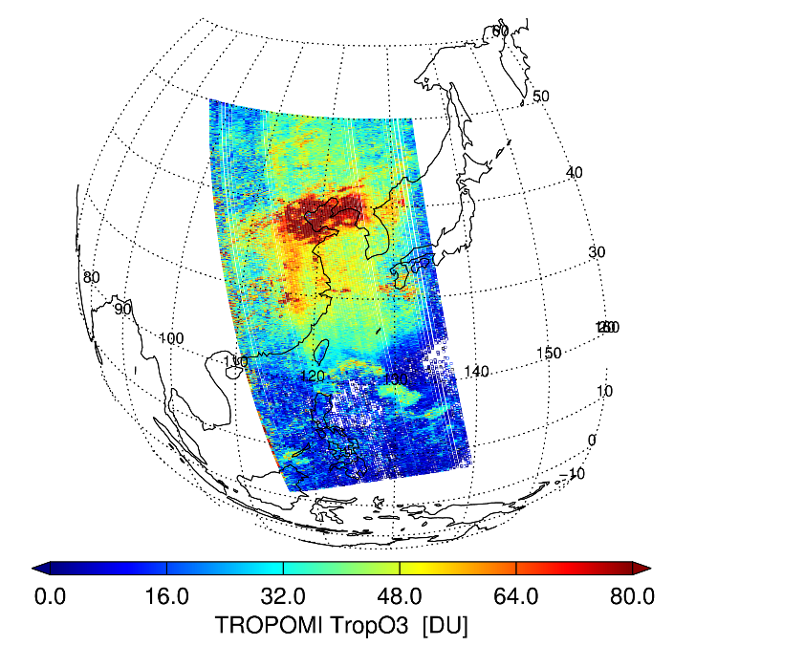
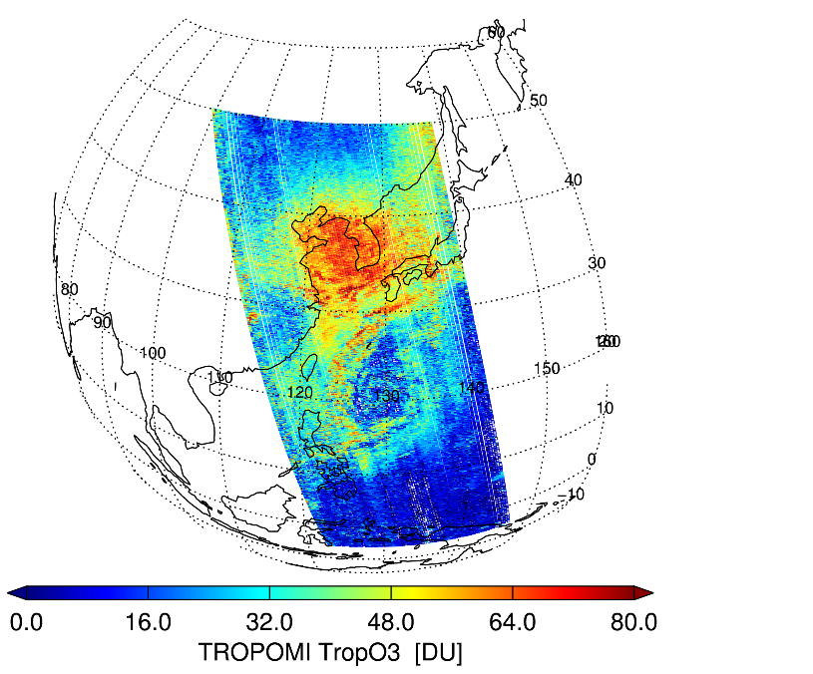
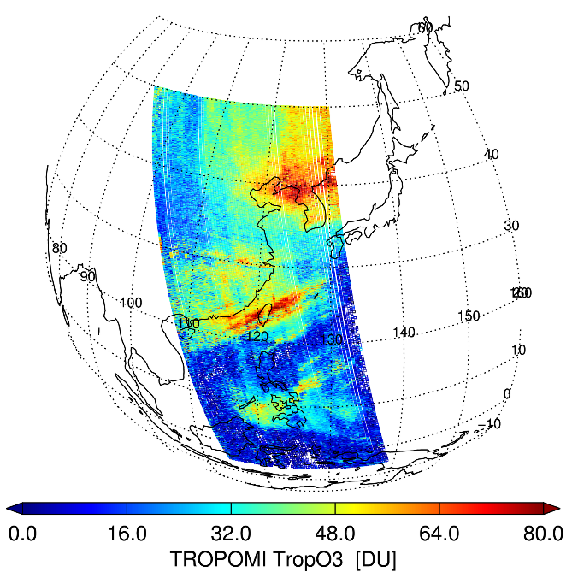
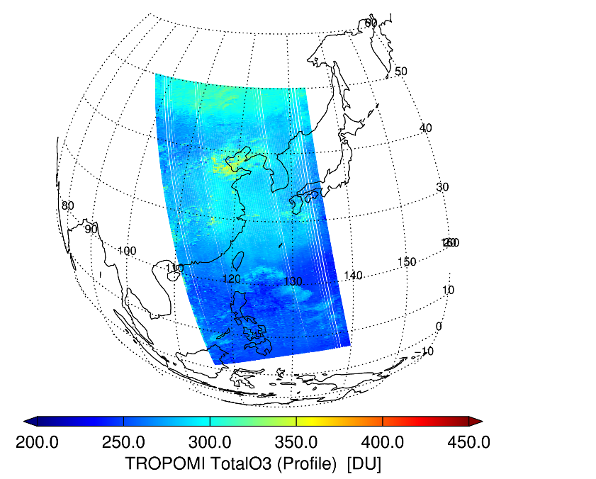
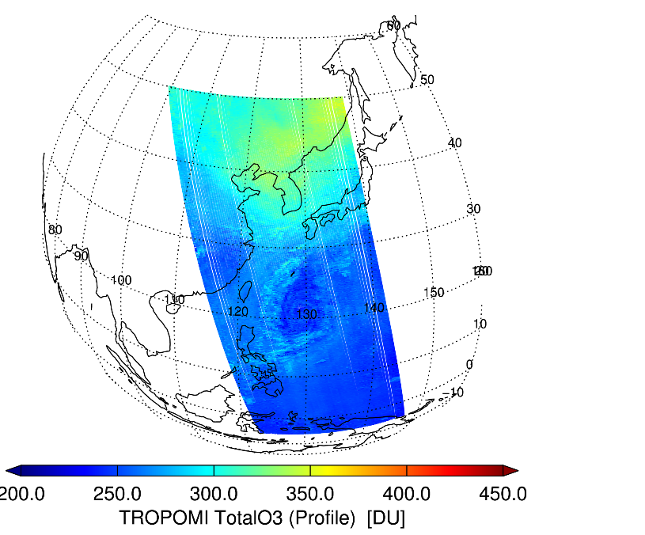
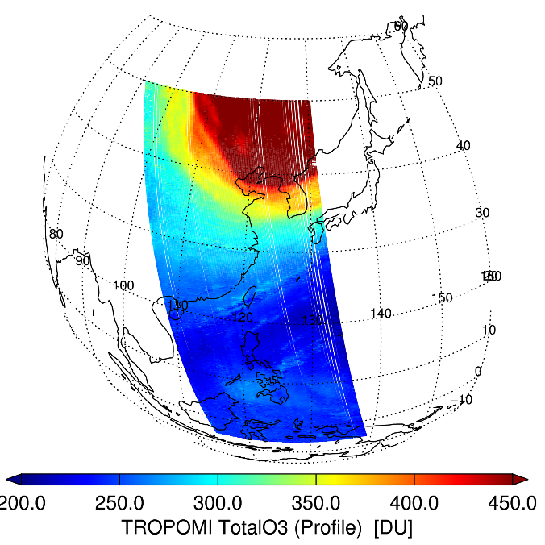
TROPOSPHERIC Ozone
2018.08.08
2018.09.26
2019.03.30
GEMS L2 Algorithm
Tropospheric Ozone
(*Operational products Not released for this period)
High in Summer
GEMS L2 Algorithm
Total Ozone
(Integrated from Ozone profile products)
Over East Asia, high tropospheric ozone are well captured well especially in summer.
Striping pattern of tropospheric ozone may be improved in the future after soft calibration.
Jae H. Kim (jaekim@pusan.ac.kr)
Notes:
For the Ozone profile, operational products are not released yet.
As a result of using GEMS algorithm, The retrieved results showed reasonable spatial distribution.
Over East Asia, high tropospheric ozone are well captured especially in summer.
Also, profile integrated Total Ozone showed significant results.
Striping pattern of Tropospheric Ozone may be improved in the future after soft calibration.

Slide 16






Nitrogen Dioxide
2018.12.12
2018.12.14
2018.12.18
Seoul Metropolitan Area
(SMA)
GEMS L2 Algorithm
VCD
China
TROPOMI L2 VCD
(Operational)
GEMS : DOAS method, TROPOMI : DOAS method, Different Slit Function may be major reason.
Hanlim Lee (hllee@pknu.ac.kr)
Notes:
For, Nitrogen Dioxide Column Amount. Both algorithms are based on DOAS method.
For Both Products. , It showed high concentrations in China and SMA
For December 18th, in 2018, a continuous NO2 plume over ocean showed the possibility of transportation of the plume.
However, GEMS showed slightly higher value compared to Operational products.

Slide 17
NO2 – Possible Reason for the Difference
 | GEMS L2 algorithm | TROPOMI L2 algorithm
Fitting Window | 432 – 450 nm | 405 – 465 nm
Applied FWHM | 0.47 nm (After Calibration), Gaussian | 0.55 nm (Based on ATBD), ISRF
Cross-section | NO2 220K (Vandaele et al. [1998]) | NO2 220K (Vandaele et al. [1998])
 | O3 243K, 293K (Bogumil et al. [2000]) | O3 243 K (Gorshelev et al. [2014], Serdyuchenko et al. [2014])
 | Ring Chance and Spurr. [1997] | Ring Chance and Spurr. [1997]
 | O4 Thalman and Volkamer. [2013] | O4 Thalman and Volkamer. [2013]
 | No H2O | H2O
DOAS fitting window would not affect VCD.
Difference of Slit Function (FWHM) and Cross-section may be the possible reason.
Applying same fitting window, FWHM, and cross-section may reduce the difference.
Notes:
The Difference may be caused due to the fitting window, spectral calibration issue, and cross-section usage.
GEMS algorithm used FWHM of 0.47 nm after spectral calibration.
Also, Both algorithm use different cross-sections in terms of Ozone and H2O.
Difference of Slit Function (FWHM) and Cross-section may be the possible reason

Slide 18
Validation of Operational Nitrogen Dioxide with Pandora data in Korea
Seoul
Busan
Seoul
X: Pandora, Y : TROPOMI L2 Nitrogen Dioxide (Operational)
Period : 2018.04.30 – 2019.03.05
Seoul, Busan : Large City, NO₂ emissions local inhomogeneity.
→ underestimation of TROPOMI NO₂ (Relatively large FOV)
Pandora : SZA < 75°, errorfit < 0.05, VCD Error < 0.05 DU
Spatial Collocation – 0.1°, Temporal Collocation – 30 min
Busan
Pandora Network in Korea
Sang-Woo Kim (sangwookim@snu.ac.kr), Chang-Keun Song (cksong@unist.ac.kr)
Notes:
When we validate the Operational Nitrogen Dioxide with Pandora data, It is underestimated the Pandora measurements.
Since, Seoul, Busan is a large city, therefore NO2 emissions may have local inhomogeneity.
This may affect the underestimation of TROPOMI NO2, which have Relatively high FOV.

Slide 19





Formaldehyde
High HCHO over Seoul Metropolitan Area (2018.05.31)
High PM Concentration over China-Korea (2019.03.04)
GEMS L2 Algorithm
VCD
TROPOMI L2 VCD
(Operational)
[Major Reason for differences]
TROPOMI algorithm : DOAS method, 5th polynomial order.
GEMS algorithm : Non-linear fitting method, 3rd polynomial order
Rokjin Park (rjpark@snu.ac.kr)
Notes:
For formaldehyde, Significant signals were obtained, over SMA and for high PM concentration cases.
However, GEMS L2 Algorithm slightly underestimates the TROPOMI.
GEMS algorithm used Non-linear fitting method, and 3rd polynomial order, While TROPOMI algorithm are used 5th polynomial order.
Both algorithm did not consider aerosol in this retrieval.
This could be the major reason for the differences.

Slide 20






AEROSOL : Long-range transport case
AOD 443 nm (GEMS L2 algorithm)
TROPOMI HCHO (Operational)
High AOD, PM Concentration over Korea (2019.03.04)
SSA 443 nm (GEMS L2 algorithm)
TROPOMI UVAI (Operational)
[Ground PM in Seoul]
PM 10 > 180 $μ$g/m³
PM 2.5 > 120 $μ$g/m³
Notes:
Interestingly, HCHO showed similar pattern with AOD, especially for high aerosol pollution cases.
This slide shows the severe aerosol cases occurred in March in this year over Korea peninsula.
GOCI image shows severe aerosol transportation from China.
At the same time, AOD and HCHO obtained from TROPOMI showed high values.
High SSA and low UVAI implies that these plumes are weakly absorbing.

Slide 21



AEROSOL (UVAI)
2018.07.02
2019.03.04
GEMS UVAI Algorithm
(354, 388 nm)
TROPOMI UVAI
(354, 388 nm)
(Operational)
Differences in calculated normalized radiance and interpolation processes, rather than differences in algorithms, may be the cause of this slight differences.
Notes:
+/-0.3nm Radiance mean / +/-0.3nm Irradiance mean

Slide 22






Sulfur Dioxide
The eruption of Kuchinoerabujima volcano, Japan, 2019.01.17
Anthropogenic
Emission in China
2019.02.19
Northern Sulawesi & Halmahera, Indonesia
2019.03.03
GEMS L2 Algorithm
VCD
TROPOMI L2
VCD
(Operational)
GEMS algorithm : PCA based method, TROPOMI : DOAS method.
GEMS algorithm slightly overestimate for anthropogenic emission cases possibly due to the selection of Clean sector or Principle components (PCs).
Additional Test about Number of PCs selection is needed in the future analysis.
Hanlim Lee (hllee@pknu.ac.kr)
Notes:
Kuchinoerabujima : south of Kagoshima; Halmahera : just south of equator
For Sulfur Dioxide, GEMS algorithm uses PCA based method, while TROPOMI use DOAS method.
The results between GEMS L2 Algorithm and Operational Algorithm showed very similar patterns.
Both Algorithm could well capture the SO2 events such as volcano, or Anthropogenic Emissions in China.
However, it seems that GEMS Sulfur Dioxide slightly overestimate for Anthropogenic Emission cases
Possibly Due to the selection of Clean sector or Principle components (PCs)
Additional Test about Number of PCs selection is needed in the future analysis.

Slide 23






UV Index (Surface Irradiance)
Typhoon Case
2018.08.20
Severe Cloud Case
2018.08.28
Low UV Index in Winter
2018.12.22
GEMS L2 algorithm
UV Index
(*Operational products Not released)
GEMS L2 algorithm
Cloud Optical Depth
Surface Irradiance tend to be low in areas with typhoons and clouds.
In the future, GEMS UV Index algorithm can be compared with TROPOMI L2 operational products.
Notes:
For Surface UV Irradiance, , operational products are not released yet.
As a result of using GEMS algorithm, it shows reasonable value in Summer and Winter case study,
UV index values ​​tended to be lower in areas with typhoons and clouds.
In the future, GEMS UV Index algorithm can be compared with TROPOMI L2 operational products.

Slide 24

GEMS Validation Network

Slide 25
GEMS Validation Network
Network Name | Network Full-name | Instrument | Observation | Reference, (homepage) | GEMS Product | YSU, Seoul
WOUDC | World Ozone and Ultraviolet Radiation Data Centre | Dobson spectrophotometer | TO₃, O₃ umkehr | Fioletov et al. (1999), (https://woudc.org) | TO₃, O₃ profile | ✓
 |  | Brewer spectrophotometer | TO₃, O₃ umkehr, AOD, SO₂ total column density, UV irradiance, UV index
 |  |  |  |  | TO₃, SO₂, AOD, UV index | ✓
Pandora network | Pandora network | Pandora spectrometer | Total columns of O₃, NO₂, HCHO, their vertical profiles | Herman et al. (2009), (https://pandora.gsfc.nasa.gov, http://pandonia.net) | TO₃, NO₂, HCHO | ✓
EANET | Acid Deposition Monitoring Network in East Asia | Wet and dry sampler | Wet deposition (sulfate), dry deposition (concentrations of SO₂, NO_{2,} and O₃) | Sugimoto and Uno (2009), (http://www.eanet.asia) | SO₂, NO₂, Tropospheric O₃
MAX-DOAS network | Multi-Axis Differential Optical Absorption Spectroscopy network | MAX-DOAS | Tropospheric NO₂, AOD | Kanaya et al. (2014) (https://ebcrpa.jamstec.go.jp/maxdoashp) | Tropospheric NO₂, AOD | ✓
AD-NET | Asian dust and aerosol LIDAR observation network | LIDAR | Extinction coefficients of attenuated backscatter, aerosol, dust, spherical particle | Sugimoto and Uno (2001), (http://www-lidar.nies.go.jp/AD-Net) | AOD, AEH
KALION | Korea aerosol LIDAR observation network |  | Attenuated backscatter coefficient, aerosol extinction coefficient | Kim et al. (2015), (http://www.kalion.kr)
MPLNET | NASA Micro-Pulse LIDAR Network |  | Cloud heights, thin cloud extinction optical depths, cloud phase, aerosol height*, aerosol depolarization ratio profiles* | Welton et al. (2001) (https://mplnet.gsfc.nasa.gov)
AERONET | Aerosol Robotic Network | Sun photometer | Size distribution, refractive index, phase functions, water vapor, Angstrom exponent, fine mode fraction, AOD, SSA | Holben et al. (1998), (https://aeronet.gsfc.nasa.gov) | AOD, SSA | ✓ ✓
SONET | Sun–sky Radiometer Observation Network | Sun photometer |  | Li et al. (2018), (https://aeronet.gsfc.nasa.gov)
SKYNET | Sky radiometer network | Sky radiometer | AOD, SSA | Takamura (2004), (https://www.skynet-isdc.org)
SPARTAN | Surface PARTiculate mAtter Network | Air Photon | Mass concentration; Chemical components (e.g. BC, SO₄²⁻, NO₃⁻, NH₄⁺) | Snider et al. (2015), (https://www.spartan-network.org/) | AOD, SSA, AI, | ✓
GAW WDCA | Global Atmosphere Watch World Data Centre for Aerosols | Aerosol sampler | Aerosol particle number concentration, size distribution, light scattering coefficient, AOD | WMO/GAW report No. 153 (2003), (https://www.gaw-wdca.org) | AOD
Ceilometer network | Ceilometer network | Lidar | Cloud bottom height, cloud fraction | Münkel et al. (2010) (https://data.kma.go.kr/data/) | Cloud fraction | ✓
*Only available at AERONET observation times

Slide 26





Column to Surface Concentration – Aerosol
Machine Learning Algorithm
Monthly average estimated PM2.5 and in situ PM_{2.5}, 2017
2017
PM2.5 (μg m⁻³)

Slide 27






Column to Surface Concentration – O₃ & NO₂
O₃
NO₂
Model results with over-/sub- sampling technique
Jung Ho Im (ersgis@unist.ac.kr)

Slide 28

A Day in the Life of the GEO AQ Constellation
(May 31)
1 hour
Instrument delivered 2018
Oct 2019 – Mar 2020
UV-Vis 300-500 nm
O₃, NO₂, SO₂, HCHO, AOD, AI, AEH
3.5 km N/S x 8 km E/W @38N
7 km N/S x 8 km E/W @38N (gas), 3.5 km N/S x 8 km E/W @38N (aerosol)
Revisit
Status
Launch
Payload
Products
Spatial Sampling
Nominal product resolution
GEMS
TEMPO
+ AMI
1 hour
Instrument delivery 2018
2019-2021 pending host selection
UV-Vis 290-490, 540-740 nm
O₃, trop. O₃, 0-2km O₃, NO₂, HCHO, SO₂, CHOCHO, AOD, AAI
≤ 2.22 km N/S x 5.15 km E/W @35N
≤ 8.88 km N/S x 5.15 km E/W @35N
1 hour
Detailed Design, Phase C
2021 (Flight Acceptance Review first instrument)
UV-Vis-NIR 305-500, 750-775 nm
O₃, trop. O₃, NO₂, SO₂, HCHO, AAI, AOD, height-resolved aerosol
8 km x 8 km at 45N
8.9 km N/S x 11.7 km E/W @40N
Sentinel-4
+GOES-R/S ABI
w/TROPOMI, GF-5 & MAIA @ LEO
28
Courtesy Ben Veihelmann (graphic) & Jay Al-Saadi (data)
+ MTG-I/S

Slide 29
SUMMARY
GEMS is to be launched no later than March 2020, to form GEO AQ Constellation with TEMPO and Sentinel-4 by early 2020s.
GEMS science algorithms Ver. 1 are to be delivered to GEMS Ground Station, ESC by the end of June. These algorithms have been tested with L1b data from OMI, TROPOMI, GEOTASO, and simulated radiance spectra.
Science algorithms were tested with the TROPOMI Level 1b data and cross-validated with the TROPOMI Level 2 products and the data from ground-based network over East Asia.
Overall, TROPOMI L2 operational algorithm and GEMS algorithm captured high concentration episodes well. Both products showed good agreement in spatial distribution for Total Ozone, NO₂, SO₂, HCHO, UV aerosol index. However, absolute values between the two products showed slight differences possibly due to the differences in algorithms, spectroscopic data, surface albedo and spectral calibration.
Machine learning algorithm also showed possibility to estimate surface concentration from columnar measurements of GEMS for aerosols. Similar work is under the development for trace gases by NIER.

Slide 30


Slide 31


Instrument Specification : GEMS vs TROPOMI
[TROPOMI]
 | UV |  | UVIS |  | NIR |  | SWIR
Band | 1 | 2 | 3 | 4 | 5 | 6 | 7 | 8
Spectral coverage [nm] | 270 - 320 |  | 320 - 495 |  | 675 - 775 |  | 2305 - 2385
Full spectral coverage [nm] | 267 - 332 |  | 303 - 499 |  | 660 - 784 |  | 2299 - 2390
Spectral resolution [nm] | 0.49 |  | 0.54 |  | 0.38 |  | 0.25
Spectral sampling ratio | 6.7 |  | 2.5 |  | 2.8 |  | 2.5
Spatial sampling [km²] | 7 x 28 | 7 x 3.5 |  |  |  | 7 x 3.5 | 7 x 7
[GEMS]
 | UV - VIS
Spectral coverage [nm] | 300 - 500
Full spectral coverage [nm] | 298 - 501
Spectral resolution [nm] | < 0.6
Spectral sampling ratio | ∼ 3
Spatial sampling @ Seoul [km²] | 8 x 3.5 (Aerosol) | 8 x 7 (Trace-gas)
498.2 nm
301.8 nm
Notes:
This Slide shows the Instrument Specification of GEMS and TROPOMI.
Compared to TROPOMI, GEMS does not measure NIR, and SWIR.
Therefore, it is not possible to provide CO and Methane.
For the UV-Vis wavelength, GEMS have relatively high FWHM. (?)
Spatially, GEMS L1B data will have similar resolution with TROPOMI data.

