Slide 1
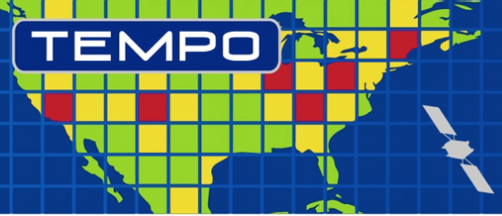
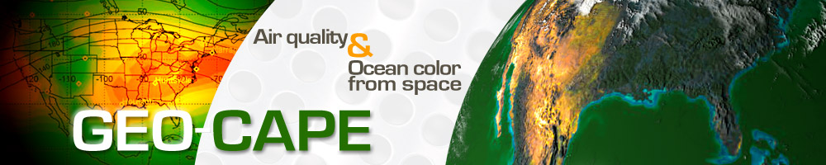
Geostationary observations of aerosols and opportunities for air quality applications in North America
Mian Chin
On behalf of the GEO-CAPE Aerosol Working Group
Report at the TEMPO 2018 workshop, Boulder CO
Patricia Castellanos, Robert Chatfield, Mian Chin, Pubu Ciren, Arlindo da Silva, Santiago Gasso, Hiren Jethva, Shobha Kondragonta, Alexei Lyapustin, Shana Mattoo, Lorraine Remer, Meytar Sorekhamer, Steve Superczynki, Qian Tan, Omar Torres, Jun Wang & group, Yujie Wang, Yasuko Yoshida, Hongbin Yu, Yang Zhang

Slide 2
GEO-CAPE Aerosol WG study in the past decade
The GEO-CAPE Aerosol Working Group was formed in late 2009 to work on the aerosol science questions, objectives, measurement requirements, and the Science Traceability Matrix
Our studies have been centered on how to meet the measurement requirements and how to answer the science questions in the following investigations:
  Retrieval opportunity of daytime AOD from geostationary satellite as a function of pixel spatial resolution (Remer/Mattoo et al.,AMT 2012; Jethva/Torres, in prep; Zhang/Yu et al., 2012)
  TEMPO-GOES synergy for GEO-CAPE aerosol objectives (Ciren/Kondragunta, Lyapustin)
  AQ applications of geostationary observations (Tan/Chin/Yu, Sorekhamer/Chatfield)
  Evaluation of available algorithms for aerosol retrieval over North America (Superczynski/Kondragunta et al., JGR 2016; Jethva/Torres/Yoshida, in preparation)
  Possibility to retrieve aerosol height information (Xu/Wang et al. GRL, Gasso/Torres, AMT 2016)
Most results are directly relevant to TEMPO

Slide 3
For AQ applications (AOD ➔ PM2.5), we need
multiple observations of AOD per day
high quality of AOD (minimum cloud contamination)
understanding of AOD-PM2.5 relationship variabilities
  aerosol vertical distribution
  aerosol composition (type)
  humidification factors
They can be better achieved with TEMPO-GOES synergistic approach

Slide 4
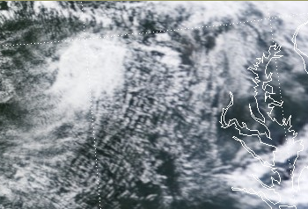
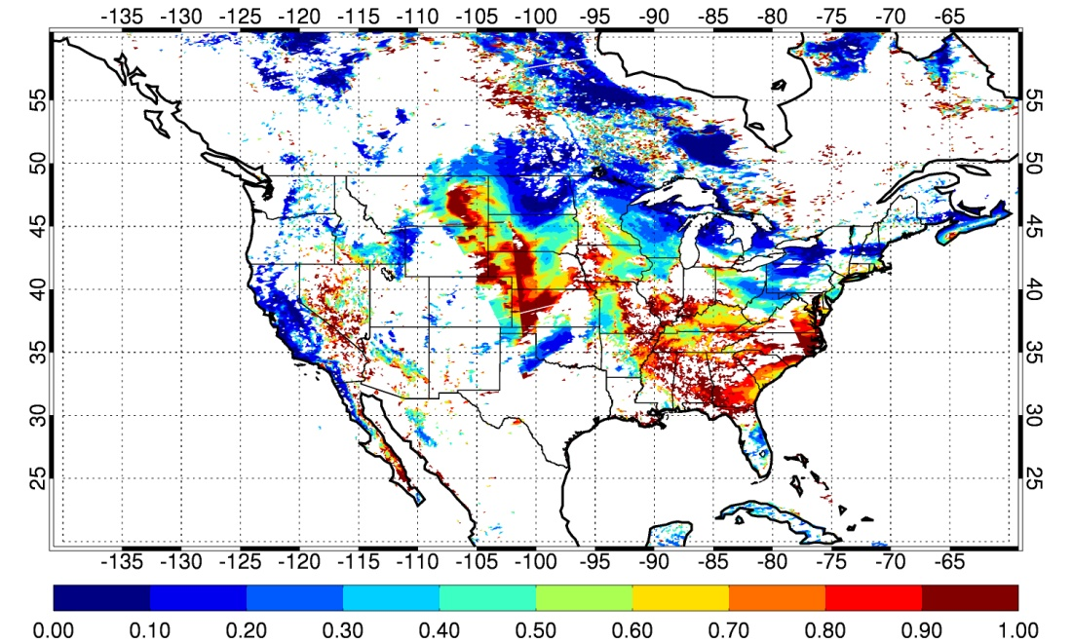
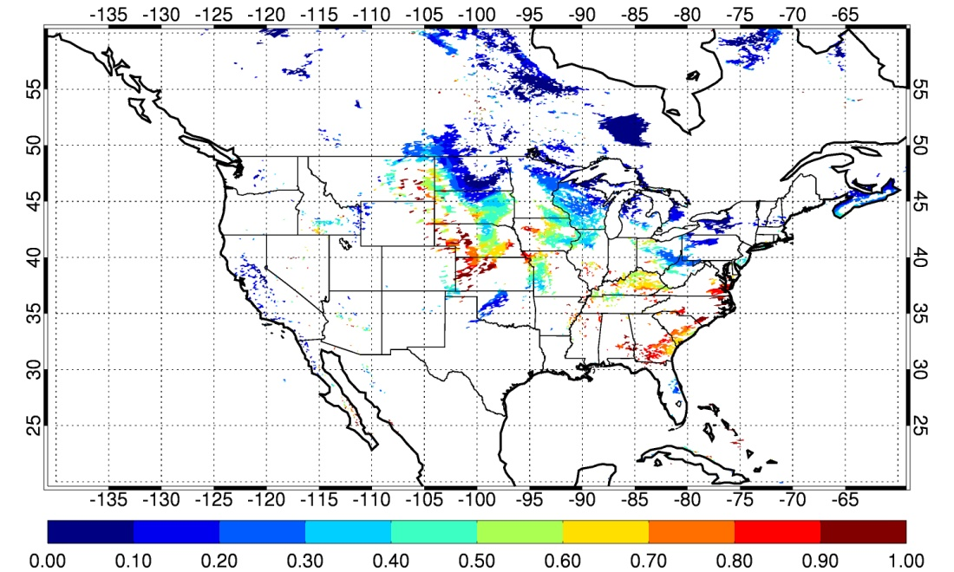
1) Temporal and spatial observation opportunity as a function of pixel resolution
Lorraine Remer, Shana Mattoo, Hiren Jethva, Omar Torres
Temporal retrieval availability - example in 1°x1° area in Virginia, August 12 2012
Spatial retrieval availability of AOD at 1x1 km and 4 km x 2 km pixel resolution – study using MODIS Dark Target retrieval for July 1, 2012
1-km
2-km
1x1km,
CM σ_{s} > 0.0025
(1)
4x2km,
CM σ_{s} > 0.0025
(2)
4-km
Temporally, TEMPO will have reduced AOD retrieval availability in partial cloudy scene. The % reduction depends on the cloud amount
Spatially, TEMPO will have only about half coverage of 1x1km pixel on average with the western US suffers the most
8-km
(Remer, L. A., S. Mattoo, R.C. Levy, A. Heidinger, R. B. Pierce, and M. Chin, AMT 2012)

Slide 5
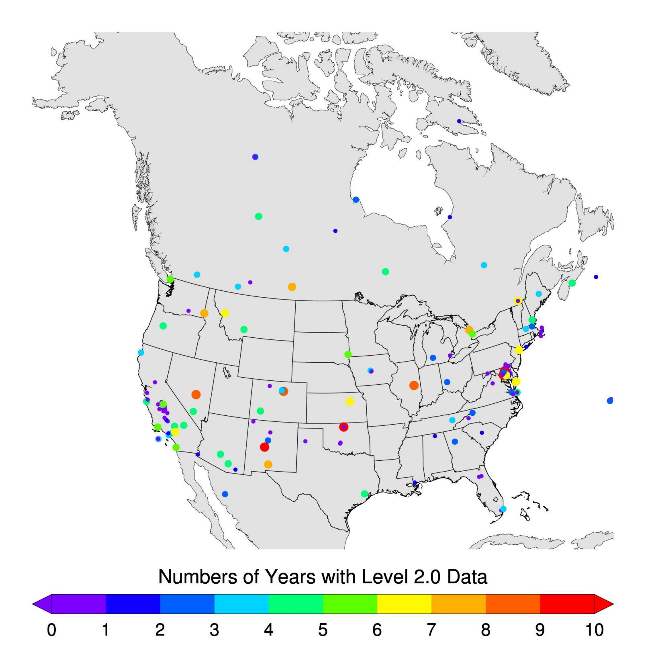
2) AOD retrieval quality – evaluate MODIS AOD retrieved with Dark Target, Deep Blue, and MAIAC algorithms
Hiren Jethva, Omar Torres, Yasuko Yoshida
Geographical Distribution of AERONET Sites over North America
Spatio-Temporal Approach
+
40 km
40 km
N_{min}=160 ΔT =±30 mins.
Satellite overpass time
AERONET direct meas.
+
+
+
+
ΔT
Only best quality satellite AOD retrievals are considered in this analysis.

Slide 6
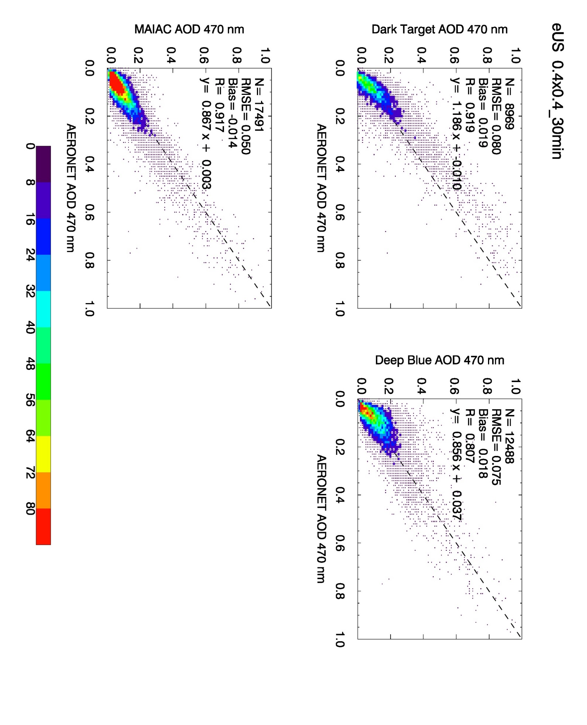

Comparisons of AOD from MAIAC, DT, DB with AERONET
Eastern U.S.
Eastern US | MAIAC | Dark Target | Deep Blue
N Corr. Slope Y-int RMSE Bias | 17491 0.917 0.867 0.003 0.050 -0.014 | 8969 0.919 1.186 -0.010 0.080 0.019 | 12488 0.807 0.856 0.037 0.075 0.018
MAIAC vs. AERONET
Dark Target vs. AERONET
Deep Blue vs. AERONET
Western U.S.
Western US | MAIAC | Dark Target | Deep Blue
N Corr. Slope Y-int RMSE Bias | 26293 0.837 0.754 0.035 0.053 0.011 | 9561 0.798 1.072 0.035 0.104 0.043 | 16785 0.733 0.835 0.027 0.073 0.010
MAIAC vs. AERONET
Dark Target vs. AERONET
Deep Blue vs. AERONET
MAIAC is able to retrieve a lot more data and smaller RMSE than DT and DB, especially over bright surfaces

Slide 7
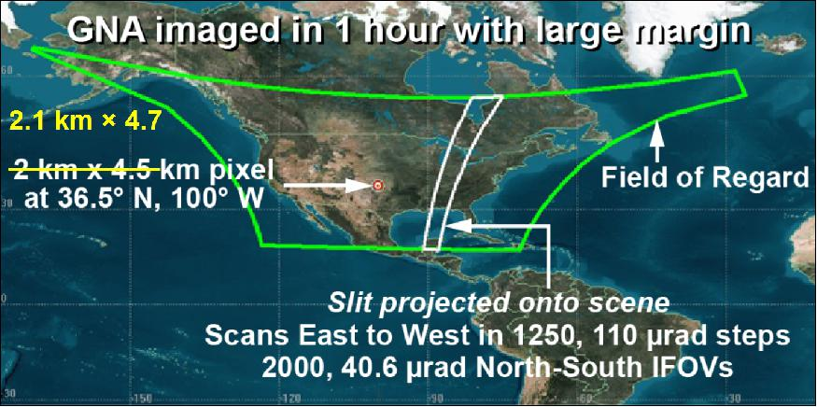
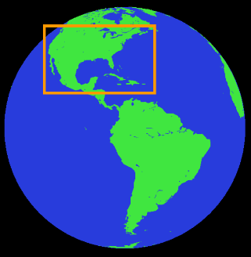
3) TEMPO and GOES-16 synergy
 | TEMPO | GOES-16 ABI
Spectral range: | UV-Vis, Hyperspectral, 0.29-0.74 µm (no coverage between 0.49-0.54 µm) | Vis-IR Bands: 0.47, 0.64, 0.865, 1.378, 1.61, 2.25, 3.90, 6.19, 6.95, 7.34, 8.50, 9.61, 10.35, 11.20, 12.30 µm
Spatial resolution: | 2.1 x 4.7 km at nadir | 0.5, 1, 2 km (vis), 2 km (IR) at nadir
Temporal coverage: | 1 hour (AOD) | 15 min full disk, 5 min CONUS
Center longitude: | 100ºW | 75.2ºW
Synergy: Obtaining better aerosol products and more information | Cloud mask: Use 0.5 km ABI data to derive cloud mask and apply to TEMPO Aerosol type: Use deepblue-IR (TEMPO-ABI) spectral information to derive smoke/dust masks Aerosol SSA and height: Extrapolate ABI AOD to UV, then retrieve SSA and aerosol centroid height at UV Joint TEMPO-ABI retrieval: AOD (and AAOD) using UV-IR spectral information (BRDF, absorption, etc.)

Slide 8
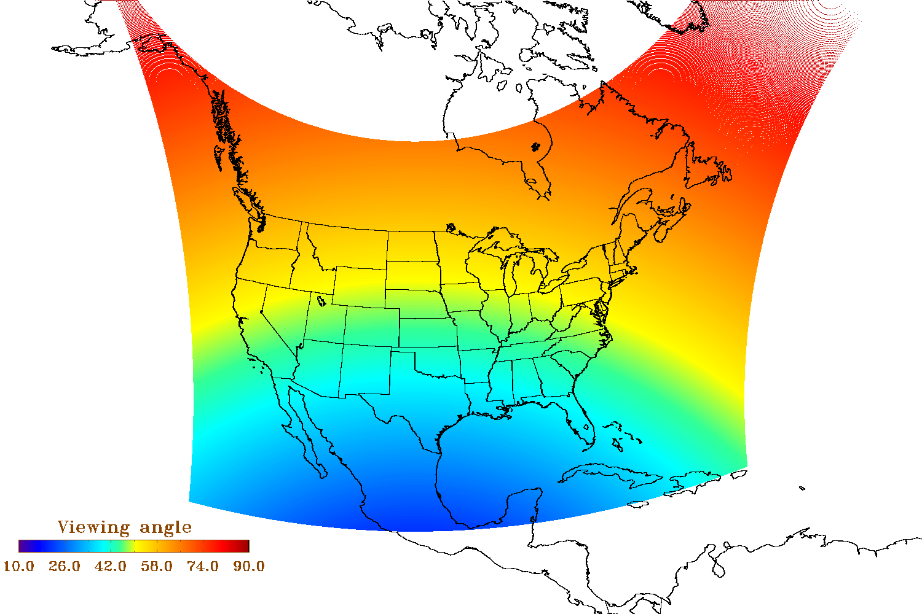
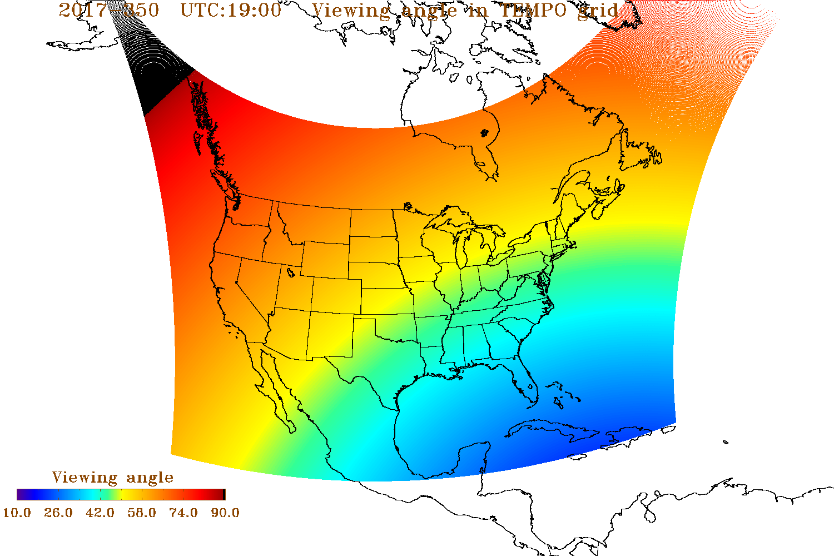
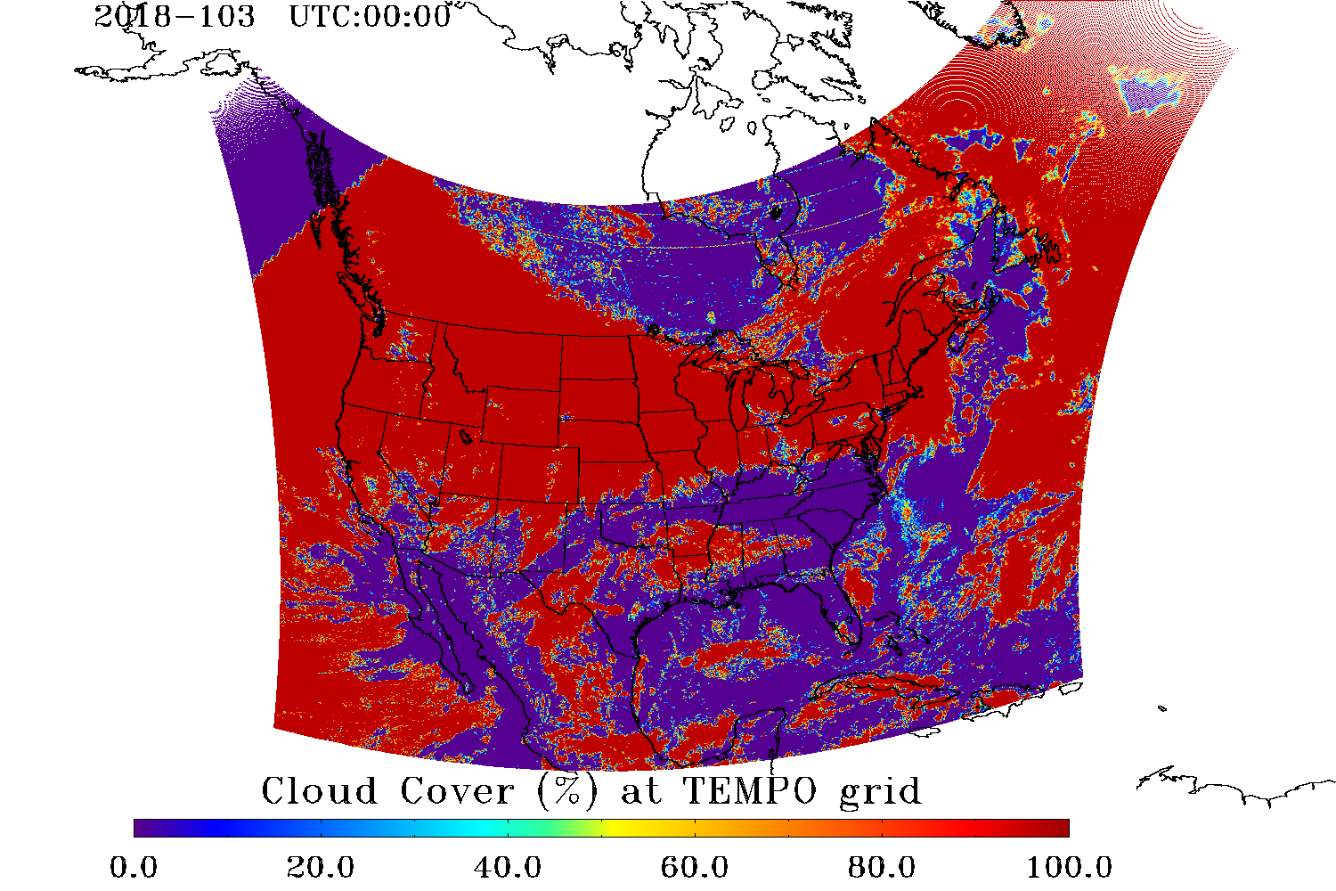
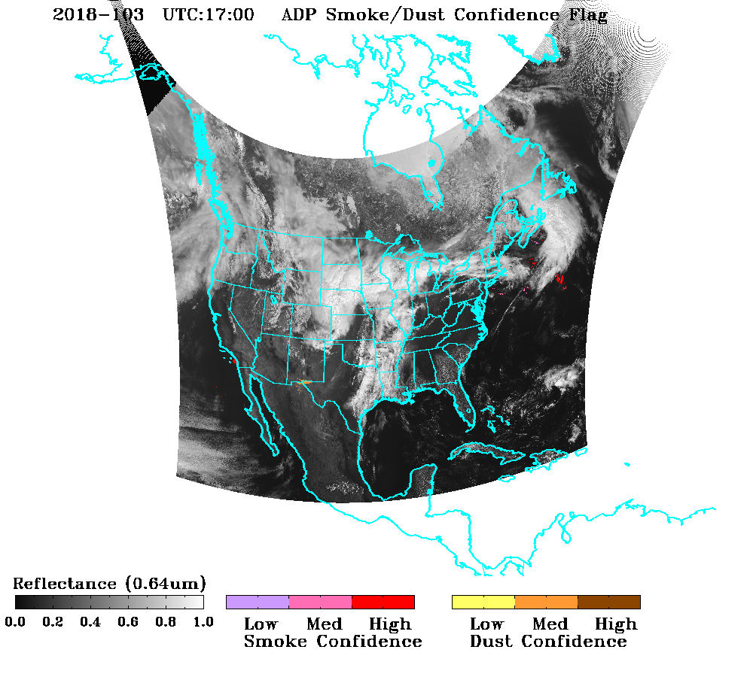
TEMPO proxy from ABI for aerosol retrieval
TEMPO viewing angle (100°W)
GOES-16 viewing angle (75.2°W)
Pubu Ciren, Shobha Kondragunta
TEMPO and GOES-16 have different viewing angles
NOAA generated proxy data for TEMPO using GOES-16 ABI reflectance (mapping to TEMPO geometry)
Also mapping ABI cloud fractions to TEMPO geometry
GOES-16 cloud % mapped to TEMPO
Smoke/dust detected from “TEMPO”
Case of 4/13/2018

Slide 9
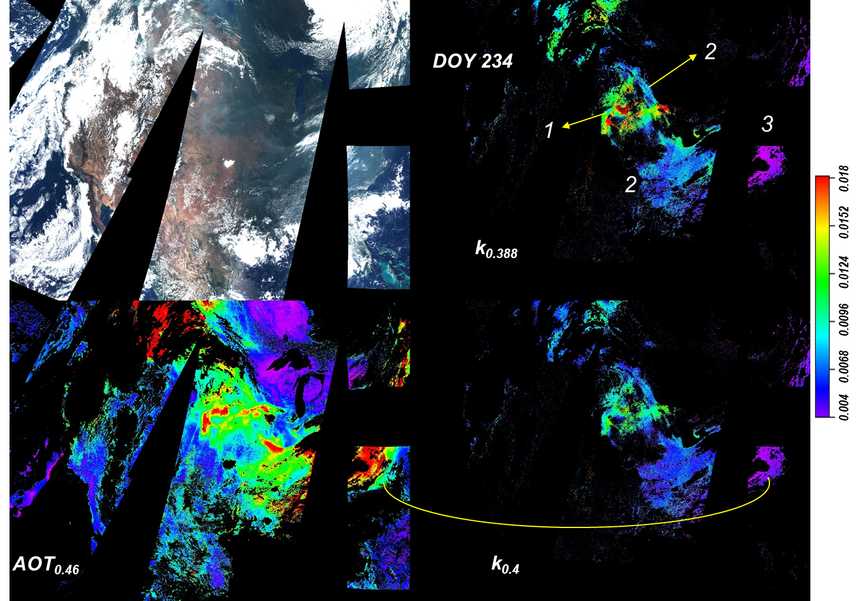
Pilot study of AOD and absorption retrieval from GLI – implications for TEMPO-ABI joint retrieval (UV-IR)
Alexei Lyapustin et al.
GLI: Global Imager on the Japanese ADOES satellite (only lasted a few months)
UV to longwave IR, 1x1 km
Using GLI data to assess the value of UV-IR consistent retrieval with MAIAC algorithm
The case study showing the AOD, aerosol absorption, and the spectral absorption information – possibility of separating BrC, BC, and other aerosols

Slide 10
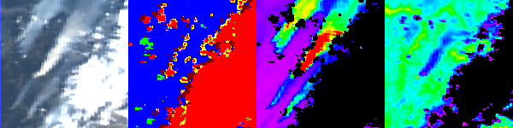
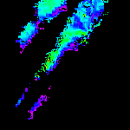
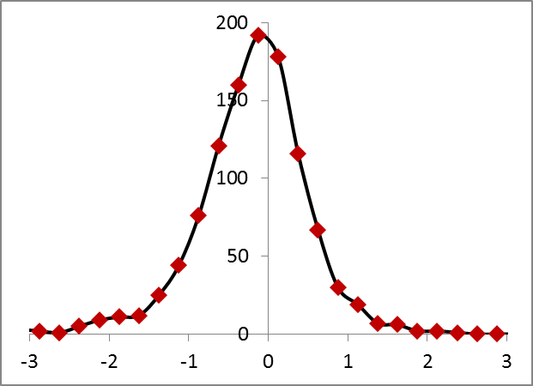
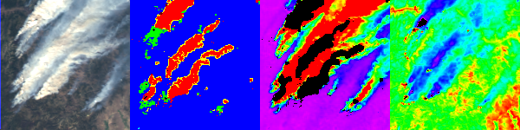
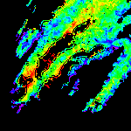
Examples of retrieving aerosol plume height
Dust plume height retrieval with O2-A and -B band (Jun Wang et al.)
(Xu, Wang et al., GRL)
Smoke plume height retrieval with thermal contrast over Asia, Himawari data (Alexei Lyapustin)
RGB CM AOD_{0.47} Tb₁₁ (K) H^{s} (km)
(a)
Histogram of MODIS-MISR plume height difference (2000-2008); 59.3% of MAIAC plume heights are found within 500m of MISR MINX values
H^{MISR}-H^{MODIS}
km

Slide 11
Geostationary satellite observations of aerosol and applications for air quality study – how can AOD be used for surface PM2.5 applications?
The purpose of the studies we’ve done is to assess how to use the best approach to obtain high quality AOD and related information (aerosol type, plume height, absorption, etc.) for science and applications
One of the major applications for using geostationary satellite aerosol data is air quality
  How can we use the geostationary satellite observations of daytime variation of AOD to derive the surface PM2.5 concentrations?
  What are the feasibility and challenges?

Slide 12
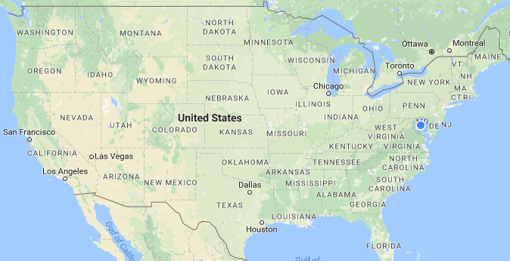
Using collocated AOD (AERONET) and PM2.5 (EPA) measurements to assess the AOD-PM2.5 relationships in different environments and time scales
Qian Tan, Alex Coy, Mian Chin, Hongbin Yu
Data:
  Column 440 nm AOD: AERONET
  Column water vapor: AERONET
  Surface PM2.5: USA EPA AQS
  Hourly average
Pair of AOD-PM2.5 sites selection criteria: AOD and PM measurement sites within 5 km in distance
  Near Washington DC: GSFC AOD and Prince George’s County PM2.5 (3.9 km apart), 2012, 2013, 2014
  Fresno AOD and PM2.5 (0.1 km apart), 2012, 2013, 2014
  St. Louis: St. Louis University AOD and St. Louis City PM2.5 (3.7 km apart), 2013, 2014, 2015
  Houston: Univ. Houston AOD and Harris County PM2.5 (2.9 km apart), 2012
See poster given by Qian Tan

Slide 13
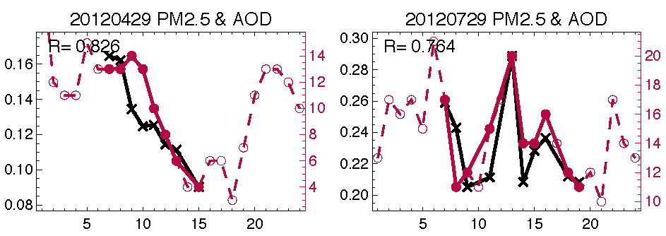
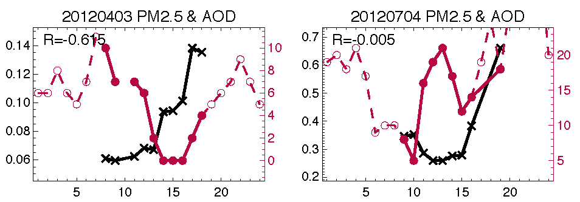


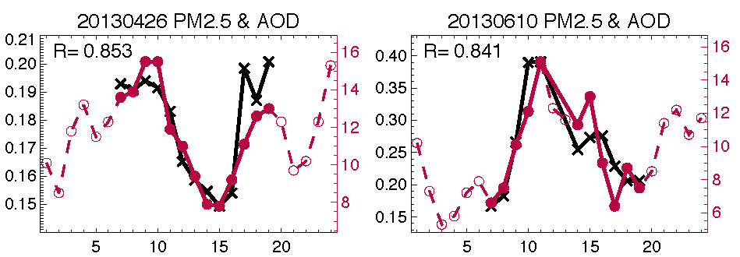
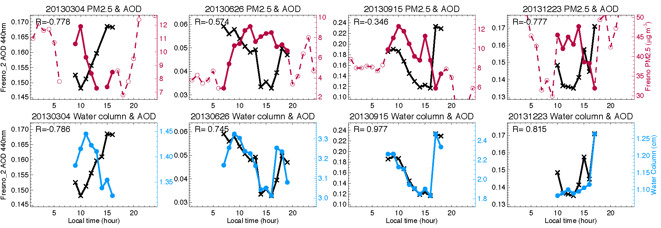
Examples of daytime AOD-PM2.5 correlations over near GSFC, MD and Fresno, CA: the good and the bad
GSFC
AOD-PM2.5
Fresno
AOD-PM2.5
For all the four locations in multiple years, we found that only 13-22% days the daytime AOD and PM2.5 are correlated with R ≥ 0.7, but 30-57% days when daytime AOD and PM2.5 are un-correlated with R < 0

Slide 14
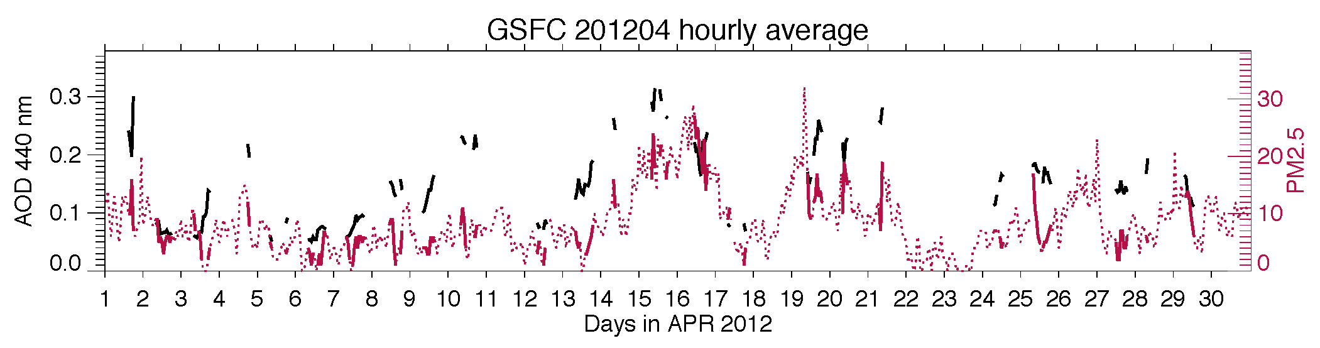
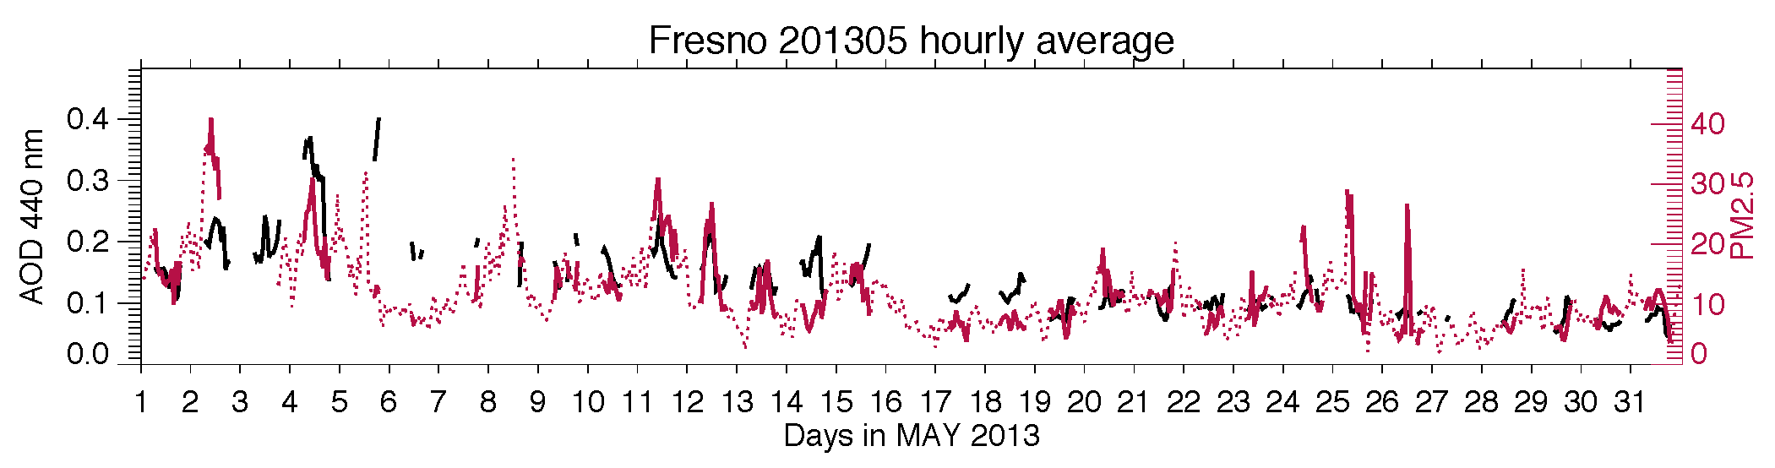
But on day-to-day basis, the variations of AOD and PM2.5 are mostly in-sync: Examples of hourly variations within a month

Slide 15
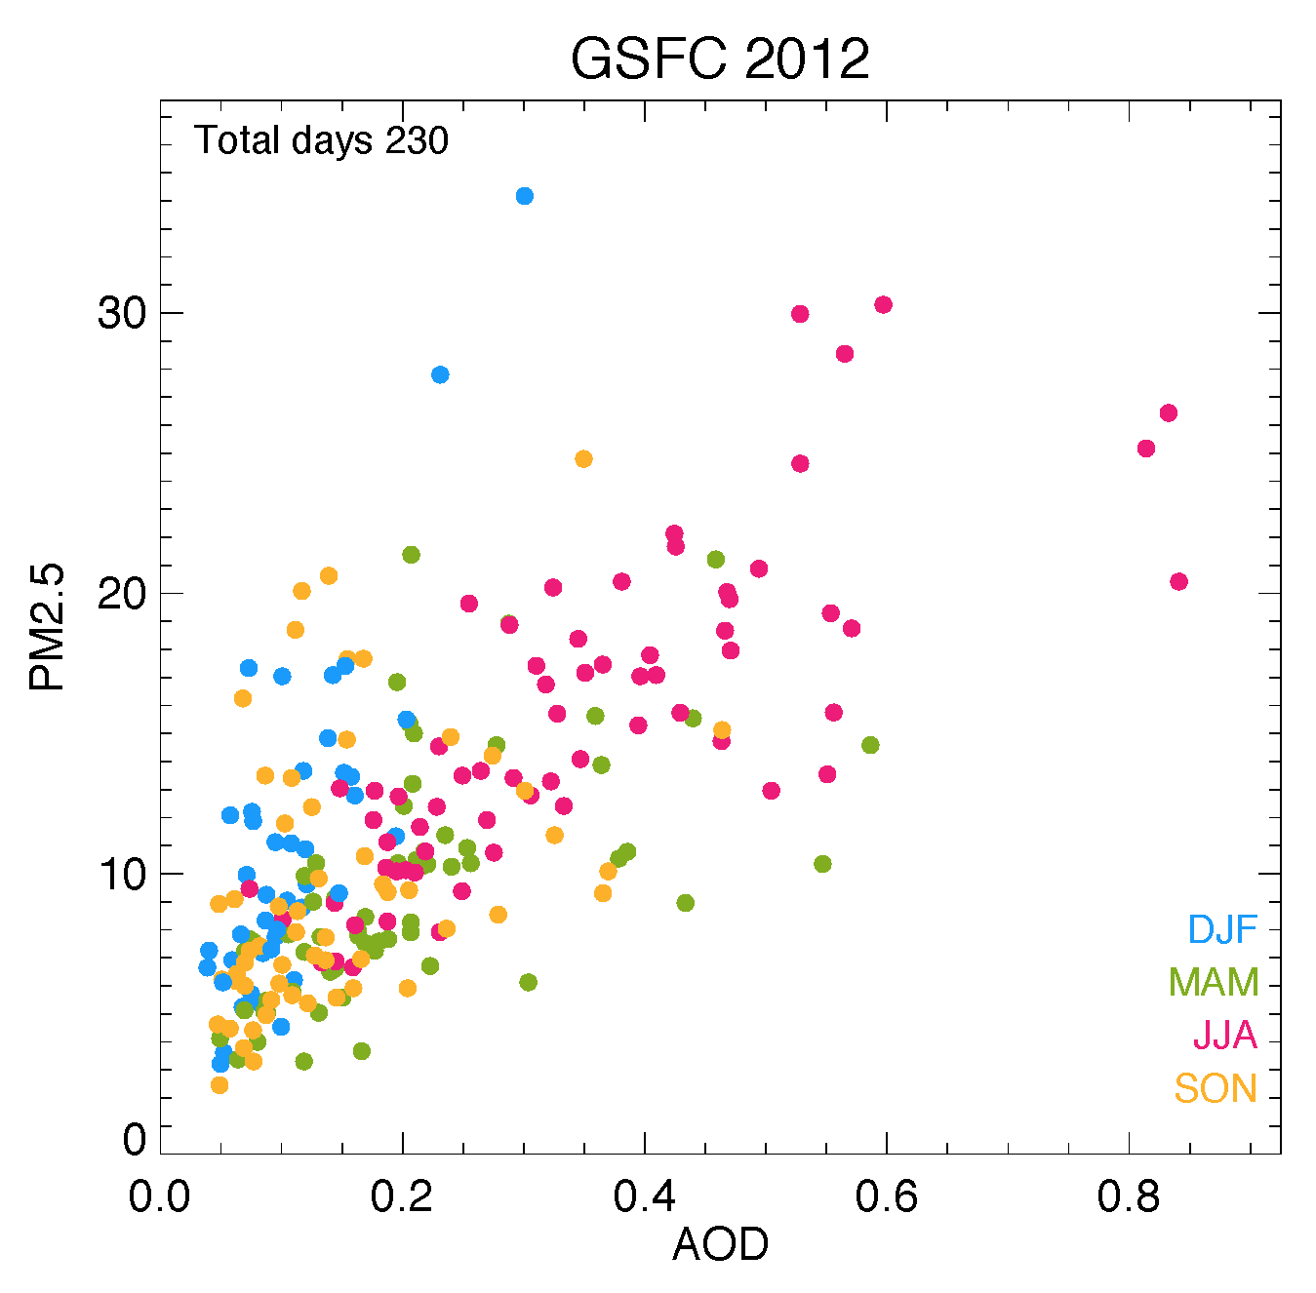
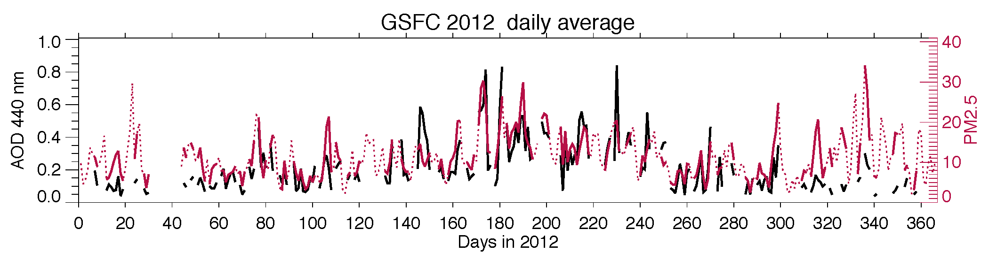
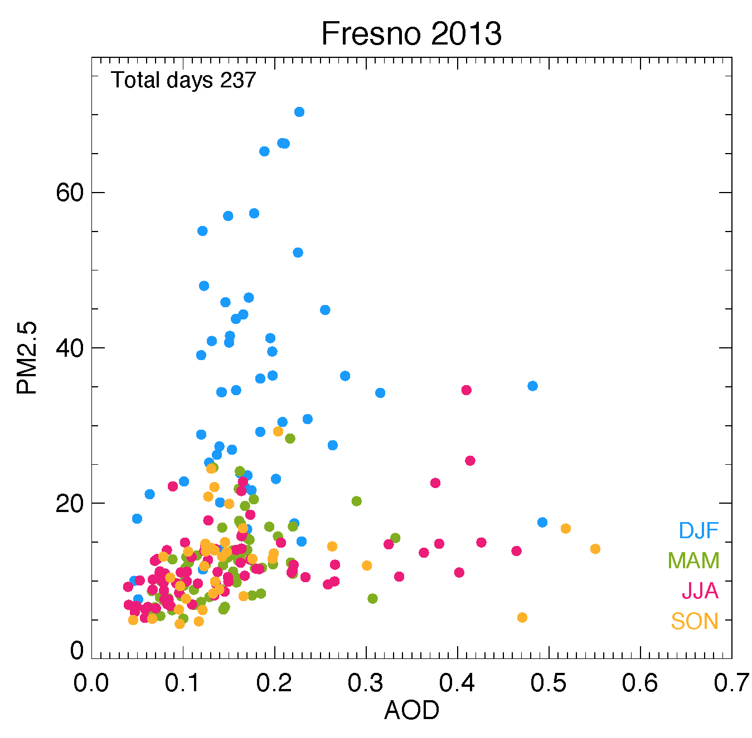
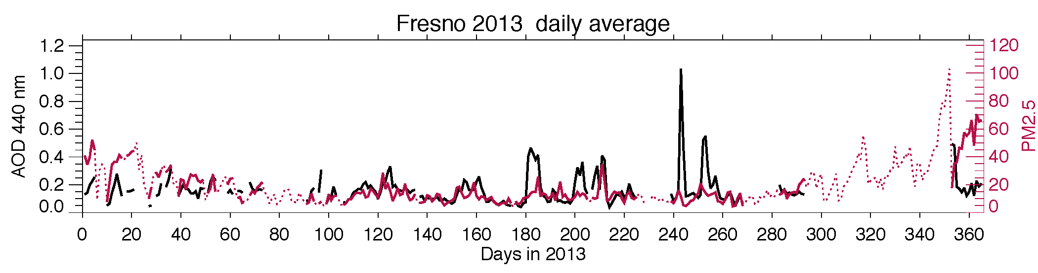
However, the AOD-PM2.5 ratio changes with seasons

Slide 16
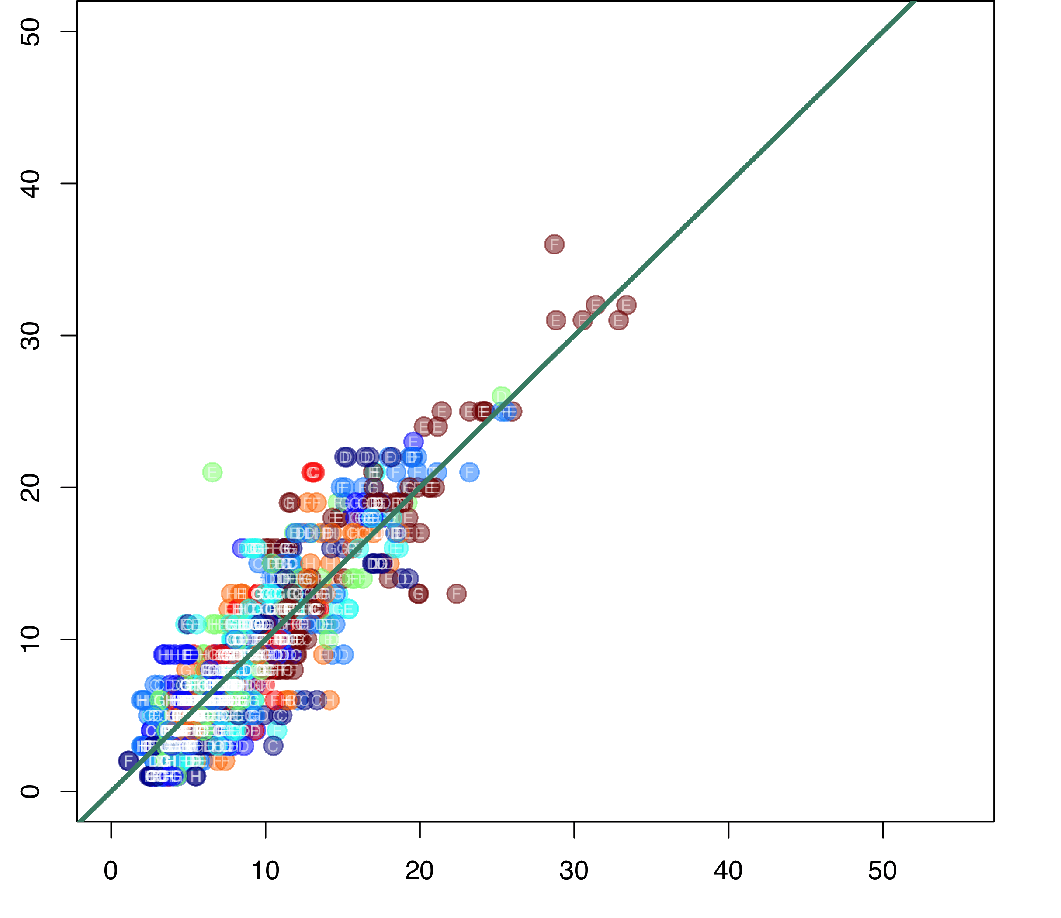
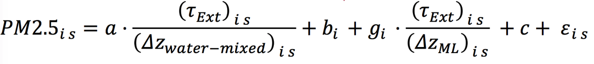
Direct scaling of AOD for PM2.5 is not reliable, and other factors have to be considered to understand the AOD-PM2.5 relationship
Robert Chatfield, Meytar Sorekhamer
Obs PM2.5
Example of daytime AERONET AOD and EPA PM2.5 near GSFC:
Selected time - Spring season at local time 11-15 hours (well mixed PBL)
Selected pollution events
Scale AOD with column water vapor and surface RH
Calibrated daily
Obs AOD
Obs PM2.5
Fitted PM2.5

Slide 17
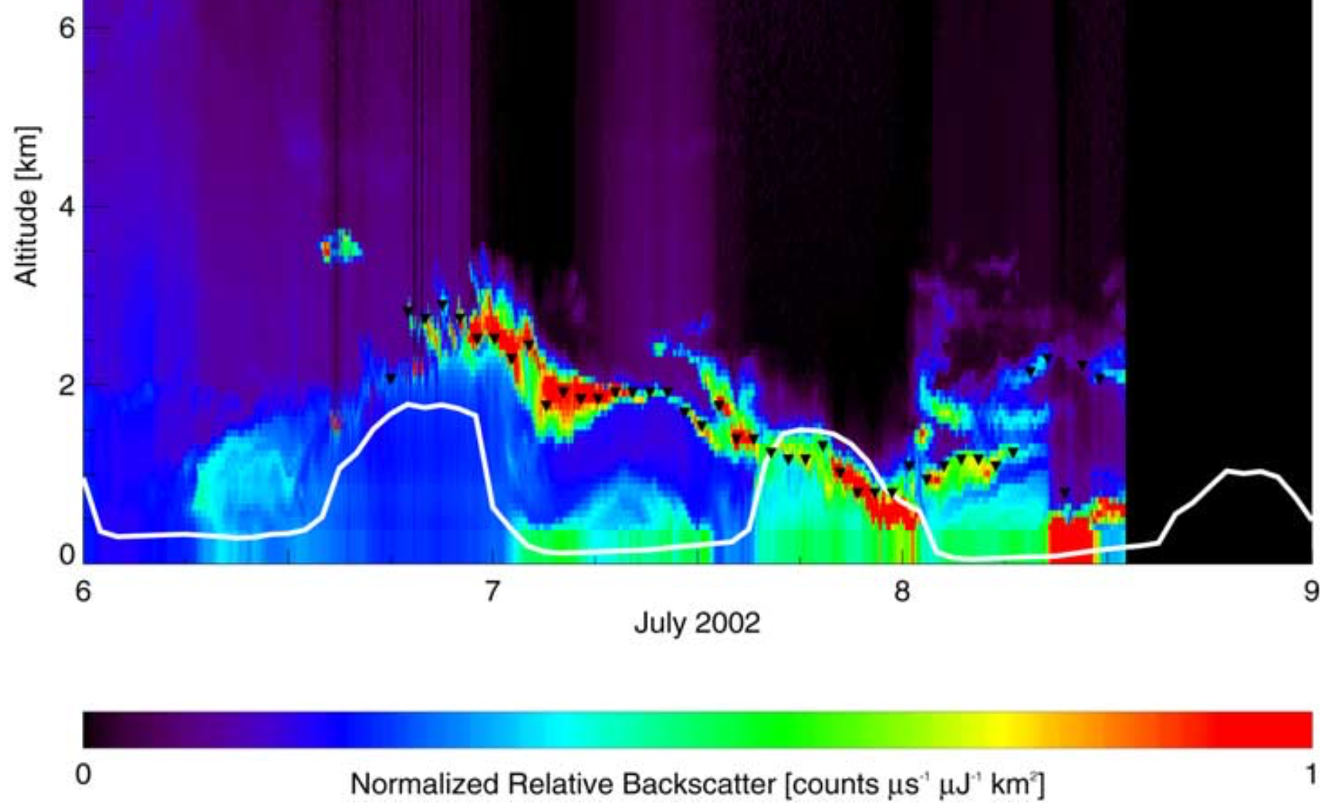
Important factors determining AOD-PM2.5 relationships:
RH effect: AOD is RH dependent, but PM2.5 is not
Aerosol vertical profile: determine the column burden and surface amount relationship
Aerosol composition: determine the mass extinction efficiency (or aerosol mass to extinction conversion)
AOD-H2Og
Aerosol backscatter profile at GSFC

Slide 18
What we can do in the next few years
Producing joint retrieval of aerosol products:
  Over the US: TEMPO-ABI (UV-IR spectral range) for better cloud screening and AOD, AAOD, AI, AOCH, aerosol above clouds products
  Over Asia: GEMS-AHI-AMI (UV-IR spectral range, AOD, AAOD, AI, AOCH, aerosol above clouds)
  Global: TROPOMI, VIIRS (UV-IR spectral range, AOD, AAOD, AI, AOCH, aerosol above clouds)
  LEO+GEO synergy (TROPOMI, VIIRS, PACE – GOES, Himawari, GEMS, TEMPO)
Air quality application assessment:
  Obtaining solid, robust assessment on the feasibility of using geostationary satellite data for surface PM2.5 (under what conditions, which ancillary information are needed, and how practical)
  Recommendations to the user community on how to use geostationary satellite data for AQ

Slide 19

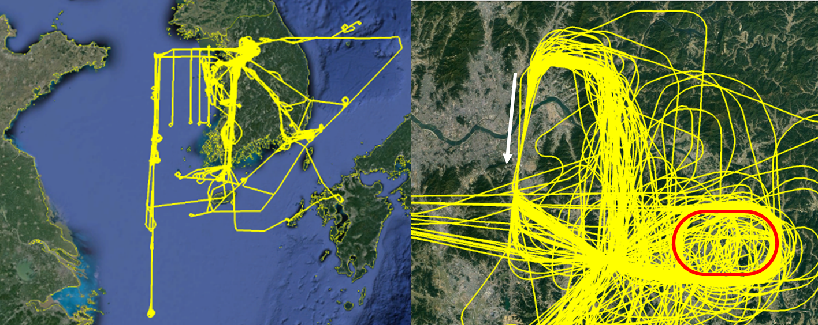
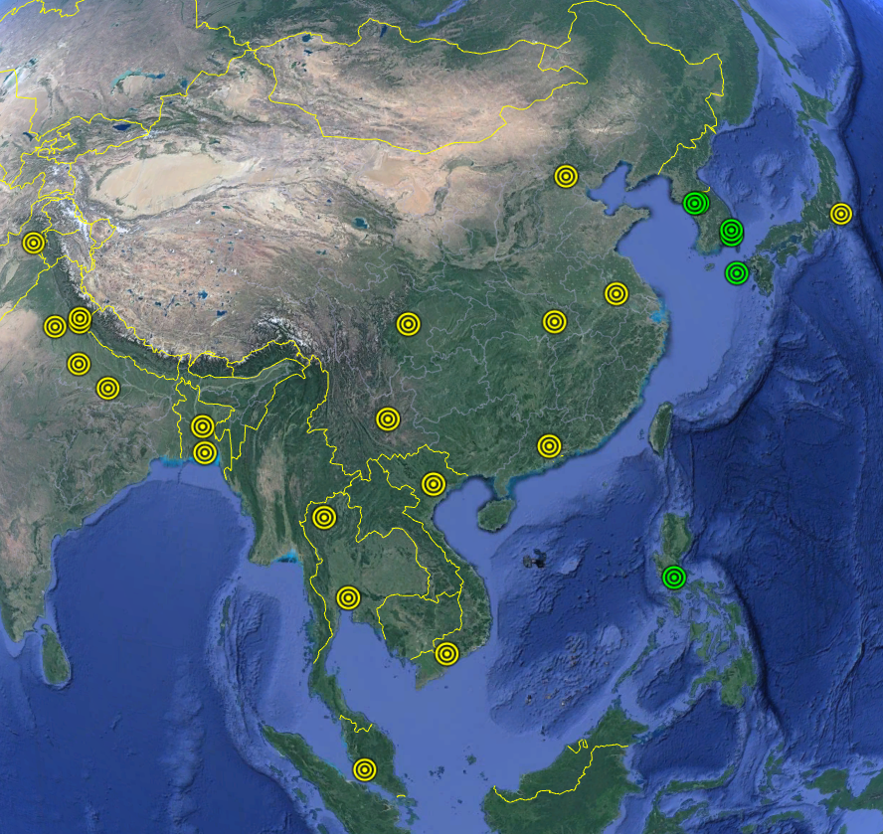
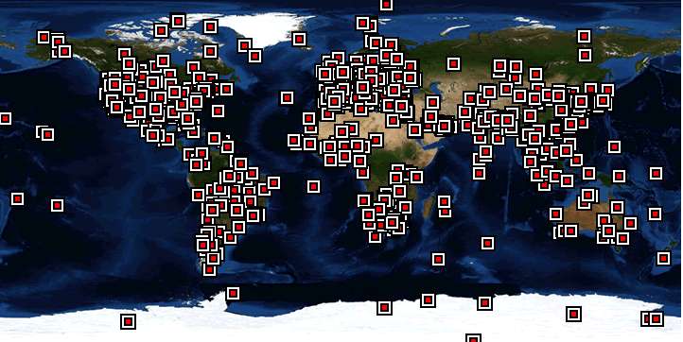
Proposed EVS-3 proposal:
Hemispheric Airborne Measurements of Air Quality (HAMAQ)
PI: James Crawford, NASA Langley Research Center
HAMAQ
HAMAQ Goal: Evaluate and exercise the integrated observing system for air quality
Question: How can observations from the international air quality constellation be effectively integrated into assessments of air quality in the Northern Hemisphere?
Expected Outcome: Infusion of satellite information to improve air quality ground monitoring, spatial coverage, forecasting, and decision making; GEMS and TEMPO validation
KORUS-AQ Flight Sampling Strategies
Asian Pandora Network
AERONET sites for AOD validation
See poster given by Qing Liang on behalf of Jim Crawford and HAMAQ team

