Slide 1
Strategic Communications Public Engagement
Student Collaboration
Mary Dussault (SAO C/PE)
Margaret Pippin (LaRC SC)
June 6, 2018
mdussault@cfa.harvard.edu

Slide 2
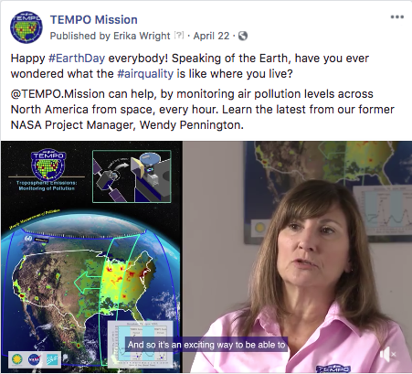
C/PE GOALS & ACTIVITIES
Broadly communicate the science and engineering aspects of TEMPO and provide educational and societal benefits that maximize the impact of the science mission.
Engage diverse stakeholder audiences in learning about — and using — TEMPO’s science objectives and resulting data in ways that make the STEM content in AQ research accessible and relevant.
Enable anytime/anywhere engagement by providing target audiences with intuitive portals to TEMPO’s rich scientific stories and data.
Insure broad dissemination and the participation of underrepresented groups, targeting areas disproportionately affected by air pollution.
TEMPO website with media features
User-friendly TEMPO data interfaces
Partnerships with STEM education projects
Public engagement events and opportunities
News and social media activities

Slide 3
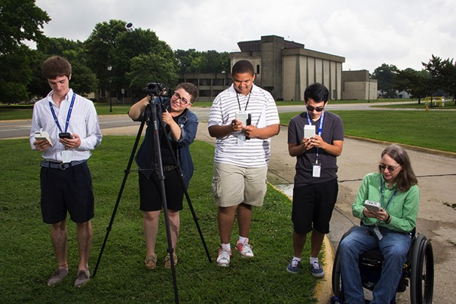
SC GOALS & ACTIVITIES
Develop tools that can be used to directly engage a diverse network of students and universities in TEMPO experimental validation.
Enable a broader group of students to engage with NASA AQ research using those tools during and after the TEMPO mission.
Use and evaluate simple low-cost, robust, & user-friendly hand-held devices to make AQ-related measurements
Develop an experimental design approach for measuring temporal and spatial variability on a TEMPO footprint scale using small sensors
Pursue Experimental Validation Network for TEMPO at students’ home institutions
NEW EMERGING EFFORT: TEMPO Jr. Scientists via GLOBE Citizen Science partnerships
TEMPO Student Interns at LaRC with
M. Pippin

Slide 4
SC – CPE Program Overview
Together, the TEMPO Student Collaboration and E/PO programs provide a coherent progression of AQ-related authentic research experiences for different audiences, supporting pathways for NASA STEM engagement.
Focused impact contributing to Mission & STEM Careers
Authentic Data Experiences
Undergraduate Student Collaboration Research Projects
10s
100s
Professional Development Programs for Classroom and Informal Educators
1,000s
Development of Standards-Aligned Curriculum Supplements
10,000s
Collaborative efforts with NASA, SI (e.g. GLOBE, Digital Quests)
100,000s
Broader impact contributing to general scientific and technological literacy
Partnerships with Museums & Community organizations
1,000,000s
TEMPO Website, Online (Mobile) Data, Tools and Resources

Slide 5
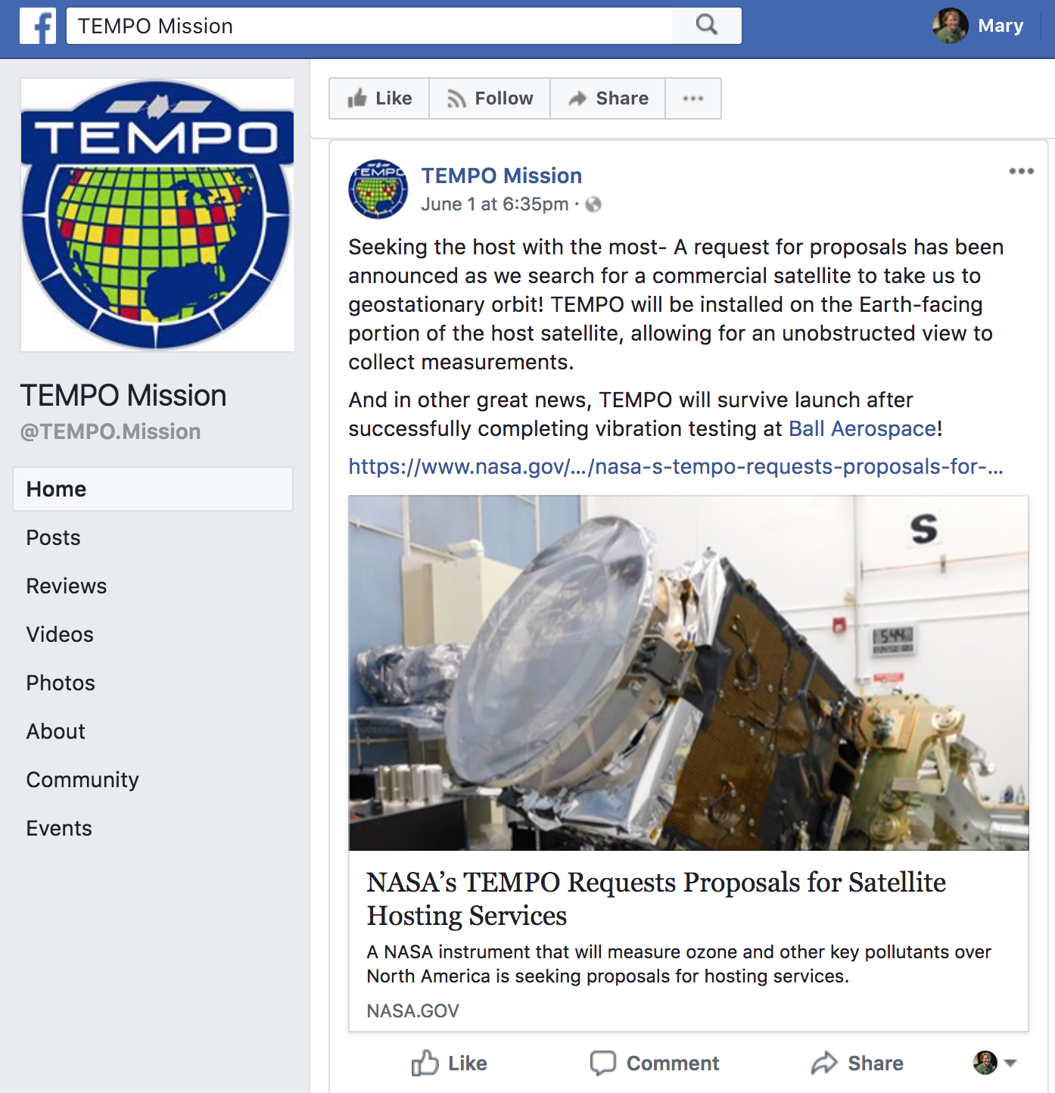
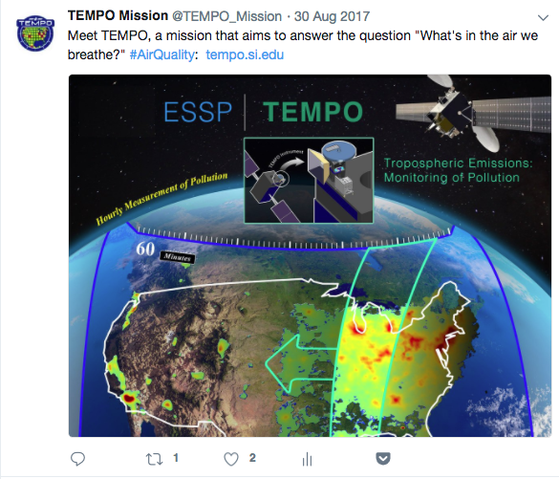
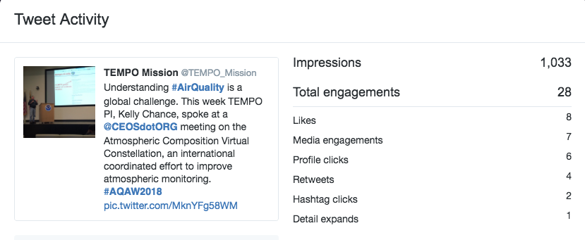
@TEMPO_Mission
We Need You!
- images, data, events, video

Slide 6
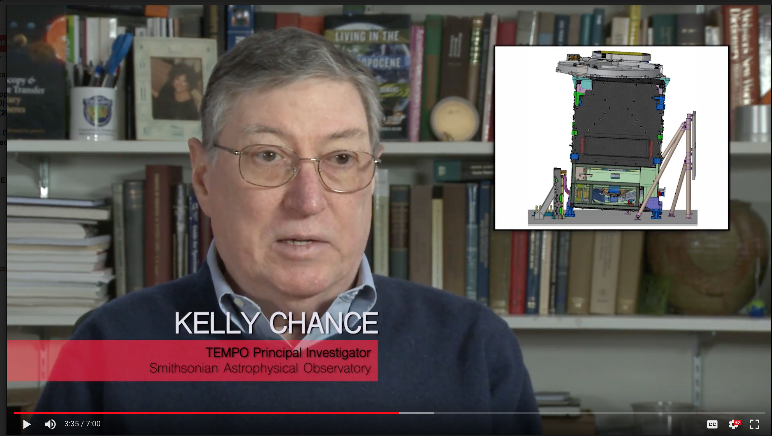
Sneak Preview: TEMPO – It’s About Time

Slide 7

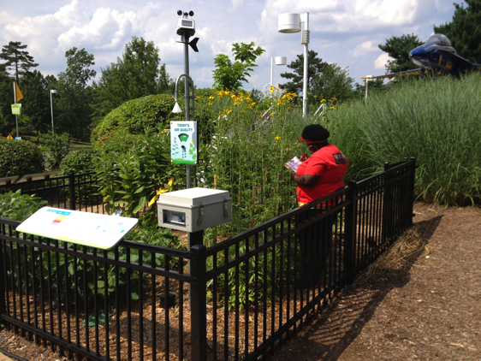
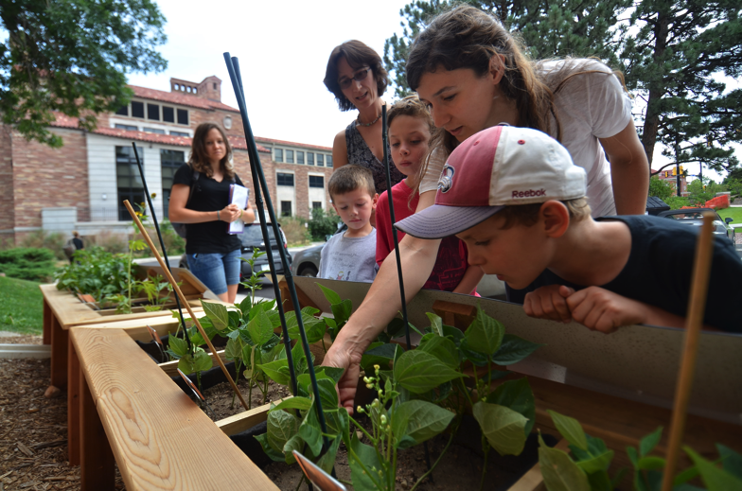
Museum-Hosted Ozone Gardens
Student Research
Citizen Science
Public Engagement
Notes:
Sites for Student Science, Citizen Science, Public Engagement

Slide 8
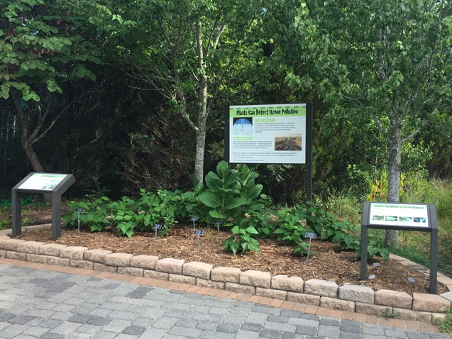
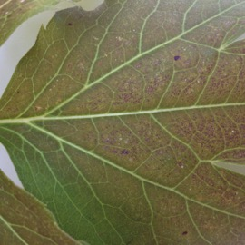
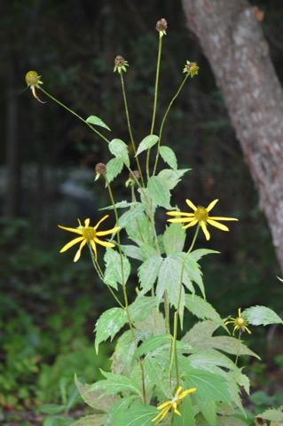
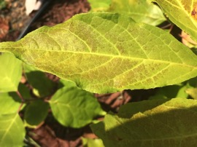
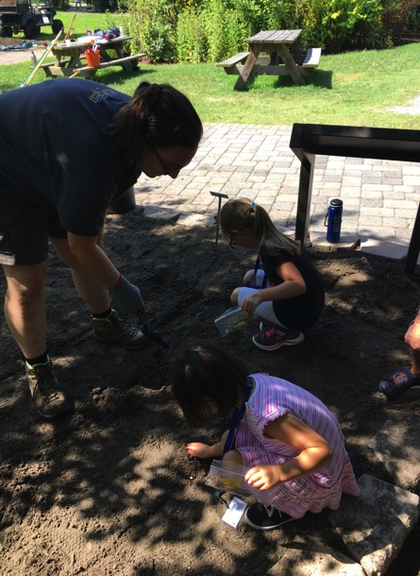
TEMPO C/PE – Ozone Garden Network
Developing a program model to engage learners of all ages in TEMPO science via public ozone garden exhibits and associated activities.
Started pilot program at VA Living Museum in 2017
  (VLM had partnered with LaRC since 2014)
TEMPO Garden Network growing this year – 5 sites +
Network members receive garden manuals and education guides, materials for hands-on activities and citizen science data collection, training via Zoom video meetings
Ozone Garden exhibit at VLM

Slide 9
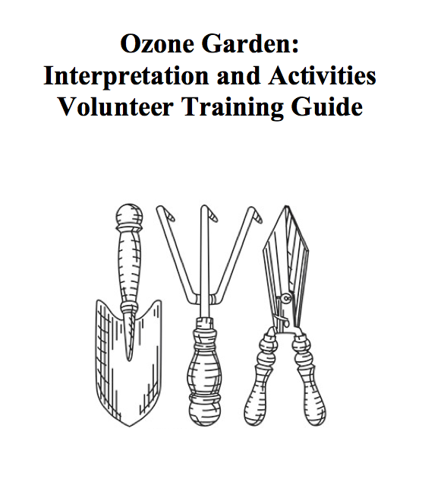
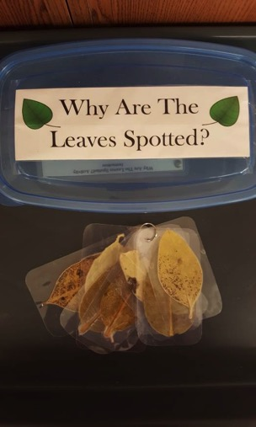
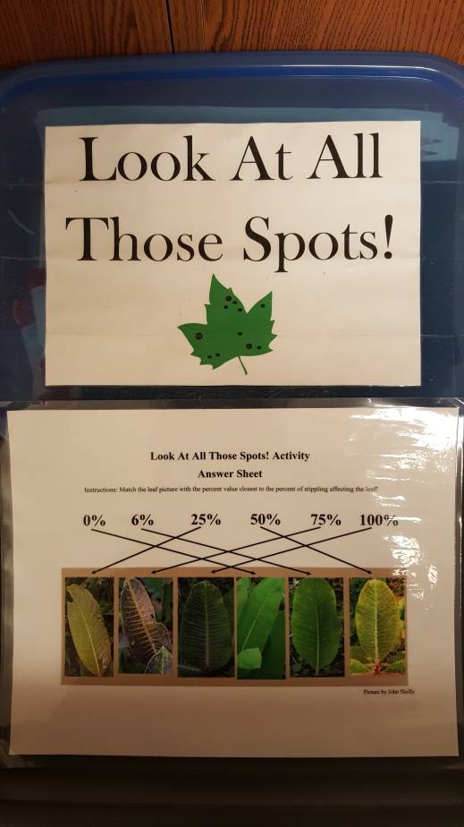
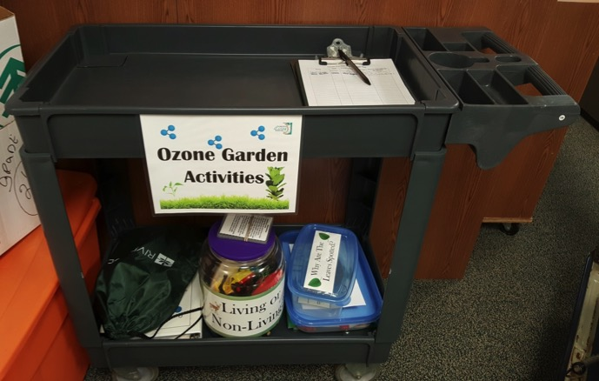
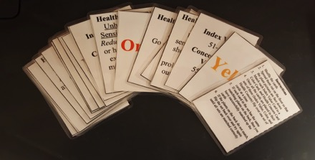
Ozone Garden “Kit”

Slide 10
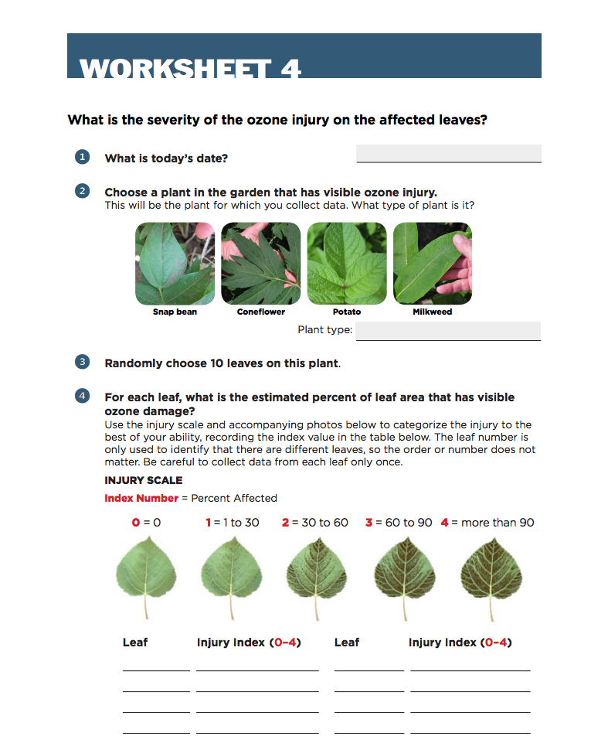
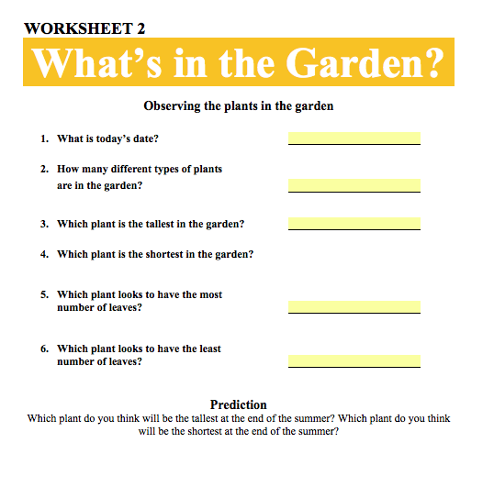

Ozone Garden Kit: Citizen Science Activities

Slide 11
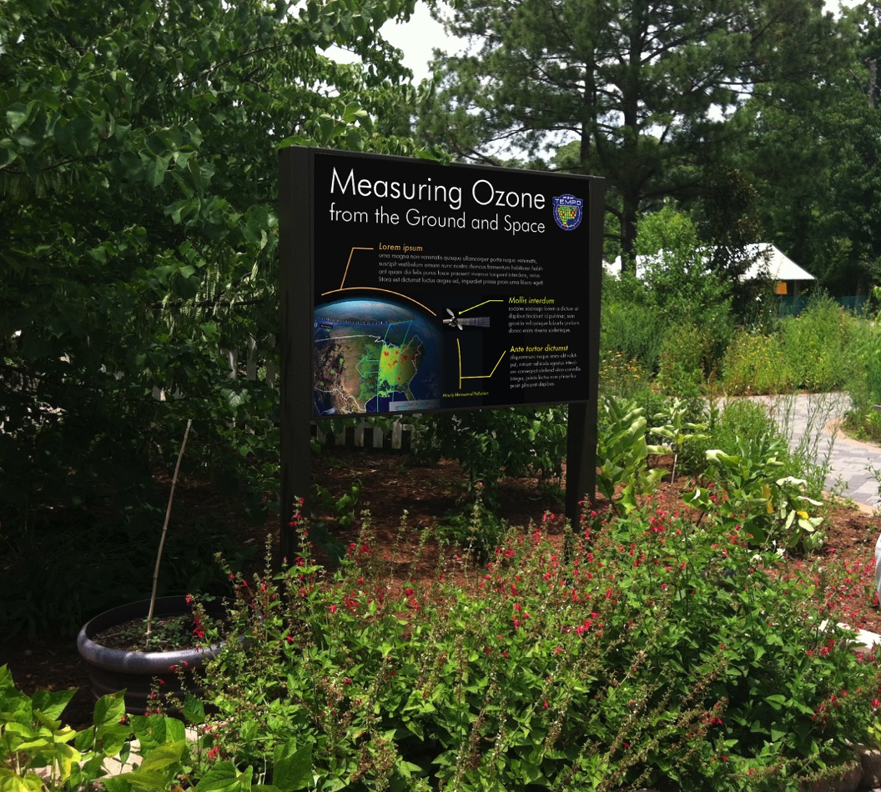
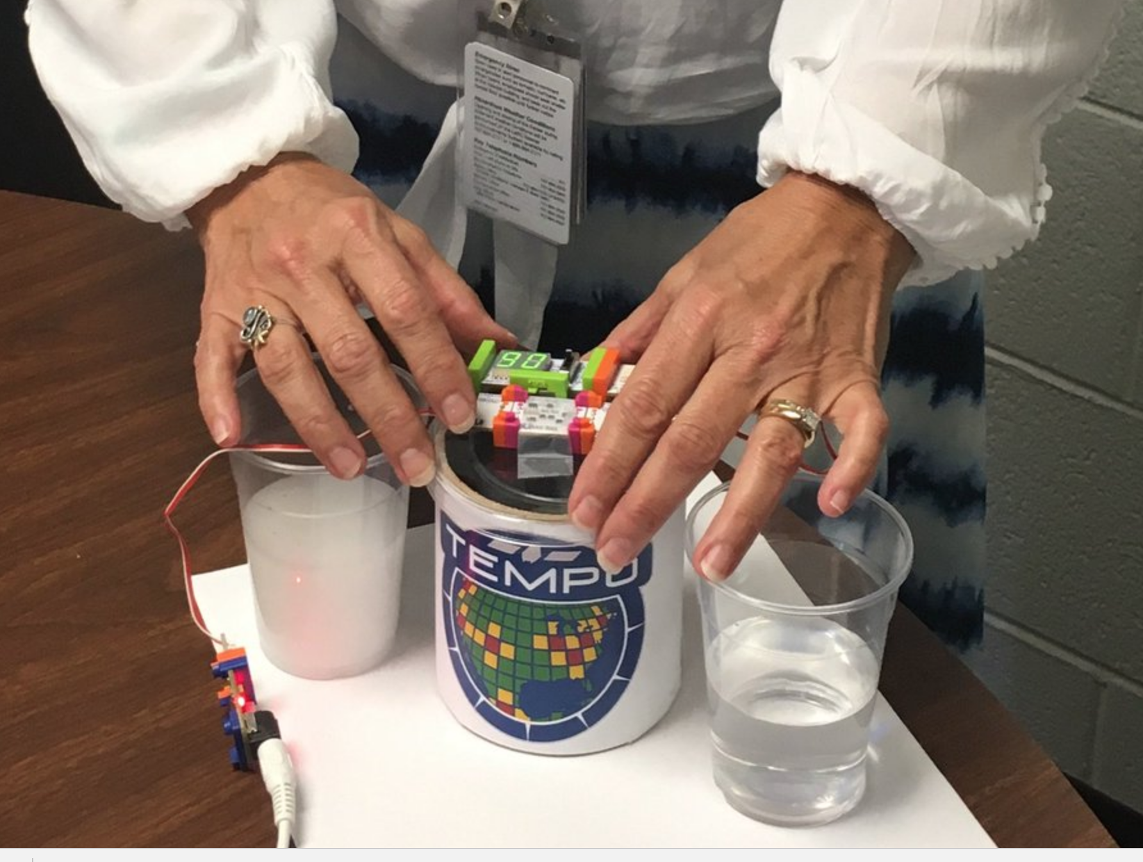
Connecting O3 Gardens to TEMPO:
Graphic Templates & Hands-on Activities

Slide 12
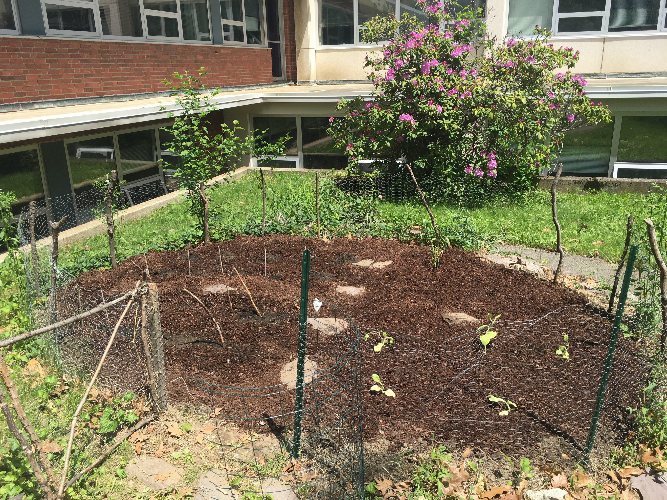
Network of Collaborators for Ozone Gardens
TEMPO C/PE-supported sites:
SAO
Virginia Living Museum, VA
McAuliffe Center at Framingham State University, MA
Children’s Museum of NH
Queens Botanical Gardens, NY
South Dakota Discovery Center, SD
Our Lady of Mt Carmel School, VA
Mountain View School, NJ
More to come!
Collaborating Organizations:
NCAR/UCAR
Saint Louis University
GSFC
GLOBE
EPA
GO3
Hands on the Land
ASTC, Smithsonian Affiliations, American Public Gardens Association

Slide 13



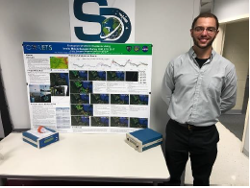
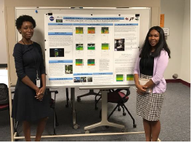
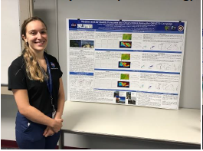
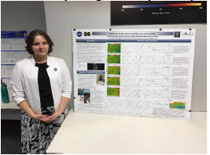
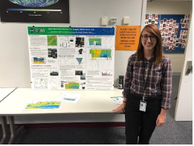
Student Collaboration participates in
Ozone Water Land Environmental Transition Study
Pablo Sanchez & Jeremy Schroeder
Mobile ozone and UAV ozone
Desorae Davis & Angie Atwater - MPL
Lindsey Rodio - Forecasting
Emily Gargulinski – Ozonesondes
Betsy Farris - Ozone Lidar
Notes:
TEMPO SC provided 2B POMs (ozone instruments) for mobile measurements and 2B model 202s for stationary sites
Posters are displayed – go see what great work the students have been doing!!

Slide 14
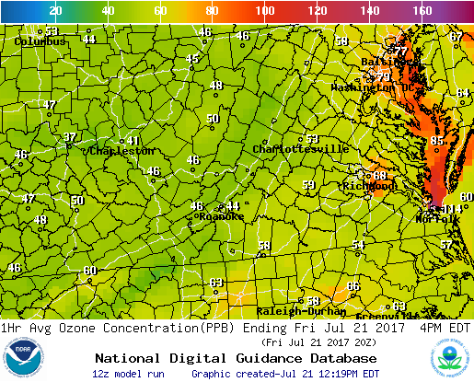
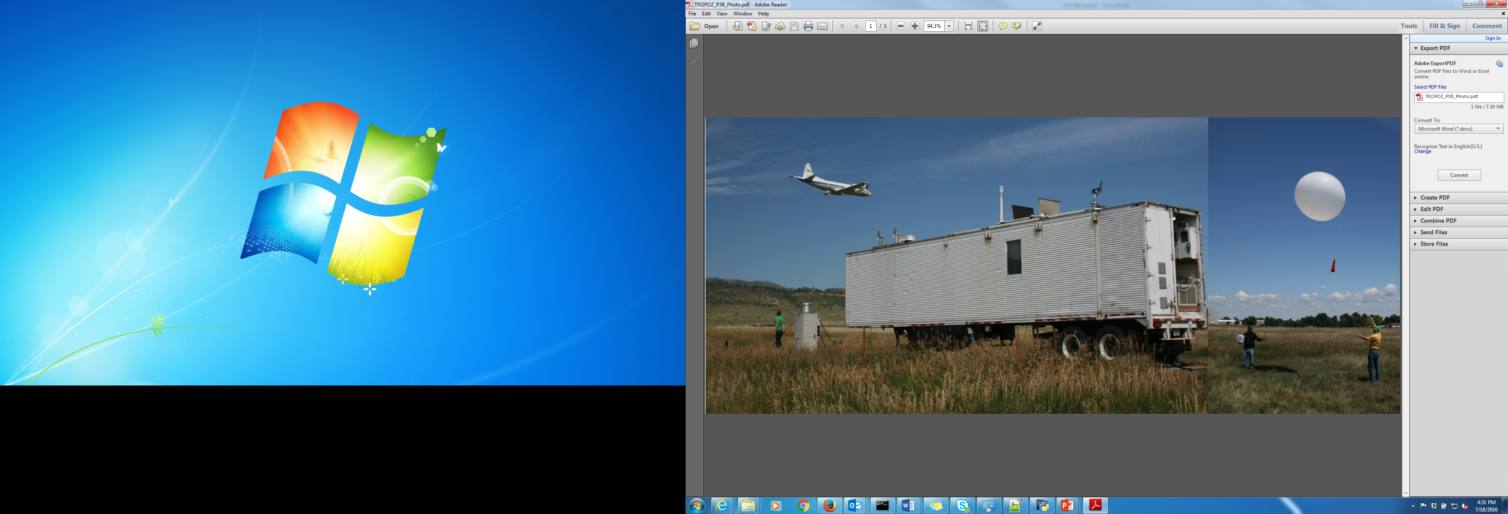
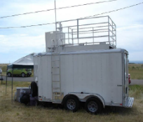
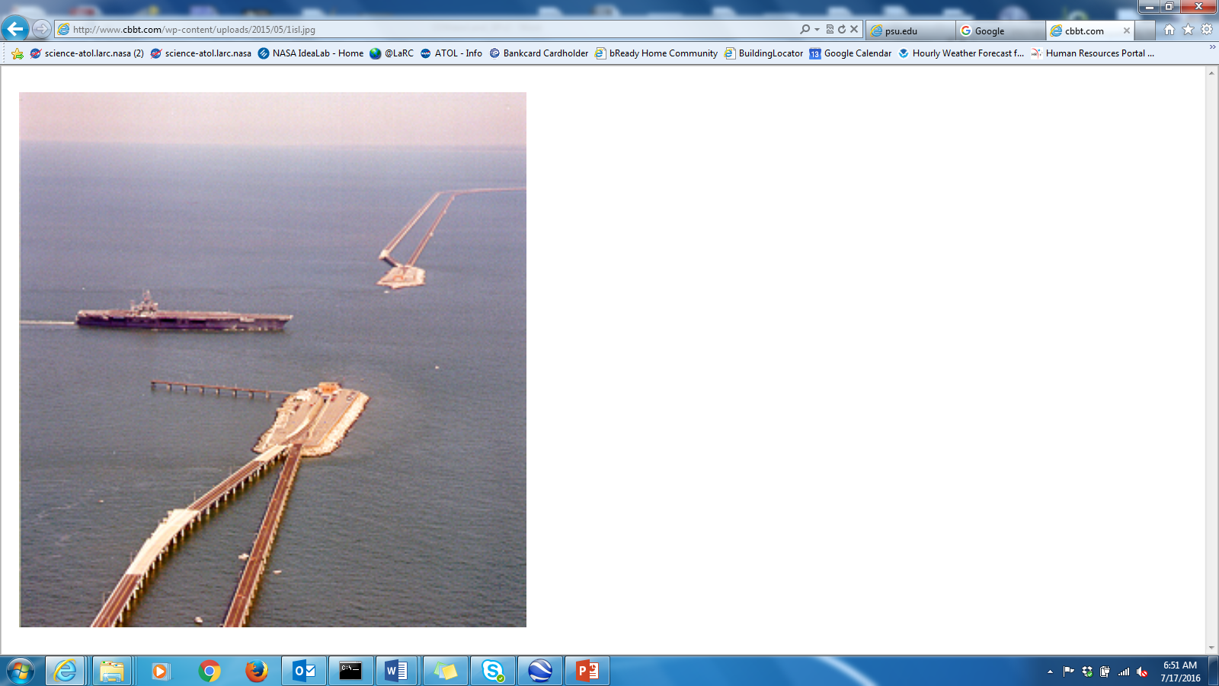
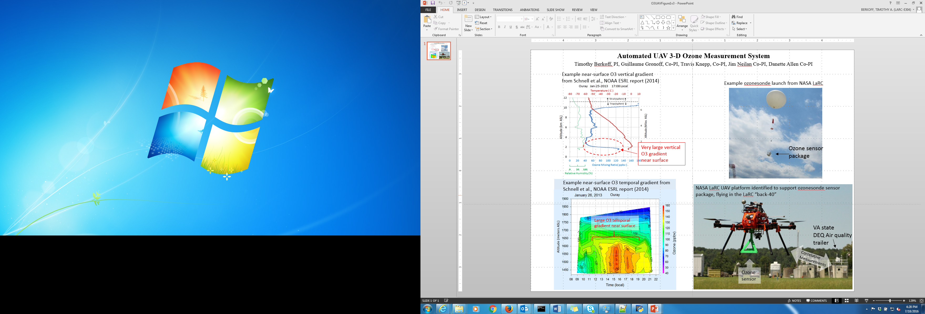
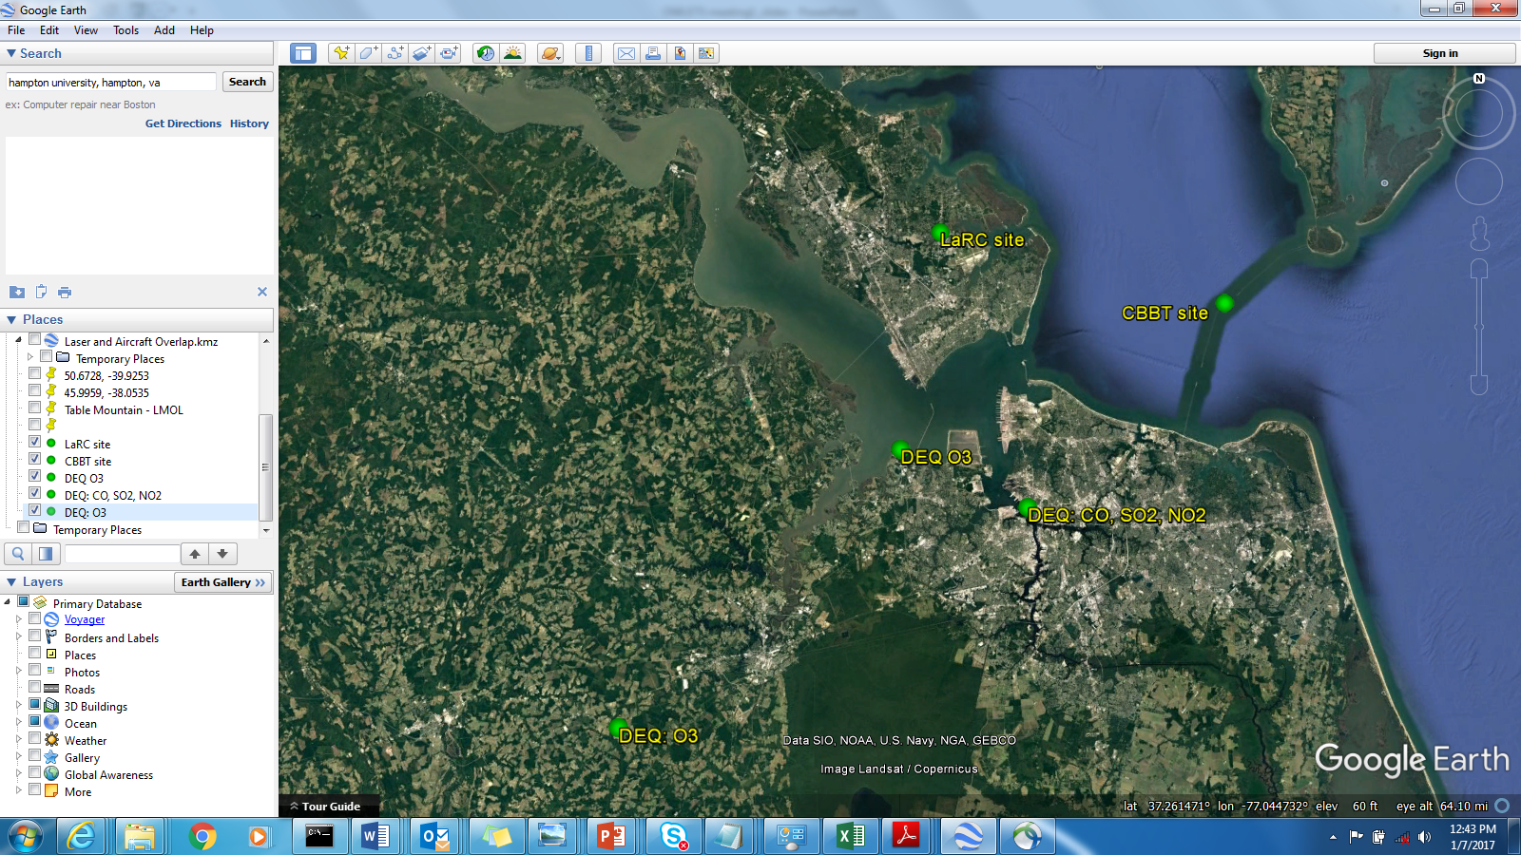
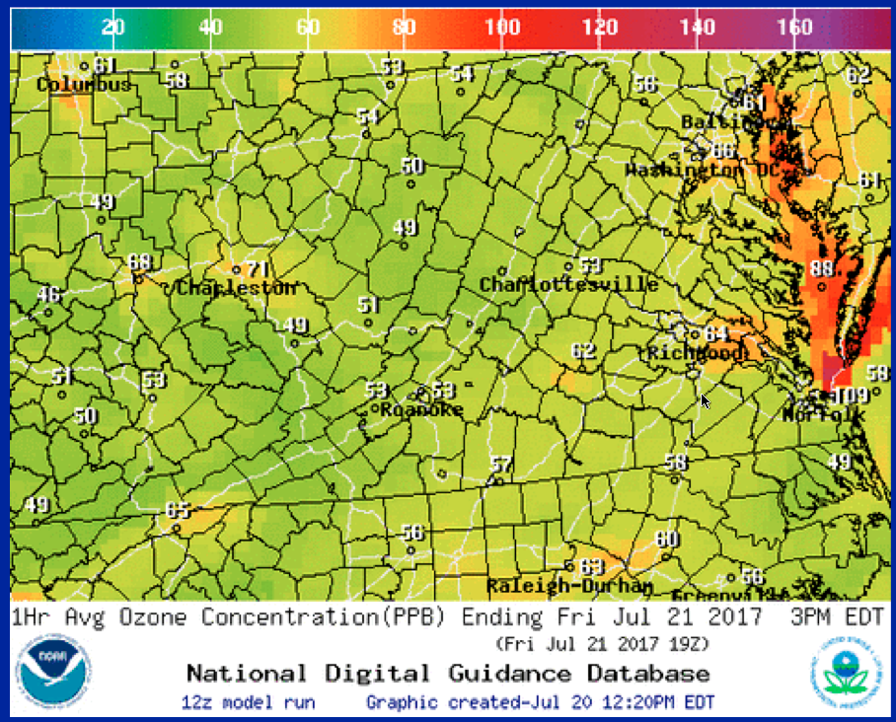
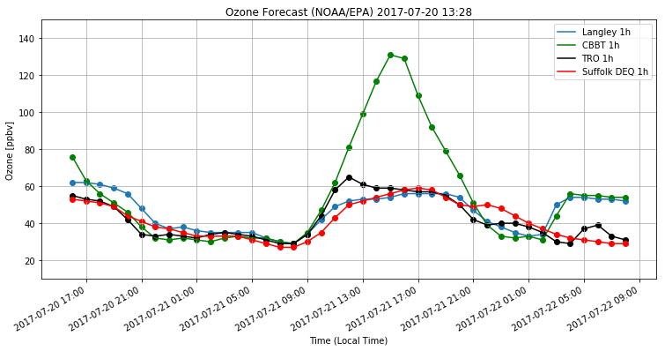
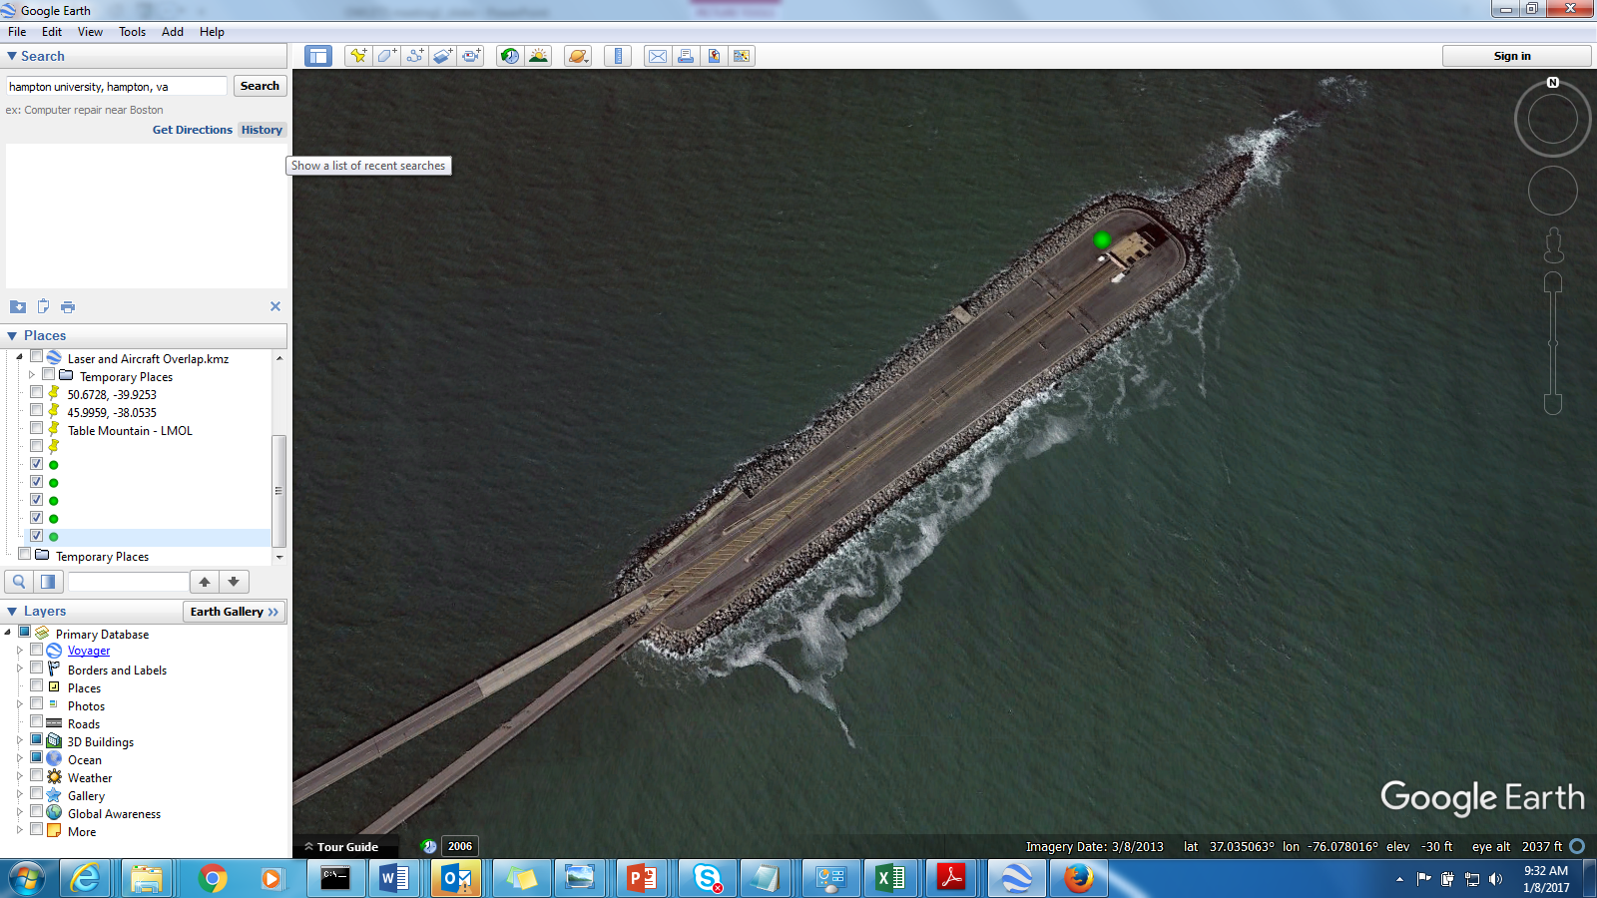
Map of Measurements & Forecast July 21, 2107
GSFC O₃ lidar
LaRC O₃ lidar
CBBT site
UAV/drone
Surface ozone, ppbv
Ozone lidar
UAV operations
O₃ sondes
Pandora
AERONET
DEQ site
NASA LaRC
Ozone lidar
Surface O₃
O₃ sondes
UAV
Other locations:
Additional fixed &
Mobile in-situ
CBBT
Surface ozone forecast 48 hr time series
CBBT
CBBT
NASA LaRC
Lidar location
Sullivan, J., et al., The Ozone Water-Land Environmental Transition Study (OWLETS): An Innovative Strategy for Understanding Chesapeake Bay Pollution Events, submitted to BAMS, March 2018.
NOAA National Guidance Digital Database http://airquality.weather.gov

Slide 15
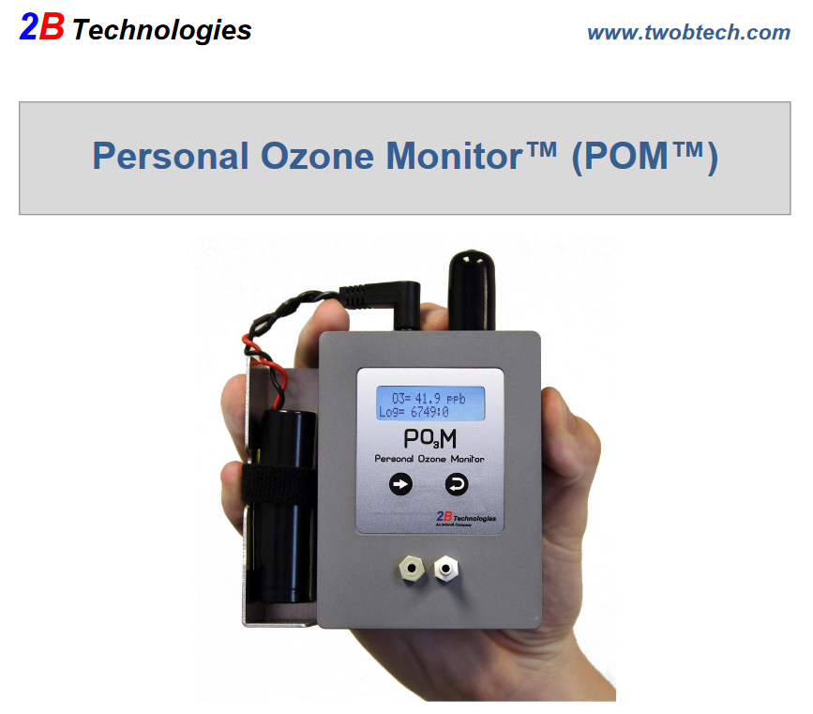
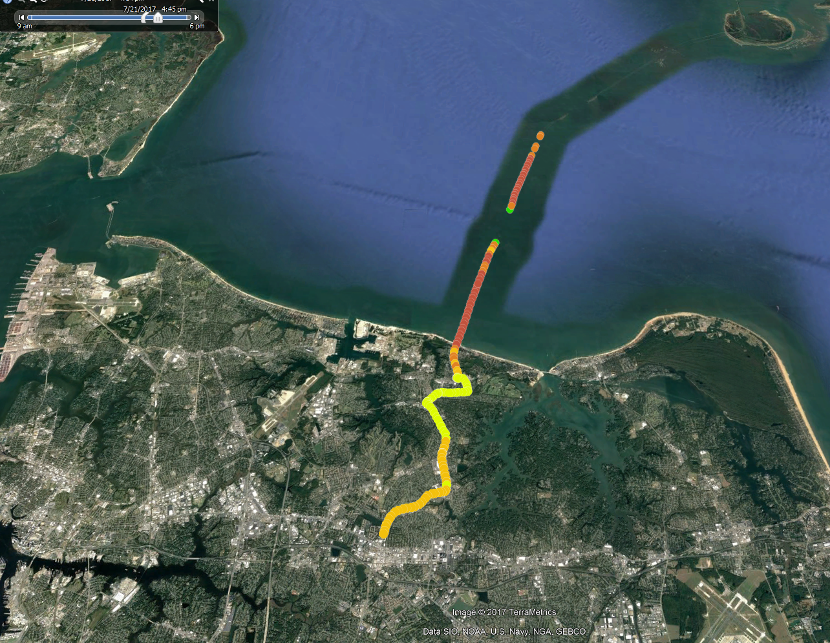
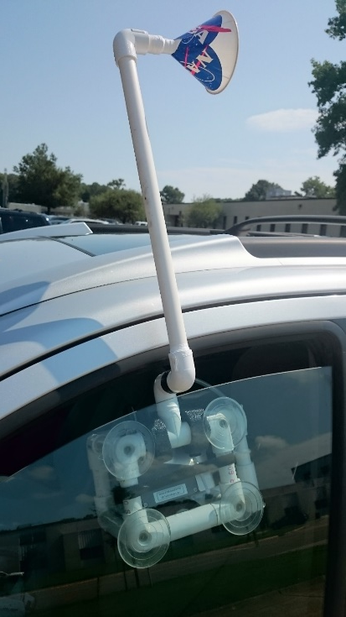
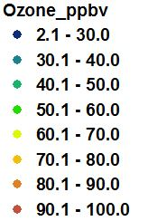
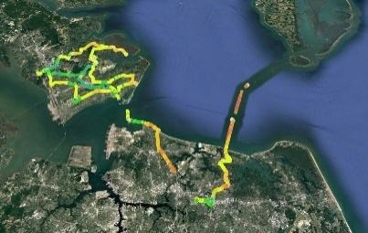
Mobile car in-situ measurements
Ozone Water Land Environmental Transition Study
Example car in-situ ozone sensor data segment from July 21
Caution: preliminary data
CBBT site
CBBT site
Car
in-situ
ozone
sensor
configuration
Car #1
July 21
Car #2
OWLETS activities supported by LaRC TEMPO Student Collaboration
Notes:
We had 2 mobile untis – one on peninsula and the other on southside and CBBT (Chesapeake Bay Bridge Tunnel) Lidar was on 3rd island of CBBT

Slide 16
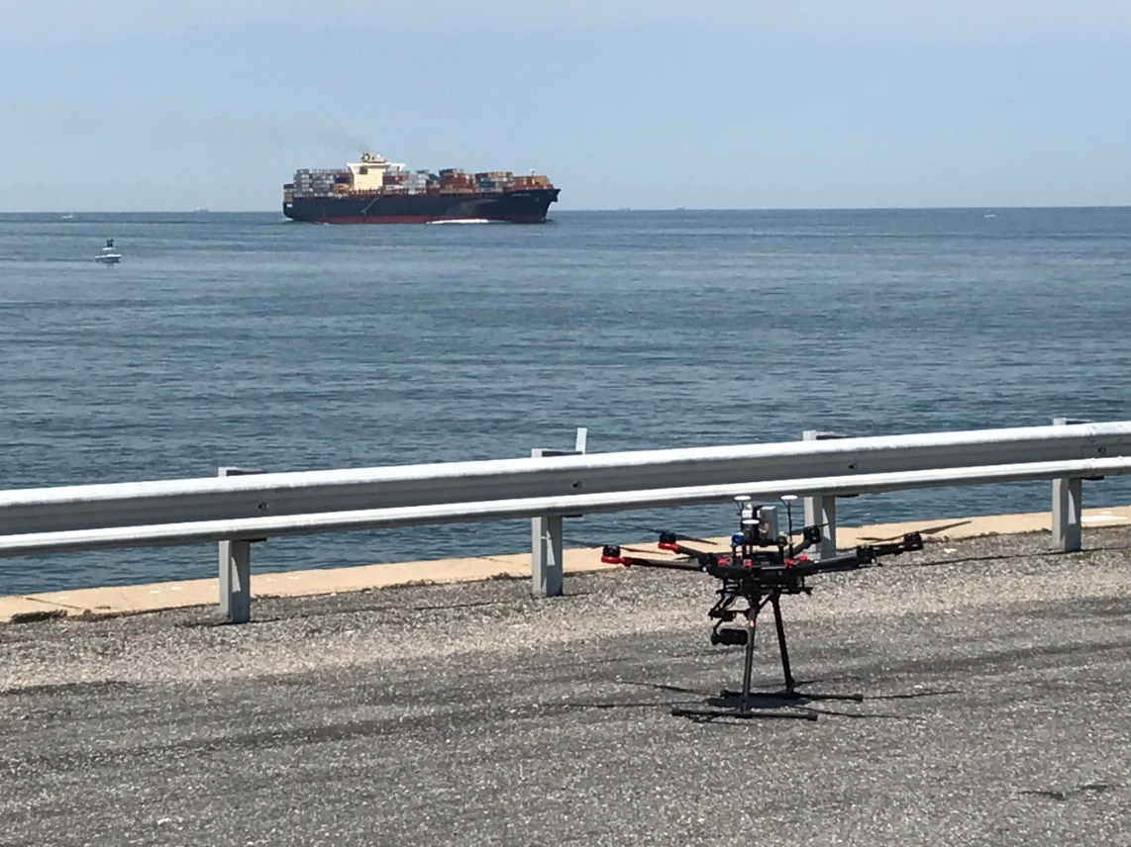
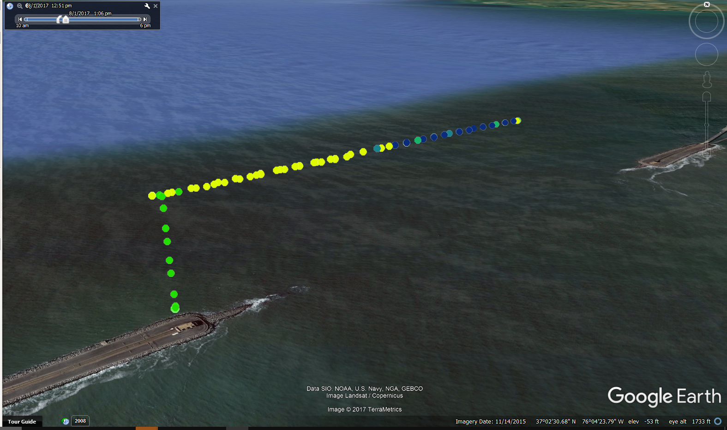
UAV in-situ ozone measurements
Ozone Water Land Environmental Transition Study
CBBT site with UAV in foreground and
a ship about to pass through channel
UAV August 1 flight from the CBBT third island
Caution: preliminary data
Ship channel
O₃ titration
~1 km
horizontal
UAV
~200 m
altitude
Gronoff, G., et al, A Method for Observing Near Range Point Source Induced O3 Titration Events Using Co-located Lidar and Pandora measurements, submitted to Atmospheric Measurement Techniques, April 2018.
OWLETS UAV/Drone activities supported by NASA’s Science Innovation Fund and LaRC TEMPO Student Collaboration
Notes:
Also a TEMPO student has a draft paper with her as first author. (see below)
This student is now at Ball Aerospace working on TEMPO and GeoTASO related projects.
Demonstration of an off-axis parabolic receiver for near-range retrieval of lidar ozone profiles
Betsy M. Farris, Guillaume P. Gronoff, Bill Carrion, Travis Knepp, Margaret Pippin, Timothy A. Berkoff, in draft.

Slide 17
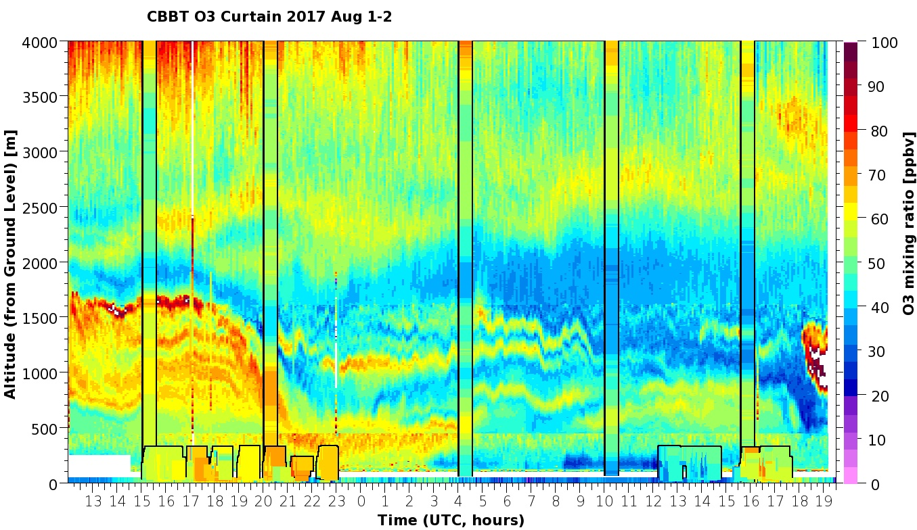
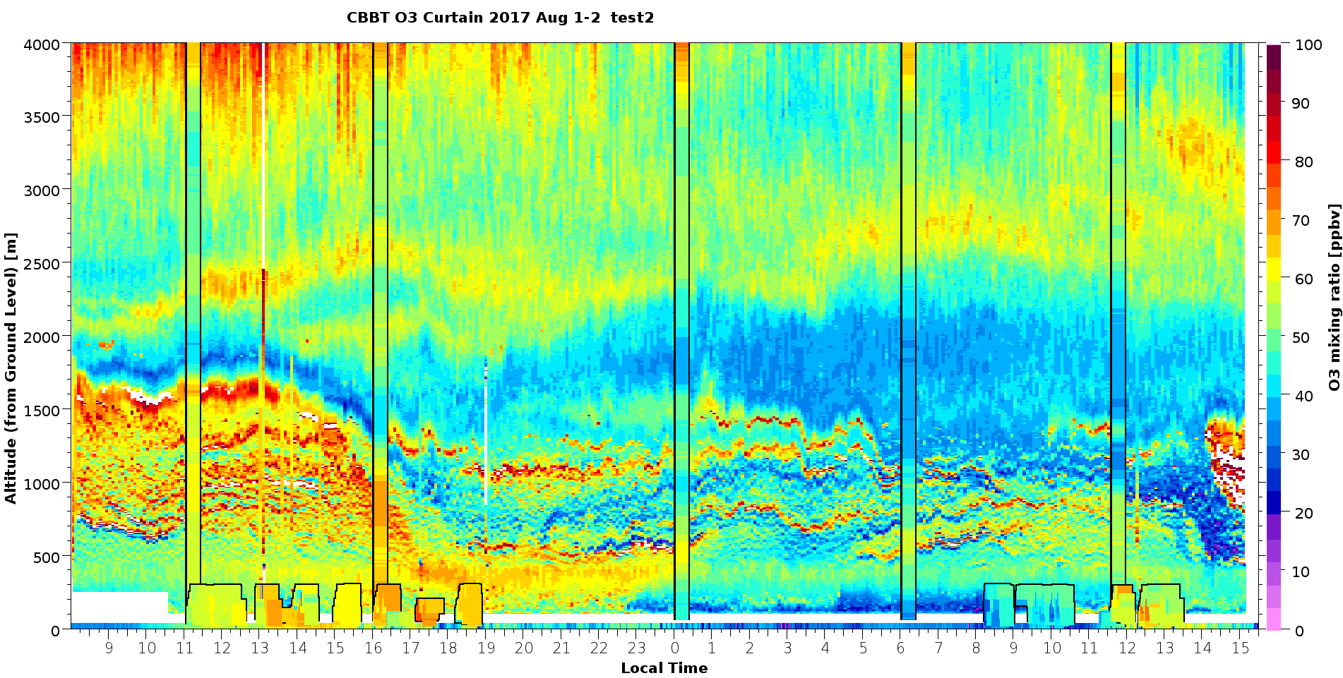
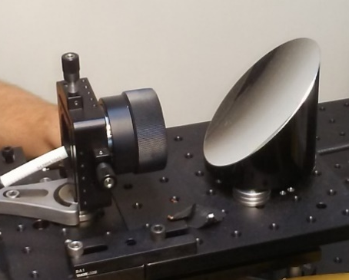
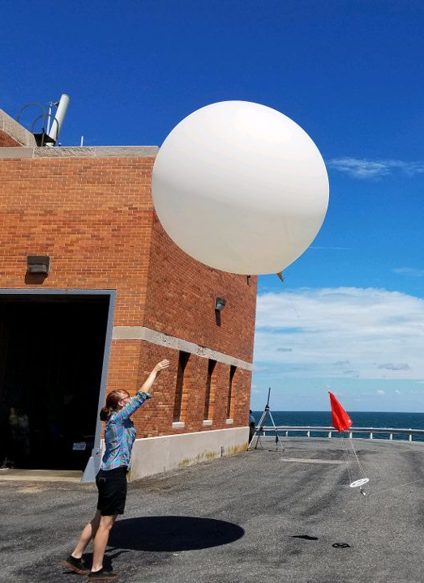
Validation of new near-field
receiver (0.12 to 1.5 km)
Ozone Water Land Environmental Transition Study
Example data from LMOL during the OWLETS campaign
Small diameter Fiber
coupled 90-deg off
axis parabola
Sonde
data
Sonde
data
UAV data
Surface data
Local Time [hour]
UAV data
Farris, B., et al, Demonstration of an off-axis parabolic receiver for near-range retrieval of lidar ozone profiles, submitted to Atmospheric Measurement Techniques, June 2018

Slide 18
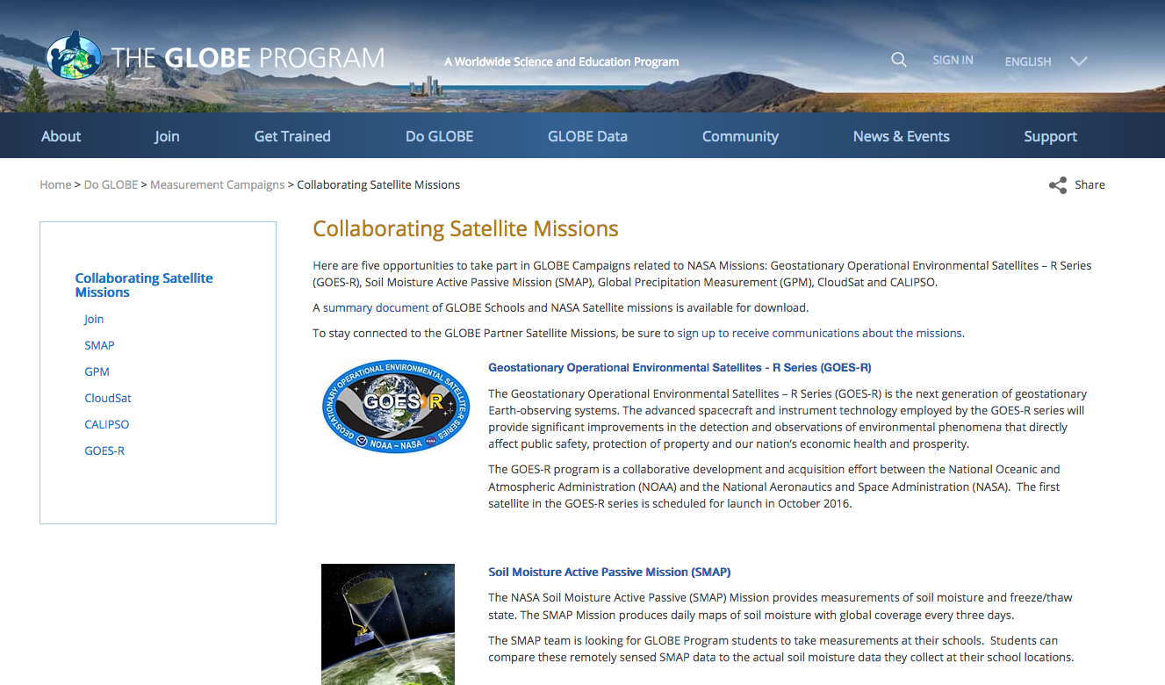
TEMPO
Tropospheric Emissions: Monitoring of Pollution (TEMPO)

Slide 19

TEMPO Jr Scientists
TEMPO
GLOBE
Collaborating
Satellite
Missions
Air Quality Campaign
Evaluate Sensors
Use Sensors
Junior Scientist Team (K – 12 Students)
Network of Sites

Slide 20
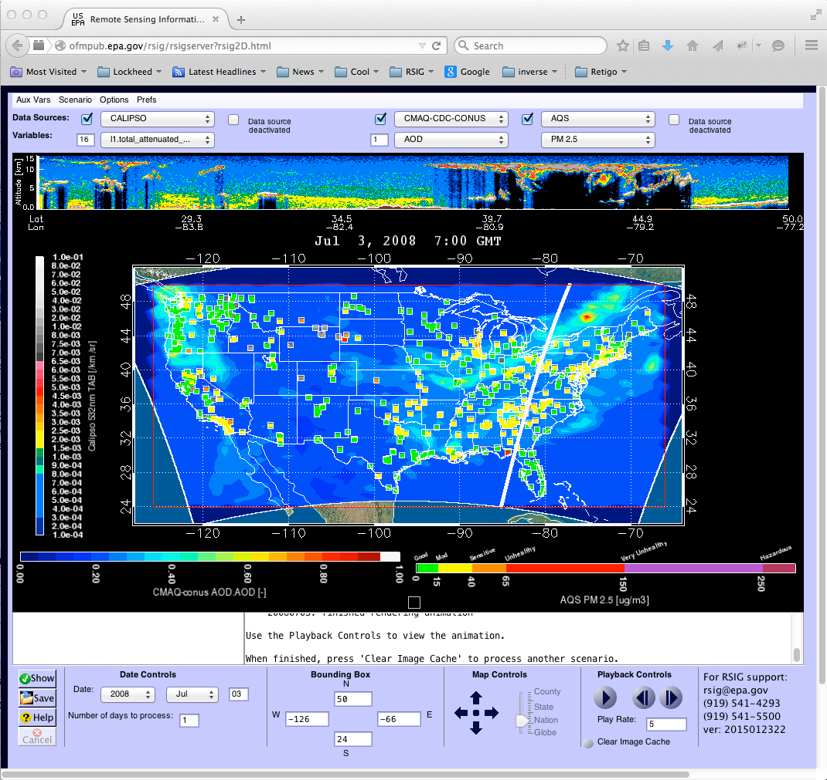



Next Challenge:
User-friendly data interfaces for the public
World-view?

