Slide 1


Principal Component Analysis SO₂ Retrieval Algorithm – Potential Application to TEMPO
Can Li
NASA GSFC Code 614 & ESSIC, UMD
Email: can.li@nasa.gov
Joanna Joiner, Nick Krotkov, Yan Zhang, Simon Carn, Chris McLinden, Vitali Fioletov
TEMPO Science Team Meeting
June 2, 2016
Washington DC

Slide 2
Take home message
SO₂ has come down in the TEMPO domain, but TEMPO SO₂ data may still be of science value;
PCA algorithm – data driven, straightforward to implement, now produces operational OMI PBL SO₂ product with good data quality
Application to TEMPO – feasible, given PCA approach’s speed, and ability to produce consistent retrievals between instruments
May be implemented with GEMS

Slide 3
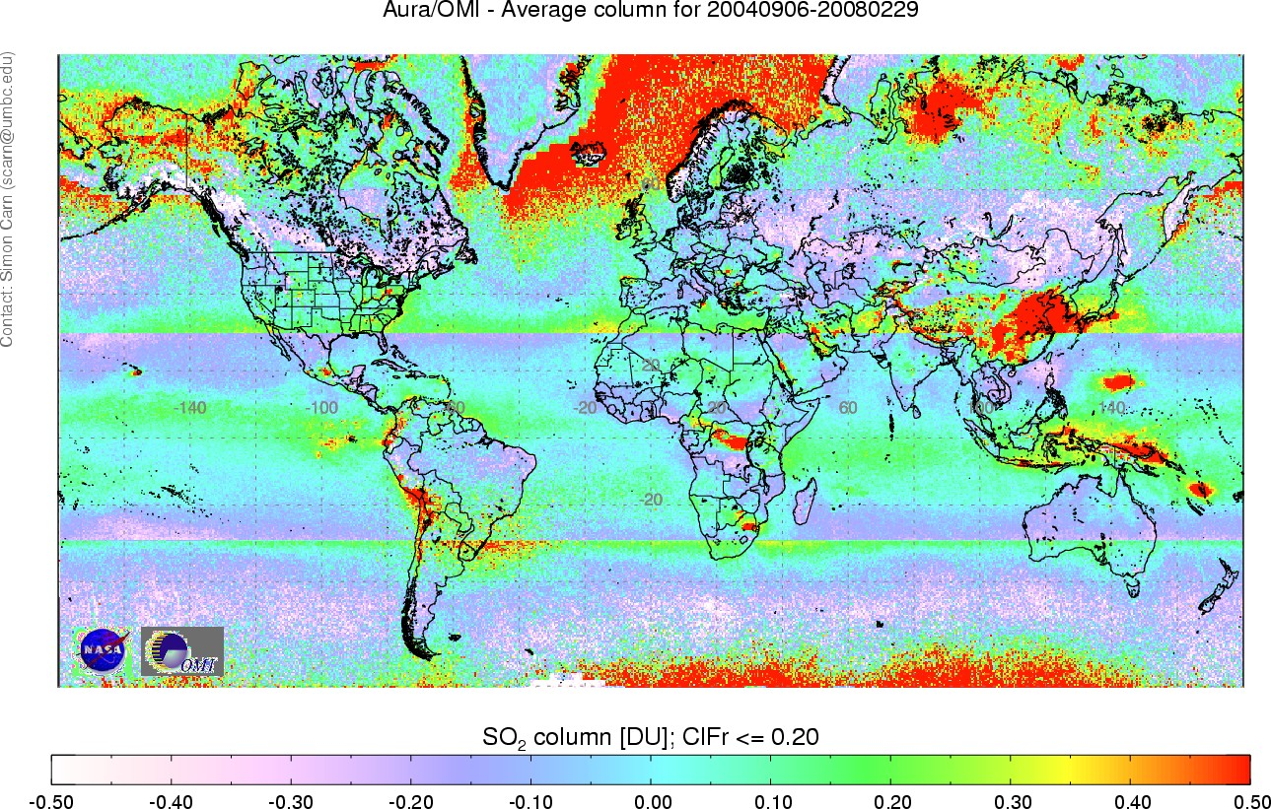
Background and Motivation
Previous Version OMI PBL SO₂ (Sept. 2004 – Feb. 2008)
Motivation: Band Residual Difference (BRD) algorithm fast and sensitive, but large noise and artifacts (only 3 pairs of wavelengths)
Objective: develop an innovative approach to utilize the full spectral content from OMI while maintaining computational efficiency

Slide 4
Basis – Spectral fitting algorithms
First look at the DOAS Equation:
Measured sun-normalized radiances
Rayleigh and Mie scattering, surface reflectance etc.
Various gas absorbers (O₃, SO₂ etc.)
The Ring effect
Plus additional measurement artifacts terms (e.g., wavelength shift, stray light, etc.) and/or radiance data correction schemes
Utilization of the full spectral content, but some terms are difficult to model (e.g., RRS)

Slide 5
Methodology (Framework): PCA
Instead of explicit modeling of ozone, RRS, and other instrumental features, we use a data-driven approach based on principal component analysis (PCA) with spectral fitting
Measured N-value spectrum
SO₂ column amount
PCs from SO₂-free regions, (O₃ absorption, surface reflectance, RRS, measurement artifacts etc.) other than SO₂ absorption
Pre-calculated SO₂ Jacobians (assuming O₃ profiles, albedo, etc.)
Fitting of the right hand side to the spectrum on the left hand side -> SO₂ column amount and coefficients of PCs
(See Guanter et al., 2012; Joiner et al., 2013; Li et al., 2013)

Slide 6
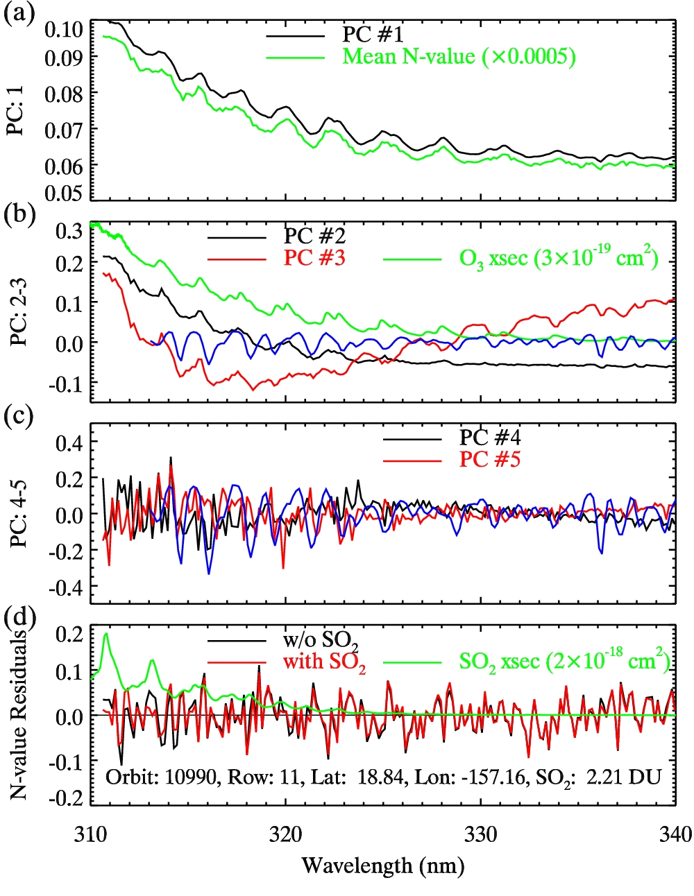
Principle Components and Residuals
Example PCs from entire row # 11, Orbit 10990
(Var.% 99.8492)
PC #1: Mean spectrum
(a-c) First few PCs
Blue line: scaled reference Ring spectrum
(Var.% 0.1264)
PC #2: O₃ absorption
(Var.% 0.0217)
PC #3: Surface reflectance (also Ring signature)
(Var.% 5.32E-5)
PCs #4 and #5: likely measurement artifacts, noise (>99.99% variance explained)
(Var.% 4.79E-5)
(d) Least squares fitting residuals for a pixel near Hawaii
Smaller residuals with SO₂ Jacobians fitted

Slide 7
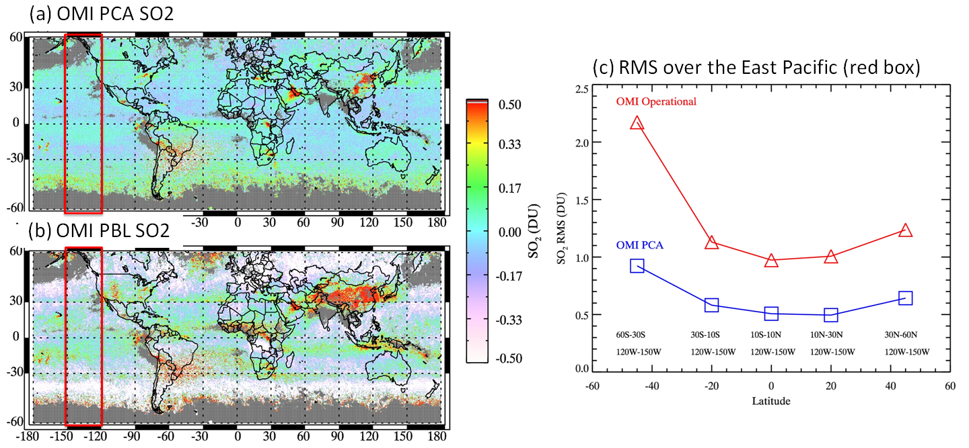
Results: noise and artifact reduction
August, 2006
OMI BRD
Instantaneous FOV
OMI BRD SO2
OMI PCA
PCA algorithm reduces retrieval noise by a factor of two as compared with the BRD algorithm
SO₂ Jacobians for PCA algorithm calculated with the same assumptions as in the BRD algorithm

Slide 8
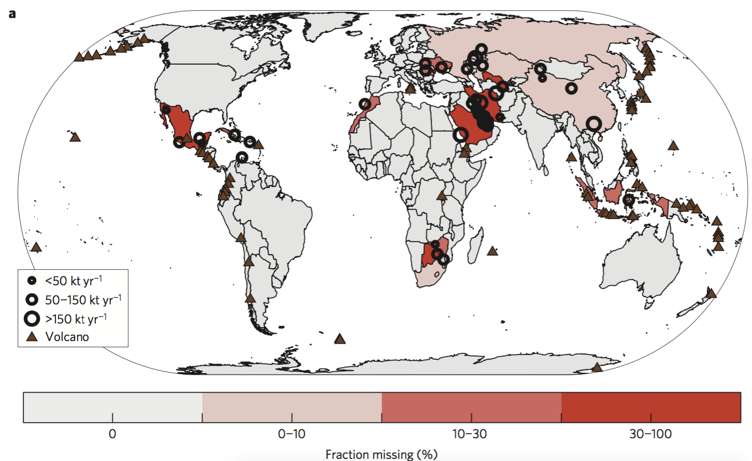
When combined with wind data and careful, innovative data analysis …
An independent “top-down” global SO₂ emission inventory [McLinden et al., 2016];
Annual emissions quantified for ~500 large sources, ~40 missing or unreported in “bottom-up” inventories, or ~6-12% of the total anthropogenic sources;
Emissions quantified for 75 volcanoes – large differences between OMI measurements and the Aerocom database.

Slide 9
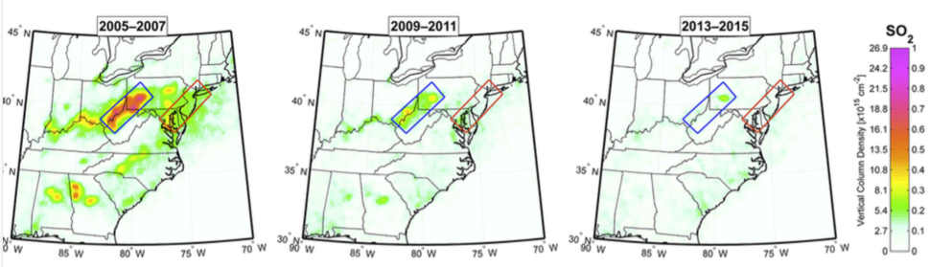
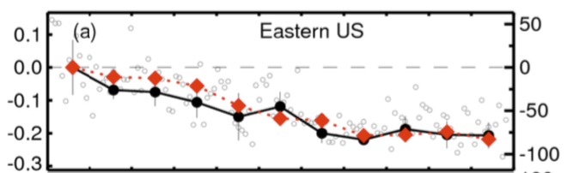

SO₂ change over the U.S. during the OMI era
Inventory
[Krotkov et al., 2016]
OMI
OMI PCA SO₂ retrievals suggest large decrease of SO₂ over the eastern U.S., in agreement with emission inventory;
Currently emissions barely detectable by OMI – requires averaging of large dataset;
More frequent measurements by TEMPO will help to continue the monitoring.

Slide 10
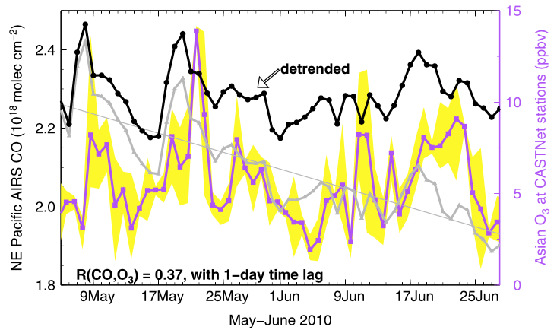
Outside contribution to air pollution over the western North America?
An important science question of the GEO-CAPE mission is to assess the impact of inter-continental transport on air quality;
The planned CO product for GEO-CAPE could have served as a tracer for pollutant inflow, as demonstrated with AIRS CO data by Lin et al. [2012]

Slide 11
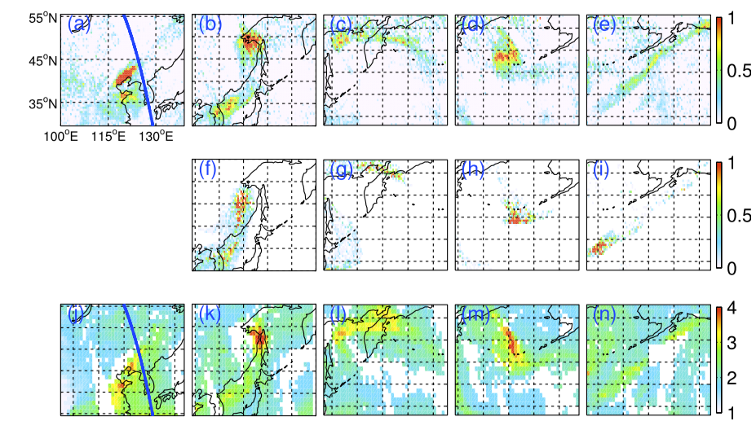
A transpacific transport episode in Oct. 2006 detected with OMI SO₂ Data [Hsu et al., 2012]
OMI SO₂
Tracer SO₂
AIRS CO
Among the species of that can be retrieved with TEMPO, SO₂ may serve as a tracer for transpacific transport:
Longer lifetime than other TEMPO species (rapid LRT events)
Characteristics of Asian emissions

Slide 12
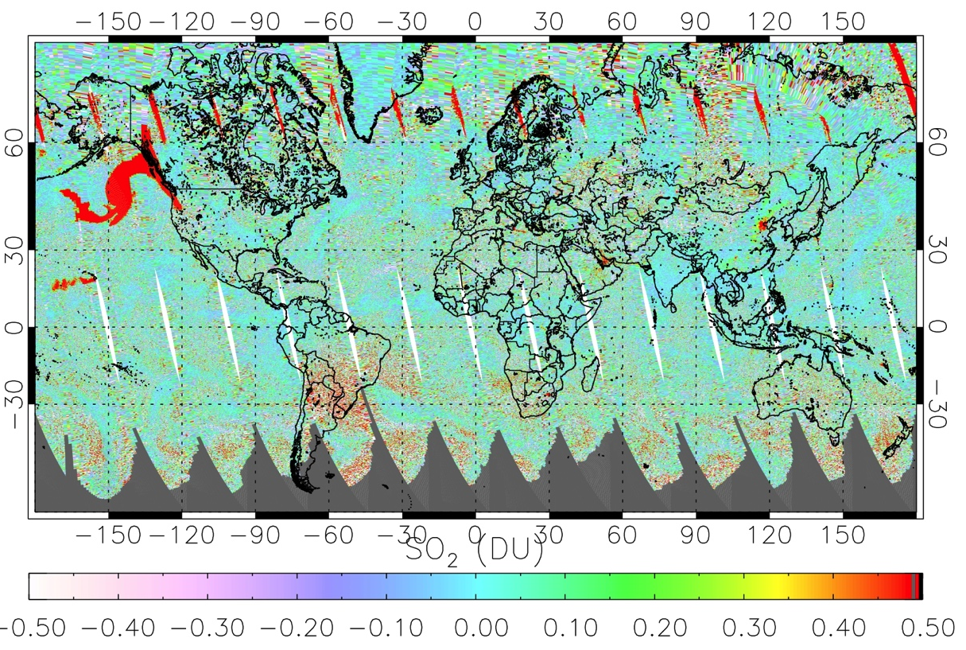
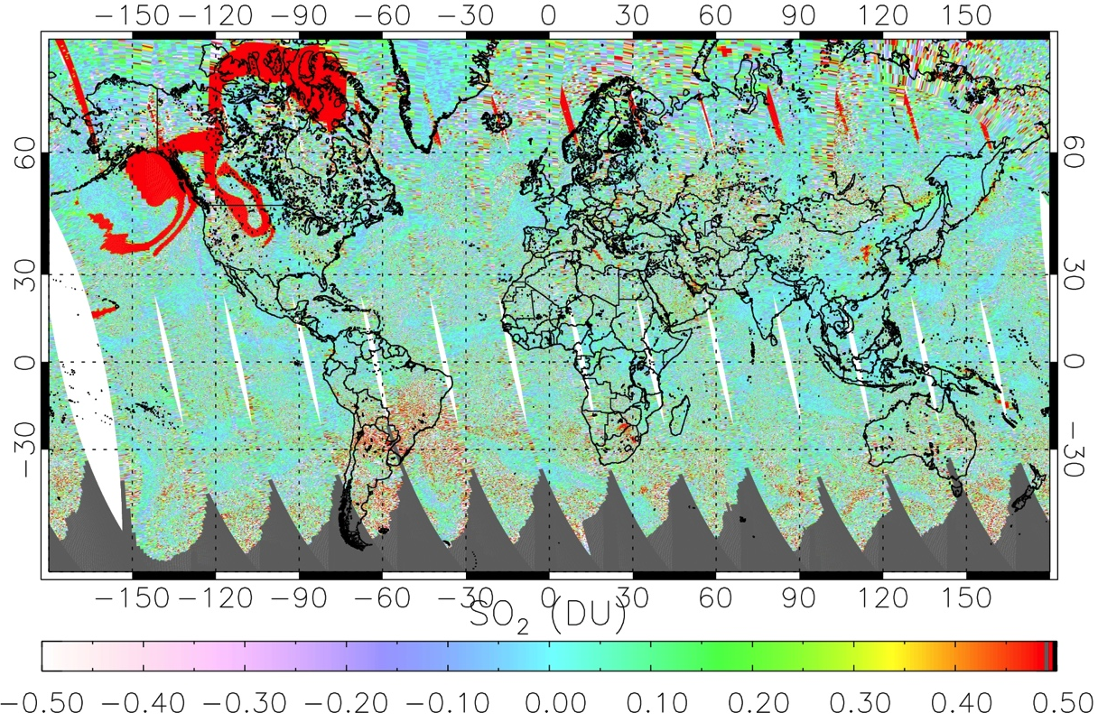
Volcanic SO₂ retrievals for aviation safety applications
August 11, 2008
A number of volcanoes in or just outside of the TEMPO domain may pose threat to aviation safety or even human lives;
Frequent TEMPO SO₂ measurements may help to mitigate these threats.
August 12, 2008
New OMI operational volcanic SO₂ product assuming 3 km plume height [Li et al., 2016, in prep]

Slide 13
Execution Speed of the PCA SO₂ Algorithm
~4 min per OMI orbit (~70,000 pixels) using simplified SO₂ Jacobians LUT ;
5 days used for reprocessing 10-year OMI data for the current operational PBL product;
~65 min per OMI orbit using full LUT - can be reduced to ~10 min if cross-section is used in fitting for SCD and then converted to VCD using AMF;
~20 s per OMPS orbit (~10,000 pixels) using simplified SO₂ Jacobians LUT

Slide 14
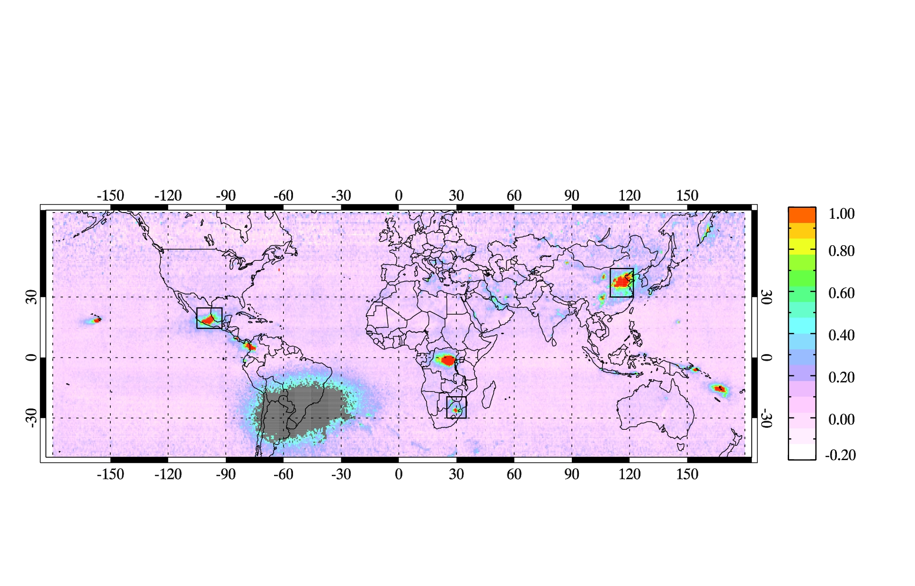

Good consistency between OMI and OMPS Annual Mean PBL SO₂ Retrievals for 2012
OMI
OMPS
[Zhang et al., 2016, in prep]

Slide 15
Daily regional SO₂ loading over Mexico (PBL retrievals)
[Zhang et al., 2016, in prep]

Slide 16
Daily OMI/OMPS regional volcanic SO₂ loading near Hawaii (PCA 3-km retrievals)
Daily spatial correlation
[Li et al., 2016, in prep]

Slide 17
Implementation with TEMPO
PCA conducted for the same group of CCD pixels along the direction of scan (similar to the OMI algorithm);
Take advantage of natural variability due to clouds, O₃, reflectivity and also observational difference such as different viewing zenith angles;
Data over ocean are important – offers variability for PCA analysis, also coverage for pollution inflow
For final SO₂ product, needs L2 O₃ and cloud products as input (no need for NRT product);
Uses L1B data as is (may sample multiple days for PCA), but may benefit from instrument characterization done for other algorithms.

Slide 18
Conclusions
The PCA SO₂ retrieval approach – data-driven, good quality, straightforward to implement.
If implemented with TEMPO may provide science return in 1) remaining large SO₂ sources; 2) inflow of Asian pollution; 3) aviation safety.
If implemented with both GEMS and TEMPO may help to establish source-receptor relationship between two continents.

