Slide 1
GeoTASO: An airborne testbed for TEMPO and GEMS trace gas retrievals
Caroline Nowlan, Xiong Liu, Gonzalo Gonzalez Abad, Kelly Chance, Peter Zoogman
Harvard-Smithsonian Center for Astrophysics, Cambridge, MA
James Leitch, Joshua Cole, Tom Delker, Bill Good, Frank Murcray, Lyle Ruppert, Dan Soo
Ball Aerospace, Boulder, CO
Chris Loughner, Melanie Follette-Cook, Scott Janz, Matt Kowalewski, Ken Pickering
NASA GSFC, Greenbelt, MD
Jay al-Saadi
NASA LaRC, Hampton, VA
TEMPO Science Team Meeting, 1-2 June 2016

Slide 2
How GeoTASO Informs TEMPO
Sensor-algorithm interactions and key parameters
Identifies sensor artifacts that influence retrieval accuracy
Highlights tests and measurements needed for good retrievals
Can conversely show where sensor performance and testing can be relaxed
Algorithm preparation/tuning for TEMPO
Offers direct test of algorithm performance vs. SNR and spectral passband/sampling
Tests surface reflectance effects on retrievals
Demonstrate combined UV/Visible ozone retrieval
High spatial resolution checks for any smaller scale effects on space-based retrievals
(Jim Leitch, GeoTASO IIP Final Review 2014)
Satellite analogue for preparatory field campaigns
Future validation instrument

Slide 3
GeoTASO Instrument

Slide 4
GeoTASO Instrument
Geostationary Trace gas and Aerosol Sensor Optimization
Measures with two 2D CCD detector arrays (UV and VIS)
 | GeoTASO | TEMPO
Wavelength range | 290 – 400 nm (UV) 415 – 695 nm (VIS) | 290 – 490 nm (UV) 540 – 740 nm (VIS)
Nominal spectral sampling | 3.1 pixels/FWHM | 2.9 pixels/FWHM
Nominal spectral resolution | 0.43 nm (UV) 0.88 nm (VIS) | 0.57 nm
Native spatial resolution | 9 m x 50 m | 2.1 km x 4.4 km
Reference spectrum | Zenith or clean nadir | Solar diffuser

Slide 5
GeoTASO Campaigns
Campaign | Location | Dates
Test flights | Virginia/Maryland | July 2013
DISCOVER-AQ | Texas | September 2013
DISCOVER-AQ | Colorado | July-August 2014
Ocean color | NOAA ship, off Virginia | July 2015
KORUS-AQ | Korea | May-June 2016
NO₂ retrievals from DISCOVER-AQ Texas 2013 available online on NASA data archive
Nowlan et al., AMTD, 2015
L1B data for DISCOVER-AQ Colorado is available from NASA ftp as of May 2016 (contact Jay al-Saadi)

Slide 6
GeoTASO Spectrometer

Slide 7
GeoTASO Observations
Native resolution is ~9 m x 50 m with SNR=65 (NO₂) and SNR=110 (HCHO)
Co-add to reduce noise
For NO₂, we provide data at 250 m x 250 m

Slide 8
Trace Gas Retrievals

Slide 9
NO₂ over Downtown Houston 13 September 2013
Vertical
Column

Slide 10
NO₂ over Downtown Houston 13 September 2013

Slide 11
NO₂ over Denver, Raster Scans 2 August 2014
8:00 – 11:30 AM Local time
2:00 – 4:00 pm local time
Slant
Column

Slide 12
Colorado Formaldehyde

Slide 13
Denver HCHO

Slide 14
O₃ Profiles
Preliminary
UV-only retrieval
Use UV and Visible channels to test O₃ profile retrievals
Some challenges:
Absolute radiometric calibrations need to be very accurate
Development of a good reference spectrum

Slide 15
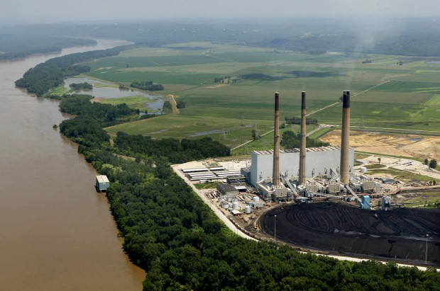
GeoTASO SO₂
GeoTASO measured coincident slant columns of NO₂ and SO₂ downwind from Labadie Power Station, Missouri’s largest coal-burning power plant, on transit from Colorado to Virginia (08/13/2014)
Photo by J.B. Forbes

Slide 16
Calibration, Characterization and Level 2 Data Quality

Slide 17
Characterization using Flight Data: Background
Slit function shape parameters and wavelength dispersion are fit before trace gas retrieval using a high-resolution solar reference spectrum (i.e., Chance and Kurucz, 2010)
See Liu et al., 2005 (GOME), Liu et al., 2010 (OMI), Cai et al., 2012 (GOME-2)
For aircraft data, need to fit “pseudo-absorbers” (O₃ etc.) at the same time as we do not have an exo-atmospheric spectrum

Slide 18
Characterization using Flight Data: Slit Function
Slit function shapes and widths are very stable across both dimensions of CCD array (<0.01 nm differences).

Slide 19
Characterization using Flight Data: Wavelength Registration
Wavelength sampling varies across spatial dimension
Zenith spectra are collected at center of array using optical fiber
Fitting a wavelength shift relative to zenith reference in retrieval works fine for NO₂
HCHO is more sensitive to calibration errors, and cross-track dependent clean nadir reference works best

Slide 20
Level 0 to Level 1B Processing
Remove dark current
Correct for:
Offset
Crosstalk
Smear
Out-of-band straylight
Out-of-field straylight
Convert to scene radiance using radiometric calibration data
Geolocation

Slide 21
Level 0 to Level 1B Processing: Noise introduced by calibrations
Stray light corrections have spectral noise
These can be smoothed, or else will introduce noise that increases fitting residuals
A persistent pattern shows up in all spectra in L0→L1B version with stray light smoothing turned off.

Slide 22
Level 0 to Level 1B Processing: Red field effect in NO₂ retrievals
RMS
RGB Image
Regions of high RMS correlate with bright red-brown fields (bare soil?)
Likely from incorrect out-of-band stray light correction
Luckily, the Colorado campaign had few of these observations.

Slide 23
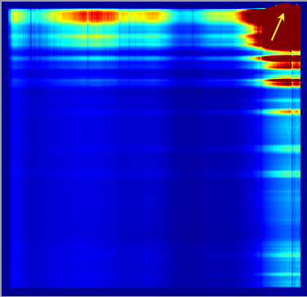
Level 0 to Level 1B Processing: Along-Track Striping
Saturated pixels at edge of cross-track view can bleed into out-of-field detector pixels which are used for stray light corrections
Raw CCD frame
Along-track striping in Level 2 retrievals can appear if stray light is not removed correctly

Slide 24
Effects of Slit Size
GeoTASO was designed to take replaceable slits of varying sizes
DISCOVER-AQ Texas used four slit sizes on different flights
 | 26.0 μm | 32.5 μm | 39.0 μm | 45.5 μm
UV sampling (pixels/FWHM) | 2.5 | 2.8 | 3.1 | 3.5
VIS sampling (pixels/FWHM) | 2.5 | 2.7 | 3.1 | 3.6
UV FWHM (nm) | 0.34 | 0.39 | 0.43 | 0.49
VIS FWHM (nm) | 0.70 | 0.75 | 0.88 | 1.00
undersampled

Slide 25
Effects of Slit Size (NO₂)
DISCOVER-AQ Texas NO₂ Fitting Uncertainties
SNR is lower for narrower slits
Integration time was the same for all flights
Cost of low throughput not offset by benefits of higher spectral resolution for two narrowest slits

Slide 26
Validation

Slide 27
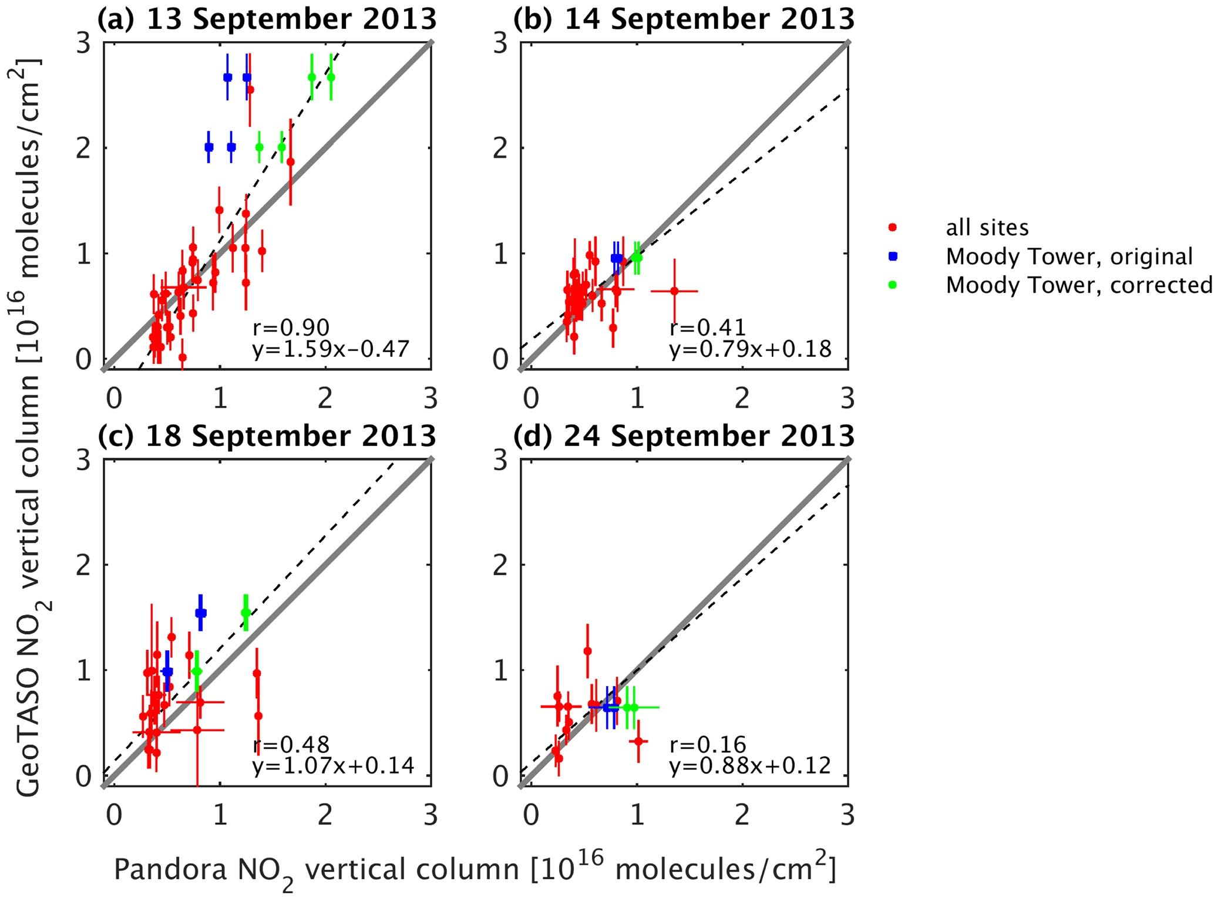
GeoTASO NO₂ vs PANDORA NO₂ Houston Urban Flights
NO₂ at 250 m x 250 m resolution has fitting uncertainty of 2.2e15 molecules/cm²
TEMPO will have coarser spatial resolution (2.1x4.4 km²) and higher precision
Expect similar features (correlation increases with range of NO₂) but lower slope (lower spatial resolution) and reduced r (lower spatial and temporal resolution)

Slide 28
GeoTASO NO₂ vs In Situ NO₂ Houston Urban Flights
(Following Lamsal et al., 2008)

Slide 29
Current Status and Summary
L1B data
DISCOVER-AQ Texas available
UV data contaminated by stray light
Contact Jim Leitch at Ball Aerospace or Caroline at SAO
DISCOVER-AQ Colorado available as of May
Contact Jay al-Saadi
Level 2 data
DISCOVER-AQ Texas NO₂ on data archive
DISCOVER-AQ Colorado non-final results available from SAO
See Nowlan et al. (2015, AMTD)
Instrument currently deployed in KORUS-AQ
Ball has transferred instrument to Scott Janz at NASA GSFC

