Slide 1
TEMPO Instrument Update
Dennis Nicks, Program Manager
TEMPO Science Team Meeting
June 1-2, 2016
dnicks@ball.com

Slide 2
Ball TEMPO Program Status
Instrument CDR completed in June 2015
  Successful review with positive comments from review board
  All instrument action items closed
Flight CCDs selected in February 2016
  New Lot 3B parts with extended etch process resulted in lower dark current over Lot 1 parts
  Predicted instrument performance achieves Level 1 Baseline Science requirements
Subsystems are completed or in processing / final test
  Subsystems either meet requirements, or have acceptable performance when considering system level margin
6/1/2016

Slide 3
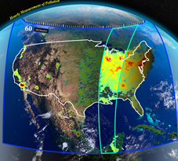
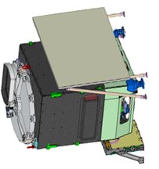
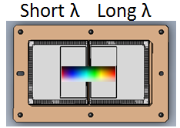
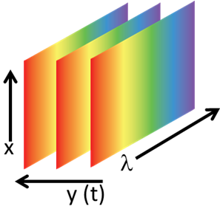
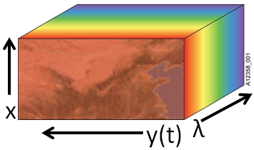
TEMPO Operations: Step / Stare Imaging over Field of Regard
Parameter | Current Best Estimate
Frame Integration Time | 118 ms
Image Frame Rate | 7.92 Hz
Image Frame Time | 2.65 s
Number of Coadds | 21
Scan Mirror Step Size | 114 µrad
Number of Scan Mirror Steps | 1283
Coverage Time | 59.1 min
TEMPO step / stares over GNA in
1283 steps from East to West over 59.1 min
Ground processing spatially bins and geo-locates image
Images from each scan mirror position are co-added on board
Transmit co-added images to ground

Slide 4
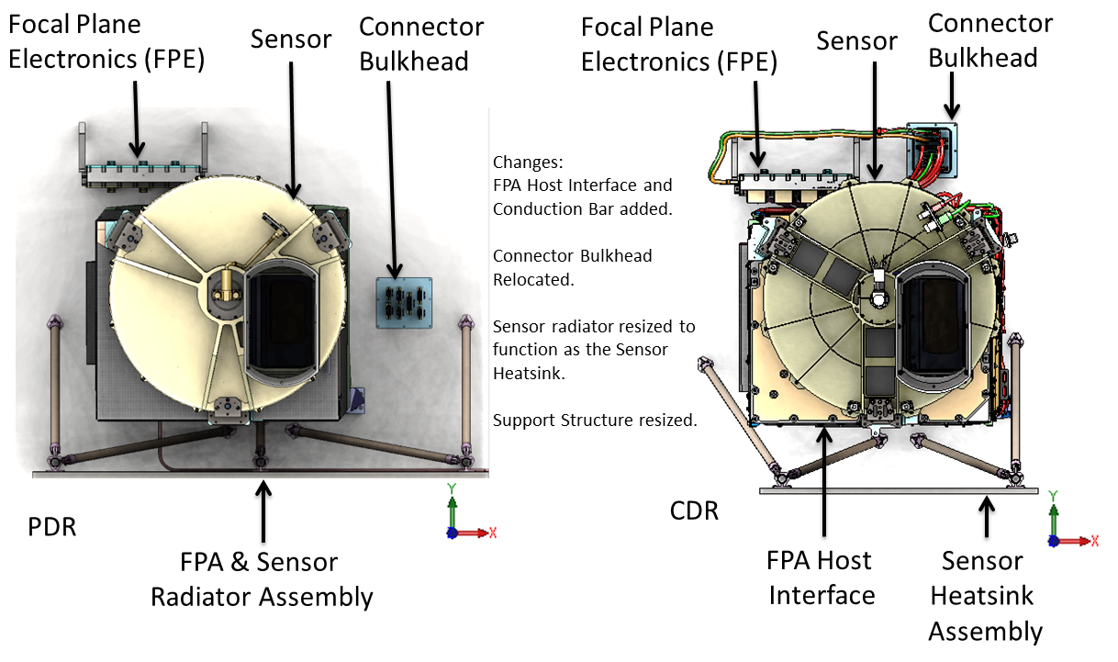
TEMPO Mechanical Design Changes from PDR to CDR

Slide 5
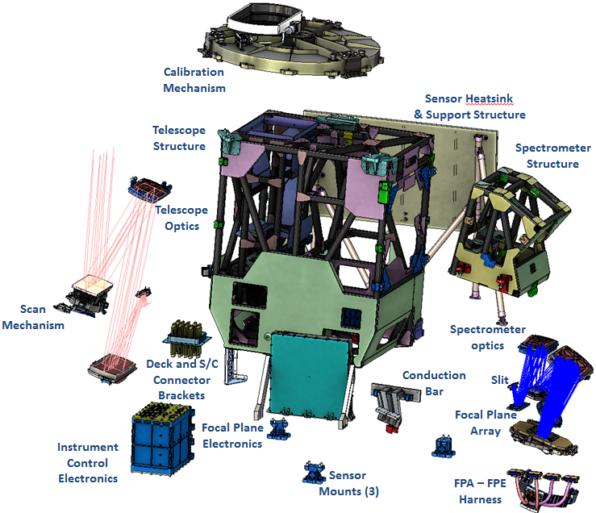
TEMPO Instrument:
Expanded View

Slide 6
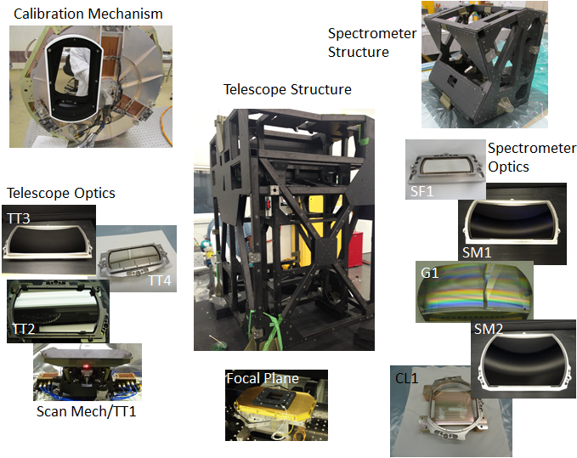
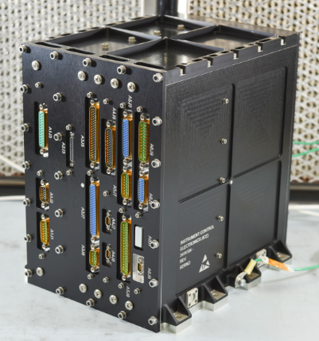
Subsystems In Work, or Completed
Instrument Control Electronics

Slide 7
Design Changes Since CDR
Optical bench design changes for launch loads
  Installed fasteners to augment composite bonds for strength
“Extended Etch” process for CCDs
  Reduce dark current seen in Lot 1 CCDs
  Lot 3B “Extended Etch” resulted in 40% reduction in dark current
CCD Flight Temperature cooled to -20 C
  Was -17 C
  Additional dark current reduction of ~25%

Slide 8
CCD Dark Current Improvement
FT6BS-014 – Lot 3B – UV CCD
Threshold for reasonable EOL DC
FT6BS-007 – Best part from Lot 1
0.03% of CCD Pixels reasonable EOL DC
FT6BS-017 – Lot 3B – Vis CCD
Threshold for reasonable EOL DC
96.4% of CCD Pixels Exceed the reasonable EOL DC
Threshold for reasonable EOL DC
0.04% of CCD Pixels Exceed reasonable EOL DC
Dark current images and data from CCDs are all taken under same temperature and integration time, and plotted on the same scale

Slide 9
TEMPO Parameters are Stable
Parameter | SRR Value | PDR Baseline | CDR Baseline | Notes
Frame Integration Time | 95.83 ms | 118 ms | 118 ms
Image Frame Rate | 10 Hz | 8.19 Hz | 7.92 Hz
Image Frame Time | 2.70 s | 2.69 s | 2.65 s
Number of Coadds | 27 | 22 | 21
Scan Mirror Step Size | 115 urad | 114 µrad | 114 µrad
Number of Scan Mirror Steps | 1267 | 1278 | 1283
Coverage Time | 59.14 min | 59.39 min | 59.1 min
Parameters assume TEMPO orbit at the extremes of the orbit arc range
An orbit toward center of GNA improves performance

Slide 10
SNR Model Updates Since CDR
The TEMPO radiometric model has undergone several changes since CDR, including:
  Include flight CCD performance for both dark current and QE
  As-tested EOL radiation degradation for CCDs
  CCD performance at -20C
  As measured spectral reflectivity at component level
  As measured grating performance at component level
  Updated detector read noise, full well and CTE values
  Updated the number of worst-case pixel transfers
  Updated Detector full well, read noise and CTE values
SNR estimates assume the TEMPO EOL CTE as called out in the TEMPO FPS specification

Slide 11
SNR Performance Vs Requirements Over Time
All SNR estimates represent EOL performance
CDR estimate incorporated Lot 1 Dark Current estimates
Current estimate incorporates Lot 3B Dark current measurements
SNR minimum margin is now 25%
In all cases, current SNR predictions are better than PDR estimates
Next update will be during instrument throughput testing at instrument level

Slide 12
KTP Summary: Science Performance
KTP | Reqt | This Month | Last Month | Trend | Notes
Bandwidth | < 0.6 nm | 0.599 nm | 0.599 nm | No Change
Bandwidth Symmetry | < 6% | ≤ 6% | ≤ 6% | No Change
Radiometric Calibration Accuracy | < 4% (1-sigma) | 7.5% (1-sigma) Radiance at 290 nm 3.9% (1-sigma) Radiance at 300.0 nm / 2.99% (1-sigma) Irradiance Best Case = all compliant | 7.5% (1-sigma) Radiance at 290 nm 3.9% (1-sigma) Radiance at 300.0 nm / 2.99% (1-sigma) Irradiance Best case = all compliant | No Change | Assumes worst case, with no storage region dark current monitor used (would improve performance) Baseline Level 1 Science Requirements still met with margin
Radiance Stray Light | 300 nm: < 30% 310 nm: < 15% 320 – 740 nm: < 5% | 300 nm: 11.6% 310 nm: 2.2% 320 – 740 nm: < 3.0% | 300 nm: 11.6% 310 nm: 2.2% 320 – 740 nm: < 3.0% | No Change
Albedo Stray Light | 300 nm: < 15% 310 – 740 nm: < 3% | 300 nm: 2.2% 310 – 740 nm: <1% | 300 nm: 2.2% 310 – 740 nm: <1% | No Change
Structured Stray Light | < 5e-4 | < 5e-4 | < 5e-4 | No Change
6/1/2016

Slide 13

KTP Summary: Science Performance
KTP | Reqt | This Month | Last Month | Trend | Notes
FOR | 4.61° N/S FOR (derived) 8.35° E/W FOR (derived) | 4.76° N/S FOR 8.951° E/W FOR | 4.76° N/S FOR 8.951° E/W FOR | No Change
GSD | ≤ 2.22 km, ≤ 5.15 km @ C.F.* | 2.21 km, 4.97 km @ C.F.* | 2.21 km, 4.97 km @ C.F.* | No Change
E/W Step Overlap | 6 µrad | 6 µrad | 6 µrad | No Change
MTF | > 0.16 @ 0.5 cyc/N-S GSD > 0.3 @ 0.5 cyc/E-W GSD | 0.19 @ 0.5 cyc/N-S GSD 0.44 @ 0.5 cyc/E-W GSD | 0.19 @ 0.5 cyc/N-S GSD 0.44 @ 0.5 cyc/E-W GSD | No Change
Spectral Sampling | ≥ 2.7 pixels / FWHM | 2.9 pixels / FWHM | 2.9 pixels / FWHM | No Change
LPS | 290 – 490 nm: < 5% (1-sigma) 540 – 690 nm: < 20% (1-sigma) | 290 – 490 nm: < 4% (1-sigma) 540 – 690 nm: < 15% (1-sigma) | 290 – 490 nm: < 4% (1-sigma) 540 – 690 nm: < 15% (1-sigma) | No Change
SNR | See SNR chart | See SNR chart | See SNR chart | No Change
Alignment Knowledge (0th, 1st, 2nd, 3rd +) | 0th: < 40 µrad over 1 hour, 1st: < ±0.0015 over one orbit , 2nd: < ±0.01 /rad over one orbit, 3rd +: < 20 µrad (3σ) over FOR | 18.62 µrad 0.0007 0.0078 / rad 18.20 µrad | 18.62 µrad 0.0007 0.0078 / rad 18.20 µrad | No Change
Alignment Knowledge over Two Adjacent N-S Swaths | < 2.5 urad (3-sigma, per-axis) | 0.30 µrad | 0.30 µrad | No Change
* C.F. = Chance Farm at Geodetic 36.5° N, 100° W

Slide 14
Summary
TEMPO Subsystem Manufacturing Completing
  Preparing for final assembly and test late this year
Lot 3B detectors resulted in a 40% reduction in dark current
Minimum SNR margin to EOL performance estimates is greater than 20%
  Incorporates as-manufactured component level spectral reflectivity measurements, as-measured component level grating performance and as-measured component level CCD performance at -20 C
Baseline Level 1 Science Requirements met with margin, using current instrument performance predictions
  Continue to discuss risks and opportunities
Communicate early and often with NASA LaRC and SAO
  Better understanding of dependence of algorithm performance and instrument performance results in sensible trades and optimal performance
  SAO, LaRC and Ball teams are focused on providing the best science performance

