Slide 1
Data Needs for Model Evaluation for Ozone and Regional Haze Planning
Gail Tonnesen
EPA Region 8
TEMPO Applications Workshop: Hourly Air-Quality Data from Geostationary Orbit
National Space Science and Technology Center, Huntsville AL, 12-13 July, 2016

Slide 2
Topics
Ozone Exceptional Event Demonstrations for Wildfires and Stratospheric Intrusion.
Estimates of U.S. Background O3 and international transport of O3.
O3 attainment planning and O3 sensitivity to VOC and NOx.
Regional Haze planning: estimates of natural visibility and international transport contributions to regional haze.

Slide 3
EPA, State and Tribe Planning Needs
States, Tribes and EPA use photochemical models to develop Implementation Plans (SIPs, TIPs, or FIPs) that demonstrate:
  Attainment of National Ambient Air Quality Standards for O3.
  Good Neighbor SIPs for interstate transport of ozone.
  Progress toward regional haze goal of natural visibility conditions at Class I Areas.
Air Quality goals are evaluated for a subset of days:
  O3 attainment is typically evaluated for the ten highest modeled ozone days.
  Regional haze goal is evaluated for the 20% worst anthropogenic impairment days and for the 20% best visibility days.

Slide 4
EPA, State and Tribe Planning Needs
Models should accurately simulate background O3 and natural haze levels on individual days:
  Background O3 and natural haze levels are highly variable in space and time.
  Do models accurately represent background O3 and natural haze on the subset of days used for air quality planning?
  Can the next generation of satellite data help provide more accurate estimates of daily ozone and natural haze?
Days with high ozone or haze levels caused by Exceptional Events can be excluded from the planning process.
  For O3, states prepare an exceptional event demonstration for review by EPA.
  For regional haze, data analysis methods are used to estimate the natural haze level on each day.

Slide 5
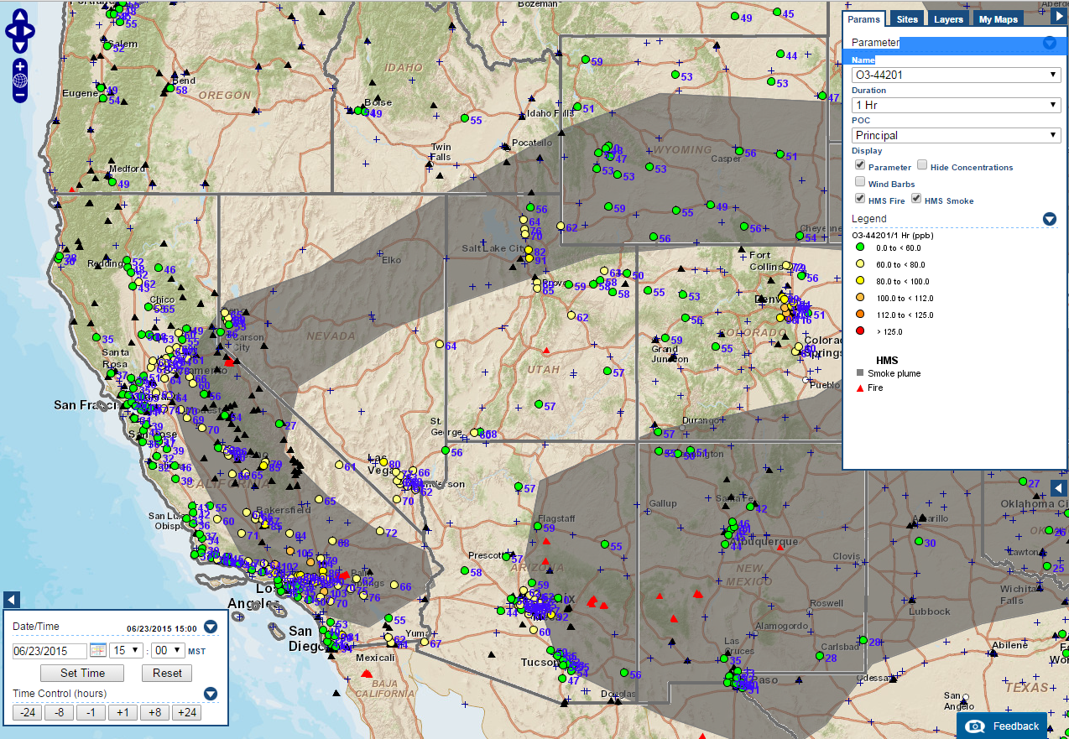
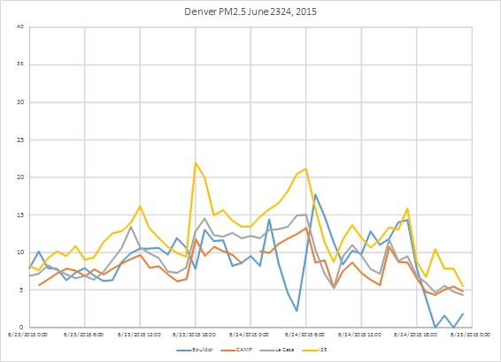
Ozone Exceptional Event Complexity
Denver O₃, June 23, 2015: 91 ppb (hourly 122 ppb).
Smoke from California Fires north and Arizona fires south of Denver.
Urban 8-hour O₃ at 91 ppb was 35 ppb higher than the highest rural site in Colorado, at 56 ppb.
Smoke impact, if any, is ambiguous.
Wildfire Plumes, June 23, 2015
Smoke Impacts on PM₂₅?
Notes:
MODSIS and GOES data is used to estimate location of smoke plumes.
This example shows the complexities inherent. June 23, 2015 was one of the two highest ozone days in Denver in 2015. Fires were burning in California and Arizona with regional impacts. Satellite imagery on the day showed smoke plumes both north and south of Denver that day. PM2.5 data in Denver was relatively high (for Denver) but generally below 15 ug/m3. the exception was a brand new near-roadway PM2.5 monitor which saw rush hour traffic peaks around 25 ug/m3. Smoke impact in the PM2.5 data was ambiguous. More sophisticated investigation would be needed to say whether smoke impacts were significant in Denver on June 23.

Slide 6
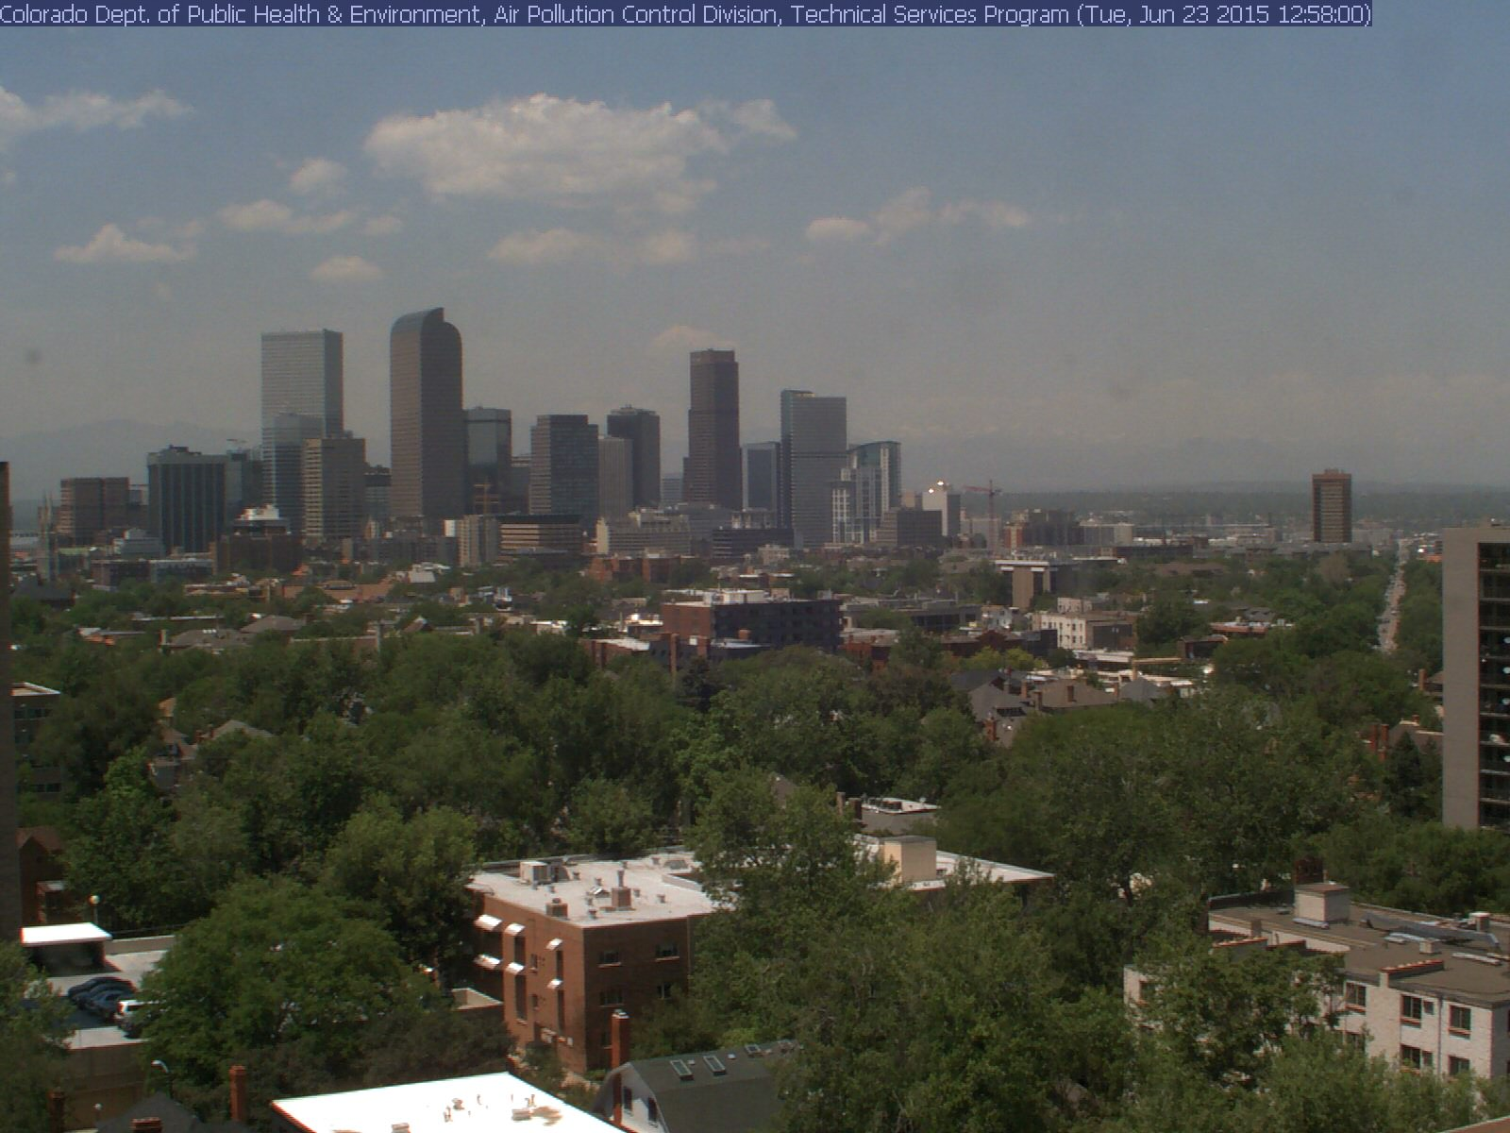
Denver Visibility (20-25 miles)
1:00 pm June 23, 2015
Notes:
Denver has a state only visibility standard with hourly visibility measurements and imagery. This view from June 23 shows 20 to 25 mile visibility at 1:00 pm. Hazy, but not terribly smoky.

Slide 7
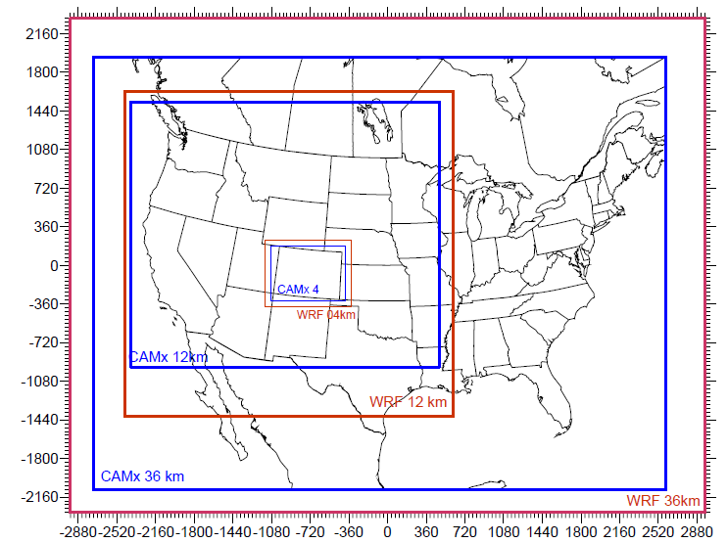
Nested 36/12/4-km Model Domains
WRF and CMAQ or CAMx
Vertical Grid:
Typically 20 to 40 layers from the surface up to the lower stratosphere at 50 mb.
Lateral BC from Global Models:
MOZART
GEOS-Chem
AM3
RAQMS

Slide 8
CMAQ simulations for the
Wallow Fire, Arizona June 2011
Photochemical models often over estimate ozone in wild fire plumes:
  CMAQ simulations for the June 2011 Wallow Wildfire in eastern AZ consistently over predict O3 when the model fire plume overlaps with monitors.
  CMAQ also predicts very high concentrations of HCHO and higher aldehydes in the fire plume.
  Baker et al., (2016), Contribution of regional-scale fire events to ozone and PM2.5 air quality estimated by photochemical modeling approaches, Atmospheric Environment 140 (2016) 539-554, http://dx.doi.org/10.1016/j.atmosenv.2016.06.032
However, O3 monitoring data was not available in the area of the modeled wire fire plume on many days. No aldehyde data available.
Will TEMPO data be useful for evaluating model performance for wildfires for O3 and its precursors, including HCHO, in areas that lack ambient monitors?

Slide 9
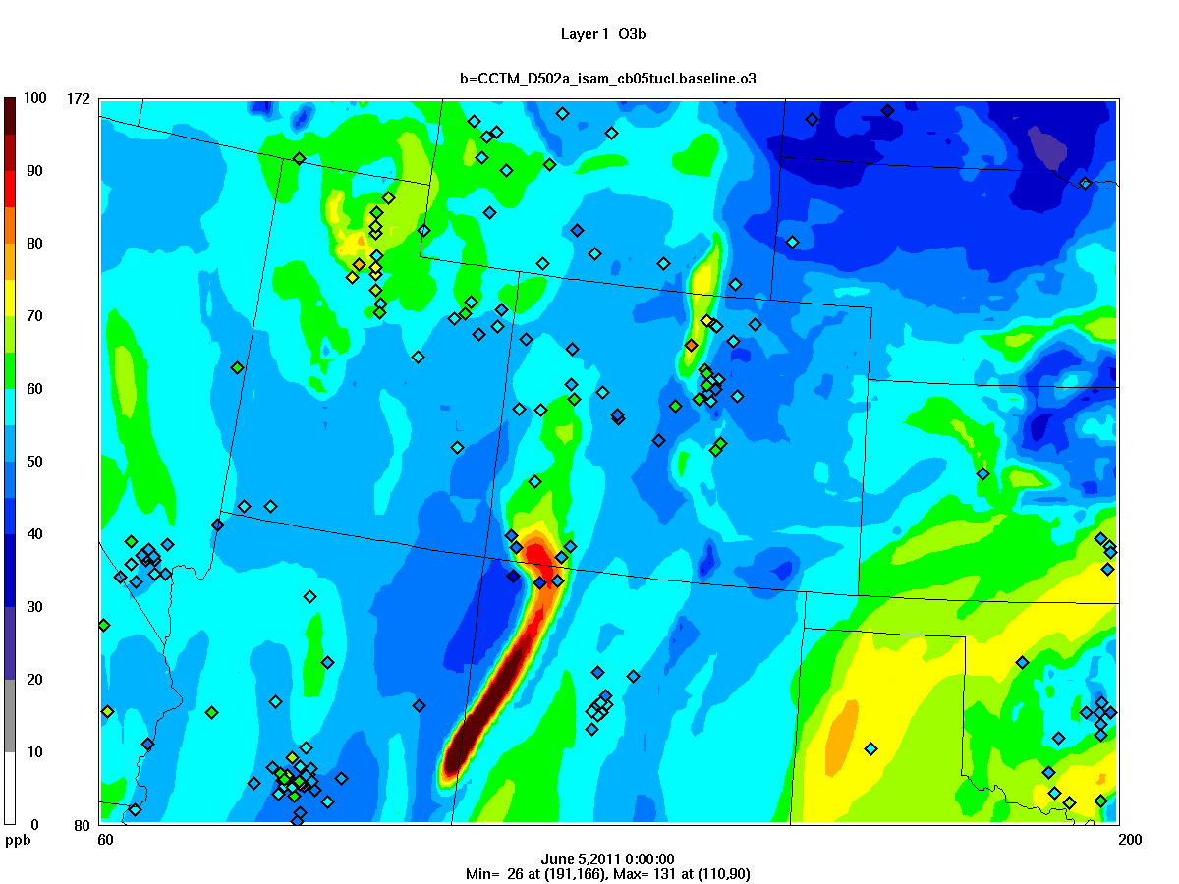
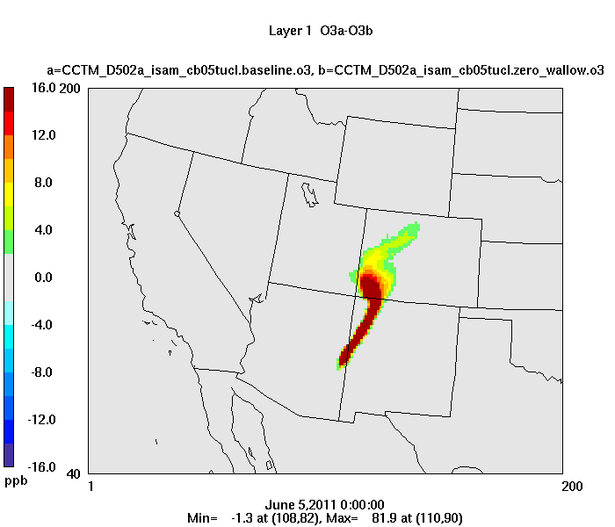
Wallow Fire, Ozone in Layer 1, 5 PM MDT, June 4

Slide 10
Ozone Attainment Planning
Model evaluation is completed for historical O3 episodes to assess if the model is reliable for projecting future changes in O3.
The base year O3 design values is calculated at the weighted average of 5 years of the 4th highest daily 8-hour average O3.
Model ozone relative response factor (RRF) is used to project the future ozone design value.
  RRF = Future model O3/Base year model O3 (average ratio for the ten highest modeled O3 days.
  Future O3 design value = (RRF)(Base Year O3 Design value)
  The Relative Response Factor approach is adopted to correct for model bias.
The state successfully projects attainment of the O3 NAAQS if the future design value does not exceed the NAAQS.

Slide 11
Ozone SIP Modeling
Denver O3 attainment demonstration at the Chatfield monitor.
Ozone precursors were reduced by about 30%, but the average RRF is 0.94, or 6% reduction in ozone in 2017.
Model response is stiff because of high background O3 and modeled NOx disbenefits at the Chatfield monitor.
Can we use satellite data to evaluate the model for both of these effects?

Slide 12
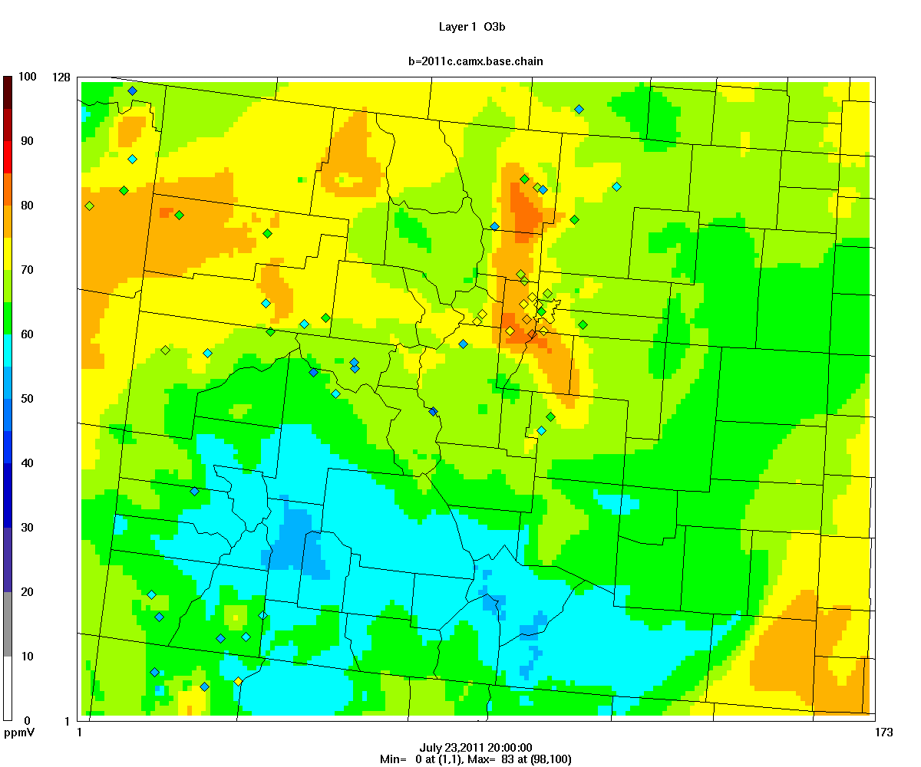
1-hour O3 model and obs at 1 pm LDT July 23, 2011
Model performs well in the Denver area but is biased high for regional ozone on July 23.

Slide 13
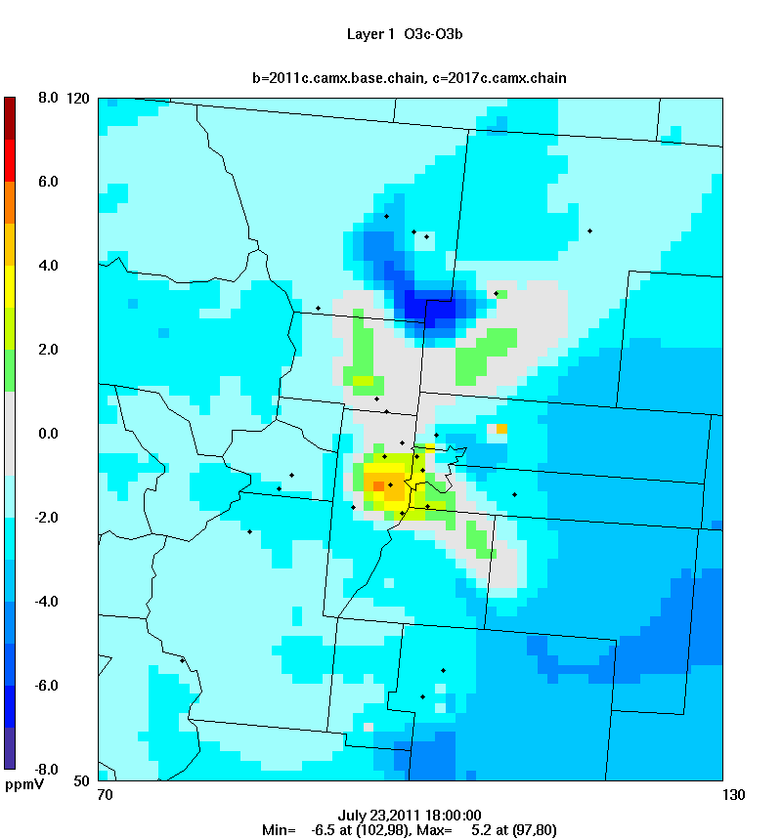
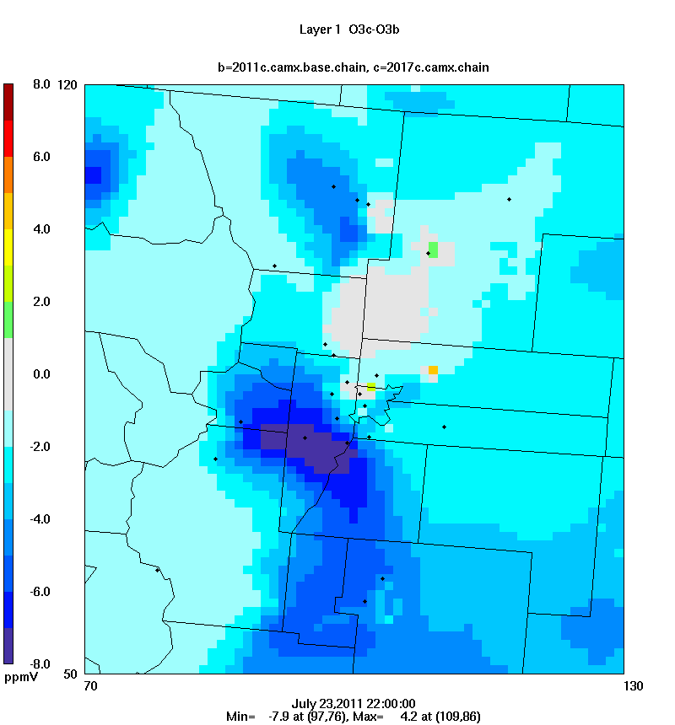
July 23 Model response (2017 – 2011) for 1-hour average O3
Hourly O3 NOx disbenefits in morning and benefits in afternoon. 8-hour average has small benefit.
Delta O3 at 11 am LDT
Delta O3 at 3 pm LDT

Slide 14
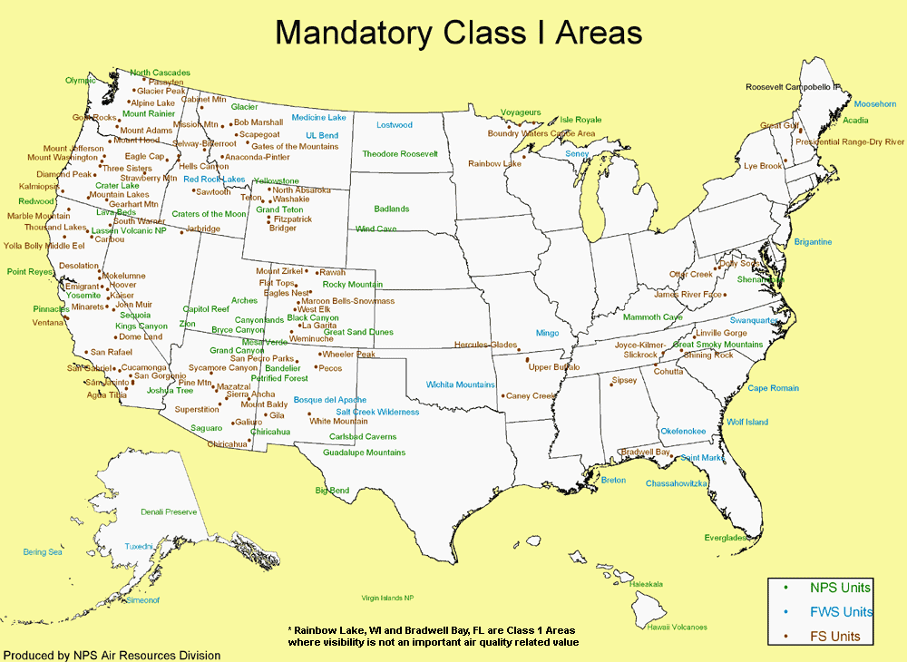
Regional Haze
Clean Air Act goal is to achieve natural visibility at Class I areas by 2064.
Regional haze metrics rely on IMPROVE monitoring data:
light extinction: b_{ext} (Mm⁻¹)
visual range = 3.91/b_{ext} (km)
deciviews = 10 ln(b_{ext}/10 Mm⁻¹)
20 Mm⁻¹ = 200 km = 11 dv
States submit SIPs every 10 years showing progress on improving visibility.
Some western Class I areas did not achieve progress goals in the first planning period, but progress was evaluated on the 20% worst days that included wildfires.

Slide 15
Regional Haze Planning
Sawtooth IMPROVE data 2012
Old Approach
Haze evaluated on the worst 20% visibility days that included wildfires. Max extinction = 500 Mm⁻¹
EPA has proposed to revise the Regional Haze Rule so that progress and the URP are evaluated for anthropogenic visibility impairment:
  Goal is to exclude days that are affected by uncontrollable episodic extreme events such as wildfire and dust storms.
  Visibility Impairment is evaluated relative to natural haze conditions:
        bext = light extinction (Mm⁻¹)
        Impairment (deciviews) = 10 ln(bext_{total}/bext_{natural})
New Approach
Impairment evaluated on the worst 20% days. Max extinction = 26 Mm⁻¹. However, it appears that some days with wildfire contributions are still included.

Slide 16
Regional Haze Planning
States are not responsible for visibility impairment caused by international transport, but estimates of international transport have large uncertainty which makes it difficult to estimate the contributions of US sources and international sources to visibility impairment.
Will TEMPO data be useful for day specific estimates of:
  Natural sources of haze, including wildfires and dust storms.
  Evaluating international transport of PM2.5 including sulfate, nitrate, and dust.
  Evaluating modeling performance for both the cleanest days (PM2.5 concentrations less than 1 ug/m3) and the most impaired days.
TEMPO data could be useful for Regional Haze SIPs that will be due in 2028.

Slide 17
Summary
State, Tribe and Federal Air Quality planners need:
  High spatial resolution hourly measurements of O3 and precursors for urban O3 planning.
  Regional scale measurements of O3 and precursors for evaluation of O3 exceptional events and background O3 levels.
  Measurements of speciated PM to evaluate natural haze levels and international transport of visibility impairing pollutants.

