Slide 1
Estimating volcanic ash emissions by assimilating satellite observations with the HYSPLIT dispersion model
Tianfeng Chai^{1,2}, Alice Crawford^{1,2}, Barbara Stunder¹, Roland Draxler¹, Michael J. Pavolonis³, Ariel Stein¹
NOAA Air Resources Laboratory, College Park, MD
Cooperative Institute for Climate and Satellites, University of Maryland, College Park, Maryland
NOAA Center for Satellite Applications and Research, Madison, WI

Slide 2
Motivation
Currently NOAA National Weather Service (NWS) runs the Hybrid Single Particle Lagrangian Integrated Trajectory (HYSPLIT) dispersion model with unit mass release rate to predict the transport and dispersion of volcanic ash.
The model predictions provide information for the Volcanic Ash Advisory Centers (VAAC) to issue advisories to meteorological watch offices, area control centers, and flight information centers.
Quantitative forecasts can be generated by estimating the volcanic ash source terms based on the satellite retrievals of volcanic ash mass loadings.

Slide 3
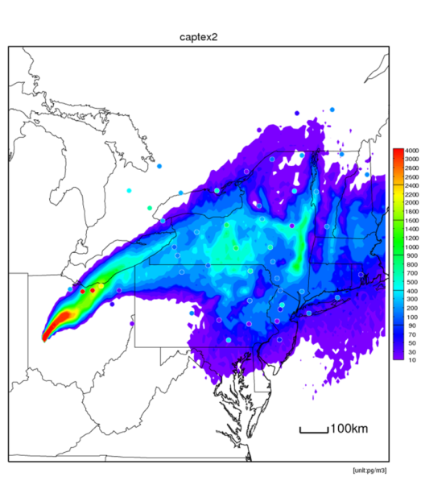
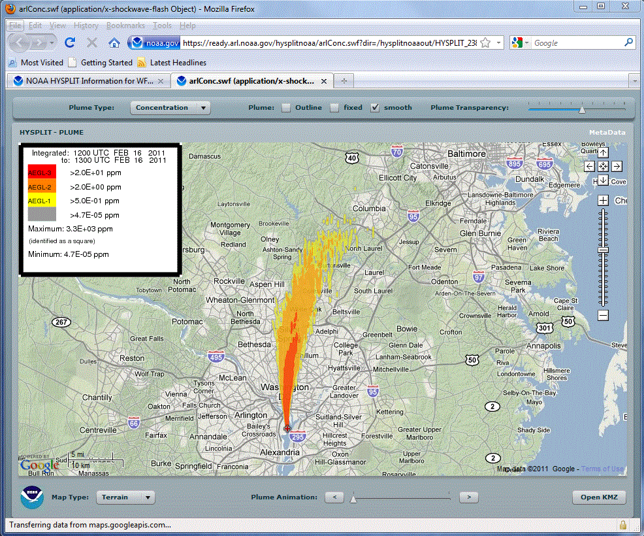
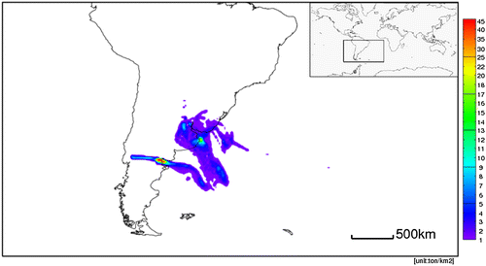
HYSPLIT Dispersion model
CAPTEX
NOAA ARL HYSPLIT (Hybrid Single Particle Lagrangian Integrated Trajectory Model) is used for volcanic ash dispersion forecasts
Applications include the simulation of atmospheric tracer release experiments, radionuclides, smoke originated from wild fires, volcanic ash, mercury, and wind-blown dust, etc.
Emergency Response Chemical Releases
The 8 Jun 2011 eruption of the Cordón Caulle volcano in South America for 0600 UTC (Stein et al, 2015, BAMS)

Slide 4
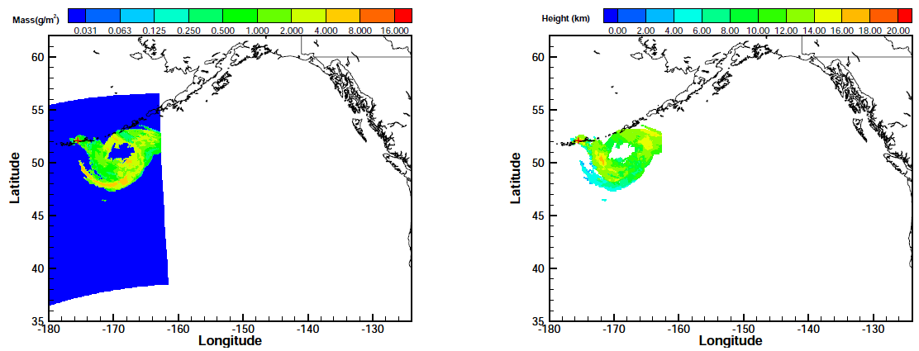
Volcanic Ash- 2008 Kasatochi eruption
MODIS volcanic ash mass loadings (left) and ash plume top height (right) of the 2008 Kasatochi eruption (shown with “+”). Top: 13:00-14:00 UTC on Aug 8, 2008; bottom: 00:00-01:00 UTC on Aug 9, 2008

Slide 5
HYSPLIT Inverse Modeling Methodology
In this top-down approach, the unknown emission terms are obtained by searching the emissions that would provide the best model predictions closely matching the observations.
The unknowns of the inverse problem are the emission rates q_{ikt} at each location i, at different height k and period t. They are solved by minimizing a cost function F,
Notes:
where cº_{nm} is the m-th observed concentration or mass loading at time period n and c^{h}_{nm} is the HYSPLIT counterpart. As shown in Equation (1), a background term is included to measure the deviation of the emission estimation from its first guess q^{b}_{ikt}. The background terms ensures that the problem is well-posed even when there are not enough observations available in certain circumstances. The background error variances σ²_{ikt} measure the uncertainties of q^{b}_{ikt}. The observational error variances ε²_{nm} represent the uncertainties from both the model and observations as well as the representative errors. F_{other} refers to the other regularization terms that can be included in the cost function. The optimization problem can be solved using many minimization tools, such as L-BFGS-B package, to get the final optimal emission estimates.

Slide 6
Past HYSPLIT inverse modeling application
Fukushima Nuclear Accident
Reference: Source term estimation using air concentration measurements and Lagrangian dispersion model – Experiments with pseudo and real cesium-137 observations from the Fukushima nuclear accident, Chai, T., R. R. Draxler, and A. Stein, Atmospheric Environment, 106, pp. 241-251, doi:10.1016/j.atmosenv.2015.01.070, 2015

Slide 7
Volcanic ash mass loading calculations
1) Surface to cloud top; 2) Single layer; 3) Three layers.
G1
G2

Slide 8
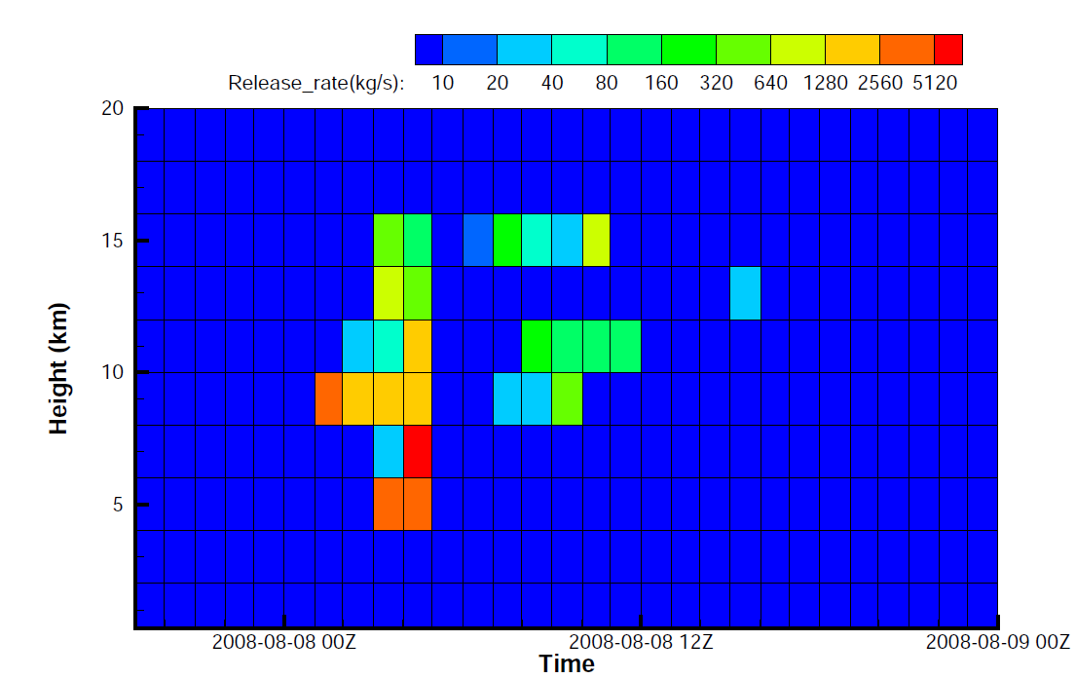
Sensitivity tests
Volcanic ash release results with different background error estimations
First guess (Background) uncertainty set as 10¹² g/hr, or 2,800 kg/s
First guess (Background) uncertainty set as 10¹⁶ g/hr, or 28,000,000 kg/s
Notes:
Volcanic ash release results with different background error estimations
(Top: $\sigma_{ij} \approx 2.8\times 10^{3}$ kg/s; Bottom: $\sigma_{ij} \approx 2.8\times 10^{7}$ kg/s).
%$\sigma_{ij}$ are presumed as $ 2.8\times 10^{3}$ for the top and $2.8\times 10^{7}$, kg/s, respectively.
%From the top to bottom the $\sigma_{ij}$ are presumed as $ 2.8\times 10^{3}$,
%$2.8\times 10^{5}$, $2.8\times 10^{7}$, kg/s, respectively.
The TCMs for the emission inverse were generated using HYSPLIT runs with GDAS meteorological data.
Only ash cells of the satellite data at G1 and G2 are used in the emission inverse.
Model counterparts are obtained by integrating from surface to plume heights at ash cells.

Slide 9
“Zero” observations as extra constraints
H: Clear regions, ash-free pixels;
T: Clear column above ash cloud;
B: Clear column below ash cloud.

Slide 10
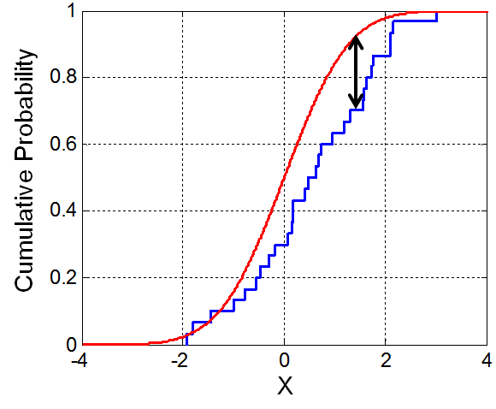
Evaluation metric
FB: Fractional Bias;
KSP: Kolmogorov-Smirnov parameter
Illustration of KSP (wikipedia.org)

Slide 11
Inverse modeling test results – “Rank” (G2)
MA: integrating from surface to cloud top;
M0: a single model layer where the cloud top resides;
M1: integrating over three layers centered at cloud top.

Slide 12
Inverse modeling test results – “Rank” (G4)
0Z on Aug.10, 2008
MA: integrating from surface to cloud top;
M0: a single model layer where the cloud top resides;
M1: integrating over three layers centered at cloud top.

Slide 13
Summary
Volcanic ash source terms are estimated by assimilating satellite observations;
Forecasts with estimated ash source terms are good with “Rank” reaching 3.0;
Different options in calculating the ash mass loadings do not make much differences;
Extra “zero” observations do not help inverse modeling.

Slide 14
Thank you!

