Slide 1
Tropopshric Ozone Enhancement Due to Lightning
-- Observations and Models
Lihua Wang
1st TEMPO Applications Workshop
Huntsville, AL
July 12-13, 2016

Slide 2
Introduction
Lightning is a particularly signifant NOx source in the middle and upper troposphere where it affects tropospheric chemistry and ozone.
More than 80% of summertime upper tropospheric NOx above the eastern United States is produced by lighting, assuming a lightning NOx emission rate of 250 mol per flash (Cooper et al., 2009).
Many uncertainties to quantify the influence of lightning on tropospheric ozone concentration.

Slide 3
Two case studies
1. July-September 2006
---- CMAQ model, NLDN CG flashes, Pickering’s LNOx profile, OMI NO2 and O3, ozonesondes
2. July 2011
----WRF/Chem model, NLDN CG flashes, LNOM-simulated LNOx profile, ozonesondes, HYSPLIT back-trajectory

Slide 4
Case 1: July-September 2006

Slide 5
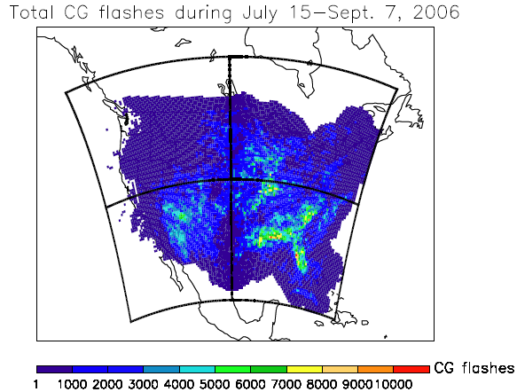
National Lightning Detection Network (NLDN)
Figure 1. Lightning contributes 27% of the total NOx emission during Jul. 15 – Sept. 7, 2006 (Wang et al., 2013), assuming Detection Efficiency=95%, IC:CG ratio=3:1, and LNOx production rate = 500 moles per flash).

Slide 6
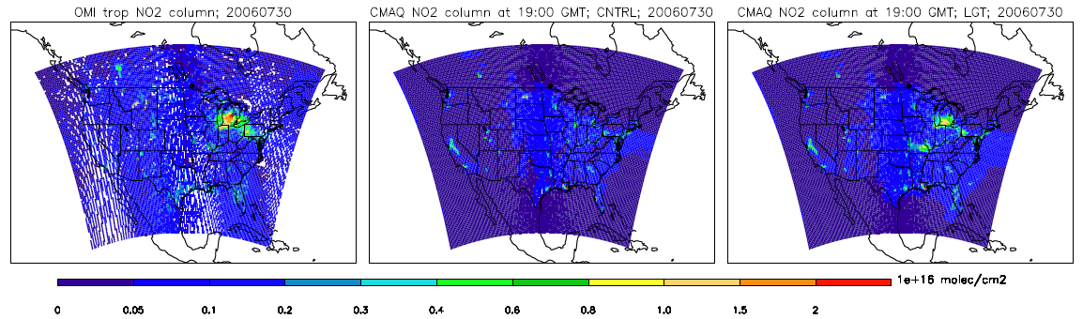
Tropospheric NO2
OMI
CMAQ-CNTRL
CMAQ-LGT
Figure 2. OMI tropospheric NO₂ column on July 30, 2006 (left) and tropospheric NO₂ at 19:00 UTC, July 30, 2006, from two CMAQ simulations: CNTRL (middle) and LGT (right).

Slide 7
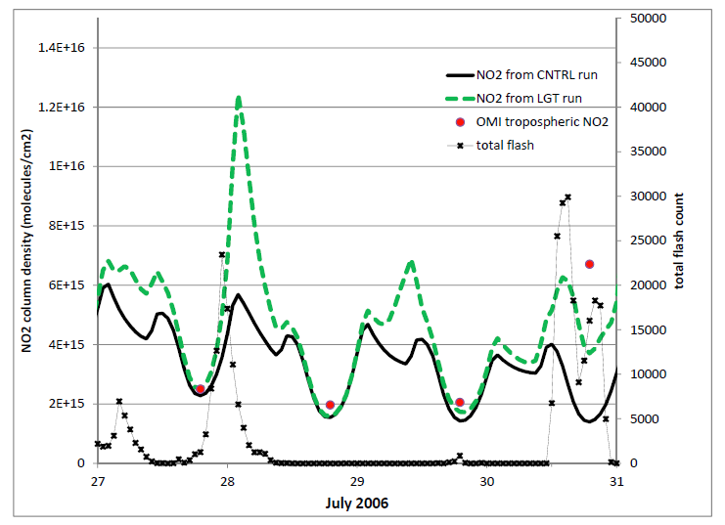
Figure 3. Total flash numbers, area-averaged NO2 columns from OMI and two CMAQ runs (CNTRL and LGT) over Michigan region.

Slide 8
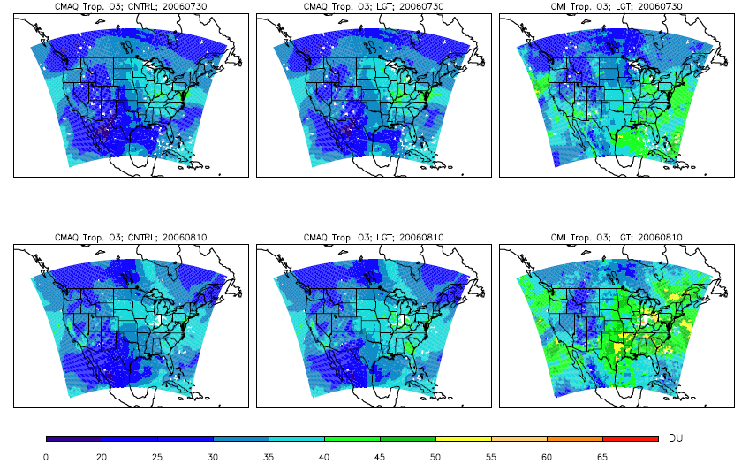
Tropospheric O3 column
Jul. 30
Aug. 10
Figure 4. Model-predicted tropospheric ozone column at 19:00 GMT of (upper) 30 July 2006 and (bottom) 10 August 2006, compared with OMI tropospheric ozone retrieval. Left: CNTRL; middle: LGT; right: OMI.

Slide 9
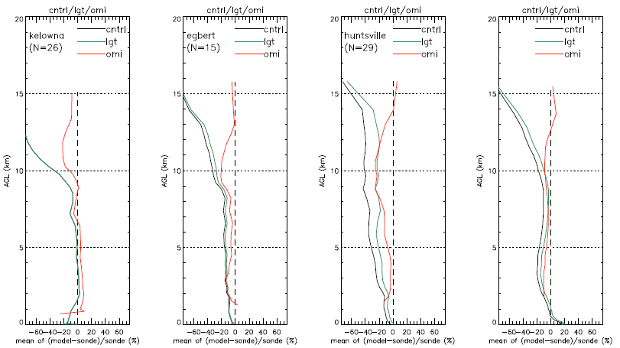
Evaluating model-simulated and OMI-measured O3 profiles using ozonesondes
Figure 5. Mean normalized bias of model-predicted ozone (CNTRL and LGT runs) and OMI O₃, evaluated by ozonesondes at three sites: Kelowna, Egbert, and Huntsville, representing three kinds of lightning influence: not influenced, improved, and significantly improved, respectively. The last panel gives the overall influence at these 18 sites.

Slide 10
Lightning-influenced O3 at IONS06 stations
Kelowna
Bratt’s Lake
Egbert
Paradox
Yarmouth
Trinidad Head
Boulder
Valparaiso
Narragansett
Walsingham
Beltsville
Socorro
Huntsville
Wallops Island
Table Mountain
Holtville
Houston
Research vessel Ron Brown
Figure 6. LNO_{x} influenced O₃ at IONS06 stations.
Three groups are divided: Not influenced, Improved, and Significantly improved.

Slide 11
Case 2: July 2011

Slide 12
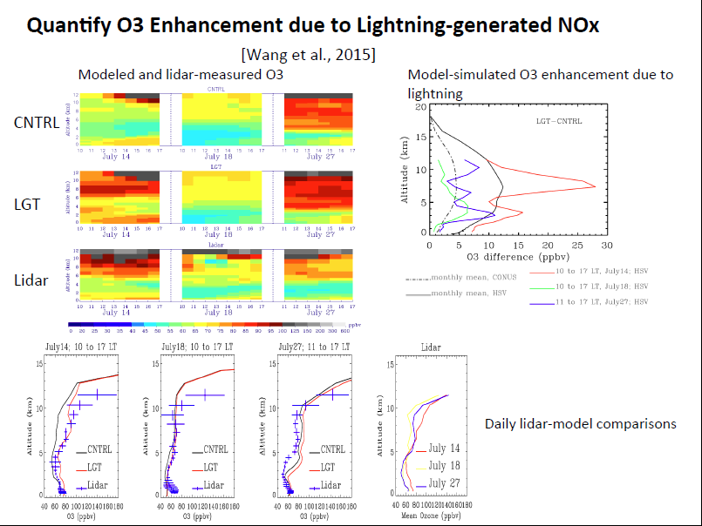

Slide 13
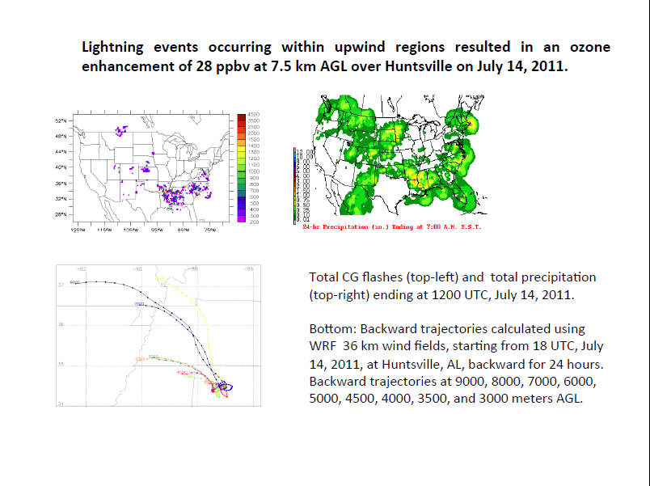

Slide 14
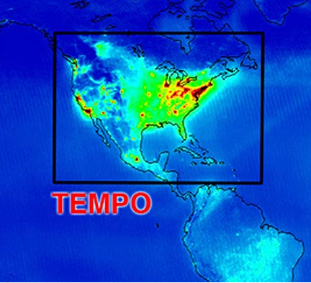
TEMPO
UV/VIS air quality spectrometer
Measurements of O3, NO2, SO2, formaldehyde, and aerosol
Over Greater North America, from Mexico City to the Canadian tar sands, from the Atlantic to the Pacific
Every daylight hour
Geostationary orbit -- enables continuous data collection over this region
Identify/quantify lightning-produced NOx and O3 enhancement effectively, by combining with lightning observations (i.e., NLDN)

Slide 15
Summary
Lightning-produced NO emissions lead to tropospheric ozone enhancement.
Dispersion models (i.e., HYSPLIT) calculate back trajectories for finding out the lightning sources that causes ozone enhancement.
This enhancement can be quantitatively estimated by combining measurements of lightning (i.e., NLDN), O3 (i.e., ozonesonde, lidar, satellite) with chemical models such as CMAQ and WRF/Chem.
Geostationary TEMPO measures O3, NO2, etc. every daylight hour across Greater North America, which helps to identify and quantify lightning-created NO and O3 enhancement more effectively.

Slide 16
Thank you!

