Slide 1


Using TEMPO to Evaluate the Impact of Ozone on Agriculture
Denise L. Mauzerall
Princeton University
TEMPO Applications Workshop
Shelby Center for Science and Technology
Huntsville, AL
July 12, 2016

Slide 2
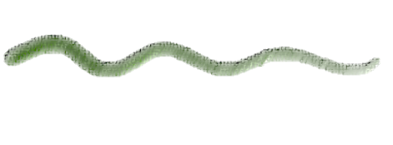
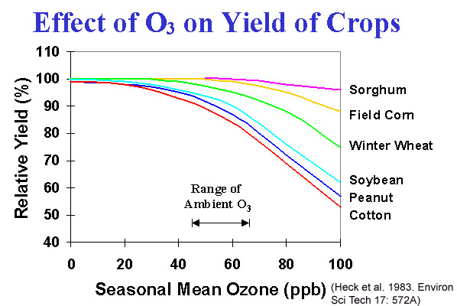
Negative Effect of Ozone (O₃) Pollution on Agricultural Yields
Challenge: Need to double global grain production by 2050 while reducing environmental footprint of agriculture.
Reducing surface ozone concentrations increases agricultural yields and improves public health.
Reductions in O₃ result from controls on:
- Nitrogen oxides (NO_{x})
  Carbon monoxide (CO)
  Hydrocarbons
  Methane (CH₄)

Slide 3
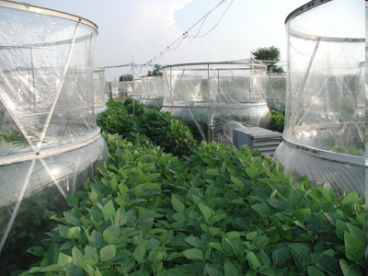
O₃ Pollution and Crop Yield Reductions
Large-scale, open top chamber (OTC) studies have been used to derive concentration:response functions to predict the relative yield (RY) of a crop at a given O₃ level during the growing season.
  U.S. National Crop Loss Assessment Network (NCLAN) study in 1980s
  European Open Top Chamber (EOTC) program in 1990s
  Smaller-scale studies in Asia and other developing countries
Notes:
While O3 has been studied in field-level experiments, at the time of commencement of my research projects, global scale estimate of O3 impact did not exist

Slide 4
O₃ Exposure Metrics
Seasonal Mean or Cumulative Hourly Exposure Metrics are used.
Mauzerall and Wang, 2001

Slide 5
Global Estimates of O₃ Damage use Models with Integrated Assessment Approach
Intermediate Outcome | Method
1) Surface O₃ concentrations | Simulated using MOZART-2 CTM in 2000 and 2030 according to IPCC SRES A2 and B1 scenarios (Horowitz et al., 2006)
2) Plant Exposures to O₃ | Calculated using various metrics for each scenario derived from field studies
3) Yield Loss | Estimated using concentration:response functions obtained from the US NCLAN study and Mills et al. (2007), convert to crop production loss (soybean, maize, wheat)
4) Economic Valuation | Estimated value of lost production based on producer prices in 2000
[Avnery et al., 2011a, 2011b]

Slide 6
Simulate O3 Concentrations using Global Atmospheric Chemistry Transport Model MOZART-2 Simulations
Resolution: 2.8˚ lat x 2.8˚ lon; 34 sigma levels (surf.– 40 km)
Timestep: 20 minutes
Winds: MACCM (climatological)
Photochemistry: 63 chemical species (O₃, NO_{x}, hydrocarbon)
Present-day surface emissions (EDGAR v2.0):
  Anthropogenic fossil fuel combustion
  Biomass burning
  Biogenic emissions
  Soil emissions
  Oceanic emissions
  Lightning: NO_{x} source in convective clouds
Transport: Advection and Convection
Dry and wet deposition
Notes:
Transport – wind, turbulence
Chemistry – production and loss
Deposition – wet and dry

Slide 7
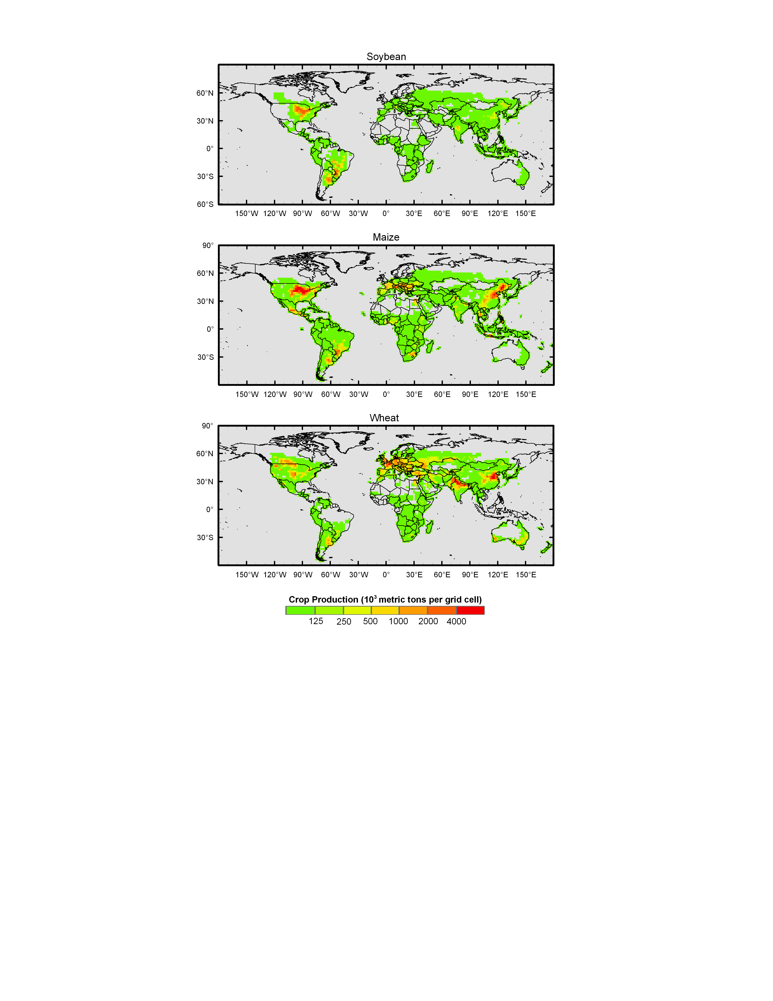
Crop Production - 2000
Global crop distribution dataset (Monfreda et al., 2008; Ramankutty et al., 2008) for soybean, maize, and wheat
5 min horizontal resolution based on combining agricultural inventory data with satellite imagery from 1998-2002
Notes:
MODIS-derived land cover product aboard AQUA satellite and the SPOT VEGETATION GLC2000 data set

Slide 8
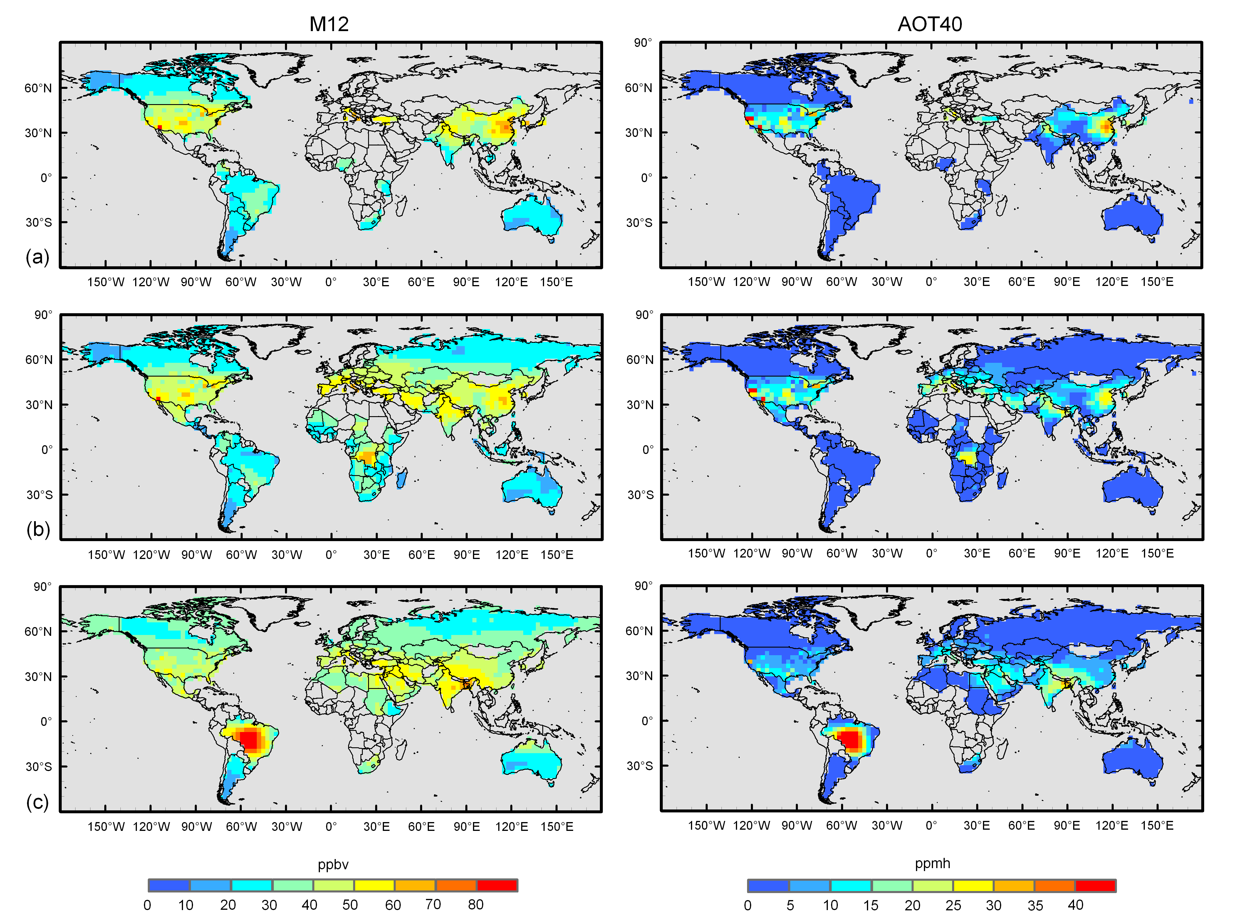
Year 2000 AOT40 O₃ Exposure
Calculated from MOZART-2
Soybean
Maize
Wheat
[Avnery, Mauzerall et al., 2011a]
Notes:
Growing season data compiled from USDA and other sources, 95% of produciton
O3 exposure higher in NH, coincidence of soybean and maize growing seasons coincide with peak summer O3 concentrations
In SH, wheat and maize growing seasons in Brazil, and DRC respectively coincide with biomass burning seasons
M12 – 40-60 ppb, locally higher, AOT40 above 3 ppmh critical level in much of the world, 5-15 ppmh, higher eastern china, brazil, india, central US

Slide 9
Calculated Crop Yield Loss in 2000
Soybean
Global year 2000 yield losses are 4-15% for wheat, 9-14% soybean, 2-6% for maize
Crop production losses ~80-120 Mt worth $11-18 billion USD₂₀₀₀ annually
Maize
Wheat
Avnery, Mauzerall et al., Atmospheric Environment (2011a)
Notes:
Calculated RYL in each grid cell weighted by production to get national RYL
Distribution reflects:
Coincidence of O3 exposure during crop growing seasons & at specific locations where crops are grown
For AOT40, threshold dependent metric – differences in hourly O3 concentrations of only a few ppb around 40 ppb threshold generates significant difference in exposure
Soybean and maize appears more sensitive according to M12, wheat according to AOT40. This could be an artifact of statistical analysis used, or could be that wheat is more sensitive to higher O3 and this is captured better by AOT40 than mean.
Cumulative metrics more accurately predict

Slide 10
Optimistic and Pessimistic O₃ Precursor Emission Scenarios for 2030
Emissions from the IPCC SRES A2 and B1 scenarios
  Represent lower- and upper-boundary projections of O₃ precursor emissions
  Difference between A2 and B1 simulations indicates potential decreases in O₃ and associated crop yield benefits of reducing emissions of air pollutants.
http://sedac.ciesin.columbia.edu/ddc/sres/

Slide 11
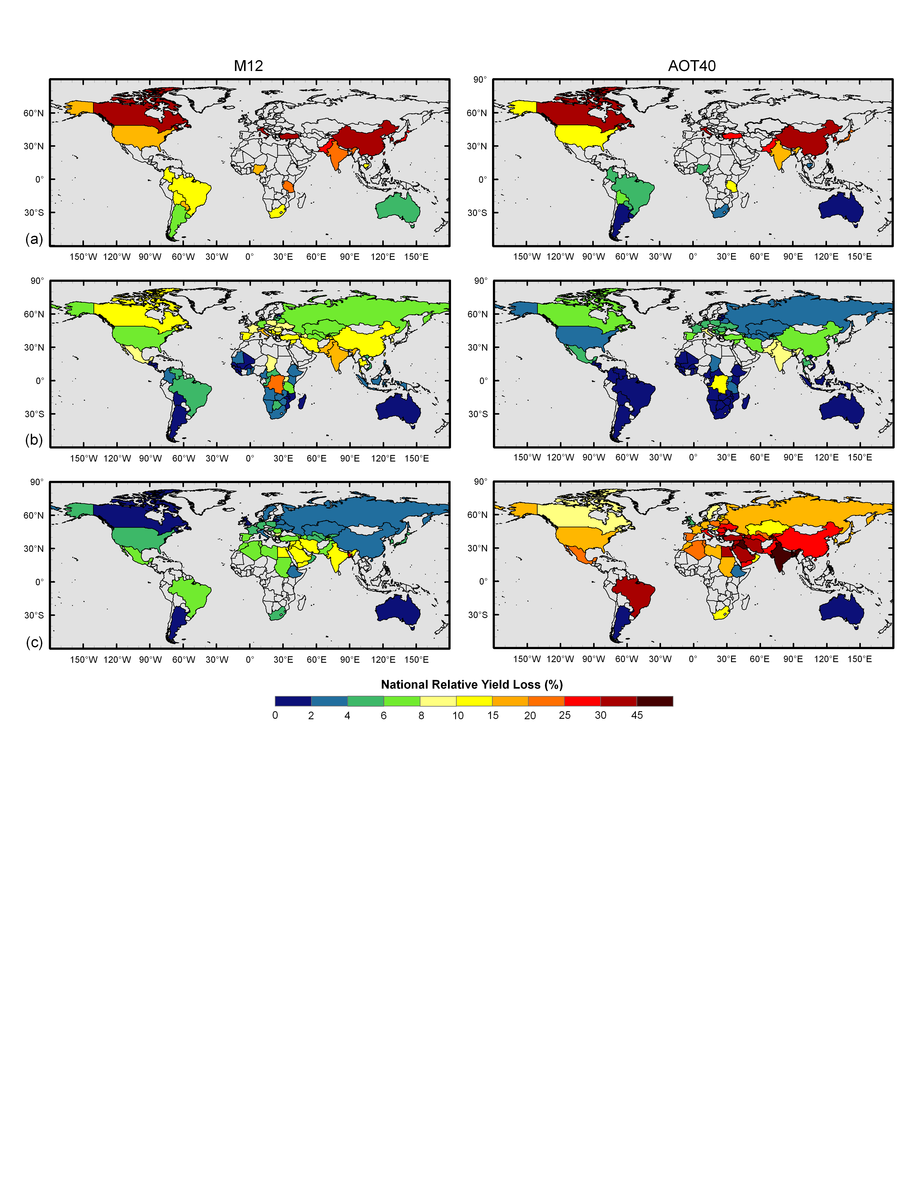
Yield Loss in 2030 (A2 – High emissions)
Soybean
Soybean
Global 2030 A2 yield losses range from 5-26% (+2-10%) for wheat, 15-19% (+1-11%) for soybean, and 4-9% for maize (+2-3%)
Crop production losses 120-230 Mt worth $17-35 USD₂₀₀₀ (+$6-17 billion) annually
Maize
Maize
Wheat
Wheat
[Avnery et al., 2011b]
Avnery, Mauzerall et al., (2011b)
Notes:
wheat ranges from 5.4-26% (a change of +1.5-10% from year 2000 values), 15-19% for soybean (+0.9-11%), and 4.4-8.7% for maize (+2.1-3.2%)

Slide 12
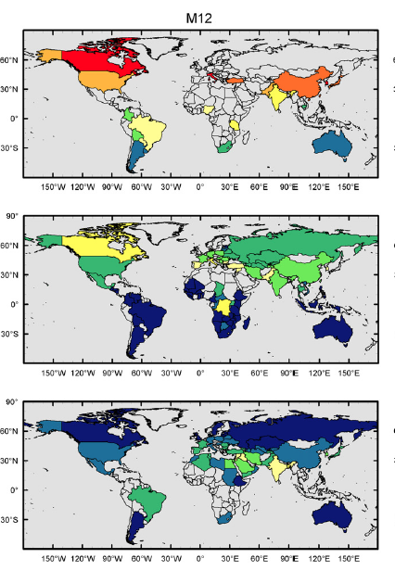
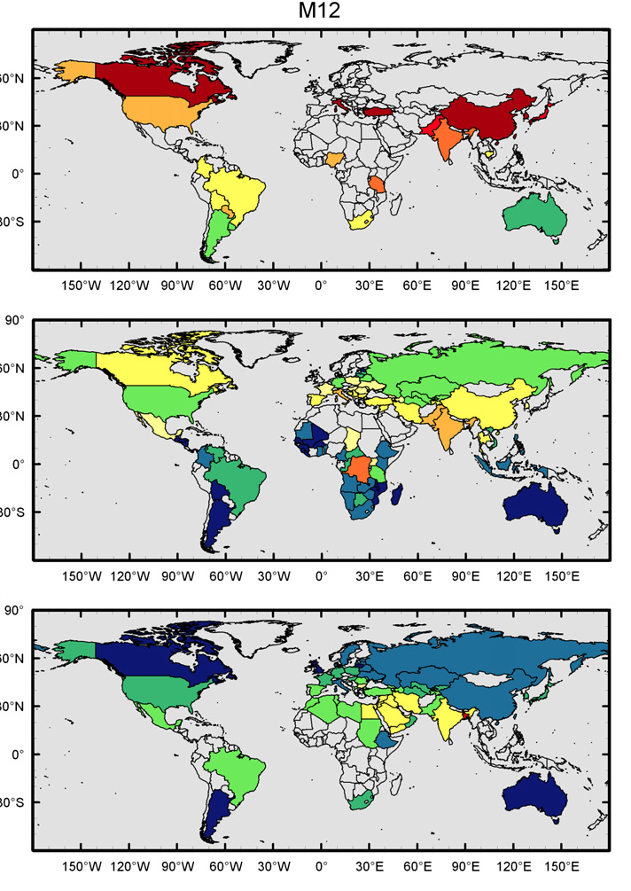
Yield Loss from Ozone Exposure (%)
2000
2030 (High: A2)
Soybean
Soybean
Maize
Maize
Global year 2000 yield losses 4-15% for wheat, 9-14% soybean, 2-6% for maize
Crop production losses ~80-120 Mt worth $11-18 billion USD₂₀₀₀ annually
Global year 2030 yield losses potentially increase to 5-26% for wheat, 15-19% for soybean, 4-9% for maize.
Crop production losses 120-230 Mt worth $17-35 USD₂₀₀₀ (+$6-17 billion) annually
Wheat
Wheat
(Avnery, Mauzerall, et al. 2011a)
(Avnery, Mauzerall, et al. 2011b)
Notes:
Calculated RYL in each grid cell weighted by production to get national RYL
Distribution reflects:
Coincidence of O3 exposure during crop growing seasons & at specific locations where crops are grown
For AOT40, threshold dependent metric – differences in hourly O3 concentrations of only a few ppb around 40 ppb threshold generates significant difference in exposure
Soybean and maize appears more sensitive according to M12, wheat according to AOT40. This could be an artifact of statistical analysis used, or could be that wheat is more sensitive to higher O3 and this is captured better by AOT40 than mean.
Cumulative metrics more accurately predict

Slide 13
Benefits of Reducing
Conventional Ozone Precursors
Compare losses of high pollution (A2) and low pollution (B1) scenarios
Improving air quality through reductions in conventional ozone precursors increases crop yields.
Choosing O₃ resistant crop cultivars can reduce losses.
India, U.S., and China experience greatest gains >$1.5 billion each
Change in 2030 EL (2030A2 – 2030B1)
Change in EL (Million USD₂₀₀₀)
Notes:
~30% reduction in NOx & NMVOC, 50% CO, 20%CH4

Slide 14
TEMPO Provides Opportunities to
Improve Agricultural Yields
TEMPO hourly 5-10km horizontal resolution data can be used to calculate local crop yield losses using a variety of cumulative exposure metrics. Spatial and inter-annual variability as well as trends in losses can be estimated.
TEMPO will help identify regions where use of O₃ resistant cultivars is particularly valuable.
TEMPO NO_{x} measurements can characterize NO_{x} emissions from fertilizer applied to agricultural fields including spatial and temporal variability depending on farmers practices (eg. autumn vs. spring application, varying fertilizer types and application rates, etc.). This will facilitate an evaluation of potential benefits for surface O₃ concentrations of improved nitrogen use efficiency in fertilizer application.

