Slide 1
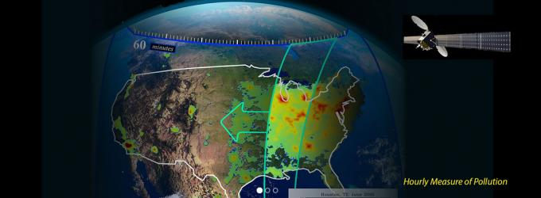

TEMPO Applications to Emissions Quantification and Understanding
Greg Frost
NOAA Earth System Research Laboratory
Acknowledgements to Si-Wan Kim (NOAA/U Colorado), NASA GEO-CAPE Atmospheric Composition Science Working Group, and NASA AQAST

Slide 2
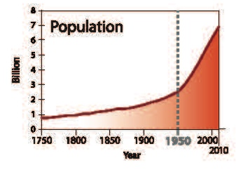
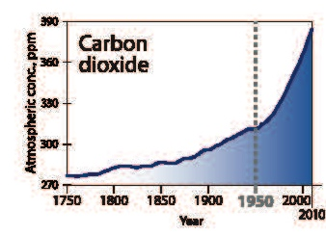
Need for Top-Down Methods for Quantifying Emissions
Actions about the atmosphere focus on emissions. Emission inventories are critical for understanding emissions in the past, present and future.
Inventories are inherently complex and therefore uncertain, and these uncertainties are difficult to quantify.
X±? ton/yr
Rapid societal development results in new challenges to emissions understanding. Similarly, efforts to circumvent controls may be difficult to detect.
W. Steffen et al., The Anthropocene Review, 2015
Top-down methods based on observations can provide objective tests of inventories and help improve the scientific basis of emissions.
Top-Down Approaches
Reconciliation
Synthesis to Benefit Stakeholders
Bottom-Up Inventories
Improvement
We cannot manage what we can’t measure – John Burrows

Slide 3
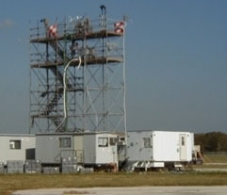
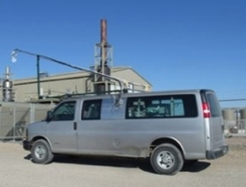
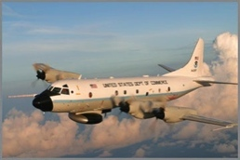


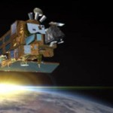
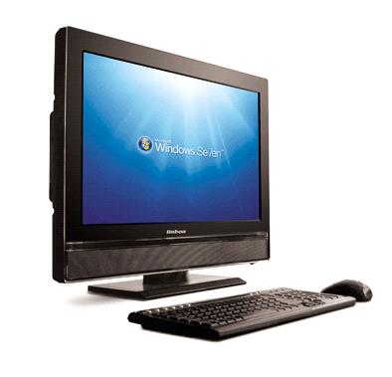
TEMPO will provide observational constraints on emissions, atmospheric transport and chemical processes
TEMPO will be part of an integrated observing strategy employing complementary approaches

Slide 4
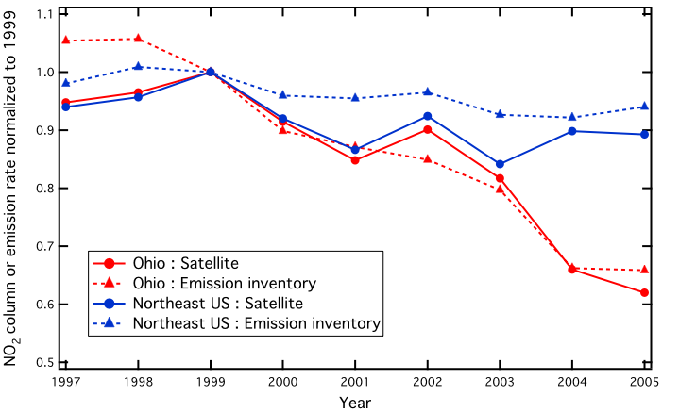
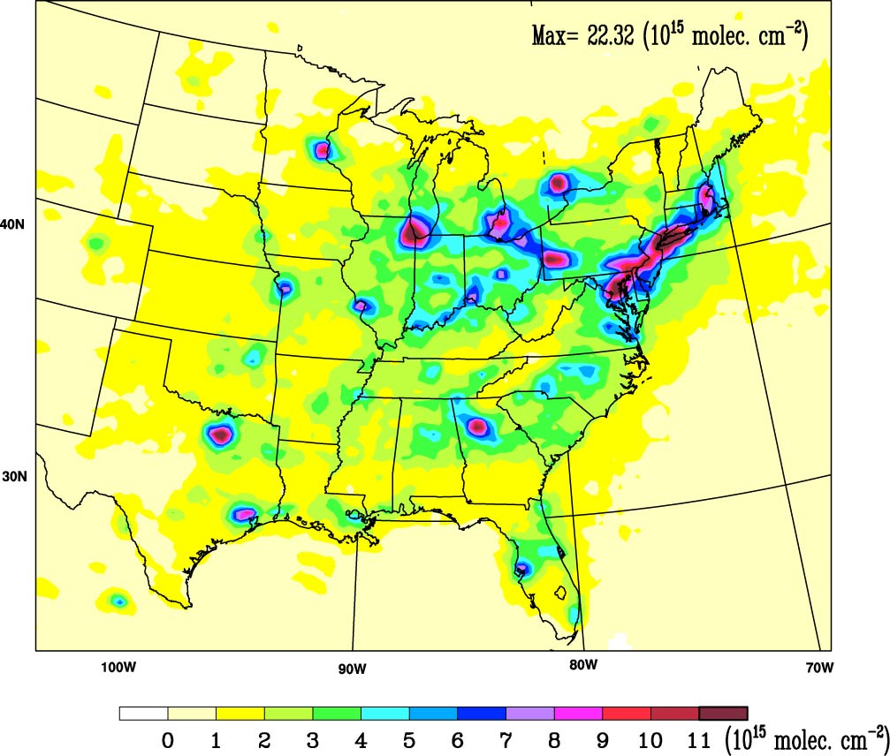



TEMPO NO₂ will help constrain NO_{x} emissions trends
Ohio River Valley: Satellite (GOME/SCIA)
Ohio River Valley: Inventory
Northeast US: Satellite (GOME/SCIA)
Northeast US: Inventory
SCIAMACHY
Summer 2004
S.-W. Kim et al., Geophys. Res. Lett., 2006
2005
BEHR OMI NO₂
Summer
2011
A. R. Russell et al., Atmos. Chem. Phys., 2012

Slide 5
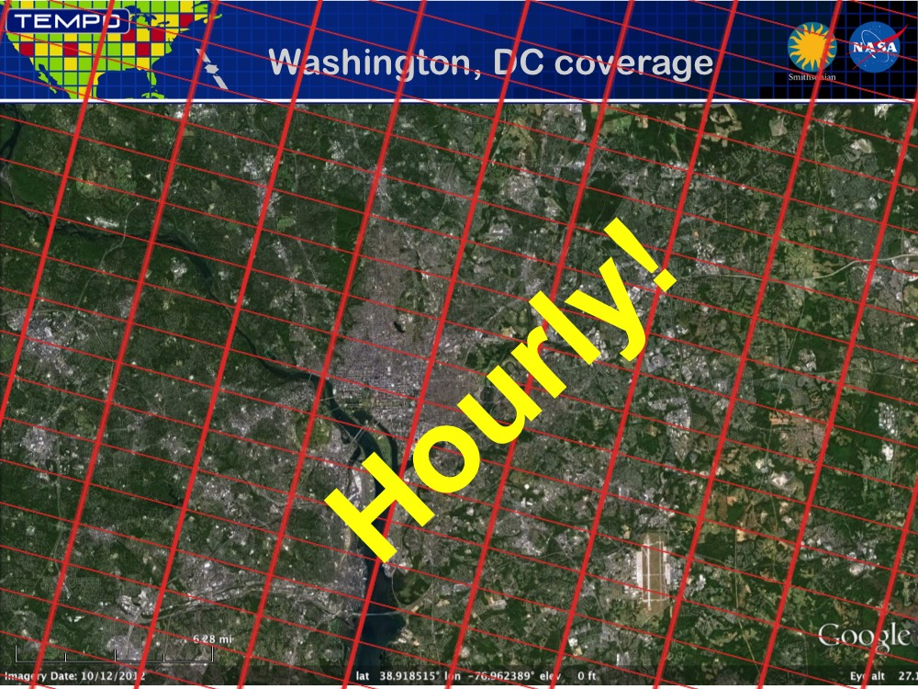
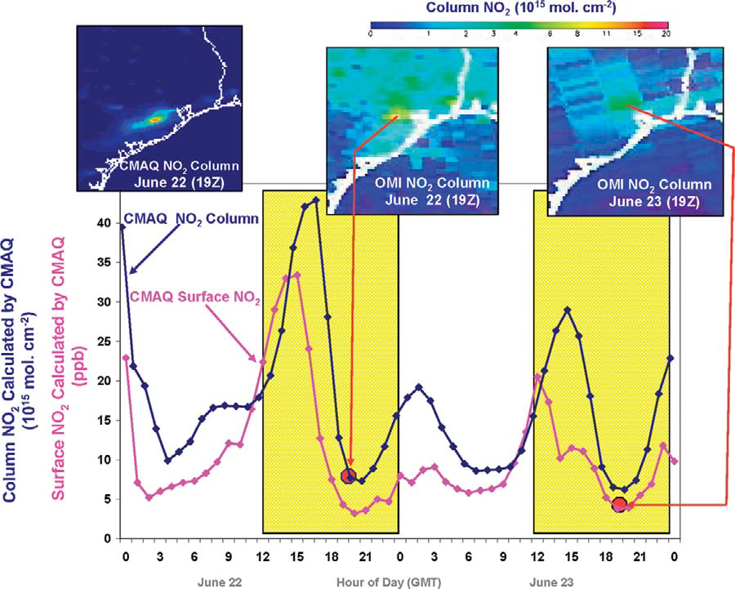
TEMPO offers improved emissions constraints compared to LEO platforms
Kelly Chance and Jay Al-Saadi
TEMPO’s hourly sampling and high spatial resolution will enable it to…
Evaluate temporal variations, spatial mapping, and sector-specific emissions in unprecedented ways
Resolve daytime cycles in emissions and chemistry
Improve detection of lower frequency variations in emissions and processes
Fishman et al., BAMS, 2008

Slide 6


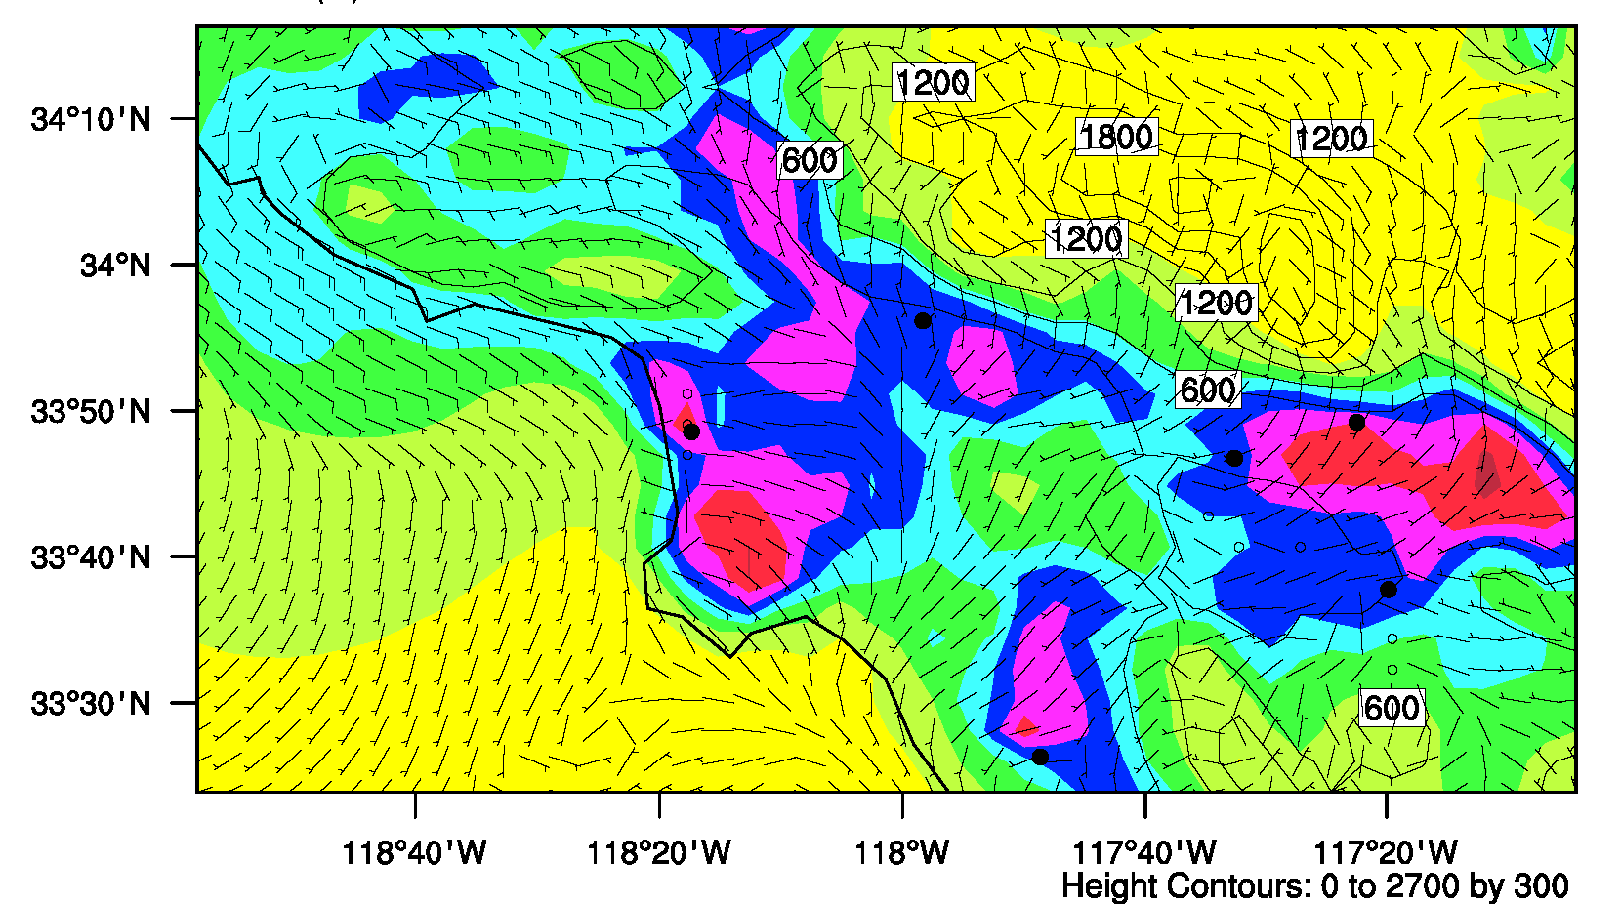
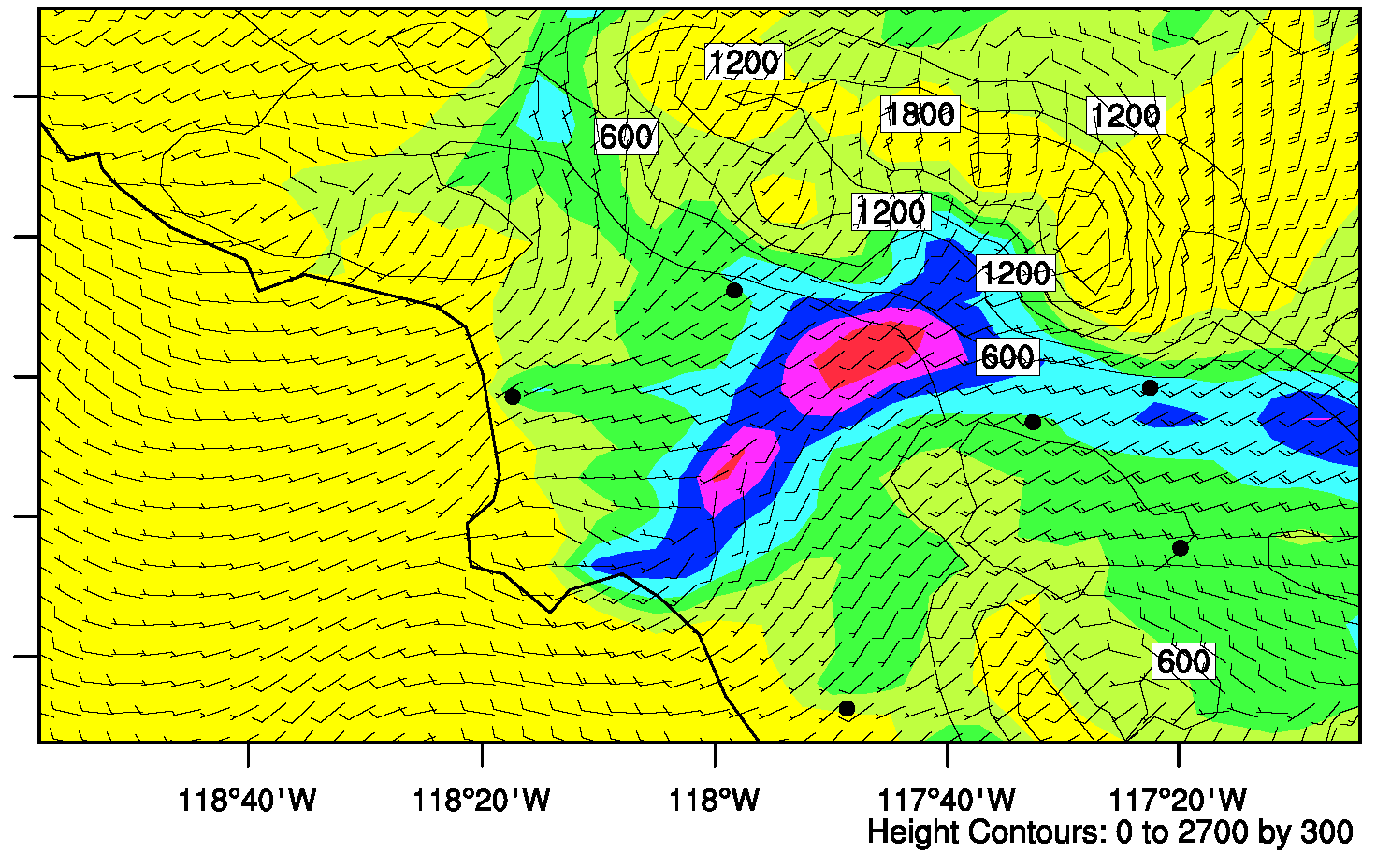
TEMPO can spatially resolve urban emissions & chemistry
Field observations provide test of air quality model
Aircraft
NO₂
Model
NO₂
Kim et al., JGR, 2016
NO₂ columns modeled at approximate TEMPO resolution
Pasadena
Fontana
LAX
Ontario
Riverside
08 PST
17 PST
Irvine
(10¹⁵ molec. cm⁻²)
Si-Wan Kim et al.

Slide 7

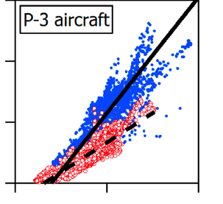
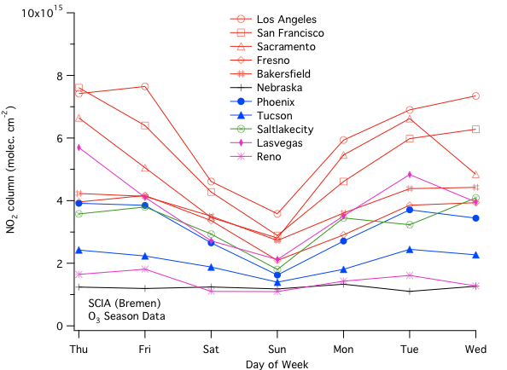

TEMPO will resolve day of week variations with much fewer samples than LEO platforms
Selected Western US Cities
SCIAMACHY NO2 (U. Bremen), May-Sept 2003-2007
Weekend
Weekday
NO₂ Column (cm⁻²)
Thu Fri Sat Sun Mon Tue Wed
Pollack et al., JGR, 2012
S.-W. Kim et al., JGR, 2009

Slide 8

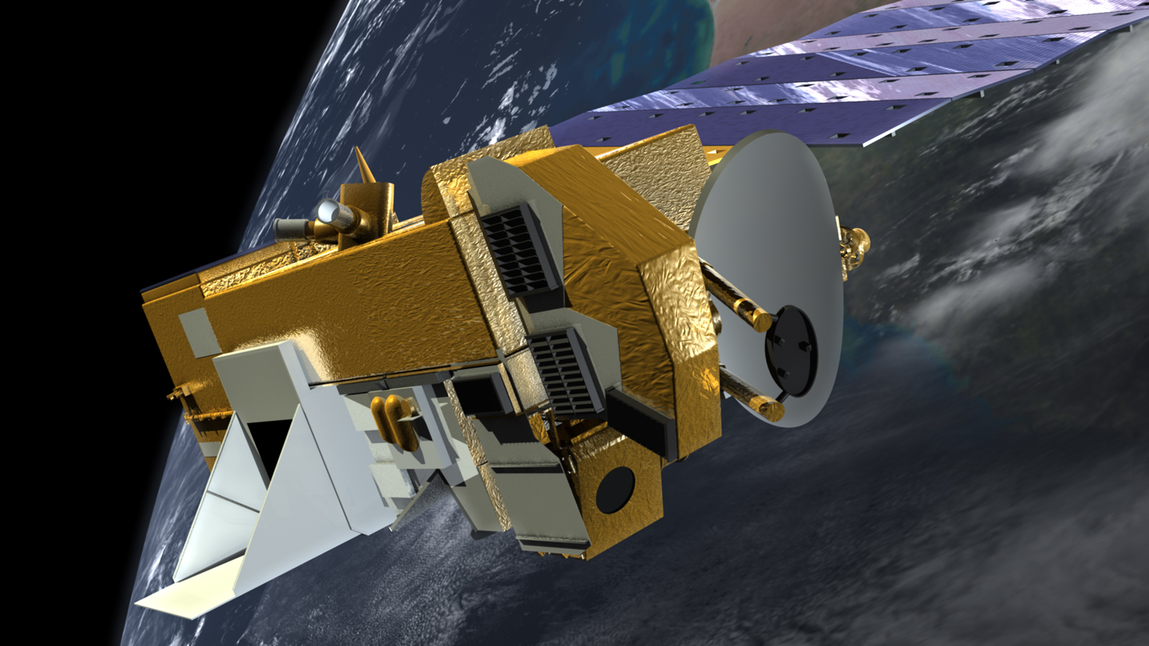
TEMPO will be useful for monitoring complex source regions
TEXAQS, Summer 2006
Satellite (OMI) vs. Model (WRF-Chem) NO₂
Aircraft (WP-3D) vs. Model (WRF-Chem) NO₂
S.-W. Kim et al., Atmos. Chem. Phys., 2011
OMI NO₂ columns indicate overestimate of NO_{x} emissions by inventory in Houston
Aircraft data reveal that inventory overestimates result from biases in port and industrial point sources while motor vehicle emissions are well represented by inventory
Higher resolution satellite data like those of TEMPO may be allow similar source separation

Slide 9
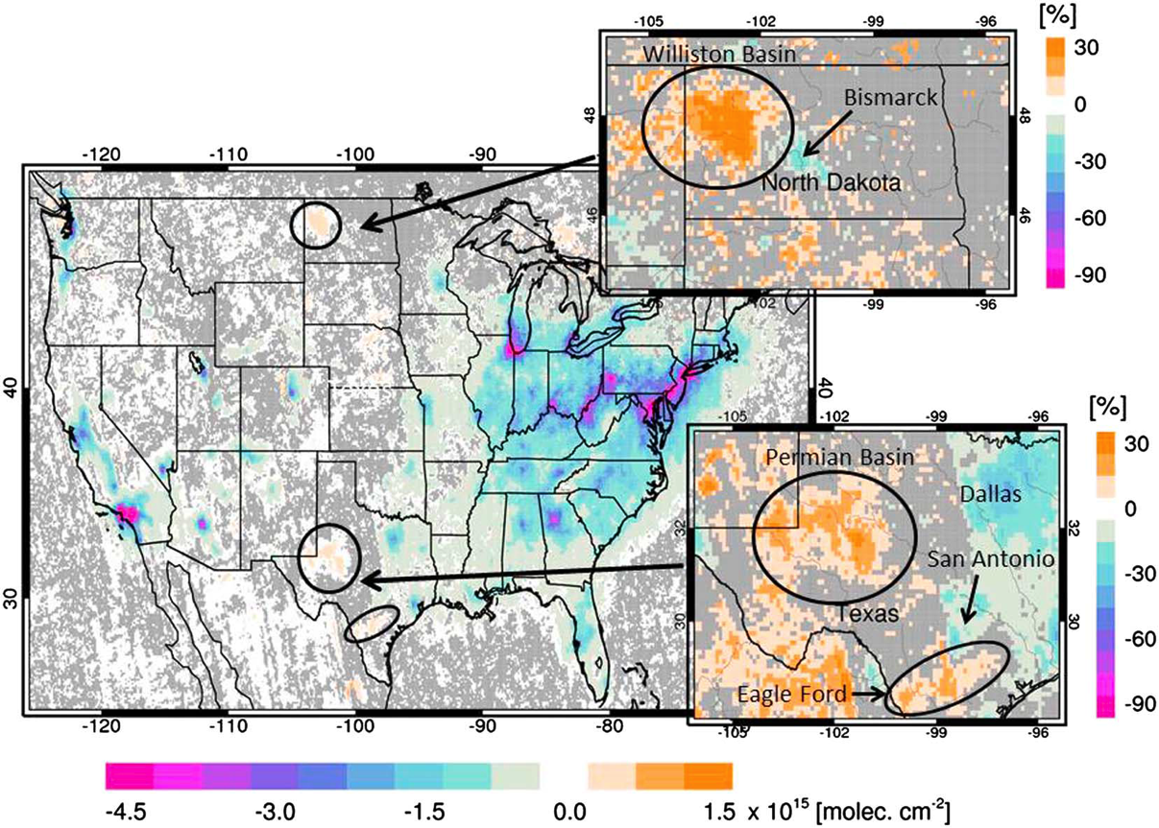
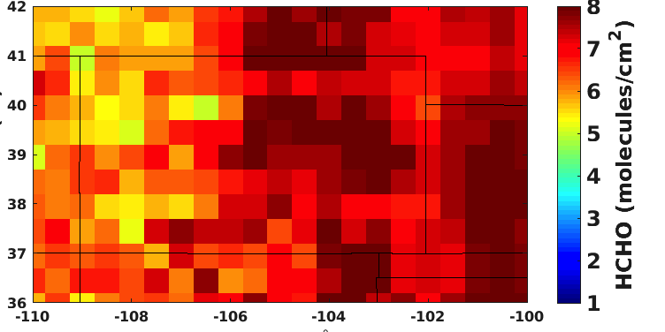
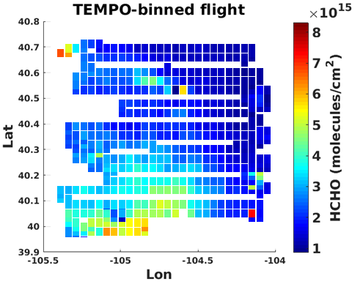
TEMPO could help to characterize emissions from evolving sources, such as oil and natural gas basins
Changes in OMI NO₂ columns, 2005-2014
Duncan et al., JGR, 2016
COLORADO
Frank Keutsch, Mitchell Thayer, et al.

Slide 10
TEMPO HCHO may provide constraint on urban VOC emissions
Comparisons of WRF-Chem Model to CalNex 2010 observations in Pasadena
Model VOCs/GC-MS VOCs
Long-path DOAS and Model HCHO
Si-Wan Kim et al.
Field observations and surface monitoring provide complementary information for sorting out VOC sources and their impact on HCHO

Slide 11
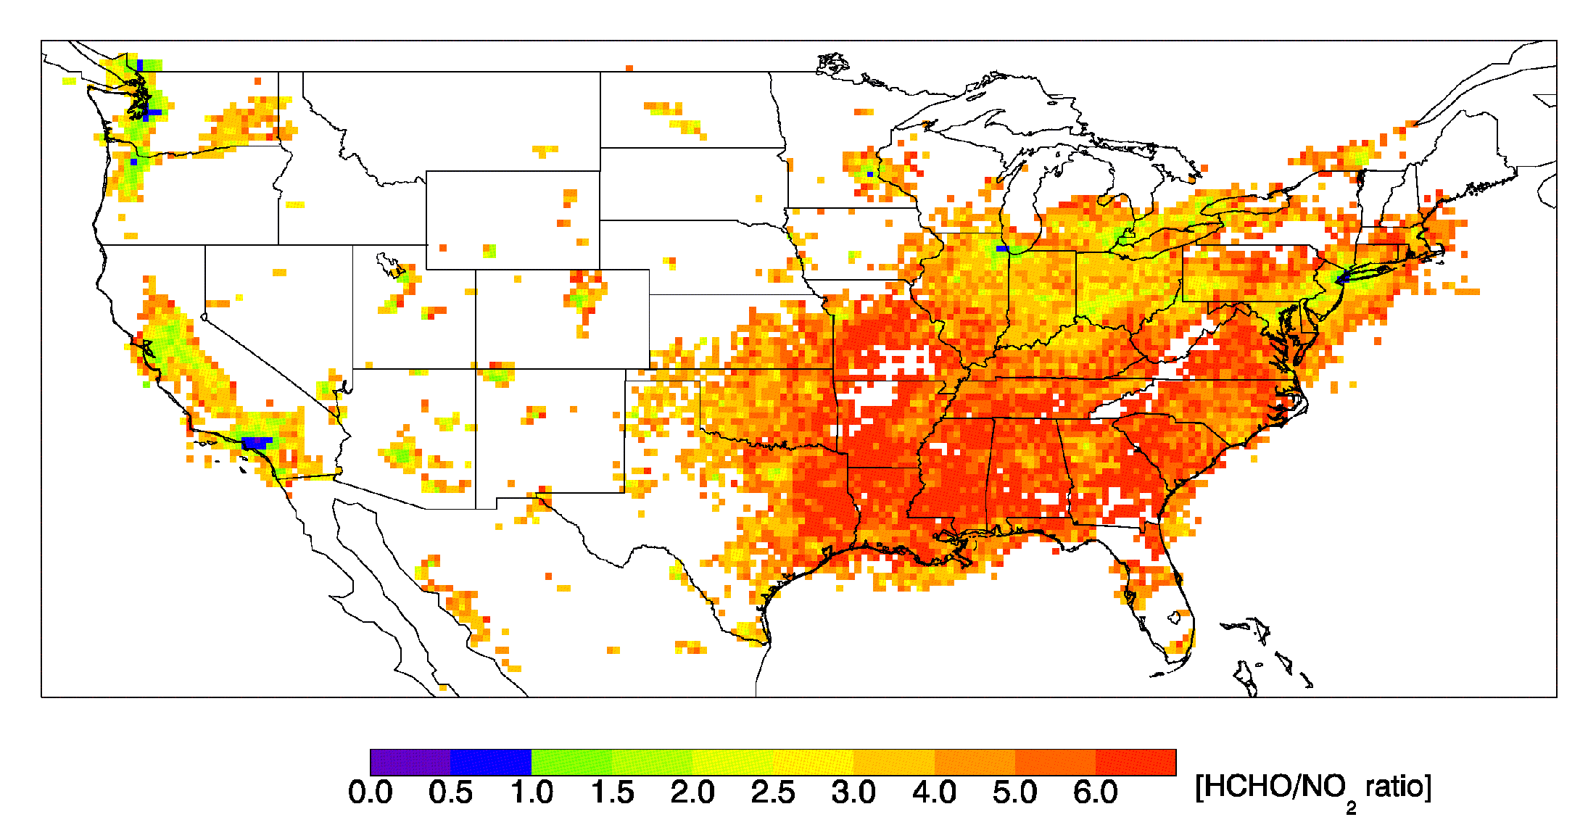
TEMPO may help assess control strategies
OMI
HCHO/NO₂
Natural VOCs from trees are so high in the East that ozone production is primarily controlled by reducing NO_{x} emissions.
Ozone production is controlled by reducing VOC emissions in downtown LA.
Duncan et al., Atmos. Environ., 2010
Reduce VOC Emissions
Transition
Reduce NO_{x} Emissions
HCHO/NO₂ columns used to explore sensitivity of ozone formation to changes in VOC and NOx emissions
Indicator ratios will vary with time of day, day of week, and temperature, reflecting emissions source mixtures and chemistry

Slide 12
TEMPO’s high-resolution retrievals require high resolution inputs
  Quantify high-resolution inputs to air mass factor: vertical profiles, terrain height
  Use field campaign data and regional model to understand sensitivities
Ratio of HCHO AMFs = Default AMF/WRF-Chem AMF
Ratio of AMFs
Si-Wan Kim et al.

Slide 13
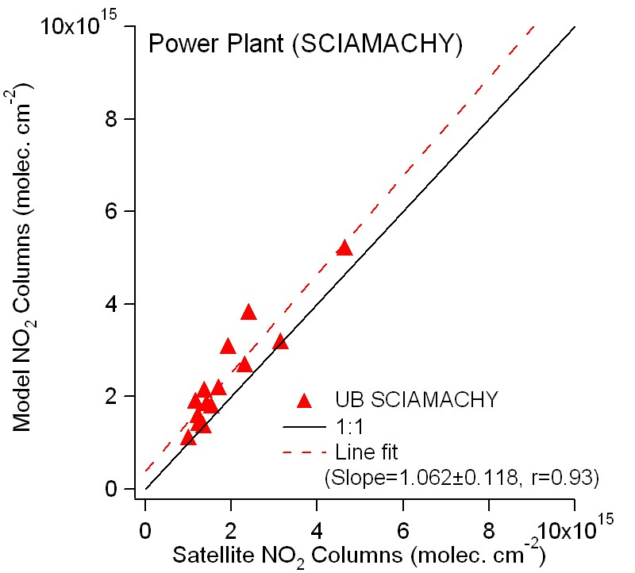
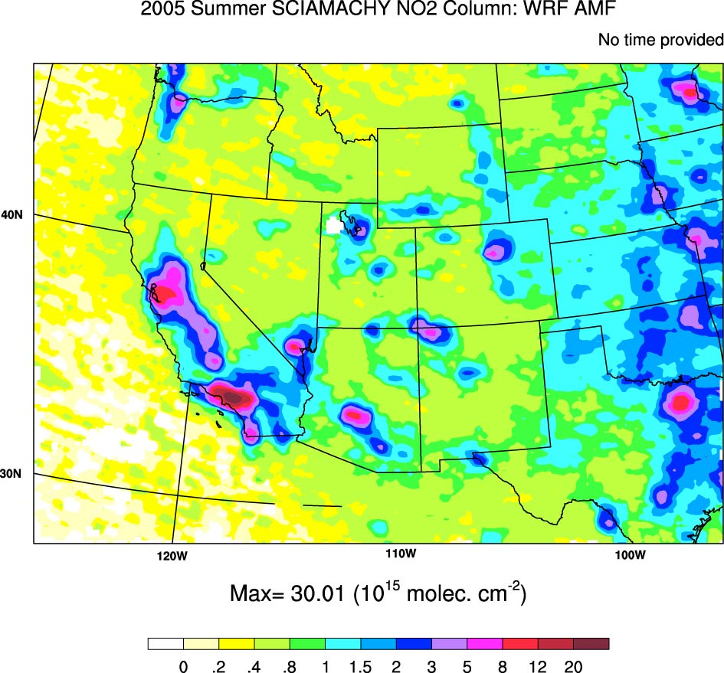
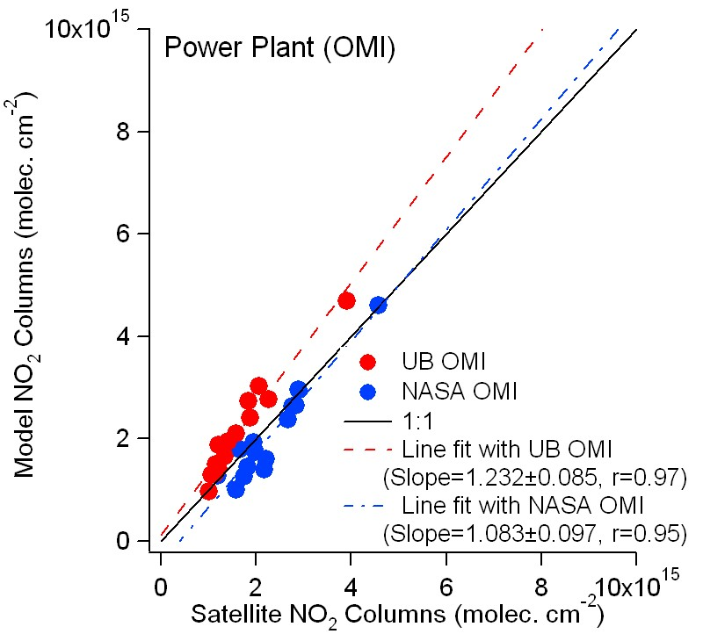
Retrieval uncertainties can impact absolute emissions estimates
North Valmy
Colstrip
Dave Johnston/
Laramie River
Intermountain
Hunter /
Huntington
Jim Bridger/
Naughton
Reid Gardener
Craig/Hayden
Mohave
Bonanza
Navajo
Four Corners/
San Juan
Cholla/Coronado/ Springerville
US power plants directly monitor their emissions (CEMS)
Leverage power plant satellite signals to understand retrieval uncertainties
S.-W. Kim et al., J. Geophys. Res., 2009

Slide 14
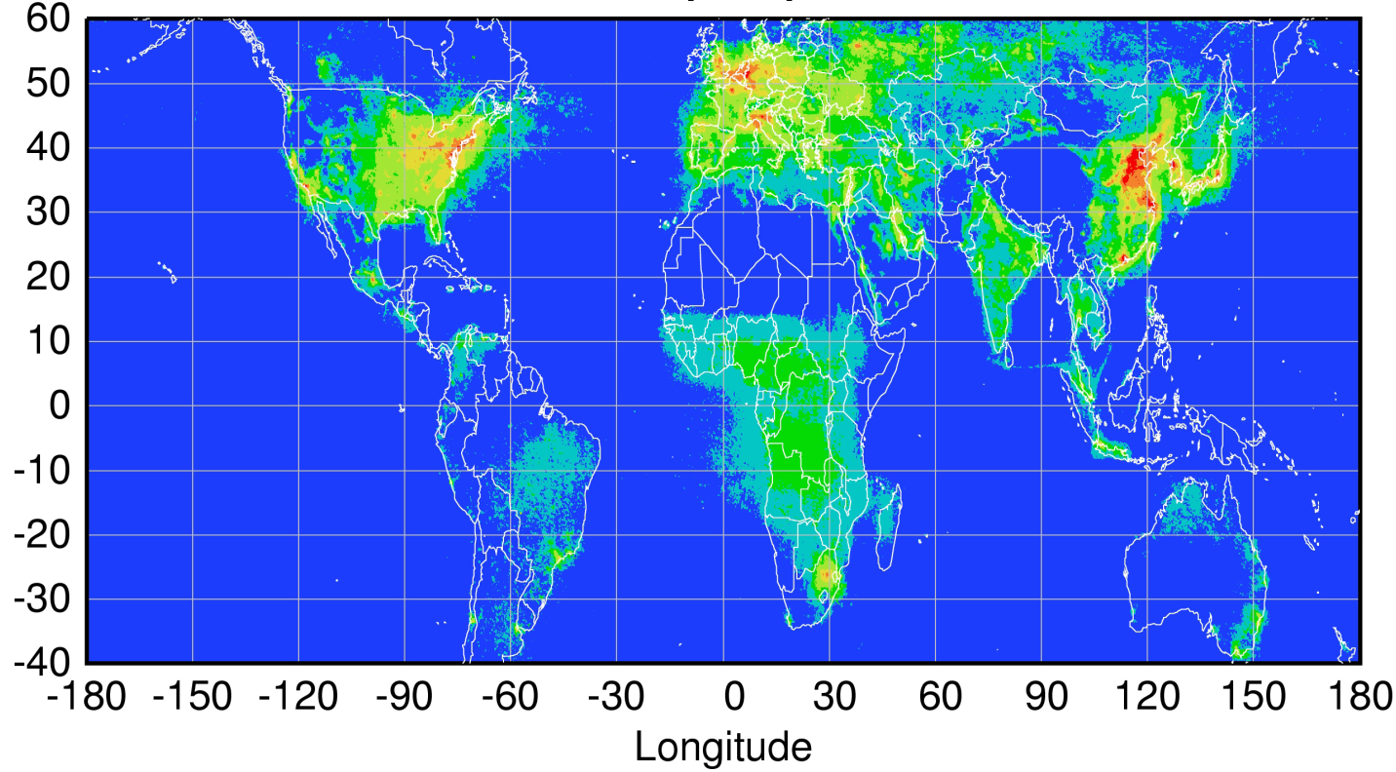
TEMPO in global GEO monitoring constellation
Sentinel-4
TEMPO
GEMS
Spatial coverage of funded GEO spectrometers 2018-2020
Courtesy Jhoon Kim,
Andreas Richter
Policy-relevant science and environmental services enabled by common observations
Improved emissions at common confidence levels over Northern Hemisphere
Improved air quality forecasts and assimilation systems
Improved assessment of impacts

Slide 15
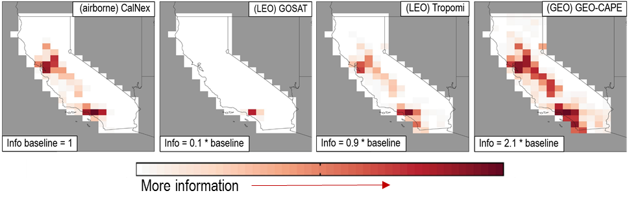
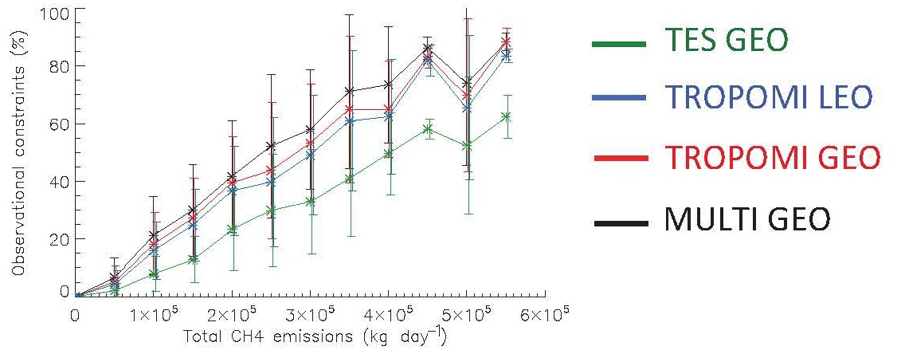
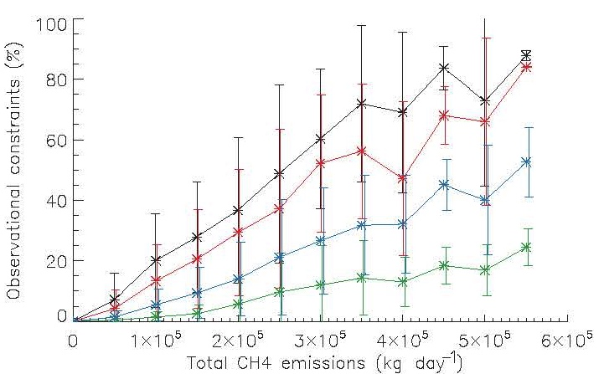
Constraints on methane from proposed GEO IR instrument
GEO measurements, particularly multi-spectral (TIR+SWIR), constrain CH₄ emissions better than comparable LEO observations
Increased frequency of GEO sampling allows shorter averaging periods to be used and CH₄ emissions to be studied on finer timescales
Wecht et al., ACP, 2014
30 days
3 days
Bousserez et al., Atmos Chem Phys, 2016

Slide 16
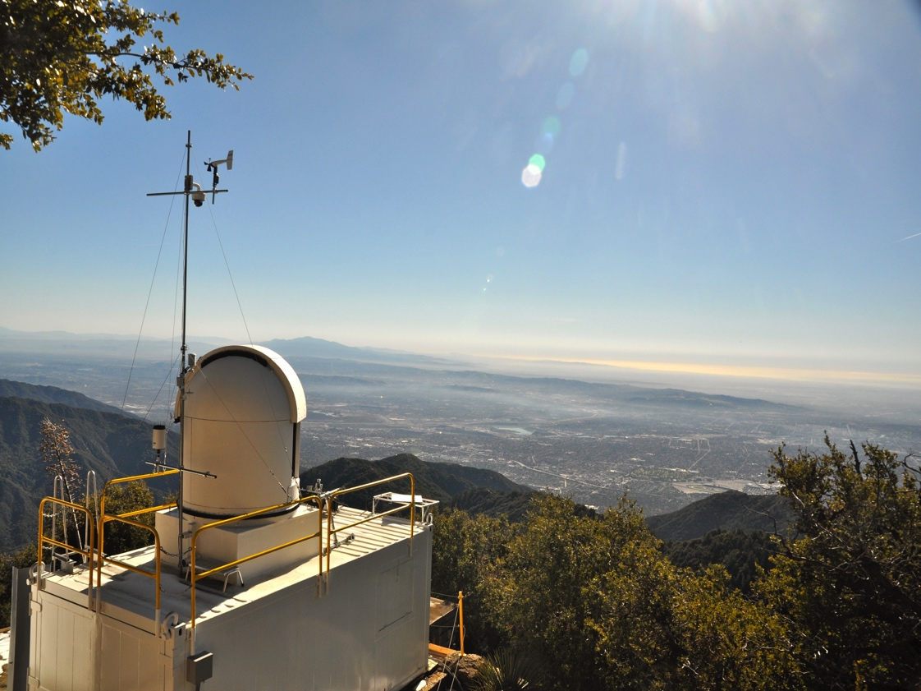
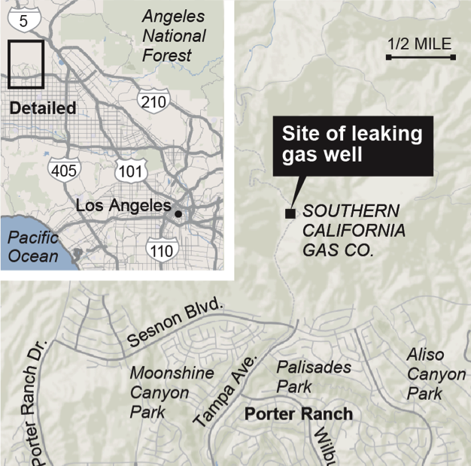
California Laboratory for Atmospheric Remote Sensing (CLARS)
GEO IR instrument as an urban CH₄ monitor
Azimuthal
Scan
Pointing Mirror
1.7 km a.s.l.
FTIR Spectrometer
K. W. Wong, 2015; D. Fu, 2014

Slide 17
Lessons learned from AQAST: How to convey science to EPA, States, local agencies
http://aqast.org

Slide 18


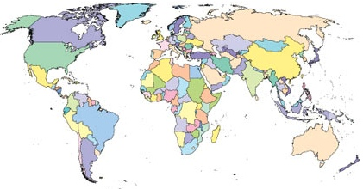




Bringing TEMPO products to international partners in research, regulation, and policy
National/Regional Working Groups
GEIA member(s)
SSC member(s)
1800+
GEIA Working Groups: China, Latin America and Caribbean,
VOCs, Urban Areas
www.igacproject.org
http://www.geiacenter.org/

Slide 19
More Information
Greg Frost: gregory.j.frost@noaa.gov, http://www.esrl.noaa.gov/csd/staff/gregory.j.frost/
Bousserez, N. et al. (2016) Atmos. Chem. Phys., doi:10.5194/acp-16-6175-2016
Duncan, B. N., et al. (2010) Atmos. Environ., doi: 10.1016/j.atmosenv.2010.03.010
Duncan, B. N., et al. (2016) J. Geophys. Res., doi:10.1002/2015JD024121
Fishman, J., et al. (2008) Bull. Am. Meteor. Soc., doi: 10.1175/2008BAMS2526.1
Fu, D., et al. (2014), Atmos. Meas. Tech. 7: 713-729. 10.5194/amt-7-713-2014
Kim, S.-W., et al. (2006) Geophys. Res. Lett., doi: 10.1029/2006GL027749
Kim, S.-W., et al. (2009) J. Geophys. Res., doi: 10.1029/2008JD011343
Kim, S.-W., et al. (2011) Atmos. Chem. Phys., doi: 10.5194/acp-11-11361-2011
Kim, S.-W., et al. (2016) J. Geophys. Res., doi: 10.1002/2015JD024292
Pollack, I. B., et al. (2012) J. Geophys. Res., doi: 10.1029/2011JD016772
Russell, A. R., et al. (2012) Atmos. Chem. Phys., doi: 10.5194/acp-12-12197-2012
Steffen, W., et al. (2015) The Anthropocene Review, doi: 10.1177/2053019614564785
Streets, D. G., et al. (2013) Atmos. Environ., doi: 10.1016/j.atmosenv.2013.05.051
Wecht, K. J., et al. (2014) Atmos. Chem. Phys., doi: 10.5194/acp-14-8173-2014
Wong, K. W., et al. (2015) Atmos. Chem. Phys., doi: 10.5194/acp-15-241-2015

