Slide 1
Initial thoughts on the benefits of TEMPO data for AQ management
1st TEMPO Applications Workshop
7/12/2016
(dolwick.pat@epa.gov)

Slide 2
Overview
There are a wide variety of potential uses of TEMPO measurements to inform air quality management.
To focus this discussion, this talk will focus on three of the six science questions identified on the TEMPO factsheet, providing relevant EPA assessment examples where possible.
How does intercontinental transport affect air quality?
More broadly, how can TEMPO data be used to inform estimates of “background” pollutant levels?
How can observations from space improve AQ forecasts and assessments?
As other presentations will be focusing on TEMPO-driven improvements to model inputs, this presentation will focus on how TEMPO data can inform more rigorous model performance evaluations.
How do episodic events affect atmospheric composition and air quality?
Most importantly, how can we effectively incorporate TEMPO data into the development and maintenance (in a changing climate) of conceptual models of AQ formation and transport across the U.S. Within those conceptual models, how can TEMPO data identify exceptions (i.e., inform “exceptional event” determinations).

Slide 3
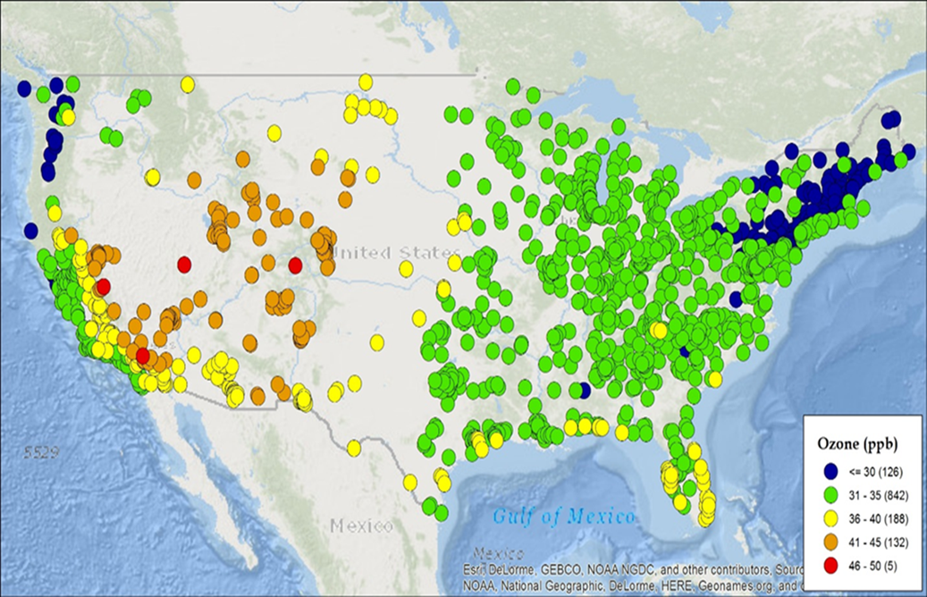
TEMPO & Estimating AQ Background (1/2)
Increasingly stringent ambient air standards, as well as a recent emphasis on returning to natural levels of regional haze, has led to increased focus on background pollutant concentration levels.
Currently our primary tool to assess background AQ levels are nested global/regional AQ models.
This map shows estimates of seasonal mean U.S. background ozone concentrations at surface monitoring locations across the U.S., from an EPA CMAQ simulation for a 2007 base year.

Slide 4
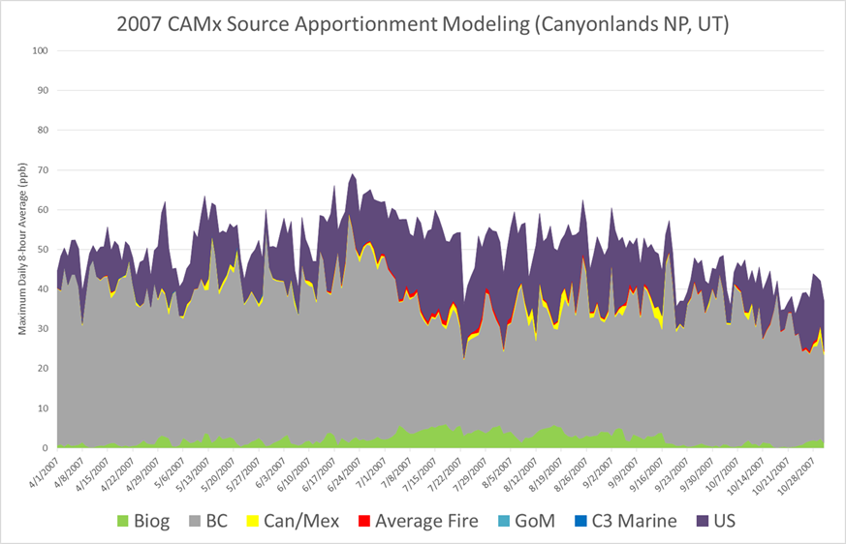
TEMPO & Estimating AQ Background (2/2)
For this specific AQM use, a particular set of inputs and processes become of primary import … all of which are well-suited for TEMPO:
land-biosphere interactions (biogenics)
fire emissions / plume chemistry
stratosphere-troposphere exchange
lightning NOx
atmosphere-ocean interactions
transport aloft
evaluation in data-poor areas
identification of transcontinental transport (when differentiating between natural and domestic background)
This map shows CMAQ estimates of various terms contributing to total modeled ozone concentrations at Canyonlands NP from April-Oct 2007.

Slide 5
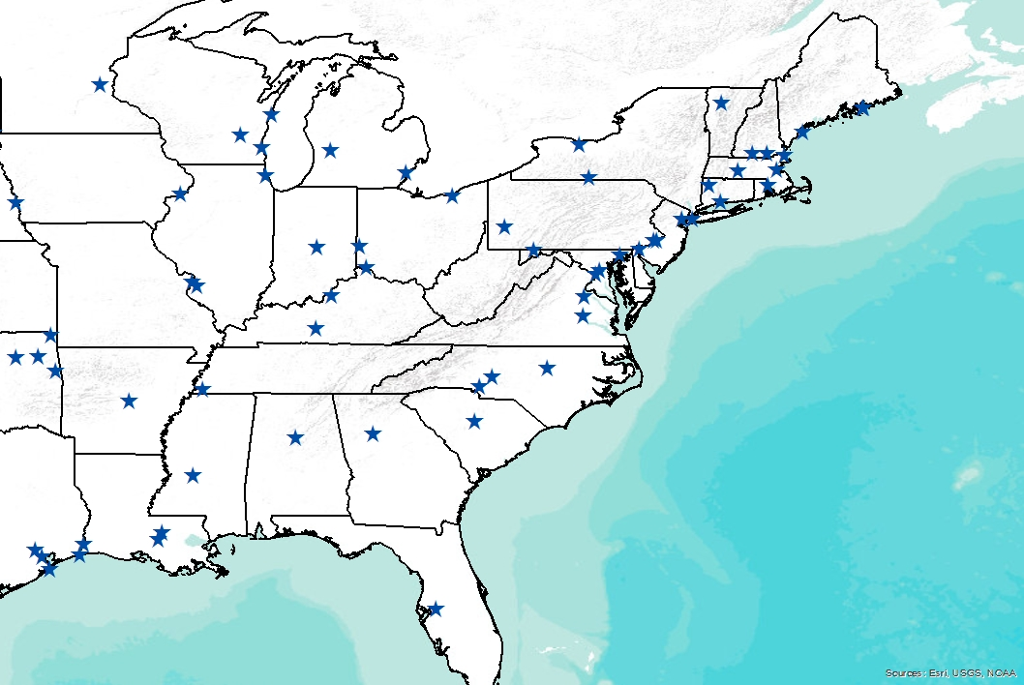
TEMPO & Enhanced AQM evaluations (1/4)
The relative scarcity of pollutant data above the surface with which one can assess retrospective AQ simulations can be a limitation in current model evaluations.
Furthermore, even at the surface monitoring networks can be relatively limited and introduce potential sampling biases into the evaluation.
Tendency for sites to be urban-oriented
Subsequent slides show a small subset of potential TEMPO-informed analyses.
This figure shows the location of NOy measurements in the AQS network in 2011 across the eastern U.S.

Slide 6
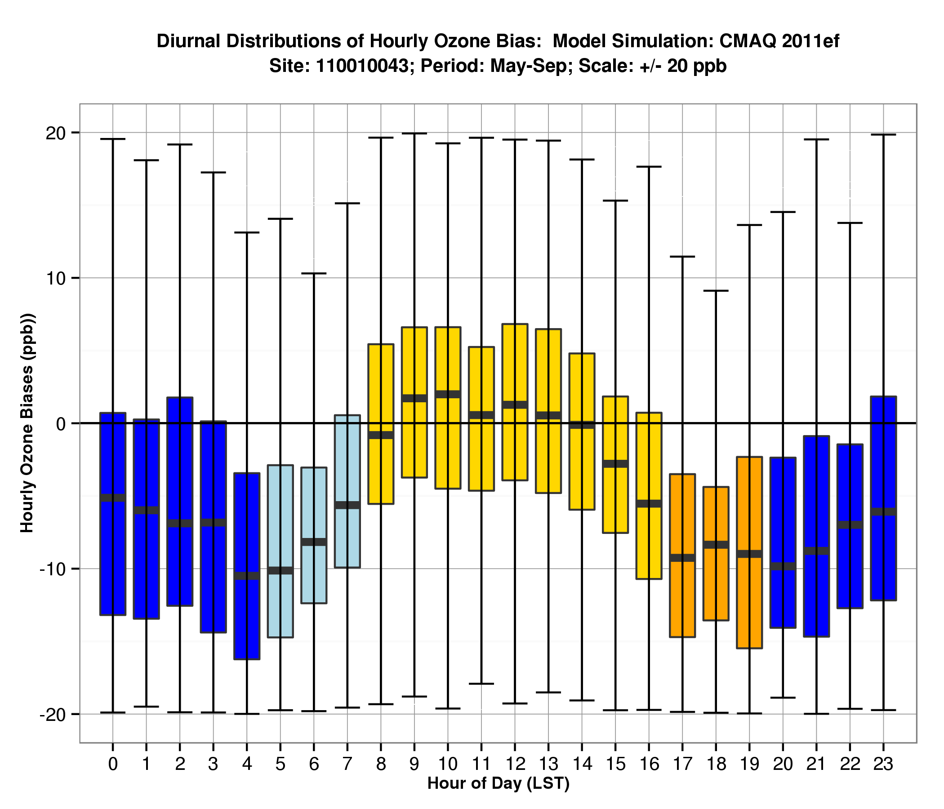
TEMPO & Enhanced AQM evaluations (2/4)
Enhanced ability to assess model’s ability to capture diurnal changes in AQ concentrations.
Plot shows distributions in modeled O3 bias by hour of the day at a site in Washington D.C. between May – Sep 2011

Slide 7
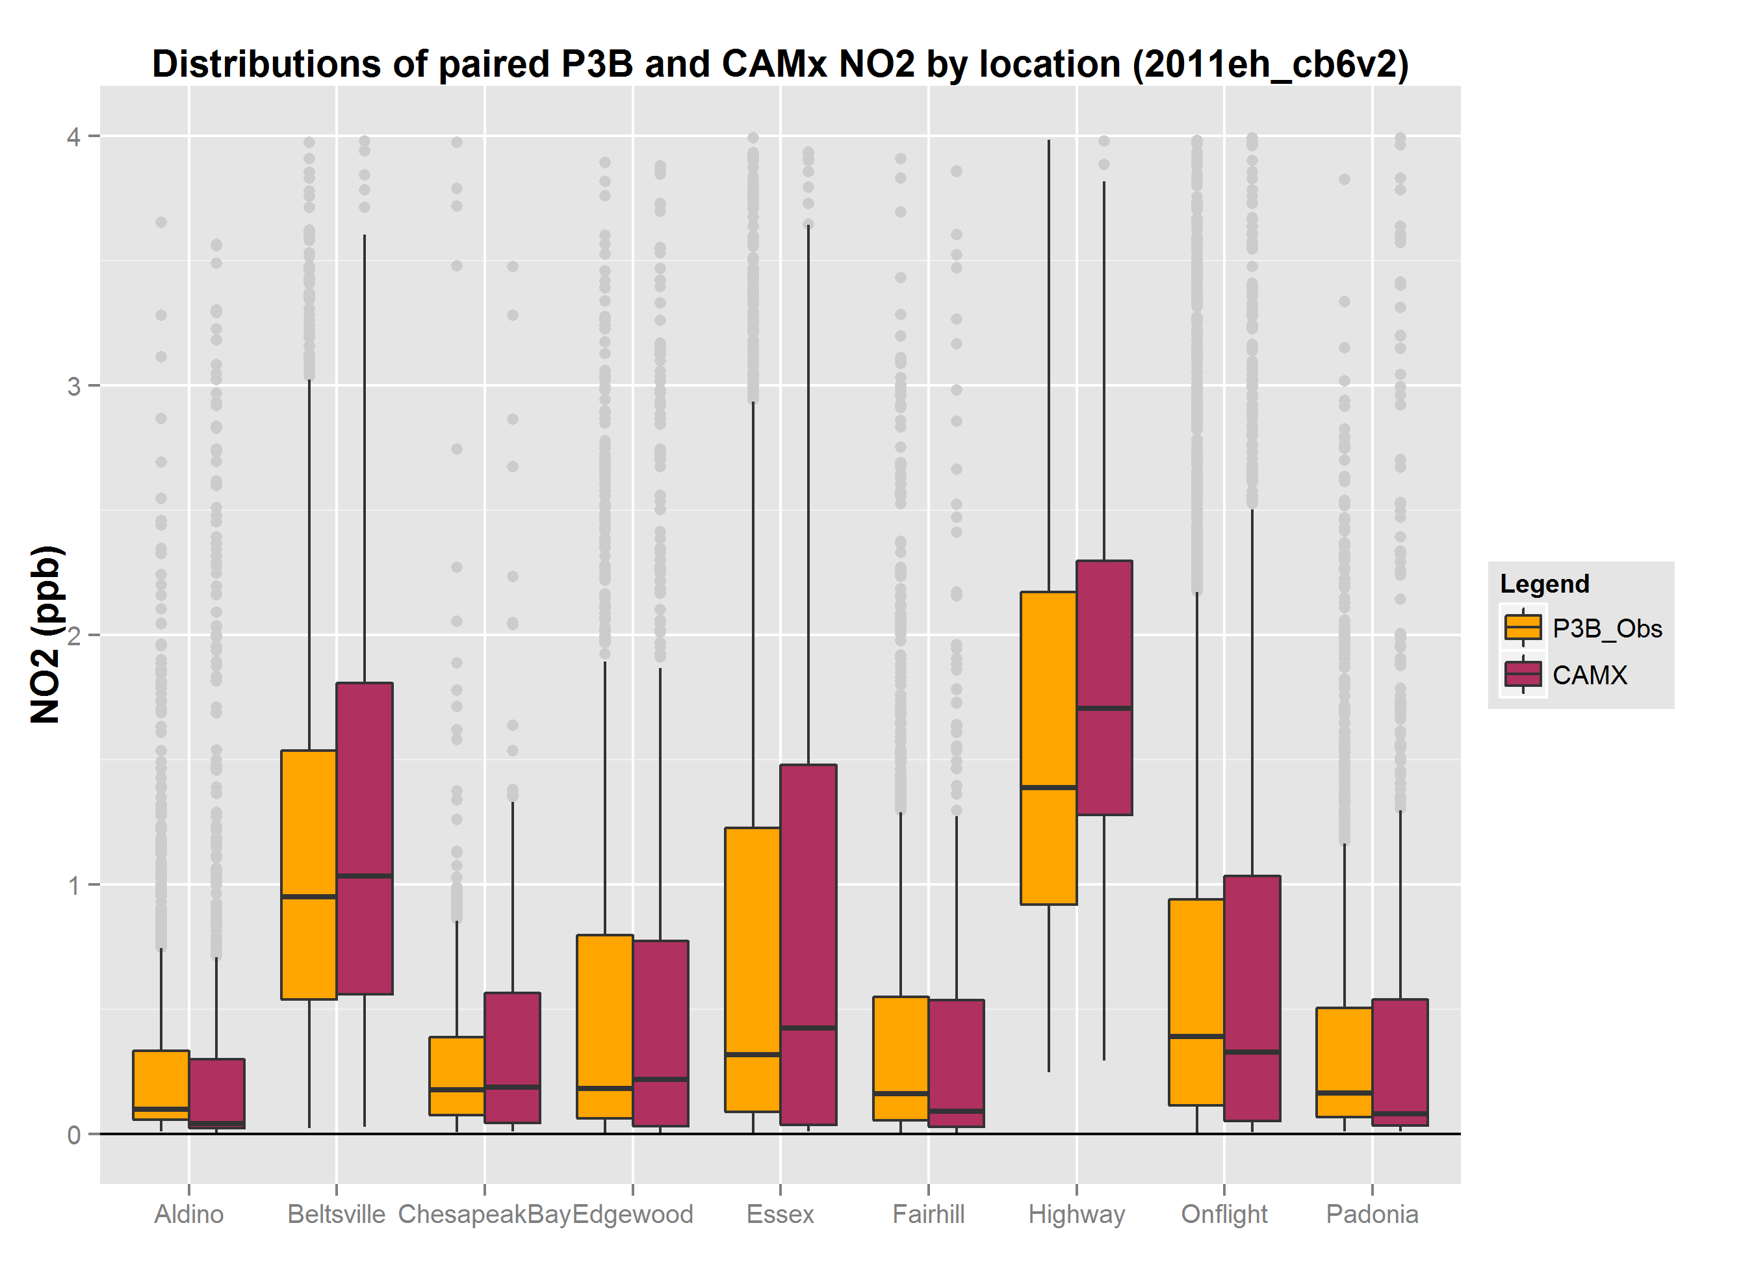
TEMPO & Enhanced AQM evaluations (3/4)
Enhanced ability to assess model’s ability to capture intra-regional differences in AQ concentrations.
Plot shows spatial distributions of aircraft and modeled NO2 by location over the 2011 DISCOVER-AQ region/period by location.

Slide 8
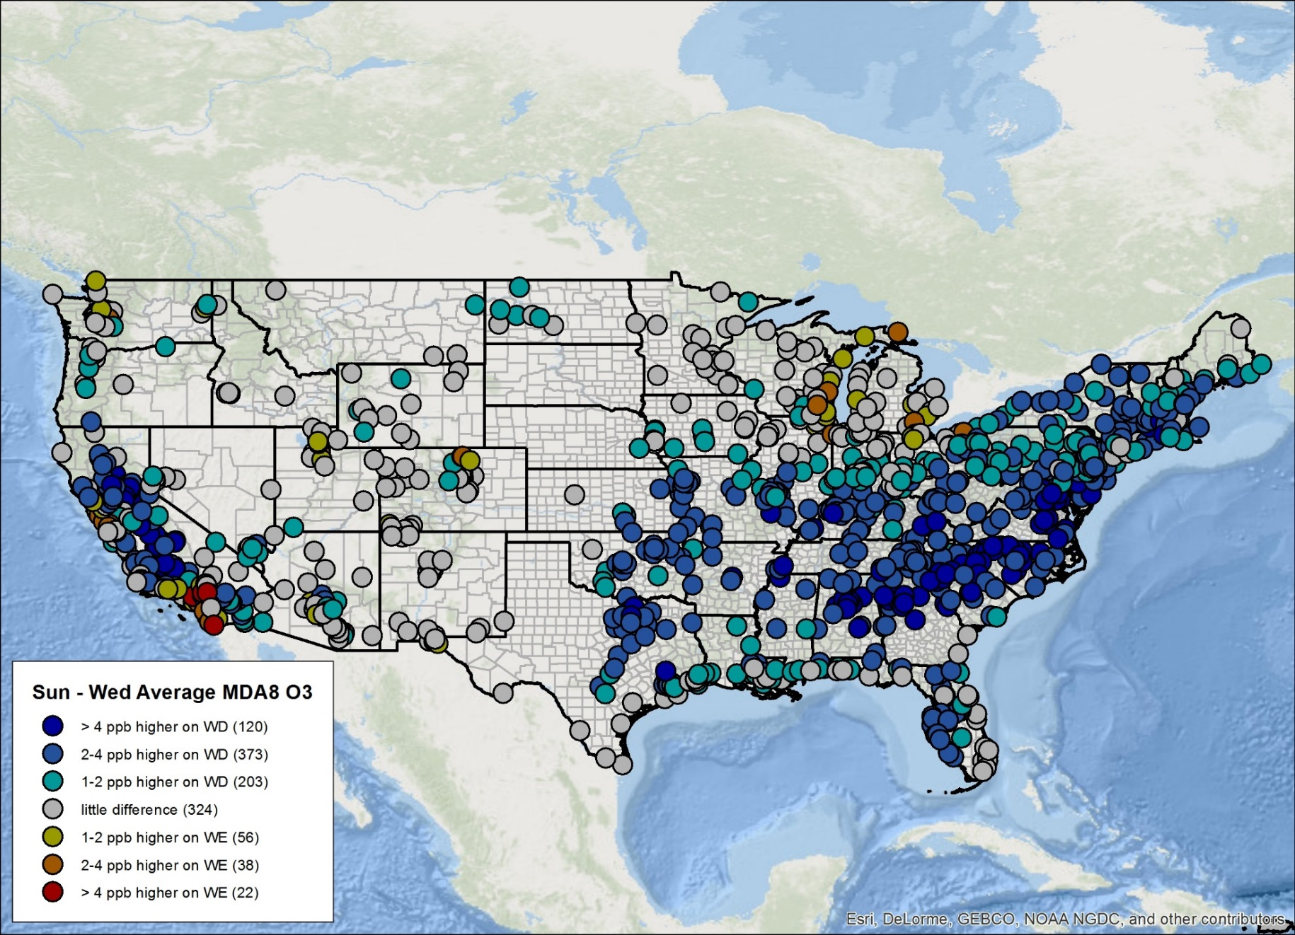
TEMPO & Enhanced AQM evaluations (4/4)
Enhanced ability to assess model’s ability to capture dynamic changes (e.g., weekend-weekday ozone signals, or annual trends)
Figure shows the average MDA8 O3 on Sundays relative to Wednesdays over the 2006-2015 period

Slide 9
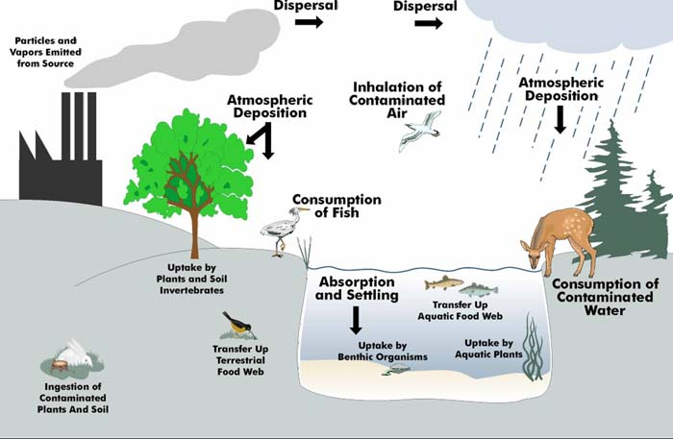
TEMPO, conceptual models, & episodic events
Prior to any modeling exercise to support AQ management, the first step is to develop a conceptual model of pollutant formation, transport, and loss for the region/pollutant of interest.
Section 319(b) of the Clean Air Act defines an exceptional event to be an event that affects air quality in such a way that:
there exists a clear causal relationship between the specific event and the monitored exceedance,
the event was not reasonably controllable or preventable, and
the event was caused by human activity that is unlikely to recur at a particular location or was a natural event.
TEMPO has potential to inform both conceptual models and exceptional events.
Schematic of a simple conceptual modeling courtesy of EPA Regional Vulnerability Assessment Program

Slide 10
Closing thoughts
TEMPO data holds promise for providing an unprecedented leap in the resolution and comprehensiveness of assessments to inform AQ management.
Realization of that potential will require actions, including but not limited to:
Active and early training of AQ assessment end-users on how to best leverage TEMPO data.
ARSET provided value to EPA. Training provides compound interest. Best if started before data stream starts.
Active and frequent collaboration between TEMPO and AQ model developers.
Model developers are often most attuned to the latest specific areas of model improvements and how they can be effectively evaluated.
Active and candid communication between TEMPO and AQ assessment end-users.
Within the end user community, groups will sometimes settle on the opposite ends of the following spectrum: TEMPO data will solve all my problems -> TEMPO data are unsuited to solving any of my problems.
From an end-user perspective, it is as important to identify caveats and uncertainties, establish a means of matching model data to TEMPO data, and determine the universe of applications to which the TEMPO data is well-suited … as it is to have a larger suite of potential tools.
Would like to encourage alternate mechanisms for collaboration (e.g., short-term staff exchange, topic-based webinars)

