Slide 1
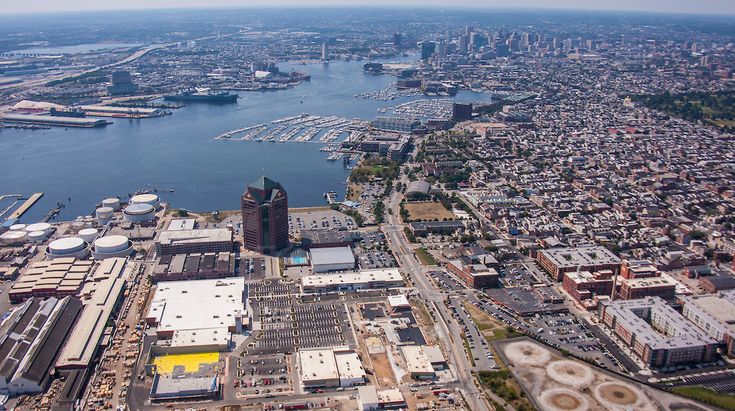



Moving from interannual analyses to day-to-day (and even glimpsing minute-to-minute) NO2 variations
ACAM data
Scott Janz
Matt Kowalewski
Jay Al-Saadi
PANDORA data
Jay Herman
Elena Spinei
Nadar Abuhassan
Luke Valin, LDEO - Columbia University, EPA/ORD
Arlene Fiore (LDEO), Jim Szykman (EPA/ORD)

Slide 2
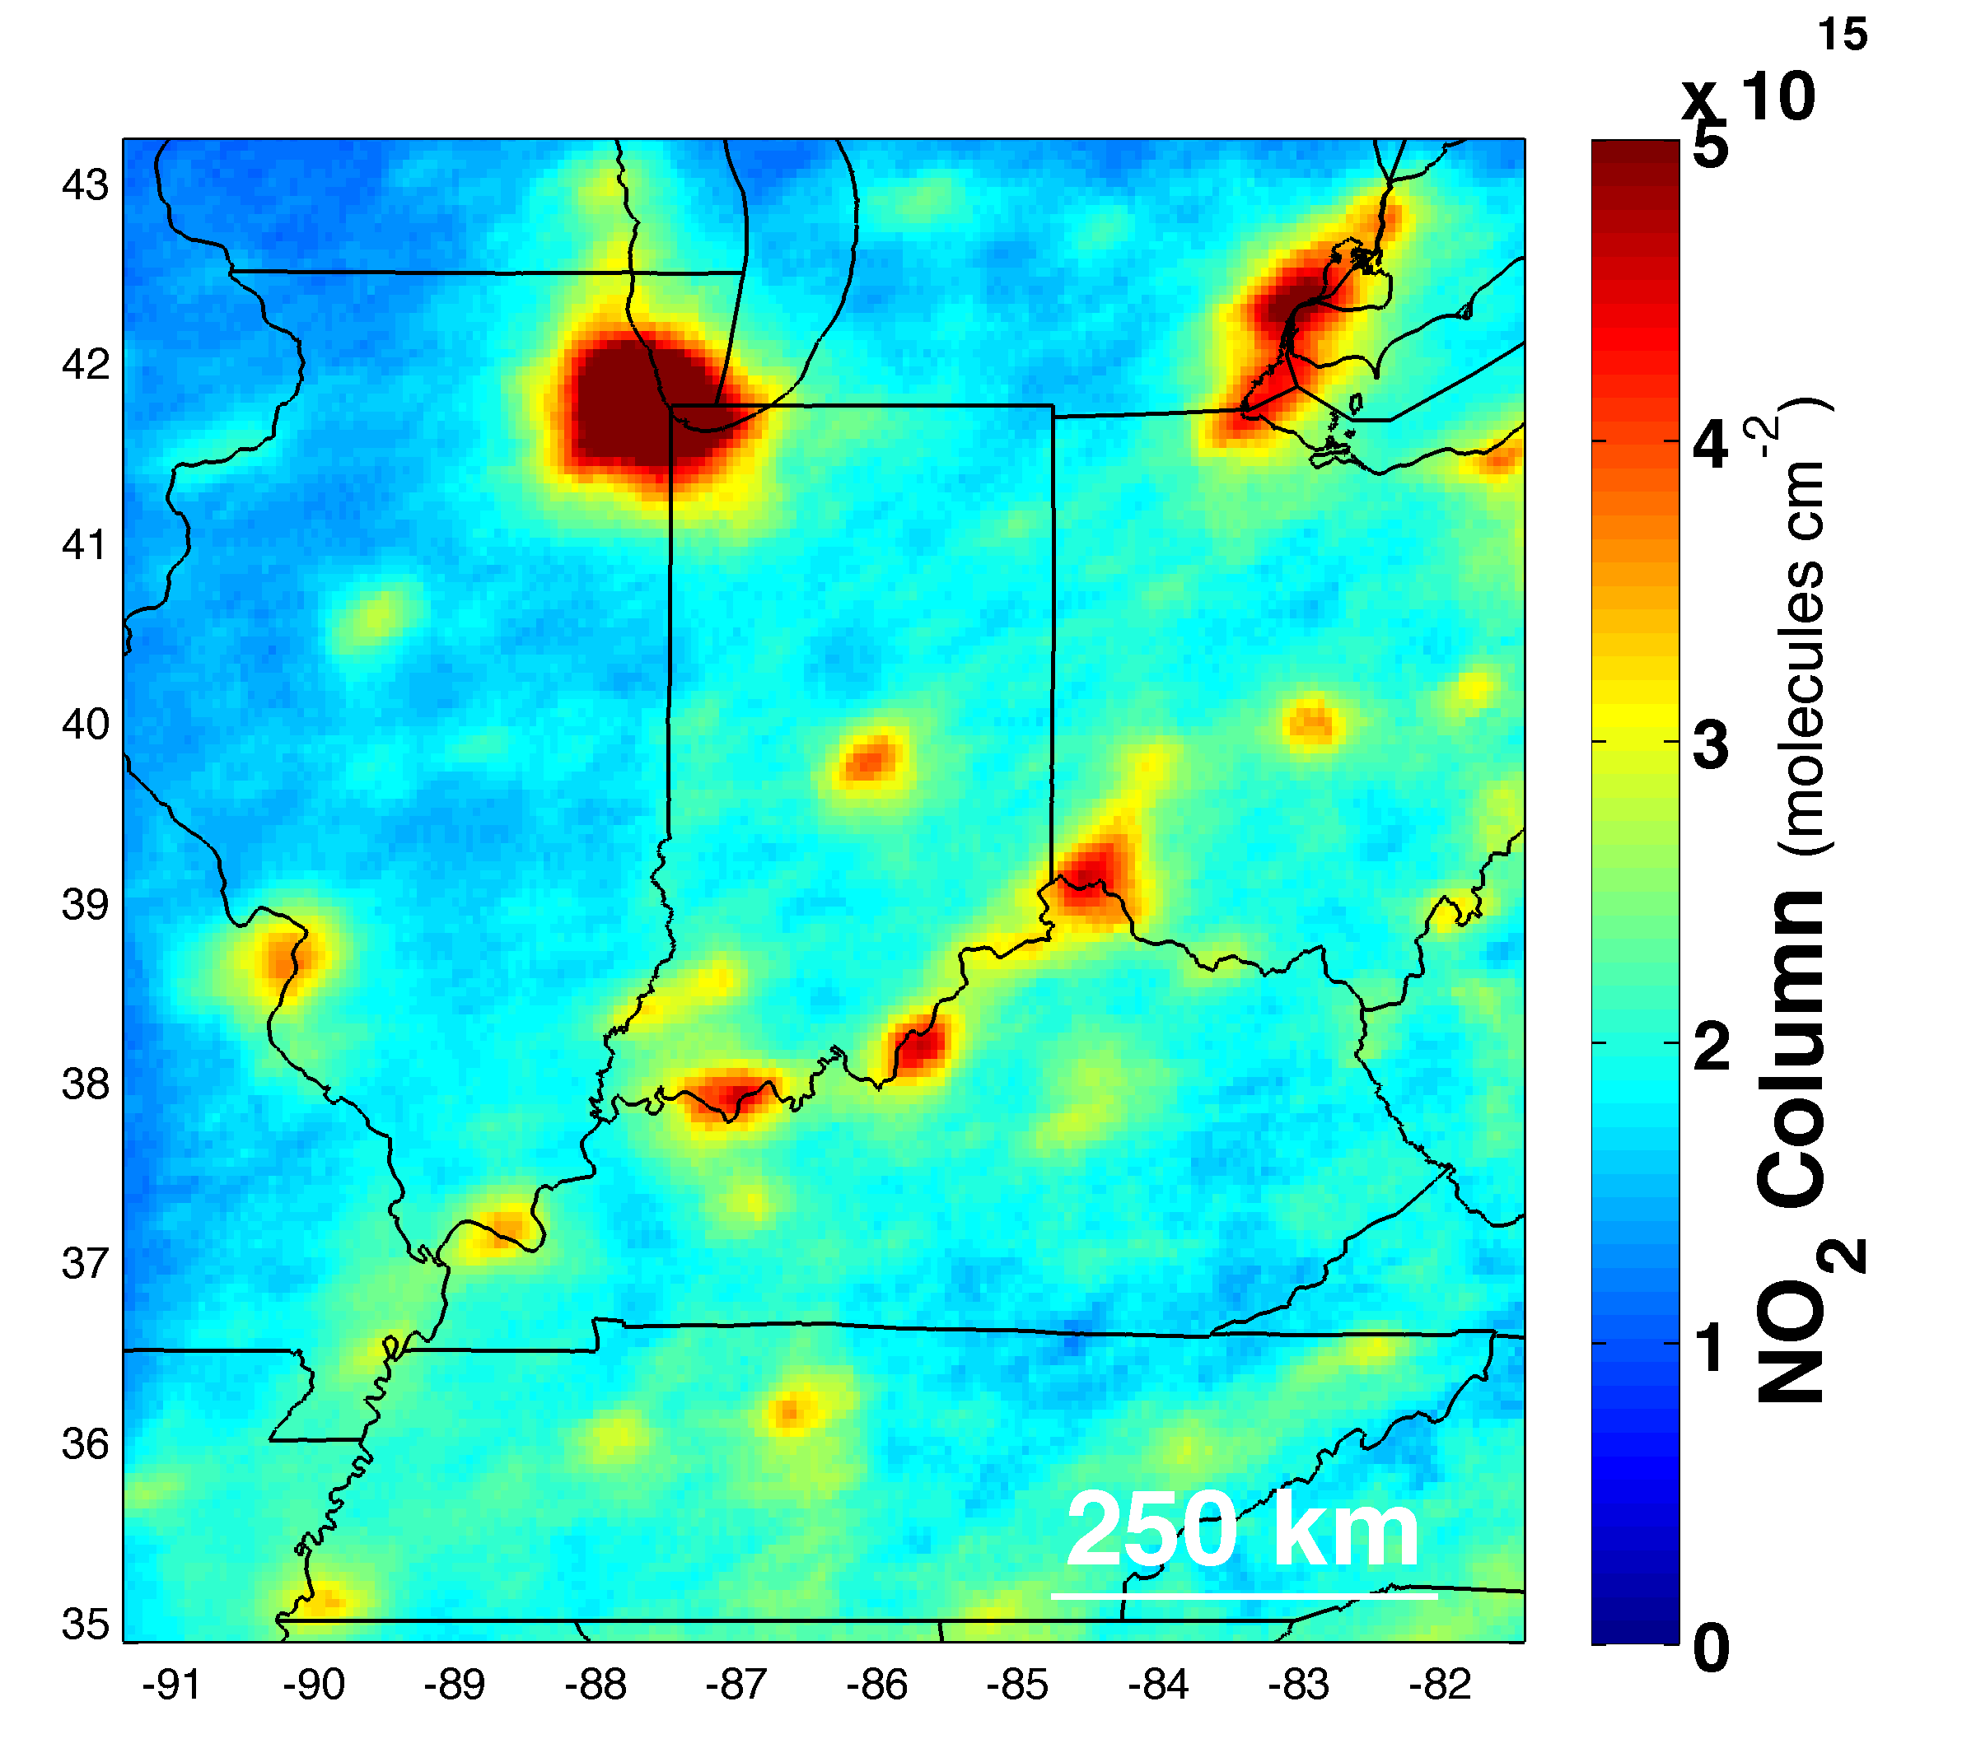
                OMI NO₂ Column - 1:30 PM daily measurement
                June- August; 2005 – 2012;
                N ≈ 150 cloud-free measurements per site
Long-term averages provide detailed information on the spatial pattern of NO_{X} emission sources.

Slide 3
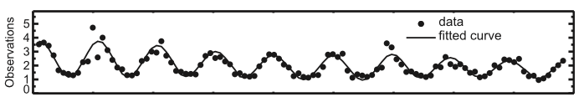
Monthly, regional-averaged NO₂ columns observed by Aura/OMI are
1) consistent year to year (high precision) + trend
2) in agreement with trends observed at the surface
E.g., Lamsal et al., 2015; Duncan et al., 2013; Russell et al., 2010
OMI Monthly NO2 Columns (×10¹⁵ mol. cm⁻²) East U.S. (36 – 40°N; 70 – 75°W) Lamsal et al., 2015
See airquality.gsfc.nasa.gov for trends near you

Slide 4
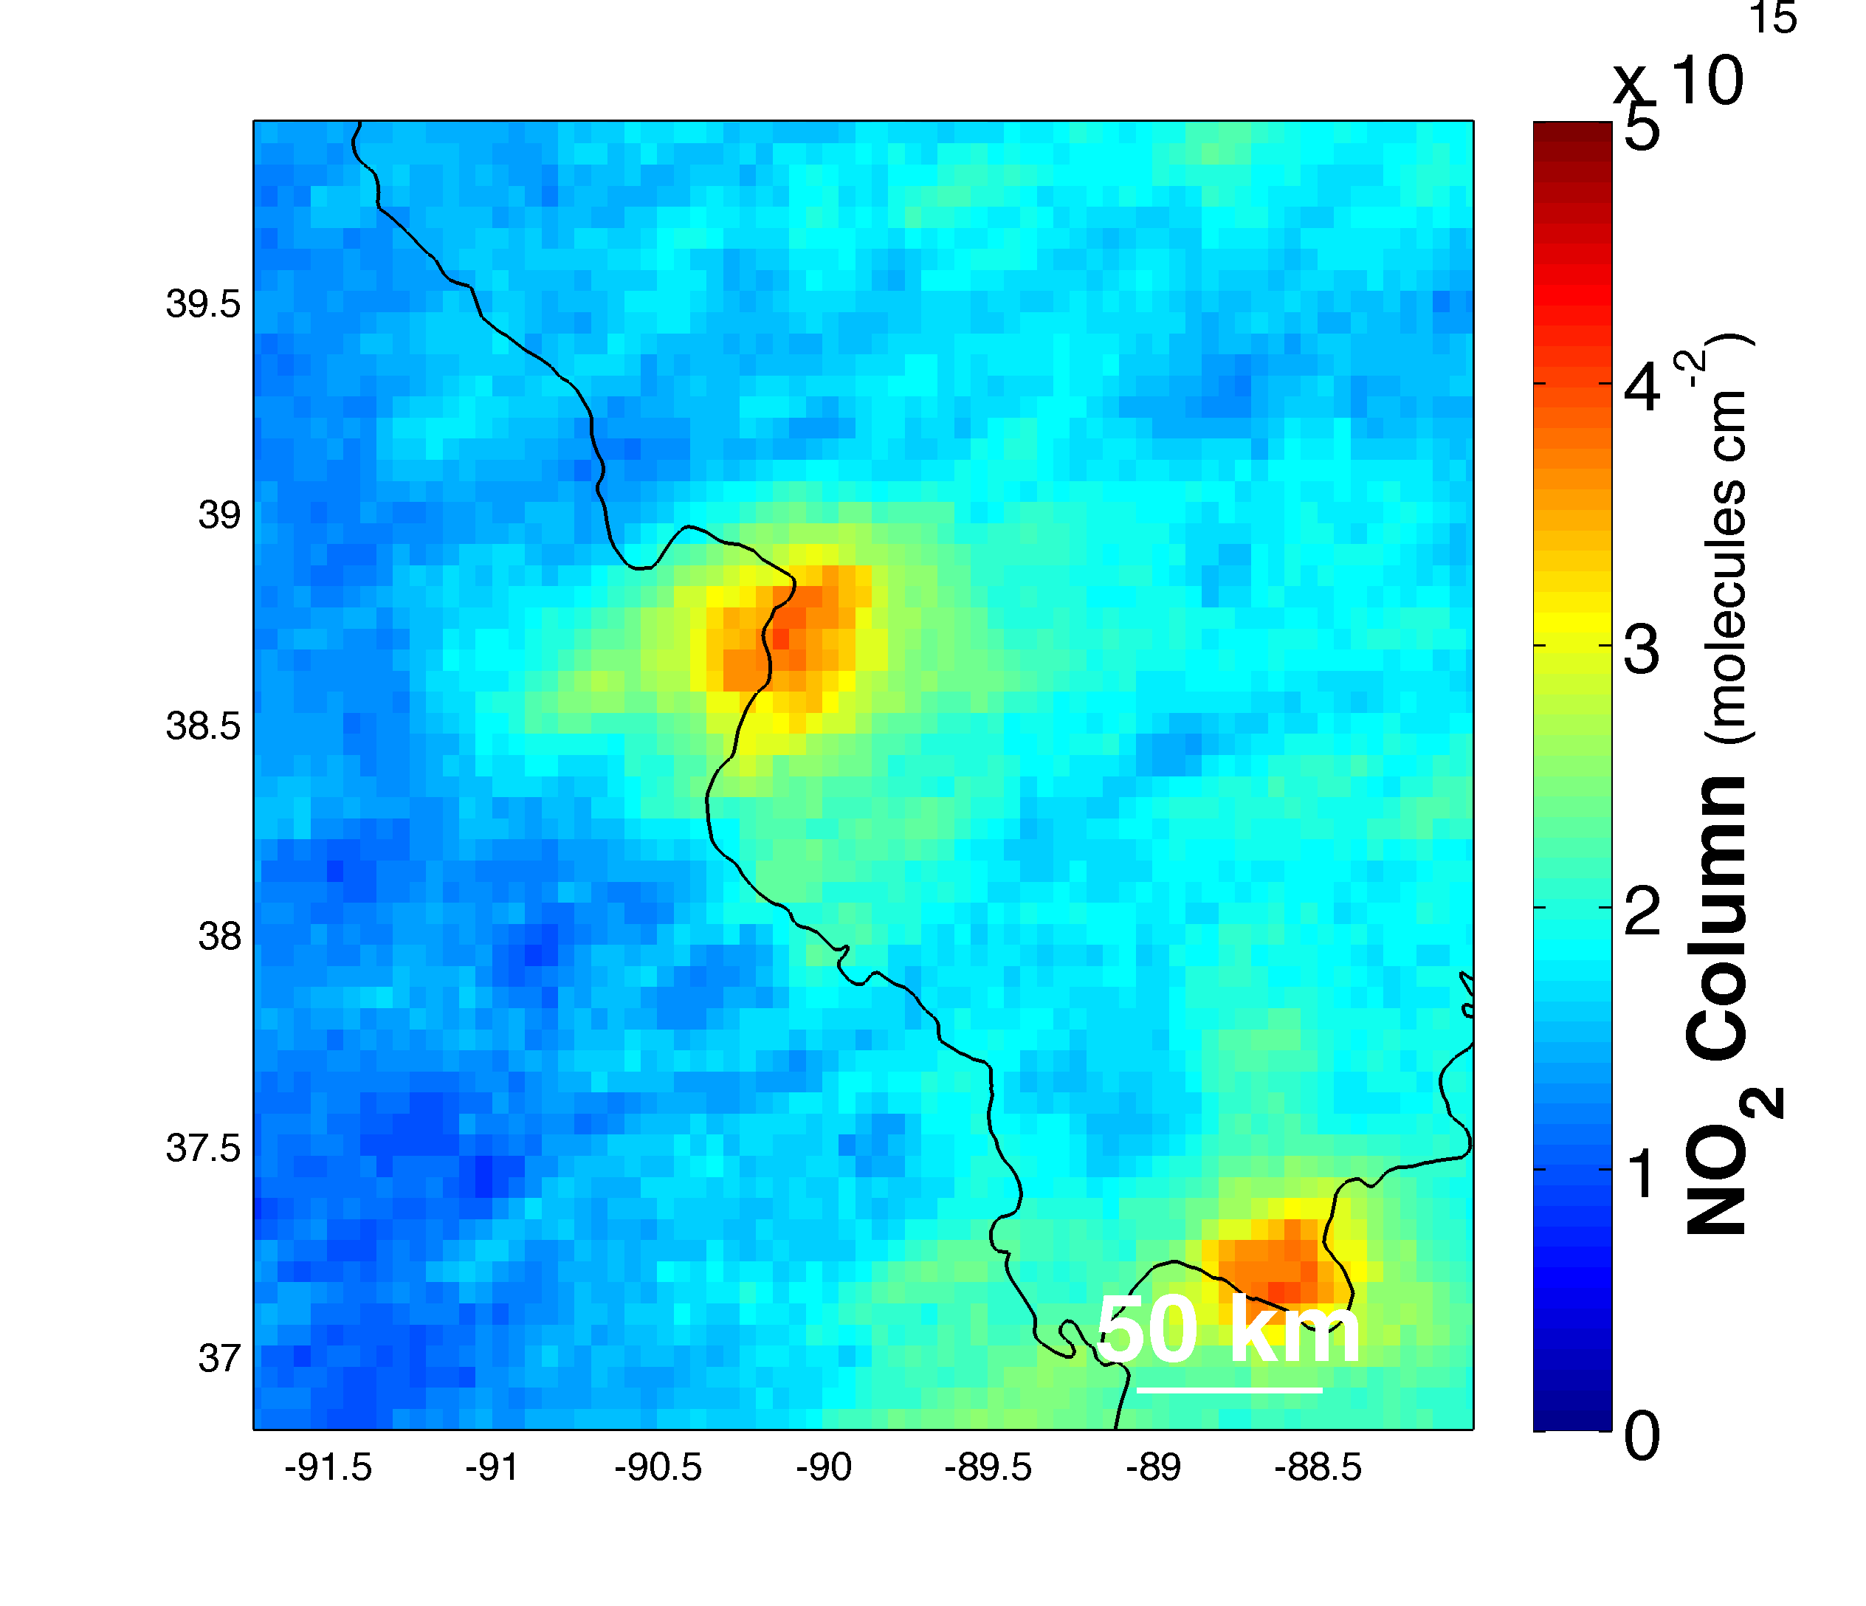
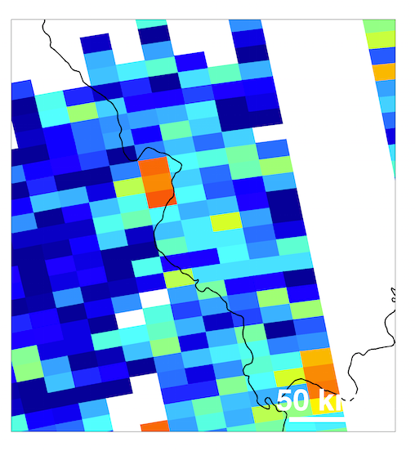
Application: Can OMI measure the influence of power plants on NO₂ in my city?
Ameren Missouri-Labadie Plant, Labadie, MO
~50 km west of central St. Louis
NEI2011: 52nd largest point source of NO_{X} (9891 tons / yr)
~ 1.7×10¹⁵ molecules cm⁻²
Jun-Aug 2005-2012
Due-West Winds (u>0; |v|<1 m s⁻¹)
N=38 cloud-free measurements
Tuesday, 29 Jul 2008
σ_{(N=1)} = 1.0×10¹⁵ molecules cm⁻²
σ_{(N=38)} = 0.16×10¹⁵ molecules cm⁻²
No
Yes
Notes:
Abs(V-component; 3x3 box average) <1 m s-1; U-component; 3x3 box average > 0 m s-1

Slide 5
Can OMI measure the influence of power plants on NO₂ in my city?
Ameren Missouri-Labadie Plant, Labadie, MO
~50 km west of central St. Louis
NEI2011: 52nd largest point source of NO_{X} (9891 tons / yr)
~ 1.7×10¹⁵ molecules cm⁻²
Jun-Aug 2005-2012
Due-West Winds (u>0; |v|<1 m s⁻¹)
N=38 cloud-free measurements
Tuesday, 29 Jul 2008
Will increase for TEMPO: variation will not be averaged over as large of footprint
Will decrease for TEMPO: ~100x increase in N
σ_{(N=1)} = 1.0×10¹⁵ molecules cm⁻²
σ_{(N=38)} = 0.16×10¹⁵ molecules cm⁻²
Notes:
Abs(V-component; 3x3 box average) <1 m s-1; U-component; 3x3 box average > 0 m s-1

Slide 6
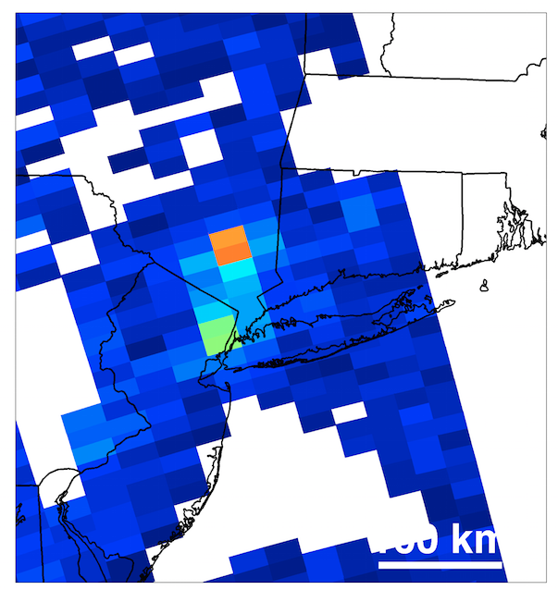
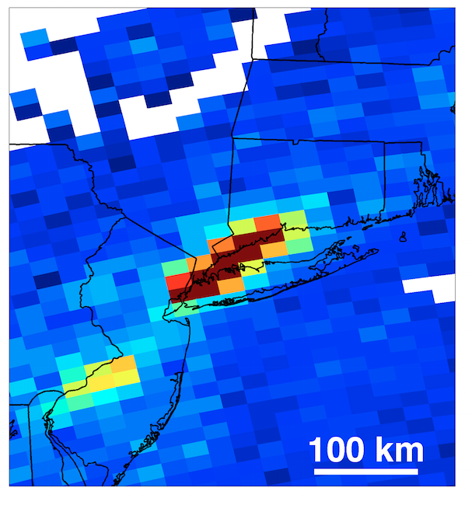
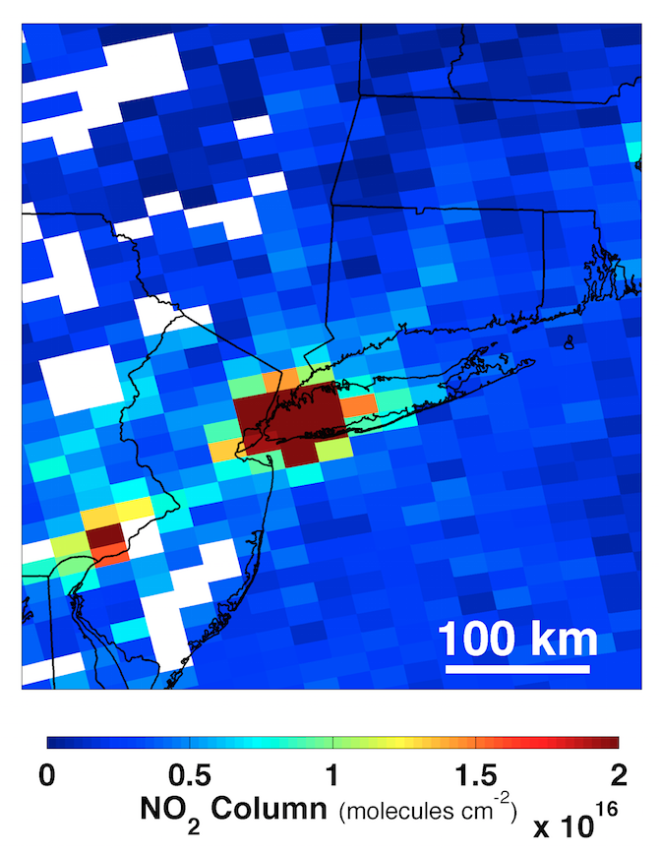
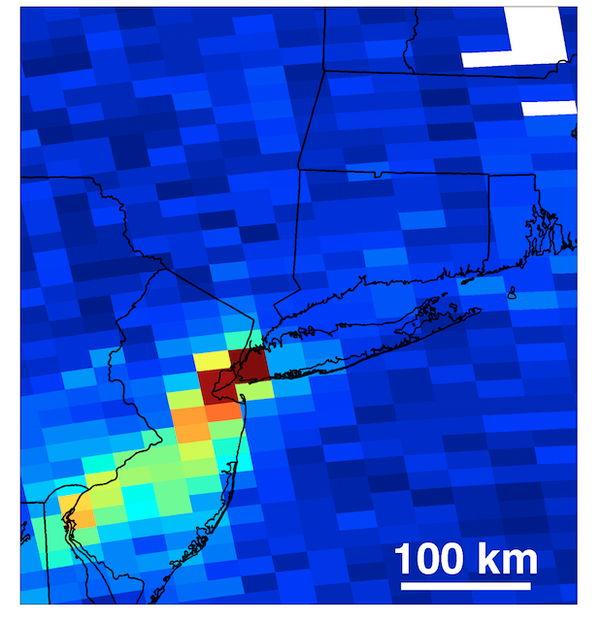
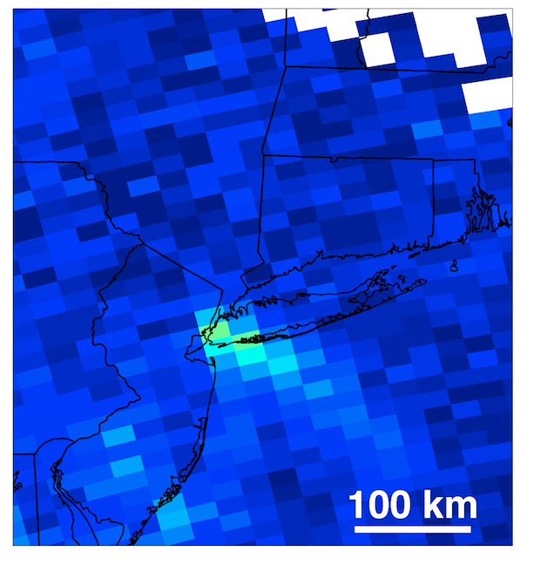
There is incredibly detailed information on daily variation E.g., OMI NO₂ columns over NYC
Wed., 20 July 2011
Tue., 26 July 2005
SSE winds
SW winds
Wed., 8 June 2005
Stagnant conditions
Thur., 25 Aug 2005
Sat., 23 July 2007
NE winds
Strong NW winds

Slide 7
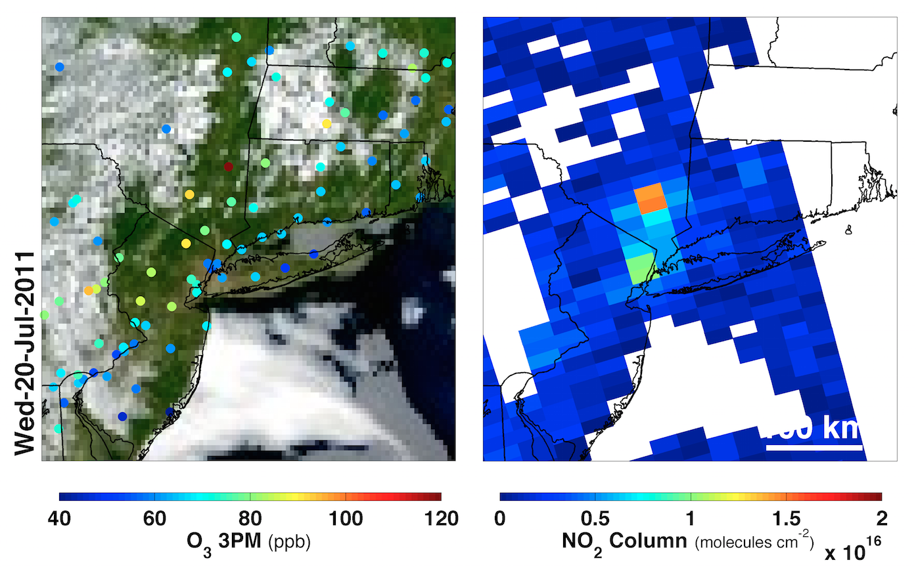
NO2 column provides information on precursor emissions and transport: Poughkeepsie O3 at 3PM - 120 ppb, NYC ~ 60 ppb
Wednesday 20 July 2011
NO_{x} Emission
NO₂ Columns
NO_{x} removal
+NO₃ PM
VOC, oxidant
chemistry
13 km hr⁻¹
Ozone production
-- Identify high priority data segments (geographic, spectral) necessary to generate near real time NO2 products for use in statistical or dynamical O3 forecast models

Slide 8
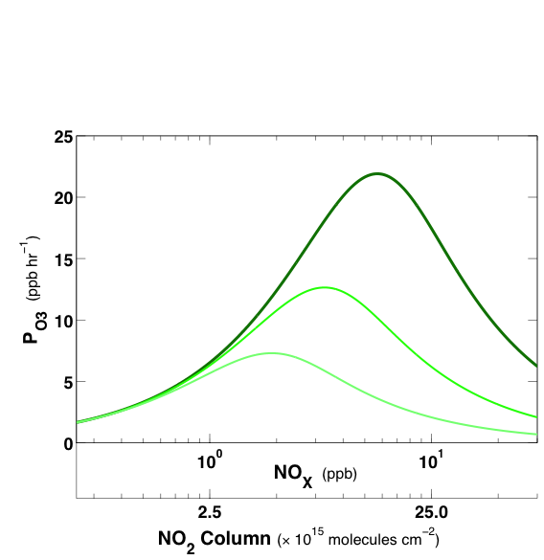
Ozone production (P_{O3}) depends on
1) NOx
2) VOC (correlated with temperature)
More VOC
Biogenic VOC ~ Temperature
What information can currently available measurements of NO2 columns provide on surface O3 exposure?

Slide 9
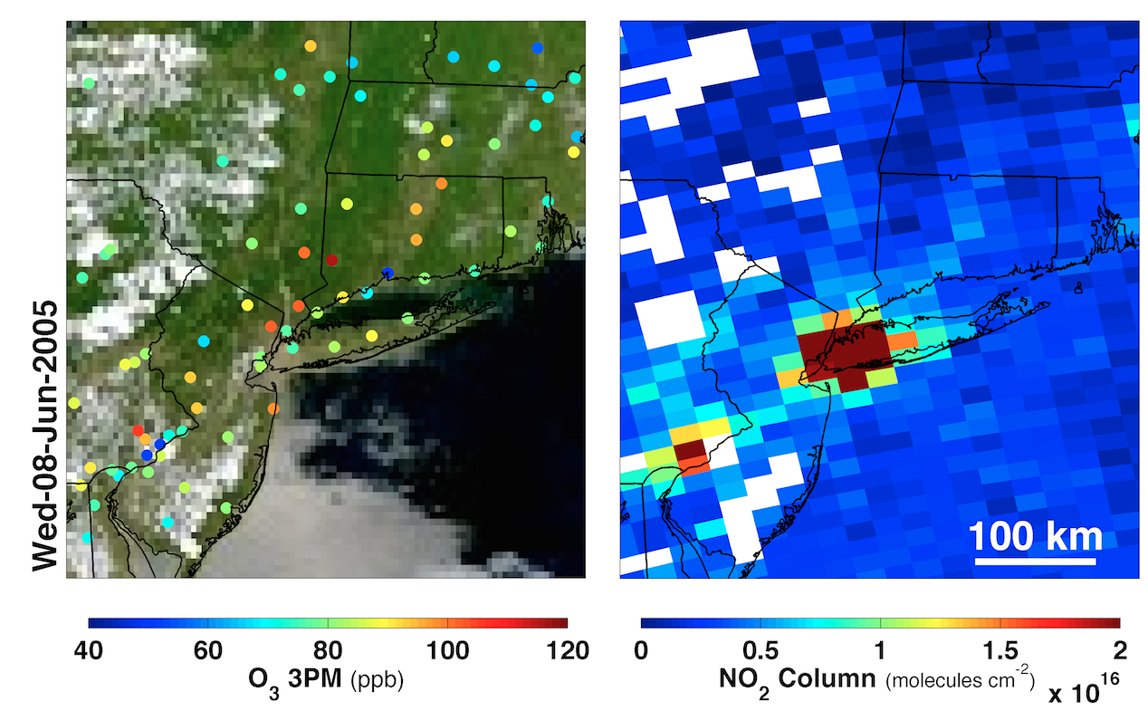
NYC– stagnant winds, large NO₂ columns, Hot temperatures: slow net P_{O3} in NYC, fast P_{O3} at edge
6 km hr⁻¹
T_{1PM} = 31° C

Slide 10
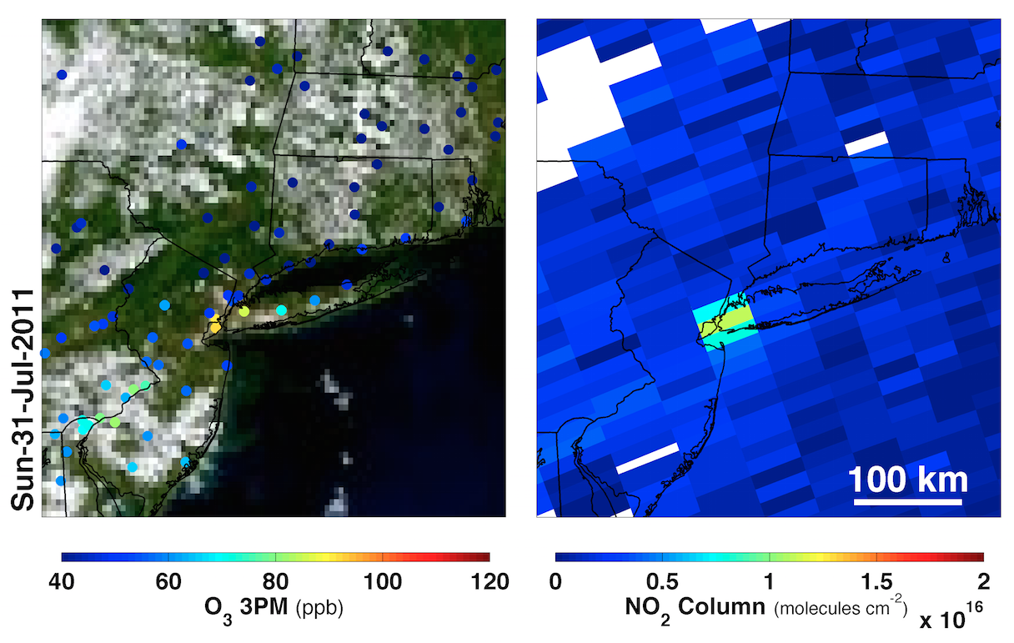
NYC – stagnant winds, intermediate NO₂ columns, warm temperatures: very fast local P_{O3}
3 km hr⁻¹
T_{1PM} = 28° C

Slide 11
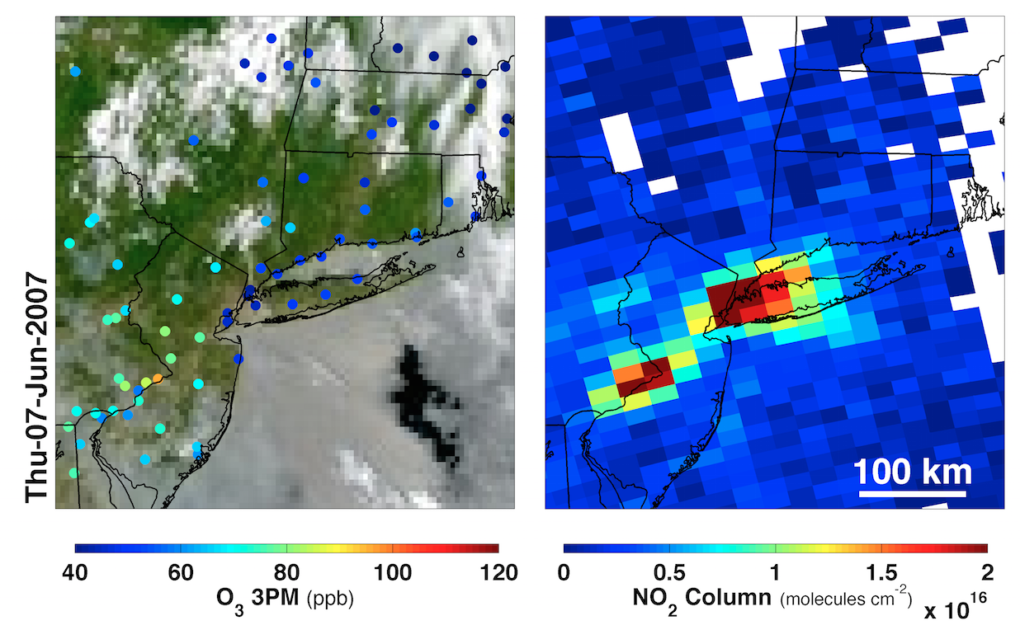
NYC– stagnant winds, large NO₂ columns, cold temperatures: slow local P_{O3}, net local O₃ destruction
4 km hr⁻¹
T_{1PM}=19° C

Slide 12
DISCOVER-AQ: Initial glimpses at the monitoring network of the future

Slide 13
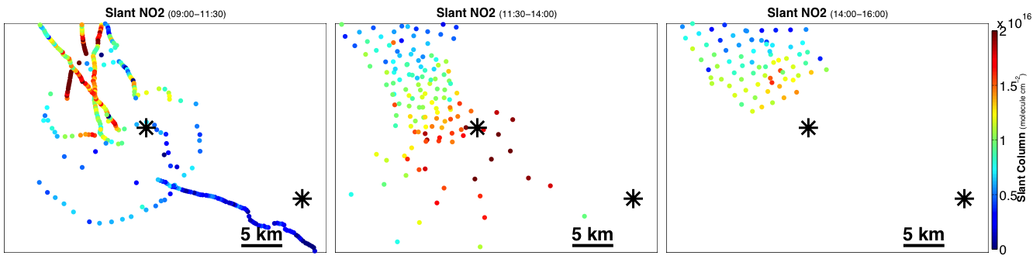
ACAM (“TEMPO flight simulator”)
Bakersfield, January 2013
Morning
Mid-day
Afternoon
Bakersfield
Bakersfield
Bakersfield
Wind
Data courtesy of NASA-GSFC (S. Janz)
SW transport of high NO2 over Bakersfield site between morning and mid-day with steep gradients (~0 – 2×10¹⁶ molecule cm⁻²)

Slide 14
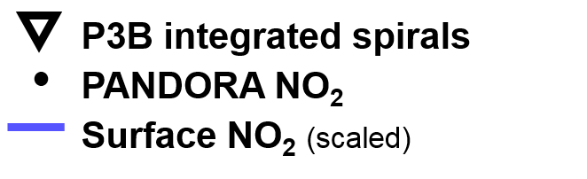
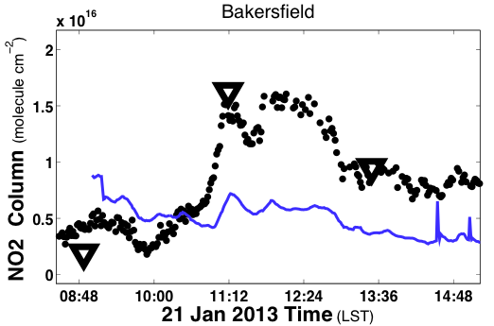
Data courtesy of USEPA (R. Long), NCAR (A. Weinheimer) and NASA‑GSFC (J. Herman)
P3B integrated spirals
PANDORA NO₂
Surface NO₂ (scaled)
PANDORA NO2 columns (●) and integrated P3B NO₂ profiles (▼) are consistent with ACAM slant NO2 observations.
The relationship of column (●) and surface NO₂ ( —, scaled) highlights impacts of boundary layer growth.

Slide 15
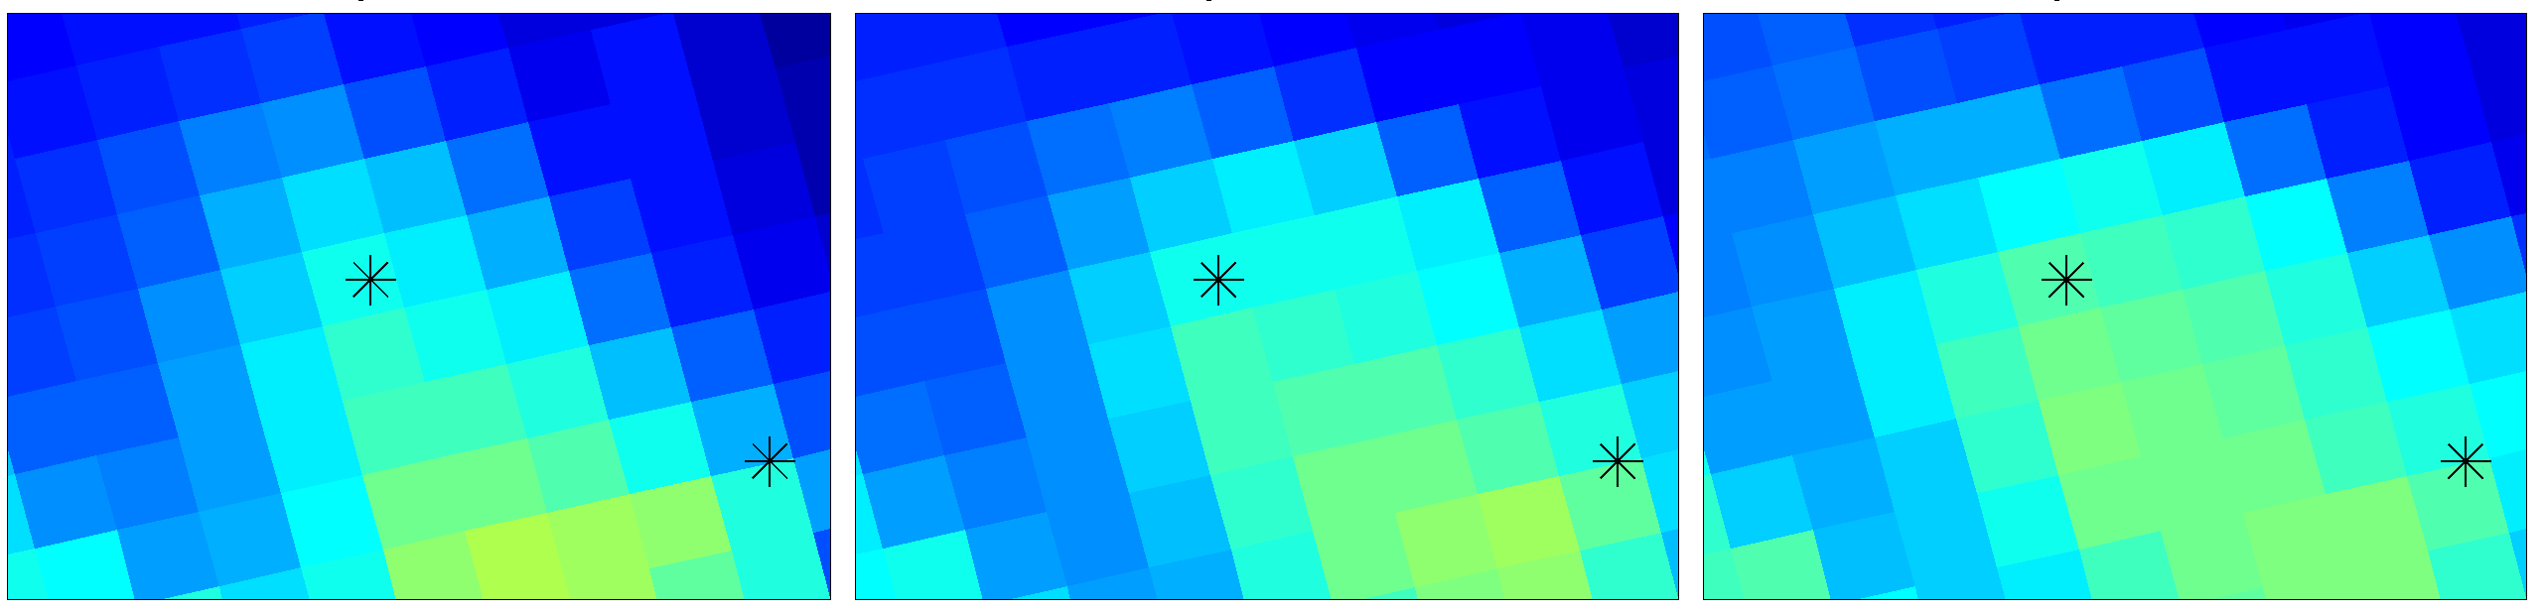
CMAQv5.1/4KM does not capture spatial variation
-- NO2 columns provide extremely detailed information on pollutant transport
-- Need to combine chemical and met reanalysis?
Morning
Mid-day
Afternoon
Bakersfield
Bakersfield
Bakersfield
Wind
Data courtesy of NASA-GSFC (S. Janz)
CMAQv5.1/4km
Bakersfield
Bakersfield
Bakersfield
Courtesy of EPA/NERL/CED

Slide 16
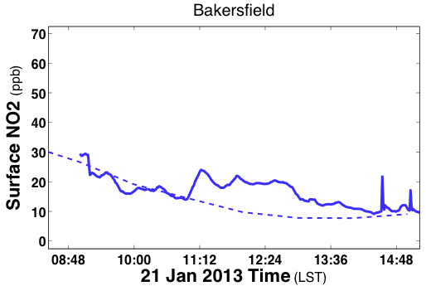
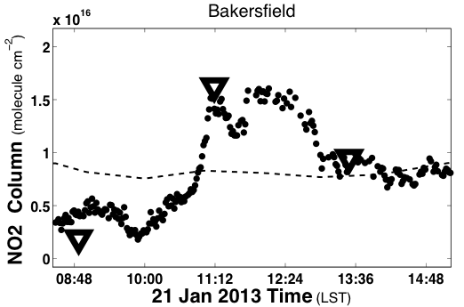
Simulated
Observed
Highlights the limitations of evaluating model performance using surface data alone (top), particularly in conditions where mixing (or lack of mixing) are difficult to simulate
Simulated
Observed

Slide 17
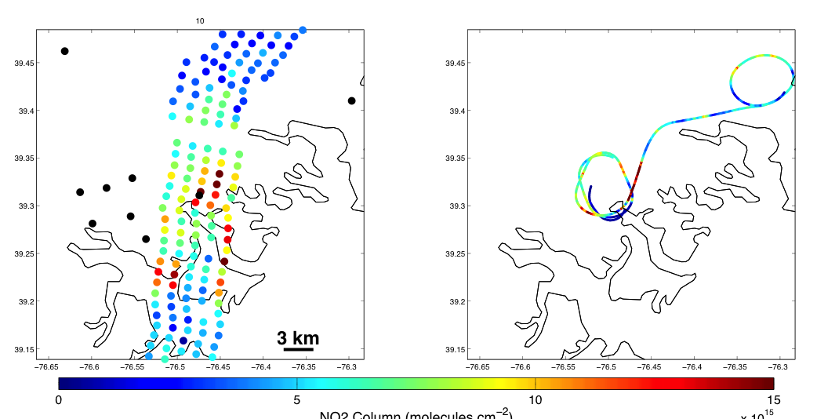
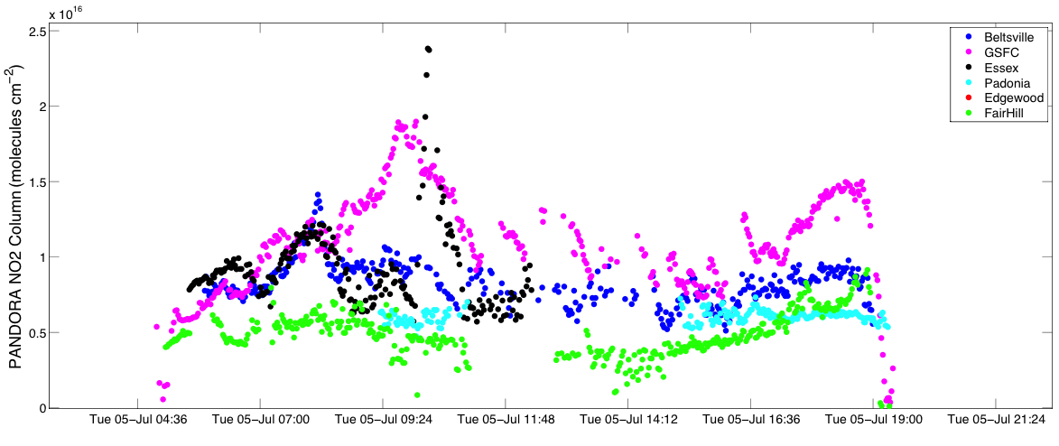
ACAM NOx Emission/transport monitoring capabilities can go down to minute-to-minute time scale.
Essex, MD, DAQ-Maryland
Tuesday, 5 July 2011
A data-driven phonebook? Local AQ managers are provided an automated list of potentially relevant stakeholders based on TEMPO measurements
~30 minute NO2 column enhancement
observed by PANDORA over Essex at 10:15 AM
ACAM NO2 Column
10 – 10:15 AM
P3B in situ NO2 spiral scaled to column (ppbx3e15)
10 – 10:15 AM
Essex site
Essex site

Slide 18
Conclusions
Air quality managers want information on causes of exceedance events - daily variations, local scales
  See aqast.wisc.edu for AQAST engagement of AQ managers with current resources on East US pollution episodes
DISCOVER-AQ ground and satellite simulator resources provide an initial glimpse of monitoring network of future - column, surface and model needs
Met reanalysis/forecast systems are not optimized for scales of observations that will be available

Slide 19
Recommendations to data providers
Include measurements and expected values of well understood species (e.g., O4 column, O2 column, Ring “column”) in trace gas level 2 and 3 products.
Identify high priority data segments for faster response forecasting needs.
Compute column quantities of NO2 and HCHO (including loss and production terms) as standard suite of model results

Slide 20
Extras

Slide 21
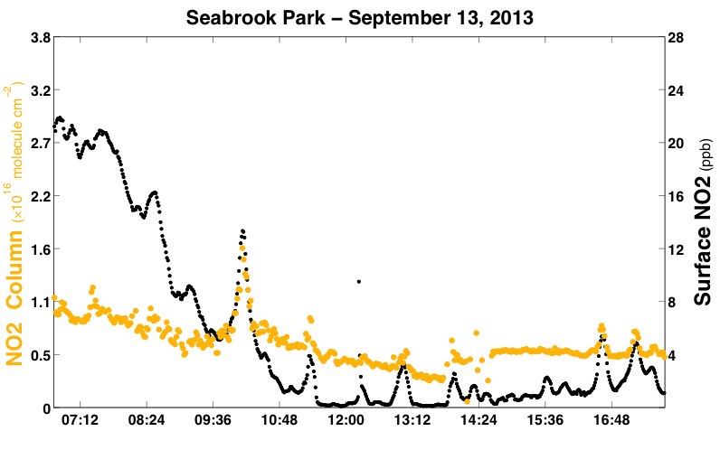
DISCOVER-AQ Houston
PANDORA NO2 column
EPA CAPS NO2
What is the relationship between surface exposure and column concentrations?
Data courtesy of USEPA (R. Long) and NASA-GSFC (J. Herman)
Local Standard Time

Slide 22
What is the relationship of NO₂ column (molecules cm²) to NO_{X} emissions (tons / day)?
Labadie PP: 27 tons/day * (2000 lbs/tons) / (2.2 lbs/kg) / (0.044 kg/mole) * (6.02e23 molecules/mole) / (1e10 cm^2/ km^2) / (24 hours/day) / (50x50 km^2) * (4 hour lifetime) *0.75 NO2:NOx
~ 1.7 × 10¹⁵ molecules cm²
OMI daily measurement 1σ Noise:
~ 1× 10¹⁵ molecules cm²

Slide 23
OMI NASA-SP and DOMINO Validation:
One possible stakeholder takeaway:
Factor of 2 “uncertainty”
2008
NASA Standard Product
vs INTEX-B NO2
Slope: 0.86
Y-intercept: 0.14 × 10¹⁶ cm⁻²
DOMINO
vs INTEX-B NO2
Slope: 1.68
Y-intercept: -0.59 × 10¹⁶ cm⁻²

Slide 24
Bucsela et al., 2013 ( panel c – latest version)

Slide 25
Russell et al., 2011 ( before SP and DOMINO updates)

