Slide 1
Global and regional air quality forecasting and assimilation relevant to the TEMPO mission
Richard Ménard, Didier Davignon*, Christ McLinden, Jean de GrandPré,
Yves Rochon, Alain Robichaud, and several others
Air Quality Research Division, (*) Canadian Meteorological Center
1st TEMPO Application Workshop, University of Alabama, Hunstville, June 12, 2016

Slide 2
Modeling and assimilation approach used in Canada
Use an integrated / unified modeling and assimilation approach for meteorology and chemistry
Same model that is used for meteorology and chemistry
Same model that is used for global and regional applications
The assimilation system (EnVar: hybrid) used for
meteorology and for chemistry is similar
Present : Chemistry: static covariances
Meteorology : hybrid (static + EnKF 256 members 512
Future (4 years) :
Chemistry long-lived (CO2, linearized chemistry) : hybrid (static + EnKF)
Chemistry short-lived: hybrid (static + climatological ensembles)
Harmonize the remote sensing with our modeling and assimilation components (e.g. AMF from GEM-MACH)

Slide 3
Ensembles: transport of tracer : Correlation after 5 days
N = 20

Slide 4
Ensembles: transport of tracer : Correlation after 5 days
N = 100

Slide 5
Ensembles: transport of tracer : Correlation after 5 days
N = 500

Slide 6
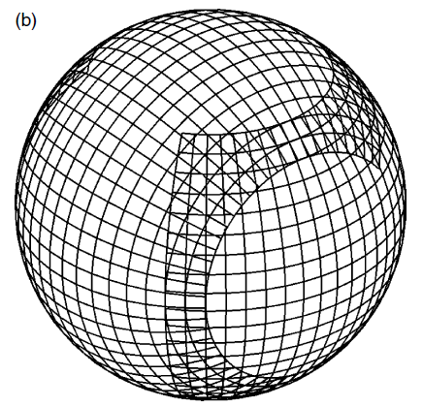
GEM Canadian NWP model GEM-MACH GEM with online chemistry
Meteorological model GEM (25 km)
regional 10 km
GEM-Regional
SRPDQA-016
Grid projection | Rotated Lat/Lon
Time step | 300 s for meteorology; 900 s for chemistry
Horizontal grid-spacing | Δx=10 km (528x708)
Model top | 80 vertical levels to 0.1 hPa (~60 km)

Slide 7
Overview of current systems
GEM-MACH Regional (10 km) - Operational
Operational AQ forecasting
Wildfire emissions
Air Quality Health Index (AQHI)
Analyses using AirNow observations, derived AQHI maps
Long-term analysis and its effect on human health
AQ Analyses at 2.5 km (operational for the PanAm games)
GEM Global NWP (25 km) – Operational in 2017
Linearized ozone chemistry online (strato only) with NWP model.
with/without radiative coupling
UV-Index forecasting
GEM-MACH Global (100km) – In R&D
Tropo-strato version of the GEM-MACH regional but with linearized O3
chemistry in the stratosphere

Slide 8
GEM-MACH10 – Regional Air Quality Deterministic Prediction System
r100/r112
Pre-calculated
Execution of 00, 12 UTC runs
(GEM-regional)
SMOKE
(emission
processing)
gm00/gm12
Piloting fields
(meteorology)
Chemical initial conditions
(from previous gm)
Emissions
database
Model Output:
48-h forecast
O₃, NO₂, PM_{2.5} SO₂, NO, PM₁₀
+
Meteorological
fields
GEM-MACH
Notes:
What’s important to note b/w these 2 slides is that:
1- We are not proposing a chnage to the regional model. Still a separate run.
2- Most of the pieces of the puzzle will change so this is major change in infrastructure.

Slide 9
GEM-MACH Wildfire Project
FireWork framework (Pavlovic et al. 2016, JA&WMA)
Fire Information from AVHRR/MODIS
USA
Canada
CWFIS
(Cdn Wildland
Fire Information
System)
CWFIS
(Cdn Wildland
Fire Information
System)
Weather model output (GEM)
BlueSky FEPS only
Emissions (SMOKE)
BlueSky FEPS only
GEM-MACH

Slide 10
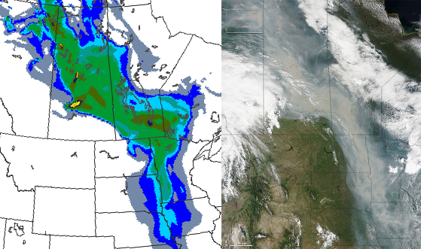
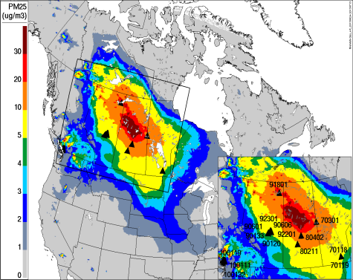
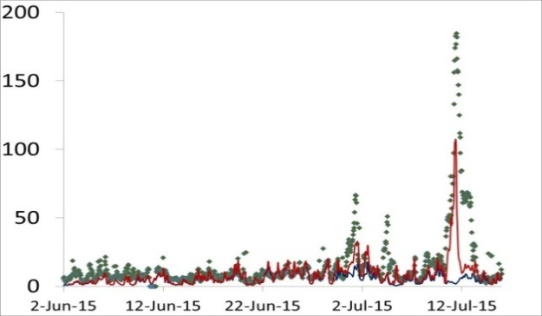
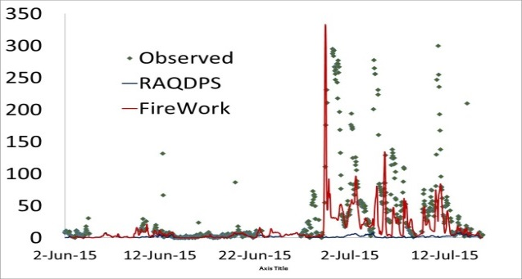
June 24th – July 15th 2015 Case
Le 29 juin, une "rivière de fumée" a été observée entre le NO du Canada et le centre des ÉU. FireWork a bien performé pour prévoir la région affecté.
Contribution des feux de forêt aux PM_{2.5} à la surface , prévue par FireWork 2015-06-28 12utc
valide à 29 juin à 12UTC.
June 29th,2015
Source: NASA Earth Observatory
http://earthobservatory.nasa.gov
Validation against observation
Contribution to surface
Edmonton, AL
(averaged of 9 stations)
Prince Albert, SK
(station ID 80402)

Slide 11
FireWork partners/clients
US Air
Resource Advisors
SUPREME Système de surveillance et de prévention des impacts sanitaires des événements météorologiques extrêmes
BlueSky Team
Canadian Wildland Fire Information System

Slide 12
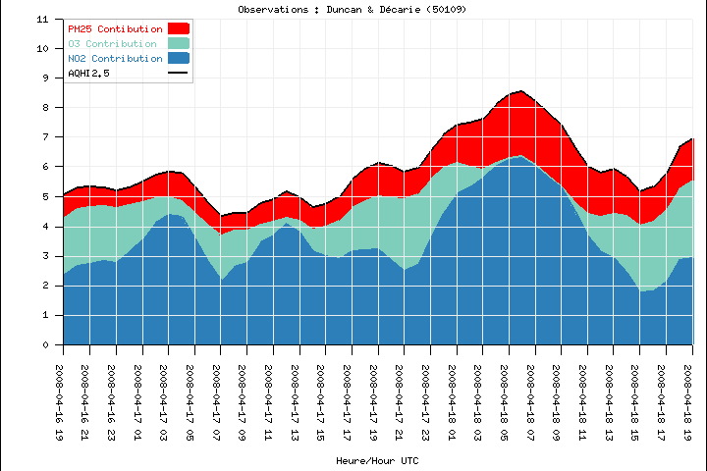
Canadian Air Quality Health Index (AQHI) (Stieb et al. 2008, JA&WMA)
Ten year old program that has evolved from an O₃-only forecast in Eastern Canada to a Canada-wide O₃, NO₂, PM_{2.5} forecast program
Forecast is communicated in most areas as an Air Quality Health Index (AQHI)
AQHI = 10/10.4×100×[(exp(0.000871[NO₂])-1)
+(exp(0.000537[O₃]) -1)+(exp(0.000487[PM_{2.5}]) -1)]
10 point scale that links air quality to the health risk associated with exposure to a 3 pollutant mixture
Developed by Health Canada (Stieb et al., 2008, JA&WMA ) from Canadian multi-city mortality/morbidity studies of short term health effects and AQ data from the Canadian National Air Pollution Surveillance Network (NAPS)
Notes:
Canadian program is a 10 year old program that has evolved from an O3 only forecast to a Canada-wide forecast for 3 smog related pollutants
In most areas, the AQ forecast is communicated through an index which was designed by Health Canada based on Canadian mortality/morbidity studies of short-term health effects.
It combines information on the 3 pollutants: O3, PM2.5 and NO2, to provide a forecast of the integrated health risk of exposure to the pollutant mix.

Slide 13
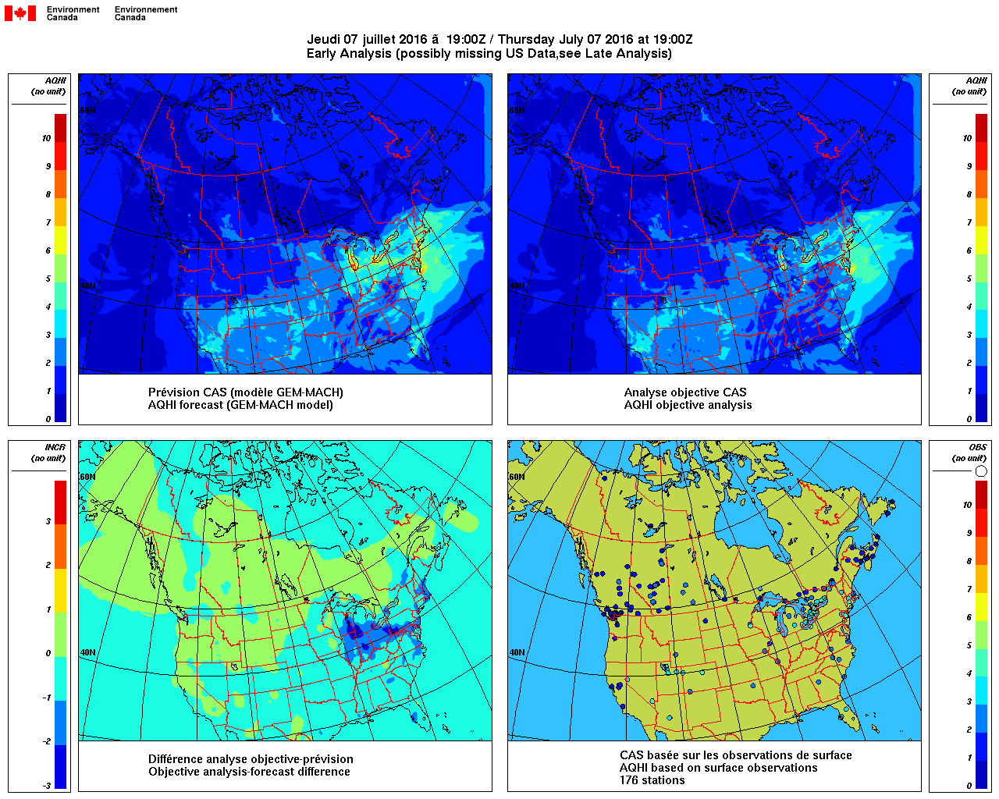
AQHI products
Monitoring – based on observations of O₃, NO₂, and PM_{2.5}
Forecast at observation sites. GEM-MACH forecast corrected by model output statistics.
Maps of AQHI based on analyses of O₃, NO₂, and PM_{2.5}
(Robichaud et al. 2015, Air Qual Atmos Health, DOI 10.1007/s11869-015-0385-9

Slide 14
Optimum Interpolation AQ analyses
Operational since 2013 (experimental since 2003)
(Ménard and Robichaud 2005, ECMWF Proceedings)
O₃ and PM_{2.5}
In April 2015 we added NO, NO₂, SO₂, and PM₁₀
Optimum interpolation (OI) currently
Uses a local Hollingsworth-Lönnberg fitting to obtain error variance
Uses a parametrization of error statistics for isolated stations
Has a seasonal bias correction, based on four large regions
Next release
Maximum likelihood estimation of correlation length
Use compact support correlation models
(Ménard et al. 2016, JA&WMA)
Use hybrid error statistics. Locally averaged H-L or Desroziers in
observation space and ensemble of model runs
Run in assimilation mode for (at least) verification

Slide 15
Applications : Health effects
10 year AQ analyses using AirNow CHRONOS and GEM-MACH
Robichaud et Ménard, 2014, Atmos. Chem. Phys., 14, 1769-1800
Ambient PM_{2.5}, O₃, and NO₂ Exposures and Associations
with Mortality over 16 Years of Follow-Up in the
Canadian Census Health and Environment Cohort (CanCHEC)
Crouze et al. (2015), Environ. Health Perspect., 123, 1180-1186
The Canadian Urban Environmental (CANUE) Health Research Consortium
Jeff Brook (PI) (ECCC and UofT) with 15 Canadian Universities,
Federal, Provincial and Local Governments.
Develop an easy access geospatial data server (e.g. Google Earth)
to support quantitative research on the effect urban environment
on health. Data linked to postal codes will contain information
on numerous metrics, NDVI, local climatic zones, building density, land use,
noise level, air pollution, greenspace, walkability. Data from 1980’s up to now.
GEM 10 km reanalysis since 1979. AQ rerun with GEM-MACH and AQ OI
(going back at least 2001) is being considered

Slide 16
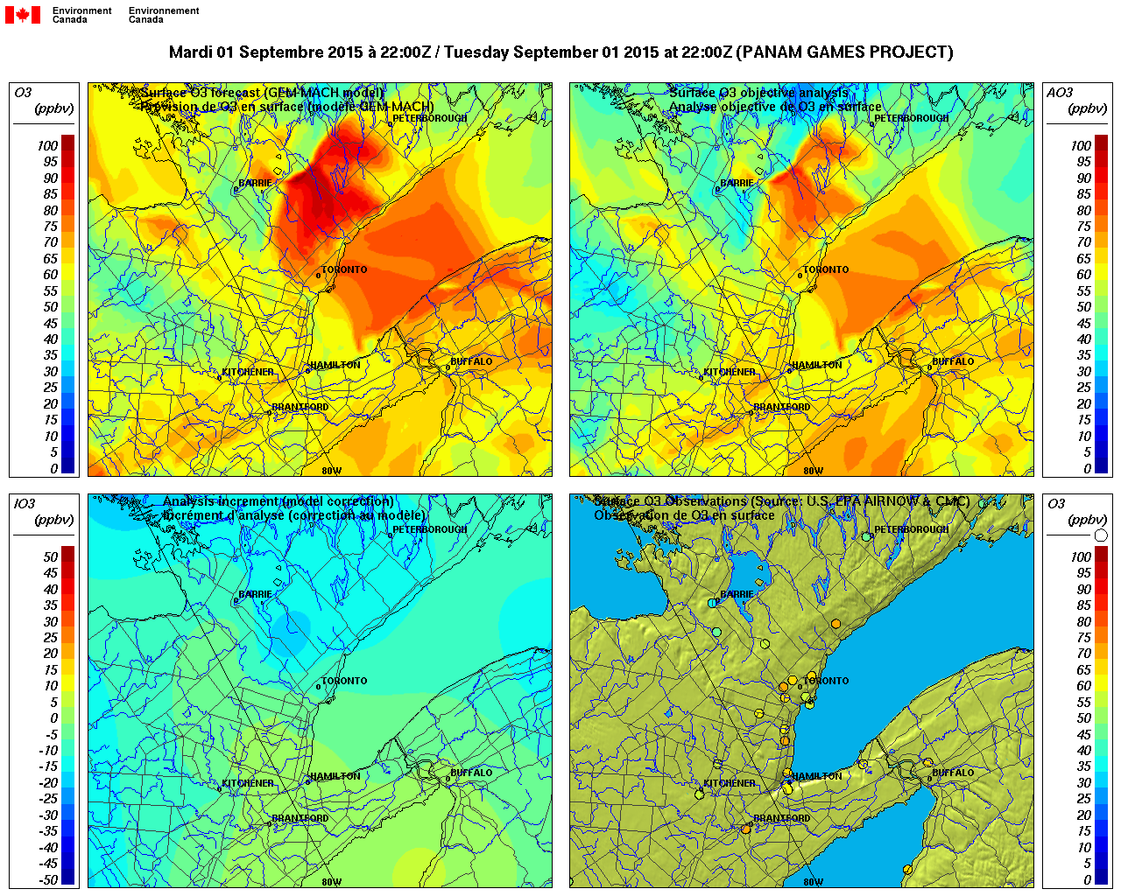
2.5 km AQ analyses (PanAm Games)
ozone
GM
OA
AI
OBS

Slide 17
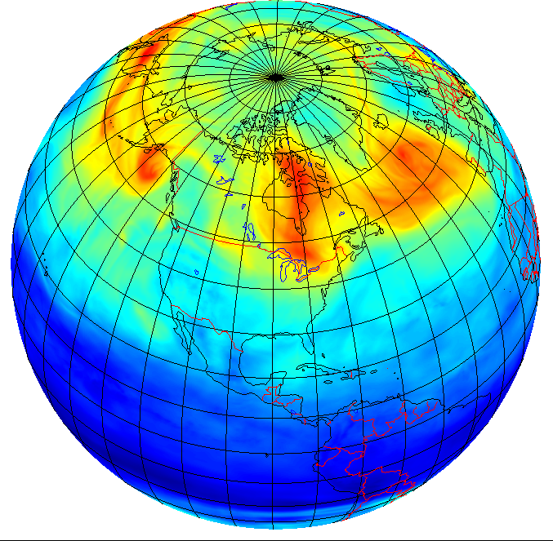
GEM NWP Global with LINOZ
LINOZ is a linearized ozone chemistry (McLinden et al. 2000, JGR)
3D-Var-Chem
Spectral formulation as in meteorology
Could use hybrid error covariances from ensembles
Estimation of error variances
based on Desroziers
Real time observation
GOME2, OMPS
Produces UV Index
Assimilation of total column GOME2 O₃ at 33 km

Slide 18
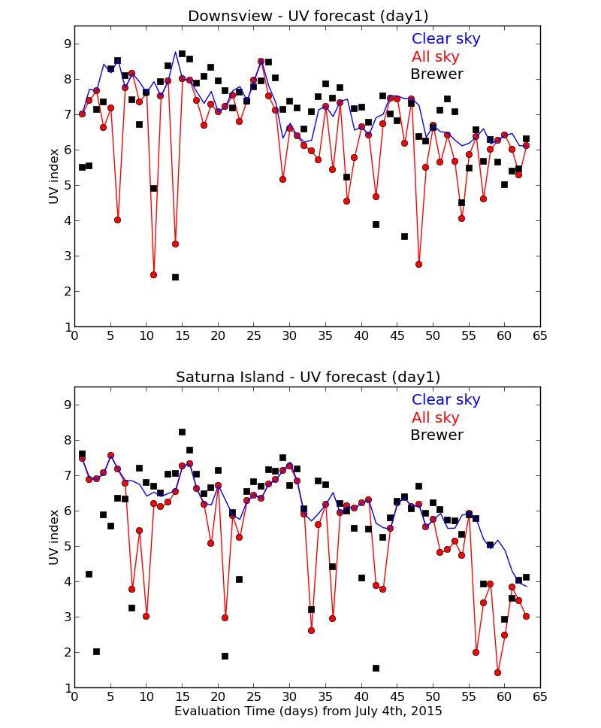
Verification of the maximum UV Index in a day against Brewers
Clouds from model GEM
UV index based on
radiative calculation
using 4 broad bands
UV-B (280-294)
(294-310)
UB-A (310-330)
(330-400)

Slide 19
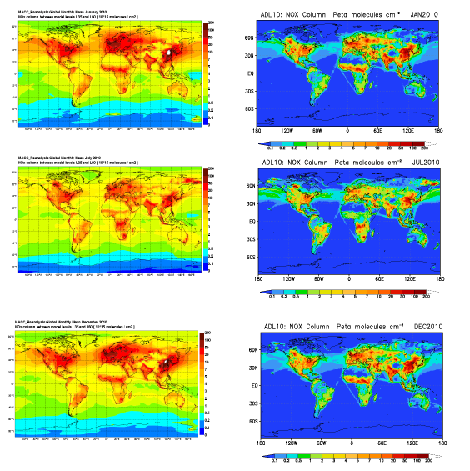
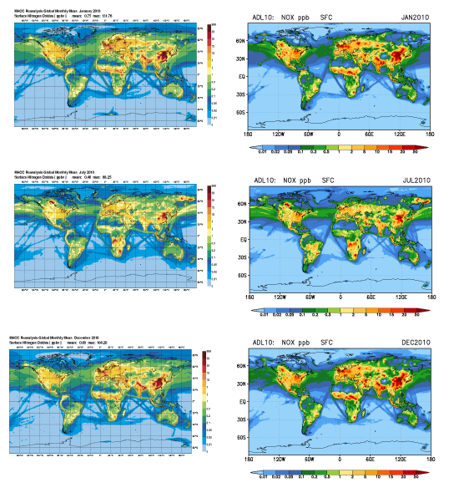
GEM MACH Global
comparison with MACC-II
Column NOx
Surface NOx

Slide 20
Where we are heading for 2020
To consolidate the 3 main systems into an hybrid EnVar
framework and port to operations
AQ applications using an hybrid with climatological ensemble of model output
NWP application using and hybrid with an Ensemble Kalman filter
The OI will be replaced by LAM spectral formulation for the static
The global NWP model will be running at 10 km
The global GEM-MACH will be running at 40 km with assimilation
of aerosols
The regional AQ model will run at 10 km with 2.5 km windows
over populated areas
Conduct an AQ reanalysis at 10 km resolution since 2001
Integrate the remote sensing for assimilation and for a correction on bottom-up emissions

Slide 21
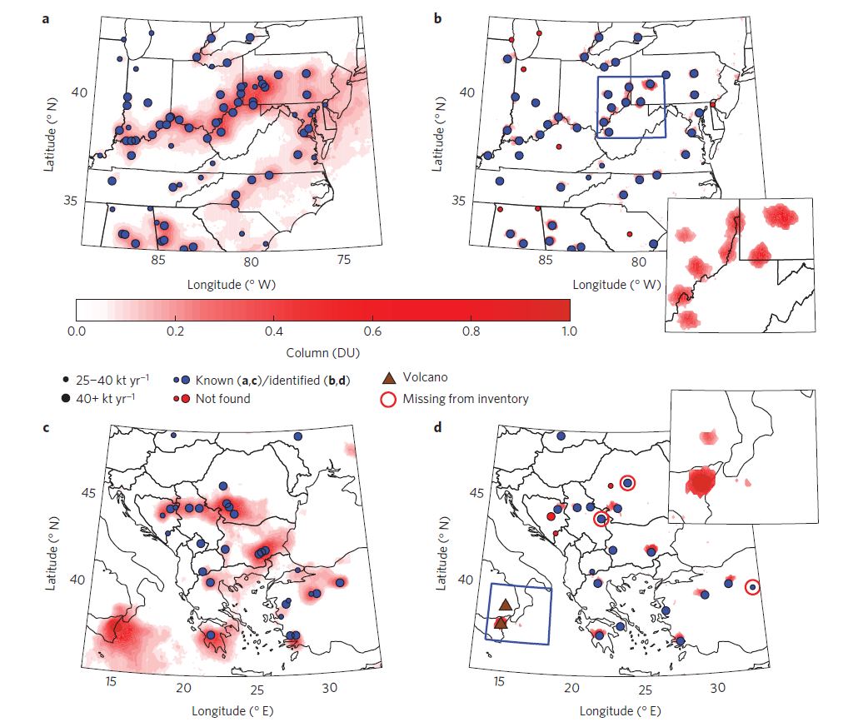
SO₂ emission retrieved from OMI (McLinden et al 2016)

Slide 22
What do you want from TEMPO? – responses from Cdn forecasters / scientists
Surface concentrations, especially for O₃, NO₂, PM_{2.5}, at highest spatial resolution possible
Also VCD / AOD products, trop/strat components, O₃ profiles (also: uncertainties, averaging kernels, detection limits, cloud information, dust, fine/coarse mode))
Multiple temporal scales (hourly, daily mean, monthly mean, annual mean)
NRT (<3 hour preferred) access to level 1 data, level 2 products; available from ECCC servers
Multiple data formats: BUFR, netcdf, ascii, kml, GIS layers; ingestible by current ECCC tools; software to read/manipulate data
Online visualization tools (e.g., https://worldview.earthdata.nasa.gov/)
Straightforward ways to present data so non-specialists can interpret
Wild fire data, hotspots and plumes updated in real time
plume heights
merged with fire products from GOES-R
Emissions at high spatial resolution

Slide 23
Thanks for your attention

Slide 24
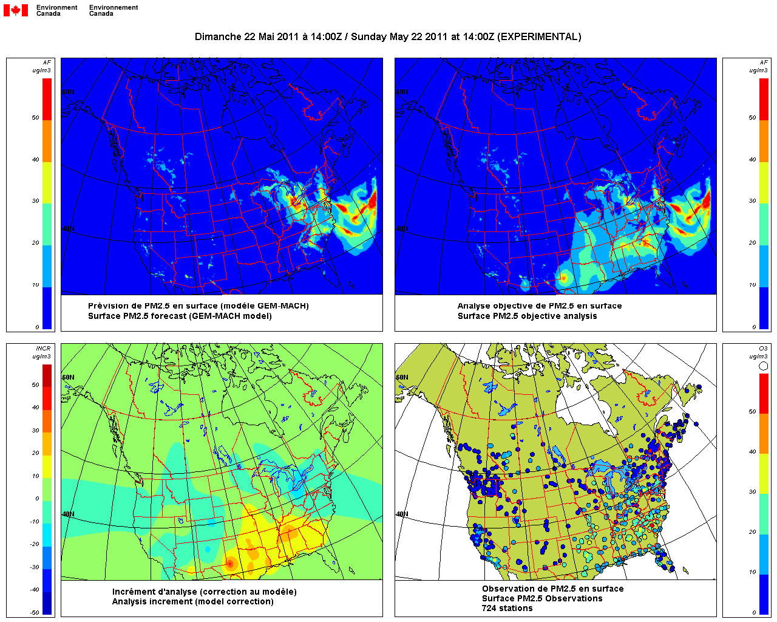
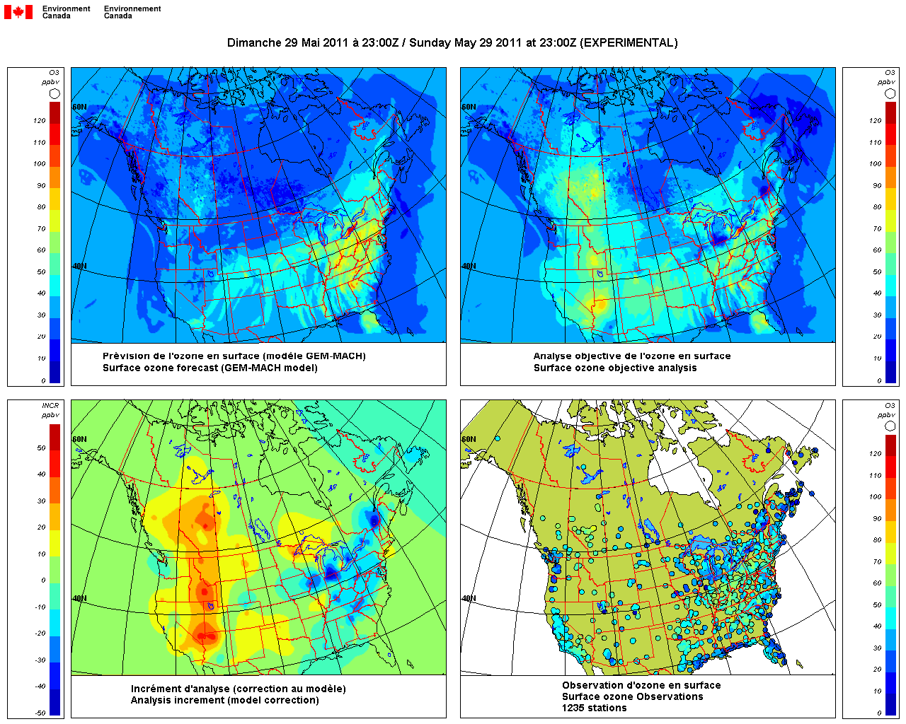
Forecast Guidance – Objective Analysis http://aqhi.cmc.ec.gc.ca
**developed at AQRI & CMC/CMDA by A. Robichaud, R. Ménard, Y. Zaitseva
Products are hourly surface analyses for O₃ and PM_{2.5} (eventually NO₂)
Generated using an improved optimum interpolation technique
Observations from Canadian networks (direct from providers) and U.S. networks (from EPA/AIRNow)
Forecasts from GEM-MACH10 as background
=> Combining together model forecasts and observations provide our best knowledge of the state of the atmosphere.
Ozone
PM2.5

Slide 25
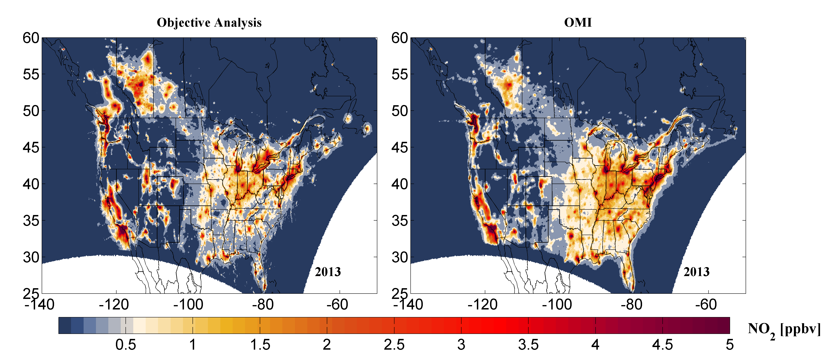
Comparison of annual mean NO₂ analyses with OMI
Need to correct for NOz interference in surface measurements
(From Lamsal et al., 2010)

Slide 26
Objectives of the Canadian operational air quality forecast program
The Air Quality Health Index or (AQHI) is a scale designed in Canada to help understand the :
Impact of air quality on health.
It is a health protection tool used to make decisions to reduce short-term exposure to air pollution by adjusting activity levels during increased levels of air pollution.
The Air Quality Health Index also provides advice on how to improve air quality by proposing behavioral change to reduce the environmental footprint.
This index pays particular attention to people who are sensitive to air pollution. It provides them with advice on how to protect their health during air quality levels associated with low, moderate, high and very high health risks.

Slide 27
AQ Processes in GEM-MACH
gas-phase chemistry (ADOM-II mechanism)
Particles formation (CAM): natural emissions, nucleation, condensation, coagulation, activation, dry deposition, wet deposition
2 size bin allowed for particle size (PM2.5 et PM10)
aqueous-phase chemistry (chemistry in cloud droplets)
heterogeneous inorganic chemistry (HETV)
secondary organic aerosol formation(IAV)
dry and wet deposition of gaseous species and particles
vertical diffusion of chemical species

Slide 28
AQ Processes in GEM-MACH
input and injection of anthropogenic surface emissions and elevated emissions (incl. plume rise)
calculation and injection of biogenic emissions (BEIS3)
chemical lateral boundary conditions (for LAM)
chemical upper boundary conditions (model top)
initialization of chemical species (including cycling of chemical tracers from day to day)

Slide 29
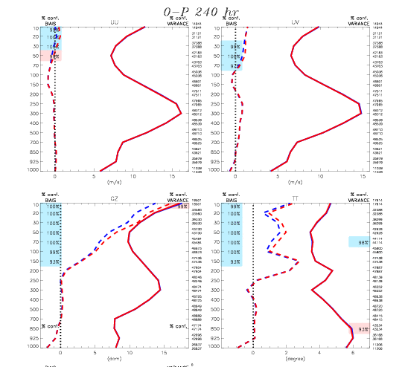
Linearized chemistry (LINOZ)
800x600 (50 km)
Jan-Feb 2009
Cooling (~.5°)
Observation minus 240-hr forecast (O-F) global mean differences (solid) and standard deviations (dashed) against radiosondes for the period Jan 1st to Feb 28th 2009 for the zonal wind component (top left), meridional wind component (top right), geopotential height (bottom left), and temperature (bottom right). Results from non-interactive (blue) and interactive (red) ensemble ozone forecasts have been launched from Y3H9CN13 analyses in which MLS std. ozone measurements have been assimilated. The squares on the left and right axis indicate respectively the levels of significance for the differences of the means and standard deviations at the level of 90 % or more.

Slide 30
October 2020
GEM-MACHv2, 10km, 96hr forecast (pilot GDPS 10 km) with updated particulate matter (i.e., aerosol) module, chemical boundary conditions from a global air quality deterministic prediction system (GAQDPS)
FireWork, 10km, 72 hr - Regional air quality assimilation using the EnVar in 3D model;
Assimilation of satellite and surface observations
Global Air Quality Deterministic Prediction System at 40 km based on GEM-MACH-Global with LINOZ - Global assimilation of aerosol optical depth, ozone, and NO2.
High-resolution 2.5km model, 24/36 hour forecast (pilot RAQDPS 10 km) - Objective analysis at 2.5 km - GEM-LINOZ as part of GEM version used for the GDPS and applied to ozone interactive forecasting;
Additional forecasting of GHGs (CH4 and N2O) if not already done. - Assimilation of ozone and GHG satellite data as part of the GDPS assimilation system with chemical data assimilation in 3D mode

