Slide 1
Quick overview of existing Early Adopter paradigms in NASA Earth Science
Doreen Neil
July 12, 2016

Slide 2
Goal of Early Adopters Programs *
The Early Adopter (EA) programs
promote applications research
to provide a fundamental understanding of
how to bring Mission data products into organizations'
policy, business, and management activities
to improve decision making efforts.
* Based on SMAP, SWOT, and ICESAT Early Adopters programs

Slide 3
Characteristics of an EA program
Early Adopters should be solicited through an informal call for nominations.
EA is an unfunded activity* formalized through an early data access agreement between the mission and the participating organization.
Each EA will be partnered with a Science Team (ST) member who is developing a product that the EA could use.
The EA will receive access to developmental products and interaction with the ST product developer, enabling the EA to understand and integrate the new products into their systems, and quantify benefits.
The ST member will gain a partner who can evaluate products and offer feedback from a functionality perspective (as well as potential calibration and validation information).
Products provided to the EA organizations could be derived from the airborne simulator or models, and should be similar in format and functionality to the anticipated products from the mission.
* The Early Adopters are not funded. NASA has provided funding to projects for EA coordinators, metrics, reports
Notes:
3

Slide 4
Who are Early Adopters?
Early Adopters are defined as those groups and individuals who:
have a direct or clearly defined need for Mission data,
who have an existing application,
who have an interest in utilizing a planned Mission product, and
who are capable of applying their own resources (funding, personnel, facilities, etc.) to demonstrate the use of Mission data for their particular system or model.
The EA takes a lead role in Mission applications research, meetings, workshops, and related activities.
The EA will use preliminary data products to emulate the structure of Mission data products.
The Mission DAAC will be used to deliver the EA products.
Notes:
4

Slide 5
What is the Goal of Early Adopters?
The goal of the Early Adopter designation is to provide individuals and groups with the unique opportunity to demonstrate the use of Mission data in the particular EA operational system or model before launch of the satellite.
Early Adopters commit to engage in pre-launch research, with specific expertise and guidance from the Mission and Applications Team
to accelerate the integration of Mission products after launch into the specific EA application,
to provide the Mission with valuable feedback on how the Mission can be used for decision support.
Some success stories follow.
Notes:
5

Slide 6
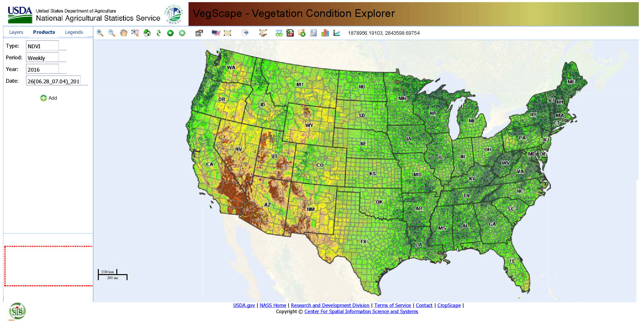
National Soil Moisture Monitoring (SMAP launched in January 2015)
The USDA National Agricultural Statistical Service has launched a web-based U.S. crop vegetation condition explorer or assessment and monitoring applications: VegScape. This web-based application has been designed to be a platform for accessing, visualizing, assessing and disseminating crop soil moisture condition derivative data products produced using SMAP data.

Slide 7
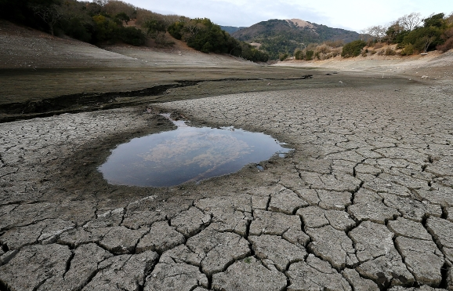
SWOT and water applications
SWOT (Surface Water and Ocean Topography) is jointly developed and managed by NASA, the French Space Agency (CNES), and the Canadian Space Agency (CSA), for launch in 2020.
Reservoir storage is poorly known and there is a lack of pervasive measurements documenting the water levels. Changes in reservoir storage may be known to governing agencies, but can be unknown to downstream neighboring communities and countries, making it impossible for communities downstream to adequately model future flow dynamics within their borders. SWOT is designed to accurately measure monthly to seasonal changes in reservoir storage. The information will be made available to water managers and other interested parties.
Model predictions (and hence drought monitoring) can be greatly enhanced through assimilation of space-based surface water observations such as those from the future AirSWOT and SWOT missions. There may be opportunities to combine surface water measurements from AirSWOT and SWOT with other satellite data and modeling (i.e., GRACE) to improve observations and predictive capabilities.

Slide 8
Examples of SMAP Early Adopter Activities *
The Canadian Land Data Assimilation System (CaLDAS): Description and Synthetic Evaluation Study-- developed at the Meteorological Research Division of Environment Canada to better represent the land surface initial states in environmental prediction and assimilation systems, featuring the use of improved precipitation forcing through the assimilation of precipitation observations.
Modeling Regional Crop Yield and Irrigation Demand Using SMAP Type of Soil Moisture Data--Georgia Institute of Technology, Numerical experiments demonstrate that incorporating the SMAP data into the agricultural model reduces uncertainty of modeled crop yields
Ingestion of Simulated SMAP L3 Soil Moisture Data into Military Maneuver Planning--U.S. Army Corps of Engineers, Soil strengths and resulting vehicle speeds will have the greatest effect at low vehicle speeds.
Assessing the Impact of L-Band Observations on Drought and Flood Risk Estimation: A Decision-Theoretic Approach in an OSSE Environment--a soil moisture OSSE that employs simulated L-band measurements and assesses its utility toward improving drought and flood risk estimates (Earth System Science Interdisciplinary Center, College Park)
Skill and Global Trend Analysis of Soil Moisture from Reanalyses and Microwave Remote Sensing– performed by ECMWF, in-situ soil moisture measurements from 2007 to 2010 used to determine the reliability of a new, microwave-based multisatellite surface soil moisture dataset.
* Published in a special collection for SMAP in the Journal of Hydrometeorology (JHM)

Slide 9
Possibilities for TEMPO Early Adopter Activity
The following talks suggest applications in the areas of emissions estimates, crop yield, regional AQ forecast. Some possibilities:
Demonstrating Cross-Platform data use with Constellation observations, particularly with synthetic data and skill measures from OSSEs. (international partners)
Ability to link AQ forecast information with urban services like hospital emergency room staffing and urban transit. (clear public benefit)
Potential for aviation notifications (volcanic eruptions).

