Slide 1
Project Overview
Wendy Pennington, TEMPO Instrument Project Manager
July 23, 2011
(757).864.47126
Wendy.f.,pennington@nasa.gov

Slide 2
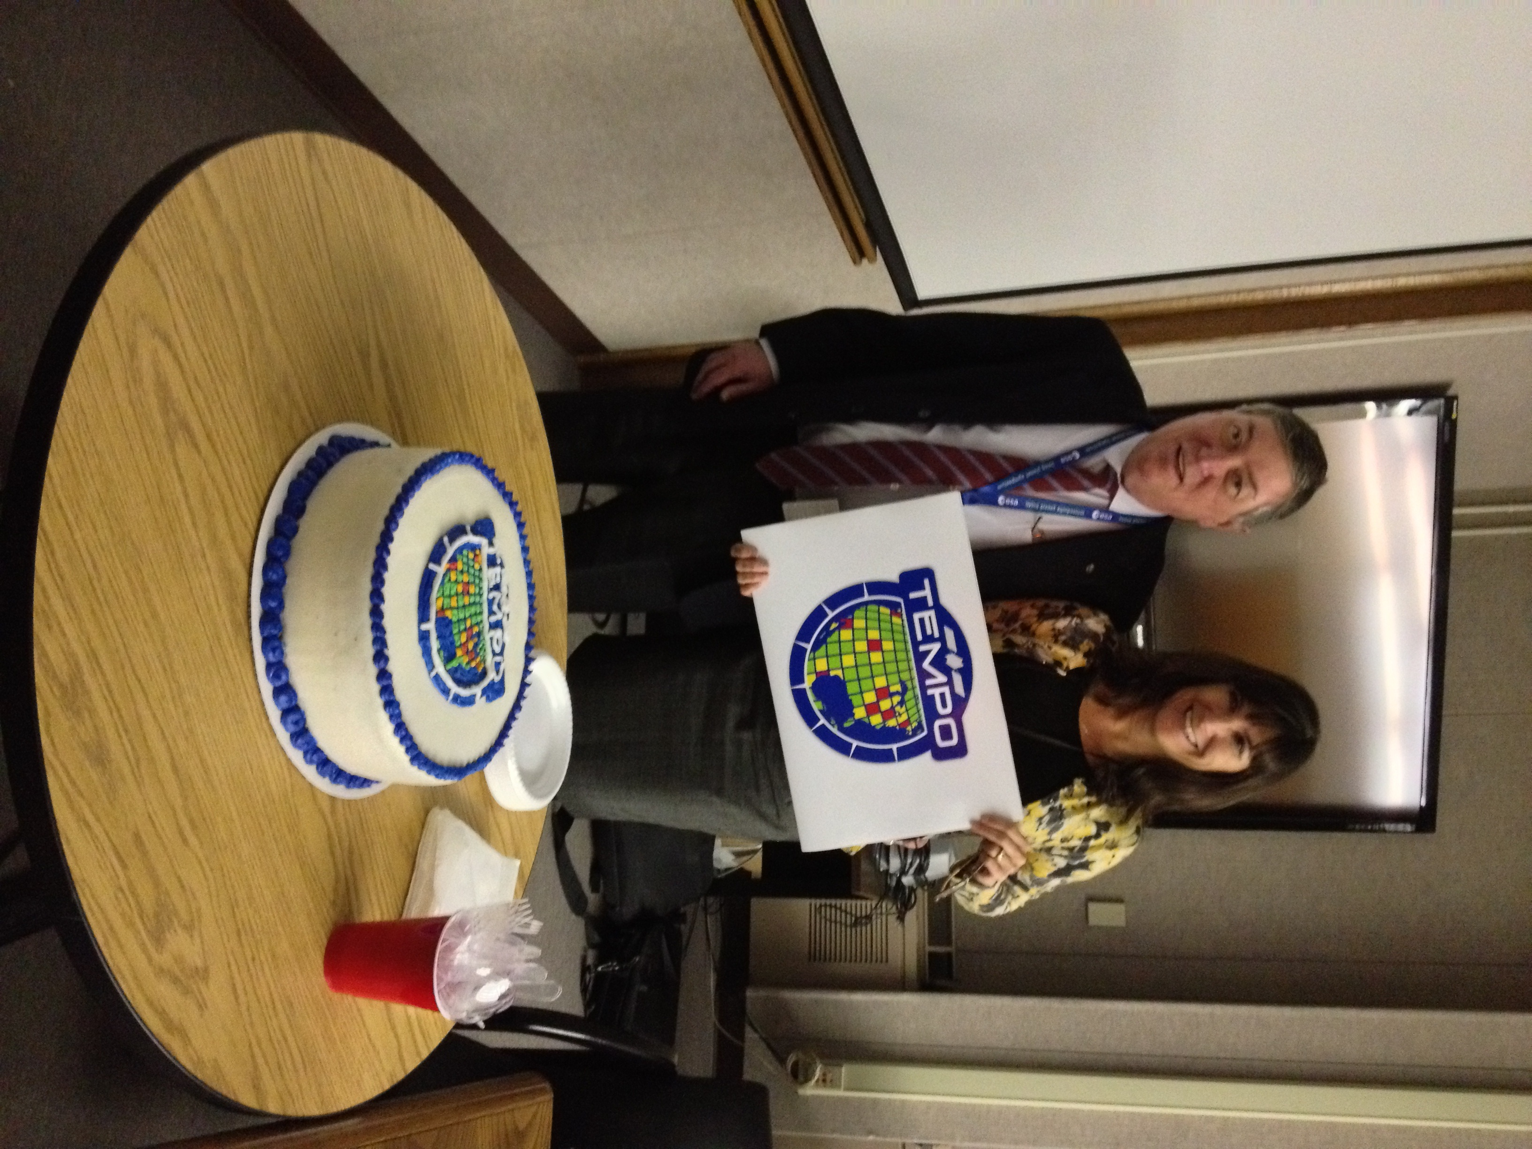
Project Management Overview
It’s about time!
February 7, 2013

Slide 3
Introductions
Project Management Team

Slide 4
Project Initiation and Key Events Timeline
November 2012 - TEMPO Selected under a one step AO EV-I1
December 2012 - NASA HQ Kickoff and debrief held
February 2013 - TEMPO held first Team Face to Face Kickoff meeting with LaRC/Ball/SAO February 2013 at Langley to develop operating relationships
May 2013 - HQ directed Langley to lead the Mission (Host Accommodations and Access) responsibility with Alan Little named as lead
May 6 2013 - Team released the Instrument contract RFP
May 22 2013 - Updated the cost phasing plan to ESSP PO
June 12 2013 - Received Ball RFP Proposal
Today-Science Team Meeting, 60 Garden Street

Slide 5
TEMPO Instrument Project
Organization
Investigation Advisory Panel
SAO:Roger Brissenden LaRC: Steve Jurczyk, Ball: Mark Bergeland
TEMPO
PI: Kelly Chance
Deputy PI: Xiong Liu
Program Administrator: Joseph Webber
SAO PM Stuart McMuldrock
Principal Investigator
Investigation Lead
  Overall investigation success
  Scientific integrity
  Algorithm Development
  et
SAO, LaRC, Ball top mgmt representation
Organizational affairs
Science Team
Algorithm Development
Validation and Analysis
Science Advisory Panel
Project Management
Project Mgr: Wendy Pennington, NASA Langley
Project Scientist: David Flittner, NASA Langley
Deputy PM: Craig Jones, COR
Deputy PM Resources: Don Shick
Programmatic and Technical Implementation
Instrument Contract Management
Science Advocacy
Schedules
Program funding reporting
Science Advocacy
Science Assessment
International Geo Constellation
Instrument Requirements
Verification and Validation
Interface Control
Systems Engineering
Project SE: David Rosenbaum
Mark Andraschko
Safety & Mission Assurance
Jose Caraballo
Product quality
Product and personal safety
Reliability
Instrument
Dennis Nicks
CE: Brian Baker
SE: Laura Lewandoski
Ground
Systems
Raid Suleiman
Instrument Operations
Raid Suleiman
Science Data Processing System
Kelly Chance
Science Communications
Alex Griswold
Flight Instrument
Spacecraft I&T Support
Instrument Ops support
Instrument Operations System
TEMPO Unique Hardware and Software
Facilities and infrastructure
Instrument Commanding
Telemetry monitoring
ATBD’s
INR
L1-L3 data products
DAAC
Public Relations
Education
Outreach
Student Collaboration*
SAO
NASA Langley
Ball

Slide 6
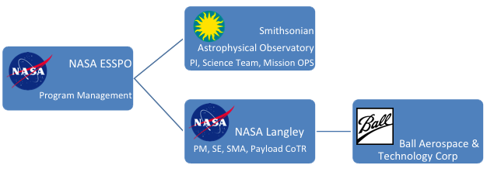
TEMPO Funding Path
Science Team, Univ.
Carr Astronautics
RT Solutions, Inc.
Subcontractors
Subcontractors
NASA GSFC
Government Science Team
NOAA
EPA

Slide 7
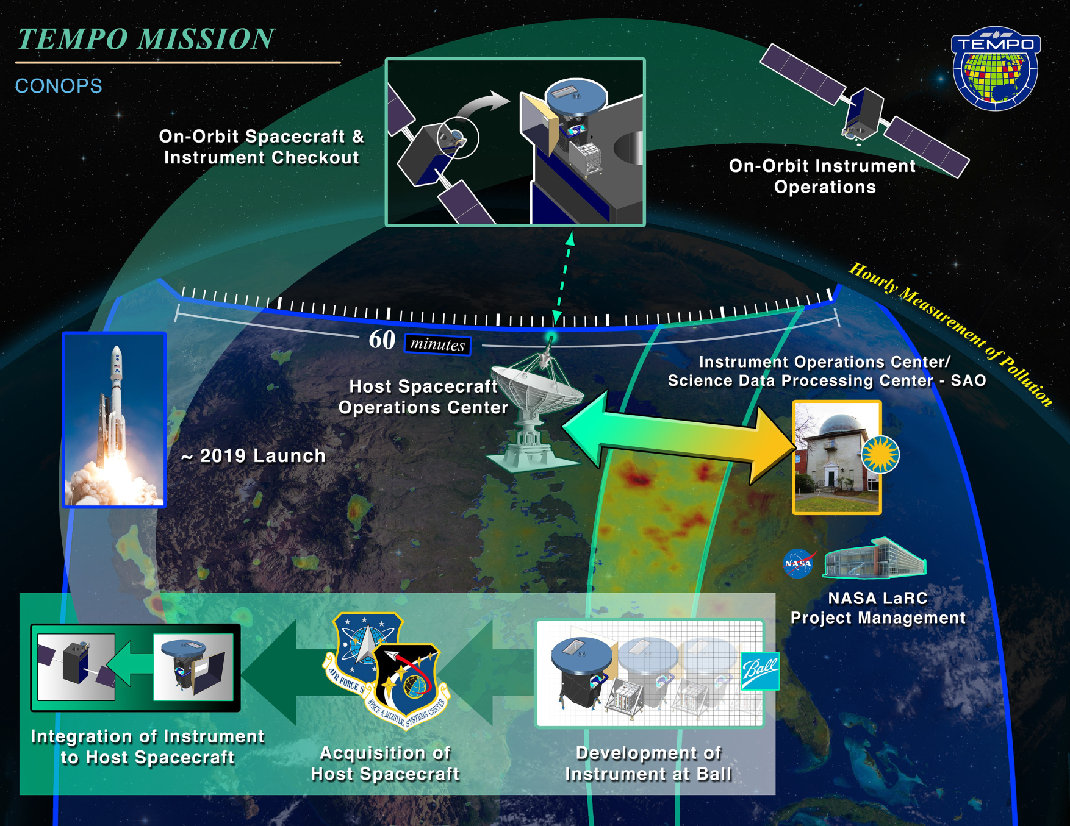
Concept of Operations

Slide 8
TEMPO System
TEMPO on Host System
Ground System Segment
Science Segment
TEMPO Instrument
Instrument Operations & Science Data Center
Instrument/Interface Control Doc
Instrument
Accommodations/Platform Interface
Launch Segment
Science Data Processing
Spacecraft Segment
S/C Ops Center
TEMPO
Instrument Project
TEMPO
Mission Project Office

Slide 9
TEMPO Communication and Decisions
ESD
Steve Voltz
Ken Jucks: PS
Sanghamitra Dutta: PE
ESSP PO
Mission Manager : Diane Hope
Chief Engineer: Randy Regan
ESSP PO
Directed Mission
Project Manager: Alan Little
Systems Engineer: Barbara Hilton
TEMPO Instrument Investigation
PI: Kelly Chance
PM: Wendy Pennington
Chief/Systems Engineer: Dave Rosenbaum
Program Level Requirements
ESD Science (AO)
Programmatic Constraints
Investigation Level 1 Requirements
Baseline/Threshold Science Requirements
Science Performance
Modeling and error budgets
Instrument Requirements
Science Data Processing req
Ground IOC req
Mission level Requirements
S/C Environments
Capabilities
Gap Accommodations provisions
Space to Ground Comm
Launch Vehicle and environments
Orbit and operations

Slide 10
Project Classification and
Compliance
Complies with Agency and Center Requirements
  Agency Guidance
    NPR 7120.5E NASA Space Flight Program and Project Management Handbook
    NPR 7123.1A NASA Systems Engineering Processes and Requirements
    NPR 8705.4 Risk Classification for NASA Payloads
  Primary Center Guidance
    LPR 7120.5 Space Flight Project Practices Handbook
    LPR 7123.1 LaRC Systems Engineering Processes and Requirements
  Category 3, Mission Class C per 8705.4(med risk, med priority, less than 2yrs)

Slide 11
Technical Issues, Concerns
S/C Interface and Environments Definition
  Mission Office has a plan to address this, but the Commercial Communications Satellite industry timeline for interaction occurs much later and is much shorter than we are used to.
Detector Operating Temperature is under evaluation
  Ball believes the current SNR, but not dark current, requirements can be met at the 5C temperature they bid/proposed.
  PI and science team recommend lower temp
  Currently studying performance impact trades
    Operating “cooler” increases test complexity and cost
Cost cap is challenging… Evaluating opportunities to reduce cost while incurring acceptable technical risk
  Technical issues managed as being highly coupled with cost (risk)

Slide 12
Upcoming
Complete Instrument Contract
  Pricing, Negotiations, Finalization/Signature ATP expect late August early September
Complete SRR/MDR Product Development
  Requirements baseline
  Requirements database development and population
  Project controlled documents
Finalize Instrument Trade Studies and Analyses

Slide 13
Draft Instrument Schedule

Slide 14
Summary
  TEMPO is a partnership
  Hosted
  Cost Capped
  On time
Thank you

Slide 16
TEMPO/GEMS Mgmt. Approach
Implement Common System Architecture and Designs to Maximum Extent Possible
  Instruments are highly similar (UV/Vis spectrometers in geosynchronous orbits)
  Leverage Efficiencies due to single NRE design activity
  Common designs/EDU and hardware (built to print), common I&T plans, GSE
  Reduced/shared Systems and Design Teams, matrixed from the Instrument Space Products Area managed under one Product Area Manager (PAM)
  Design to envelope requirements of both programs
Align Technical Requirements
  Shared/reduced Systems Engineering, common subsystem specifications
  Common requirements verification
Align TEMPO and GEMS Schedules More Effectively
  Ball will maintain single, integrated IMS
  GEMS current schedule is ~10 months ahead of TEMPO front end, catches up to about 3 months by the end
  To benefit from design phase efficiencies for common hardware, need to be more closely aligned
  I&T schedules need to be phased enough such that common GSE can be reduced

Slide 17
Organization Functions
Principal Investigator Deputy PI PM for SAO Ops Instrument Ops and Ground | Investigation Lead Overall investigation success Scientific integrity Algorithm Development Operations Center, Science Data Processing
Project Management Project Scientists Contracting Officer Representative Budget and Resources Schedule Analyst Configuration Manager Administrative support | Programmatic and Technical Implementation Instrument Contract Management, Science Advocacy Schedules Program funding reporting
Science Team | Algorithm development, validation, analysis, science advocacy

