Slide 1
TEMPO Mission Project
July 23, 2013
Project Manager: Alan Little

Slide 2
TEMPO Mission Project
TEMPO instrument selected under EVI-1
AO solicited Science, Instrument, Operations, and associated project management, systems engineering, and safety and mission assurance
NASA responsible for getting TEMPO Instrument on orbit
NASA Earth Science Division directed NASA LaRC to implement a flight project for the TEMPO satellite host

Slide 3
TEMPO Organization
ESSP PO
TEMPO
PI: Kelly Chance
Deputy PI: Xiong Liu
Program Administrator: Joseph Webber
Investigation Advisory Panel
Science Advisory Panel
Science Team
Mission Management
Mission Project Manager: Alan Little
Deputy Project Manager/Resources: Don Shick
Coordination of Mission activities
Color code
Instrument Project
Management Support
Schedule Lead: Ken Parkinson
Configuration Manager: Kennedy Delgado
Resources: Linda Moore
Risk Manager: Craig Hutchinson
Mission Project
Systems Engineering
Mission Systems Engineer: TBN
Safety & Mission Assurance
SMA Manager: Jose Caraballo
Instrument
Instrument PM: W. Pennington
Instrument DPM/COR: Craig Jones
CE: Dave Rosenbaum
Project Scientist: David Flittner
Ground
System
Lead: TBN
Mission Operations
Lead: TBN
Host Satellite
Lead: TBN
I&T
Lead: TBN

Slide 4
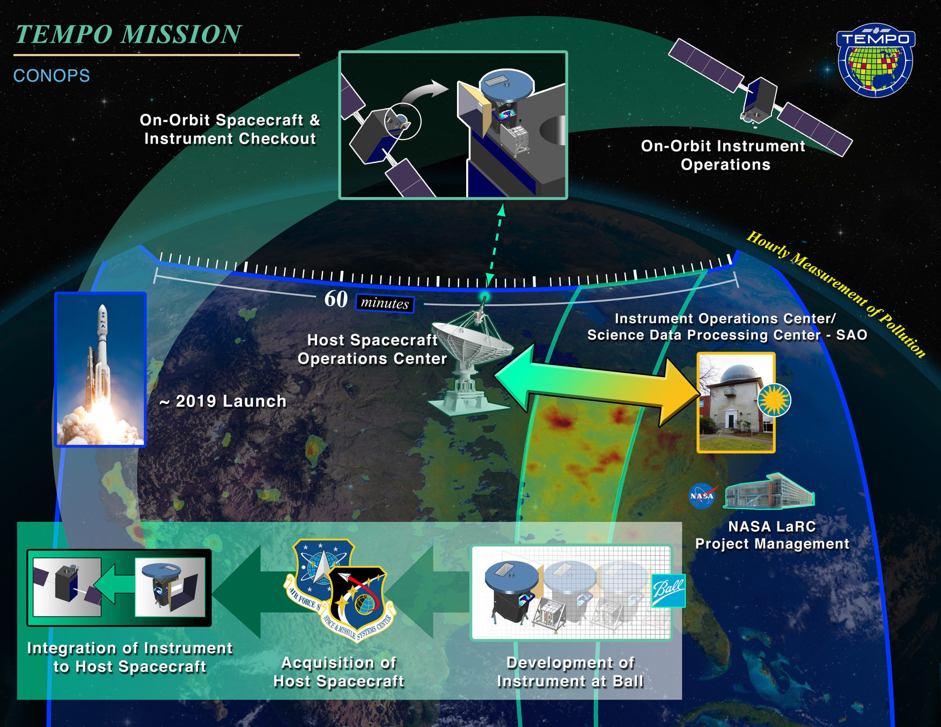
Concept of Operations

Slide 5
What is HoPS?
HoPS: Hosted Payload Solutions
Indefinite Delivery, Indefinite Quantity contract with “lanes” for LEO and GEO hosted payloads
Implemented by USAF Space and Missile Systems Center (SMC)
Fixed price contracts for Hosting
RFP for Air Force contract will be released in Q4 FY13
NASA/SMC collaboration
NASA is implementing a Memorandum of Agreement with SMC for collaboration on the HoPS contract
NASA is supporting the RFP development and proposal evaluation

Slide 6
TEMPO Accommodation Studies
TEMPO accommodation studies solicited through HoPS contract
Solicitation included with HoPS RFP
Up to four six-month studies to evaluate
Accommodation of TEMPO instrument on GEO host satellites
Address contamination, jitter
Initial draft interface control document
Identify launch opportunities that potentially meet TEMPO requirements
Coordinating with other NASA hosted payloads
Laser Communications Relay Demonstration (LCRD)
Global-scale Observations of the Limb and Disk (GOLD)

Slide 7
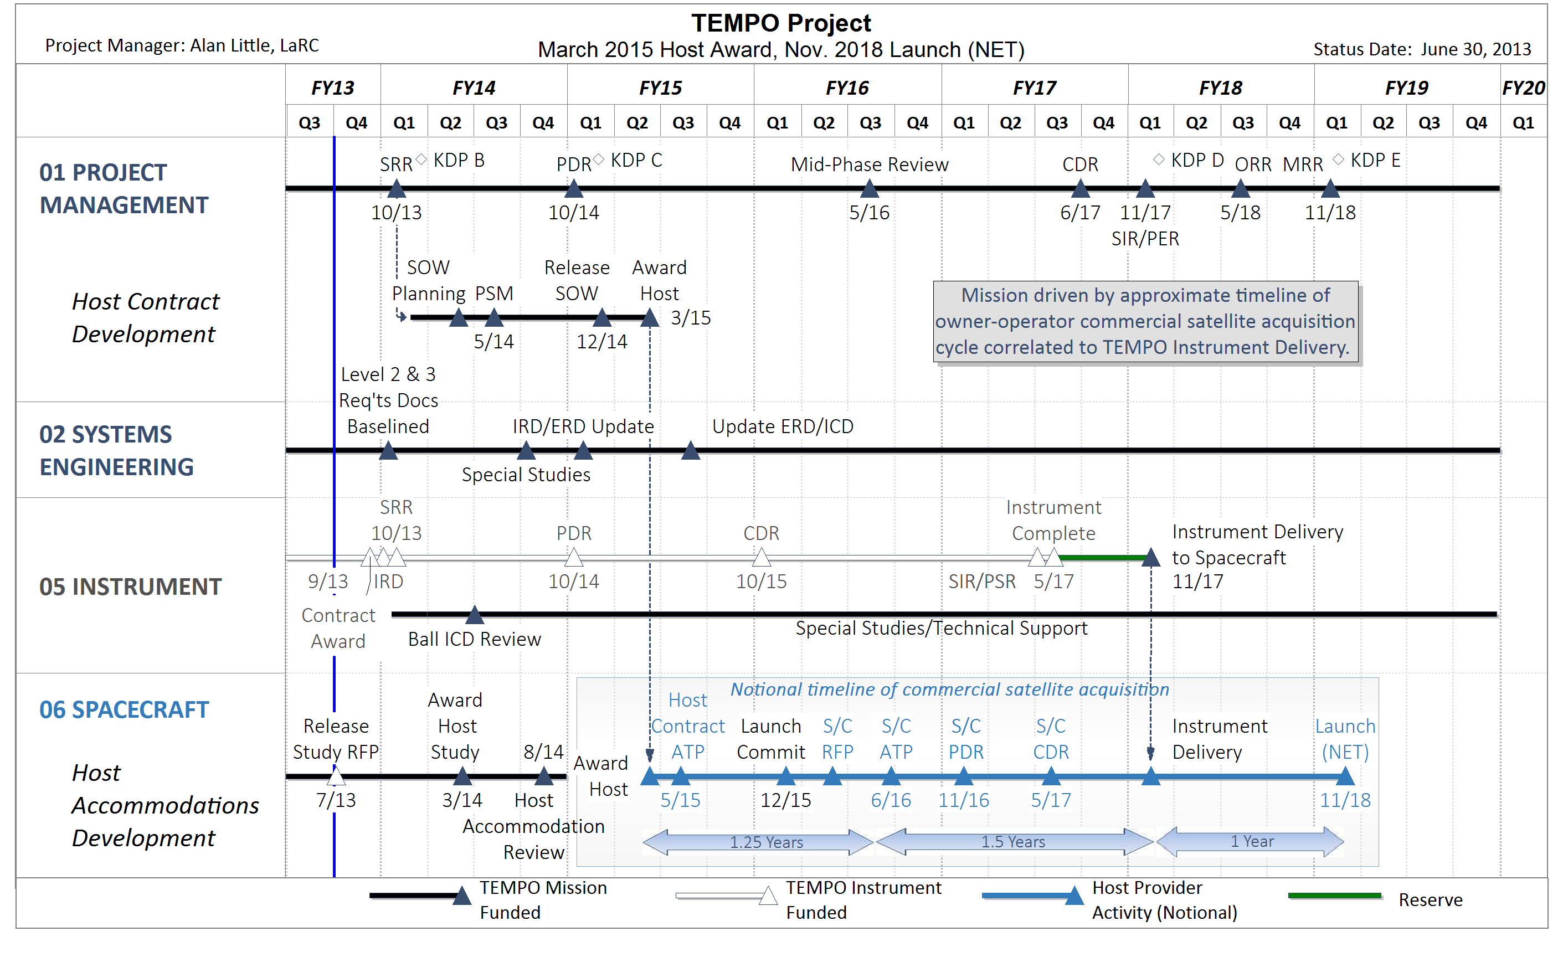
TEMPO Mission Overview Schedule

Slide 8
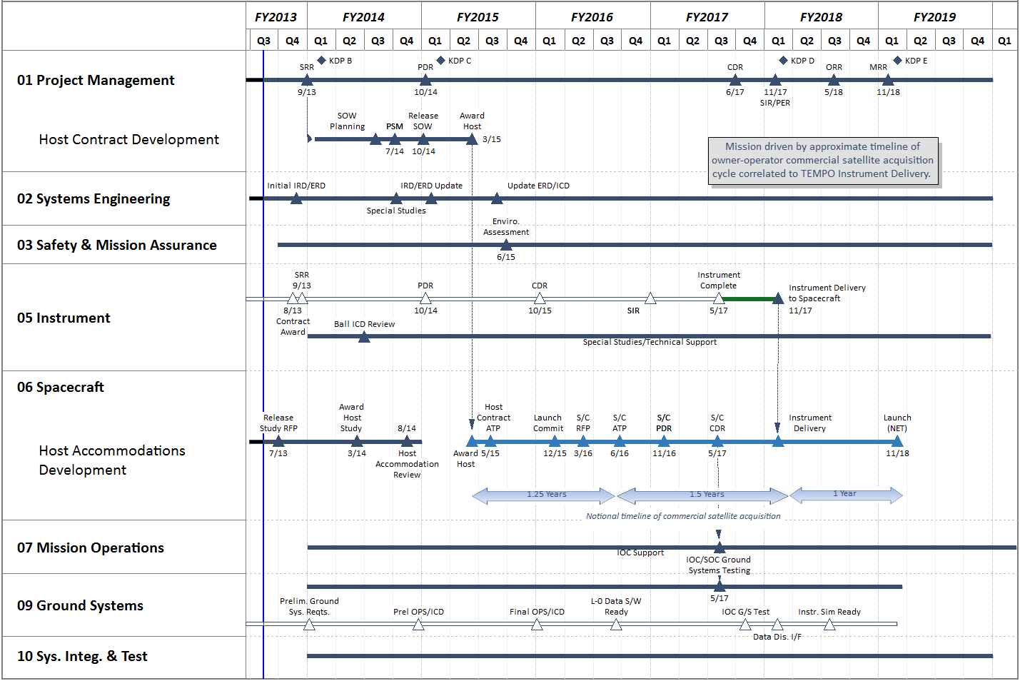
TEMPO Accommodation Mission Schedule Drivers
Primary Mission Schedule Drivers (details for each follow)
1) Procurement of Host 2) Need for Early Design of Interfaces 3) Spacecraft Host Availability

Slide 9
TEMPO Accommodation Mission Schedule Drivers
Primary Mission Schedule Drivers
1) Procurement of Host
2) Need for Early Design of Interfaces
3) Spacecraft Host Availability
Procurement of Host
Assuming utilization of HoPS (Air Force Hosted Payloads Solution office) IDIQ for procurement of Host
HoPS IDIQ SOW planning/work to start after SRR (~Oct)
Draft IDIQ SOW for Host is submitted to HoPS ~April 2014. Final release by HoPS ~October 2014. Host Contract award March 2015 with Host ATP May 2015.
Can move right without affecting spacecraft timeline (no more than spacecraft ATP -2 months) but with potential increased risk to instrument/spacecraft interface design.

Slide 10
TEMPO Accommodation Mission Schedule Drivers
Primary Mission Schedule Drivers
1) Procurement of Host
2) Need for Early Design of Interfaces
3) Spacecraft Host Availability
Interfaces Designed Early
Current Schedule:
Instrument PDR ~10/2014. CDR ~10/2015. Instrument complete ~5/2017.
Host contract award ~3/2015. Spacecraft award notionally mid-2016 for 11/2018 launch.
Original instrument assumption included spacecraft selection by instrument PDR or as early as possible after PDR.
Time period between Instrument PDR & Host award poses risk to instrument-to-spacecraft interface.
Work currently underway to identify interface bounding parameters and specific risks associated with later spacecraft ATP. Early TEMPO Host Accommodation studies will provide additional input into risk assessment.
Instrument

Slide 11
TEMPO Accommodation Mission Schedule Drivers
Primary Mission Schedule Drivers
1) Procurement of Host
2) Need for Early Design of Interfaces
3) Spacecraft Host Availability
Spacecraft Host Availability
Assuming a ~30 month spacecraft development cycle with payload need/instrument delivery 12 months prior to launch. Assuming earliest possible launch for planning purposes.
Initial 18 months of spacecraft development cycle occur prior to instrument delivery, driving spacecraft ATP to ~6/2016.

Slide 12
Key Dates
Key dates
Spacecraft vendor known: between 5/15 and 6/16
Spacecraft location known: ~5/15
Spacecraft integration begins: 11/17
Earliest launch: 11/18

Slide 13
Backup

