Slide 1
Trace gas algorithms for TEMPO
G. Gonzalez Abad¹, X. Liu¹, C. Miller¹, H. Wang¹, C. Nowlan² and K. Chance¹
¹Harvard-Smithsonian Center for Astrophysics
²Dalhousie University
ggonzale@cfa.harvard.edu

Slide 2
Overview
TEMPO trace gas requirements
Generic trace gas algorithm framework
Slant column retrieval
Vertical column determination
Current examples of working or in development algorithms at SAO: H₂CO, SO₂ ,C₂H₂O₂, BrO and OClO for low earth orbit platforms OMI and GOME-2
Future studies for algorithm upgrades

Slide 3
TEMPO trace gas requirements
Standard products: H₂CO, SO₂ and C₂H₂O₂
Secondary products, BrO, H₂O, OClO and plume height-resolved volcanic SO₂

Slide 4
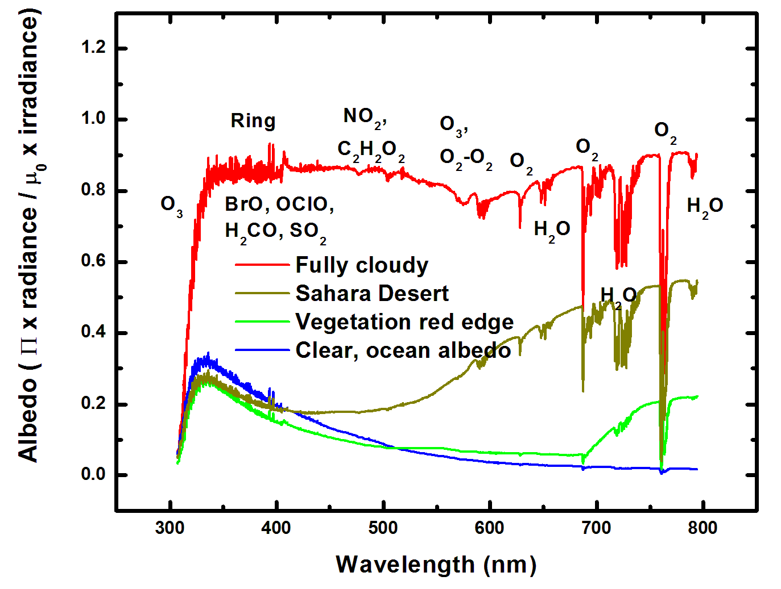
TEMPO trace gas requirements

Slide 5
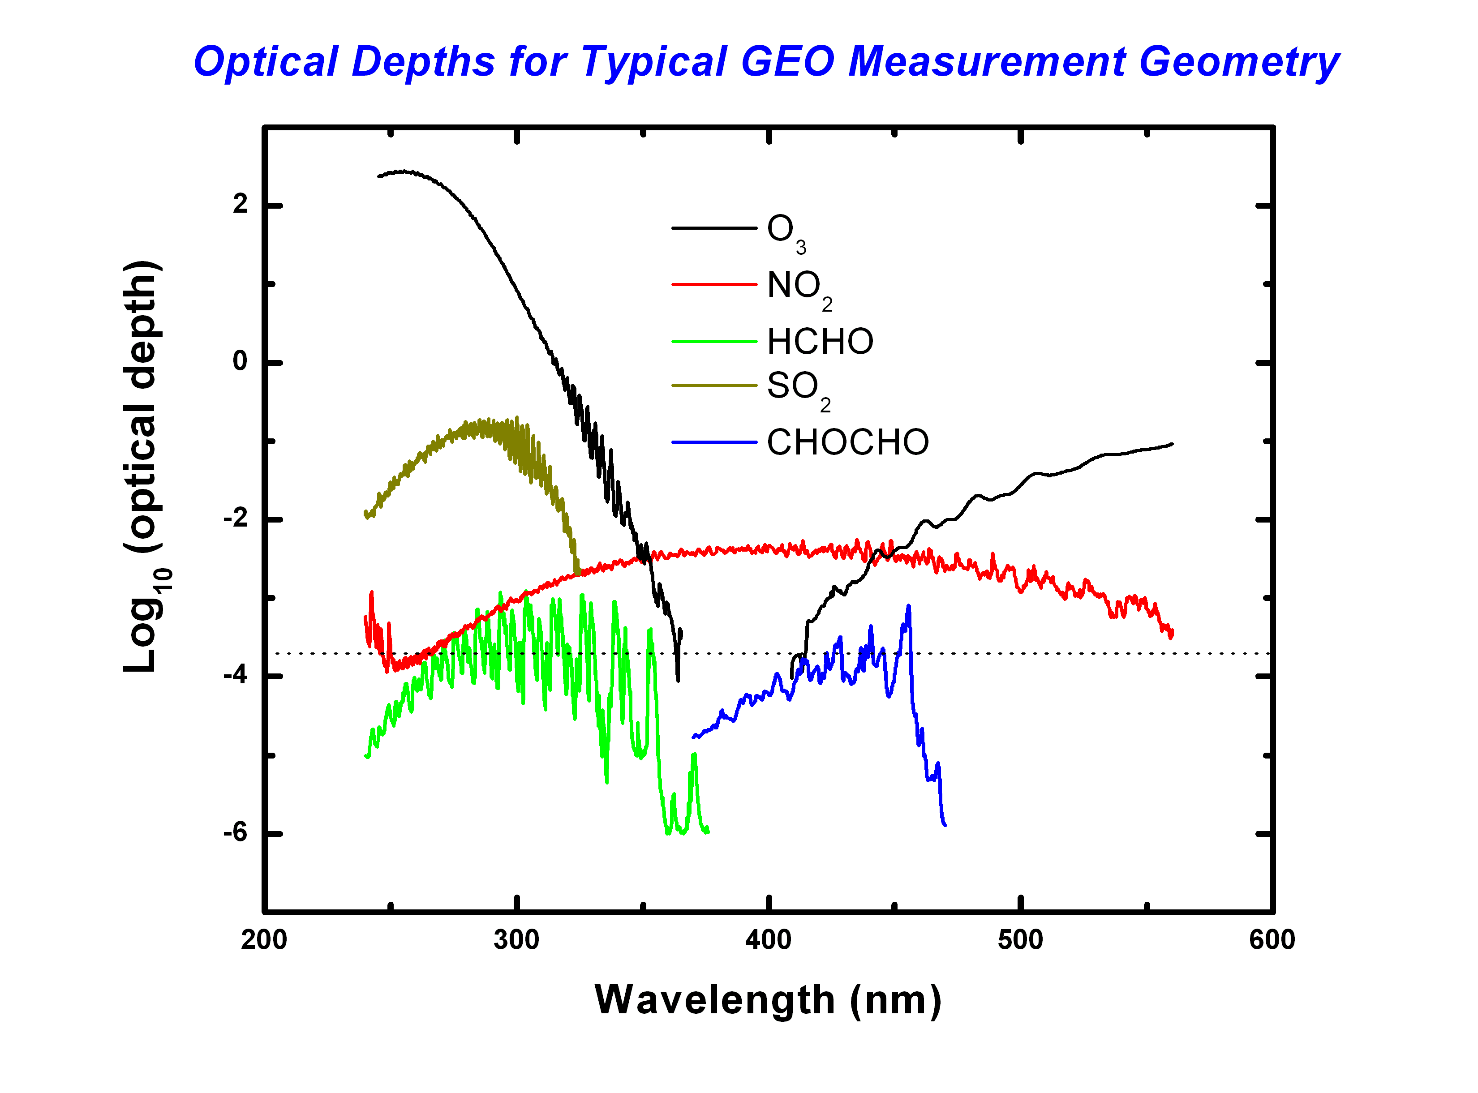
TEMPO trace gas requirements
Best fitting to date:
2.0×10⁻⁴ full-scale radiance
(Instrument vs. algorithm: Tied! S/N drives instrument if meas. requirements can be met

Slide 6
Generic algorithm framework
Two step approach
Direct fitting of radiance spectra to obtain slant columns + Air Mass Factors (AMFs) to convert to vertical columns
One step approach
Target molecule cross sections are multiplied by wavelength-dependent AMFs for direct retrieval of vertical columns.

Slide 7
Generic algorithm framework
AMF calculations
Scattering weights + shape factors (Palmer et al., 2001)
Shape factors to be obtained from model climatology, i.e., GEOS-Chem
Scattering weights from VLIDORT:

Slide 8
Generic algorithm framework
AMFs for partially cloudy pixels, single pixel approximation (Martin et al., 2002)
Cloudy SZA: 28°
Clear SZA: 24°
Cloudy VZA: 16°
Clear VZA: 2.7°
Cloudy cloud fraction: 0.2
Clear cloud fractions: 0.01

Slide 9
Generic algorithm framework
Scattering weights lookup table:
VLIDORT calculations from 300 to 500 nm
Find compromises between resolution and computing performance.
Parameterization on albedos and relative azimuth angles of radiance and Jacobians (Bhartia & Wellemeyer, 2001):

Slide 10
Generic algorithm framework
AMF sensitivity to O₃ concentration

Slide 11
Generic algorithm framework
AMF sensitivity to O₃ concentration

Slide 12
Generic algorithm framework
AMF sensitivity to O₃ concentration

Slide 13
Generic algorithm framework
AMF sensitivity to NO₂

Slide 14
Generic algorithm framework
Typical retrieval flow chart for two step retrieval
L1 data
Read L1 data
Auxiliary data
Read auxiliary data
Wavelength calibration using high resolution solar spectrum
Compute I0 correction
Compute undersampling spectrum
Compute Ring spectrum
Compute common mode spectrum
Direct fitting of slant columns
Lookup tables and climatology for AMF calculation
Read loo up tables & climatology
Compute AMFs
Compute vertical columns
Post processing (if needed)

Slide 15
Working algorithms from SAO
OMI operational H₂CO
Fitting window | 327.5 – 356.5 nm
Baseline polynomial | 3rd order
Scaling polynomial | 3rd order
Instrument slit function | Hyper-parameterization of pre-flight measurements
Wavelength calibration | Spectral shift (no squeeze)
Solar reference spectrum | Chance and Spurr, 1997
H₂CO cross sections | Cantrell et al., 1990; 300K
O₃ cross sections | Malicet et al., 1995; 228K
NO₂ cross sections | Vandaele et al., 1998 220K
BrO cross sections | Wilmouth et al., 1999; 228K
Molecular Ring cross sections | Chance and Spurr, 1997
Sampling correction | Computed on-line
Residual common mode spectrum | Computed on-line

Slide 16
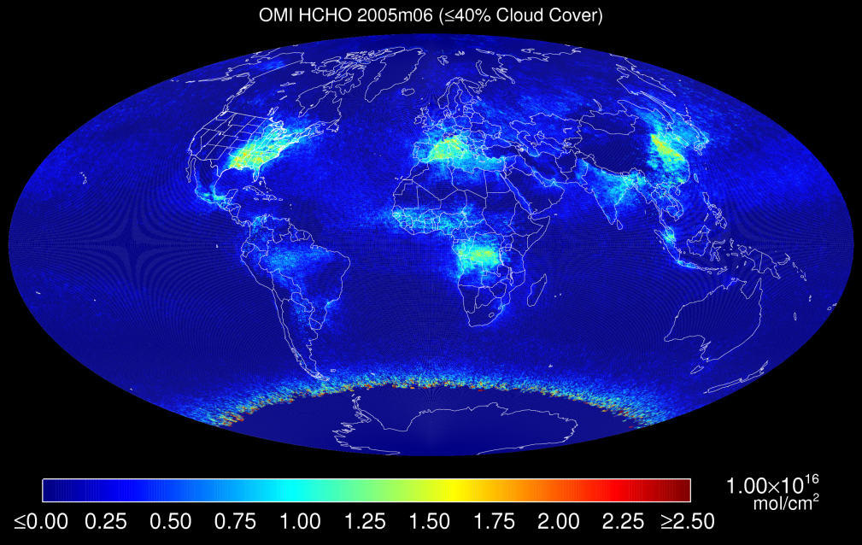
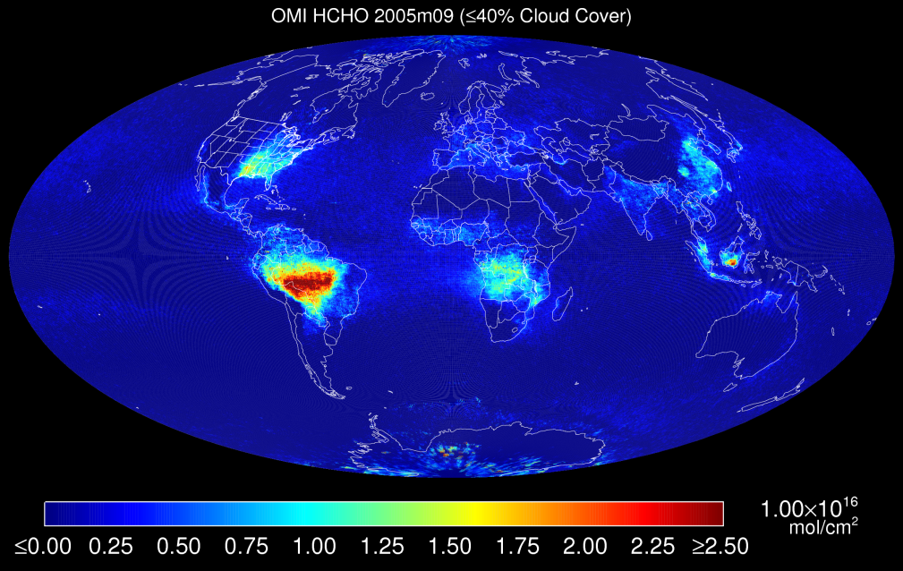
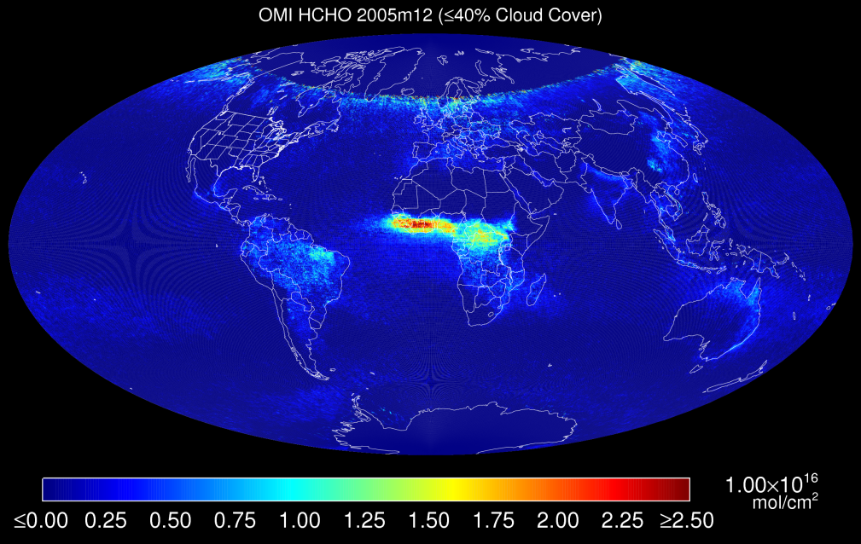
OMI operational HCHO

Slide 17
Working algorithms from SAO
OMI C₂H₂O₂
Fitting window | 431.5 – 469.5 nm
Baseline polynomial | 4th order
Scaling polynomial | 3rd order
Instrument slit function | Hyper-parameterization of pre-flight measurements
Wavelength calibration | Spectral shift (no squeeze)
Solar reference spectrum | Chance and Spurr, 1997
C₂H₂O₂ cross sections | Volkamer et al., 2005; 296K
O₃ cross sections | Malicet et al., 1995; 228K
NO₂ cross sections | Vandaele et al., 1998 220K
O₂-O₂ cross sections | Hermans BISA, 2006; 294K
H₂O cross sections | HITRAN 2008, 280K
Liquid H₂O cross sections | Pope and Fry, 1997
IO cross sections | Spietz et al., 2005; 298K
Vibrational Raman spectrum | Chance and Spurr, 1997
Molecular Ring cross sections | Chance and Spurr, 1997
Sampling correction | Computed on-line
Residual common mode spectrum | Computed on-line

Slide 18
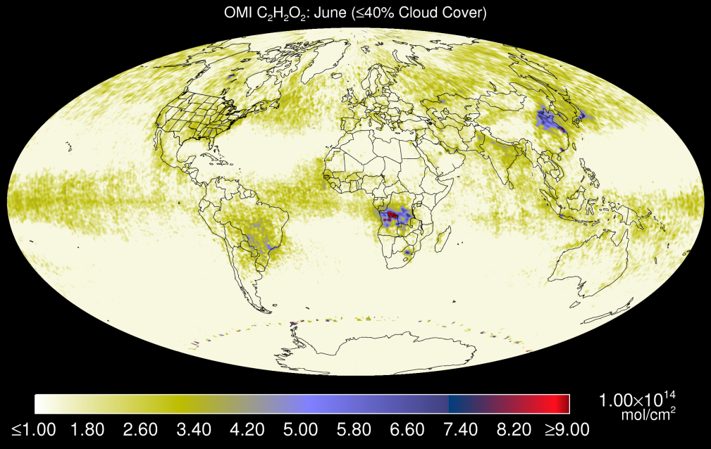
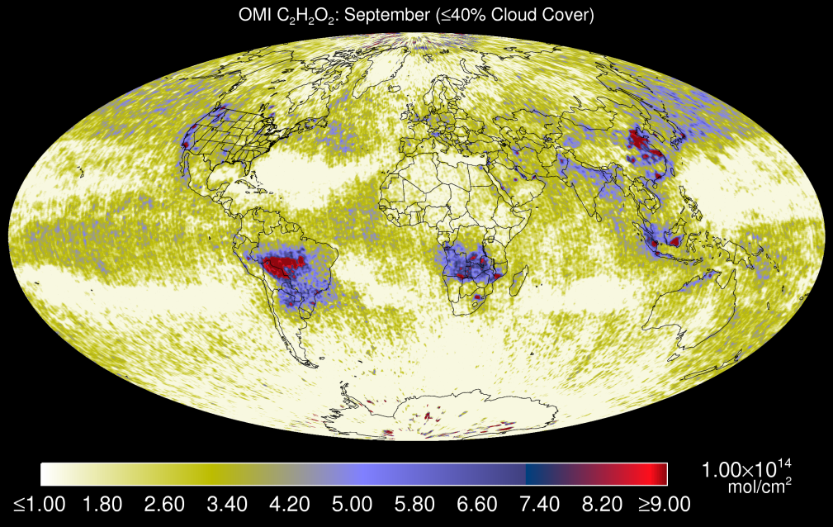
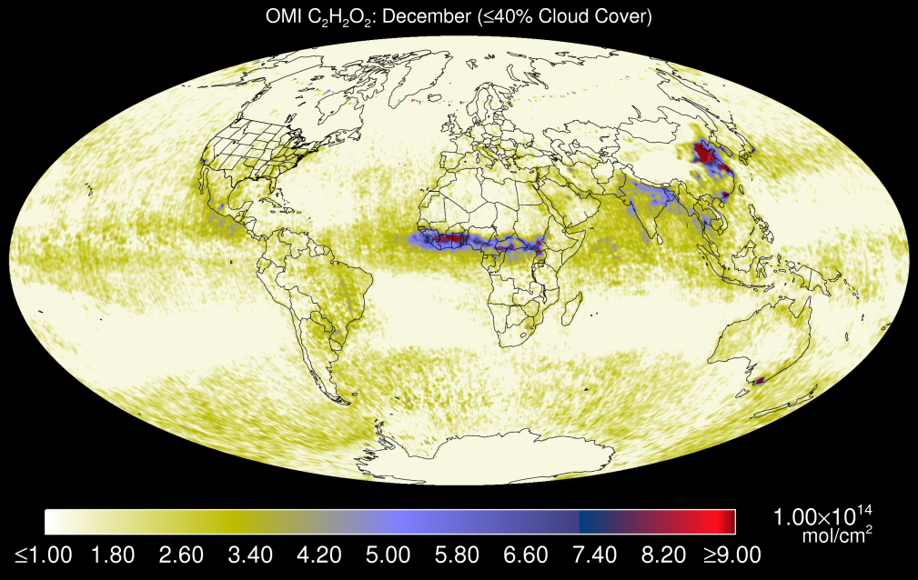
OMI CHOCHO

Slide 19
Working algorithms from SAO
OMI operational BrO
Fitting window | 319.0 – 347.5 nm
Baseline polynomial | 4^{rh} order
Scaling polynomial | 4th order
Instrument slit function | Hyper-parameterization of pre-flight measurements
Wavelength calibration | Spectral shift (no squeeze)
Solar reference spectrum | Chance and Spurr, 1997
HCHO cross sections | Cantrell et al., 1990; 300K
O₃ cross sections | Malicet et al., 1995; 218K; 295K
NO₂ cross sections | Vandaele et al., 1998 220K
BrO cross sections | Wilmouth et al., 1999; 228K
O₂-O₂ cross sections | Hermans BISA, 2006; 294K
SO₂ cross sections | Hermans et al., 2009; 295K
OClO cross sections | Kromminga et al,. 2003; 213K
Molecular Ring cross sections | Chance and Spurr, 1997
Sampling correction | Computed on-line
Residual common mode spectrum | Computed on-line

Slide 20
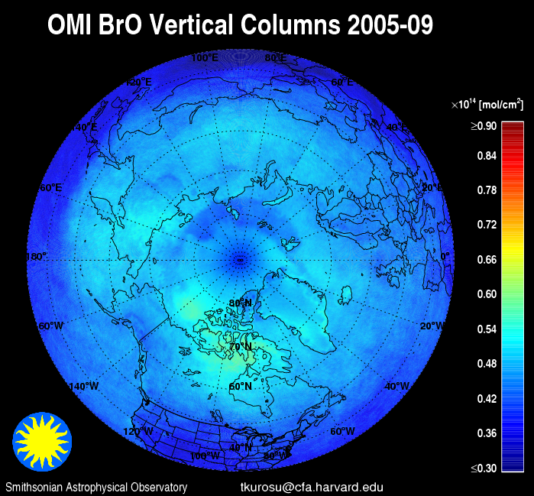
OMI operational BrO

Slide 21
Working algorithms from SAO
OMI operational OClO
Fitting window | 358.5 – 392.0 nm
Baseline polynomial | 3rd order
Scaling polynomial | 3th order
Instrument slit function | Hyper-parameterization of pre-flight measurements
Wavelength calibration | Spectral shift (no squeeze)
Solar reference spectrum | Chance and Spurr, 1997
O₃ cross sections | Malicet et al., 1995; 228K
NO₂ cross sections | Vandaele et al., 1998 220K
BrO cross sections | Wilmouth et al., 1999; 228K
O₂-O₂ cross sections | Hermans BISA, 2006; 294K
OClO cross sections | Kromminga et al,. 2003; 213K
Molecular Ring cross sections | Chance and Spurr, 1997
Sampling correction | Computed on-line
Residual common mode spectrum | Computed on-line

Slide 22
Working algorithms from SAO
GOME-2 SO₂
Fitting window | 312.0 – 330.0 nm
Baseline polynomial | 3rd order
Scaling polynomial | 3rd order
Instrument slit function | Asymmetric Gaussian fitted online
Wavelength calibration | Spectral shift (no squeeze)
Solar reference spectrum | Chance and Spurr, 1997
SO₂ cross sections | Bogumil et al., 2003; 293K
HCHO cross sections | Meller and Moortgat et al., 2000; 298K
O₃ cross sections | Brion et al., 1993; 218K, 273K
NO₂ cross sections | Vandaele et al., 1998 220K
BrO cross sections | Wilmouth et al., 1999; 228K
Molecular Ring cross sections | Chance and Spurr, 1997
Sampling correction | Computed on-line
Residual common mode spectrum | Computed on-line

Slide 23
Future studies for algorithm upgrades
O₂-O₂ spectroscopy
Continue with sensitivity studies for wavelength dependent AMF one step retrievals of SO₂ and H₂CO
OMI H₂CO retrieval upgrade
C₂H₂O₂ operational OMI retrieval (C. Miller)
H₂O operational OMI retrieval (H. Wang)
Volcanic SO₂ plume height-resolved optimal estimation retrieval (Nowlan et al. 2011)

Slide 24
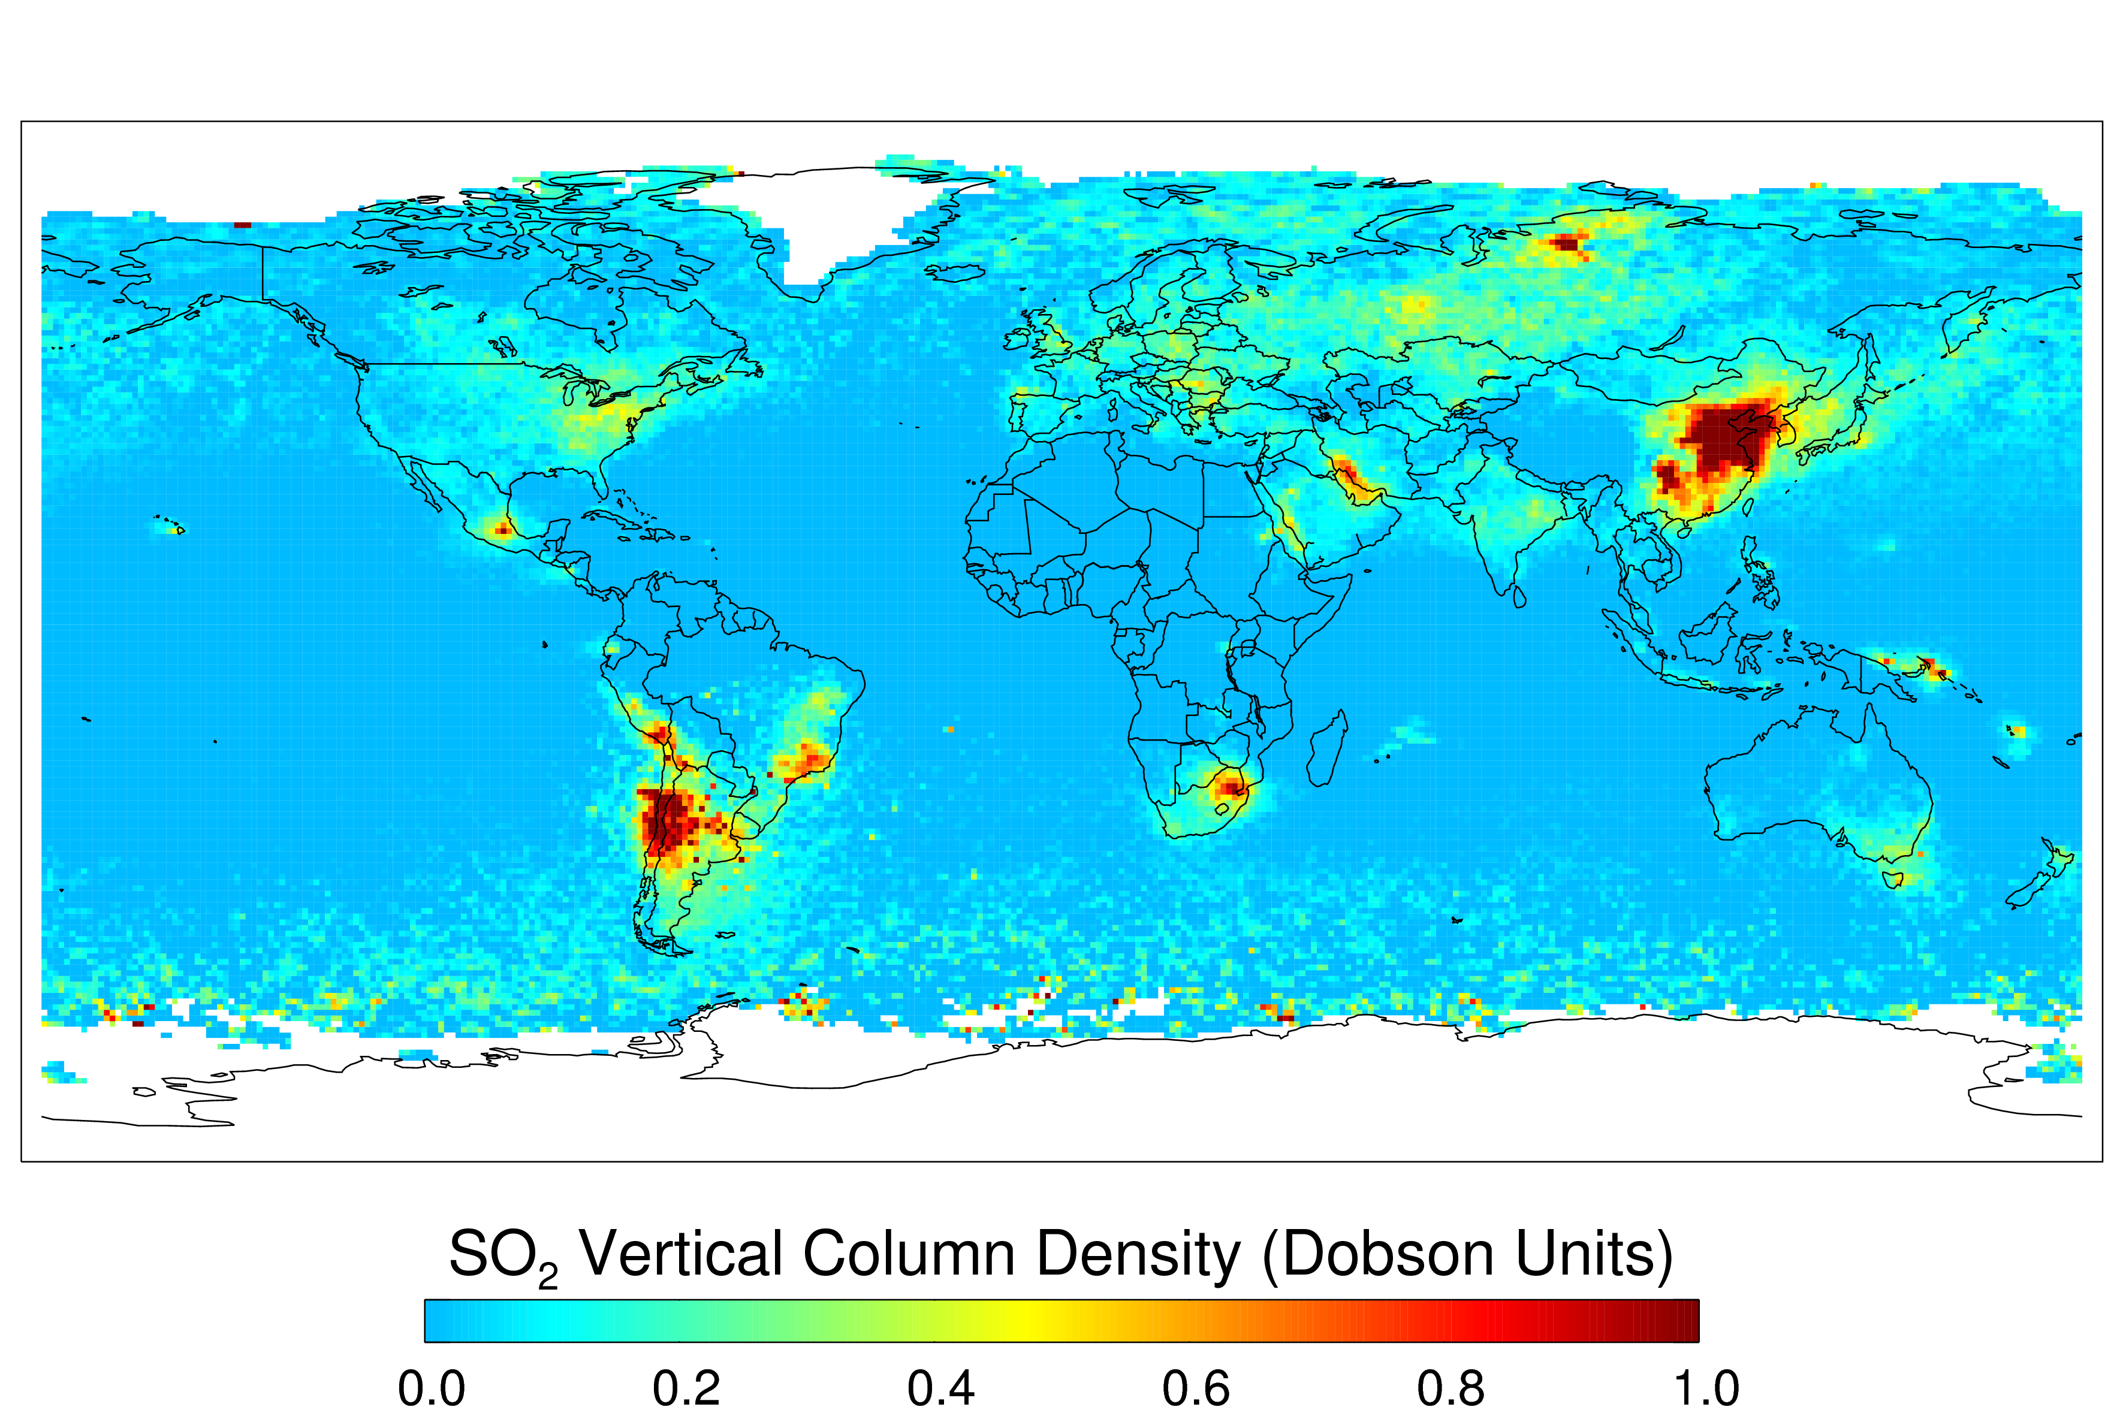
SO₂ plume height-resolved OE retrieval
Cloud fraction < 0.2, Solar Zenith Angle < 70°, no ice- or snow-covered pixels

Slide 25
OMI water vapor
July 14, 2005
Retrieval Window: [430, 480]nm
Relative uncertainty: 12%

Slide 26
Thank you!!

