Slide 1
TEMPO Data Distribution at ASDC
Jeff Walter, Pamela Rinsland, Tim Larson
8/14/2020
Notes:
STILL

Slide 2
ASDC Overview
TEMPO Products and Distribution
  Earthdata
  EPA RSIG
  GIS – Esri
  EOSDIS Near Real-Time (LANCE)
Science Outreach and Support
Discussion

Slide 3
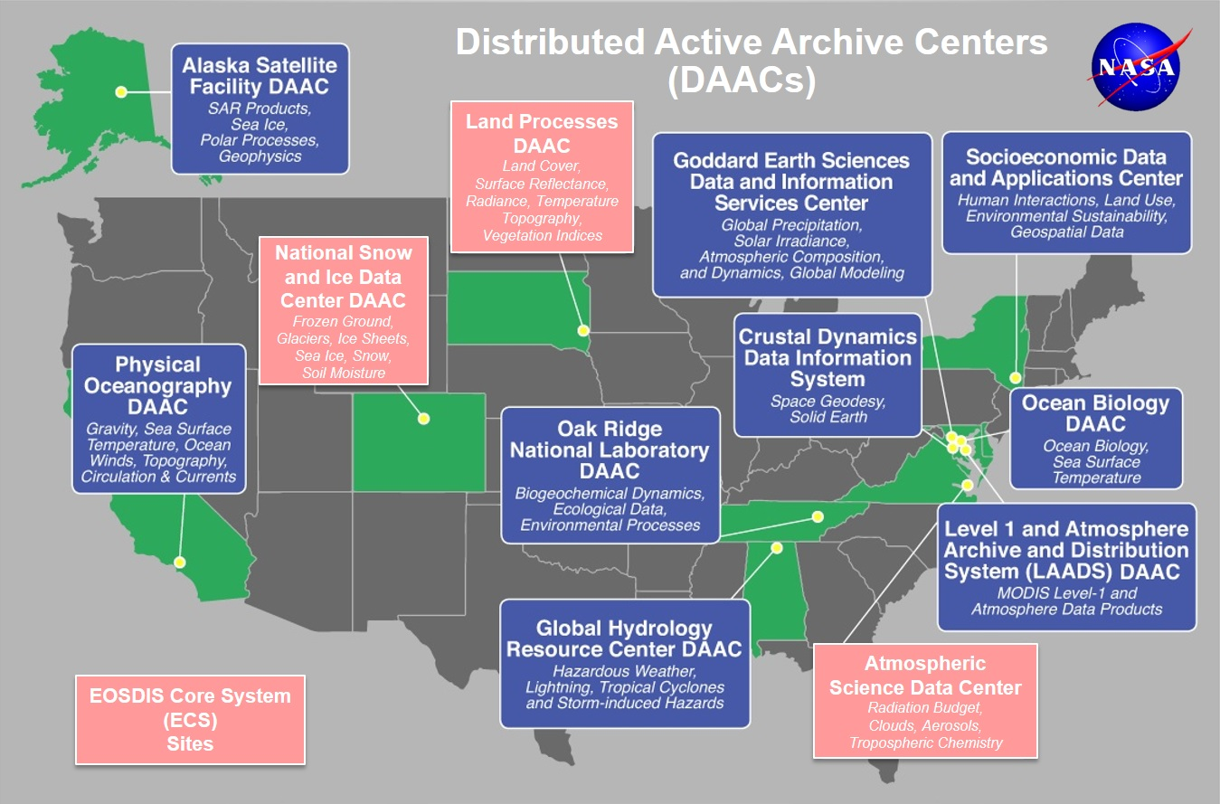
Earth Observation System Data and Information System EOSDIS
EOSDIS data centers process, archive, and distribute thousands of data products to the global user community. The primary services provided by EOSDIS are data archive & management, distribution, information management, product generation, and user support. It is comprised of multiple components including:
Distributed Active Archive Centers (DAACs)
Science Data Processing Segment (SDPS)
Science Investigator-led Processing Systems (SIPS)
Common Metadata Repository (CMR)
Earthdata
Global Imagery Browse Services (GIBS)
more

Slide 4

ASDC Vision
"To be a leading provider of atmospheric science data products and services to the science community through agility, innovation, and technical excellence“

Slide 5
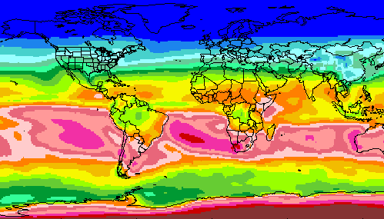
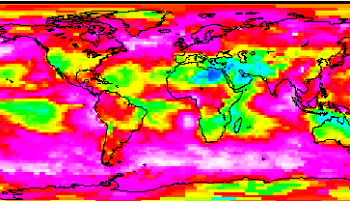
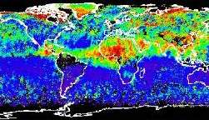
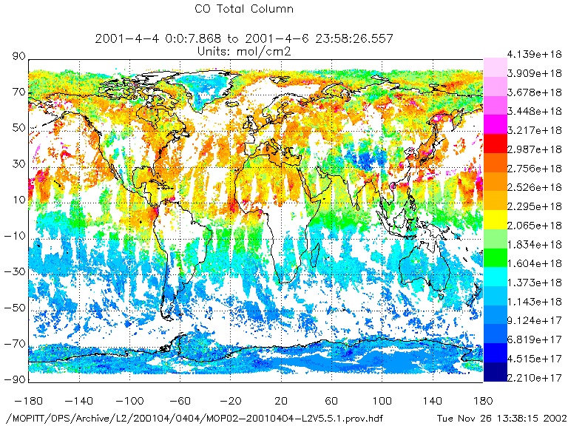
RADIATION BUDGET
CLOUDS
ASDC at a glance
44+ Science projects
  ⚬ MISR ⚬ MOPITT ⚬ MAIA ⚬ TEMPO ⚬ CERES
  ⚬ CALIPSO → RSIG (EPA)
  ⚬ Airborne field campaigns
  (KORUS AQ, DISCOVER AQ, FIREX AQ)
1100+ unique science products
Data usage (2019)
  ⚬ 2,061 Terabytes ⚬ 160,000 users
  ⚬ 158 countries
Data archive (2019)
  ⚬ 5.8 Petabytes ⚬ 141 million files (4,400 TB) on high-speed disks
Data in cloud (ongoing)
  ⚬ Data and services in the cloud
  ⚬ Scalable infrastructure
AEROSOLS
TROPOSPHERIC COMPOSITION
Primary Functions of ASDC
Ingest receive data from data provider
Archive preservation & provenance
Distribute tools and services
Process create higher level products
Outreach & Support research community

Slide 6
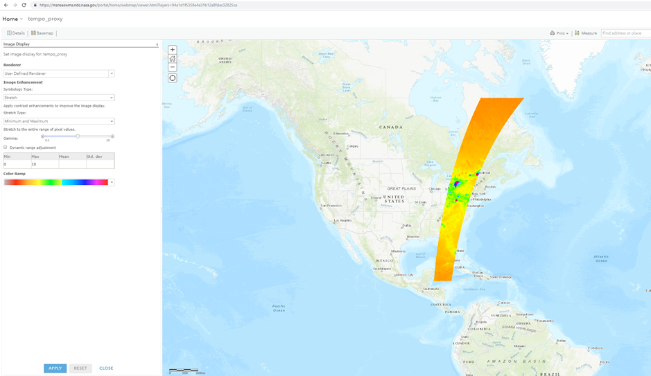
TEMPO Data Products
End-to-end product generation, metadata, and ingest testing has been ongoing between ASDC and SAO.
TEMPO files are offered in Netcdf4 format
Metadata record in ODL format.
TEMPO Data Products
Level 0 | radiance, irradiance, telemetry, dark frames
Level 1b | calibrated & geolocated radiance, irradiance
Level 2 | derived products for total O3, 03 vertical profile, formaldehyde, nitrogen dioxide, cloud pressure and fraction
Level 3 | gridded, derived products for total ozone, ozone vertical profile, formaldehyde, nitrogen dioxide, cloud pressure and fraction
Data File Naming Convention
TEMPO_NO2_L3_V01_YYYYMMDDTHHMMSSZ_ScanIDGranuleID.nc
NO2 - this is the variable or product name contained in the file L3 - this indicates the product level (L0, L1, L2, L3) V01 - this denotes the version of the data file YYYYMMDD - year, month, day HHMMSSZ - the time in UTC ScanID - this indicates the scan counter value GranuleID - this indicates the granule counter value

Slide 7
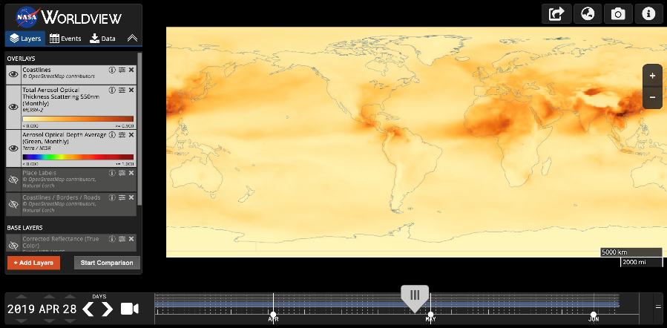



ASDC Data Distribution: Tools and Services
NASA Earthdata Search
  CMR Search ⚬ Metadata
NASA WorldView
  GIBS API ⚬ visualization
OPeNDAP
  ⚬ transform ⚬ subsetting
  ⚬ reformatting ⚬ distribution
HTTPS data access
  ⚬ datapool
  ⚬ permanent URL/direct access
  ⚬ enables scripts/workflow
Example scripts
  ⚬ Python/Jupyter Notebook
  ⚬ R scripts
  ⚬ contributed tutorials/scripts
User Support and Other Resources
Earthdata Login https://urs.earthdata.nasa.gov
Earthdata Forum https://forum.earthdata.nasa.gov/
ASDC User Support support-asdc@earthdata.nasa.gov

Slide 8
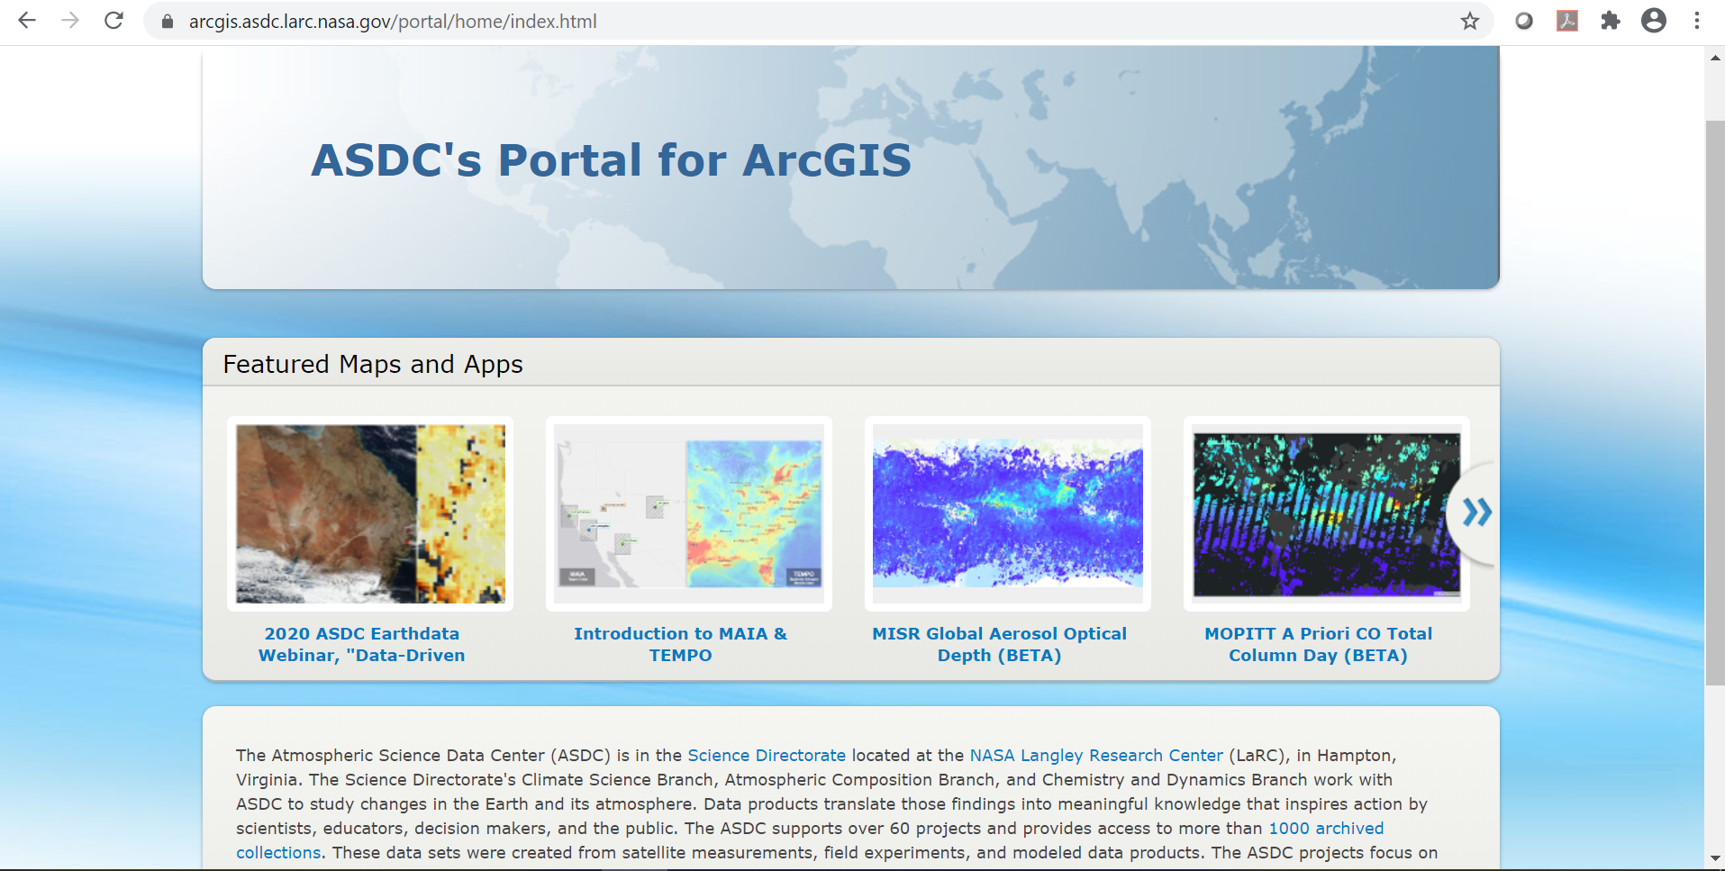

ASDC Portal for ArcGIS
ASDC datasets available publicly as image services and WMS
Incorporate data directly into web applications and desktop software
Develop storymaps, jupyter notebooks and outreach content
https://arcgis.asdc.larc.nasa.gov

Slide 9
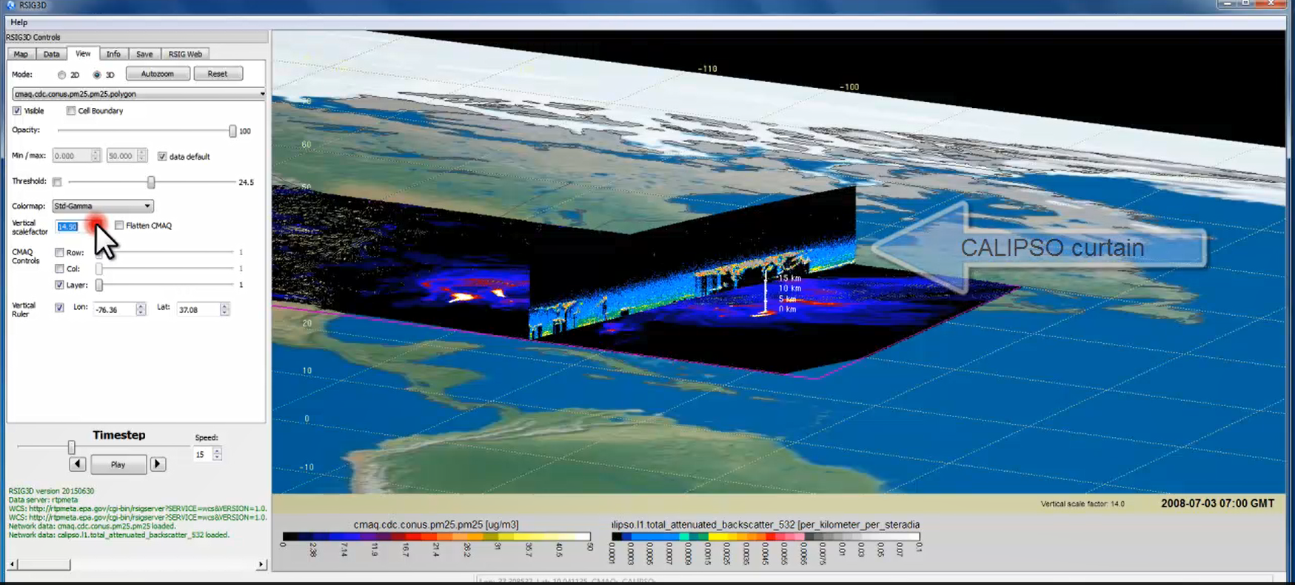
EPA RSIG3D Gateway
TEMPO data can be served directly through the EPA Remote Sensing Information Gateway. https://www.epa.gov/hesc/remote-sensing-information-gateway

Slide 10

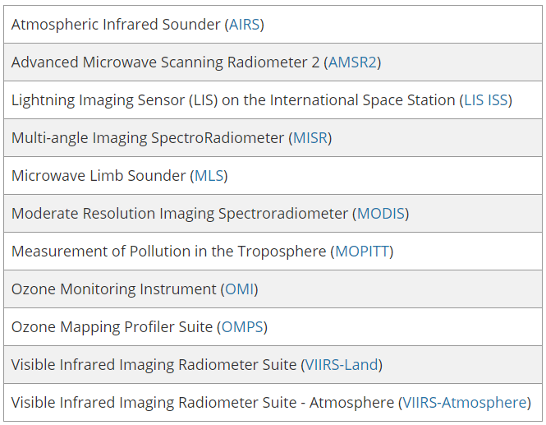
Land, Atmosphere Near real-time Capability for EOS (LANCE)
The LANCE objective is to provide near real-time data and imagery generally within three hours of an instrument observation.
NRT products and imagery are generally processed with preliminary, less-accurate ancillary data and distributed through Worldview. Standard, higher-latency products are delivered later.

Slide 11







ASDC Science Outreach and Support
We engage directly with science teams to enable data discovery and research opportunities, discuss new products, and understand how users access and download data to make the process easier and more accessible.
Data User Guides
  New mission focus
Scripting languages
  Python/Jupyter ⚬ R statistics ⚬ Other
Data file format
  CSV/text ⚬ GeoTIFF ⚬ netCDF ⚬ HDF
GIS tools
  ArcGIS ⚬ QGIS ⚬ GDAL
Esri ArcGIS Story Maps
  SAGE III, Australian Bushfires
Other tools
  Tools and languages for data analytics and visualization
Notes:
ASDC is positioned as the center for data merge and analysis of TEMPO with our other archived datasets, including MAIA and MISR. We work closely with the science team/data providers to make sure the mission is successful, and the data is shared with the world. We also interact and gather feedback from users on what they need to use the data successfully.

Slide 12
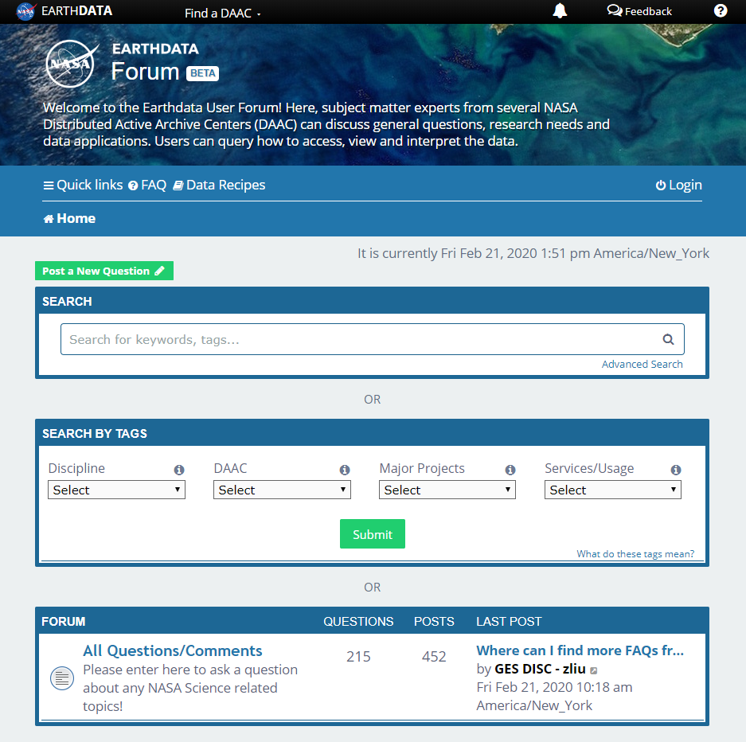
Earthdata Forum
Science Data Users can seamlessly search for information even if they do not know which DAAC the data belongs to.
Scientists & Data Providers can effectively assist their user community in more accurately using their products.
DAACs & Subject Matter Experts (SMEs) can quickly link users to existing resources.
DAAC User Services can swiftly provide inquirers with an authoritative source related to DAAC data products & services.
https://forum.earthdata.nasa.gov/
Notes:
The Earthdata Forum is our new online resource for staff members and subject matter experts from several NASA Distributed Active Archive Centers (DAACs) assist inquirers with questions about their NASA Earth science data. General questions, research needs, and data applications can all be subjects here. Members of the NASA scientific user community are encouraged also provide insights and collaborative assistance.​

Slide 13
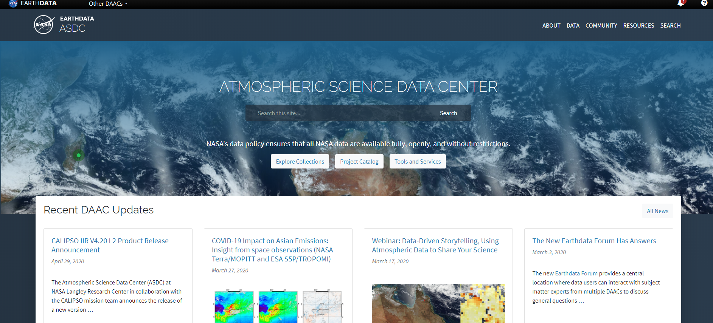
New ASDC homepage
https://asdc.larc.nasa.gov/
Notes:
Brand new website with features like filters by discipline and tools, keyword search bar, new look matching Earthdata layout
Top buttons: Explore Collections, Project Catalog, Tools and Services
News stories, outreach section coming oon
Outreach activities: Webinars, tutorials, data recipes, Jupyter Notebooks, Story Maps, more ArcGIS friendly datasets
Will be able to easily access MAIA and TEMPO data and other tools & services from this main website

Slide 14
TEMPO Near Real-Time and Cloud at ASDC
Jeff Walter, Pamela Rinsland, Tim Larson
8/14/2020
Notes:
STILL

Slide 15
Near Real-Time Overview and Considerations
ASDC in the Cloud

Slide 16
Near Real-Time
NASA’s LANCE system established as a virtual system to provide data in NRT (within 3 hours of acquisition
Leverages existing Science Data Processing and Archive components supporting a given mission
Consists of an umbrella set of requirements to ensure consistency, collaboration, coordination
Requirements for each LANCE element include:
  Process, ingest, and distribute data to user within 3 hours of acquisition
  Archive these data for 7-14 days
  Integrate ESDIS’ Earthdata Login (user registration) for access
  Provide metadata to the Common Metadata Repository
  Provide imagery to the GIBS/Worldview system
  Provide metrics to EMS
  Provide end user support
https://earthdata.nasa.gov/earth-observation-data/near-real-time
Data Processing System
DAAC

Slide 17
Land, Atmosphere Near real-time Capability for EOS (LANCE)
The LANCE objective is to provide near real-time data and imagery generally within three hours of an instrument observation.
NRT products and imagery are generally processed with preliminary, less-accurate ancillary data and distributed through Worldview. Standard, higher-latency products are delivered later.

Slide 18
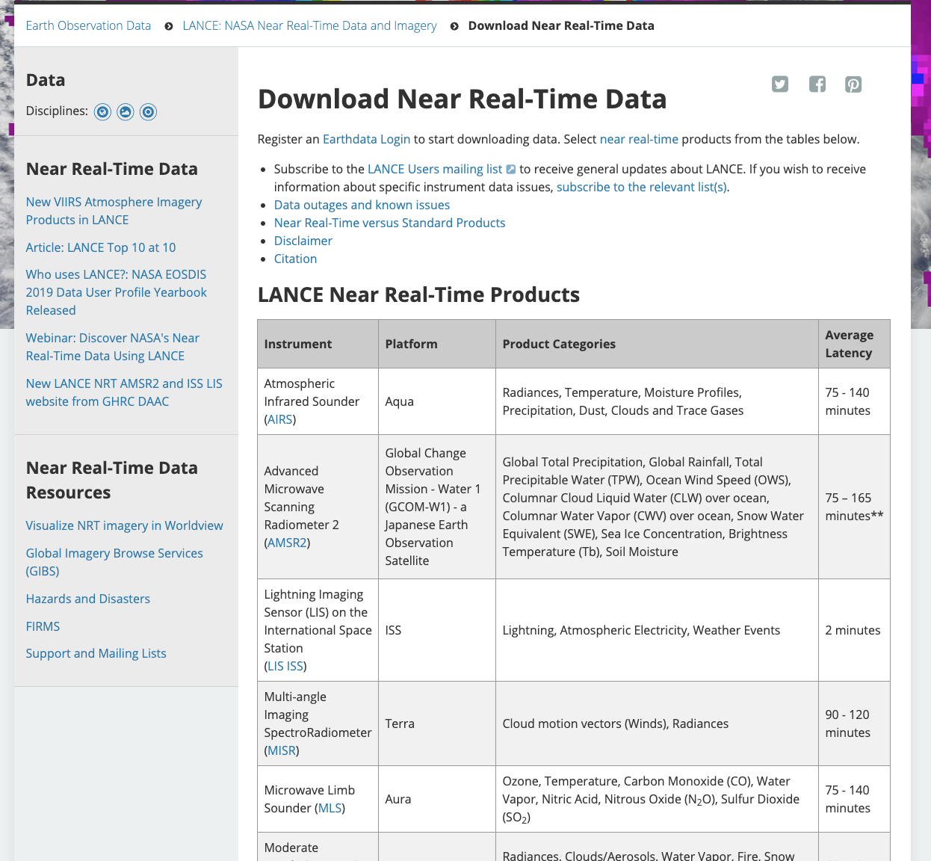

Slide 19
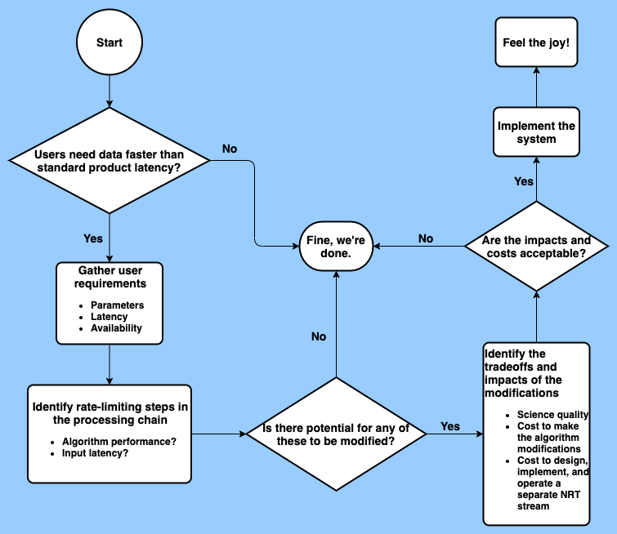
Decision Considerations

Slide 20
Latency vs Availability
LANCE has latency requirements but NOT availability requirements
  Latency requirements will be met on a “best effort” basis
If users have high availability requirements, we will need to explore redundancy of the various system elements
  Adds complexity and cost
ASDC currently supports redundancy for its NRT missions
  MISR - data processing and distribution
  MOPITT – data distribution

Slide 21
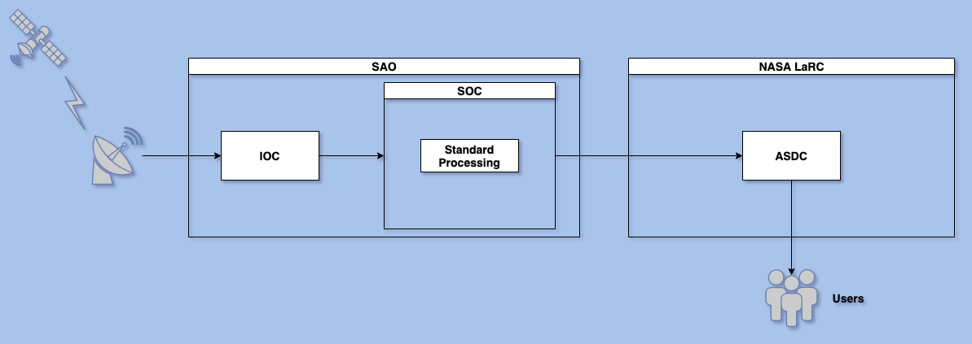
Standard Data Flow

Slide 22
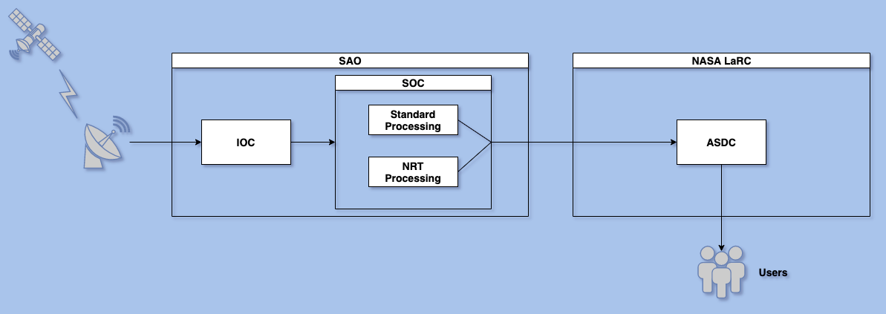
Near Real-Time: No redundancy

Slide 23
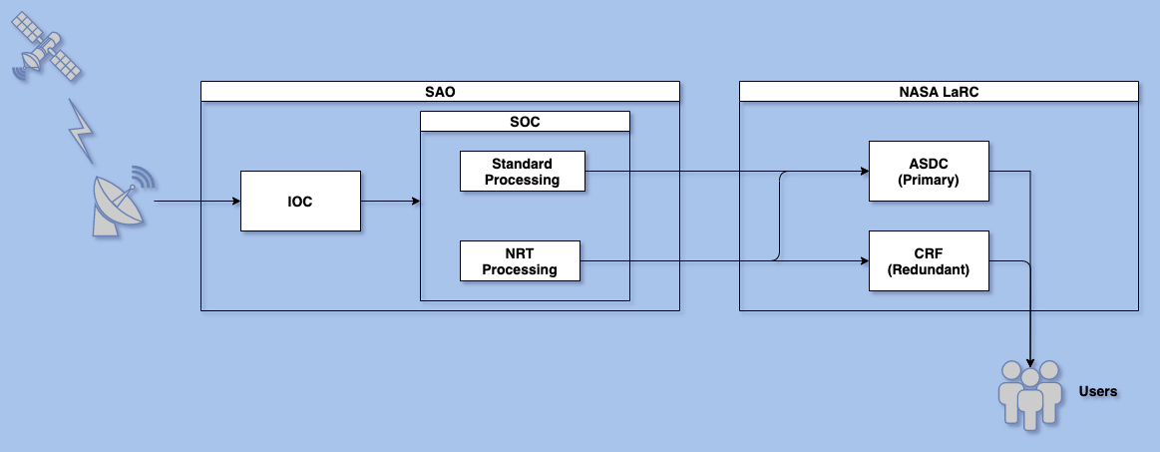
Distribution Redundancy

Slide 24
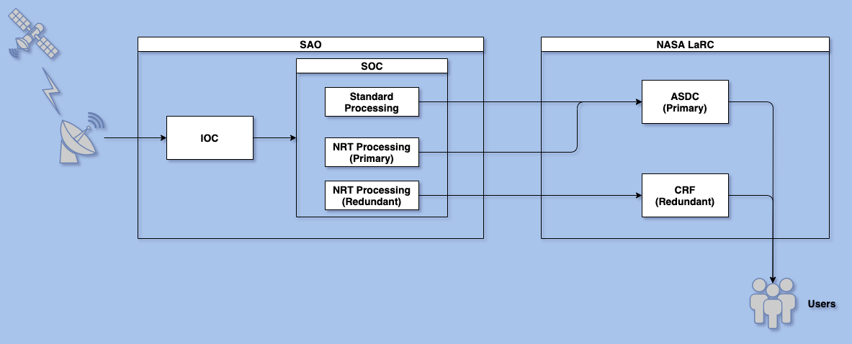
Processing + Distribution Redundancy (Local)

Slide 25
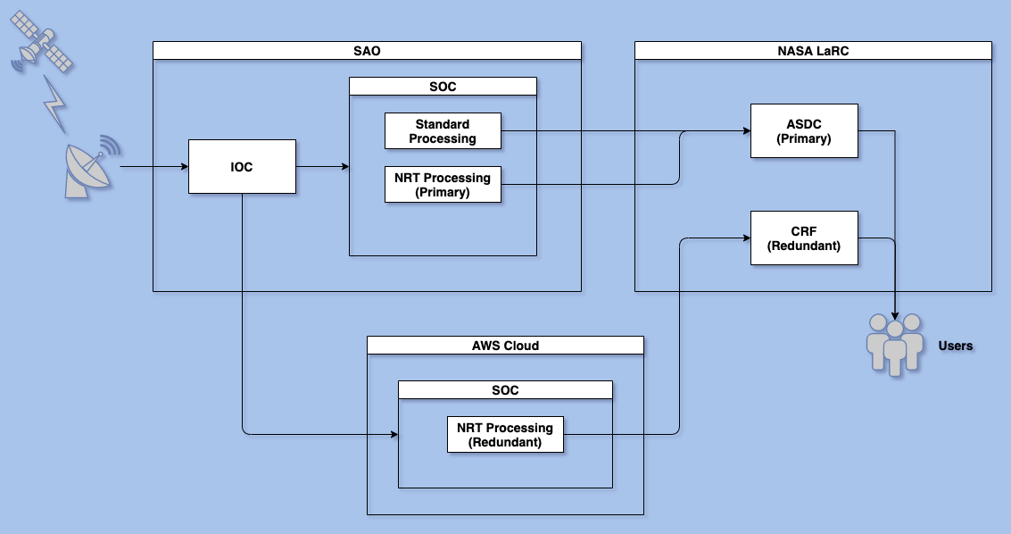
Processing Redundancy (Cloud)

Slide 26
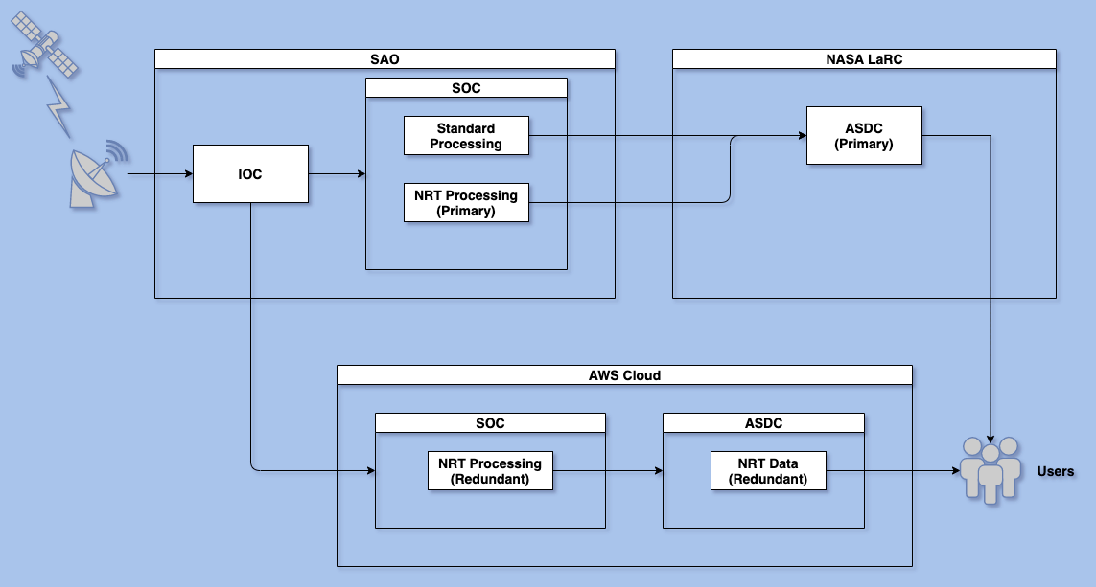
Processing + Distribution Redundancy (Cloud)

Slide 27
ASDC in the Cloud
ESDIS is heavily investing in commercial cloud
  Primary motivations
    To allow the science community to do unprecedented science with unconstrained processing and storage capacity across all EOSDIS data in a highly available environment (AWS)
    The size of future datasets makes on-premise archiving undesirable
      SWOT and NISAR are most often cited
  Building an AWS-native ingest and archive system called Cumulus that is intended to be used by all DAACs
  ESDIS pays for the storage. Users pay for their own compute resources.
  Data download will still be available free of charge

Slide 28
ASDC in the Cloud
ASDC engaged in a “Phase I” onboarding activity with ESDIS support
  Period of performance is July 2020 to December 2021
  Selected a small number of data sets from MISR, MOPITT, and CERES to ingest as part of this first phase
    Data will still be ingested and stored at ASDC with a copy sent to AWS
  Phase I does not include any services such as subsetting, etc.
  Data will continue to be archived on site at ASDC for the forseeable future
Guiding Principles
  User experience will not be interrupted or degraded
  Activities are being planned in a way to avoid introducing technical and schedule risks and dependencies
  ASDC will work closely with ESDIS to identify risks, technical challenges and uncertainties, and proposing concepts and architectures for mitigating any issues that arise

Slide 29
ASDC in the Cloud
We want to hear from you!
  Would having TEMPO data available in the cloud benefit you?
  What is the value proposition for you and your colleagues?
  Challenges with using the cloud?
  Is AWS sufficient or do you have any preference for a different cloud vendor (i.e. Google or Microsoft)? If so, why?

Slide 30
Atmospheric Science Data Center
NASA Langley Research Center
Hampton, Virginia (USA)
https://asdc.larc.nasa.gov/
support-asdc@earthdata.nasa.gov

