Slide 1
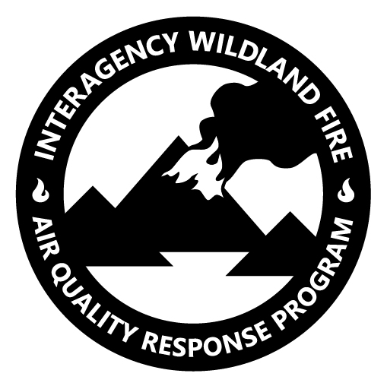
The U.S. Interagency Wildland Fire Air Quality Response Program: Potential Linkages with TEMPO
Sim Larkin, U.S. Forest Service AirFire Research Team
Contact: Sim Larkin, sim_larkin@firenet.gov

Slide 2
Smoke and Fire
On average, over 7,000,000 acres of wildfire per year (U.S.)
Doesn’t count 12,000,000+ acres of prescribed burning
Wildfires are the single biggest source of high-level air quality impacts (in U.S.)
Single fires have been known to cause significant impacts to millions
But multiple regional fires are common and can collectively impact large areas of the country
Fires differentially impact rural communities
Also those with respiratory issues (1 in 3 households)
E.g. children with asthma, COPD, emphysema
Wildfire response efforts have expanded beyond physical property and safety, now includes air impacts

Slide 3
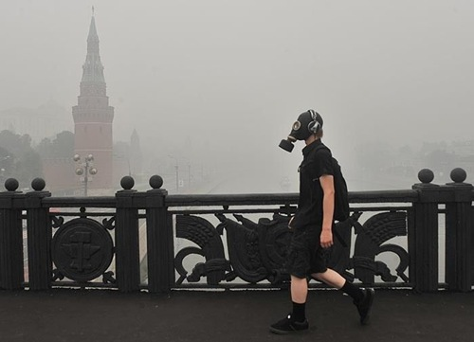
Smoke can be a problem:
How to respond?
(in real-time)
Need:
Rubric
Data
Models
Tools
Messaging
Coordination
Program
Tools
travellingboard.net

Slide 4
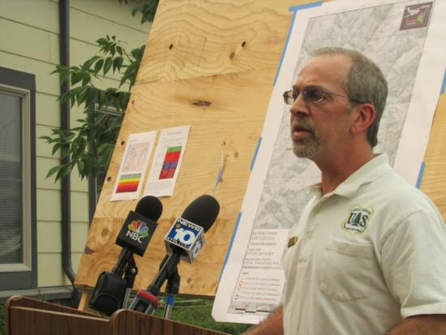
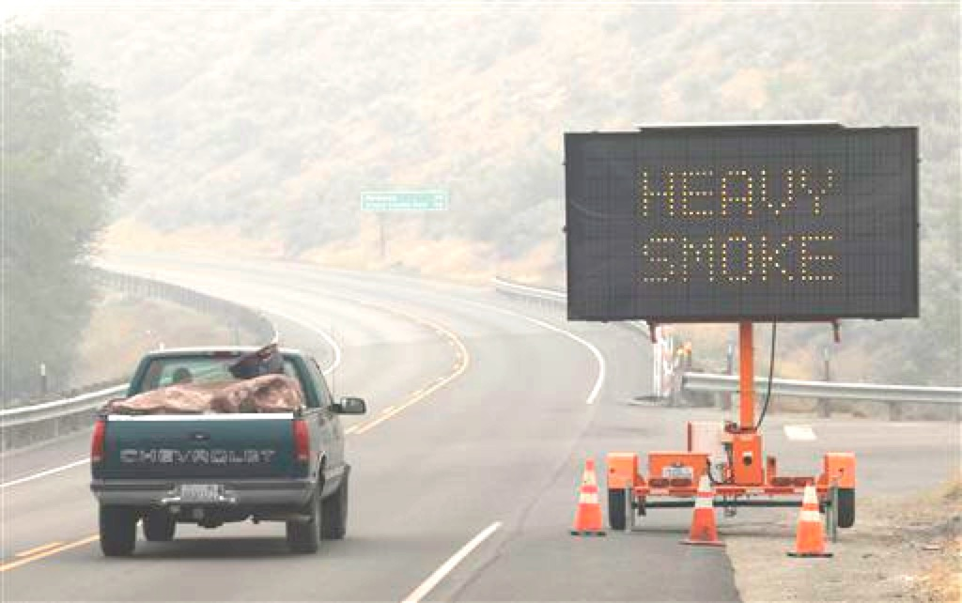
Interagency Wildland Fire Air Quality Response Program
Interagency response (2011-Present)
Operationally addressing wildfire smoke
Four components:
Modeling
Monitoring
Messaging / Communication
Active Coordinated Response
Integration / coordination
EPA, NOAA, NASA, States, and beyond
Signed into law in March (S.47)

Slide 5
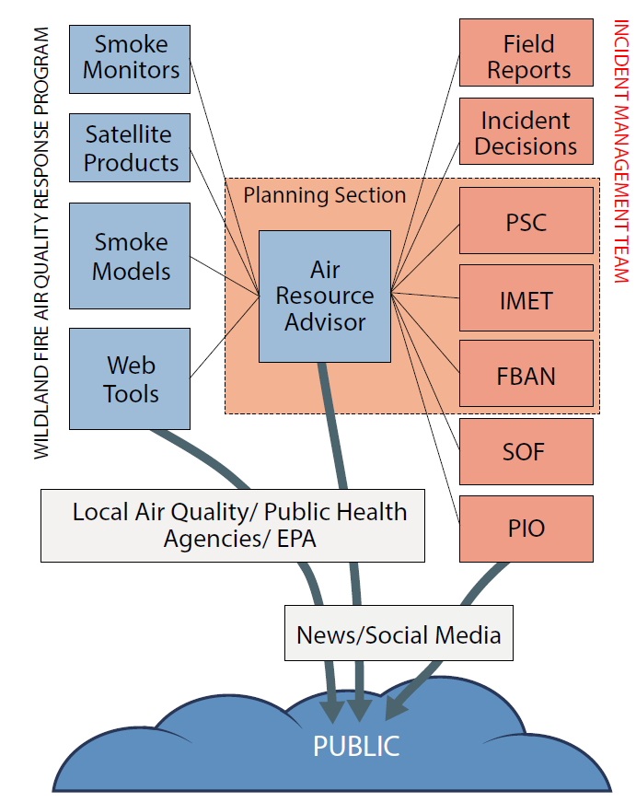
Air Resource Advisors
Smoke specialists deployed as part of an Incident Management Team (TSHP in ICS)
Enables:
Enables smoke information within Incident decisions
Allows incident decision information to be made available for modeling, etc…
Develops outlooks and other documents for communications
Works with local agencies and communities
Air Resource Advisor
2018 Smoke Outlooks
1000 issued
Covering 54M people

Slide 6
Data – Models / Systems – Tools
...
USFS PNW AirFire
Data
Models/Systems
Tools
Uses
Key Partners
Fire Information
Daily Smoke Model Runs
and Viewer
Daily Smoke Predictions
> 30 model runs daily
U.S. National Weather Service
U.S. NOAA
NW-AIRQUEST (WSU)
Environment & Climate Change Canada
Fire Information
System
BlueSky Smoke Modeling Framework
Satellite Fire Detections
BlueSky Playground Web Tool
Customizable, interactive modeling of emissions and smoke impacts
Canadian BlueSky
UBC
Canadian FS
BC Health
Integrated (Reconciled) Fire Information
Emissions and Smoke Dispersion
Ground Reporting Systems
RX Burn Modeling
Automated modeling of
proposed RX burns
California Air Resources Board
Weather Models
Air Quality Monitoring Tool & Maps
2 versions:
Public facing maps
Professional data analysis
US Environmental Protection Agency, Centers for Disease Control
Many different grids
Air Quality Obs
Aggregated Database
Emissions Inventories
Fire emissions inventories
Real-time estimates
Retrospective analyses for US National Emissions Inventory
US Environmental Protection Agency, states
Ground Monitors
Analysis Toolkits
For:
Air Quality Professionals
Researchers / Modelers
Satellite Measurements

Slide 7
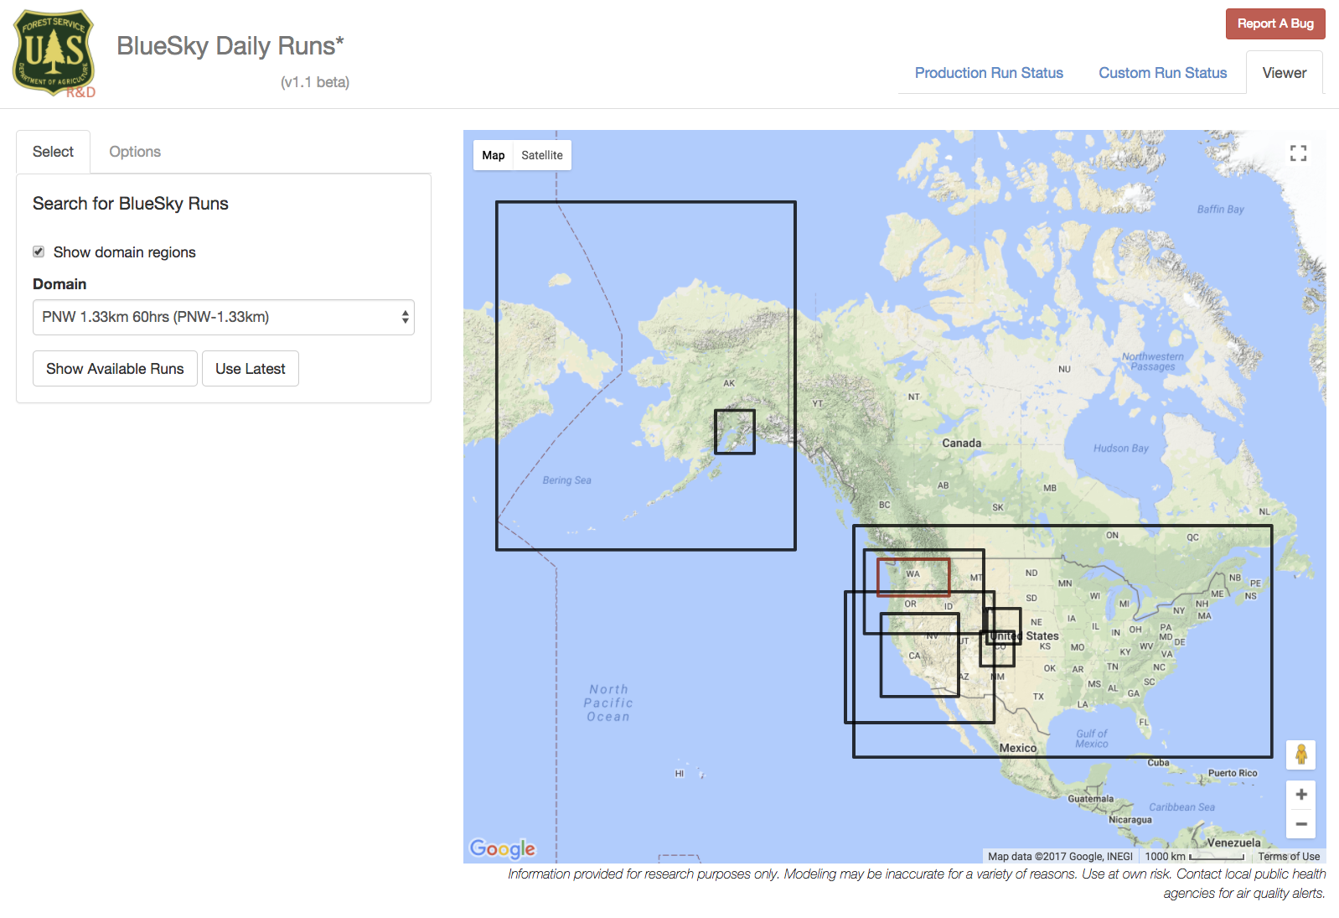
Daily Smoke Model Runs
30+ model runs daily
HYSPLIT + CMAQ
Many meteorological grids, made available by partnerships.
Current grids
UW/NWRMC (12,4,1.33-km)
NOAA NWS GFS (0.5/0.25 deg), NAM (12-km, 3-km), FIREWX (1-km)
CANSAC (6-km, 1.33-km)
U of Arizona
Florida State
Also partner with
NOAA NWS
NOAA HRRR Smoke
NW-AIRQUEST AIRPACT (WSU)
BlueSky Canada
(UBC, CA-FS, BC-Health)
ECCC FIREWORK

Slide 8
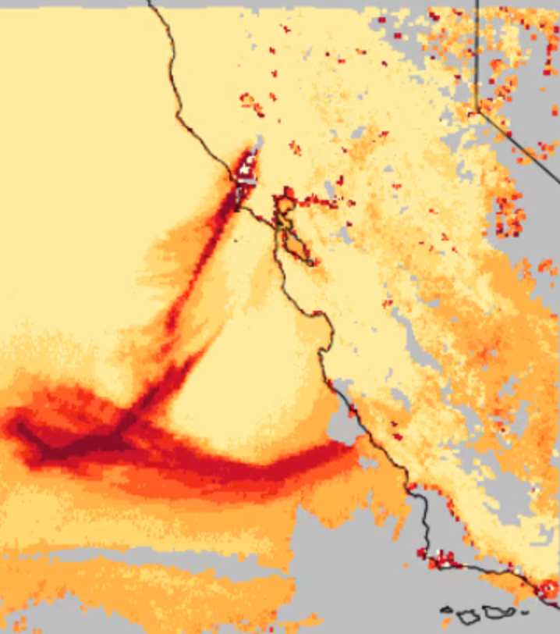
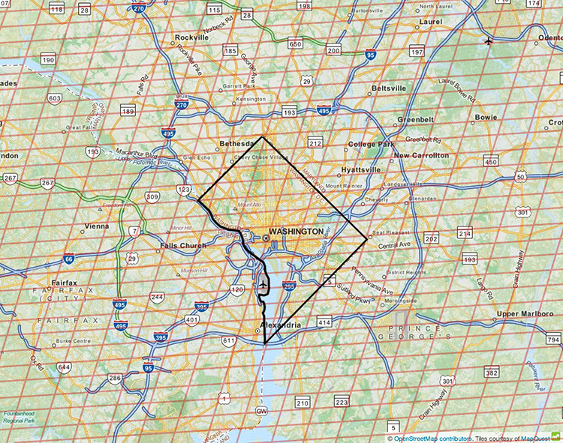
Potential Linkages with TEMPO (and sisters)
Geostationarity, temporal/spatial resolution, and instrumentation suite provide for multiple potential connections.
Particularly: Aerosol, O3, O3 Profile
Potential uses:
Situational awareness / alerts
Model initialization
Model verification
Model development
Exceptional event analysis
Eventually, historical context / trend analysis

Slide 9
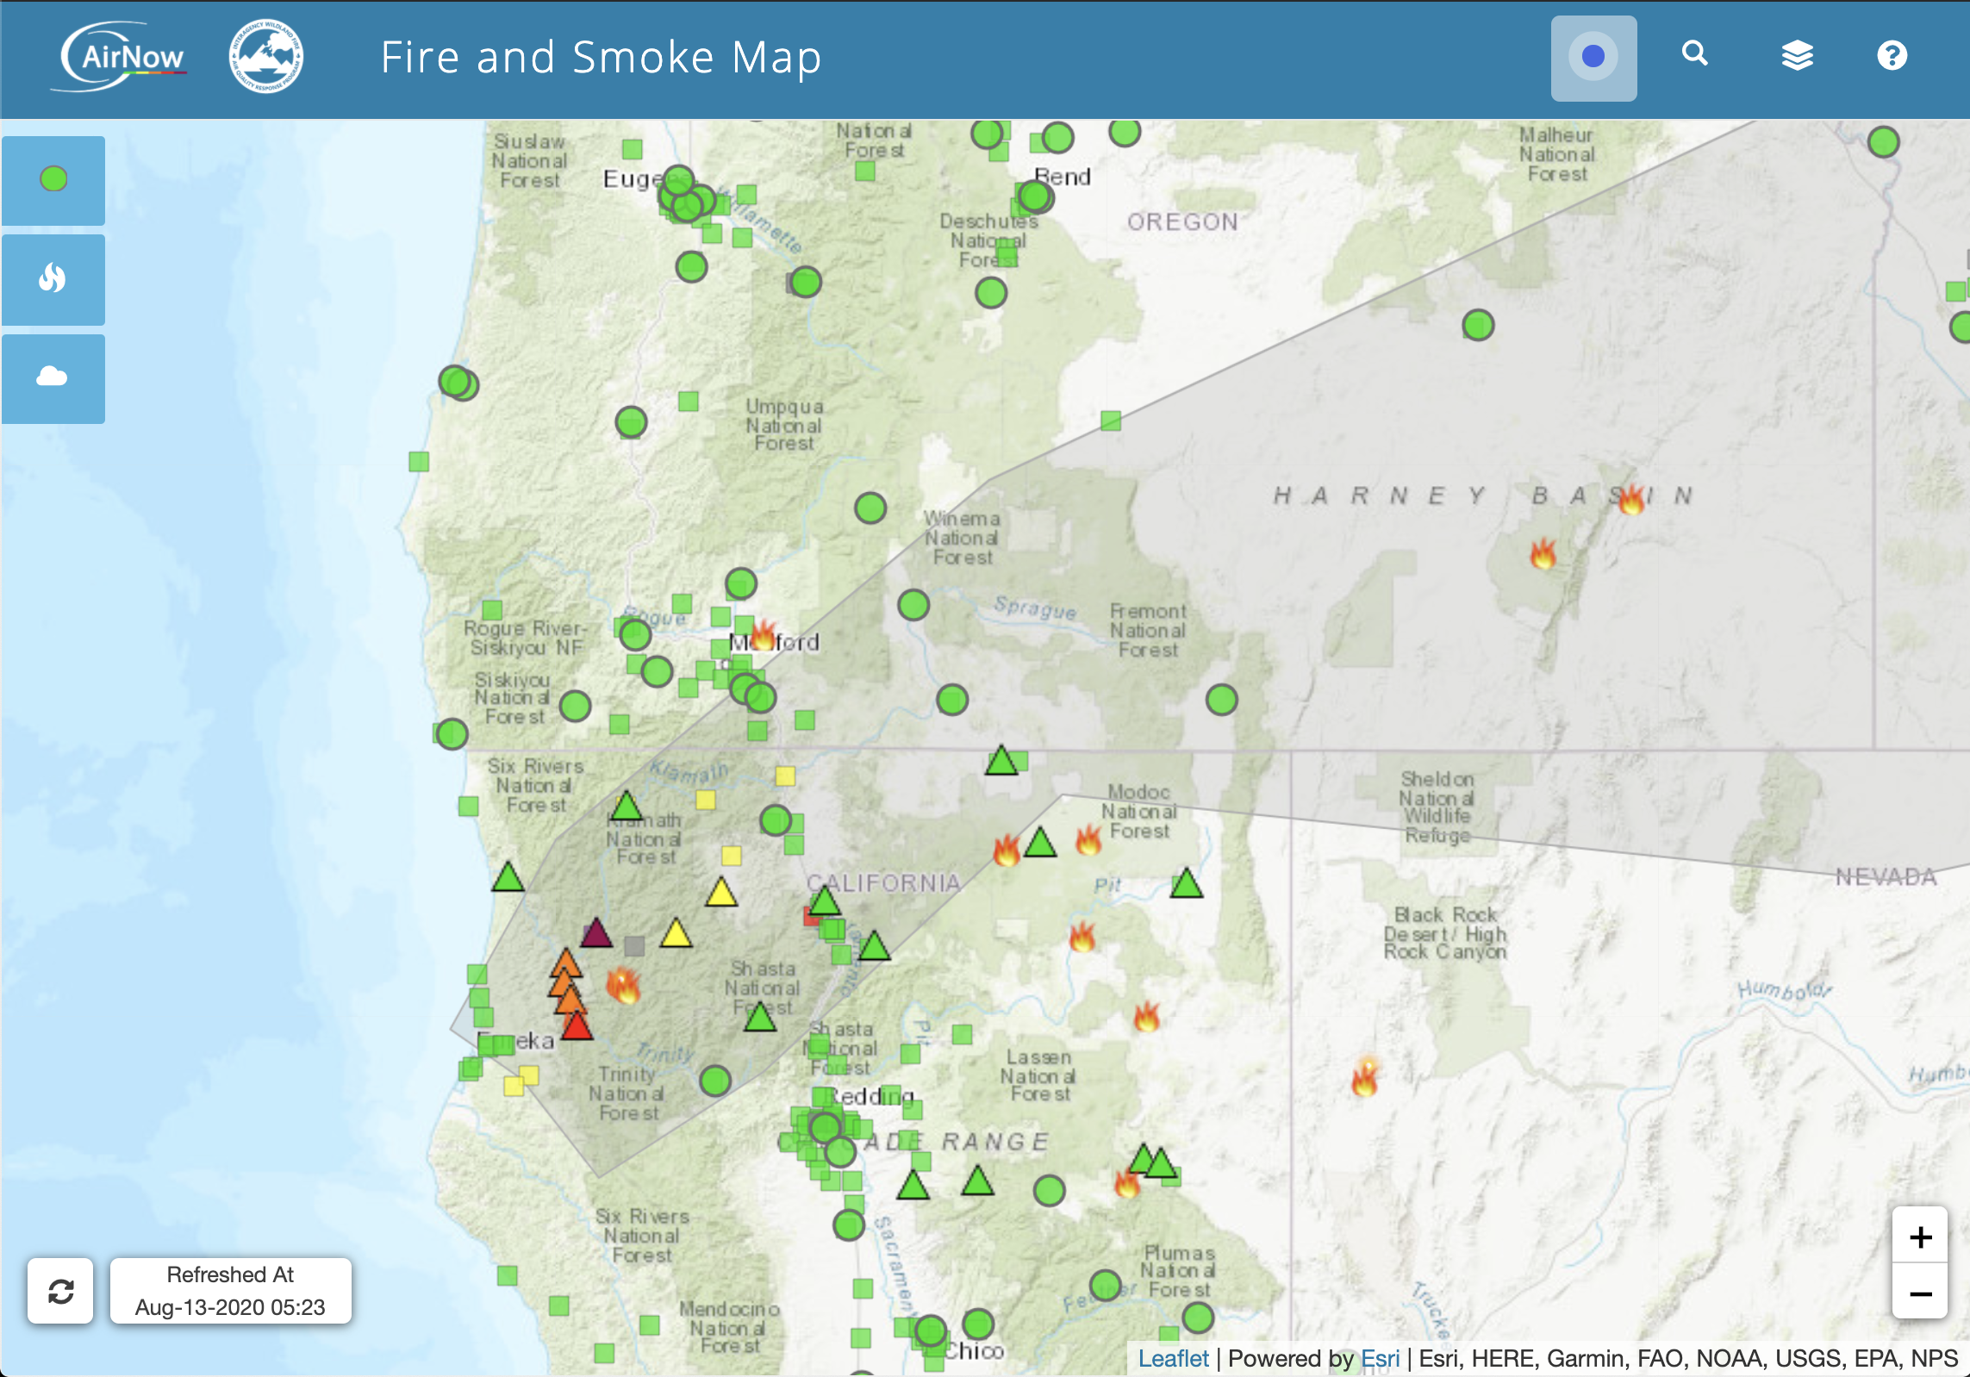
Smoke Impacts are Under-Quantified
Particularly in rural areas, smaller towns, and poorer communities
Experience with temporary monitors shows that we are likely missing many of the worst impacts on communities

Slide 10
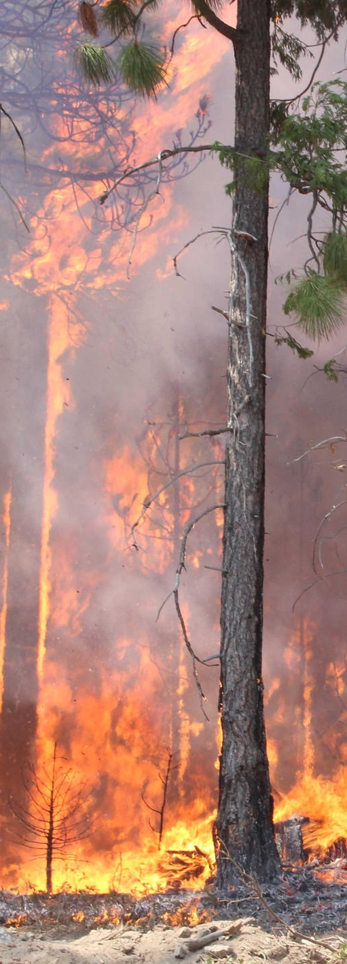
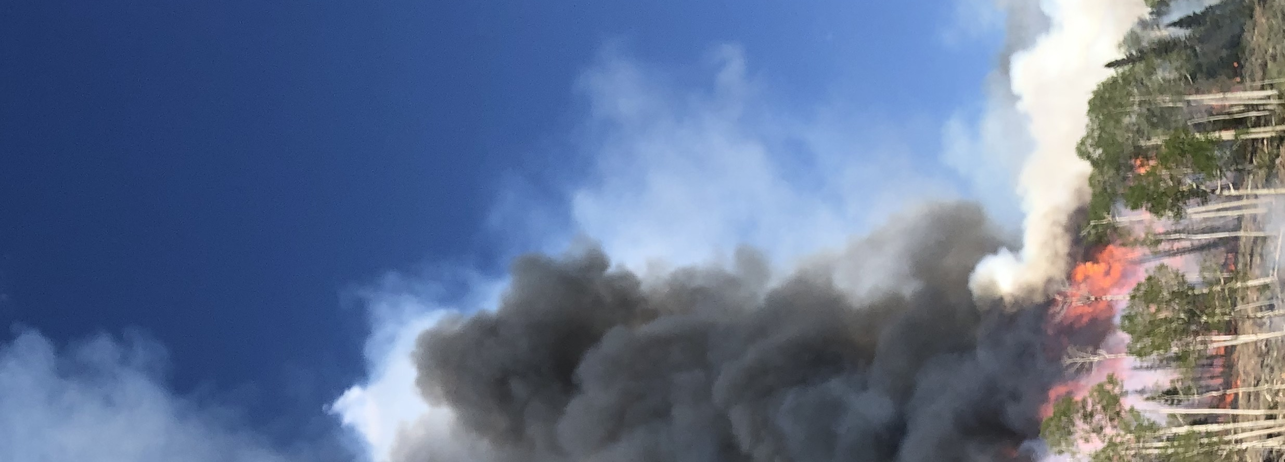
Smoke connects back to small scale complexities (and they are important!)

Slide 11
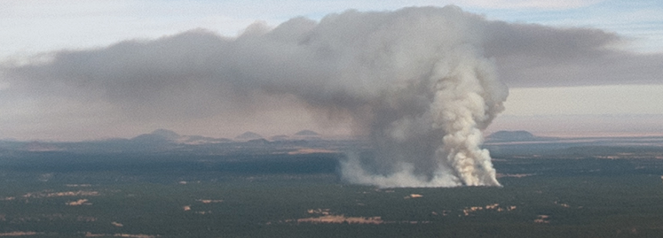
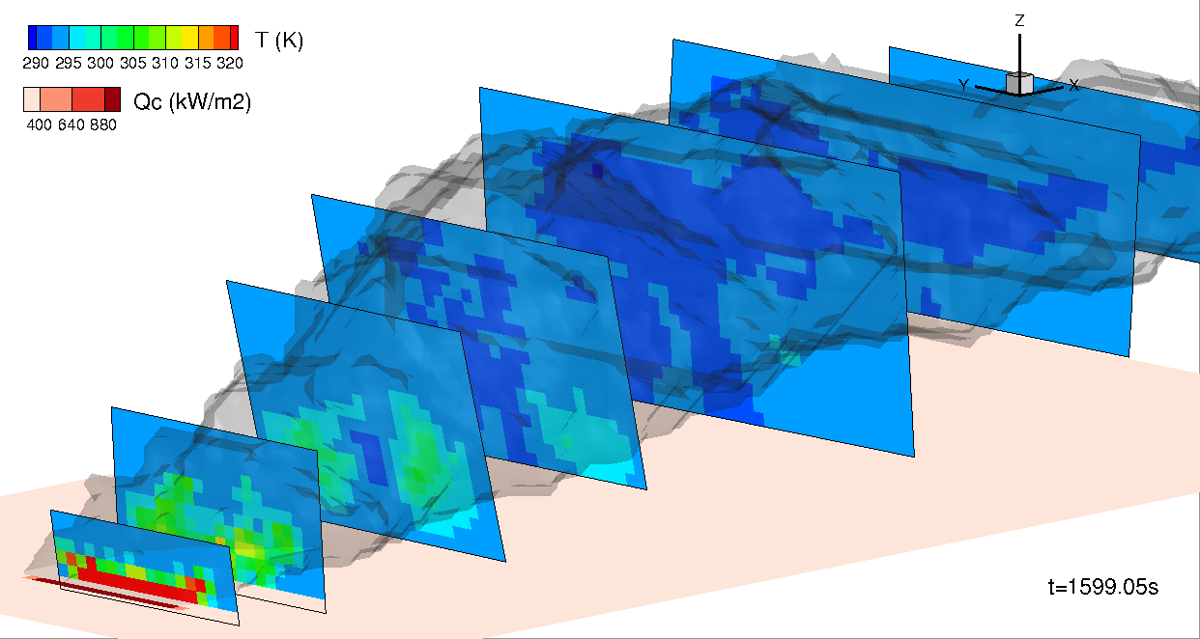
Fire and smoke models are still rapidly evolving
Fire and Smoke Model Intercomparison Project
Complex coupled fire-atmosphere-chemistry models with nested fire subdomains are coming.
But they need more testing and development.
And to do that they need more observational data.
Plume and meteorology
Mixing and entrainment
parameterizations
Identification of dynamic
regimes and parameters
Multiple core interactions
Smoke and chemistry
Flaming and smoldering emission factors
Smoke evolution and aging
UAS, lidar, towers
Airborne, platform, towers
Fire behavior and energy
Characterize spatial and
temporal heat flux density
Fuels and consumption
Multi-scale characterization
Airborne, ground and satellite platforms
Ground sampling
Air and ground Lidar
UAS mapping
Courtesy: Mell
Courtesy: Kochanski
Largest U.S. fire field ground campaign study in 30+ years.
Initial campaign: now!

Slide 12
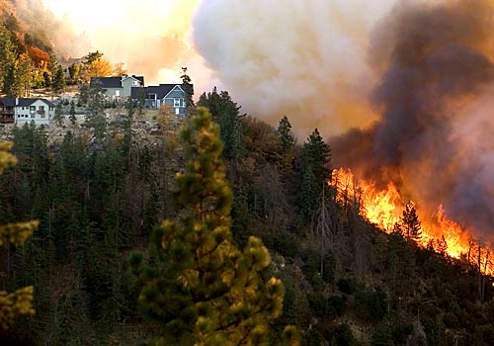
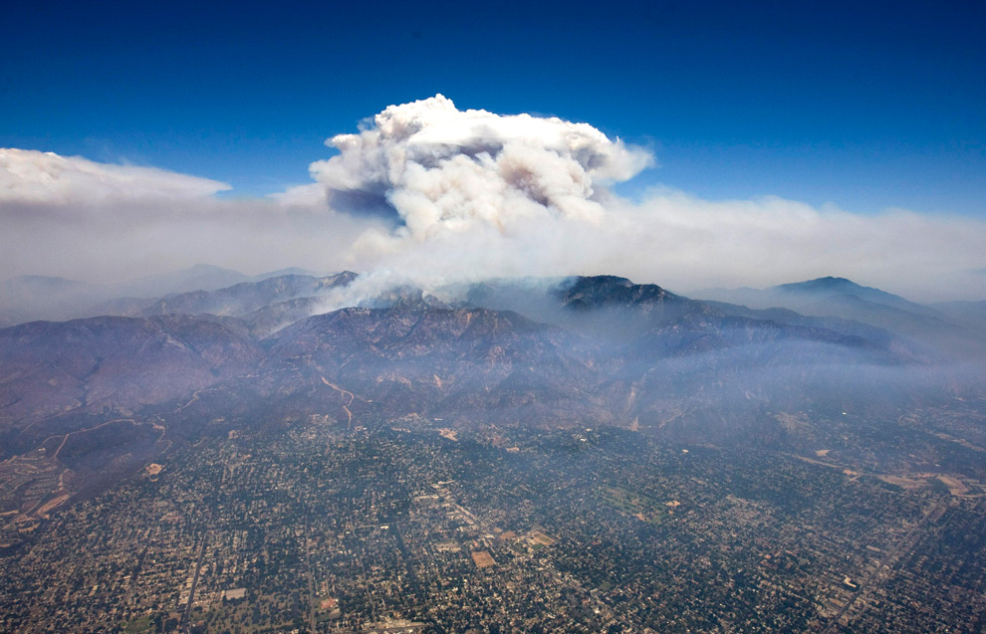
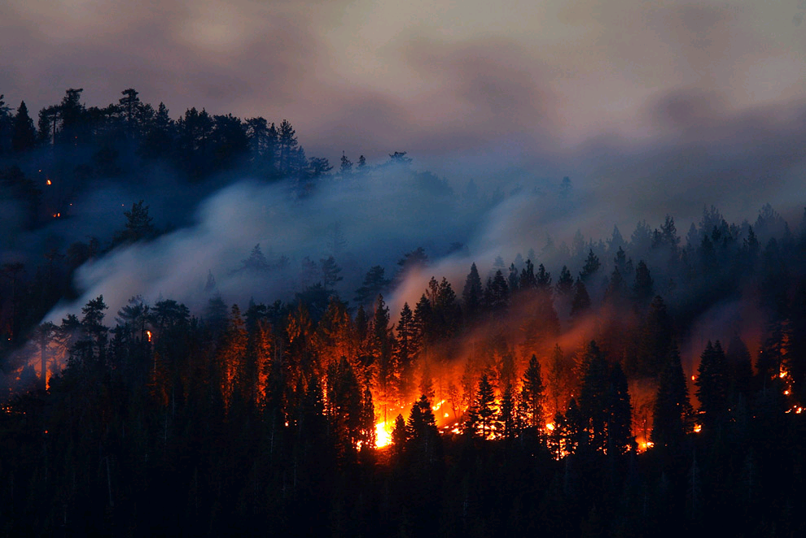
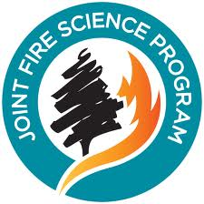
Thank you!
More Information:
Sim Larkin sim_larkin@firenet.gov
Interagency Wildland Fire Air Quality Response Program
https://wildlandfiresmoke.net
Tools: https://wildlandfiresmoke.net/tools
Contact: Pete Lahm, USFS, peter.lahm@usda.gov

