Slide 1




Free tropospheric background NO₂ as a complicating factor
for interpreting TEMPO data in terms of NO_{x} emissions and chemistry
Daniel J. Jacob, Zhen Qu, Viral Shah
Zhen Qu
Viral Shah

Slide 2
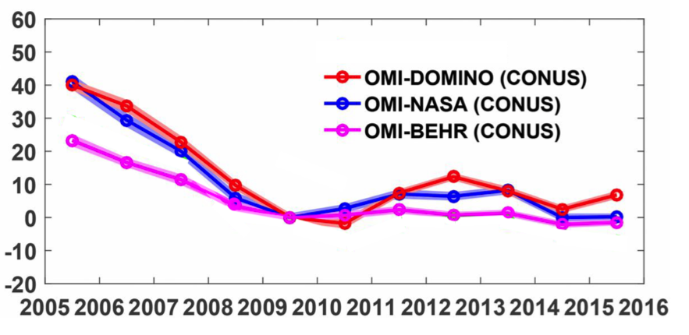
Aircraft show free tropospheric dominance of NO₂ columns from space
OMI annual tropospheric NO₂ column
trends over US, 2005-2016
Mean SEAC⁴RS NO₂ vertical profile, Southeast US
sensitivity vs. altitude
clear sky
30-50% of NO₂ seen by OMI is in upper troposphere
% change relative to 2009
NOAA (Ryerson)
Berkeley (Cohen)
GEOS-Chem
Only 20-30% is in PBL
Without understanding of free tropospheric NO₂ we will be unable to interpret TEMPO observations except in urban conditions in winter
Need to resolve discrepancies between observations and with model in upper troposphere
Troposphere-stratosphere separation of NO₂ retrieval also emerges as crucial
Silvern et al. [2019]

Slide 3
The COVID-19 test:
OMI/TROPOMI response to US NO_{x} emission decreases in March 2020 vs. 2019 compared to AQS NO₂ (true measure of NO_{x} emission decreases)
Urban sites:
Rural sites:
Satellites detect decrease at urban but not rural sites
Zhen Qu, in prep. (see e-poster)

Slide 4
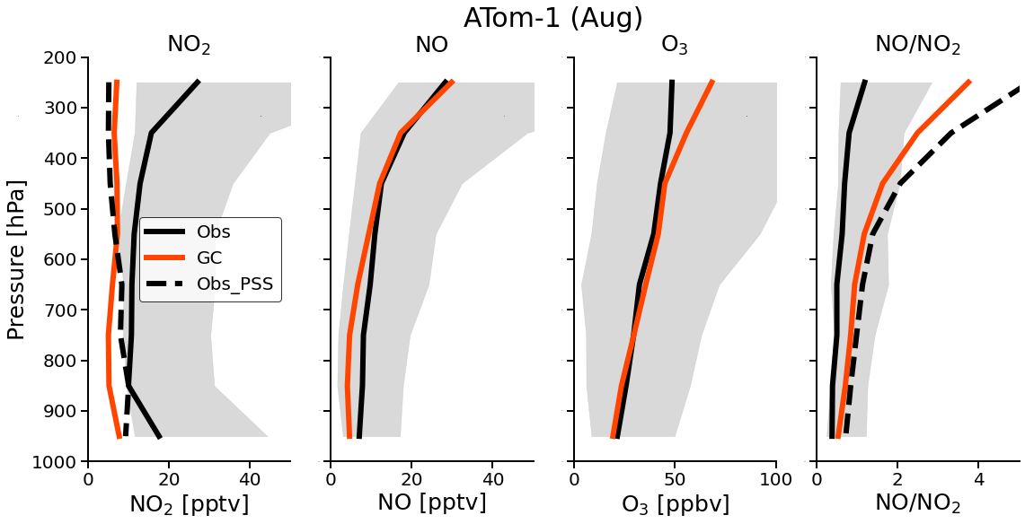
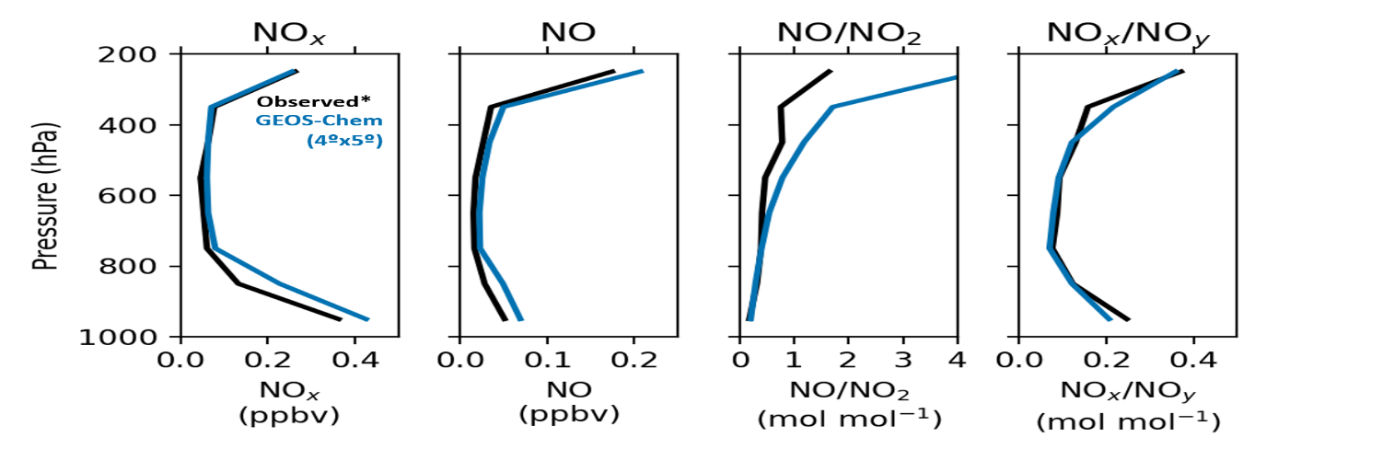
Toward better understanding of upper tropospheric NO₂
Comparison of aircraft observations to current GEOS-Chem model (12.9)
ATom data over oceans
SEAC⁴RS data over SE US
High NO_{x} in upper troposphere explained by lightning (aircraft in extropics winter)
Observed upper tropospheric NO₂ implies large error in NO-NO₂-O₂ steady state
Upper tropospheric NO is similar over ocean and land, despite continental origin for NO_{x}
Viral Shah, in prep.

