Slide 1
Multi-sensor (MODIS, OMPS, OMI, VIIRS, TROPOMI) inversion of aerosol emissions: Implication for TEMPO
Jun Wang, Daven Henze

Slide 2
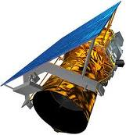
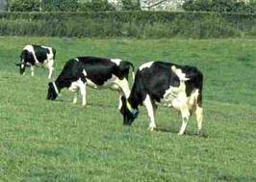
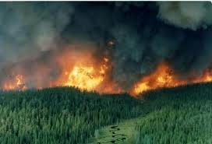
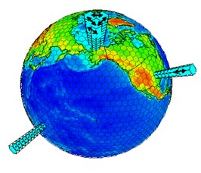
Top-Down vs. Bottom-Up estimate of aerosol emission
Bottom-up emission estimate
Top-down emission estimate
Ground-based network/data
Usually has a 2~3 yr lag
Seasonal/ monthly
Point or area average
Chemically speciated
Lack of constraint on emission above the surface
Has the potential for near real time
Daily (polar-orbiting) or higher (geo..)
Globally with high spatial resolution
Trace gases & optical thickness
Reflecting the columnar mass, and thus 1st order of emission

Slide 3
Nearly a decade of collaboration in adjoint inversion of emissions ( 9 journal papers, 3 Drs., 2 Ph.D. students)
2010-2012
MODIS radiance -> aerosol emission and precursors
OSSE for polarimetric measurements -> aerosol emissions
OMI SO2 -> SO2 emission
OMI NO2 -> NOx emission
OSSE for CLARREO type of measurements -> dust emissions
OMI SO2 + NO2 -> SO2 and NO2 emission
OMPS SO2+NO2 -> SO2 and NO2 emission
Downscaling and application for forecast & re-analysis
2019-2020
Yi Wang, Ph.D. 2019.
Qu Zhen, Ph.D. 2019
CU-Boulder
Zhendong Lu, 2019-
Colin Harkins, 2019-
CU-Boulder
Xiaoguang Xu, Ph.D. 2015.

Slide 4
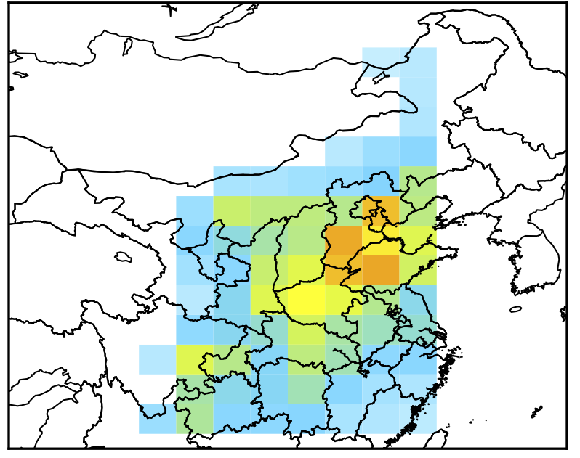
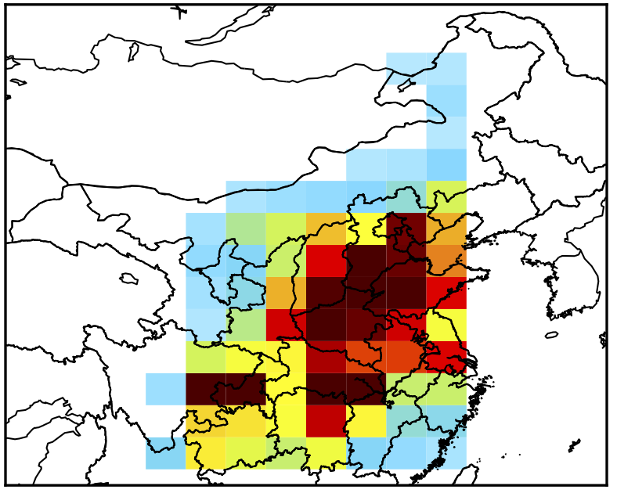
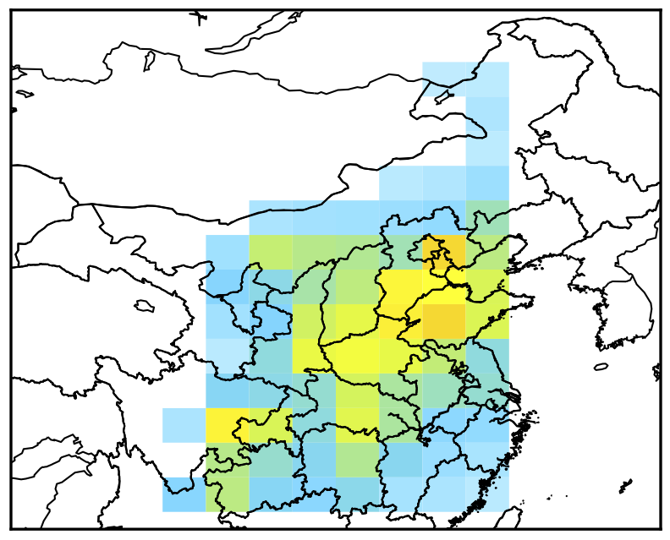
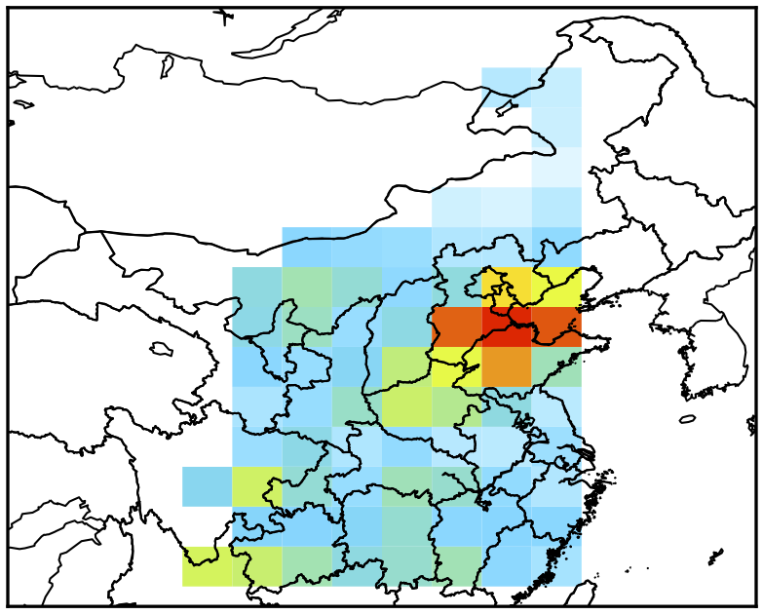
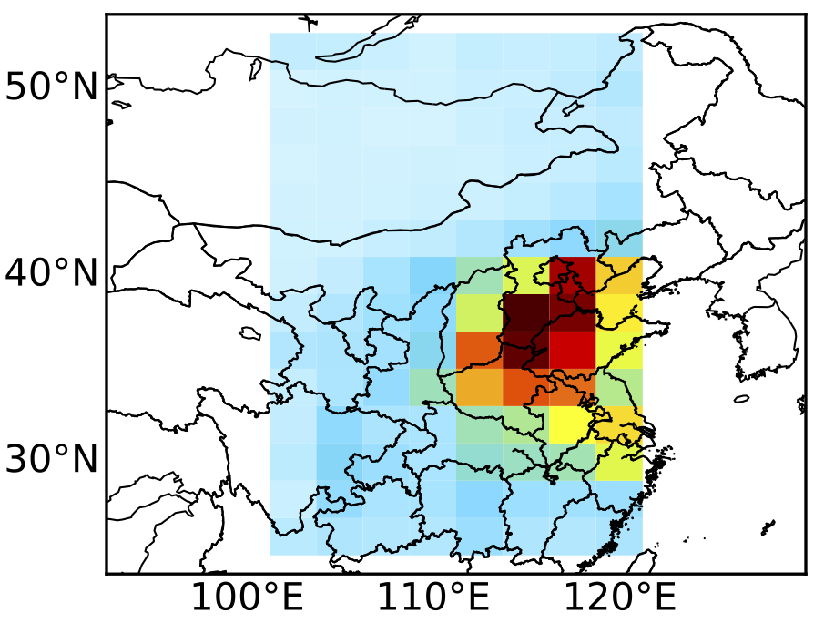
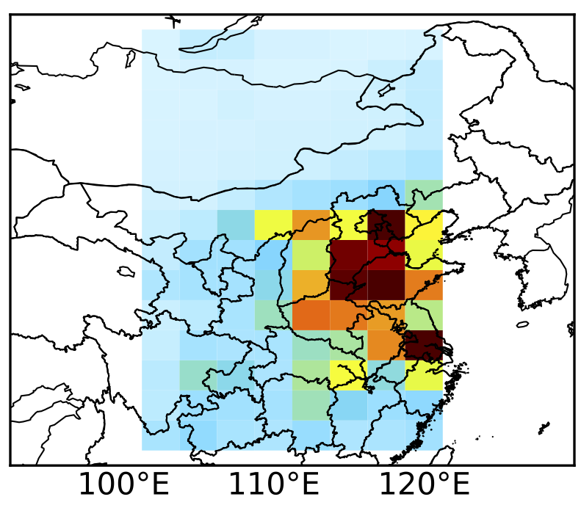
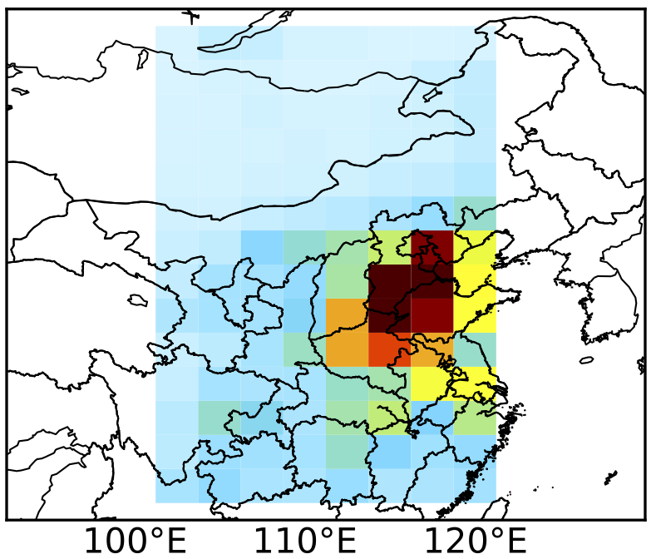
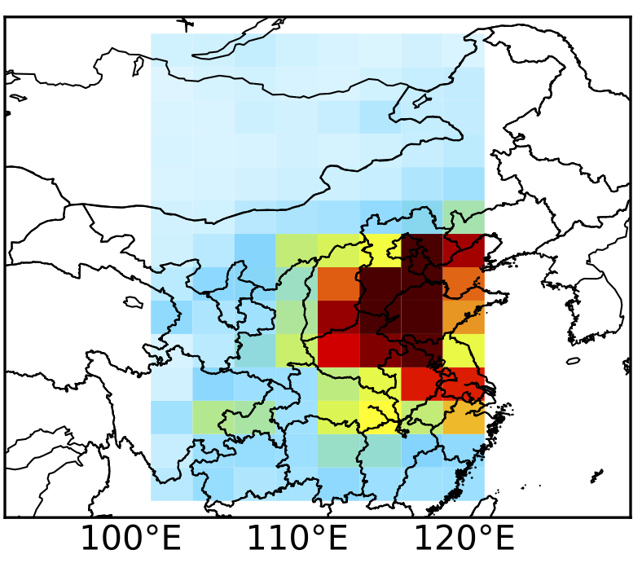
Joint inversion of SO₂ and NO_{x} emissions from OMPS
October 2013
2010 emission
October 2013
GC-adjoint
OMPS
+
Prior GC
Posterior GC
V.S.
OMI
SO₂
NO₂
Notes:
Prior and posterior emission inventories are used to simulate SO2 and NO2 in the atmosphere through GEOS-Chem model and results are validated with OMI NASA L3 observations
Prior SO2 simulation is much larger than OMI observation, and posterior simulation is in more agreement with OMI.
For NO2, Posterior simulation show improvements in terms of spatial distribution.

Slide 5
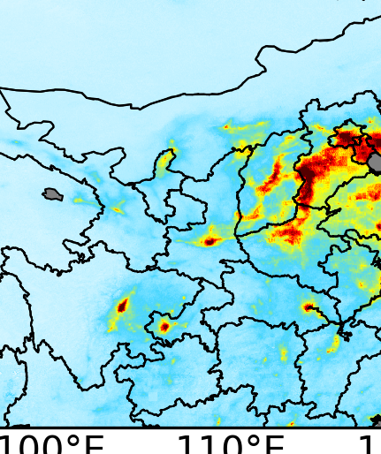
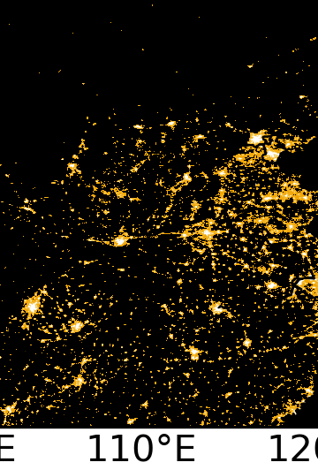
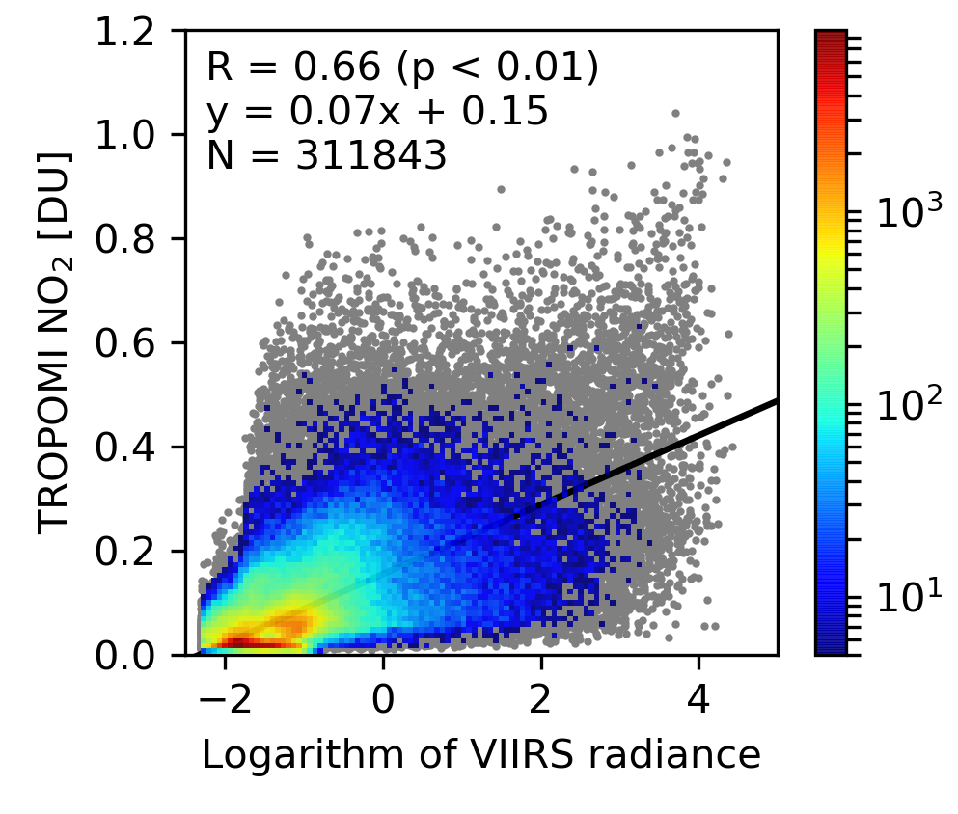
Downscaling emissions using TROPOMI NO₂ and VIIRS nighttime light
TROPOMI NO₂
VIIRS nighttime light
NO₂ VS nighttime light
#
Inverse modeling of SO₂ and NO₂ emissions over China using multi-sensor satellite data: 1. formulation and sensitivity analysis.
Inverse modeling of SO₂ and NO_{x} emissions over China using multi-sensor satellite data: 2. Downscaling techniques for air quality analysis and forecasts.
Wang, Y. et al., Atmospheric Chemistry and Physics, 2020.
Wang, Y.
Notes:
I have already shown downscale posterior SO2 emission inventory and apply it to improve surface SO2 simulation. The emission downscale approach can also be applied for posterior NOx emissions inventory.
But here I will introduce another approach for downscaling NOx emission inventory.
Here shows NO2 columns observed by TROPOMI and nighttime light observed by VIIRS.
Due to good correlation between VIIRS nighttime light and TROPOMI NO2 vertical column density. Another approach is using VIIRS nighttime light to downscale NOx emissions,

Slide 6
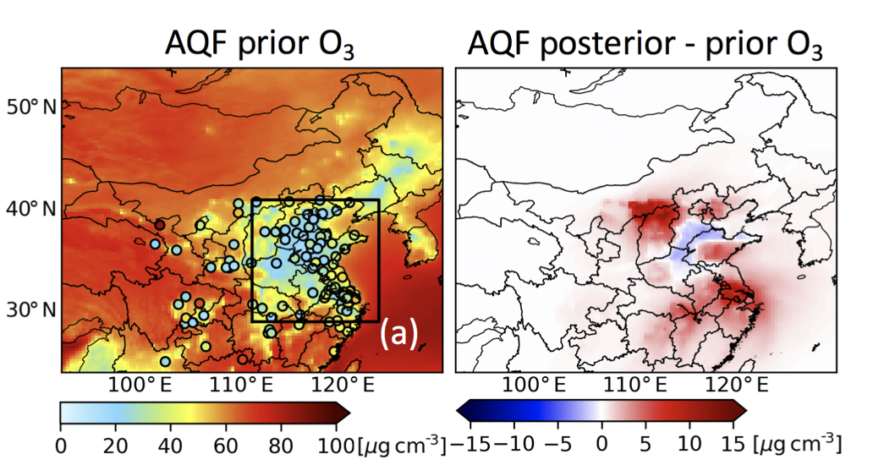
Improved forecast after using updated emission for the next month
Nov. 2013
Prior Posterior
Prior Posterior
NO₂ and O₃ forecasts are improved in Nov. 2013 by using Oct. 2013 emission constrained by OMI

Slide 7
Summary & Outlook
GEOS-Chem, 2x2.5 degree
Chemistry transport model
Continental to regional scale
Ground observations
OMI, OMPS, MODIS AOD at 10 km
Emissions
Satellite observation of gases and aerosols
Field campaigns
Air quality prediction
Chemical climate

Slide 8
Summary & Outlook
GEOS-Chem nested/ WRF-Chem
Chemistry transport model
Ground observations
Regional-local scale
TEMPO and GOES/TROPOMI…
Emissions
Satellite observation of gases and aerosols
Field campaigns
Air quality prediction/modeling
and management

Slide 9
Thank you !
Applied sciences, ACMAP, TEMPO, GEO-CAPE

